Slide 1
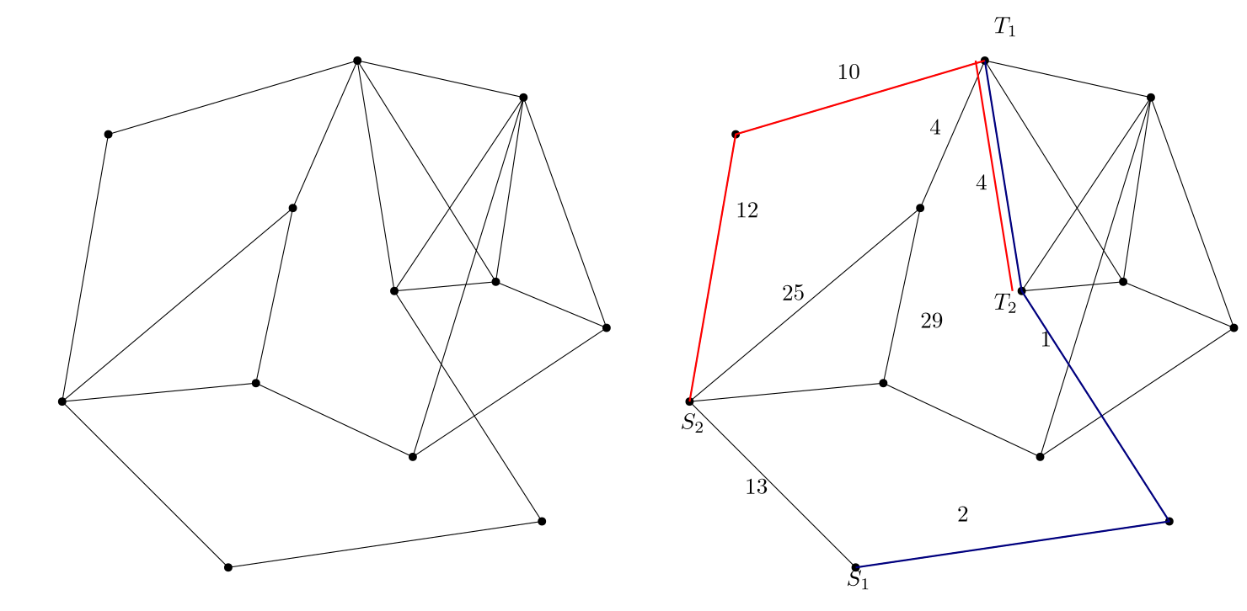
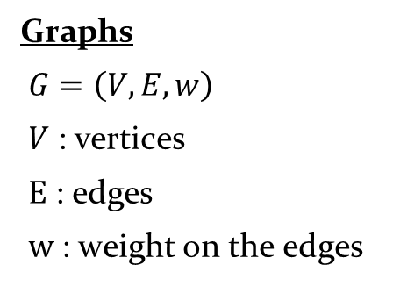
Neural Combinatorial Optimization for Multi Agent Path Finding on Graphs
y_{optimal}
x
graph encoding
Solver for Problem P
inference
y
geometric algorithm
y_{better}
Solver is an algorithm when discussing CO. It is a trained NN when discussing NCO.
Space of all possible solutions for P when input is x
Graphs
$G=\left(V,E,w\right)$
$V$ : vertices
$E$ : edges
$w$ : weight on the edges
Multi Agent Path Finding (MAPF)
A₁ , A₂ , … , A_{k} : agents
s₁ , s₂ , … , s_{k} : starting
t₁ , t₂ , … , t_{k} : target
π₁ , π₂ , … , π_{k} : paths/policy
NP-hard : O(n^{c}) algorithm unlikely
Neural Combinatorial Optimization (NCO)
CO : mathematical problem whose solution space is a set of discrete choices
NCO : neural networks learns the problem and given an output from the solution space

Slide 2
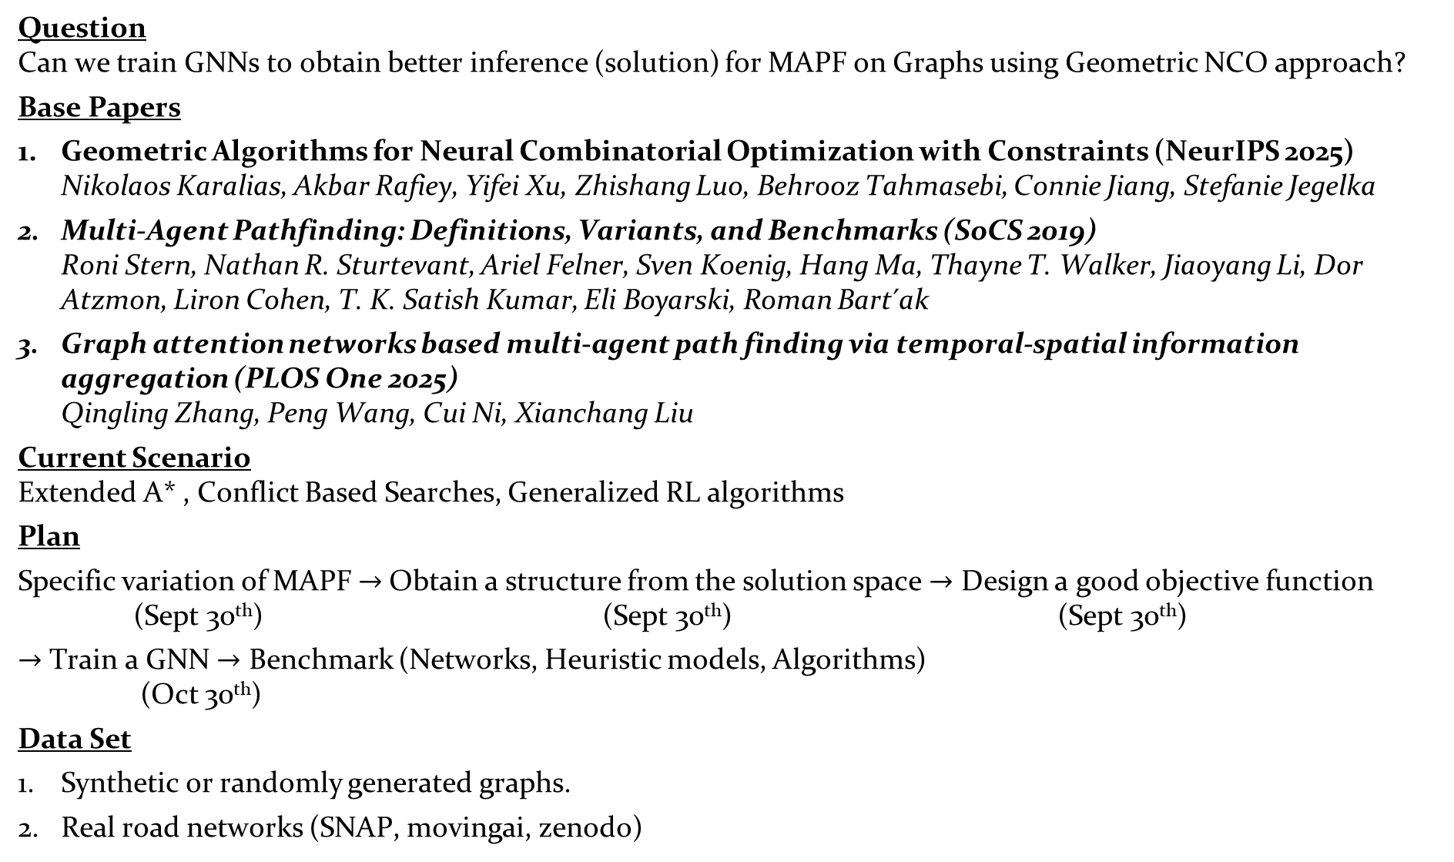
Question Can we train GNNs to obtain better inference (solution) for MAPF on Graphs using Geometric NCO approach?
Base Papers
Geometric Algorithms for Neural Combinatorial Optimization with Constraints (NeurIPS 2025) Nikolaos Karalias, Akbar Rafiey, Yifei Xu, Zhishang Luo, Behrooz Tahmasebi, Connie Jiang, Stefanie Jegelka
Multi-Agent Pathfinding: Definitions, Variants, and Benchmarks (SoCS 2019) Roni Stern, Nathan R. Sturtevant, Ariel Felner, Sven Koenig, Hang Ma, Thayne T. Walker, Jiaoyang Li, Dor Atzmon, Liron Cohen, T. K. Satish Kumar, Eli Boyarski, Roman Bart ́ak
Graph attention networks based multi-agent path finding via temporal-spatial information aggregation (PLOS One 2025) Qingling Zhang, Peng Wang, Cui Ni, Xianchang Liu
Current Scenario Extended A* , Conflict Based Searches, Generalized RL algorithms
Plan
Specific variation of MAPF $→$Obtain a structure from the solution space $→$ Design a good objective function (Sept 30th) (Sept 30th) (Sept 30th)
$→$ Train a GNN $→$ Benchmark (Networks, Heuristic models, Algorithms) (Oct 30th)
Data Set
Synthetic or randomly generated graphs.
Real road networks (SNAP, movingai, zenodo)

