Slide 1
Welcome to backend development
With
NODEJS
By 0zzy

Slide 2
What is involved
Understanding web systems architecture
Web technologies
Dynamic web development
Database systems and development

Slide 3
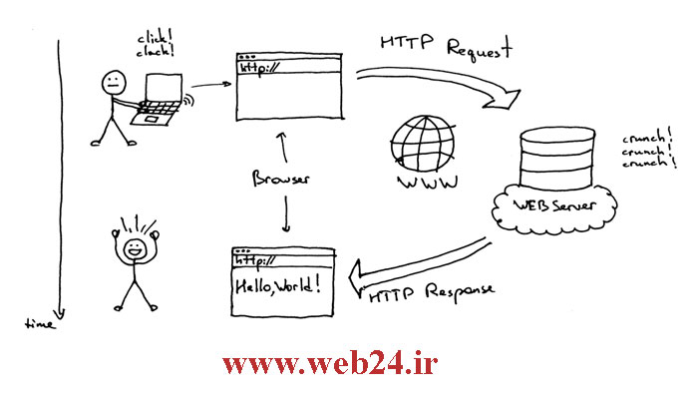
Client-server communication

Slide 4
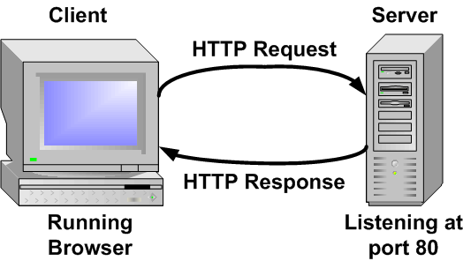
Client-server communication continued.

Slide 5
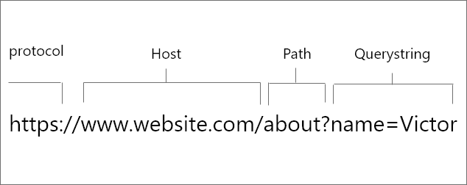
Request format

Slide 6
Web Developing with Nodejs
Nodejs;- JavaScript running on the sever
Single threaded (event loop)
Modular( build on micro services integration)

Slide 7
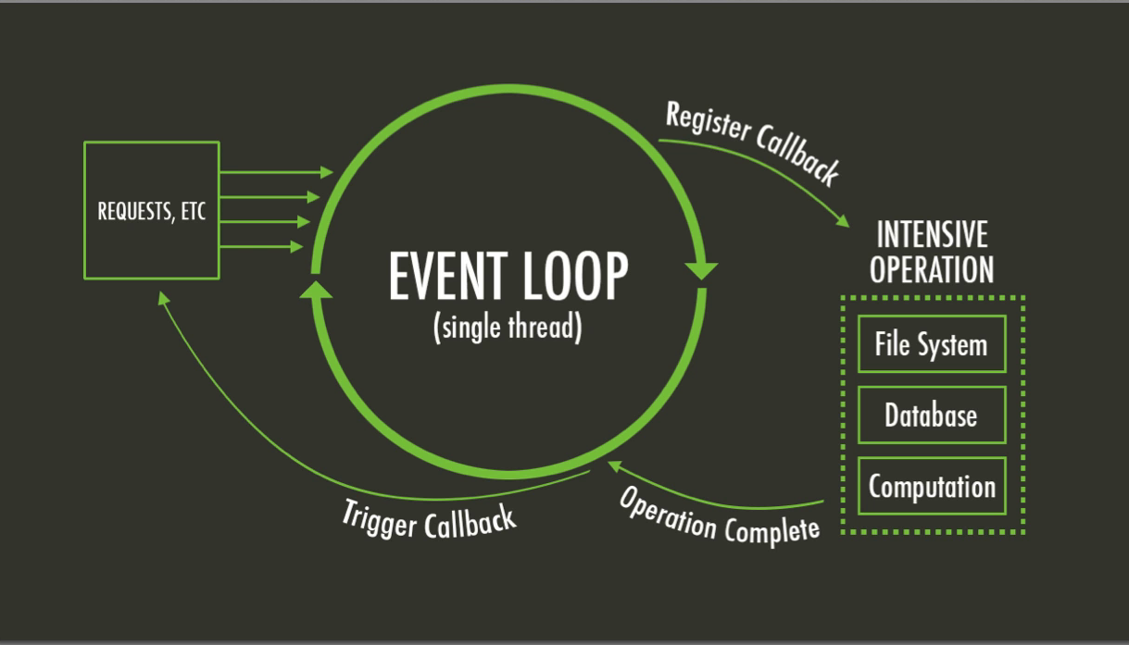
The event loop

Slide 8
Writing web applications with nodejs
Creating handlers that get called when certain Node events occur.

Slide 9
Nodejs project structure
Single directory vs framework
Single directory: all web files and resources are in one parent directory
Frameworks: (logical organization of web files and resources)

Slide 10
Getting started
From the cmd or terminal Create a Directory and cd into it
Do an npm init, press enter button.
Confirm that a package.json file is created
Create an entre-point (any valid javascript file;- ie app.js or server)

Slide 11
Hello world
//server.js
 | const http = require('http’), server = http.createServer((request,response)=>{ response.writeHead(200,{'Content-Type':'text/plain'}); response.write('Hello world'); response.end(); }); server.listen(3000,()=>{ console.log('Node server created at port 3000'); });
 | server = http.createServer((request,response)=>{
 | response.writeHead(200,{'Content-Type':'text/plain'});
 | response.write('Hello world');
 | response.end();
 | });
 | server.listen(3000,()=>{
 | console.log('Node server created at port 3000');
 | });

Slide 12
Get started cont’d
From the cmd or terminal run: node server.js - (server.js can be any other js file)
Load any of your clients-(web browser)
Request for the localhost:3000.

Slide 13
Getting used to nodejs callback
//server.js
 | const http = require('http'),
 | makeServer = function (request,response){
 | response.writeHead(200,{'Content-Type':'text/plain'});
 | response.write('Hello world');
 | response.end();
 | },
 | server = http.createServer(makeServer);
 | server.listen(3000,()=>{
 | console.log('Node server created at port 3000');
 | });

Slide 14
Routing with nodejs
Browsers request, they tell the server what they are looking for.
The server responds accordingly by giving them files they ask for

Slide 15
Routing with node
//server.js
 | const http = require('http'), url = require('url'), makeServer = function (request,response){ let path = url.parse(request.url).pathname; console.log(path); if(path === '/'){ response.writeHead(200,{'Content-Type':'text/plain'}); response.write('Hello world'); } else if(path === '/about'){ response.writeHead(200,{'Content-Type':'text/plain'}); response.write('About page'); } else if(path === '/blog'){ response.writeHead(200,{'Content-Type':'text/plain'}); response.write('Blog page'); } else{ response.writeHead(404,{'Content-Type':'text/plain'}); response.write('Error page'); } response.end(); }, server = http.createServer(makeServer); server.listen(3000,()=>{ console.log('Node server created at port 3000'); });
 | url = require('url'),
 | makeServer = function (request,response){
 | let path = url.parse(request.url).pathname;
 | console.log(path);
 | if(path === '/'){
 | response.writeHead(200,{'Content-Type':'text/plain'});
 | response.write('Hello world');
 | }
 | else if(path === '/about'){
 | response.writeHead(200,{'Content-Type':'text/plain'});
 | response.write('About page');
 | }
 | else if(path === '/blog'){
 | response.writeHead(200,{'Content-Type':'text/plain'});
 | response.write('Blog page');
 | }
 | else{
 | response.writeHead(404,{'Content-Type':'text/plain'});
 | response.write('Error page');
 | }
 | response.end();
 | },
 | server = http.createServer(makeServer);
 | server.listen(3000,()=>{
 | console.log('Node server created at port 3000');
 | });

