Slide 1
Fun Time
With Anudeep and Parth

Slide 2
Fun Time
Guess the movie!
2 truths and a Lie

Slide 3
Rules of the quiz
Format: Infinite Bounce
Every question is addressed to the team succeeding the team that answered the previous question. If no team answers the question, the next question (n+1) is addressed to the same team to which the previous question (n) was addressed.
+10 for correct answer, 0 otherwise.
Part points for cracking jokes or trivia.

Slide 4
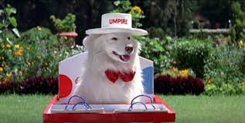
Guess the movie
A huge joint family depends on and takes their life decisions asking a dog called Tuffy.

Slide 5
Hum aapke hai kon

Slide 6
Guess the movie
✈️ 😎 🍅 💃🏻 🐃

Slide 7
Zindagi Na Milegi Dobara

Slide 8

Guess the movie

Slide 9
Drishyam

Slide 10
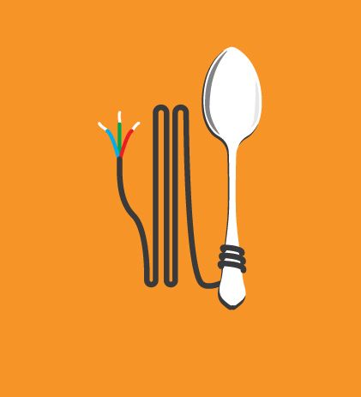
Guess the movie
🙈 🙉 🙊 🧐 📐

Slide 11
3 idiots

Slide 12
Guess the movie
Boat load of people take Ice Bucket Challenge. Ends badly. Girl floats away.

Slide 13
Titanic

Slide 14
Guess the movie
👨🏼‍🦲 👮🏻‍♂️ 👴🏻 📞 💣

Slide 15
A Wednesday!

Slide 16
Guess the movie
A grown man who can’t tie his own shoelaces ends up accidentally revealing his hidden identity to his former nanny.

Slide 17
Kabhi Khushi Kabhi Gham

Slide 18
Guess the movie
A teacher gets side-tracked due to a personal tragedy and starts teaching young boys about the importance of not giving up on girls who’ve rejected them, instead of doing his/her actual job.

Slide 19
Mohabbatein

Slide 20
Guess the movie
🤴🏻 ⚔️ 👸🏻 🕊 👩‍❤️‍👨

Slide 21
Jodhaa Akbar

Slide 22
Guess the movie
No ball saves taxes.

Slide 23
Lagaan

Slide 24
Guess the movie
Guy marries the hot girl, then marries the bff when the wife dies.

Slide 25
Kuch Kuch Hota hai

Slide 26
Guess the movie
👦🏻 🎄 🏠

Slide 27
Home Alone

Slide 28
Guess the movie
🧔🏽 🍺 🎸 🎶 ⭐️

Slide 29
Rockstar

Slide 30
Guess the movie

Slide 31
The prestige

Slide 32
Guess the movie
A nose less guy has unhealthy obsession with a teenage boy for 7 years.

Slide 33
Harry Potter Series

Slide 34
Guess the movie
Cosplay enthusiasts beat the crap out of illegal immigrants from another planet.

Slide 35
Avengers

Slide 36
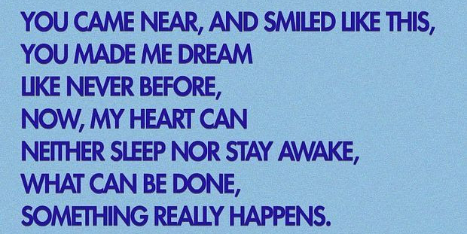
Guess the song

Slide 37
Kuch Kuch Hota Hai

Slide 38
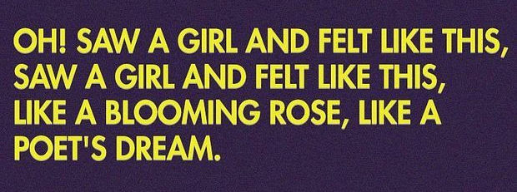
Guess the song

Slide 39
Ek Ladki Ko Dekha To

Slide 40
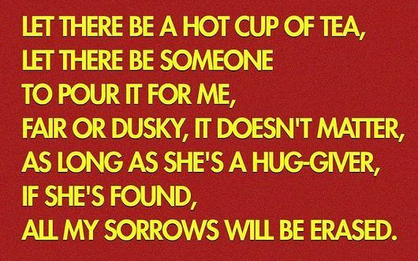
Guess the song

Slide 41
Ek Garam Chai Ki Pyali

Slide 42
Guess the movie
🤐 🐑 🐑

Slide 43
Silence of the Lambs

Slide 44
Guess the movie
🛴 👽 💪🏻 🚴‍♂️

Slide 45
Koi Mil Gaya

Slide 46

Guess the movie

Slide 47
Rab ne bana de jodi

Slide 48
Guess the movie
😠 🏑 🤬 ⏳ 🥇

Slide 49
Chak De India!

Slide 50

Guess the movie

Slide 51
Dabbang

Slide 52
Guess the movie
👳🏻‍♂️ 💰 🏏 💂🏻‍

Slide 53
Lagaan

Slide 54
Guess the movie
📖 🏊‍♀️ 🚴🏻‍♀️ 🏆

Slide 55
Student Of The Year

Slide 56
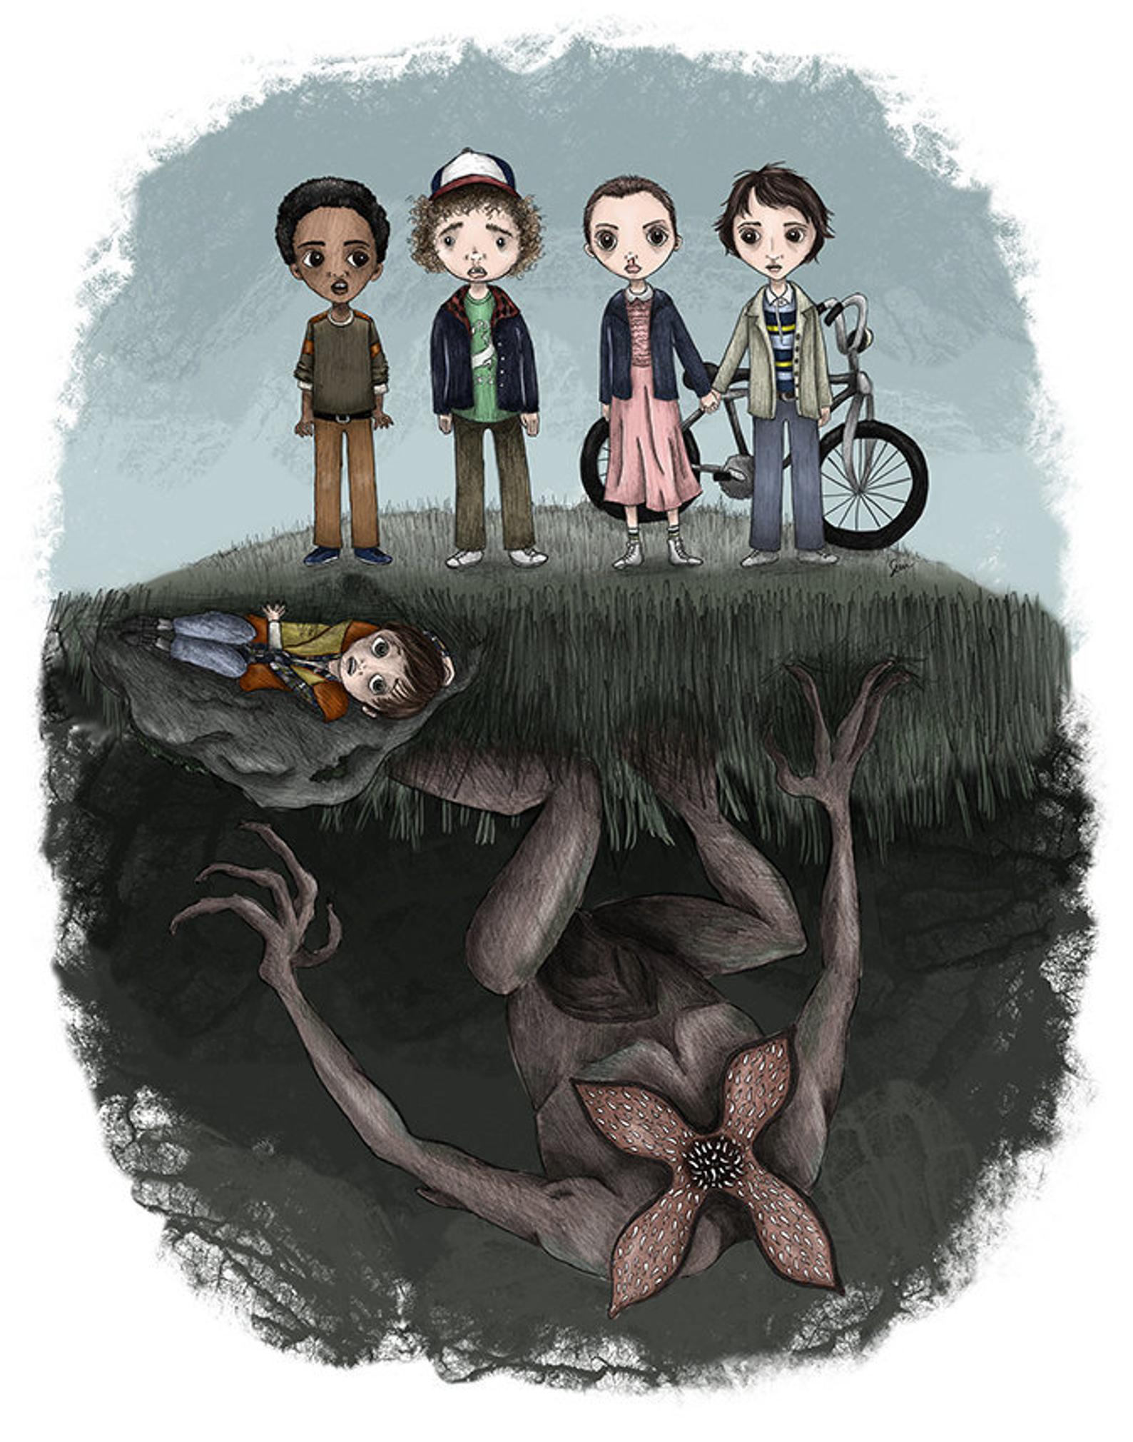
Guess the series

Slide 57
The Stranger Things

Slide 58

Guess the movie
👸🏻 👰🏻 🧳 🙅🏻‍♀️

Slide 59
Queen

Slide 60
Guess the movie
🏏 🏰 🚁 💼 🪔

Slide 61
Kabhi Kushi Kabhi Gham...

Slide 62

Guess the movie

Slide 63
Uyare

Slide 64
Guess the movie
👩🏻‍💼 👴🏻 💩 🚐 🪑

Slide 65
Piku

Slide 66
Guess the movie
📖 😢 👨🏻‍🏫 🎨 ⭐️

Slide 67
Taare Zameen Par

Slide 68
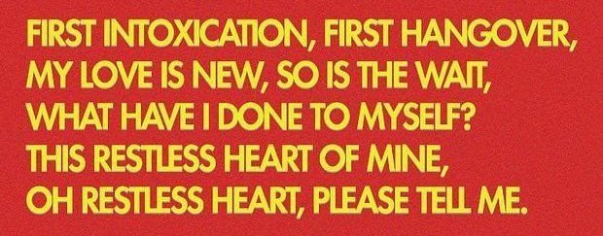
Guess the song

Slide 69
Pehla Nasha

Slide 70
Guess the movie
👦🏻 👨🏻‍🦳 🚗 🕰

Slide 71
Back to the Future

Slide 72

Guess the movie

Slide 73
Baasha

Slide 74
Guess the movie
😎 🪕 🚂 🏃🏻‍♂️

Slide 75
Dilwale Dulhania Le Jayenge

Slide 76
Guess the movie
An underqualified man cheats his way into a medical college and decides that the way he's going to make it through is by being a polite motivational speaker

Slide 77
Munna Bhai MBBS

Slide 78
Guess the movie
🤵🏻 💁🏻‍♀️ 🚂 🥁 👨‍👩‍👧‍👧

Slide 79
Jab We Met

Slide 80

Guess the movie

Slide 81
Kali

Slide 82
Guess the movie
🤖 ♻️ 🌱 🌏 🌌

Slide 83
Wall-E

Slide 84
Guess the movie
🔎 🤡 🐟 🌊 🦈

Slide 85
Finding Nemo

