Slide 1
HUMAN FACE EMOTION IN 3D
Shaik Mohammed Sameer 1602-20-737-168
Jarupla Aruna 1602-20-737-125
Chimmi Mahesh 1602-20-737-143

Slide 2
Contents
Problem Statement
Motivation
Abstract
Architecture an Design
Technology stack
Outputs
Conclusion
Future Scope
References

Slide 3
Problem Statement
Develop a multi-modal emotion detection system using advanced computer vision, speech recognition, and natural language processing (NLP) techniques to identify and track human emotions with image, text and audio streams. The system should use computer vision to accurately capture and analyze facial expressions, movements, and other visual cues, while also using speech and NLP to analyze tone, pitch, and word choice to detect emotional states in speech. The system must accurately capture and analyze facial expressions, movements, voice, and other features to detect and classify the emotional state of the person. The system should render the image of the identified person and capturing the effects of facial expressions and movements to create a realistic human face.

Slide 4
Motivation
The motivation for developing a multi-modal emotion detection system lies in its potential to enhance human-computer interaction and communication.
The ability to accurately detect and analyze emotions images and audio streams can lead to more effective virtual assistants, improved surveillance systems, and better communication platforms.
For virtual assistants, the ability to detect and analyze emotions can allow the system to provide more personalized and empathetic responses to user requests.
In surveillance systems, emotion detection can help identify potential threats or suspicious behavior.
In communication platforms, the ability to detect and analyze emotions can lead to more effective communication and collaboration.

Slide 5
Abstract
Emotion detection, which is an effortless task for humans, is complex to perform on machines. The interaction between human beings and computers will be more natural if computers are able to perceive and respond to human non-verbal communication such as emotions.
This project aims to develop a multi-modal emotion detection webapp that utilizes advanced computer vision, speech, and natural language processing (NLP) techniques to accurately identify and track human emotions in images, text and audio streams.
The system will detect and classify multiple emotions simultaneously do image rendering.
This project uses CNN to detect emotion from image and RNN to detect emotion from text and speech. It can also generate a 3D model of the image using BFM model and aspose 3d.
The system can adapt to individual differences in expressing emotions, ensure privacy and security, and have potential applications in various fields, including healthcare, education, and entertainment.

Slide 6
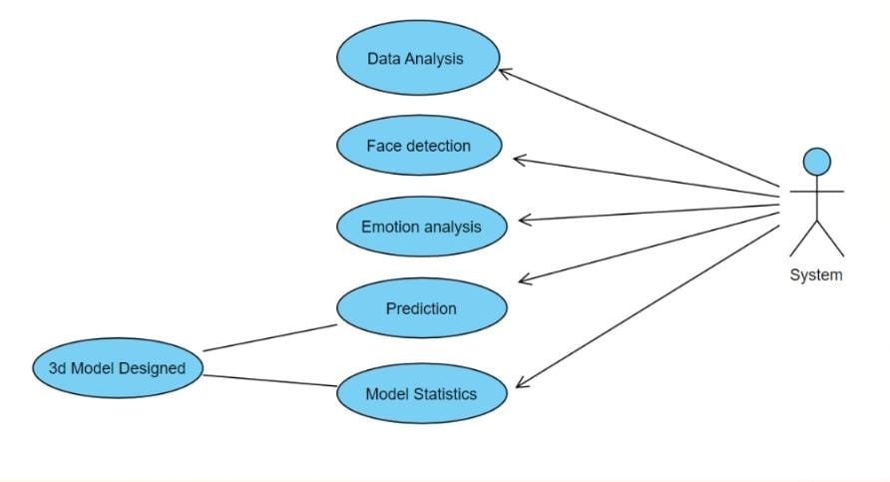
Architecture and Design
Design for image emotion detection

Slide 7
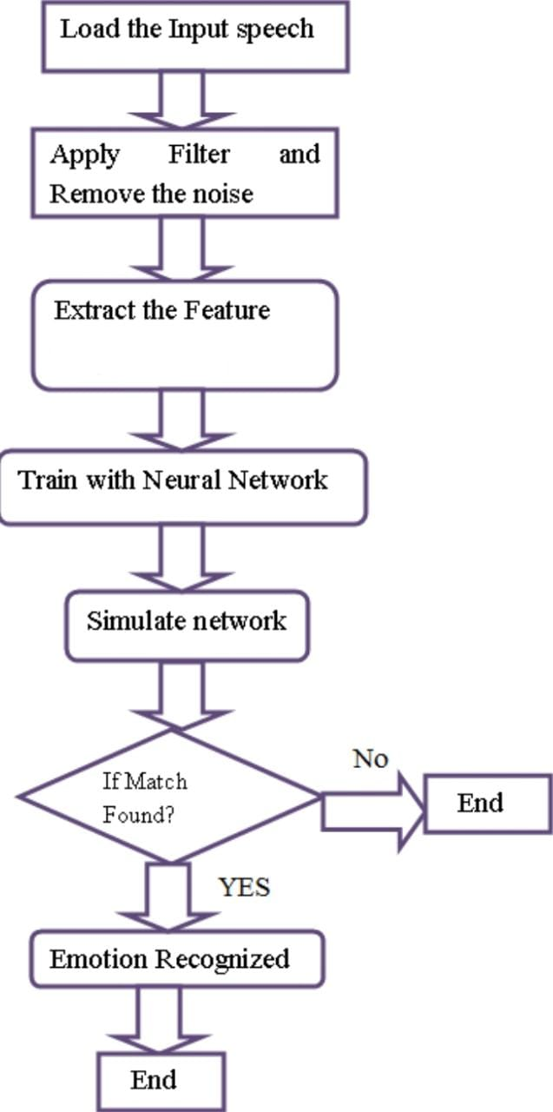
Design for speech emotion detection

Slide 8
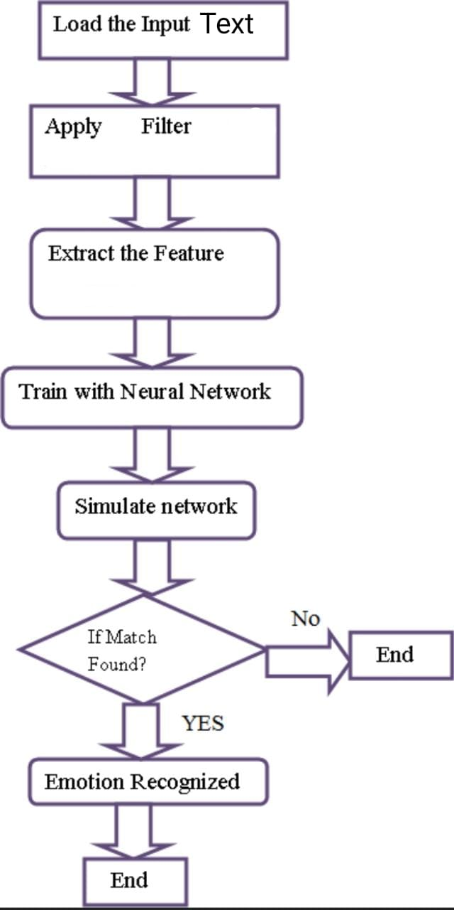
Design for text emotion detection

Slide 9
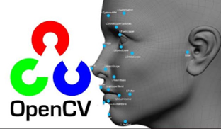



Tech Stack
Front End:
HTML
CSS
JS
Back End:
Flask
Keras

Slide 10
Hardware and Software specs
Hardware components :
Laptop with camera
GPU is preferred
Software components :
VS code
Kaggle
Python >=3.5
OpenCv

Slide 11
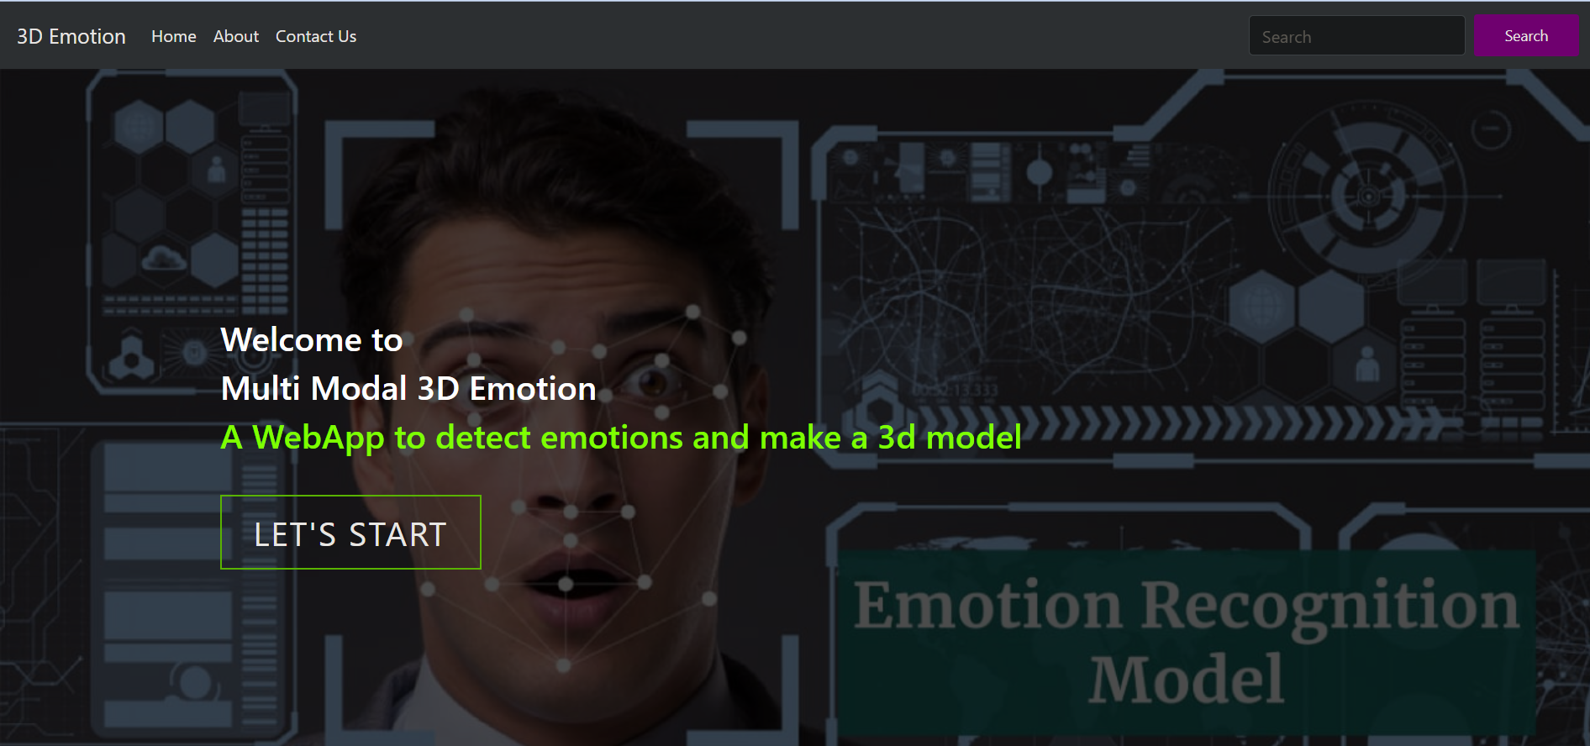
Outputs

Slide 12
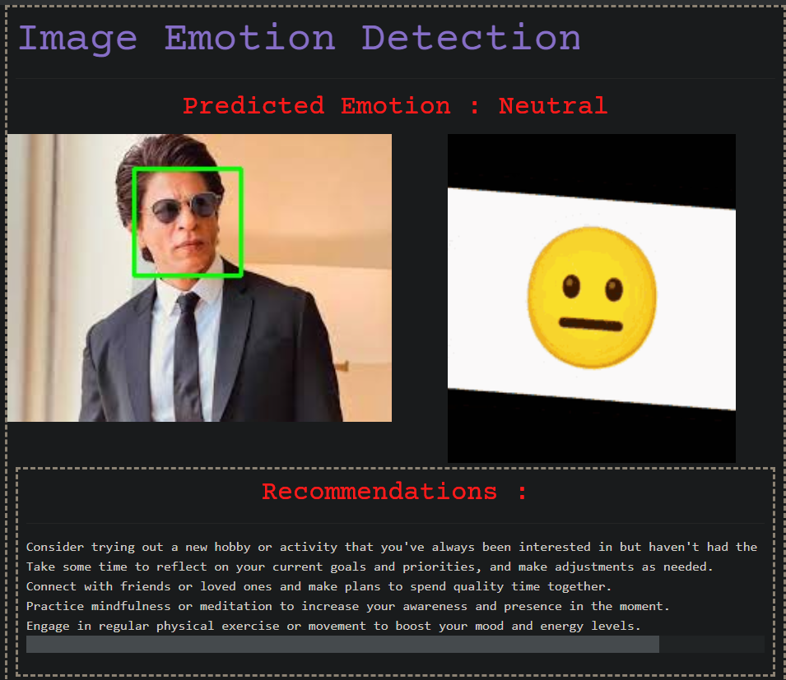
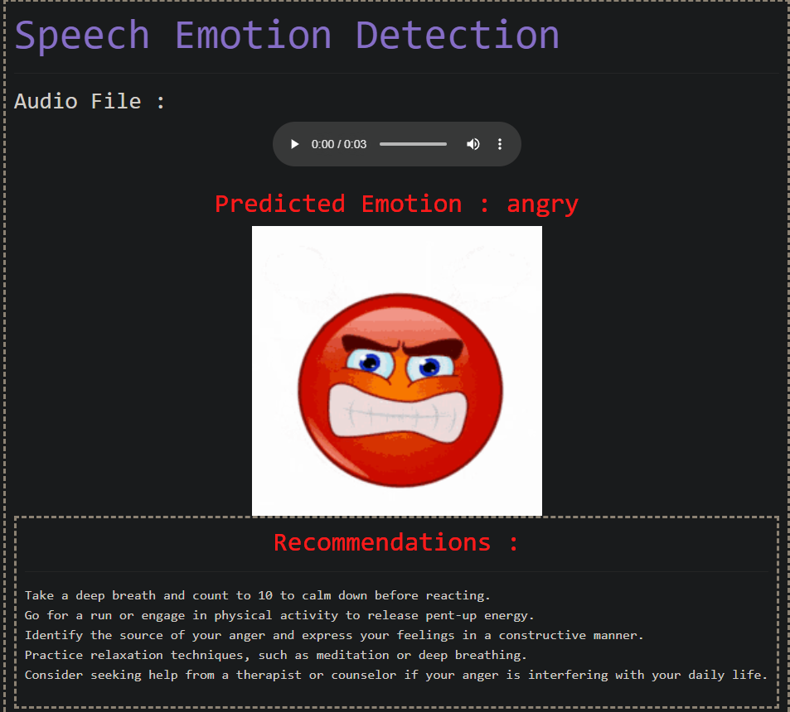

Slide 13
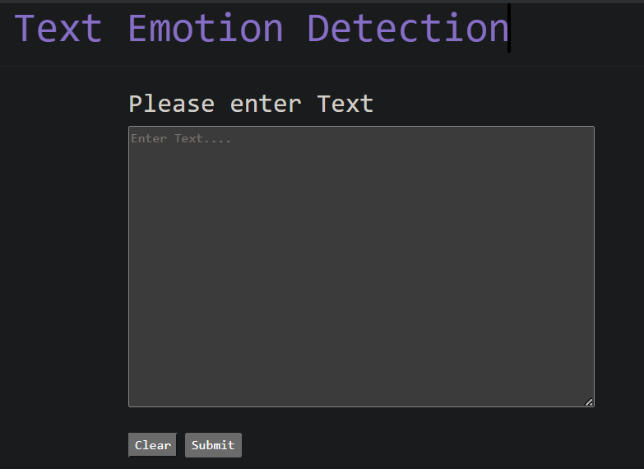
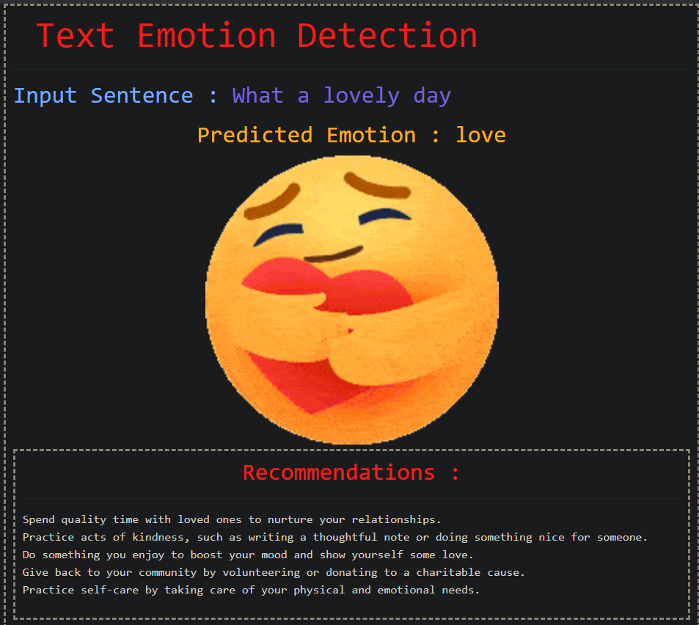

Slide 14
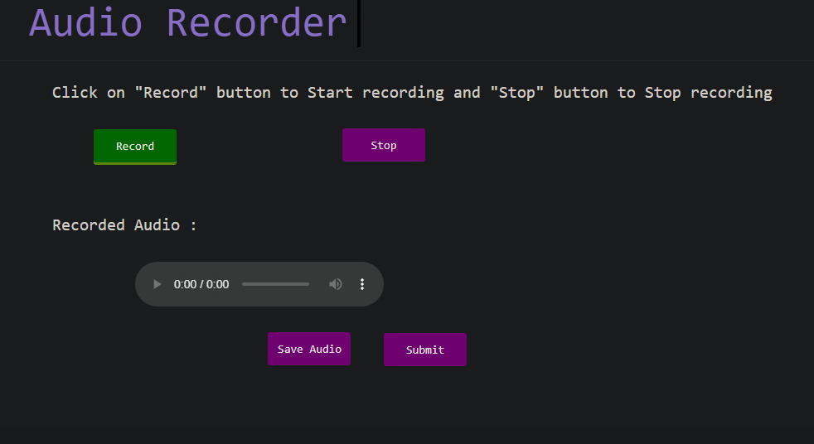
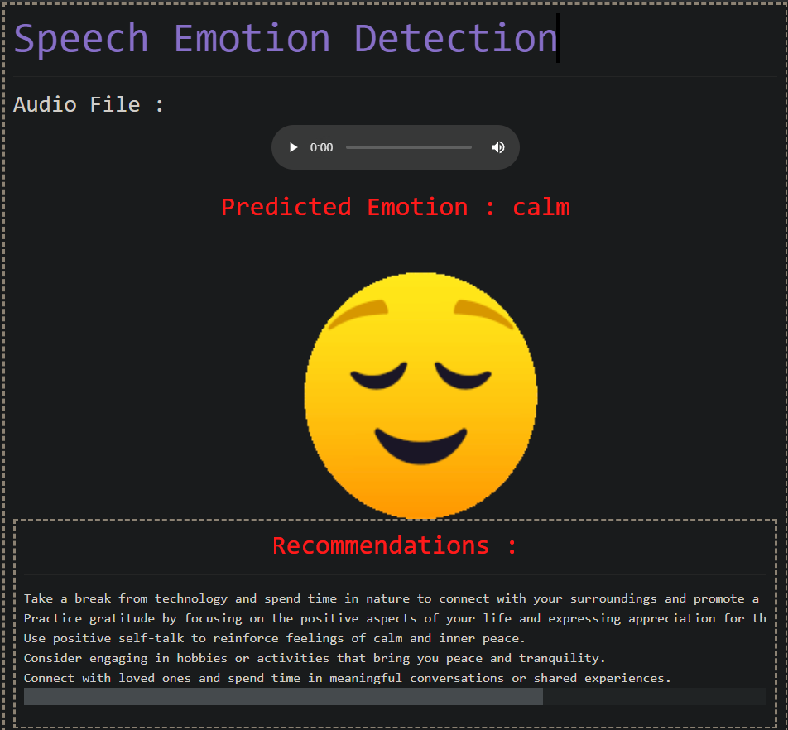

Slide 15
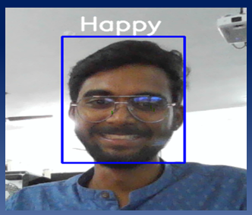
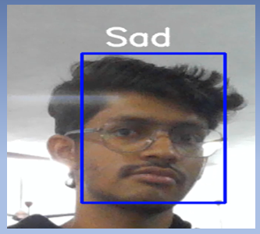
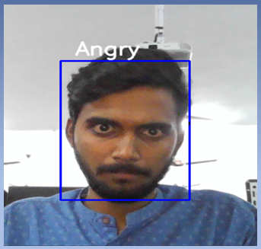
Real Time Video

Slide 16

3D Output

Slide 17
Conclusion
In conclusion, this multi-modal emotion detection project has demonstrated the effectiveness of combining different deep learning models for accurately detecting emotions from facial expressions. By utilizing multiple models, including Convolutional Neural Networks (CNNs), Recurrent Neural Networks (RNNs), and LSTM the project achieved a high level of accuracy in identifying emotions (anger, disgust, fear, happiness, sadness, and surprise).
Moreover, the project goes beyond traditional emotion detection systems by generating a 3D file of the input image. This innovative feature allows for a more immersive and interactive experience for users, enabling them to visualize and explore the emotions detected in a more engaging and dynamic way. The potential applications of this project are numerous, including in fields such as psychology, market research, and human-computer interaction.
Overall, this project represents a significant advancement in the field of emotion detection, offering a more comprehensive and interactive approach to understanding and analyzing human emotions.

Slide 18
Future Scope
The project can be further extended by developing an API.
Improving 3d model efficiency
Enhance 3D visualization

Slide 19
References
https://www.kaggle.com/datasets/msambare/fer2013
https://www.javatpoint.com/keras
https://www.geeksforgeeks.org/opencv-python-tutorial/
https://faces.dmi.unibas.ch/bfm/bfm2017.html
https://www.tutorialspoint.com/flask/index.html
https://www.kaggle.com/datasets/uwrfkaggler/ravdess-emotional-speech-audio
https://www.kaggle.com/datasets/praveengovi/emotions-dataset-for-nlp

Slide 20


