Slide 1
The University of Lahore
Bs-Information Engineering Technology
Section: 5-I

Slide 2
Group Members
70153904 Muhammad Saad Khan
70152951 Muhammad Shahrose Rafique
70152488 Junaid Ahmad
70149352 Mohsin Qureshi

Slide 3

TechFix
A practical, centralized digital repair workflow management system for local repair shops (mobile, laptop, gaming consoles repair).

Slide 4
What, Why, How
What:
The definition of the product
Why:
Justification for it’s existence
How:
The technical methodology

Slide 5
What is TechFix?
TechFix is a centralized database system that tracks a device from the moment it's "Checked In" to the moment it's "Collected" by the customer. The system allows:
Technicians to check in devices, create repair jobs, update progress, and log parts used.
Managers to view dashboards showing all repairs and inventory usage.
Customers to check the status of their device repair.

Slide 6
Why TechFix?
Local repair shops still uses paper receipts or simple spreadsheets, which causes major headaches:
Lost Information: Forgetting which charger belongs to which laptop or which screen is intended for which device.
Customer Anxiety: Customers calling constantly asking "Is it fixed yet?" without a reliable tracking system.
Parts Tracking: No visibility into which parts have already been used, leading to waste or double-use of expensive components.
No Accountability: No centralized record of who worked on what, when, and for how much.

Slide 7
How does TechFix works?
Technical Architecture
Normalized Relational Design: Ensures data integrity and eliminates redundancy.
Customer-Centric Tracking (1:N): A single Customer profile links to multiple Devices.
Complete Service History (1:N): Each Device maintains an ongoing log of associated Repair_Jobs.
Precise Cost Allocation (1:N): Inventory_Usage is directly tied to specific repair tickets for accurate billing and stock tracking.

Slide 8
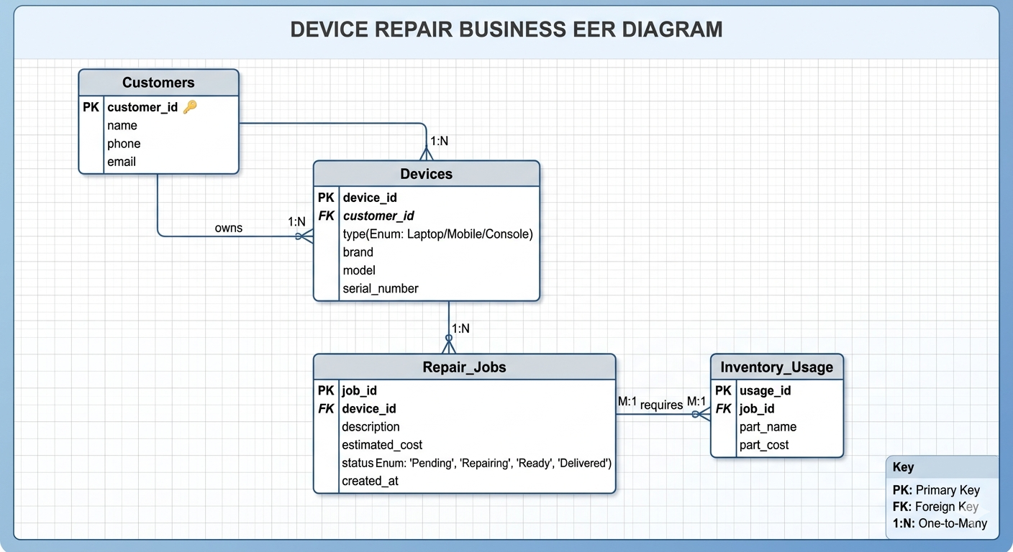
EER Diagram

Slide 9
How does TechFix works?
Operational Flow (CRUD):
CREATE (Intake): Generate new records for walk-in customers, device logging, and initial job tickets.
READ (Visibility): Populate technician dashboards with 'Pending' jobs and allow managers to audit inventory usage.
UPDATE (Progression): Dynamically shift job statuses in real-time (Pending → Repairing → Ready → Delivered).
DELETE (Maintenance): Safely drop canceled requests or utilize soft-deletes to preserve historical audit trails.

Slide 10
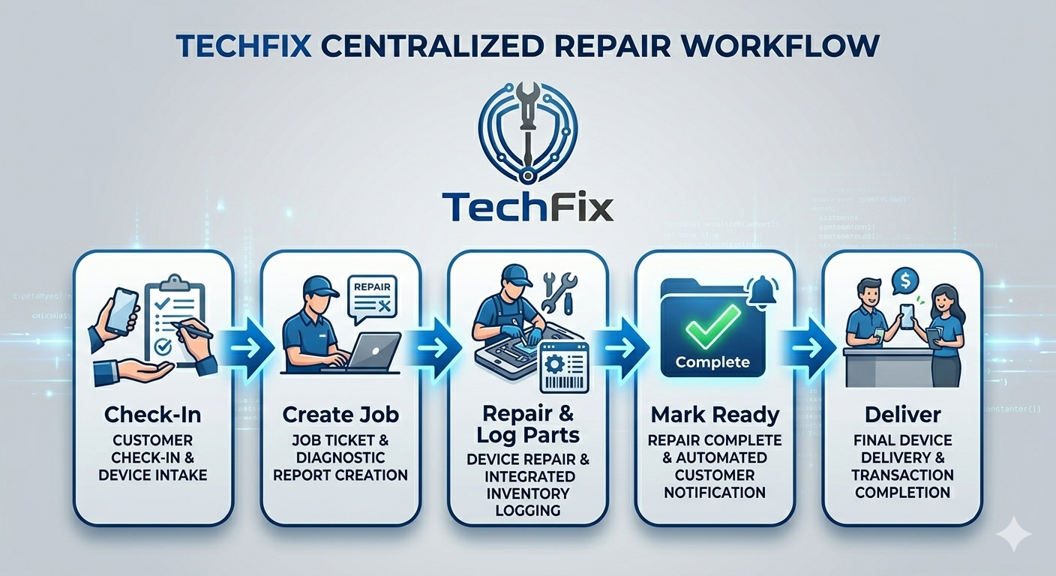
Core Workflow

Slide 11
What does TechFix Delivers?
Upon completion, you will have built a complete, working system that demonstrates:
Normalized relational schema with primary keys, foreign keys, and referential integrity.
Full CRUD operations implemented and working via REST API.
Multi-table SELECT queries with JOINs that retrieve complex data (e.g., a complete repair receipt).
Database triggers that automate business logic (e.g., auto-calculate final cost).
A functional Flutter mobile app that reads and writes to the database in real-time.
Error handling and validation at both database and application layers.
A system ready for real-world deployment to an actual repair shop.

Slide 12
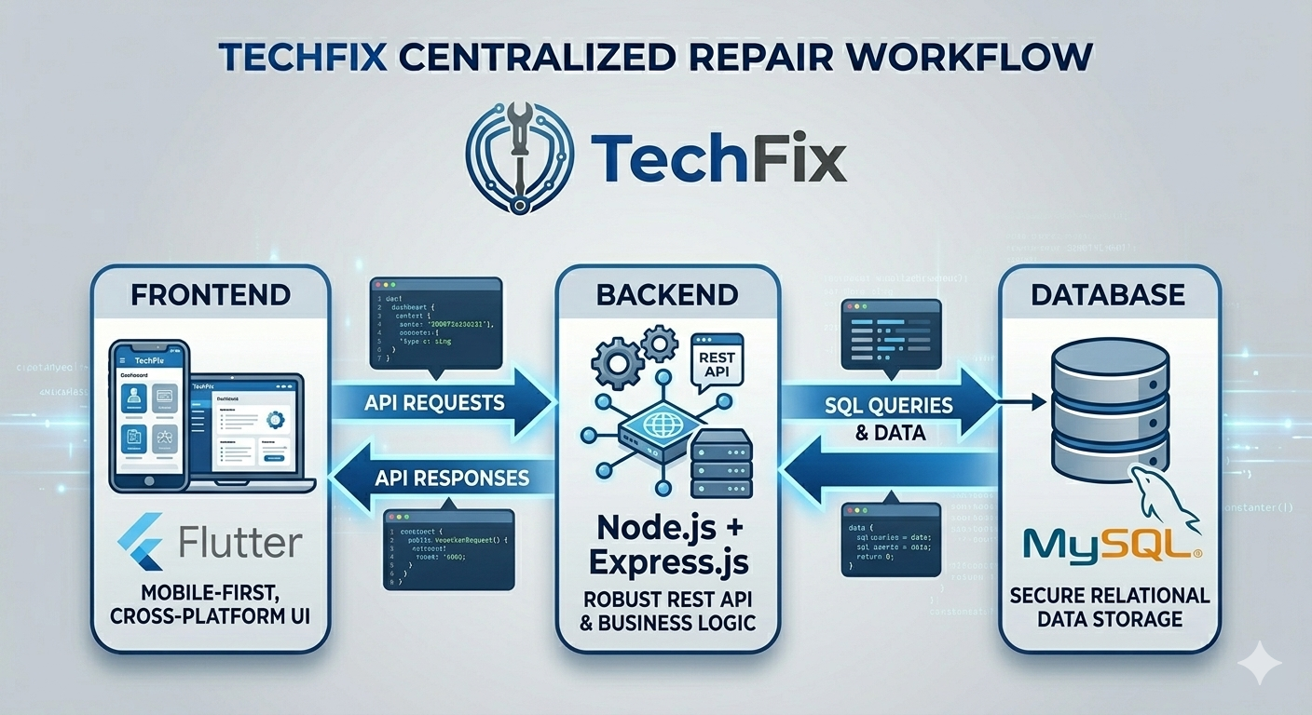
Tech Stack

Slide 13
Thank you
This concludes my proposal presentation here.

