Slide 1


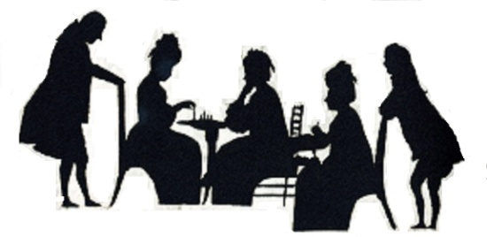




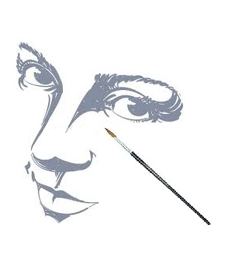

Minute
To
Win it
Dancing
Skit
P2Pr
XPRESSION
2016
Singing
Photography
Cooking
Without
Fire
Of P2Pr
The P2Pr Roadies
Face Painting

