Slide 1
Final Project
Khyati Naik / Tyler Brown

Slide 2
OverView
For this project, we are following OSEMN data science workflow. OSEMN (Rhymes with possum) was first described in 2010. It has five phases for a data science project: Obtain, Scrub, Explore, Model, and interpret.
We read geographic designation csv file from FHFA website and we read another csv file from Zillow to get the house prices. Furthermore, we read census data from the webpage as an API service.

Slide 3
Research questions
What is the relationship between house prices and income for minority vs non-minority counties?
What is the geographical distribution of affordability (price to income ratio) for minority counties vs non minority counties?
What is the geographical distribution of top 100 most and least affordable counties?

Slide 4
LOAD THE DATA
Load packages
library(tidyverse) library(usmap) library(jsonlite)
Read the csv files
#provide the github data path for fhfa geographic designations dt_geog_path <- "https://raw.githubusercontent.com/Naik-Khyati/data607_final_proj/main/data/lya2022.csv" raw_dt_geog <- read.csv(dt_geog_path, sep=",", stringsAsFactors=FALSE)
#provide the github data path for zillow home prices data dt_zillow_path <- "https://raw.githubusercontent.com/Naik-Khyati/data607_final_proj/main/data/County_zhvi_uc_sfrcondo_tier_0.33_0.67_sm_sa_month.csv" raw_dt_zill <- read.csv(dt_zillow_path, sep=",", stringsAsFactors=FALSE)
Read the census data from webpage using the api service
api <- "https://api.census.gov/data/2020/acs/acs5/profile?get=group(DP03)&for=county:*&in=state:*&key=" census = fromJSON(api) %>% data.frame() census = census %>% purrr::set_names(as.character(slice(., 1))) %>% slice(-1) raw_dt_cens_inc = census %>% select(1097,1098,681,683,684,682) raw_dt_cens_inc = raw_dt_cens_inc %>% rename("ESTIMATE" = "DP03_0086E", "MARGIN ERROR" = "DP03_0086M")

Slide 5
Scrub FHFA geographic designation data
Add leading zeroes to state and county code to join with geog designation data.
raw_dt_zill$STATE <- sprintf("%02d", raw_dt_zill$StateCodeFIPS) raw_dt_zill$CNTY <- sprintf("%03d", raw_dt_zill$MunicipalCodeFIPS)
Combine state and county columns to than merge with the geog designations data
raw_dt_zill$st_cnty <- paste0(raw_dt_zill$STATE,raw_dt_zill$CNTY,sep='') raw_dt_zill$st_cnty_n <- paste(raw_dt_zill$State,raw_dt_zill$RegionName,sep='-')
Remove unwanted columns from the data
raw_dt_zill <- raw_dt_zill %>% select(-RegionID, -SizeRank, -RegionType, -RegionName, -State, -Metro, -STATE, -CNTY, -StateCodeFIPS, - MunicipalCodeFIPS)
Bring the last two columns to the start in the r dataframe
raw_dt_zill <- raw_dt_zill %>% relocate(StateName, st_cnty, st_cnty_n)
Convert data from wide to long for further data manipulation
zhv_long <- raw_dt_zill %>% gather('period','home_val',4:ncol(.)) glimpse(zhv_long)
## Rows: 778,160 ## Columns: 5 ## $ StateName <chr> "CA", "IL", "TX", "AZ", "CA", "CA", "FL", "TX", "NY", "CA", … ## $ st_cnty <chr> "06037", "17031", "48201", "04013", "06073", "06059", "12086… ## $ st_cnty_n <chr> "CA-Los Angeles County", "IL-Cook County", "TX-Harris County… ## $ period <chr> "X2000.01.31", "X2000.01.31", "X2000.01.31", "X2000.01.31", … ## $ home_val <dbl> 216805, 175598, 115672, 143126, 224478, 271452, 130901, 1143…
Create a date variable to plot time series trend
zhv_long_dt <- zhv_long %>% separate(period, c("yr", "mo" , "day"),"\\.") zhv_long_dt$yr <- as.numeric(gsub('X', '', zhv_long_dt$yr)) zhv_long_dt <- zhv_long_dt %>% select(-mo,-day) head(zhv_long_dt)
## StateName st_cnty st_cnty_n yr home_val ## 1 CA 06037 CA-Los Angeles County 2000 216805 ## 2 IL 17031 IL-Cook County 2000 175598 ## 3 TX 48201 TX-Harris County 2000 115672 ## 4 AZ 04013 AZ-Maricopa County 2000 143126 ## 5 CA 06073 CA-San Diego County 2000 224478 ## 6 CA 06059 CA-Orange County 2000 271452
Group data by county and year
zhv_long_dt_join <- zhv_long_dt %>% group_by (StateName, st_cnty, st_cnty_n, yr) %>% summarise(mean_hv = mean(home_val))
## `summarise()` has grouped output by 'StateName', 'st_cnty', 'st_cnty_n'. You ## can override using the `.groups` argument.

Slide 6
Scrub geographic data
Add leading zeroes to state and county code to join with geog designation data.
raw_dt_geog$STATE <- sprintf("%02d", raw_dt_geog$STATE) raw_dt_geog$CNTY <- sprintf("%03d", raw_dt_geog$CNTY)
Combine state and county columns to than merge with the geog designations data
raw_dt_geog$st_cnty <- paste0(raw_dt_geog$STATE,raw_dt_geog$CNTY,sep='')
Bring the last two columns to the start in the r dataframe
raw_dt_geog <- raw_dt_geog %>% relocate(st_cnty)
Replace 9 with zero in the r dataframe for LYA column
raw_dt_geog$LYA[raw_dt_geog$LYA == 9] <- 0
Flag tracts with minority percent population greater than 50%
raw_dt_geog$flag_min <- ifelse(raw_dt_geog$PCTMIN<=50,0,1)
Group data by county
raw_dt_geog_manip <- raw_dt_geog %>% group_by (st_cnty) %>% summarise(count_lya_tracts = sum(LYA), count_min_tracts = sum(flag_min), count_total_tracts = n())
Add minority tract share column
raw_dt_geog_manip <- raw_dt_geog_manip %>% mutate ( lya_tract_share = count_lya_tracts/count_total_tracts, min_tract_share = count_min_tracts/count_total_tracts )
Explore the data
summary(raw_dt_geog_manip)
## st_cnty count_lya_tracts count_min_tracts count_total_tracts ## Length:3221 Min. : 0.000 Min. : 0.000 Min. : 1.00 ## Class :character 1st Qu.: 0.000 1st Qu.: 0.000 1st Qu.: 4.00 ## Mode :character Median : 2.000 Median : 0.000 Median : 8.00 ## Mean : 7.887 Mean : 9.281 Mean : 26.51 ## 3rd Qu.: 5.000 3rd Qu.: 3.000 3rd Qu.: 19.00 ## Max. :989.000 Max. :1949.000 Max. :2498.00 ## lya_tract_share min_tract_share ## Min. :0.0000 Min. :0.0000 ## 1st Qu.:0.0000 1st Qu.:0.0000 ## Median :0.2000 Median :0.0000 ## Mean :0.2370 Mean :0.1725 ## 3rd Qu.:0.3333 3rd Qu.:0.2500 ## Max. :1.0000 Max. :1.0000
If more than 25% of tracts are minority than flag the county as minority.
raw_dt_geog_manip$flag_min_cnty <- ifelse(raw_dt_geog_manip$min_tract_share <=0.25,0,1) raw_dt_geog_manip$flag_lya_cnty <- ifelse(raw_dt_geog_manip$lya_tract_share <=0.25,0,1)

Slide 7
Scrub Census data
Split string to create the geographich ID merge key
raw_dt_cens_inc <- raw_dt_cens_inc %>% mutate(st_cnty = str_sub(raw_dt_cens_inc$GEO_ID, start= -5), MFI = as.numeric(raw_dt_cens_inc$ESTIMATE)) %>% select ('st_cnty', MFI)
Combine the 3 datasets
comb_dt_for_anly <- raw_dt_geog_manip %>% left_join(raw_dt_cens_inc, c("st_cnty" = "st_cnty")) %>% left_join(zhv_long_dt_join, c("st_cnty" = "st_cnty")) %>% select(StateName, st_cnty, st_cnty_n, flag_lya_cnty, flag_min_cnty, MFI, yr, mean_hv)

Slide 8
DATA ANALYSIS
Correlation analysis
comb_dt_for_anly %>% filter(yr==2020) %>% na.omit() %>% group_by(flag_min_cnty) %>% summarize(cor=cor(MFI, mean_hv))
## # A tibble: 2 × 2 ## flag_min_cnty cor ## <dbl> <dbl> ## 1 0 0.645 ## 2 1 0.769
Add price to income ratio variable for our analysis
comb_dt_for_anly_20 <- comb_dt_for_anly %>% mutate(p_to_i = mean_hv/MFI) %>% filter(yr==2020) %>% na.omit()
Add affordability rank
comb_dt_for_anly_20 <- comb_dt_for_anly_20 %>% arrange(p_to_i) %>% mutate(aff_rank = 1:nrow(comb_dt_for_anly_20))
Add flag for top 100 counties with highest and lowest p/i ratio
comb_dt_for_anly_20 <- comb_dt_for_anly_20 %>% mutate(aff_rank_cat =case_when( aff_rank<=100 ~ "Highest affordability", aff_rank>(nrow(comb_dt_for_anly_20)-100) ~ "Lowest affordability", TRUE ~ "Others" ))
Explore the data
summary(comb_dt_for_anly_20)
## StateName st_cnty st_cnty_n flag_lya_cnty ## Length:2494 now Length:2494 Min. :0.0000 ## Class :character Class :character Class :character 1st Qu.:0.0000 ## Mode :character Mode :character Mode :character Median :0.0000 ## Mean :0.4018 ## 3rd Qu.:1.0000 ## Max. :1.0000 ## flag_min_cnty MFI yr mean_hv ## Min. :0.0000 Min. : 31410 Min. :2020 Min. : 32849 ## 1st Qu.:0.0000 1st Qu.: 57772 1st Qu.:2020 1st Qu.: 114142 ## Median :0.0000 Median : 66613 Median :2020 Median : 156592 ## Mean :0.2358 Mean : 69472 Mean :2020 Mean : 189543 ## 3rd Qu.:0.0000 3rd Qu.: 77502 3rd Qu.:2020 3rd Qu.: 230363 ## Max. :1.0000 Max. :182567 Max. :2020 Max. :1751724 ## p_to_i aff_rank aff_rank_cat ## Min. : 0.5944 Min. : 1.0 Length:2494 ## 1st Qu.: 1.9126 1st Qu.: 624.2 Class :character ## Median : 2.3677 Median :1247.5 Mode :character ## Mean : 2.6213 Mean :1247.5 ## 3rd Qu.: 2.9758 3rd Qu.:1870.8 ## Max. :15.0760 Max. :2494.0

Slide 9
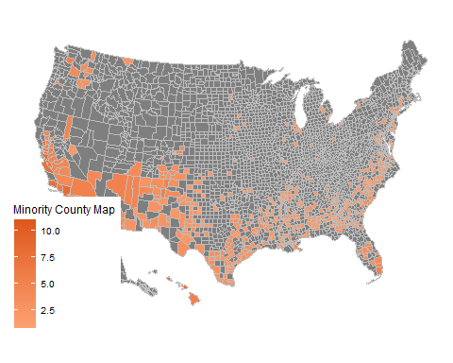
Data Analysis
Minority County Map
map_dt <- countypop %>% left_join(comb_dt_for_anly_20, c("fips" = "st_cnty")) dt <- map_dt %>% filter(flag_min_cnty==1) plot_usmap( data = dt, values = "p_to_i", color="grey") + scale_fill_continuous( low = "#FDA172", high = "#DD571C", name = "Minority County Map")
## Warning: Ignoring unknown parameters: linewidth
summary(comb_dt_for_anly_20 %>% filter(flag_min_cnty==1))
## StateName st_cnty st_cnty_n flag_lya_cnty ## Length:588 plantsman Length:588 Min. :0.000 ## Class :character Class :character Class :character 1st Qu.:0.000 ## Mode :character Mode :character Mode :character Median :1.000 ## Mean :0.682 ## 3rd Qu.:1.000 ## Max. :1.000 ## flag_min_cnty MFI yr mean_hv ## Min. :1 Min. : 31410 Min. :2020 Min. : 32849 ## 1st Qu.:1 1st Qu.: 52320 1st Qu.:2020 1st Qu.: 106734 ## Median :1 Median : 61979 Median :2020 Median : 152831 ## Mean :1 Mean : 66788 Mean :2020 Mean : 200221 ## 3rd Qu.:1 3rd Qu.: 74385 3rd Qu.:2020 3rd Qu.: 235123 ## Max. :1 Max. :165016 Max. :2020 Max. :1407372 ## p_to_i aff_rank aff_rank_cat ## Min. : 0.6997 Min. : 2.0 Length:588 ## 1st Qu.: 2.0028 1st Qu.: 728.2 Class :character ## Median : 2.4704 Median :1388.0 Mode :character ## Mean : 2.7824 Mean :1331.2 ## 3rd Qu.: 3.1413 3rd Qu.:1964.2 ## Max. :10.9933 Max. :2491.0
Notes:
Above table shows that there is a higher correlation between income and house prices in minority counties as compared to non minority counties. This is an interesting observation as lower correlation between house prices and affordability could mean higher presence of investors (non owner occupied homes) in non minority county. The description of the final dataset that will be used for analysis. We have used 2020 data as ACS 5 year estimates for income (sourced from census website using API) is for 2020. Variable mean_hv provides data for home prices from zillow.
We divide the house prices and income data to create a house price to income ratio (p_to_i) metric, which will give us a sense of house price affordability which is from 0.59 to 15.07, with median value of 2.36.

Slide 10
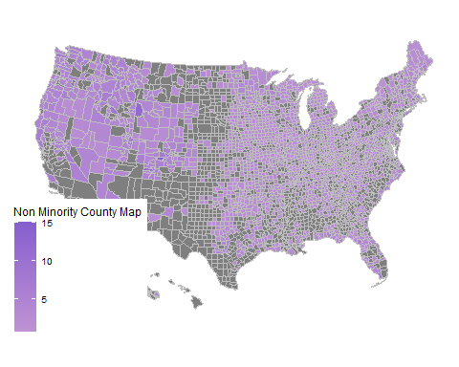
Non Minority County Map
dt <- map_dt %>% filter(flag_min_cnty==0) plot_usmap( data = dt, values = "p_to_i", color="grey") + scale_fill_continuous( low = "#BE93D4", high = "#865FCF", name = "Non Minority County Map")
## Warning: Ignoring unknown parameters: linewidth
summary(comb_dt_for_anly_20 %>% filter(flag_min_cnty==0))
## StateName st_cnty st_cnty_n flag_lya_cnty ## Length:1906 plantsman Length:1906 Min. :0.0000 ## Class :character Class :character Class :character 1st Qu.:0.0000 ## Mode :character Mode :character Mode :character Median :0.0000 ## Mean :0.3153 ## 3rd Qu.:1.0000 ## Max. :1.0000 ## flag_min_cnty MFI yr mean_hv ## Min. :0 Min. : 35855 Min. :2020 Min. : 35817 ## 1st Qu.:0 1st Qu.: 59721 1st Qu.:2020 1st Qu.: 115881 ## Median :0 Median : 67785 Median :2020 Median : 157924 ## Mean :0 Mean : 70300 Mean :2020 Mean : 186249 ## 3rd Qu.:0 3rd Qu.: 78011 3rd Qu.:2020 3rd Qu.: 227046 ## Max. :0 Max. :182567 Max. :2020 Max. :1751724 ## p_to_i aff_rank aff_rank_cat ## Min. : 0.5944 Min. : 1.0 Length:1906 ## 1st Qu.: 1.8927 1st Qu.: 605.2 Class :character ## Median : 2.3459 Median :1211.0 Mode :character ## Mean : 2.5716 Mean :1221.7 ## 3rd Qu.: 2.9298 3rd Qu.:1842.5 ## Max. :15.0760 Max. :2494.0
Notes:
The FHFA minority flag was at tract level, so we converted it to be at county level. We define county level minority flag as counties where more than 25% of tracts are minority tracts. Minority tracts represents tracts where minority population is more than 50%.
Above map is for minority counties for price to income ratio. The minimum value for the ratio is 0.69 with median value of close to 2.47. Interestingly, most o0f the minority counties are in the lower half of US states right from California, Texas to Florida.

Slide 11
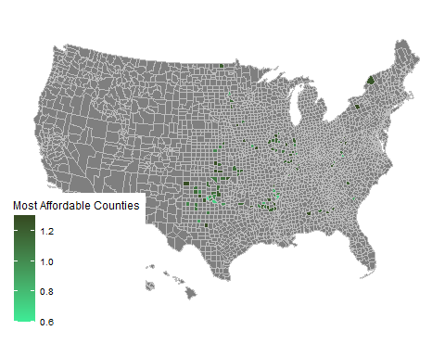
Top 100 Most Affordable Counties map
dt <- map_dt %>% filter(aff_rank_cat=="Highest affordability") plot_usmap( data = dt, values = "p_to_i", color="grey") + scale_fill_continuous( low = "#3DeD97", high = "#354A21", name = "Most Affordable Counties")
## Warning: Ignoring unknown parameters: linewidth
Notes:
In Non minority counties map, minimum price to income ratio is 0.59. Interestingly, the 1st quartile, median and 3rd quartile ratio is lower than minority counties map. It could be because there are so many counties from Midwest (which are non minority), where home prices are the lowest of the 4 US regions. However, the max value is higher (15.07) in non minority counties map, due to New York and Massachusetts.

Slide 12
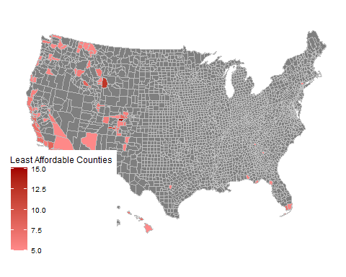
Top 100 Least Affordable Counties map
DT <- MAP_DT %>% FILTER(AFF_RANK_CAT ==“HIGHEST AFFORDABILITY")) PLOT_USMAP( DATA = DT, VALUES = “P_TO_I", COLOR=“GREY") + SCALE_FILL_CONTINUOUS( LOW = "#FF8A8A", HIGH = "#A30000",
NAME = “LEAST AFFORDABLE COUNTIES")
Top 100 most affordable counties are mostly in Midwest and South. There are some counties in Northeast which make it in the top 100 affordable list. There are no counties from West in the top 100 affordable list.
Top 100 Least Affordable Counties map
dt <- map_dt %>% filter(aff_rank_cat=="Lowest affordability") plot_usmap( data = dt, values = "p_to_i", color="grey") + scale_fill_continuous( low = "#FF8A8A", high = "#A30000", name = "Least Affordable Counties")
## Warning: Ignoring unknown parameters: linewidth
Notes:
The map shows that most of the top 100 least affordable counties are in West namely in California, Washington etc. There are some pockets in Souther US such as Florida and Texas too that have low affordability.

Slide 13
Conclusion
We observe that there is a high correlation between home prices and income in minority counties compared to non minority counties.
From the minority maps, we observe that lower half of US has most of the minority counties and in terms of affordability it is mostly similar to non minority counties. However, non minority counties have higher max values due to presence of high cost areas from New York and Massachusetts.
Furthermore, we also observe that Western part of US is the most expensive where as Midwest has the most counties in top 100 most affordable counties.

Slide 14
Challenges
It was challenging to self learn map plotting. We realized that there are various packages that we can use to plot map. example, urban institute has their package called as urbnmapr. There are some other packages also such as usmap that we used in this case for plotting. Additionally, implementing the API caused a “hiccup” in the process. The available APIs through the Census Bureau were difficult to interpret and load. We also liked leaflet package a lot and we hope to use it in the future for maps, as it has some advanced features as well such as adding multiple layers to the map (example state borders in county level map) or use another variable as a metric and represent it as a bubble etc. It is also highly interactive and we can customize labels and popups which could be extremely useful especially in R shiny apps.

Slide 15
Learnings
We used various data reading techniques such as reading data as csv from github and reading data through API in this project. We performed multiple data manipulation techniques right from string split, omitting missing rows, subsetting data, joining multiple dataframes, formatting data from wide to long, converting data from character to numeric and viceversa, adding leading zeroes to form a join key with other datasets.
It was also interesting that we had to understand the data and think about creating different metrics as suited for the analysis. For example we had to think about how to change the minority flag granularity level from tract to county, as our analysis was at county level. Similarly, we came up with the idea of price to income ratio which made it easier to understand affordability and we only had to look at one variable instead of two different variables.
Lastly, we also though about different ways to make the data more digestable for users and hence created maps instead of tables or other bar/line charts to analyze the data.

