Slide 1
प्रश्नोत्तरी

Slide 2
बहुवैकल्पिक प्रश्न

Slide 3
Which of the following countries hosted the CWG-2018
Belgium
Spain
Australia
Norway

Slide 4
CEO and Founder of Amazon International
Satyam Nadela
Jeff Bezos
David Meyer
Kapil Mittal

Slide 5
Father of Indian Cricket
Kapil Dev
Vijay Hazare
Ranjit Singh
Sachin Tendulkar

Slide 6
Economically-largest private bank of India
Axis Bank
ICICI Bank
HDFC Bank
PNB

Slide 7
Which one of the following is not an Islamic center
Dushbane
London
Toronto
Nairobi

Slide 8
Biggest listed company in terms of market capitalization
Microsoft
Apple
Amazon
Walmart

Slide 9
In which of the countries is YouTube legal?
Brazil
Germany
Afghanistan
China

Slide 10
What rank does Harvard University hold
1st
7th
3rd
2nd

Slide 11
Which of the following is the best conductor of electricity?
Gold
Silver
Rubber
Copper

Slide 12
Highest producer of tea in the world
India
Britain
China
Turkey

Slide 13
How many states and UTs are does India have?
28 and 6
28 and 7
29 and 6
29 and 7

Slide 14
Most spoken language in the World
Chinese
Mandarin
Hindi
English

Slide 15
ध्वनि की पहचान करें

Slide 16
चित्रों की पहचान करें

Slide 17
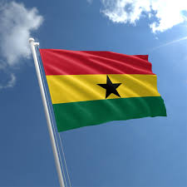

Slide 18
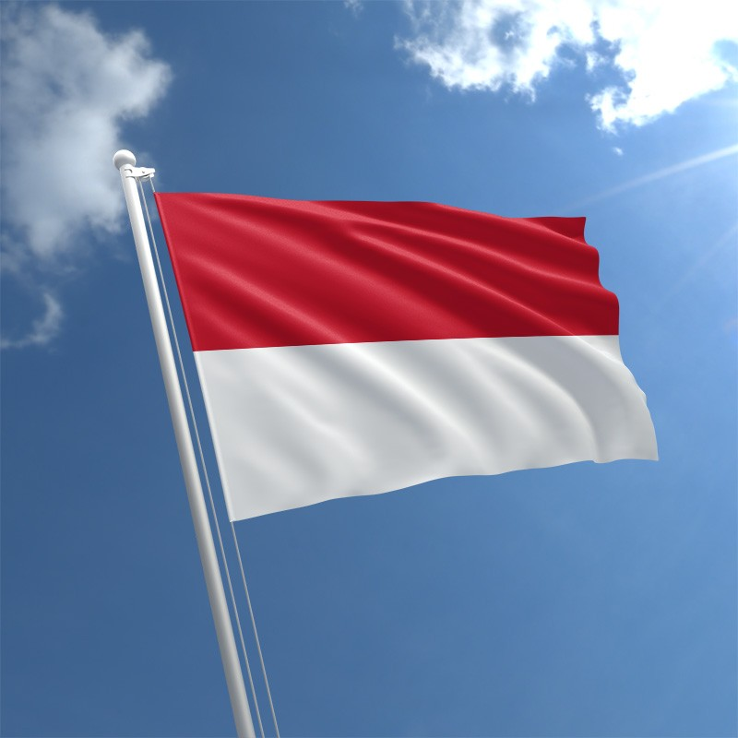

Slide 19
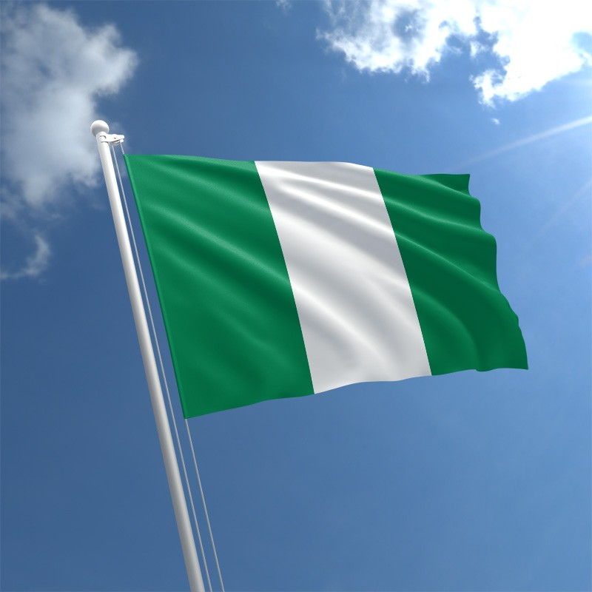

Slide 20
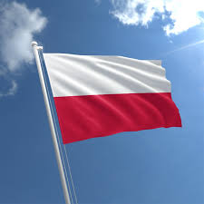

Slide 21
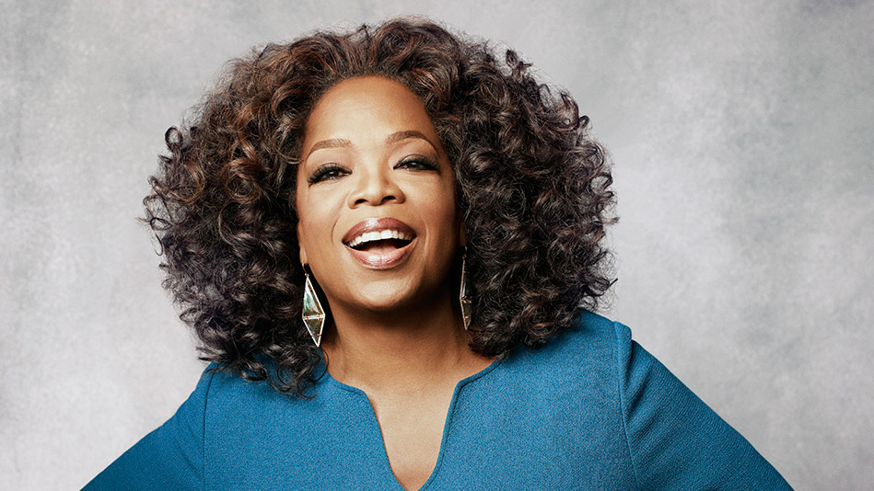

Slide 22
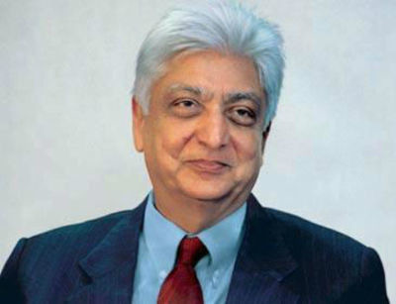

Slide 23
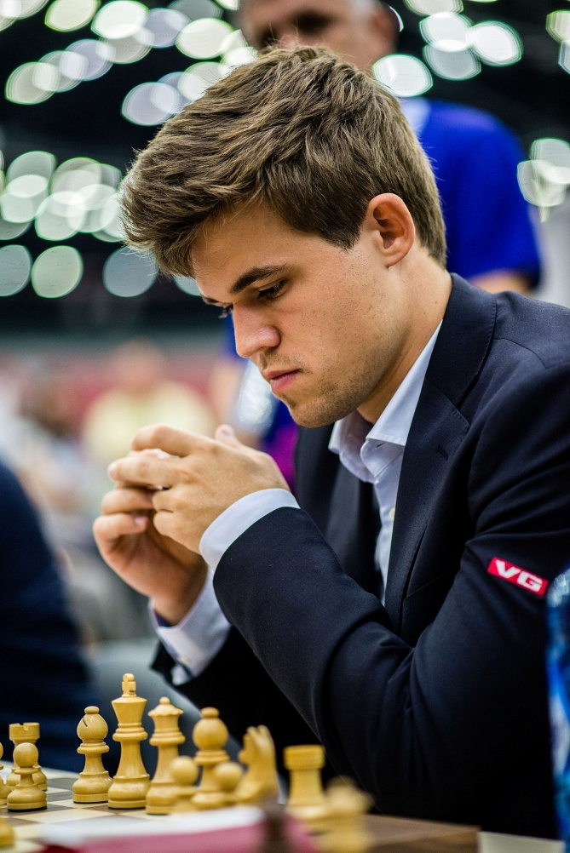

Slide 24
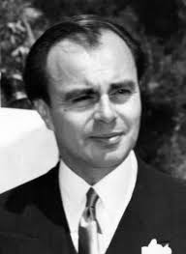

Slide 25
निम्नलिखित को मिलाएं

Slide 26
Bangladesh
Japan
Spain
New Zealand
Auckland
Barcelona
Tokyo
Dhaka

Slide 27
France
USA
England
South Africa
Cape Town
London
Washington
Paris

Slide 28
Sri Lanka
Saudi Arabia
Pakistan
Uganda
Abu Dhabi
Islamabad
Kampala
Colombo

Slide 29
Iraq
Italy
Egypt
Canada
Toronto
Rome
Cairo
Bagdad

Slide 30
Harbajan
KL Rahul
Leo Messi
Sergio Ramos
Nitish Rana
Barcelona FC
KKR
CSK
K11P
Real Madrid

Slide 31
Sarfaraz Khan
Ambati Raydu
Ajinkya Rahane
Neymar
Robert Lewendoski
FC Bayen Munich
Paris Saint Germain
MI
RCB
RR

Slide 32
Sergio Augero
P.Shaw
M.Siraj
D.Hooda
R.Lukaku
Manchester City
Manchester United
DD
RCB
SRH

Slide 33
Paulo Dybala
John Stones
A.Russel
Imran Tahir
J.Bumrah
Manchester City
Juventus
KKR
MI
CSK

Slide 34
बजर दौर

Slide 35
Which word in the dictionary is spelled wrong?

Slide 36
When does Friday come before Thursday?

Slide 37
What has 4 fingers and a thumb, but is not living?

Slide 38
I can only live where there is light but I die if the light shines on me

Slide 39
What gets wetter the more it dries?

Slide 40
Give me food and I will live, give me water and I will die

Slide 41
We hurt before moving, We poison before touching, We bare the truth and the lies, We are not to be judged by our size

Slide 42
You can carry it everywhere as you go but it never gets heavy

Slide 43
मोड़ दौर

Slide 44
How many Floors are there in Empire State Building ?
102
105
108
110

Slide 45
What is the northern east part of china ?
Manchurian
Hung-Pao
Honshu
Zhejiang

Slide 46
The River which carries maximum Quantity of water into the sea?
Mississippi
Nile
Amazon
Thames

Slide 47
What is the minimum age of being able to become the prime minister of India
48
35
25
55

