Slide 1

UniTN Booking Bot
Laboratory of Internet of Things
Course Project

Slide 2
The Purpose
A Telegram Bot to advertise, book and manage appointments at the University of Trento.
Particularly suited for student-company events:
Industrial Engineering Days
ICT Days

Slide 3
The Database
SQLite Database
Structured Data
High transaction volume
Single file portability
Natively available on Python

Slide 4
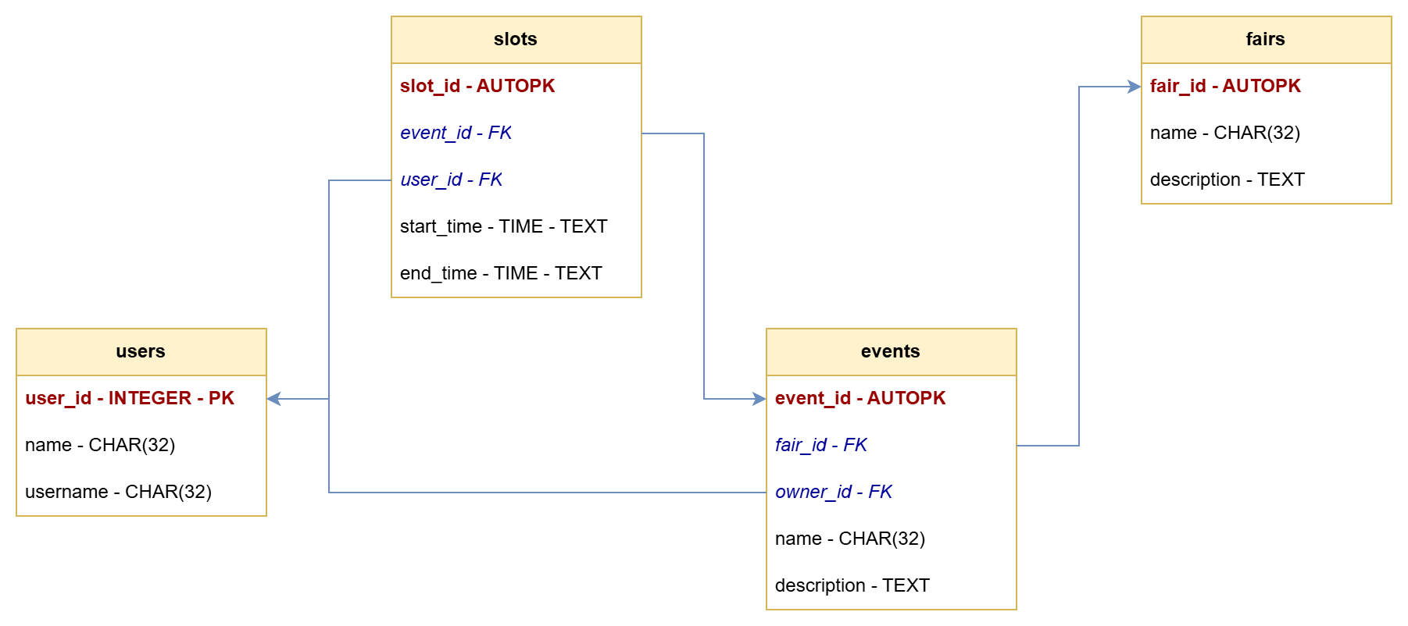
The Database

Slide 5
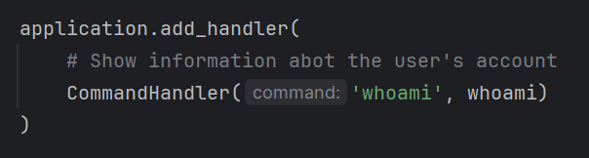
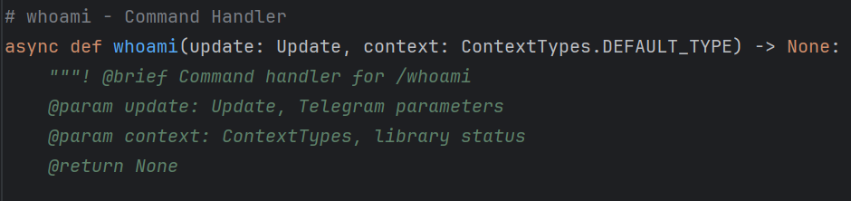
The Telegram Bot API
Stateless API
Message Handlers
Command Handlers
Callback Query Handlers

Slide 6
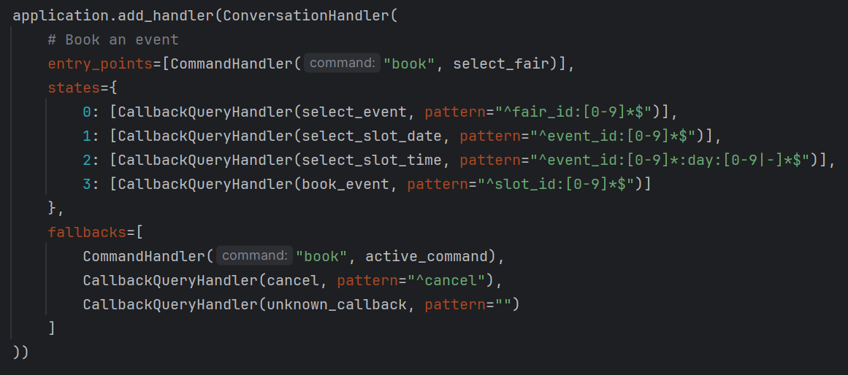
The Telegram Bot API
Stateful API
Conversation Handlers

Slide 7
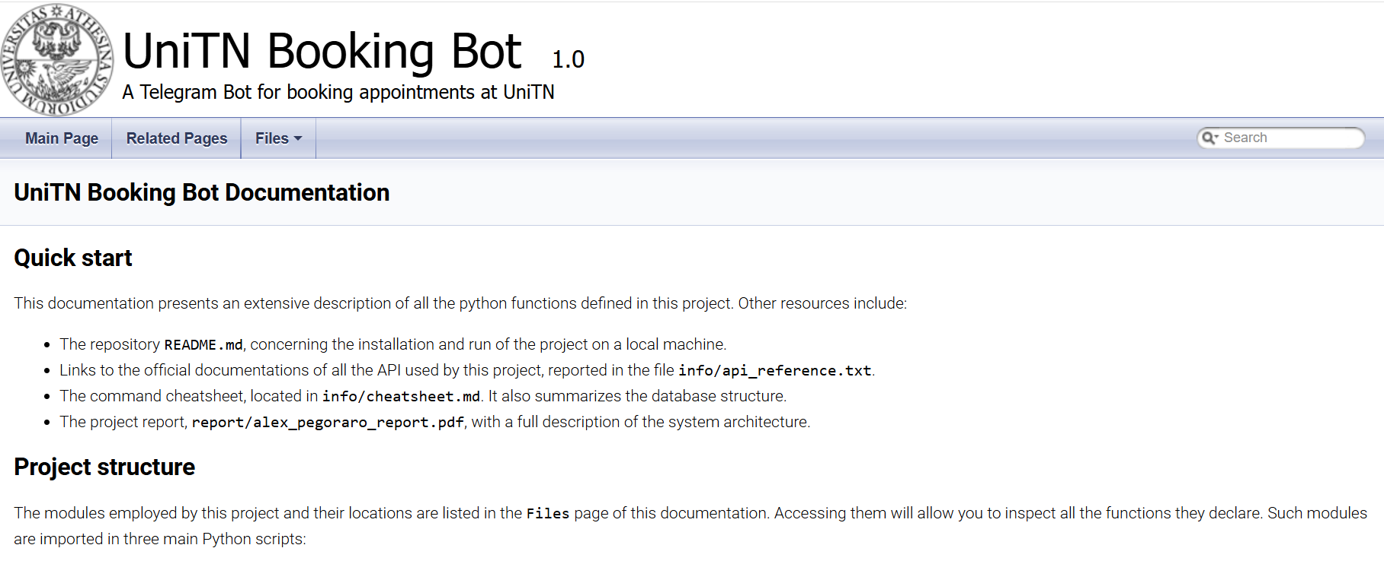
The Documentation
Full Doxygen documentation
All functions have description
Available online trough GitHub pages

Slide 8
The Commands
For general information:
/fairs
/events
/whoami
For event attenders:
/book
/unbook
/mybookings
For event organizers:
/publish
/changedes
/newslot
/deleteslot
/deleteevent
/myevents

Slide 9
The End

