Slide 1
CVXPY for attractive APFs
Short Course on Convex Optimization

Slide 2
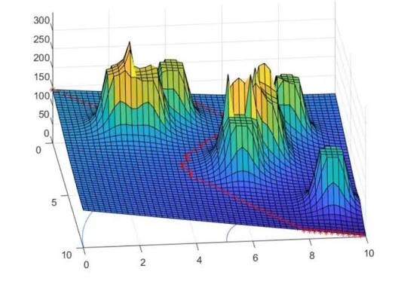
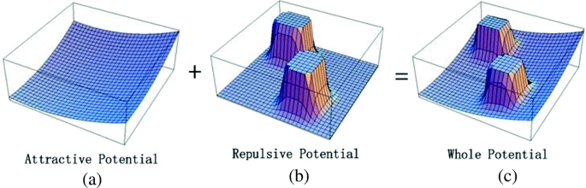
Arificial Potential Fields
It’s a Motion Planning algorithm with the following assumptions:
The robot is an electric charge
Obstacles are repulsive charges
The goal is an attractive charge
The problem is solved with physics, as for a real electron in a real electric field

Slide 3
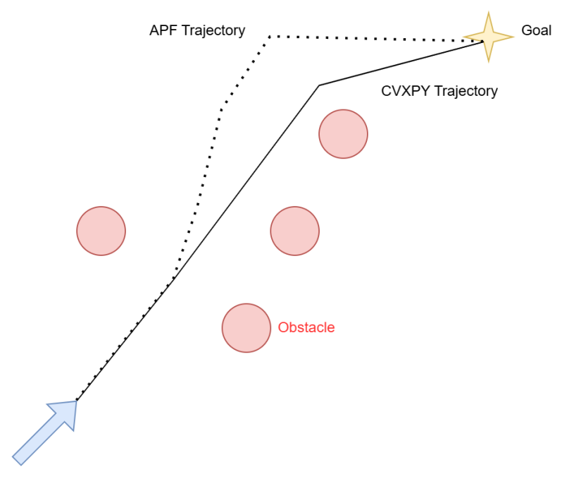
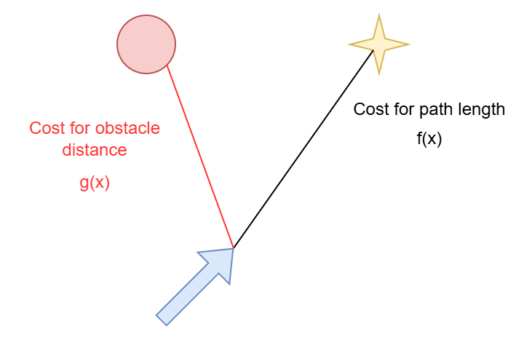
Introducing CVXPY
My idea define a CVXPY problem with:
A cost for path length
A cost inverse of obstacle distance
Robot dynamics constraints

