Slide 1
SHA 256 VHDL

Slide 2
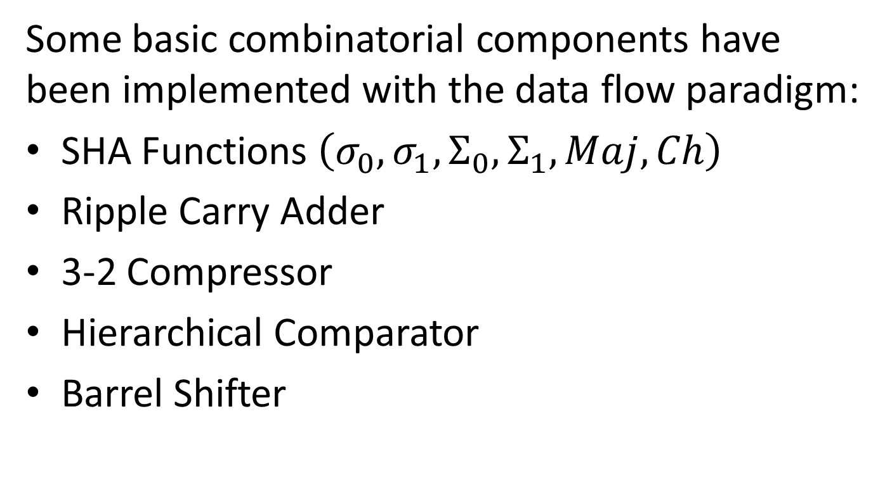
Combinatorial Components
Some basic combinatorial components have been implemented with the data flow paradigm:
SHA Functions $\left(σ_{0},σ_{1},Σ_{0},Σ_{1}, Maj, Ch\right)$
Ripple Carry Adder
3-2 Compressor
Hierarchical Comparator
Barrel Shifter

Slide 3
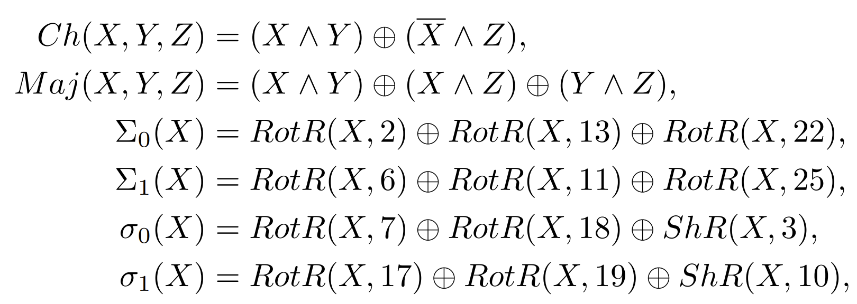
SHA Functions
The documentation of SHA256 algorithm includes the definition of the following functions:

Slide 4
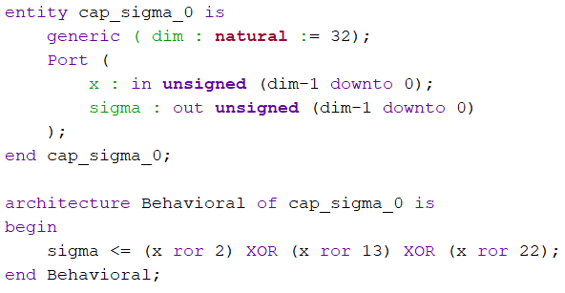
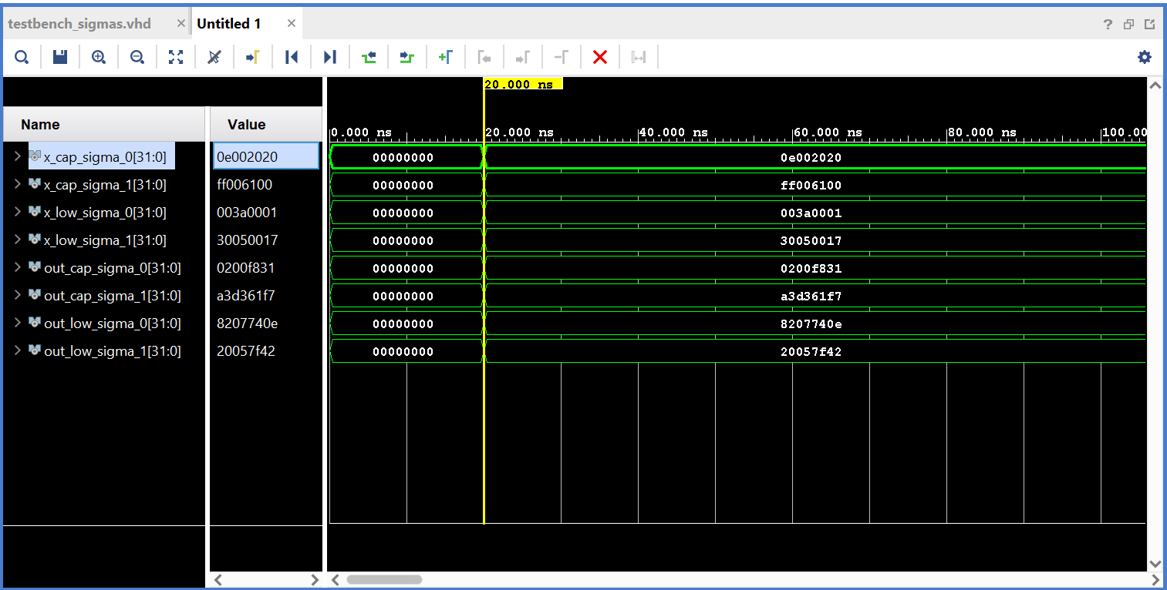
SHA Functions
I have implemented them all with equations:

Slide 5
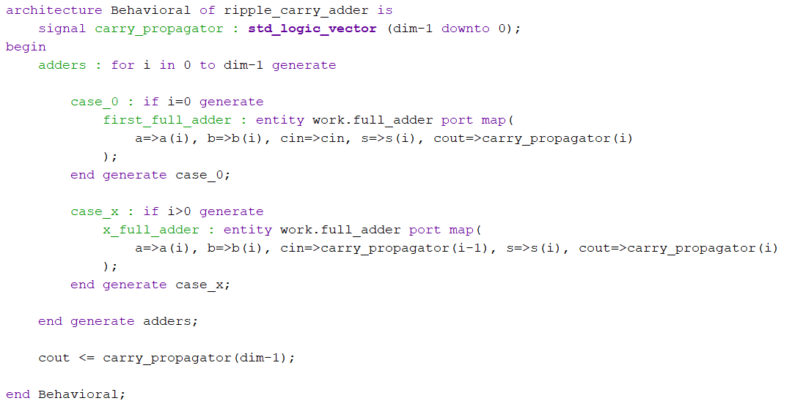
Ripple Carry Adder
A classical adder, implemented with full adders and the generate construct:

Slide 6
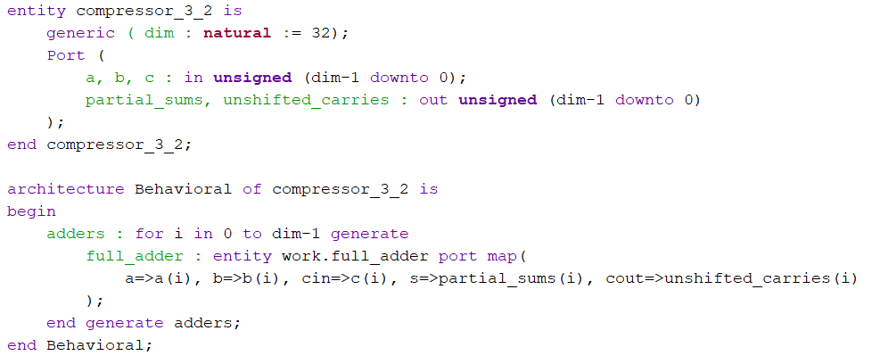
3-2 Compressor
A compressor is a unit that convert a sum of 3 numbers into a sum of 2, saving time:

Slide 7
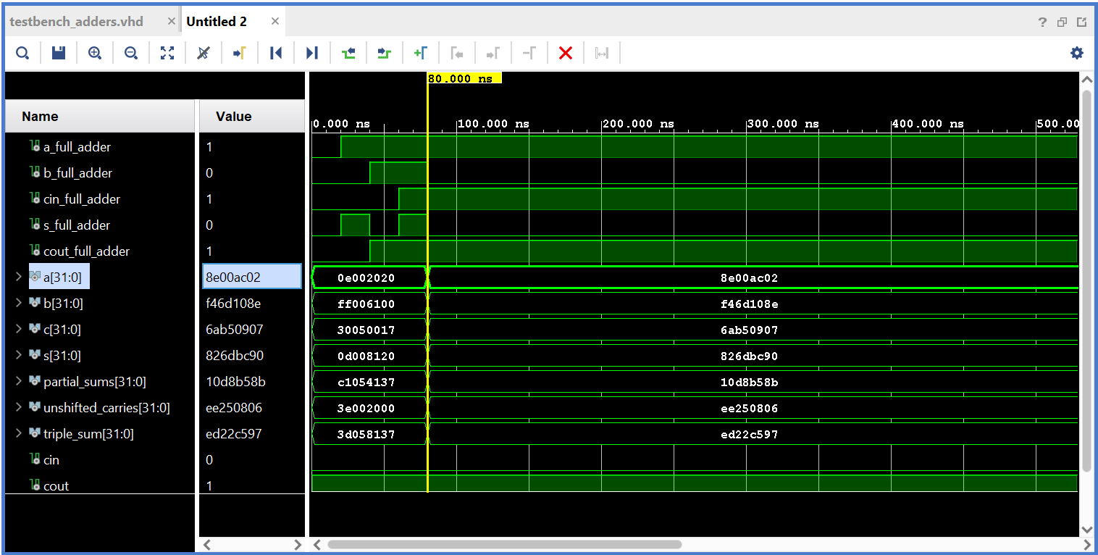
3-2 Compressor
Here’s a simulation of it and the adders:

Slide 8
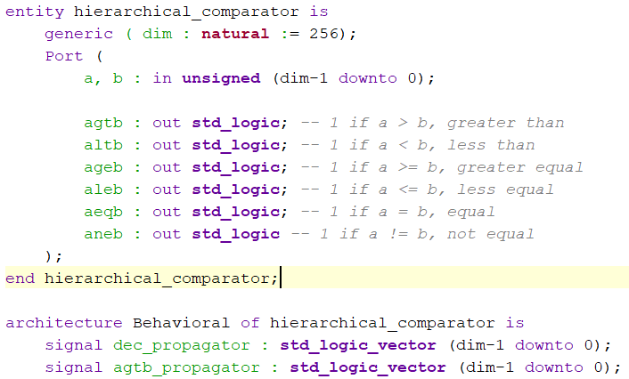
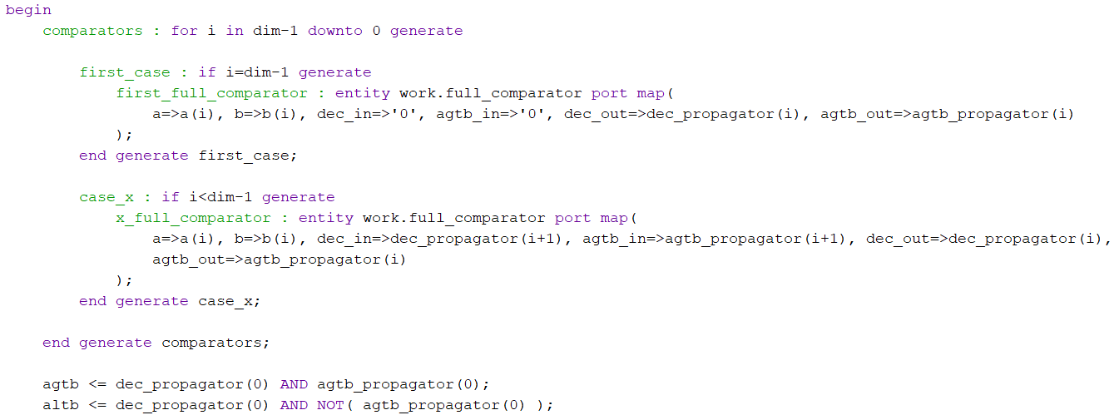
Hierarchical Comparator
Built with full comparators:

Slide 9
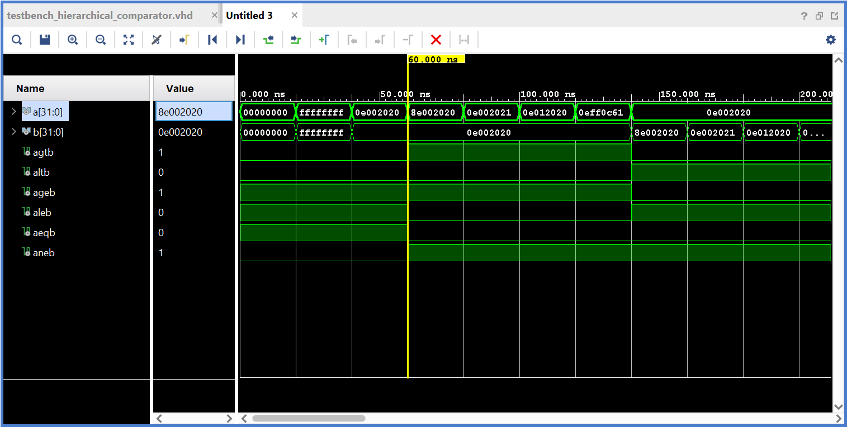
Hierarchical Comparator

Slide 10
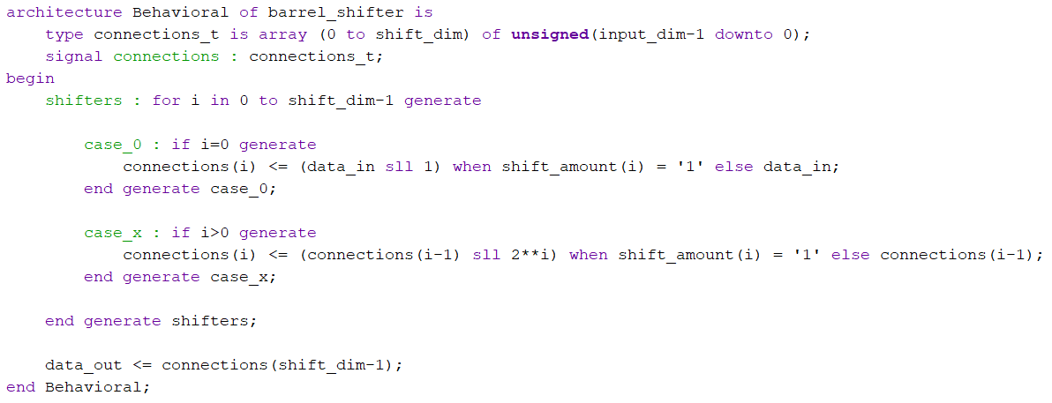
Barrel Shifter

Slide 11
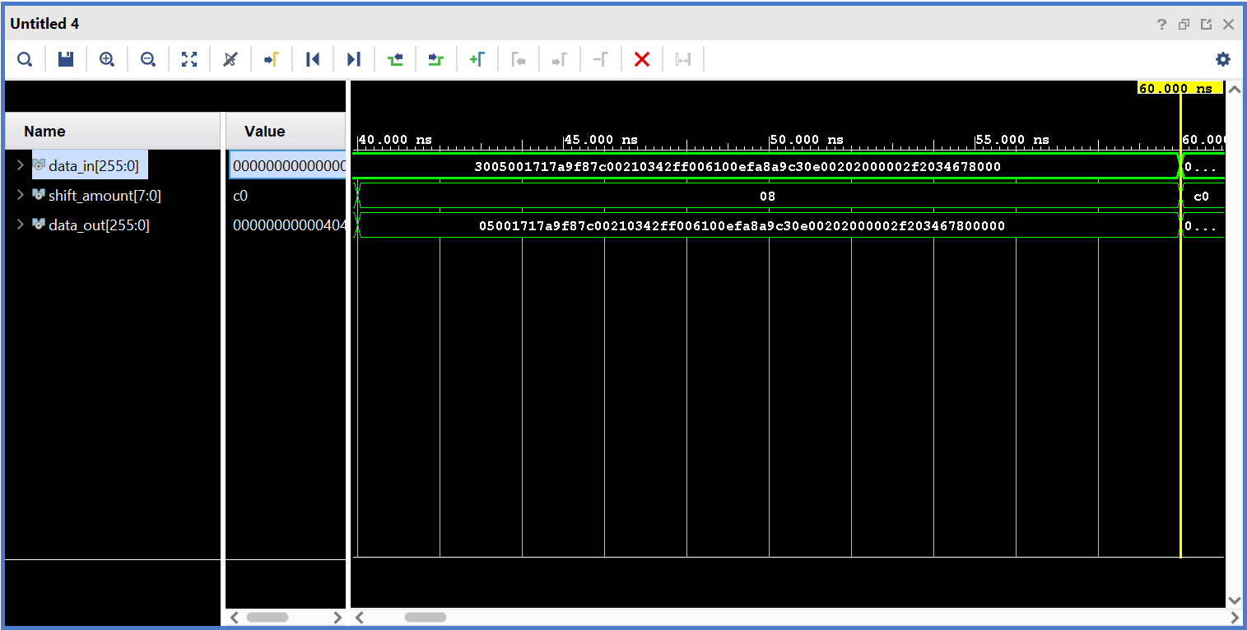
Barrel Shifter

Slide 12
Sequential Components
The project includes the following sequential units, implemented with processes:
Register File
Shift Register
Ripple Counter
Debouncer

Slide 13
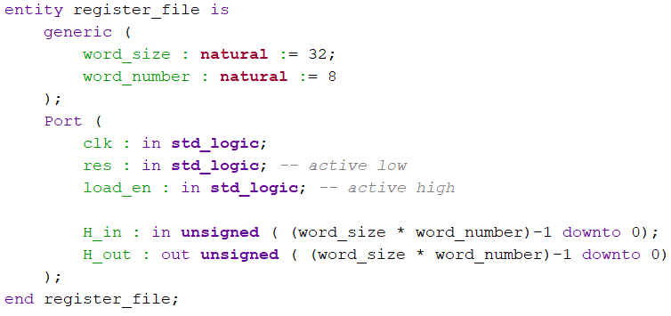
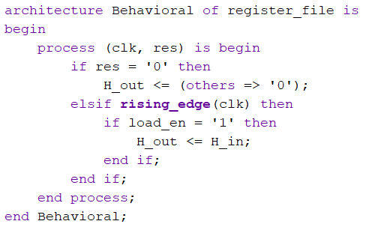
Register File

Slide 14
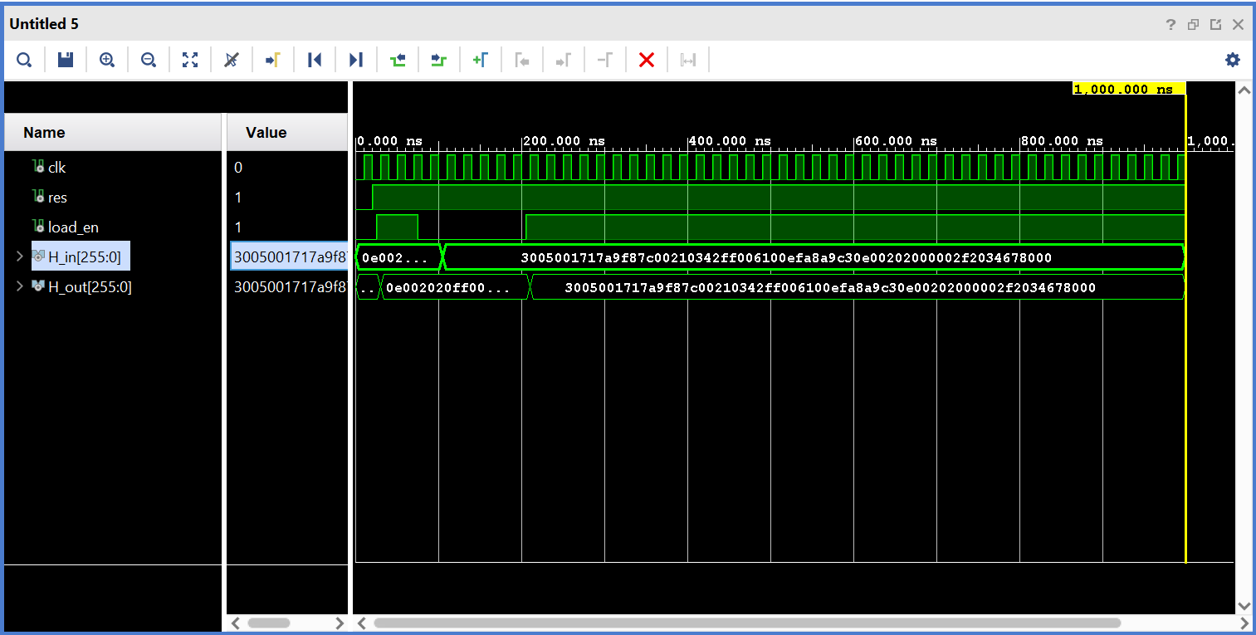
Register File

Slide 15
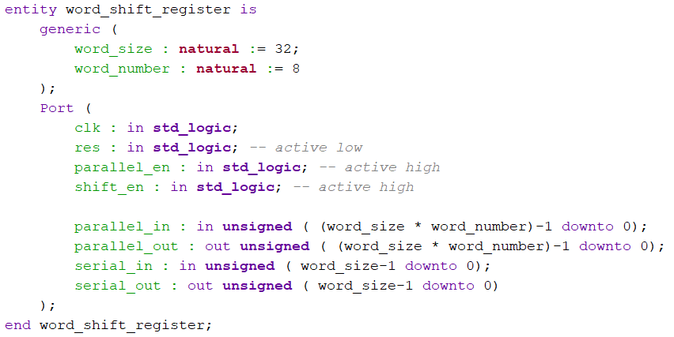
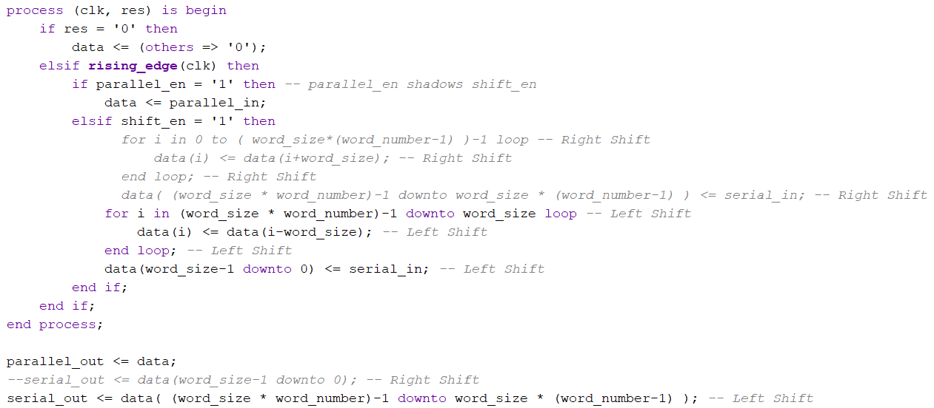
Shift Register

Slide 16
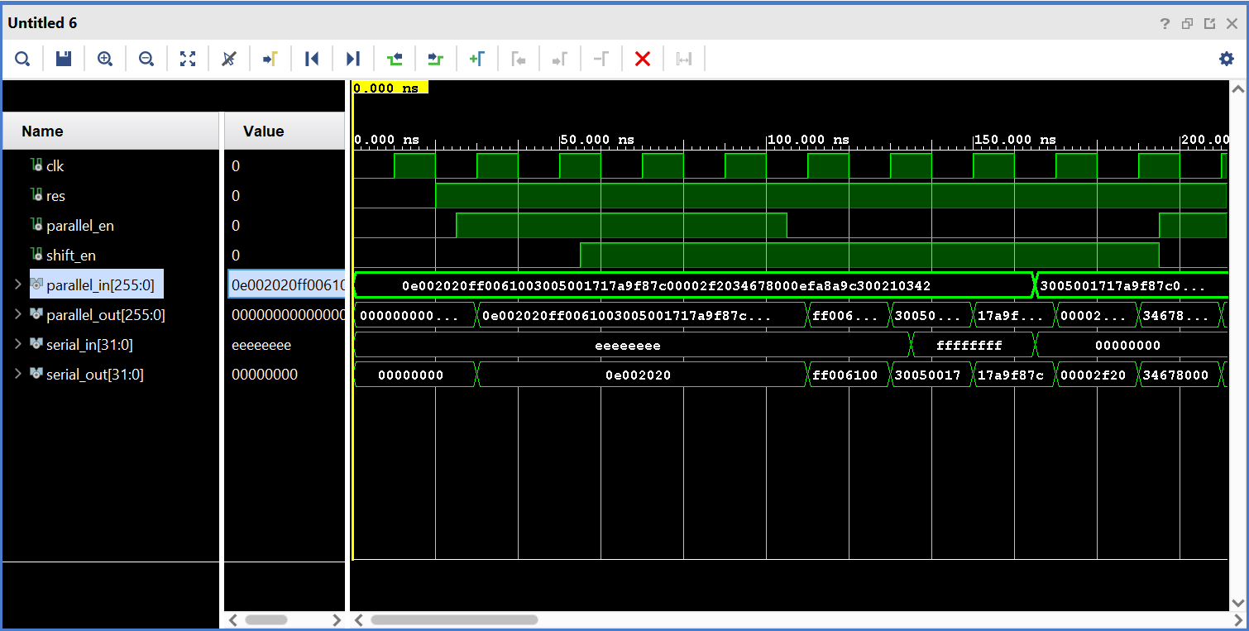
Shift Register

Slide 17
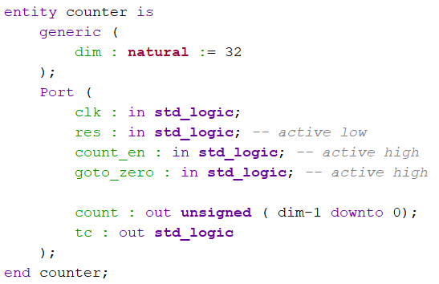
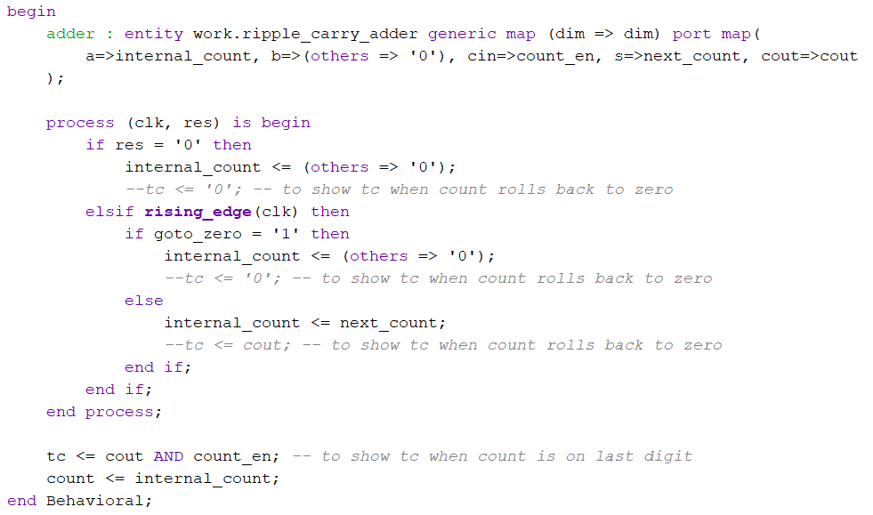
Counter

Slide 18
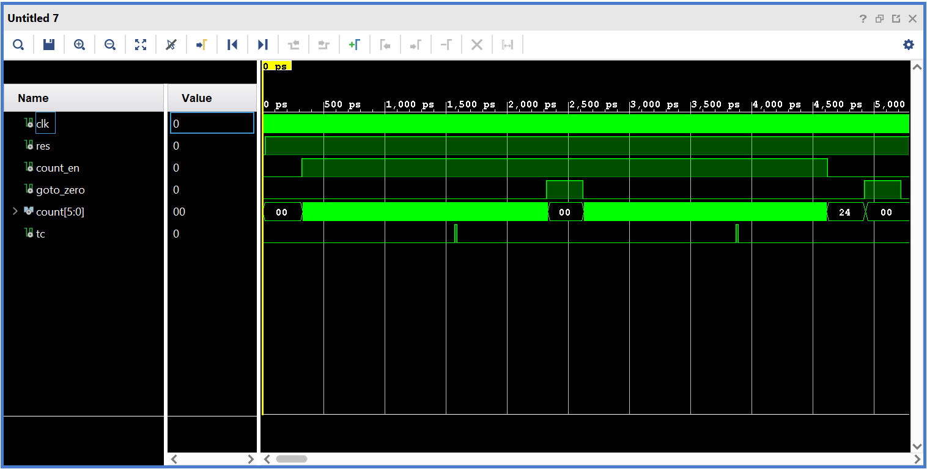
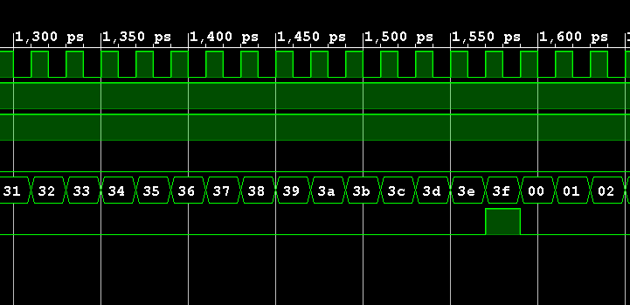
Counter

Slide 19
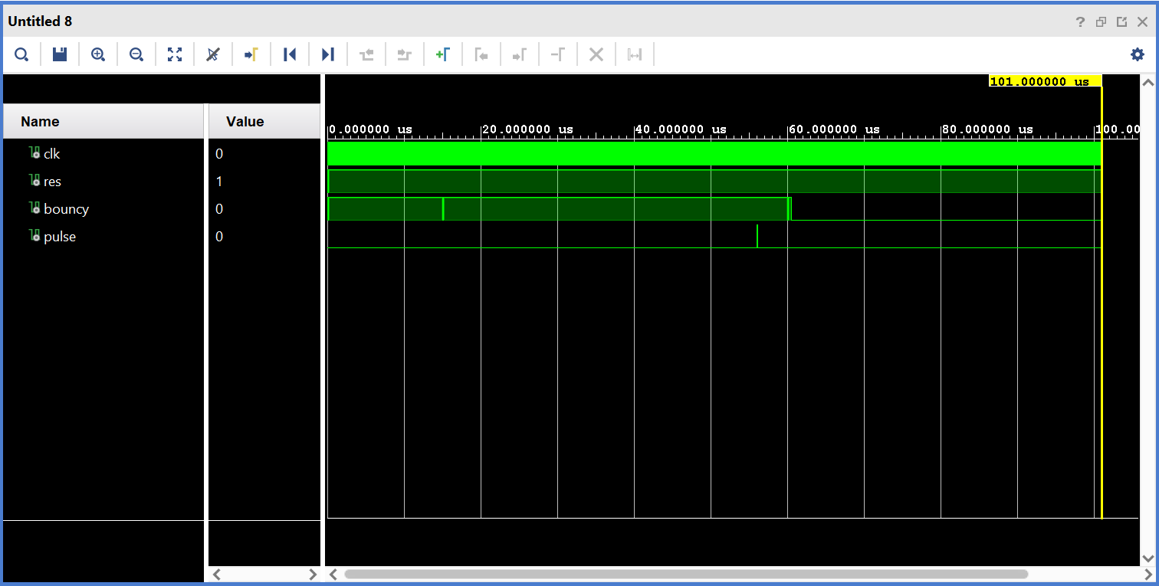
Debouncer
The debouncer is needed to clean noise on buttons. I have copied its code from the logic network course.

Slide 20
Complex Components
The previous units are used to build more structured entities, in the structural view:
Next Block Calculator
Register Update
Difficulty Decoder

Slide 21
Project Level
These are the main entities of the project, composed by a Datapath and a FSM:
Block Routine (Datapath + FSM)
Bitcoin Miner (Datapath + FSM)
Top Level

