Slide 1
SHA 256 VHDL

Slide 2
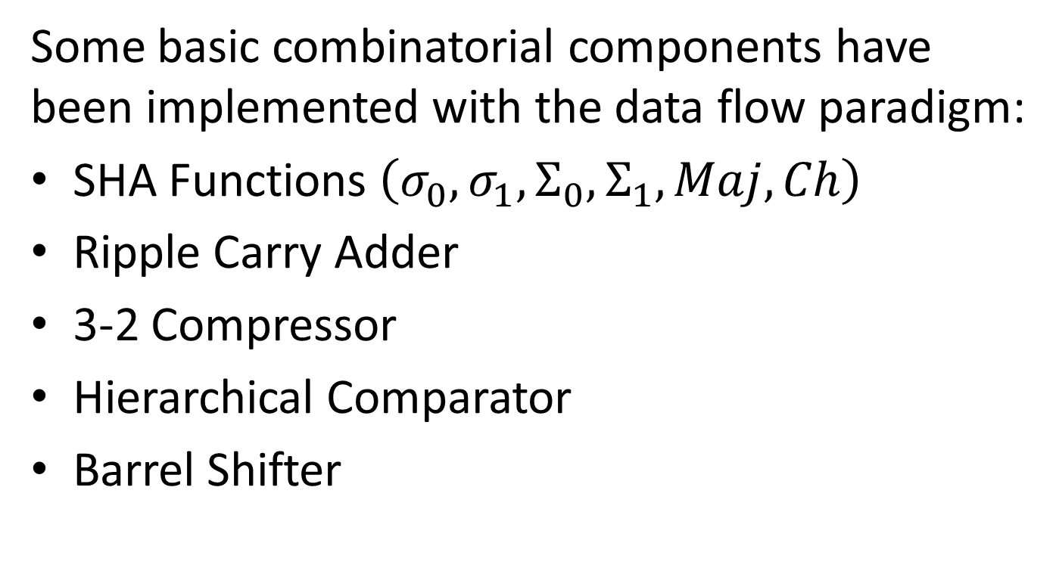
Combinatorial Components
Some basic combinatorial components have been implemented with the data flow paradigm:
SHA Functions $\left(σ_{0},σ_{1},Σ_{0},Σ_{1}, Maj, Ch\right)$
Ripple Carry Adder
3-2 Compressor
Hierarchical Comparator
Barrel Shifter

Slide 3
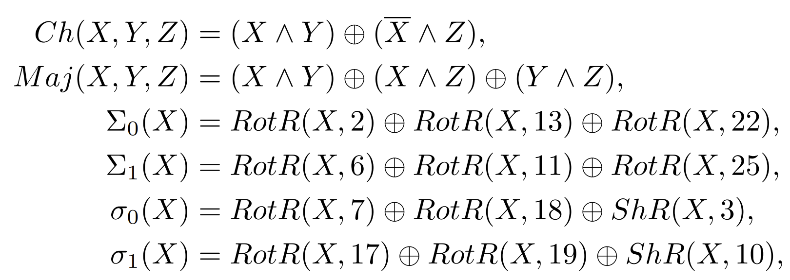
SHA Functions
The documentation of SHA256 algorithm includes the definition of the following functions:

Slide 4
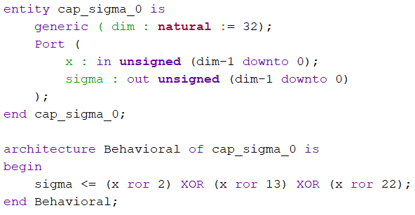
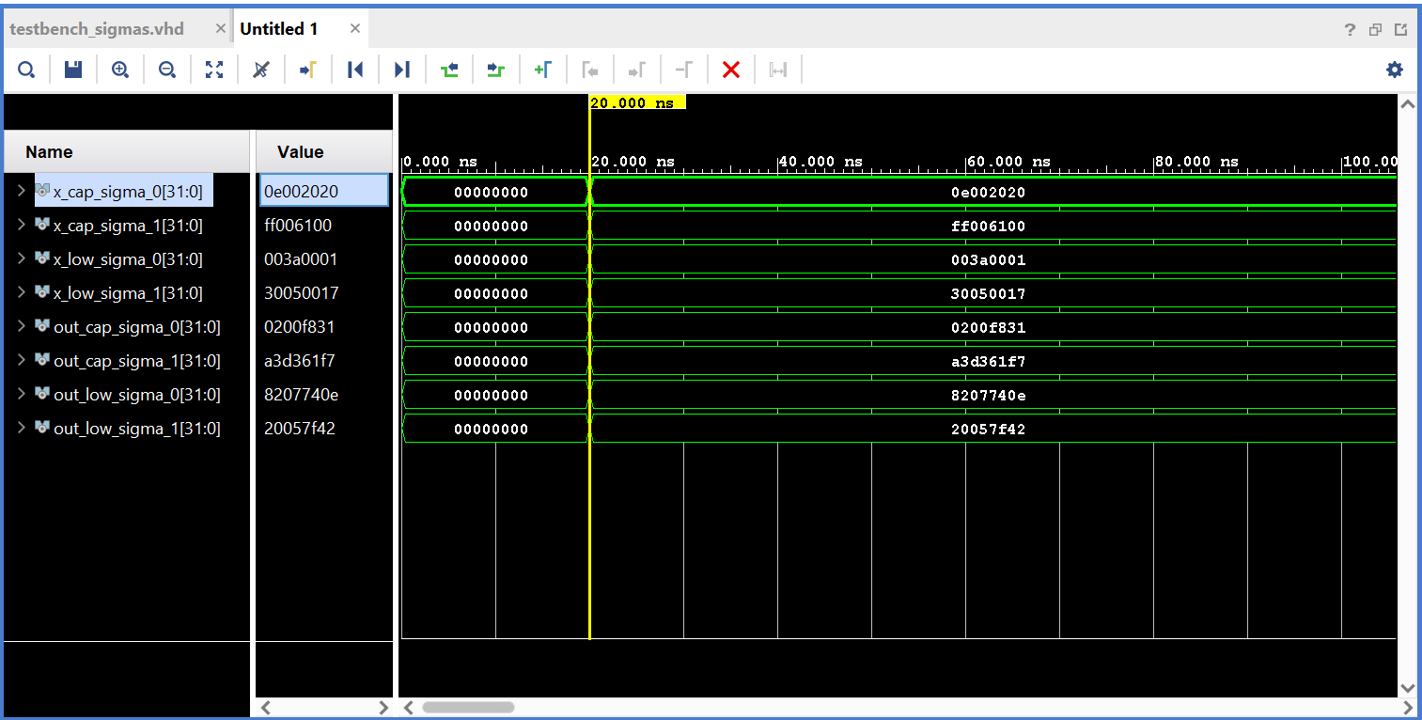
SHA Functions
I have implemented them all with equations:

Slide 5
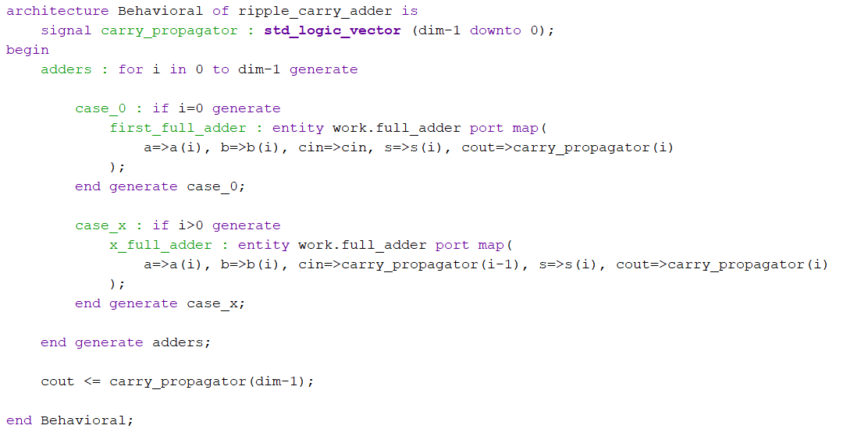
Ripple Carry Adder
A classical adder, implemented with full adders and the generate construct:

Slide 6
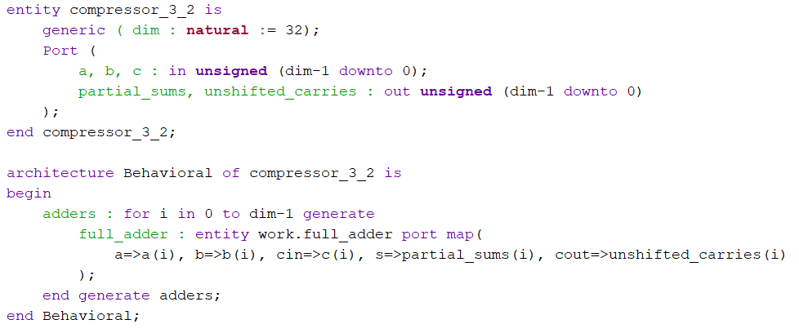
3-2 Compressor
A compressor is a unit that convert a sum of 3 numbers into a sum of 2, saving time:

Slide 7
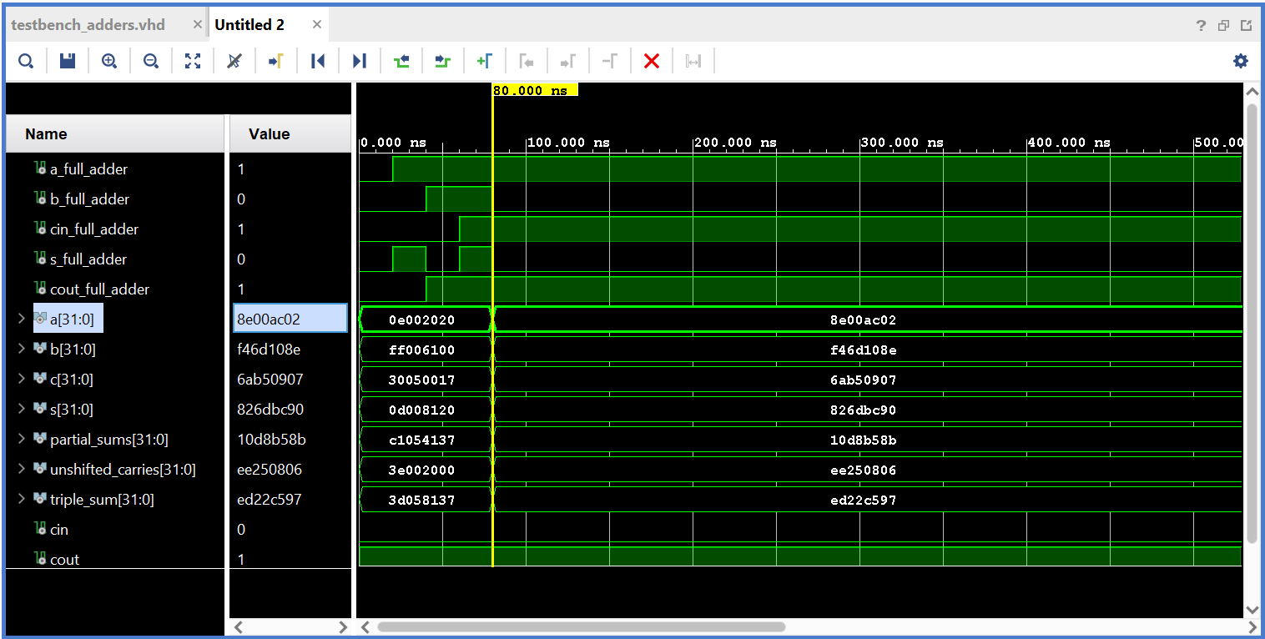
3-2 Compressor
Here’s a simulation of it and the adders:

Slide 8
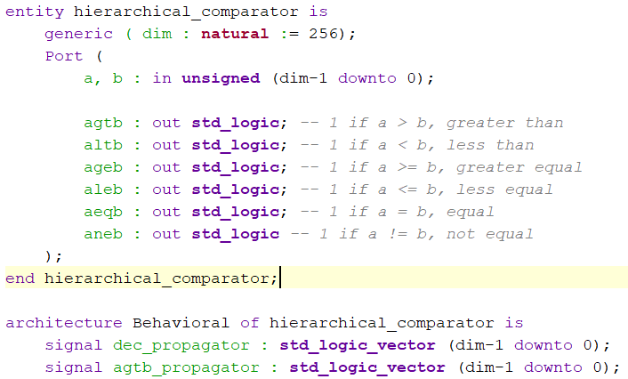
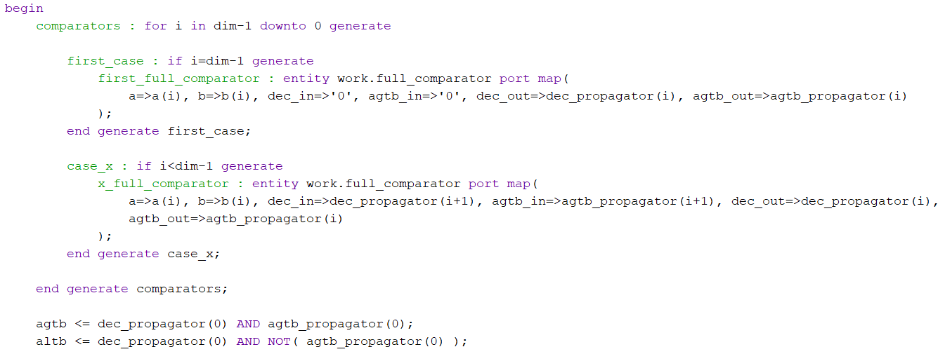
Hierarchical Comparator
Built with full comparators:

Slide 9
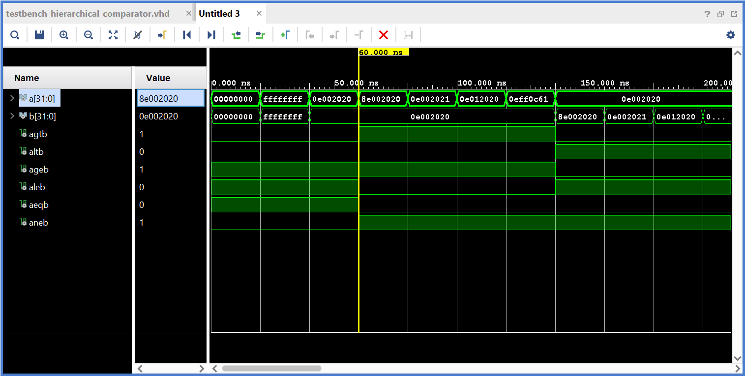
Hierarchical Comparator

Slide 10
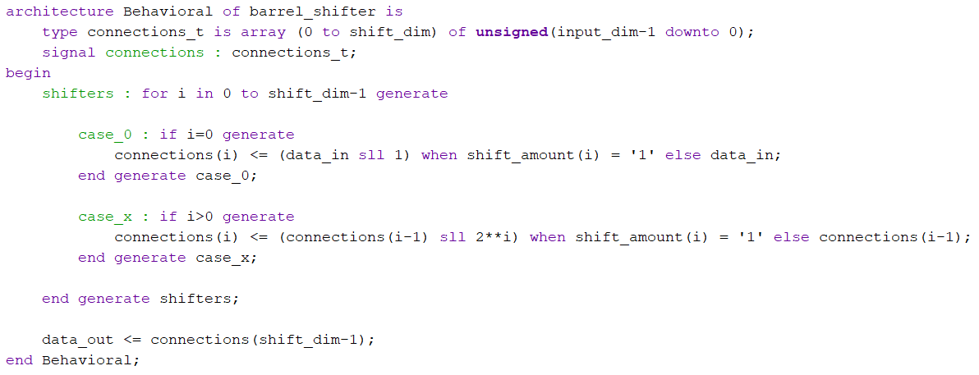
Barrel Shifter

Slide 11
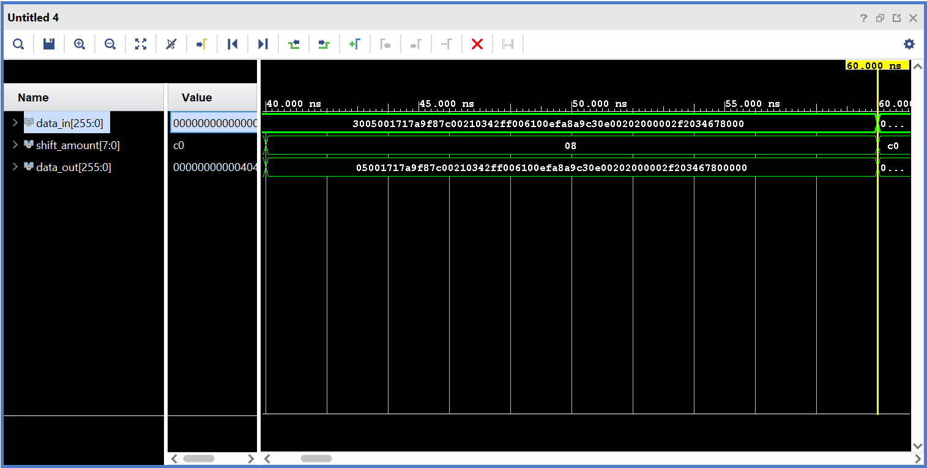
Barrel Shifter

Slide 12
Sequential Components
The project includes the following sequential units, implemented with processes:
Register File
Shift Register
Ripple Counter
Debouncer

Slide 13
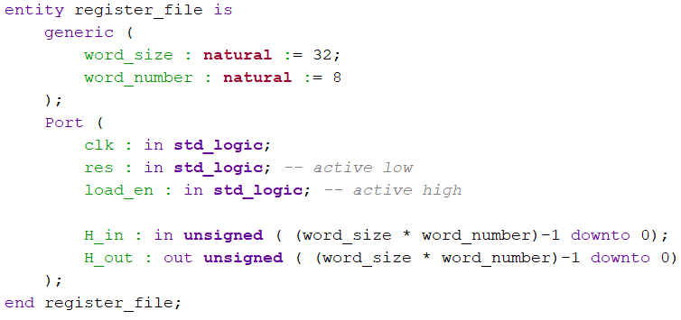
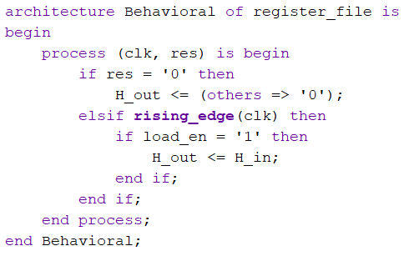
Register File

Slide 14
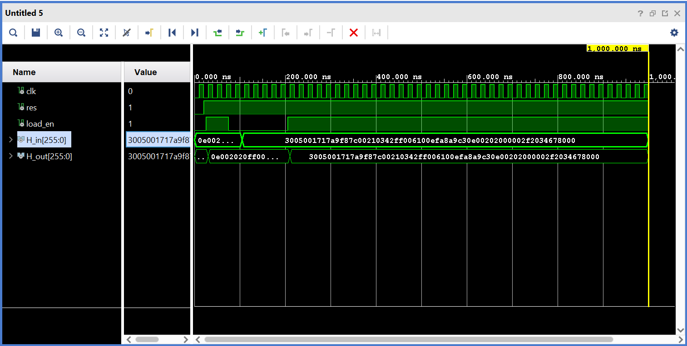
Register File

Slide 15
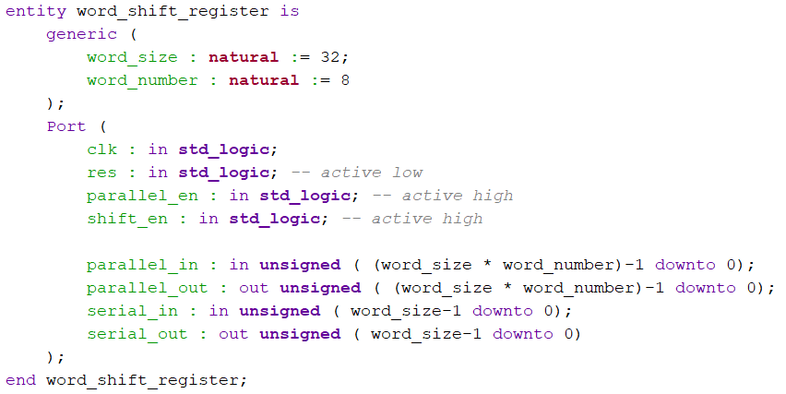
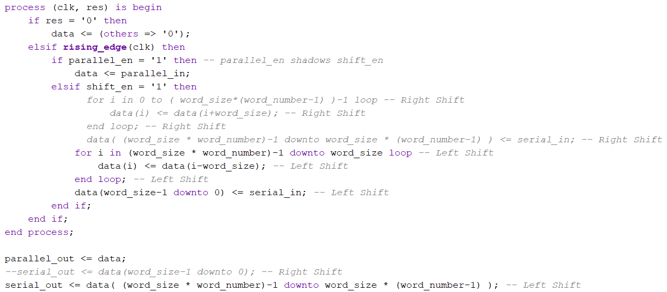
Shift Register

Slide 16
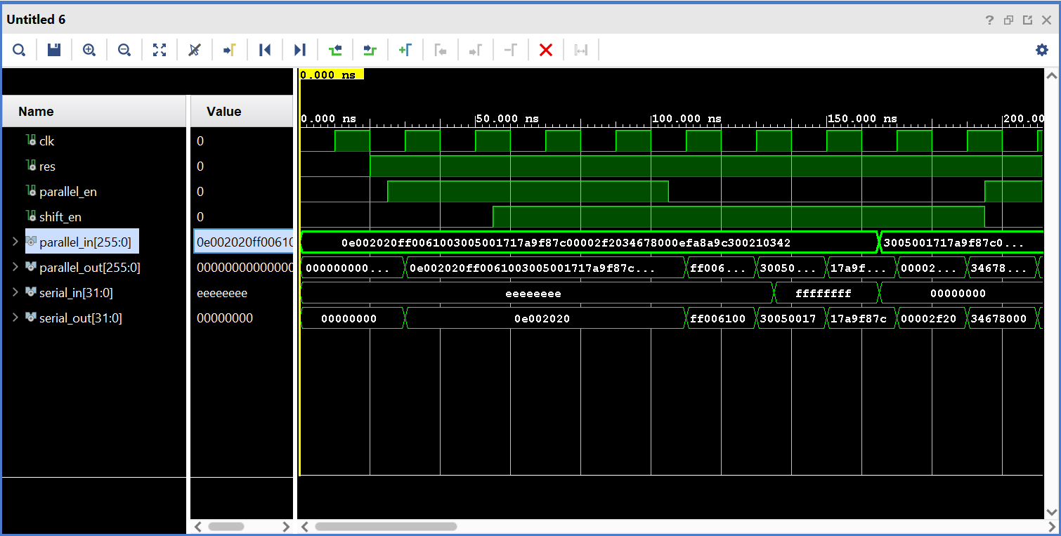
Shift Register

Slide 17
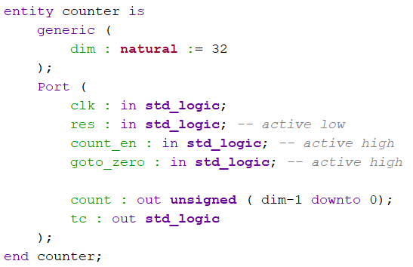
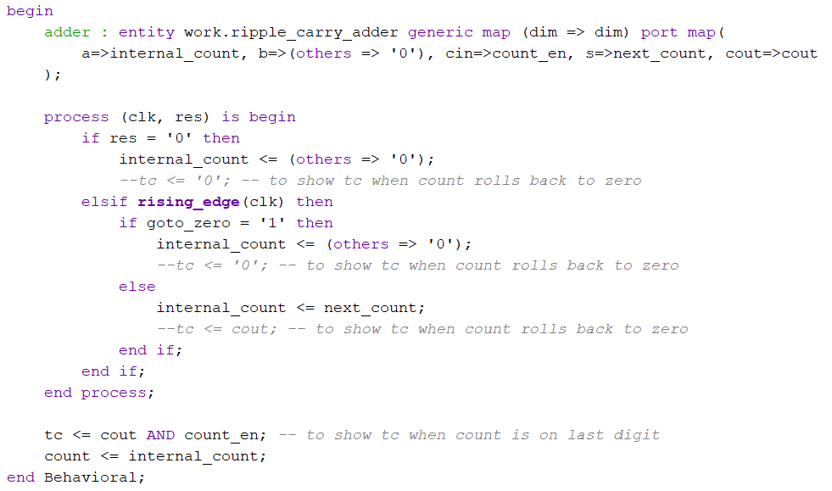
Counter

Slide 18
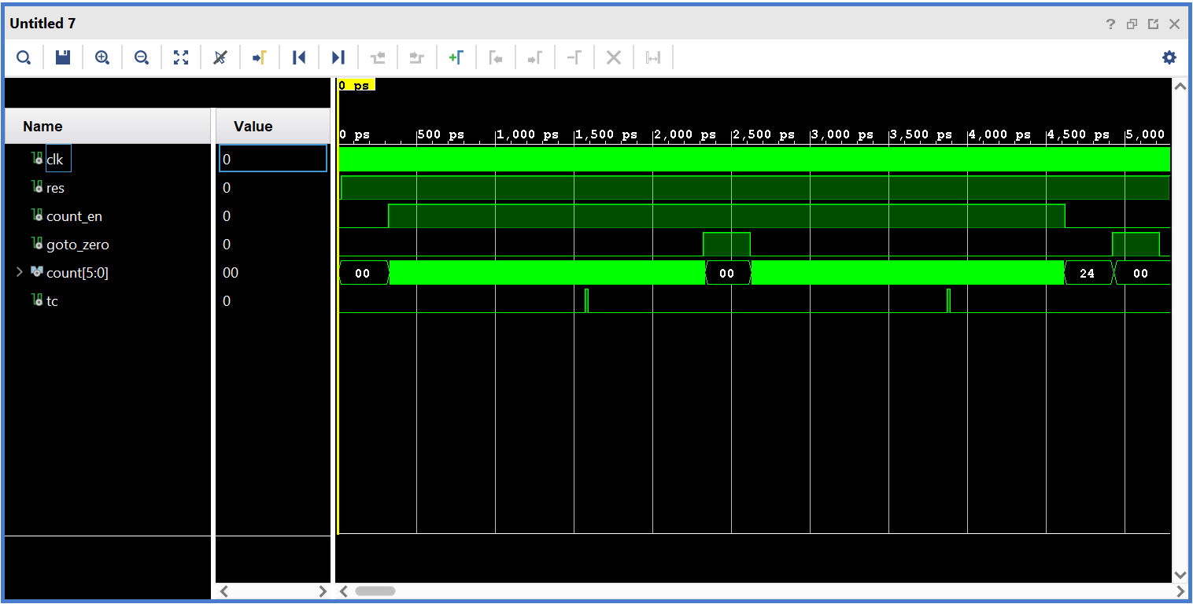
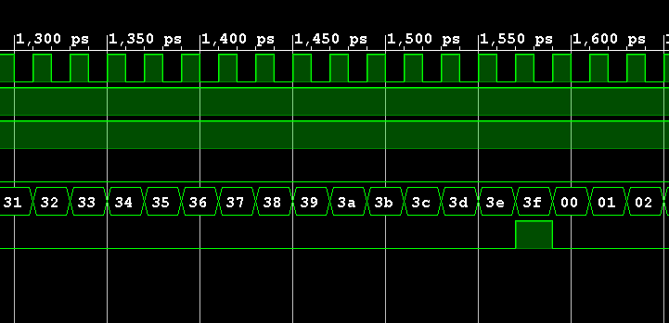
Counter

Slide 19
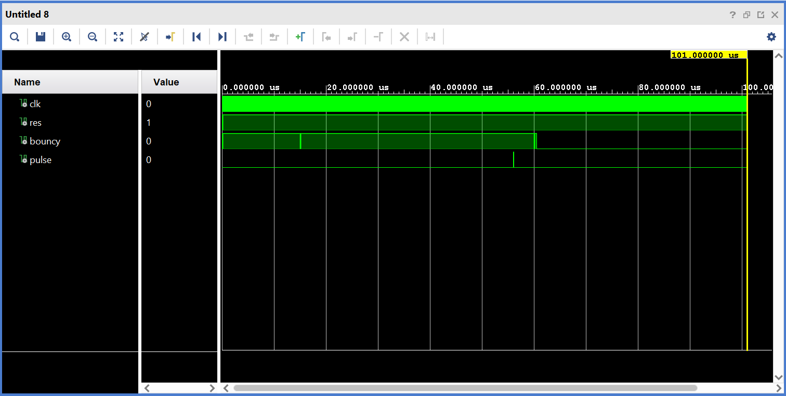
Debouncer
The debouncer is needed to clean noise on buttons. I have copied its code from the logic network course.

Slide 20
Complex Components
The previous units are used to build more articulated entities, in the structural view:
Next Block Calculator
Register Update
Difficulty Decoder

Slide 21
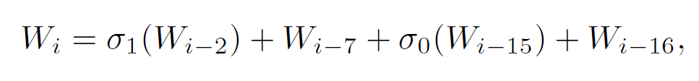
Next Block Calculator
Computes the w_{i} required at every round of the block routine. The first 16 are the split of the input block, the next are generated with the following formula:
It is implemented with a shift register and a dedicated combinatorial component that extract and sum the proper previous-words from its parallel out. At cycle i, the serial out of the register will be w_{i}.

Slide 22
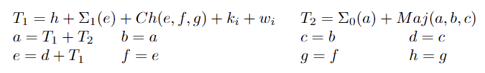
Register Update
Performs the update of abcdefgh registers at every round, as follows:
It is a purely combinatorial component and given the conspicuous number of addition it requires a cascade of compressors to be efficient.

Slide 23

Difficulty Decoder
Difficulty is the threshold below which the transaction hash must stay to be considered valid. It is stored into a pseudo floating point encoding and this components aim to expand it to a pure binary number usable by the comparator.

Slide 24
Project Level
These are the main entities of the project, composed by a Datapath and a FSM:
Block Routine (Datapath + FSM)
Bitcoin Miner (Datapath + FSM)
Top Level

Slide 25
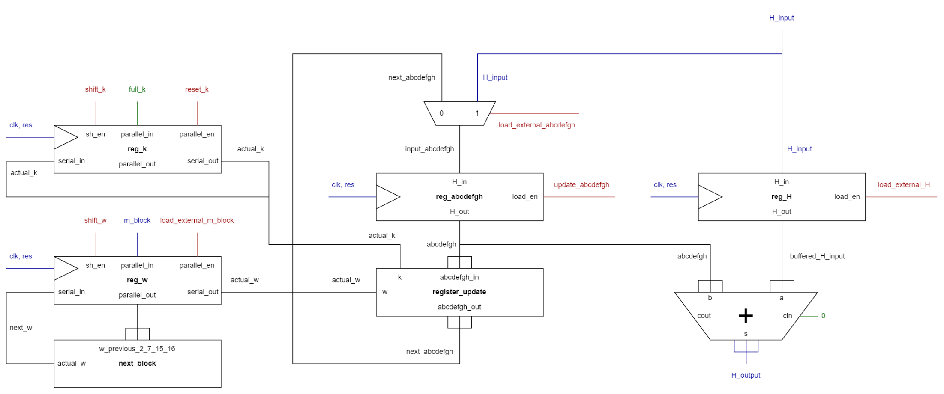
Block Routine

Slide 26
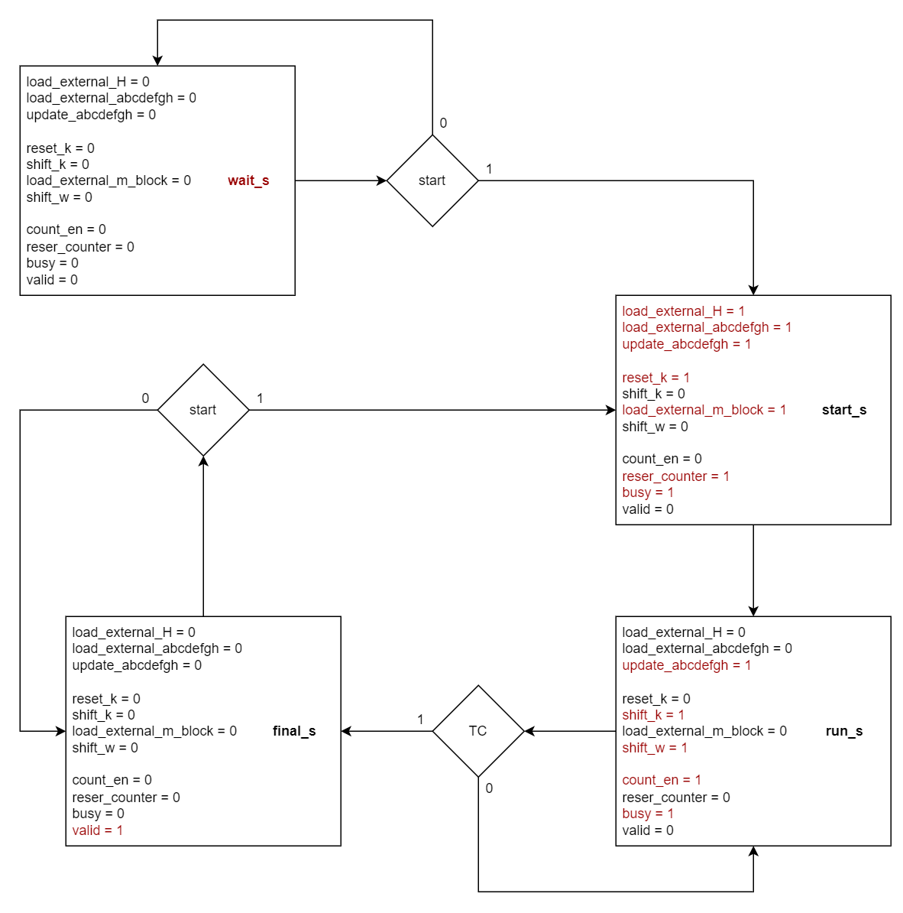
Block Routine

Slide 27
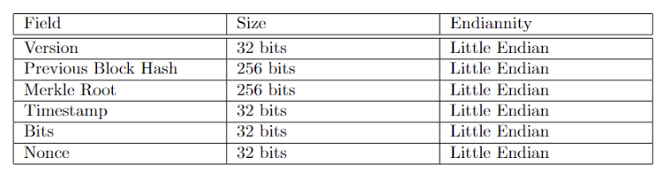
Bitcoin Miner
The inputs are pure binary big endian numbers, reversed and rearranged to form a header:
The Nonce is the value to be mined with brute force, so the user does not insert it but the initial value of the search.

Slide 28
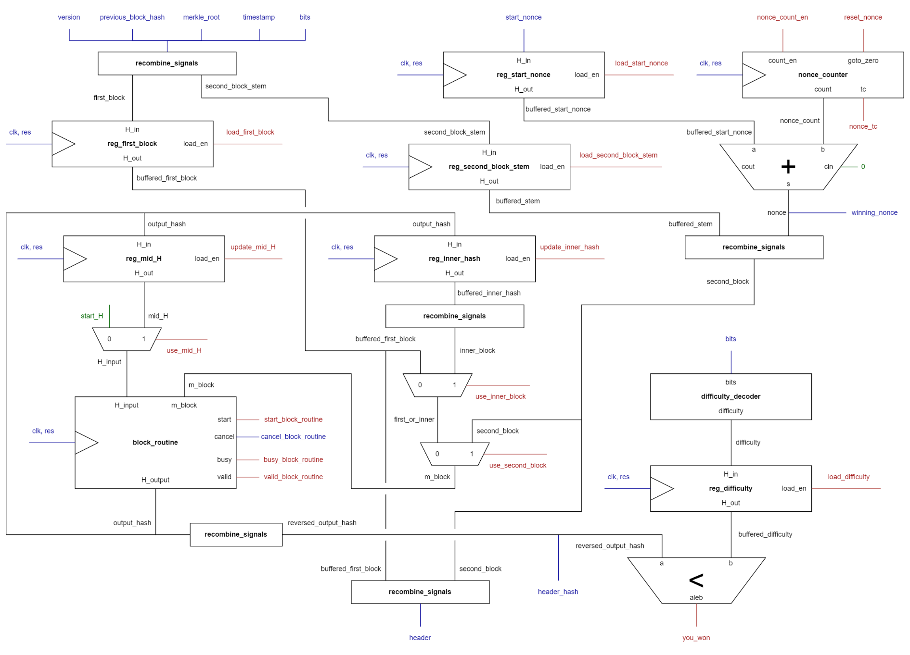
Bitcoin Miner

Slide 29
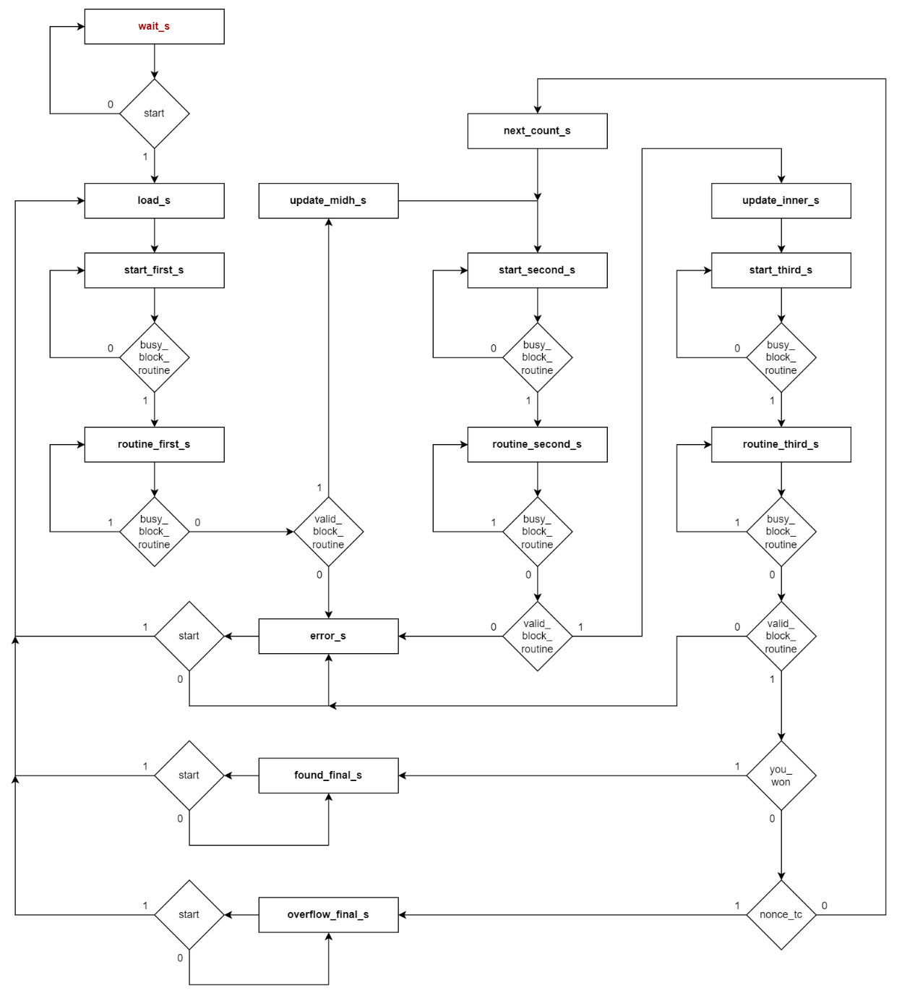
Bitcoin Miner

Slide 30
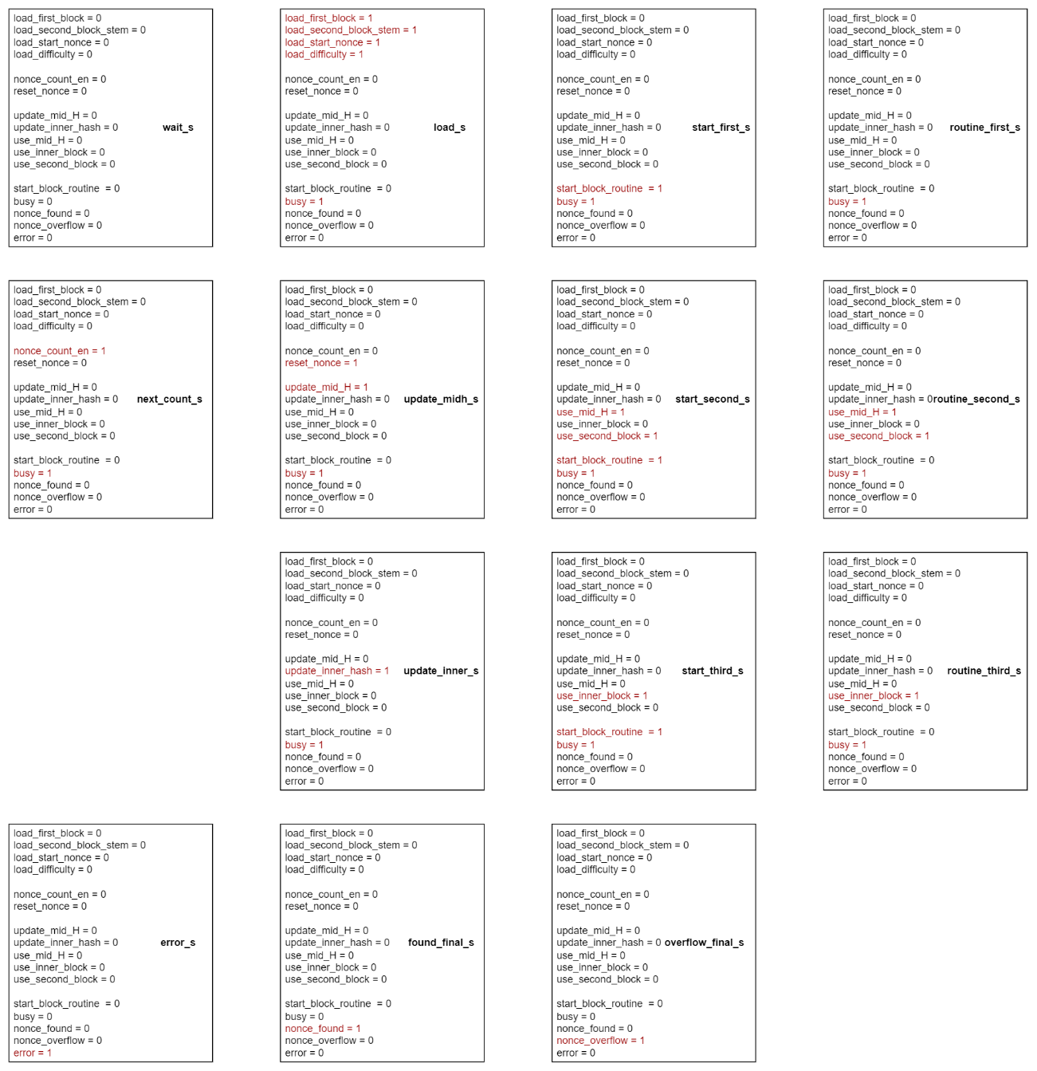
Bitcoin Miner

Slide 31
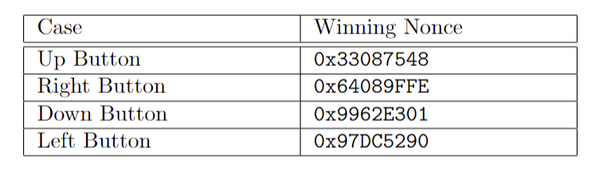
Top Level
When the user presses one of the 4 buttons, a predefined input is loaded into the bitcoin miner. The user can use switches to display parts of the output on the 7 segment display (I used the code of prof. Roberto Passerone) and compare it with the expected output.

Slide 32
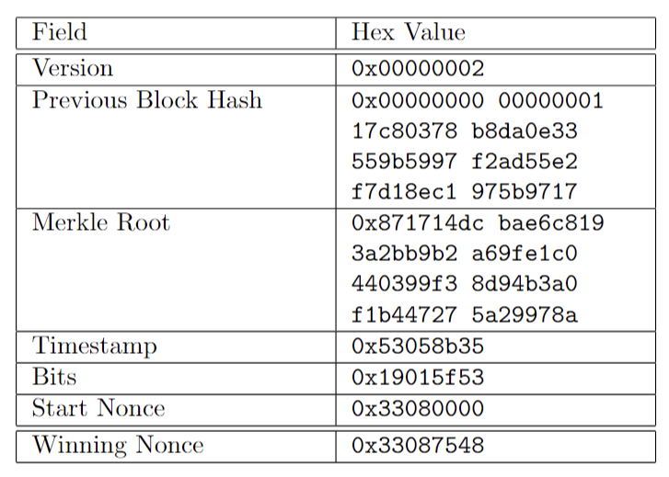
Top Level
Test-case of the Up Button:

Slide 33
Alex Pegoraro
Realized by:

Slide 34
THE END

