Slide 2
Welcome to
SkillEx
The Knowhow Exchange

Slide 3
In 3 steps:
Exchanging skills and knowhow made easy

Slide 4
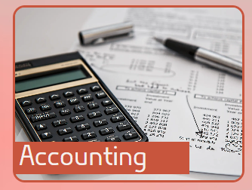
1. Choose category

Slide 5
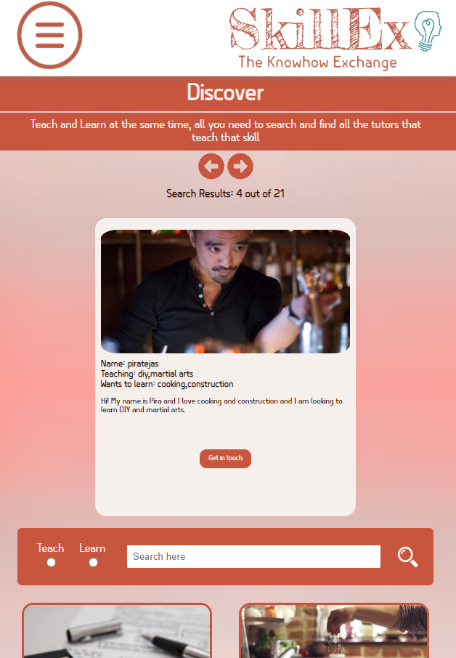
2. Choose your teacher

Slide 6

3. Enjoy learning

