Slide 1

Masked Autoencoders Are Scalable Vision Learners
Authors
Kaiming He Presentation By
Xinlei Chen Aishwarya Bhavsar
Saining Xie 029371509
Yanghao Li California State University,
Piotr Dollar Long Beach.
Ross Girshick

Slide 2
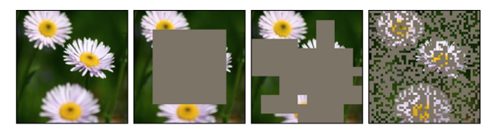
Motivation
Applications of Computer Vision in Image Recognition.
Masking the pixels of the image to train our model more accurately.

Slide 3
PROJECT GOAL
Using Vision Transformers and Autoencoders increase the accuracy of the model to 87.8%.
Reduce power, memory and computational utilization by accelerating training 3x.
Masking a high proportion of the input image, e.g., 75%, yields a nontrivial and meaningful self-supervisory task.

Slide 4
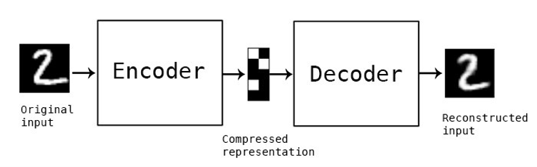
What are Masked Auto-Encoders (MAE) ?
MAE = Encoder + Decoder

Slide 5
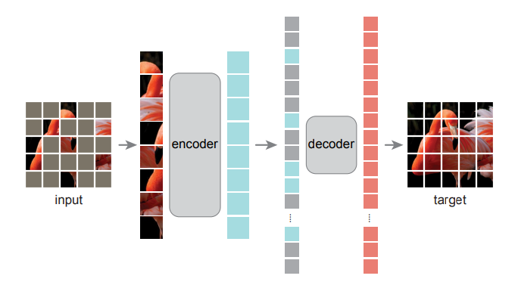
MAE Encoder Decoder Architecture

Slide 6
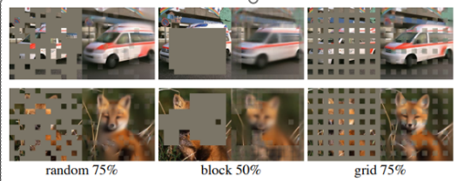
Mask Sampling Techniques: 1) Random 2) Block 3) Grid

Slide 7
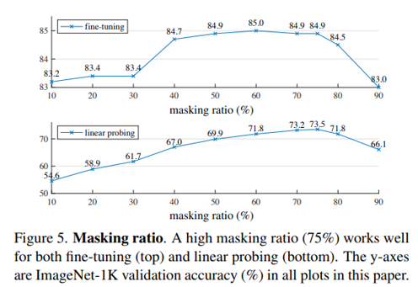
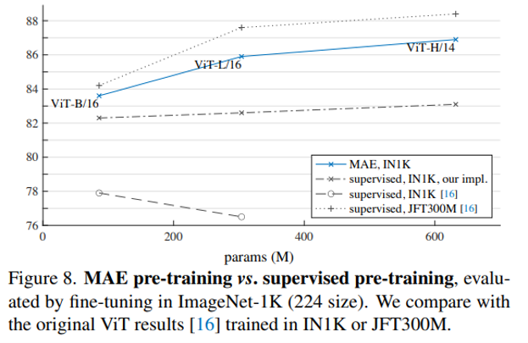
EVALUATION & RESULTS

Slide 8
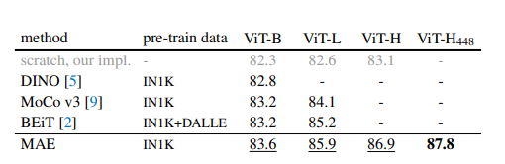
Comparisons with previous results on ImageNet 1-k

Slide 9
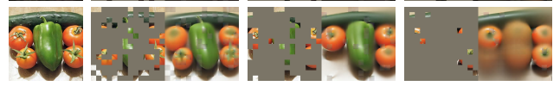
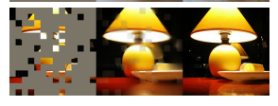
LIMITATIONS
The model may generate inexistent content.
The proposed method predicts content based on learned statistics of the training dataset and as such will reflect biases in those data, including ones with negative societal impacts.

Slide 10
CONCLUSION & FUTURE WORK
An Autoencoder—a simple self-supervised method similar to techniques in NLP—provides scalable benefits.
MAE reconstructs pixels. Our MAE infers complex, holistic reconstructions, suggesting it has learned numerous visual concepts. This behavior occurs by way of a rich hidden representation inside the MAE. This perspective will inspire future work.

Slide 11

THANK YOU

