Slide 1
Formatting
Clean Code

Slide 2
WHY ?
Communication with fellow developers
Readability => maintainability => extensibility

Slide 3
HOW ?
Vertical
200 - 500
Horizontal
100—120/line

Slide 4
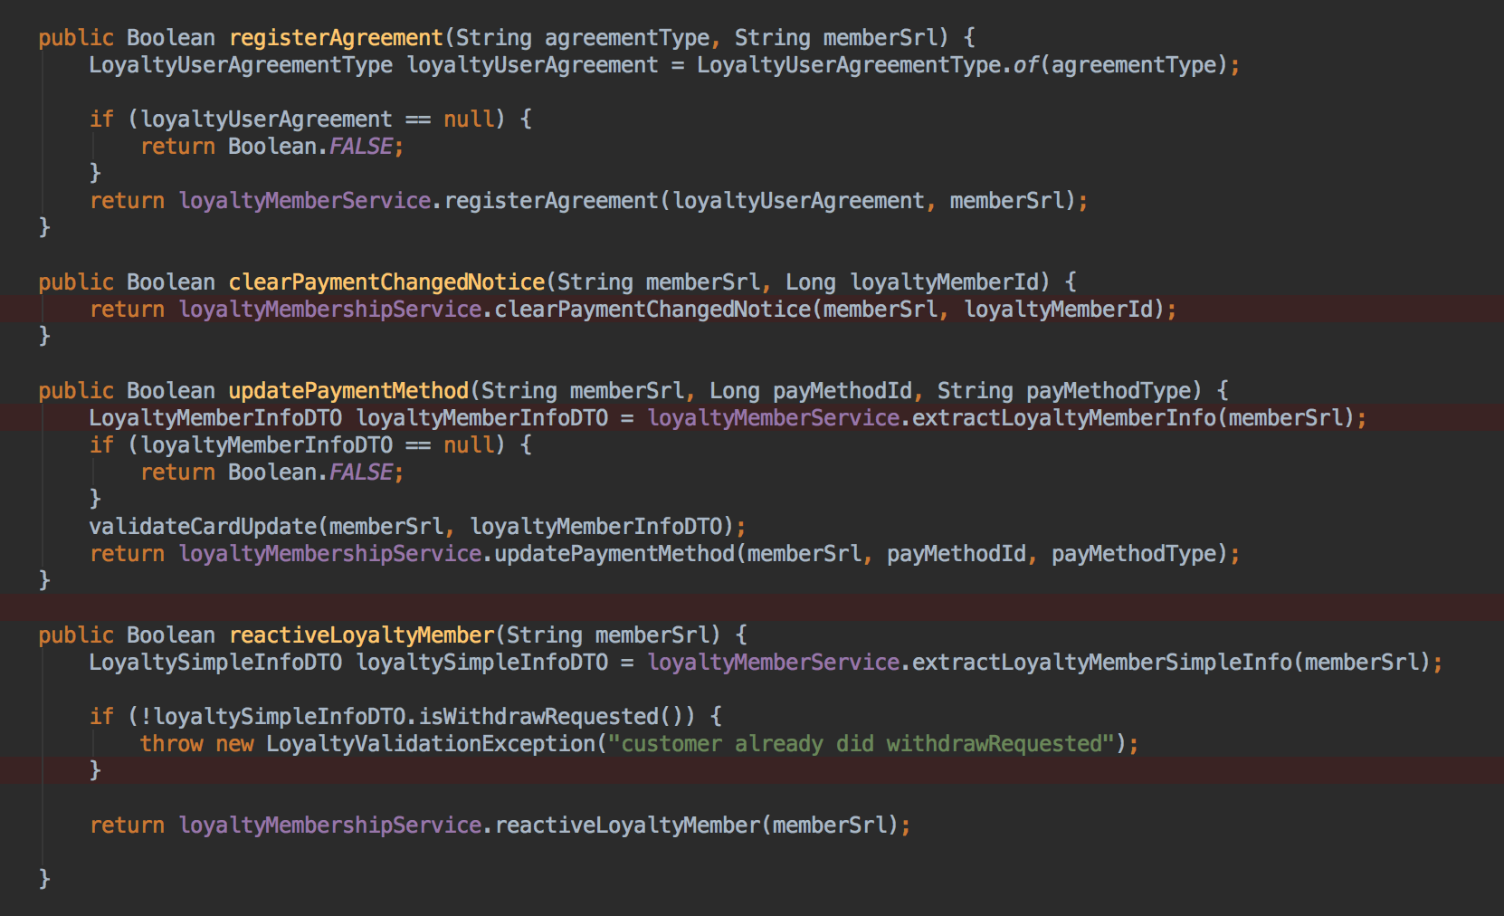
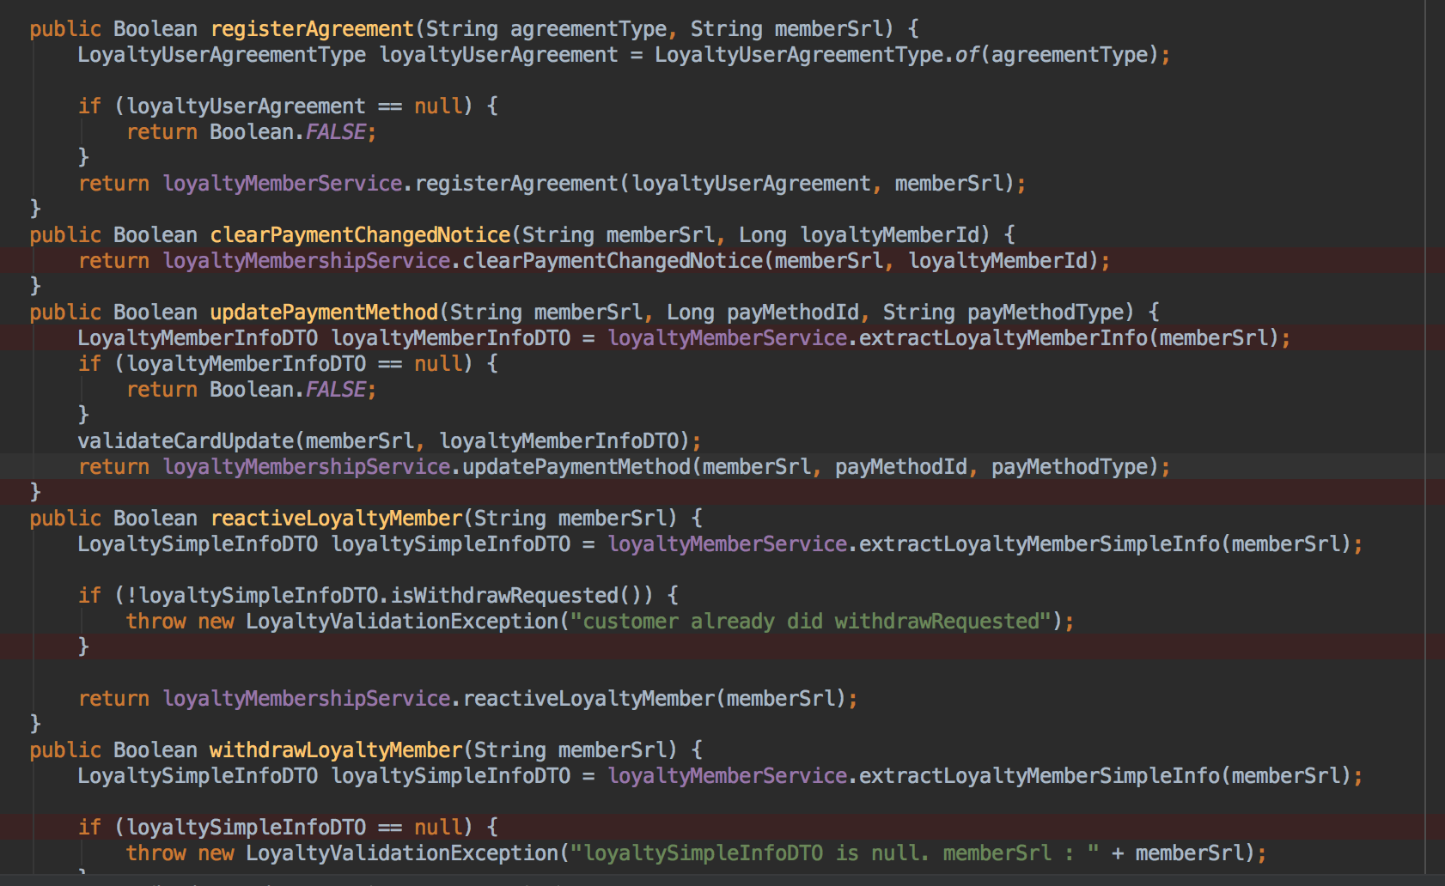
HOW ? -- Vertical Formatting

Slide 5
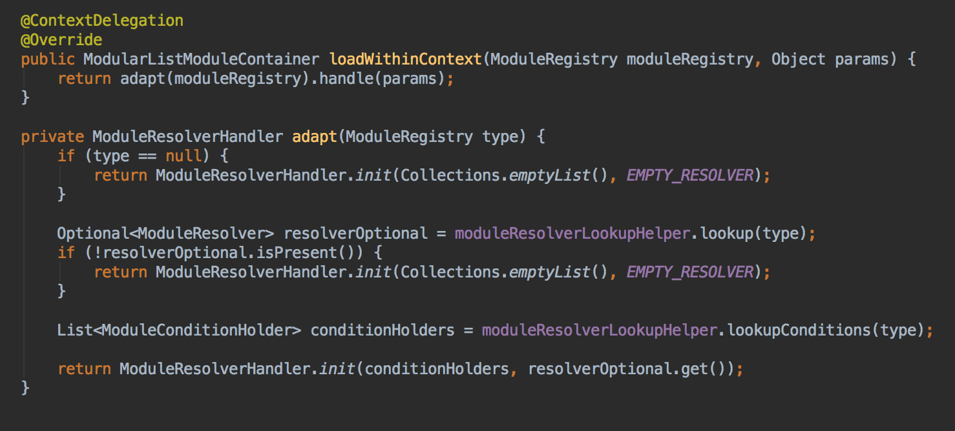
HOW ? -- Vertical Formatting
Vertical Openness Between Concepts
Vertical Distance
Variable Declarations
Instance variables
Dependent Functions
Vertical Ordering (news paper)
important comes first
low-level come last

Slide 6
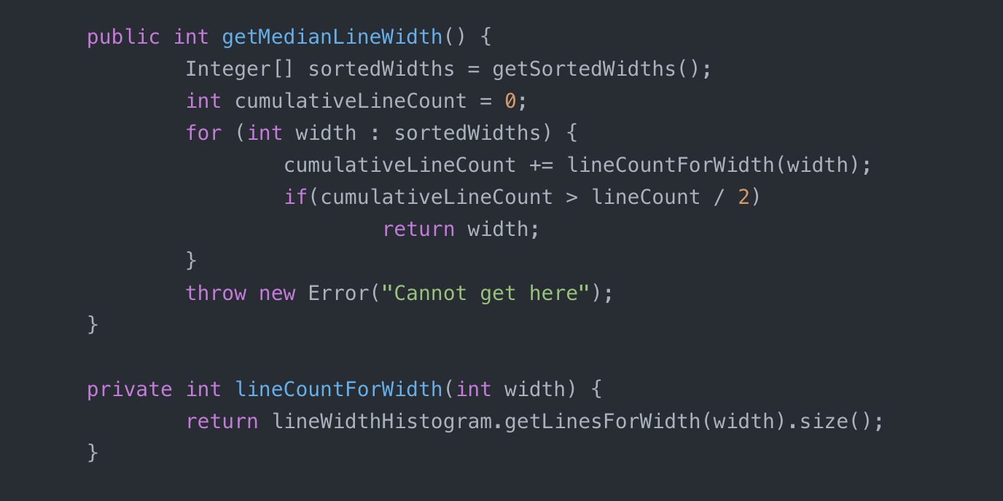
HOW ? -- Horizontal Formatting
Horizontal Openness and Density

Slide 7
HOW ?
Team Convention
More….?

Slide 8
END

