Slide 1
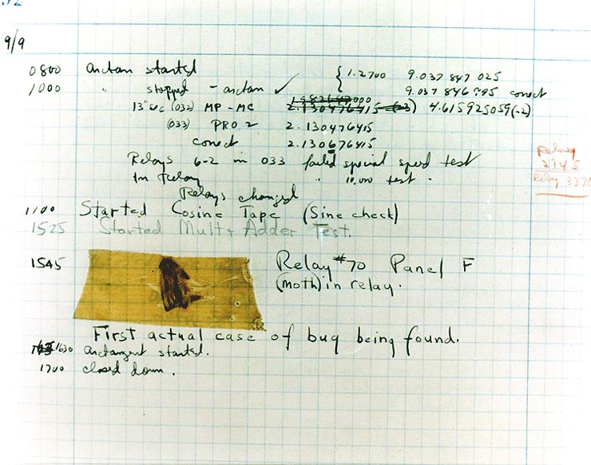
Effective Java 3RD Edition
Chapter 6. Enums and Annotations
Notes:
http://gitlab.coupang.net/kodiak/effective-java/blob/master/6_enums_and_annotations

Slide 2
Item 34: Use enums instead of int constants
Int enum pattern
// The int enum pattern - severely deficient!
public static final int APPLE_FUJI = 0;
public static final int APPLE_PIPPIN = 1;
public static final int APPLE_GRANNY_SMITH = 2;
public static final int ORANGE_NAVEL = 0;
public static final int ORANGE_TEMPLE = 1;
public static final int ORANGE_BLOOD = 2;
Disadvantages:
no type safety. (see example Item34_1_IntConstantPattern)
no namespaces for int enum groups.
Because int enums are constant variables, their int values are compiled into the clients that use them. If the value associated with an int enum is changed, its clients must be recompiled.
There is no easy way to translate int enum constants into printable strings.
There is no reliable way to iterate over all the int enum constants in a group.

Slide 3
Item 34: Use enums instead of int constants
Enums
public enum Apple { FUJI, PIPPIN, GRANNY_SMITH }
public enum Orange { NAVEL, TEMPLE, BLOOD }
enum types rectify the deficiencies of int enums.
compile-time type safety.
each type has its own namespace.
to printable strings.
reliable way to iterate.
enum types let you add arbitrary methods and fields and implement arbitrary interfaces. (i.e. associate different data/behavior with each enum type, see example Item34_2_Enum)

Slide 4
Item 34: Use enums instead of int constants
Tips
Just as with other classes, unless you have a compelling reason to expose an enum method to its clients, declare it private or, if need be, package-private.
If an enum is generally useful, it should be a top-level class; if its use is tied to a specific top-level class, it should be a member class of that top-level class.
If you override the toString method in an enum type, consider writing a fromString method to translate the custom string representation back to the corresponding enum. (see example Item34_3_FromString)
Use enums any time you need a set of constants whose members are known at compile time.

Slide 5
Item 34: Use enums instead of int constants
Strategy Enum
A disadvantage of constant-specific method implementations is that they make it harder to share code among enum constants.
See example Item34_4_StrategyEnum

Slide 6
Item 34: Use enums instead of int constants
Summary
The advantages of enum types over int constants are compelling.
Enums are more readable, safer, and more powerful.
Some enums benefit from associating data with each constant.
Fewer enums benefit from associating multiple behaviors with a single method..
Consider the strategy enum pattern if some enum constants share common behaviors.
Reference:
http://gitlab.coupang.net/kodiak/effective-java/blob/master/6_enums_and_annotations/item_34_use_enums_instead_of_int_constants.md

Slide 7
Item 35: Use instance fields instead of ordinals
ordinal()
You may be tempted to derive an associated int value from the ordinal:
Problems
If the constants are reordered, the numberOfMusicians method will break.
You can't add a second enum constant associated with an int value that you’ve already used.
You can’t add a constant for an int value without adding constants for all intervening int values.
// Abuse of ordinal to derive an associated value - DON'T DO THIS
public enum Ensemble {
SOLO, DUET, TRIO, QUARTET, QUINTET,
SEXTET, SEPTET, OCTET, NONET, DECTET;
public int numberOfMusicians() {
return ordinal() + 1;
}
}

Slide 8
Item 35: Use instance fields instead of ordinals
Solution
Never derive a value associated with an enum from its ordinal; store it in an instance field instead.
public enum Ensemble {
SOLO(1), DUET(2), TRIO(3), QUARTET(4), QUINTET(5), SEXTET(6),
SEPTET(7), OCTET(8), DOUBLE_QUARTET(8), NONET(9), DECTET(10), TRIPLE_QUARTET(12);
private final int numberOfMusicians;
Ensemble(int size) {
this.numberOfMusicians = size;
}
public int numberOfMusicians() {
return numberOfMusicians;
}
}

Slide 9
Item 35: Use instance fields instead of ordinals
Summary
ordinal() is designed for use by general-purpose enum-based data structures such as EnumSet and EnumMap.
Unless you are writing code with this character, you are best off avoiding the ordinal method entirely.

Slide 10
Item 36: Use EnumSet instead of bit fields
Bit fields
If the elements of an enumerated type are used primarily in sets, it is traditional to use the int enum pattern (Item 34), assigning a different power of 2 to each constant. See example Item36_EnumSet
// Bit field enumeration constants - OBSOLETE!
public static class Text {
public static final int STYLE_BOLD = 1 << 0; // 1
public static final int STYLE_ITALIC = 1 << 1; // 2
public static final int STYLE_UNDERLINE = 1 << 2; // 4
public static final int STYLE_STRIKETHROUGH = 1 << 3; // 8
// Parameter is bitwise OR of zero or more STYLE_ constants
public void applyStyles(int styles) { System.out.print(styles); } }
Advantages
lets you use the bitwise OR operation to combine several constants into a set, known as a bit field: text.applyStyles(STYLE_BOLD | STYLE_ITALIC);
lets you perform set operations such as union and intersection efficiently using bitwise arithmetic.
Disadvantage
all the disadvantages of int enum constants. Item34
you have to predict the maximum number of bits, choose a type for the bit field (typically int or long) accordingly.

Slide 11
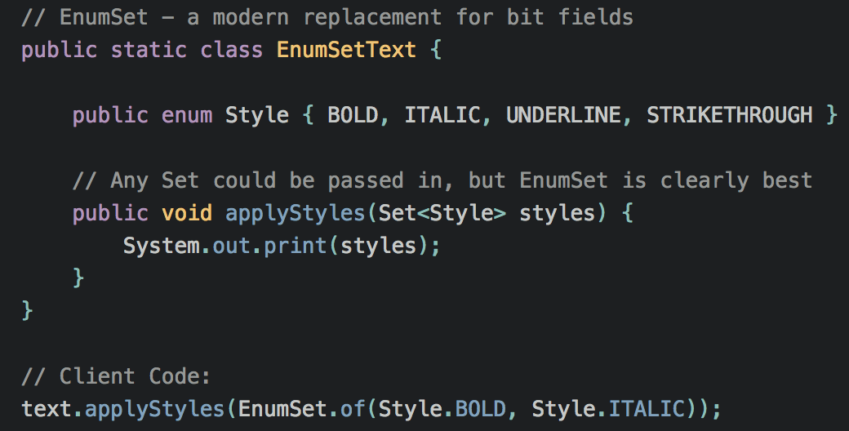
Item 36: Use EnumSet instead of bit fields
EnumSet
Advantages
EnumSet = the conciseness and performance of bit fields + all the many advantages of enum.
Disadvantage
it is not possible to create an immutable EnumSet
In the meantime, you can wrap an EnumSet with Collections.unmodifiableSet (but conciseness and performance will suffer.)

Slide 12
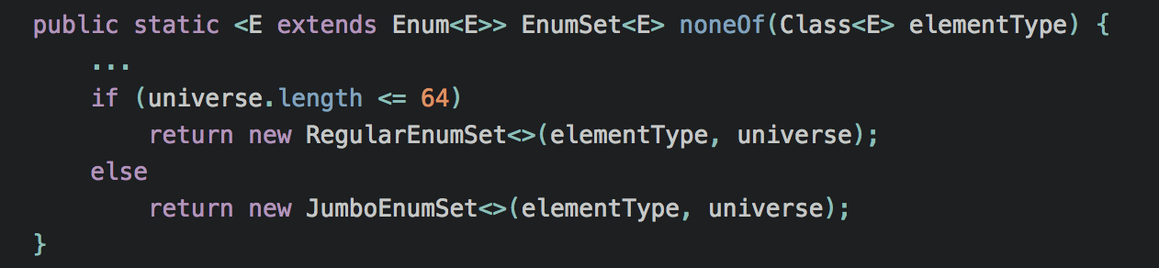
Item 36: Use EnumSet instead of bit fields
Related Item
Item 1: Consider static factory methods instead of constructors
Notes:
Summary
just because an enumerated type will be used in sets, there is no reason to represent it with bit fields.

Slide 13
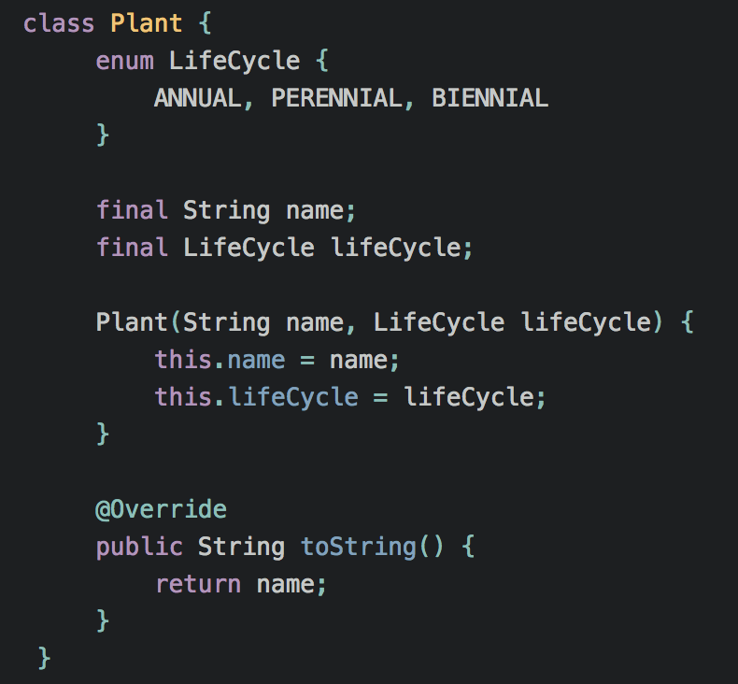
Item 37: Use EnumMap instead of ordinal indexing
Background
This simplistic class meant to represent a plant.
Suppose you have an array of plants representing a garden.
Q: How to list these plants organized by life cycle? See example Item37_EnumMap

Slide 14
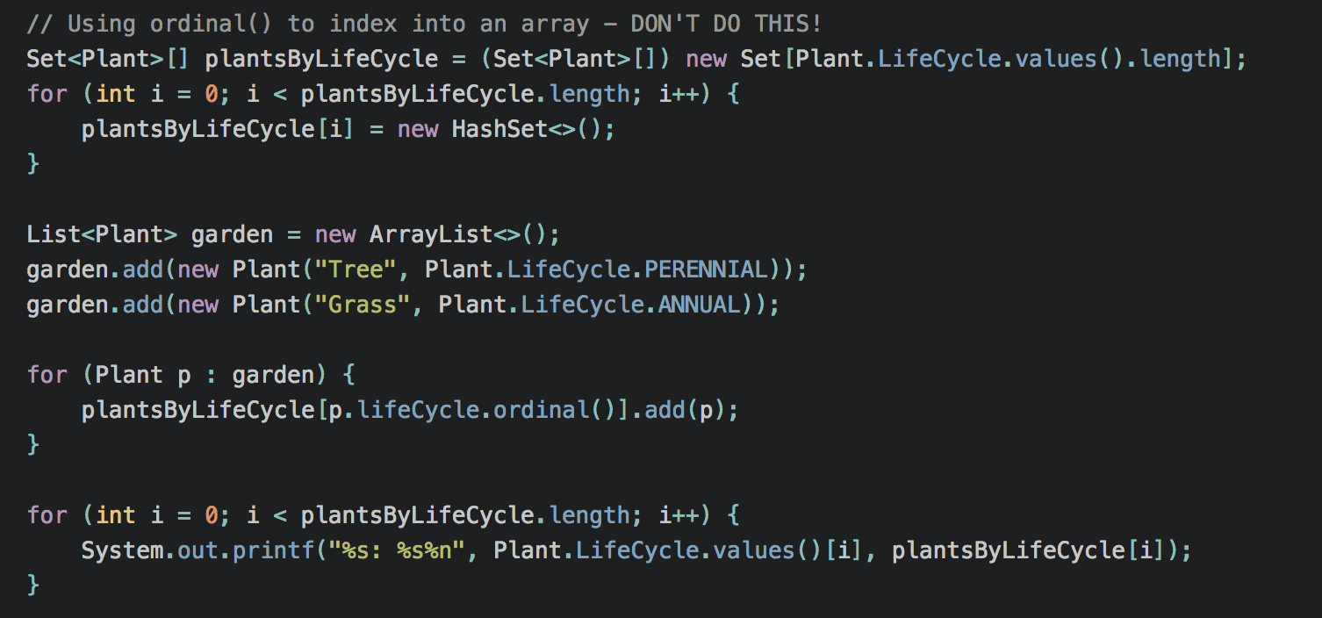
Item 37: Use EnumMap instead of ordinal indexing
Solution #1: array indexed by ordinal
Class cast: arrays are not compatible with generics.
The most serious problem with this technique is that when you access an array that is indexed by an enum’s ordinal, it is your responsibility to use the correct int value.

Slide 15
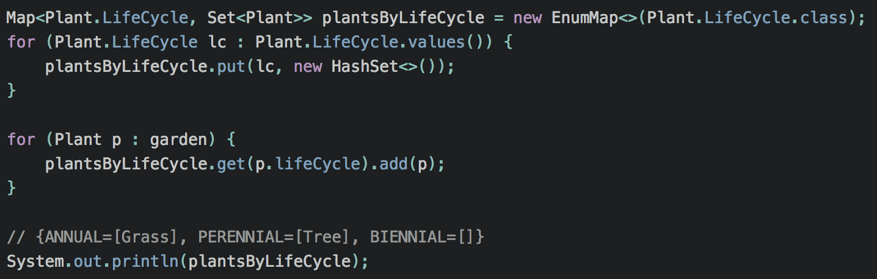
Item 37: Use EnumMap instead of ordinal indexing
Solution #2: EnumMap
it's shorter, clearer, safer. > can be further shortened by using a stream.
there's no unsafe cast.
no possibility for error in computing array indices.
it's comparable in speed to the original version.

Slide 16
Item 37: Use EnumMap instead of ordinal indexing
Nested EnumMap
See example Item37_NestedEnumMap
Notes:
http://gitlab.coupang.net/kodiak/effective-java/blob/master/main/src/java/com/effectivejava/ch06_enums_annotations/Item37_NestedEnumMap.java
In summary,
it is rarely appropriate to use ordinals to index into arrays: use EnumMap instead.
If the relationship you are representing is multidimensional, use EnumMap<..., EnumMap<...>>.
This is a special case of the general principle that application programmers should rarely, if ever, use Enum.ordinal (Item 35).

Slide 17
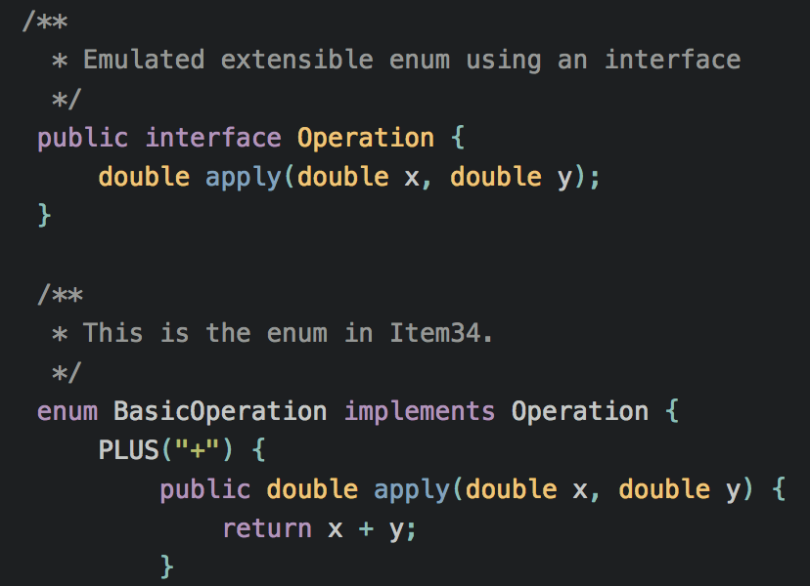
Item 38: Emulate extensible enums with interfaces
Extensible enumerated types
It's in possible to have one enumerated type extend another.
But sometimes it is desirable to let the users of an API provide their own operations, effectively extending the set of operations provided by the API.
See example Item38_ExtensibleEnum.

Slide 18
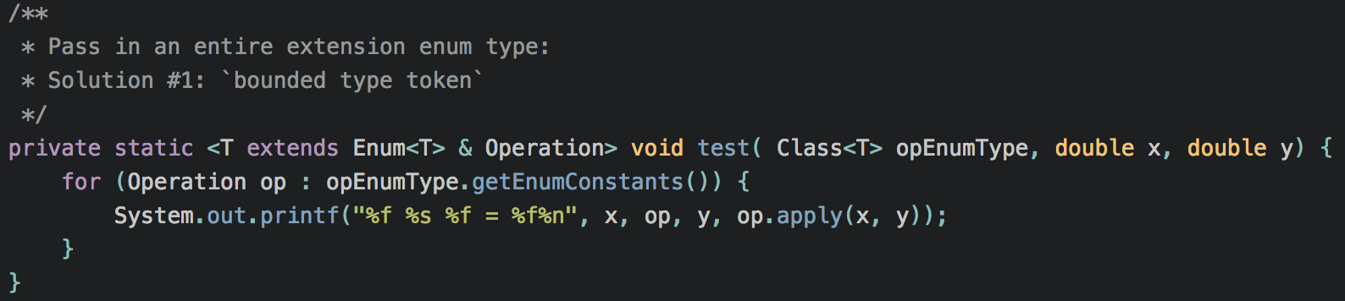
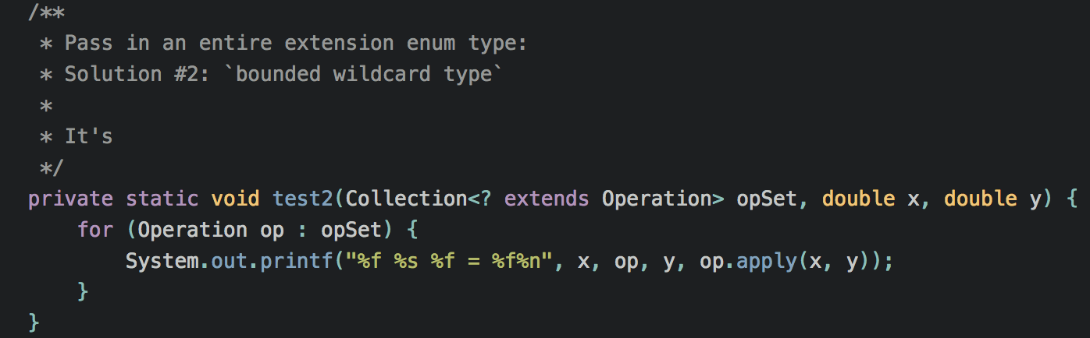
Item 38: Emulate extensible enums with interfaces
How to pass in an entire extension enum type?
Solution #2 is a bit more flexible: it allows the caller to combine operations from multiple implementation types.
Notes:
- while you cannot write an extensible enum type, you can emulate it by writing an interface to accompany a basic enum type that implements the interface.
- This allows clients to write their own enums (or other types) that implement the interface.
- Instances of these types can then be used wherever instances of the basic enum type can be used, assuming APIs are written in terms of the interface.

Slide 19
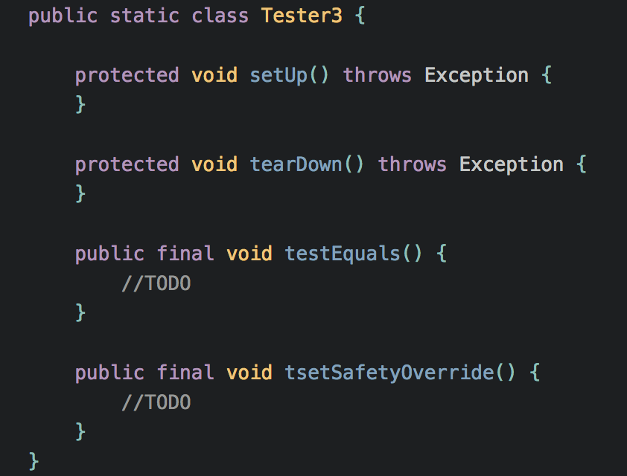
Item 39: Prefer annotations to naming patterns
What is naming pattern?
Historically, it was common to use naming patterns to indicate that some program elements demanded special treatment by a tool or framework.
For example, prior to release 4, the JUnit testing framework required its users to designate test meth- ods by beginning their names with the characters test.
Disadvantages
First, typographical errors result in silent failures. (tsetSafetyOverride in the example)
Second, there is no way to ensure that they are used only on appropriate program elements. (class TestSafetyMechanisms doesn't work)
Third, they provide no good way to associate parameter values with program elements. (suppose you want to support a category of test that succeeds only if it throws a particular exception.)

Slide 20
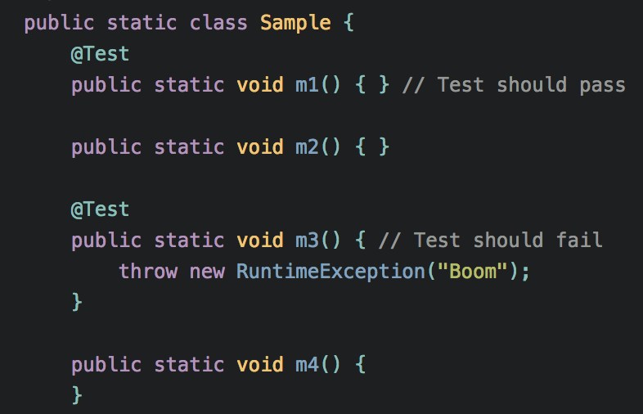
Item 39: Prefer annotations to naming patterns
Annotation
Annotations solve all of these problems nicely.
1) no typo.
2) @Target
3) associate parameter values with program elements.
Annotations don’t change the semantics of the annotated code but enable it for special treatment by tools.

Slide 21
Item 39: Prefer annotations to naming patterns
Marker annotation type
See example Item39_2_MarkerAnnotations
Annotation type with a parameter
See example Item39_3_AnnotationsParam
Annotation type with an array parameter
See example Item39_4_AnnotationsArrayParam
Repeatable annotation type
See example Item39_5_RepeatableAnnotations
Notes:
Summary
There is simply no reason to use naming patterns when you can use annotations instead.
all programmers should use the predefined annotation types that Java provides (Items 40, 27).
Also, consider using the annotations provided by your IDE or static analysis tools. Such annotations can improve the quality of the diagnostic information provided by these tools.

Slide 22
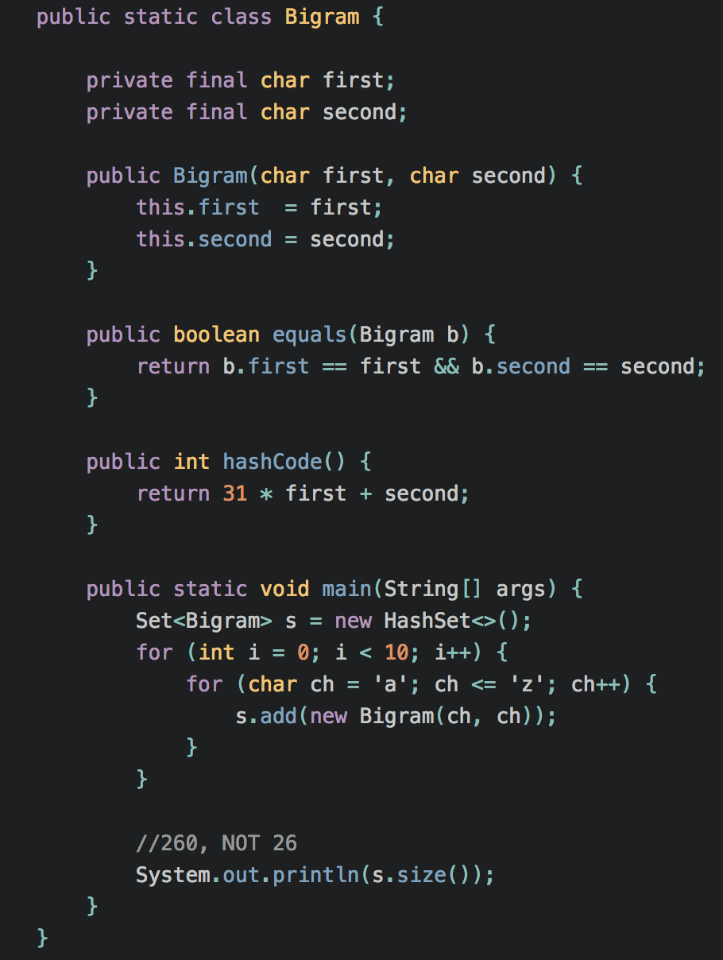
Item 40: Consistently use the Override annotation
Can you spot the bug?
Unfortunately, our hapless programmer failed to override equals, overloading it instead (Item 52).

Slide 23
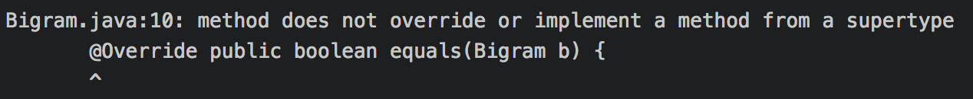
Item 40: Consistently use the Override annotation
@Override
Luckily, the compiler can help you find this error, but only if you help it by telling it that you intend to override Object.equals.
You will immediately realize what you did wrong.
Notes:
Summary
the compiler can. protect you from a great many errors if you use the Override annotation on every method declaration that you believe to override a supertype declaration,
with one exception: In concrete classes, you need not annotate methods that you believe to override abstract method declarations (though it is not harmful to do so).
> In an abstract class or an interface, however, it is worth annotating all methods that you believe to override superclass or superinterface methods, whether con- crete or abstract

Slide 24
Item 41: Use marker interfaces to define types
What is marker interface?
A marker interface is an interface that contains no method declarations but merely designates (or “marks”) a class that implements the interface as having some property. e.g. Serializable
Marker interfaces vs. marker annotations
Q: marker annotations (Item 39) make marker interfaces obsolete? A: NO!
marker interfaces define a type that is implemented by instances of the marked class; marker annotations do not. > The existence of a marker interface type allows you to catch errors at compile time that you couldn’t catch until runtime if you used a marker annotation.
marker interfaces can be targeted more precisely. > If an annotation type is declared with target ElementType.TYPE, it can be applied to any class or interface.
The chief advantage of marker annotations over marker interfaces is that they are part of the larger annotation facility.

Slide 25
Item 41: Use marker interfaces to define types
When should you use a marker annotation and when should you use a marker interface?
Clearly you must use an annotation if the marker applies to any program element other than a class or interface.
If the marker applies only to classes and interfaces, ask yourself the question “Might I want to write one or more methods that accept only objects that have this marking?” If so, you should use a marker interface in preference to an annotation.
If you can convince yourself that you’ll never want to write a method that accepts only objects with the marking, then you’re probably better off using a marker annotation.
If the marking is part of a framework that makes heavy use of annotations, then a marker annotation is the clear choice.

Slide 26
Reference
Documents:
http://gitlab.coupang.net/kodiak/effective-java/tree/master/6_enums_and_annotations
Examples:
http://gitlab.coupang.net/kodiak/effective-java/tree/master/main/src/java/com/effectivejava/ch06_enums_annotations

