Slide 1
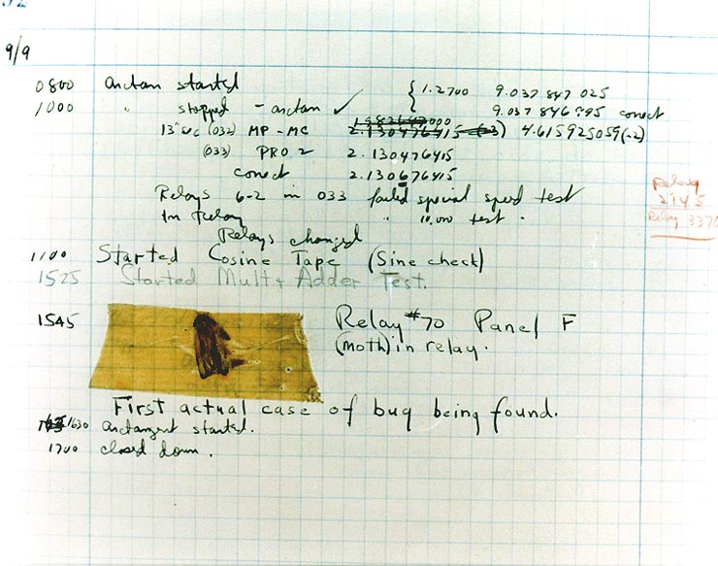
Effective Java 3RD Edition
Chapter 6. Enums and Annotations
Notes:
http://gitlab.coupang.net/kodiak/effective-java/blob/master/6_enums_and_annotations

Slide 2
Item 34: Use enums instead of int constants
Int enum pattern
// The int enum pattern - severely deficient!
public static final int APPLE_FUJI = 0;
public static final int APPLE_PIPPIN = 1;
public static final int APPLE_GRANNY_SMITH = 2;
public static final int ORANGE_NAVEL = 0;
public static final int ORANGE_TEMPLE = 1;
public static final int ORANGE_BLOOD = 2;
Disadvantages:
no type safety. (see example Item34_1_IntConstantPattern)
no namespaces for int enum groups.
Because int enums are constant variables, their int values are compiled into the clients that use them. If the value associated with an int enum is changed, its clients must be recompiled.
There is no easy way to translate int enum constants into printable strings.
There is no reliable way to iterate over all the int enum constants in a group.

Slide 3
Item 34: Use enums instead of int constants
Enums
public enum Apple { FUJI, PIPPIN, GRANNY_SMITH }
public enum Orange { NAVEL, TEMPLE, BLOOD }
enum types rectify the deficiencies of int enums.
compile-time type safety.
each type has its own namespace.
to printable strings.
iterate.
enum types let you add arbitrary methods and fields and implement arbitrary interfaces. (i.e. associate different data/behavior with each enum type, see example Item34_2_Enum)

Slide 4
Item 34: Use enums instead of int constants
Tips
Just as with other classes, unless you have a compelling reason to expose an enum method to its clients, declare it private or, if need be, package-private.
If an enum is generally useful, it should be a top-level class; if its use is tied to a specific top-level class, it should be a member class of that top-level class.
If you override the toString method in an enum type, consider writing a fromString method to translate the custom string representation back to the corresponding enum. (see example Item34_3_FromString)
Use enums any time you need a set of constants whose members are known at compile time.

Slide 5
Item 34: Use enums instead of int constants
Strategy Enum
A disadvantage of constant-specific method implementations is that they make it harder to share code among enum constants.
See example Item34_4_StrategyEnum

Slide 6
Item 34: Use enums instead of int constants
Summary
The advantages of enum types over int constants are compelling.
Enums are more readable, safer, and more powerful.
Some enums benefit from associating data with each constant.
Fewer enums benefit from associating multiple behaviors with a single method..
Consider the strategy enum pattern if some enum constants share common behaviors.
Reference:
http://gitlab.coupang.net/kodiak/effective-java/blob/master/6_enums_and_annotations/item_34_use_enums_instead_of_int_constants.md

Slide 7
Item 35: Use instance fields instead of ordinals

Slide 8
fdsf

Slide 9
Item 1: Consider static factory methods instead of constructors
Advantages of static factory methods
// Service interface public interface Service { ... // Service-specific methods go here } // Service provider interface public interface Provider { Service newService(); } // Noninstantiable class for service registration and access public class Services { private Services() { } // Prevents instantiation (Item 4) // Maps service names to services private static final Map<String, Provider> providers = new ConcurrentHashMap<String, Provider>(); public static final String DEFAULT_PROVIDER_NAME = "<def>"; // Provider registration API public static void registerDefaultProvider(Provider p) { registerProvider(DEFAULT_PROVIDER_NAME, p); } public static void registerProvider(String name, Provider p){ providers.put(name, p); } // Service access API public static Service newInstance(String name) { Provider p = providers.get(name); if (p == null) throw new IllegalArgumentException("No provider”); return p.newService(); } }
The class of the returned object can vary from call to call as a function of the input parameters
EnumSet class in the OpenJDK return an instance of one of two subclasses, depending on the size of the underlying enum type. ( <= 64 : RegularEnumSet, > 64 : JumboEnumSet )
The class of the returned object need no exist when the class containing the method is written
From the basis of Service Provider Frameworks

