Slide 1
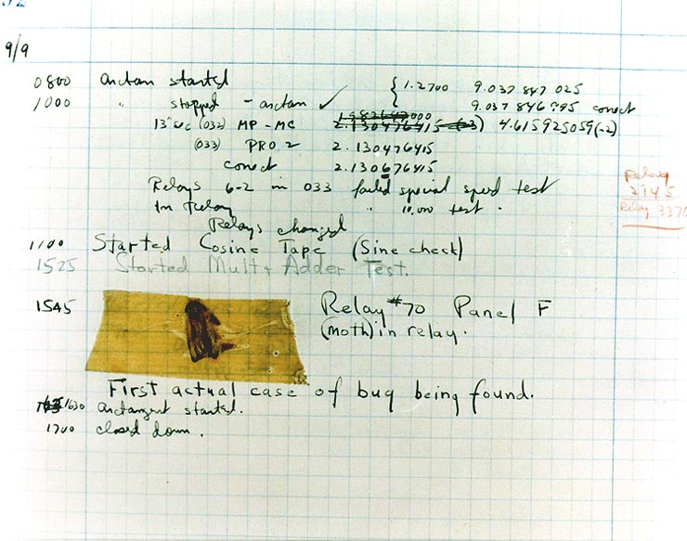
Effective Java 3RD Edition
Chapter 11. Concurrency

Slide 2
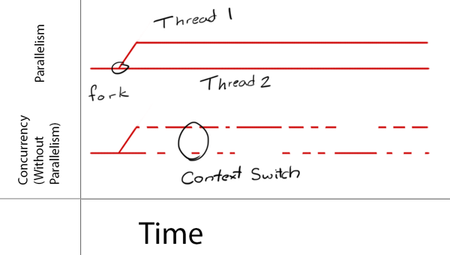
Concurrency vs Parallelism
Concurrency is when two or more tasks can start, run, and complete in overlapping time periods. It doesn't necessarily mean they'll ever both be running at the same instant. For example, multitasking on a single-core machine.
Parallelism is when tasks literally run at the same time, e.g., on a multicore processor.
Concurrency is about dealing with lots of things at once.
Parallelism is about doing lots of things at once.

Slide 3
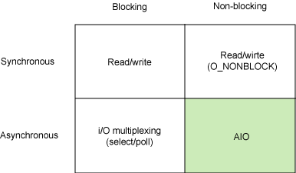
Synchronous vs Asynchronous, Blocking vs. Non-Blocking
Blocking / Non-Blocking is a matter of whether or not the called function returns immediately.
Synchronous / Asynchronous is a matter of who cares if the function being called is completed.
Notes:
They have names
They are not required to create a new object each time they’re invoked
This allows immutable classes, or to cache instance
It’s similar to the “flyweight pattern”
They can return an object of any subtype of their return type.
Interface has companion class (Type vs Types)
Flyweight 패턴은 비용이 큰 자원을 공통으로 사용할 수 있도록 만드는 패턴이다. 자원에 대한 비용은 크게 두가지로 나눠 볼 수 있다.
1. 중복 생성될 가능성이 높은 경우.
중복 생성될 가능성이 높다는 것은 동일한 자원이 자주 사용될 가능성이 매우 높다는 것을 의미한다. 이런 자원은 공통 자원 형태로 관리하고 있다가 요청이 있을 때 제공해 주는 편이 좋다.
2. 자원 생성 비용은 큰데 사용 빈도가 낮은 경우.
이런 자원을 항상 미리 생성해 두는 것은 낭비이다. 따라서 요청이 있을 때에 생성해서 제공해 주는 편이 좋다.
출처: http://effectiveprogramming.tistory.com/entry/Flyweight-패턴 [Effective Programming]

Slide 4
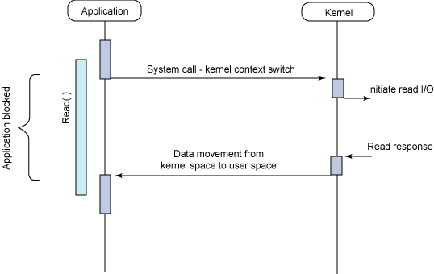
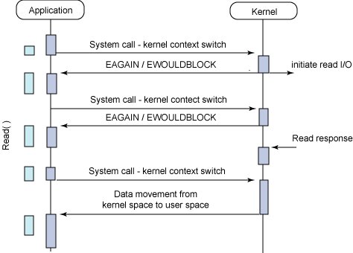
Synchronous vs Asynchronous, Blocking vs. Non-Blocking
Sync + Blocking
Sync + Non-Blocking
Notes:
They have names
They are not required to create a new object each time they’re invoked
This allows immutable classes, or to cache instance
It’s similar to the “flyweight pattern”
They can return an object of any subtype of their return type.
Interface has companion class (Type vs Types)
Flyweight 패턴은 비용이 큰 자원을 공통으로 사용할 수 있도록 만드는 패턴이다. 자원에 대한 비용은 크게 두가지로 나눠 볼 수 있다.
1. 중복 생성될 가능성이 높은 경우.
중복 생성될 가능성이 높다는 것은 동일한 자원이 자주 사용될 가능성이 매우 높다는 것을 의미한다. 이런 자원은 공통 자원 형태로 관리하고 있다가 요청이 있을 때 제공해 주는 편이 좋다.
2. 자원 생성 비용은 큰데 사용 빈도가 낮은 경우.
이런 자원을 항상 미리 생성해 두는 것은 낭비이다. 따라서 요청이 있을 때에 생성해서 제공해 주는 편이 좋다.
출처: http://effectiveprogramming.tistory.com/entry/Flyweight-패턴 [Effective Programming]

Slide 5
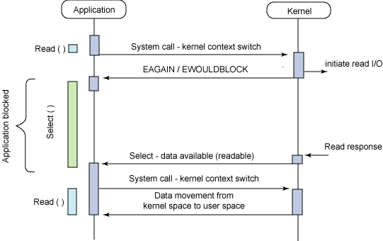
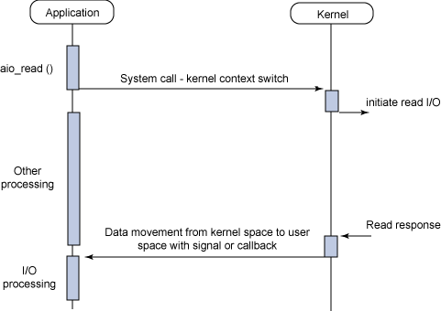
Synchronous vs Asynchronous, Blocking vs. Non-Blocking
Async + Blocking
Async + Non-Blocking
Notes:
They have names
They are not required to create a new object each time they’re invoked
This allows immutable classes, or to cache instance
It’s similar to the “flyweight pattern”
They can return an object of any subtype of their return type.
Interface has companion class (Type vs Types)
Flyweight 패턴은 비용이 큰 자원을 공통으로 사용할 수 있도록 만드는 패턴이다. 자원에 대한 비용은 크게 두가지로 나눠 볼 수 있다.
1. 중복 생성될 가능성이 높은 경우.
중복 생성될 가능성이 높다는 것은 동일한 자원이 자주 사용될 가능성이 매우 높다는 것을 의미한다. 이런 자원은 공통 자원 형태로 관리하고 있다가 요청이 있을 때 제공해 주는 편이 좋다.
2. 자원 생성 비용은 큰데 사용 빈도가 낮은 경우.
이런 자원을 항상 미리 생성해 두는 것은 낭비이다. 따라서 요청이 있을 때에 생성해서 제공해 주는 편이 좋다.
출처: http://effectiveprogramming.tistory.com/entry/Flyweight-패턴 [Effective Programming]

Slide 6
Item 78: Synchronize access to shared mutable data
Synchronized ensures..
Only a single thread can execute a method or block at one time (mutual exclusion)
All previous modifications can be visible to other threads
volatile
The language specification guarantees that reading or writing a variable is atomic unless the variable is of type long or double. But due to the memory model, it does not guarantee that a value written by one thread will be visible to another.
Atomic{Primitive Type}
java.util.concurrent.atomic.* This package provides primitives for lock-free, thread-safe programming on single variables. While volatile provides only the communication effects of synchronization, this package also provides atomicity.
Notes:
In summary, when multiple threads share mutable data, each thread that
reads or writes the data must perform synchronization. In the absence of
synchronization, there is no guarantee that one thread’s changes will be visible to
another thread. The penalties for failing to synchronize shared mutable data are
liveness and safety failures. These failures are among the most difficult to debug.
They can be intermittent and timing-dependent, and program behavior can vary
radically from one VM to another. If you need only inter-thread communication,
and not mutual exclusion, the volatile modifier is an acceptable form of
synchronization, but it can be tricky to use correctly.

Slide 7
Item 79: Avoid excessive synchronization
// Broken - invokes alien method from synchronized block! public class ObservableSet<E> extends ForwardingSet<E> { public ObservableSet(Set<E> set) { super(set); } private final List<SetObserver<E>> observers = new ArrayList<>(); public void addObserver(SetObserver<E> observer) { synchronized(observers) { observers.add(observer); } } public boolean removeObserver(SetObserver<E> observer) { synchronized(observers) { return observers.remove(observer); } } private void notifyElementAdded(E element) { synchronized (observers) { for (SetObserver<E> observer : observers) observer.added(this, element); } } @Override public boolean add(E element) { boolean added = super.add(element); if (added) notifyElementAdded(element); return added; } @Override public boolean addAll(Collection<? extends E> c) { boolean result = false; for (E element : c) result |= add(element); // Calls notifyElementAdded return result; } }
To avoid liveness and safety failures, never cede control to the client within a synchronized method or block.
public static void main(String[] args) { ObservableSet<Integer> set = new ObservableSet<>(new HashSet<>()); set.addObserver(new SetObserver<>() { public void added(ObservableSet<Integer> s, Integer e) { System.out.println(e); if (e == 23) s.removeObserver(this); } }); }

Slide 8
Item 79: Avoid excessive synchronization
Solution : make a snapshot or use CopyOnWriteArrayList
// Alien method moved outside of synchronized block - open calls private void notifyElementAdded(E element) { List<SetObserver<E>> snapshot = null; synchronized(observers) { snapshot = new ArrayList<>(observers); } for (SetObserver<E> observer : snapshot) observer.added(this, element); }
// Thread-safe observable set with CopyOnWriteArrayList private final List<SetObserver<E>> observers = new CopyOnWriteArrayList<>(); public void addObserver(SetObserver<E> observer) { observers.add(observer); } public boolean removeObserver(SetObserver<E> observer) { return observers.remove(observer); } private void notifyElementAdded(E element) { for (SetObserver<E> observer : observers) observer.added(this, element); }
As a rule, you should do as little work as possible inside synchronized regions.

Slide 9
Item 80: Prefer executors, tasks, and streams to threads
ExecutorService exec = Executors.newSingleThreadExecutor(); exec.execute(() -> { System.out.println("Test")}); exec.shutdown();
Executors.newCachedThreadPool - generally a good choice, In a cached thread pool, submitted tasks are not queued but immediately handed off to a thread for execution. If no threads are available, a new one is created.
Executors.newFixedThreadPool – generally good for heavily loaded production server

Slide 10
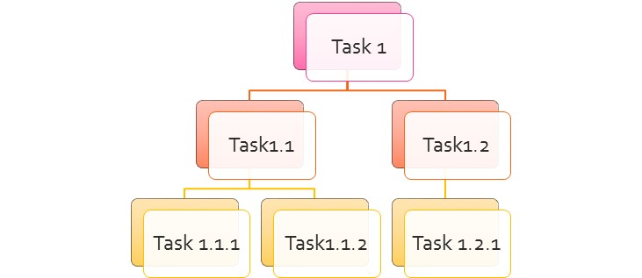
Item 80: Prefer executors, tasks, and streams to threads
The ForkJoinPool was introduced in Java 7. Is is similar to the Executor framework but with one difference. ForkjoinPools act in a recursive way, unlike Executor threads, which splits the task and submits smaller chunks to worker Threads. ForkJoinPool takes a big task, splits it into smaller tasks, and those smaller tasks split themselves again into subtasks until each subtask is atomic or not divisible. So it works recursively.
Parallel streams (Item 48) are written
atop fork join pools and allow you to take advantage of their performance benefits
with little effort, assuming they are appropriate for the task at hand.

Slide 11
Item 81: Prefer concurrency utilities to wait and notify
Given the difficulty of using wait and notify correctly, you should use the higher-level concurrency utilities instead.
In summary, using wait and notify directly is like programming in “concurrency assembly language,” as compared to the higher-level language provided by java.util.concurrent. There is seldom, if ever, a reason to use wait and notify in new code. If you maintain code that uses wait and notify, make sure that it always invokes wait from within a while loop using the standard idiom.
The notifyAll method should generally be used in preference to notify. If notify is used, great care must be taken to ensure liveness.
The higher-level utilities in java.util.concurrent fall into three categories:
the Executor Framework, which was covered briefly in Item 80;
Concurrent collections – ConcurrentMap, BlockingQueue, …
Synchronizers - CountDownLatch, Semaphore, CyclicBarrier, Exchanger, Phaser.

Slide 12
Item 81: Prefer concurrency utilities to wait and notify
Semaphore – It is a classic concurrency tool. Semaphores are often used to restrict the number of threads than can access some (physical or logical) resource.
CountDownLatch – It is a very simple yet very common utility for blocking until a given number of signals, events, or conditions hold.
CyclicBarrier – It is a resettable multiway synchronization point useful in some styles of parallel programming.
Phaser – It provides a more flexible form of barrier that may be used to control phased computation among multiple threads. A reusable synchronization barrier, similar in functionality to CyclicBarrier and CountDownLatch but supporting more flexible usage.
Exchanger – It allows two threads to exchange objects at a rendezvous point, and is useful in several pipeline designs.

Slide 13
Item 82: Document thread safety
To enable safe concurrent use, a class must clearly document what level of thread safety it supports.
Immutable—Instances of this class appear constant. No external synchronization is necessary. Examples include String, Long, and BigInteger (Item 17). @Immutable
Unconditionally thread-safe—Instances of this class are mutable, but the class has sufficient internal synchronization that its instances can be used concurrently without the need for any external synchronization. Examples include AtomicLong and ConcurrentHashMap. @ThreadSafe
Conditionally thread-safe—Like unconditionally thread-safe, except that some methods require external synchronization for safe concurrent use. Examples include the collections returned by the Collections.synchronized wrappers, whose iterators require external synchronization. @ThreadSafe
Not thread-safe—Instances of this class are mutable. To use them concurrently, clients must surround each method invocation (or invocation sequence) with external synchronization of the clients’ choosing. Examples include the general-purpose collection implementations, such as ArrayList and HashMap. @NotThreadSafe
Thread-hostile—This class is unsafe for concurrent use even if every method invocation is surrounded by external synchronization. Thread hostility usually results from modifying static data without synchronization. @NotThreadSafe

Slide 14
Item 82: Document thread safety
Documenting a conditionally thread-safe class requires care. - Collections.synchronizedMap
Map<K, V> m = Collections.synchronizedMap(new HashMap<>()); Set<K> s = m.keySet(); // Needn't be in synchronized block ... synchronized(m) { // Synchronizing on m, not s! for (K key : s) key.f(); }
To prevent this denial-of-service attack, you can use a private lock object instead of using synchronized methods
// Private lock object idiom - thwarts denial-of-service attack private final Object lock = new Object(); public void foo() { synchronized(lock) { ... } }

Slide 15
Item 83: Use lazy initialization judiciously
Under most circumstances, normal initialization is preferable to lazy initialization. If you must initialize a field lazily in order to achieve your performance goals or to break a harmful initialization circularity, then use the appropriate lazy initialization technique.
For Instance field
synchronized accessor – simplest, clearest
Double-check idiom – for performance, This idiom avoids the cost of locking when accessing the field after initialization
Single-check idiom - instance field that can tolerate repeated initialization
For static field
lazy initialization holder class idiom – It exploits the guarantee that a class will not be initialized until it is used

Slide 16
Item 83: Use lazy initialization judiciously
For instance field
// Lazy initialization of instance field - synchronized accessor private FieldType field; private synchronized FieldType getField() { if (field == null) field = computeFieldValue(); return field; }
// Double-check idiom for lazy initialization of instance fields private volatile FieldType field; private FieldType getField() { FieldType result = field; if (result == null) { // First check (no locking) synchronized(this) { if (field == null) // Second check (with locking) field = result = computeFieldValue(); } } return result; }
// Single-check idiom - can cause repeated initialization! private volatile FieldType field; private FieldType getField() { FieldType result = field; if (result == null) field = result = computeFieldValue(); return result; }

Slide 17
Item 83: Use lazy initialization judiciously
For static field
The beauty of this idiom is that the getField method is not synchronized and performs only a field access, so lazy initialization adds practically nothing to the cost of access.
// Lazy initialization holder class idiom for static fields private static class FieldHolder { static final FieldType field = computeFieldValue(); } private static FieldType getField() { return FieldHolder.field; }

Slide 18
Item 84: Don’t depend on the thread scheduler
Any program that relies on the thread scheduler for correctness or performance is likely to be nonportable.
The best way to write a robust, responsive, portable program is to ensure that the average number of runnable threads is not significantly greater than the number of processors.
In summary,
do not depend on the thread scheduler for the correctness of your program. The resulting program will be neither robust nor portable. As a corollary, do not rely on Thread.yield or thread priorities. These facilities are merely hints to the scheduler. Thread priorities may be used sparingly to improve the quality of service of an already working program, but they should never be used to “fix” a program that barely works.

