Slide 1
Generics

Slide 2
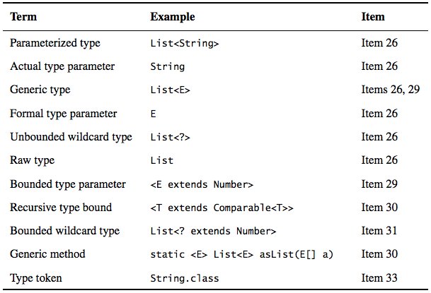

Slide 3
Item 26: Don’t use raw types
If you use raw types, you lose all the safety and expressiveness benefits of generics
You can put any element to a raw type Collection, but you can’t put any element (other than null) into a Collection<?>
You must use raw types in class literals, such as List.class, String[].class, int.class, etc. but List<String>.class, List<?>.class are not
It’s the preferred way to use the instanceof operator with generic types.
Notes:
In summary, using raw types can lead to exceptions at runtime, so don’t use them. They are provided only for compatibility and interoperability with legacy code that predates the introduction of generics. As a quick review, Set<Object> is a parameterized type representing a set that can contain objects of any type, Set<?> is a wildcard type representing a set that can contain only objects of some unknown type, and Set is a raw type, which opts out of the generic type system. The first two are safe, and the last is not.

Slide 4
Item 27: Eliminate unchecked warnings
Eliminate every unchecked warning that you can
If you can’t eliminate a warning, but you can prove that the code that provoked the warning is typesafe, then (and only then) suppress the warning with an @SuppressWarnings("unchecked") annotation
Always use the SuppressWarnings annotation on the smallest scope possible
Every time you use a @SuppressWarnings(“unchecked”) annotation, add a comment saying why it is safe to do so ？
Notes:
In summary, unchecked warnings are important. Don’t ignore them. Every unchecked warning represents the potential for a ClassCastException at run- time. Do your best to eliminate these warnings. If you can’t eliminate an unchecked warning and you can prove that the code that provoked it is typesafe, suppress the warning with a @SuppressWarnings("unchecked") annotation in the narrowest possible scope. Record the rationale for your decision to suppress the warning in a comment

Slide 5
Item 28: Prefer lists to arrays
Arrays are covariant, Generics are invariant (you’d rather find out at compile time)
Object[] objectArray = new Long[1]; objectArray[0] = "I don't fit in";
List<Object> ol = new ArrayList<Long>(); ol.add("I don't fit in");
Arrays are reified, Generics are implemented by erasure
Arrays know and enforce their element type at runtime
Generics enforce their type constraints only at compile time and discard (or erase) their element type information at runtime
Note: If you find yourself mixing arrays and generics, and getting compile-time errors or warnings, your first impulse should be to replace the arrays with lists.
Notes:
In summary, arrays and generics have very different type rules. Arrays are covariant and reified; generics are invariant and erased. As a consequence, arrays provide runtime type safety but not compile-time type safety, and vice versa for generics. As a rule, arrays and generics don’t mix well. If you find yourself mixing them and getting compile-time errors or warnings, your first impulse should be to replace the arrays with lists.

Slide 6
Item 29: Favor generic types
Notes:
In summary, generic types are safer and easier to use than types that require casts in client code. When you design new types, make sure that they can be used without such casts. This will often mean making the types generic. If you have any existing types that should be generic but aren’t, generify them. This will make life easier for new users of these types without breaking existing clients (Item 26).

Slide 7
Item 30: Favor generic methods
Notes:
In summary, varargs and generics do not interact well because the varargs facility is a leaky abstraction built atop arrays, and arrays have different type rules from generics. Though generic varargs parameters are not typesafe, they are legal. If you choose to write a method with a generic (or parameterized) varargs parame- ter, first ensure that the method is typesafe, and then annotate it with @Safe-
Varargs so it is not unpleasant to use.

Slide 8
Item 31: Use bounded wildcards to increase API flexibility
For maximum flexibility, use wildcard types on input parameters that represent producers or consumers
PECS stands for producer-extends, consumer-super
Do not use bounded wildcard types as return types
If the user of a class has to think about wildcard types, there is probably something wrong with its API
Set<Integer> integers = Set.of(1, 3, 5);
Set<Double> doubles = Set.of(2.0, 4.0, 6.0);
Set<Number> numbers = union(integers, doubles);
if a type parameter appears only once in a method declaration, replace it with a wildcard
Notes:
In summary, using wildcard types in your APIs, while tricky, makes the APIs far more flexible. If you write a library that will be widely used, the proper use of wildcard types should be considered mandatory. Remember the basic rule: producer-extends, consumer-super (PECS). Also remember that all comparables and comparators are consumers.

Slide 9
Item 32: Combine generics and varargs judiciously
it is unsafe to store a value in a generic varargs array parameter
the SafeVarargs (since java 7) annotation constitutes a promise by the author of a method that it is typesafe
it is unsafe to give another method access to a generic varargs parameter array
Use @SafeVarargs on every method with a varargs parameter of a generic or parameterized type
As a reminder, a generic varargs methods is safe if:
1. it doesn’t store anything in the varargs parameter array, and
2. it doesn’t make the array (or a clone) visible to untrusted code.
If either of these prohibitions is violated, fix it.
Notes:
In summary, varargs and generics do not interact well because the varargs facility is a leaky abstraction built atop arrays, and arrays have different type rules from generics. Though generic varargs parameters are not typesafe, they are legal. If you choose to write a method with a generic (or parameterized) varargs parameter, first ensure that the method is typesafe, and then annotate it with @Safe-Varargs so it is not unpleasant to use.

Slide 10
Item 33: Consider typesafe heterogeneous containers
Notes:
In summary, the normal use of generics, exemplified by the collections APIs, restricts you to a fixed number of type parameters per container. You can get around this restriction by placing the type parameter on the key rather than the container. You can use Class objects as keys for such typesafe heterogeneous containers. A Class object used in this fashion is called a type token. You can also use a custom key type. For example, you could have a DatabaseRow type repre- senting a database row (the container), and a generic type Column<T> as its key.

