Slide 1
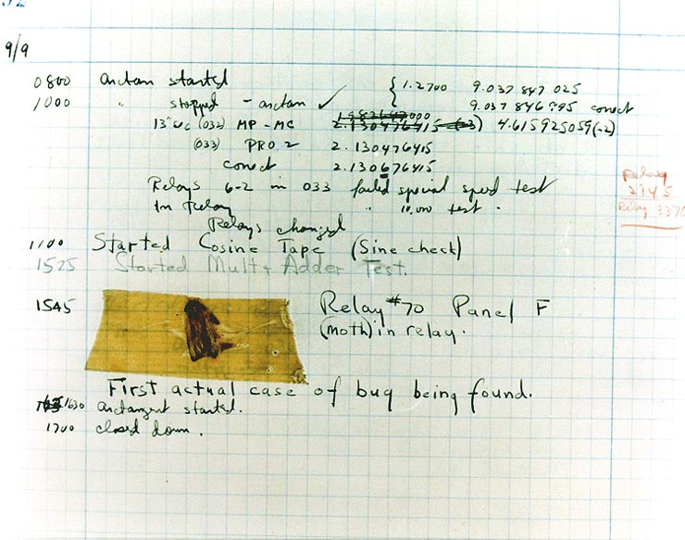
Effective Java 3RD Edition
Chapter 4. Classes and Interfaces

Slide 2
Item 15: Minimize the accessibility of classes and members
Make each class or member as inaccessible as possible.
Access levels
private
package-private (default)
protected
public
Instance fields of public classes should rarely be public.
classes with public mutable fields are not generally thread-safe.
it is wrong for a class to have a public static final array field, or an accessor that returns such a field.
Notes:
가장 중요한 것은 클래스나 멤버에 최대한 접근 불가능하도록 만드는 것이 좋다.
이를 위해서는 접근자를 잘 활용하는 것이 좋다.
private : 오직 탑레벨 클래스에서만 접근 가능하다.
package-private : 동일 패키지 내에서만 사용가능하다.
protected 서브클래스에서 접근 가능하다.
public 어디서나 접근 가능하다.

Slide 3
Item 16: In public classes, use accessor methods, not public fields
If a class is accessible outside its package, provide accessor methods.
//Encapsulation of data by accessor methods and mutators public class Point { private double x; private double y; public Point(double x, double y) { this.x = x; this.y = y; } public double getX() { return x; } public double getY() { return y; } public void setX(double x) { this.x = x; } public void setY(double y) { this.y = y; } }
public class Point { public double x; public double y; }
If a class is package-private or is a private nested class, there is nothing inherently wrong with exposing its data fields.
Notes:
and if the fields are immutable, to expose fields directly is less harmful.

Slide 4
Item 17: Minimize mutability
The rules to class immutable.
Don’t provide methods that modify the object’s state
Ensure that the class can’t be extended
Make all fields final
Make all fields private
Ensure exclusive access to any mutable components
// immutable complex number class public final class Complex { private final double re; private final double im; public Complex(double re, double im) { this.re = re; this.im = im; } public double realPart() { return re; } public double imaginaryPart() { return im; } public Complex plus(Complex c) { return new Complex(re + c.re, im + c.im); } @Override public boolean equals(Object o) { ... } @Override public int hashCode() { … } @Override public String toString() { … } }

Slide 5
Item 17: Minimize mutability
Immutable objects advantage
simple
inherently thread-safe, require no synchronization.
can be shared freely.
can share their internals.
making greate building blocks for other objects.
providing failure atomicity for free.
Immutable objects disadvantage
they require a separate object for each distinct value.
when perform a multistep operation, performance problem is magnified.
multistep operation(will be commonly required) to provide them primitives.
provide a public mutable companion class.

Slide 6
Item 17: Minimize mutability
Summarize
Classes should be immutable.
If a class cannot be made immutable, limit its mutability as much as possible
Declare every field private final.
Constructors should create fully initialized objects with all of their invariants established.

Slide 7
Item 18: Favor composition over inheritance
Unlike method invocation, inheritance violates encapsulation.
// flagile class public class InstrumentedHashSet<E> extends HashSet<E> { private int addCount = 0; public InstrumentedHashSet() { } public InstrumentedHashSet(int initCap, float loadFactor) { super(initCap, loadFactor); }
@Override public boolean add(E e) { addCount++; return super.add(e); } @Override public boolean addAll(Collection<? extends E> c) { addCount += c.size(); return super.addAll(c); } public int getAddCount() { return addCount; } }
// hashSet.addAll public boolean addAll(Collection<? extends E> c) { boolean modified = false; for (E e : c) if (add(e)) modified = true; return modified; }
public static void main(String[] args) { InstrumentedHashSet<String> s = new InstrumentedHashSet<>(); s.addAll(List.of("Snap", "Crackle", "Pop")); System.out.println(s.getAddCount()); //6 }
Notes:
the inheritance in this page, means implementation inheritance when one class extends another.

Slide 8
Item 18: Favor composition over inheritance
so use only when a genuine subtype relationship exists between the subclass and the superclass
use composition and forwarding instead of inheritance.
composition : design to make class that have field that references an instance of the existing class
disadvantage : not suited for use in callback framework because SELF problem
Notes:
example : ppt 113, book : 90

Slide 9
Item 19: Design and document for inheritance or else prohibit it
The class must document its self-use of overidable methods.
// we can know it using iterator’s remove method
/** * {@inheritDoc} * * <p>This implementation iterates over the collection looking for the * specified element. If it finds the element, it removes the element * from the collection using the iterator's remove method. * * <p>Note that this implementation throws an * <tt>UnsupportedOperationException</tt> if the iterator returned by this * collection's iterator method does not implement the <tt>remove</tt> * method and this collection contains the specified object. * * @throws UnsupportedOperationException {@inheritDoc} * @throws ClassCastException {@inheritDoc} * @throws NullPointerException {@inheritDoc} */ public boolean remove(Object o) {

Slide 10
Item 19: Design and document for inheritance or else prohibit it
A class may have to provide hooks into its internal working in the form of judiciously chosen protected methods.
The only way to test a class designed for inheritance is to write subclasses.
test your class by writing subclasses before you release it.
Constructors must not invoke overridable methods.
Neither clone nor readObject may invoke an overridable method, directly or indirectly
Summarize
designing a class for inheritance requires great effort and places substantial limitations on the class.
prohibit subclassing in classes that are not designed and documented to be safely subclassed.

Slide 11
Item 20: Prefer interfaces to abstract classes
Interface abstract class differece
to implement the type defined by an abstract class
Interfaces’s advatage
Existing classes can easiy be retrofitted to implement a new interface
to add the required methods, and add an implements clause to the class declaration.
Interfaces are ideal for defining mixins.
mixin : a type that a class can implement in addition to Its “primary type” to declare that it provides some optional hebavior ex) Comparable.

Slide 12
Item 20: Prefer interfaces to abstract classes
Interfaces’s advatage
Interfaces allow for the construction of nonhierarchical type framworks.
If don’t use interfaces, occur combinatorial explosion.
public abstract class Singer { abstract AudioClip Sing(Song s); }
public interface Singer { AudioClip Sing(Song s); }
public interface Songwriter { Song compose(boolean hit); }
public abstract class Songwriter { abstract Song compose(boolean hit); }
public abstract class SingerSongwriter extends Singer { abstract AudioClip strum(); abstract void actSensitive(); abstract Song compose(boolean hit); }
public interface SingerSongwriter extends Singer, Songwriter { AudioClip strum(); void actSensitive(); }
Notes:
https://stackoverflow.com/questions/44325301/examples-for-combinatorial-explosion-in-java

Slide 13
Item 20: Prefer interfaces to abstract classes
Interfaces’s advatage
Interfaces enable safe, powerful functionality enhancements via the wrapper class
or using skeletal implementation(abstract interface).
public abstract class AbstractMapEntry<K,V> implements Map.Entry<K,V> { // Entries in a modifiable map must override this method @Override public V setValue(V value) { throw new UnsupportedOperationException(); }
// Implements the general contract of Map.Entry.equals @Override public boolean equals(Object o) { … } // Implements the general contract of Map.Entry.hashCode @Override public int hashCode() { … } @Override public String toString() {… } }
good documentation is absoulutely essential in a skeletal implementation.
Notes:
abstract wrapper class example : book 103, ppt 126

Slide 14
Item 21: Design interfaces for posterity
It is not always possible to write a default method that maintains all invariants of every conceivable implementation.
// not override removeIf package org.apache.commons.collections4.collection; import … public class SynchronizedCollection<E> implements Collection<E>, Serializable { private static final long serialVersionUID = 2412805092710877986L; private final Collection<E> collection; protected final Object lock;
…
}
// in java8, add defatul methods on Collection
default boolean removeIf(Predicate<? super E> filter) { Objects.requireNonNull(filter); boolean removed = false; final Iterator<E> each = iterator(); while (each.hasNext()) { if (filter.test(each.next())) { each.remove(); removed = true; } } return removed; }
ConcurrentModificationException or other unspecified bebahavior may result.

Slide 15
Item 21: Design interfaces for posterity
In the presence of default methods, existing implementations of an interface may compile without error or warning but fail at runtime.
so using default methods to add new methods to existing interfaces should be avoided unless the need is critical
It is still of the utmost importance to design interfaces with great care.
While it may be possible to correct some interface flaws after an interface is released, you cannot count on it.

Slide 16
Item 22: Use interfaces only to define types
The constant interface pattern is a poor use of interfaces.
//Constant interface antipattern - do not use! public interface PhysicalConstants { //Avogadro's numbr (1/mol) static final double AVOGADROS_NUMBER = 6.022_140_857e23; //Boltzmann constant (J/K) static final double BOLTZMANN_CONSTANT = 1.380_648_52e-23; }

Slide 17
Item 22: Use interfaces only to define types
The constant interface pattern is a poor use of interfaces.
//Constant utility class public class PhysicalConstants { private PhysicalConstants() {} //prevents instantiation public static final double AVOGADROS_NUMBER = 6.022_140_857e23; public static final double BOLTZMANN_CONST = 1.380_648_52e-23; }
import static com.effectivejava.science.PhysicalConstants.AVOGADROS_NUMBER; public class Test { double atoms(double mols) { return AVOGADROS_NUMBER * mols; } }
Notes:
몰질량을 포함한 1mol의 구성 입자(원자, 분자, 이온 등) 속에 들어 있는 입자의 수이다 The mass of a mole of substance is called the molar mass of that substance.

Slide 18
Item 23: Prefer class hierarchies to tagged classes
tagged class : there is two or more function In one class, and contains tag for indicate the function.
tagged classes’s problem
verbose
error-prone
inefficient
A tagged class is just a pallid imitation of a class hierarchy.
If you encounter or be tempted to write tagged class, consider refactoring it into a hierarchy
Notes:
wrong case : pdf 132 page or book 109 ~ 111

Slide 19
Item 24: Favor static member classes over nonstatic
nested class : class defined within another class
static member classes
nonstatic member classes
anonymous classes
local classes
If you declare a member class that does not require access to an enclosing instance, always put the static modifier in its declaration

Slide 20
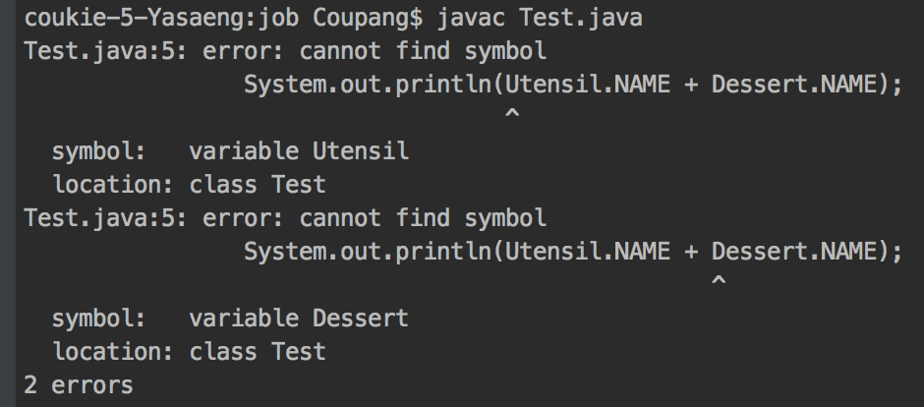
Item 25: Limit source files to a single top-level class
Never put multiple top-level classes or interfaces in a single source file.
public final class Test { public static void main(String[] args) { System.out.println(Utensil.NAME + Dessert.NAME); } }
// Utensil.java
class Utensil { static final String NAME = "pan"; } class Dessert { static final String NAME = "cake"; }
//Dessert.java class Utensil { static final String NAME = "pot"; } class Dessert { static final String NAME = "pie"; }

Slide 21
Item 25: Limit source files to a single top-level class
Never put multiple top-level classes or interfaces in a single source file.
public final class Test { public static void main(String[] args) { System.out.println(Utensil.NAME + Dessert.NAME); } private static class Utensil { static final String NAME = "pan"; } private static class Dessert { static final String NAME = "cake"; } }

