Slide 1
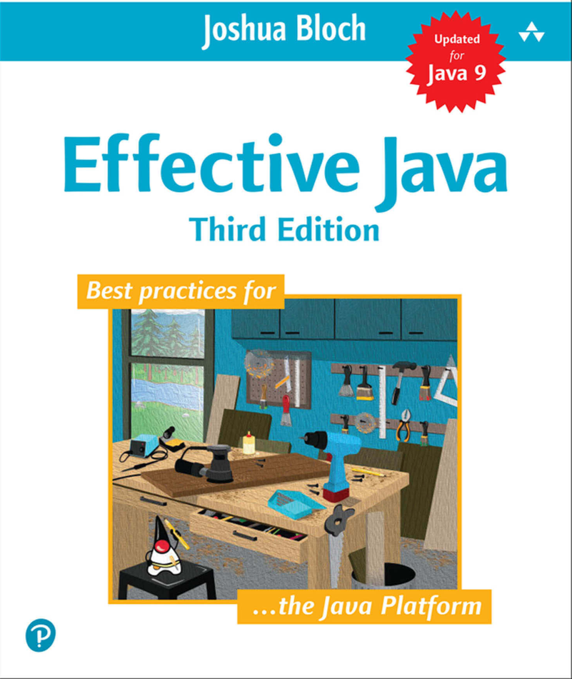
General Programming
-- Ben

Slide 2
What kind of code do you think is good programming style?
☺

Slide 3



Item 57 – Minimize the scope of local variables
Declare the variable where it is first used.
Nearly every local variable declaration should contain an initializer. (except for try/catch)
Example:
For (Element e : c) {}
For(Iterator<Element> I = c.iterator();i.hasNext();) {}
While (i.hasNext) {} (easy copy wrong and easy make bug for sub loop)

Slide 4
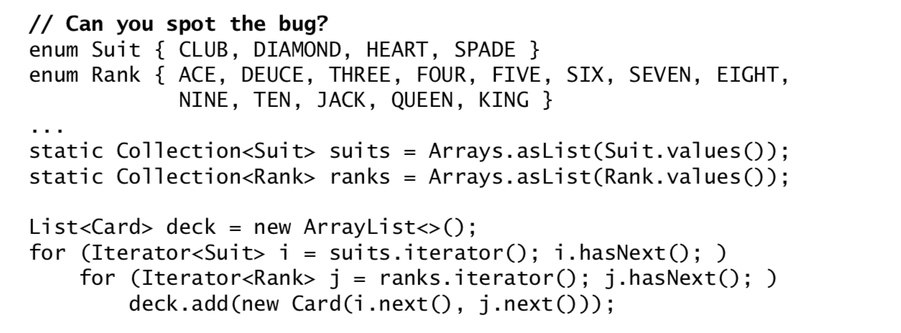
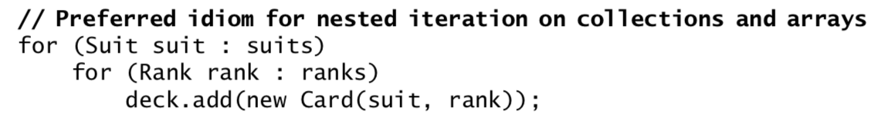
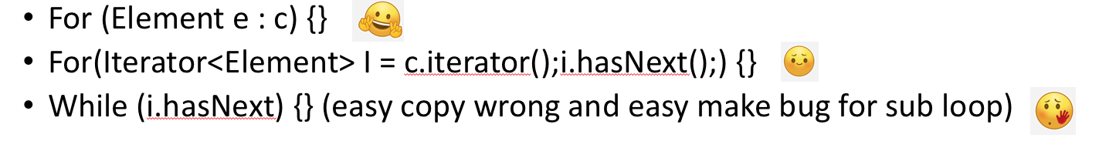
Item 58 – Prefer for-each loops to traditional for loops
If you have to use traditional loop, use “for (Element e : elements)”
Example:
Three common situation where you can’t use for-each
Destructive filtering – if you need call remove method
Transforming – if you need replace the element
Parallel iteration – if need traverse multiple collections, you need explicit control over the iterator or index.
Summary

Slide 5
Item 59 – Know and use the libraries
If you want to use a encrypt function to encrypt your file, what you do?
Write your own arithmetic?
Use library like DES/AES?
Why
Take the advantage of the knowledge of the experts who wrote it.
You don’t have to waste time to wring ad hoc solutions to problem.
Performance tends to improve over time, with no effort on your time. Because many people use them and because they’re used in industry-standard benchmarks.
Tend to gain functionality over time.
Using standard libraries is that you place your code in the mainstream. It’s easy to read, maintainable and reusable by the multitude of developers.
Summary
Use Java library first
Use high-quality 3rd libraries, such as Google’s like Guava.
Write by yourself.

Slide 6
Item – 60 Avoid Float and double if exact answers are required
What’s the answer for simple minus function?
System.out.println(1.00 - 9 * 0.10 ); (0.09999999999999998)
BigDecimal
Two disadvantages
Less convenient than primitive arithmetic type
Less slower
You can use int(9) or long(18) to calculate
Like in above example change all them into lower unit(turn all of them into cents)
Summary: use BigDecimal if you need exact calcuation

Slide 7
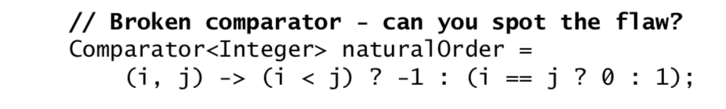
Item 61 – Prefer primitive types to boxed primitives
Such as Int, double, boolean has boxed primitive type.
Different
Primitives only have their values while boxed primitives have identities distinct from their values.
Primitive types have only fully functional values while boxed primitive type has one nonfunctional value (Null)
Primitive are more time- and space-efficient.
Summary: Use primitive types if you can.

Slide 8
Item 62 – Avoid strings where other types are more appropriate
Strings are poor substitutes for other value types like numeric, Boolean
Strings are poor substitutes for enum types
Strings are poor substitutes for aggregate types.
Strings are poor substitutes for capabilities.
Summary: use better data type exist instead of using string

Slide 9
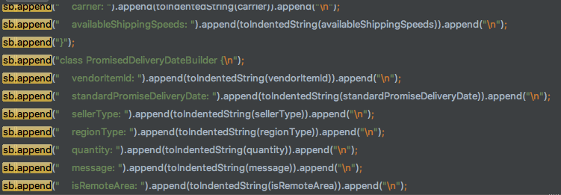

Item 63:Beware the performance of string concatenation
Use “+” performance is poor.
Summary: Use StringBuilder instead.
Good
Avoid

Slide 10
Item 64-Refer to objects by their interfaces
Use appropriate interface when it exists. (List, Set, Map)
Exception
Value classes like String, BigInteger they are rarely written with multiple implementions
Class which belong to framework whose fundamental types are classes rather than interface. Like (many java.io classes such as OutputStream)
Although an object is implement an interface, but provide some method not found in interface. (PriorityQueue has a comparator method while interface Queue don’t has)
Summary: Use interface if possible especial for some class has multiply implements.

Slide 11
Item – 65 Prefer interfaces to reflection
Summary: Great powerful toy but don’t use unless have to
No compile error check
Too many exception need catch
Performance Bad
Destroy the OOP

Slide 12
Item 66 – Use native methods(JNI) judiciously
Native method is platform base
Native method is less protable
Native method is hard to debug
Native method isn’t include in GC or even track native memory usage
Native method require “glue code” which is difficult to read and tedious to write
Summary: Try to avoid use & if you have to use think twice

Slide 13
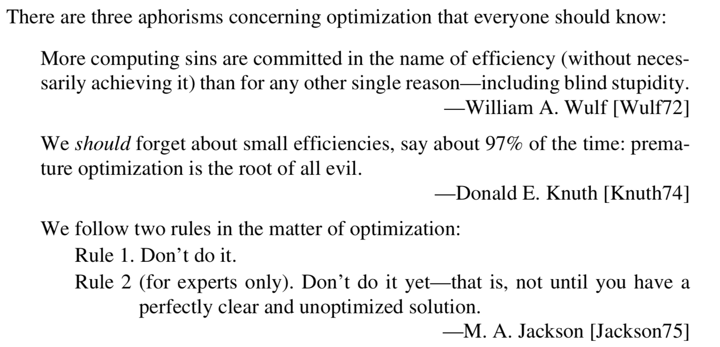
Item 67 – Optimize judiciously
Strive to write good programs rather than fast ones.
Strive to avoid design decisions that limit performance.
Consider the performance consequences of your API design decisions
Summary
Strive to write good programs, speed will follow

Slide 14
Item 68: Adhere to generally accepted naming conventions
Naming Conventions contain two categories
Typographical
Packages:
should expose with company name like (com.google)
name should be shorter meaningful abbreviations is encourage, (java.util, java.utilities)
Class:
First Letter is capitalized
Abbreviation should be avoided.(except for acronyms and certain common abbreviation like max min), If abbreviation is used, it’s all capitalizing or only first? Which one do you prefer(HTTPURL or HttpUrl)
Method/filed:
Same rule as class just first letter is lowercase
Sole exception “Constant Fields”: upper case words separated by unserscores.
Local variable
Same as method except abbreviation is permitted depend on the context like (i, houseNum)
Type parameter: T for arbitrary type, E for element type of collection, K & V is key – value, X is exception, R is for return, a sequence arbitrary is T, U, V or T1, T2, T3.
Quick reference: next slide

Slide 15
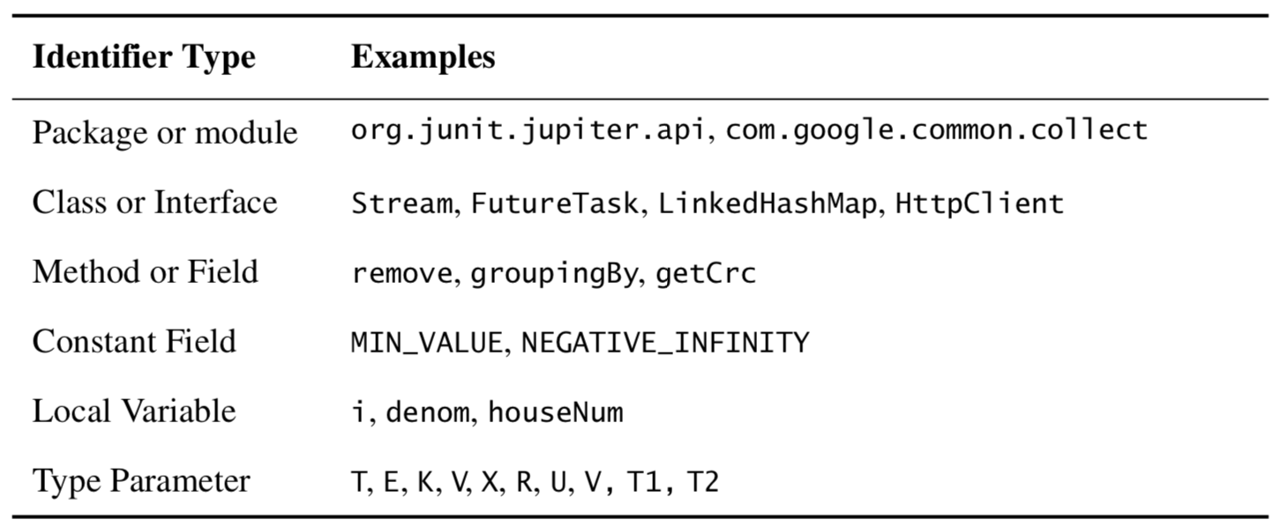

Slide 16
Grammatical(More flexible & more controversial than typographical)
Package (N/A)
Instantiable classes/enum types singular noun or noun phrase. E.G.Thread, PriorityQueue
Non-instantiable class name with plural noun, like Collections/Collectors
Interface like classes like Collection or with an adjective ending in able/ible like Runnable/Accessible
Annotation: Because so many uses, no part of speech predominates. Nouns/Verbs/Prepositions/Adjective are all common. Like BindingAnnotation
Method is
perform like action using verb like append/drawImage.
Return bool begin with is/has + noun like isDigit.
Non-Boolean noun/vern with or withtou get , first two words should readable. ([Discuss]Have to start with get?) if class contain both set/get for same attribute. It should be get/setAttribute
Special Method
Return indepent object of a different type using toType like toString, toArray
Return a view whose type differs from that of the receiving object called asType like asList
Return a primitive type with same value as Object use typeValue like intValue
For static factories include from/of/valueOf/instance/getInstance/newInstance/getType/newType
Field are less established and less important than others
Boolean like Boolean accessor methods with initial is omitted like initialized/composite
Other are usually noun like height/bodyStyle
Summary
Typographical convention are straightforward and unambiguour
Grammatical are more complex and lose.
Use them common sense and wisely. Don’t follow slavishly.

