Slide 1
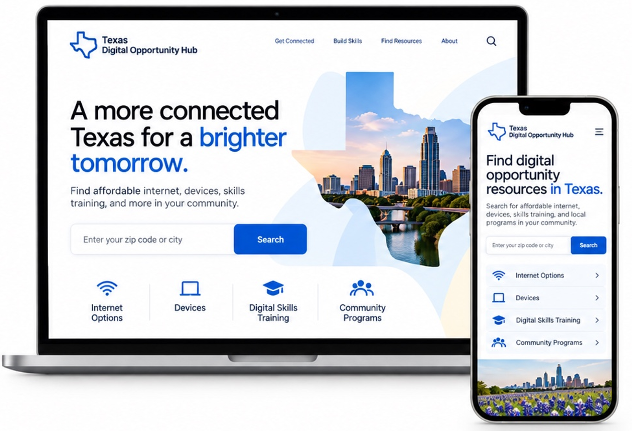




HR&A / Tech & Society Studio
Case study 3
Texas Digital
Opportunity Hub
Stack: Data management solutions
A public-facing resource hub that turns fragmented
digital opportunity data into a usable, searchable
experience for Texans looking for internet options,
devices, digital skills training, and local support.
Aggregate
trusted sources
Reduce data
complexity
Support action
statewide
View the hub

Slide 2


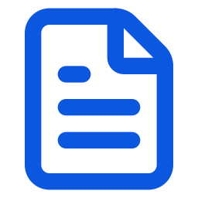








HR&A / Tech & Society Studio
The problem & approach
State programs
Turn fragmented data
into a trusted public
resource.
Agency lists
Texas
Digital Opportunity Hub
Provider websites
Enter your zip code or city
Search
The challenge
Digital opportunity information often lives across agency
lists, provider websites, training directories, and community
program inventories. Categories differ, geographies do not
align, and updates are hard to track.
Community programs
Internet
Options
Devices
Training directories
Digital Skills
Training
Community
Programs
Why this approach
The Texas Digital Opportunity Hub brings those sources
into one shared framework, making it easier to find reliable
information on internet options, devices, digital skills
training, and local support.
Local resources

Slide 3





HR&A / Tech & Society Studio
The data framework
A clear structure reduces data complexity.
The framework organizes the information people actually need: what the resource is, where it applies,
who it serves, how to access it, and when it was last updated.
Resource
The record at the center
Source
Location
Category
Eligibility
Access details
Update status
Where it comes from
Where it applies
What it helps with
Who it is for
How people use it
How it stays current

Slide 4





HR&A / Tech & Society Studio
Built for stewardship
Trusted data, built
to last.
Source
data
Review
& clean
The Hub is not just a front-end experience. It is supported
by a practical data management approach that helps teams
identify the right sources, improve quality, and maintain
information over time.
Aggregate
& organize
Update
& maintain
Texas
Digital Opportunity Hub
Get Connected
Find Resources
About
Identify sources
Aggregate clearly
Map the datasets, directories,
and partner inputs that matter
most.
Bring information from many
places into one understandable
structure.
Review quality
Maintain over time
Check for consistency,
duplicates, gaps, and
outdated records.
Support updates with clear
workflows for stewardship
and refresh.

