Slide 1
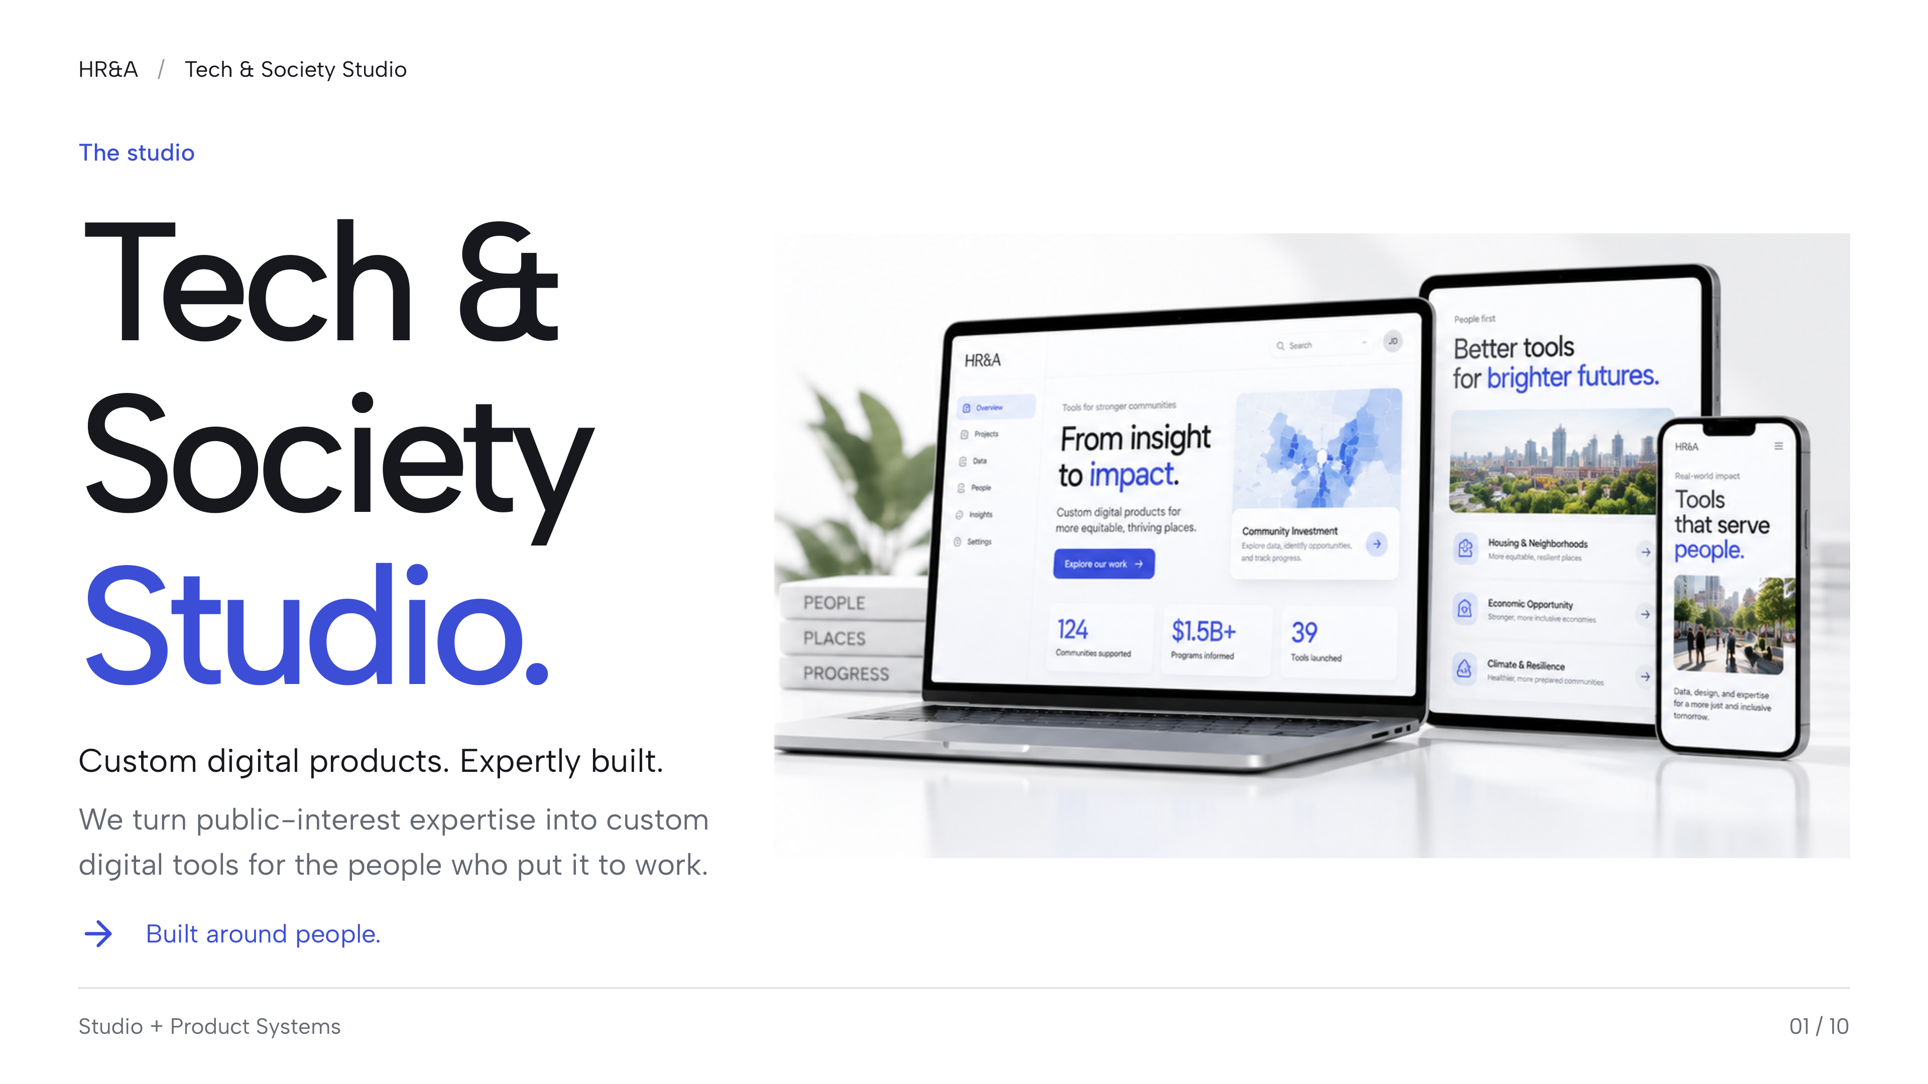
Notes:
Fixed-layout fidelity edition. Slide text, icons, and layout are preserved as a single 4K image to prevent font substitution and reflow. Individual text boxes are not editable. The editable web source and selectable-text PDF remain available separately.
HR&A
Tech & Society Studio
The studio
Tech &
Society
Studio.
Custom digital products. Expertly built.
We turn public-interest expertise into custom
digital tools for the people who put it to work.
Built around people.
Studio + Product Systems
01 / 10
/

Slide 2
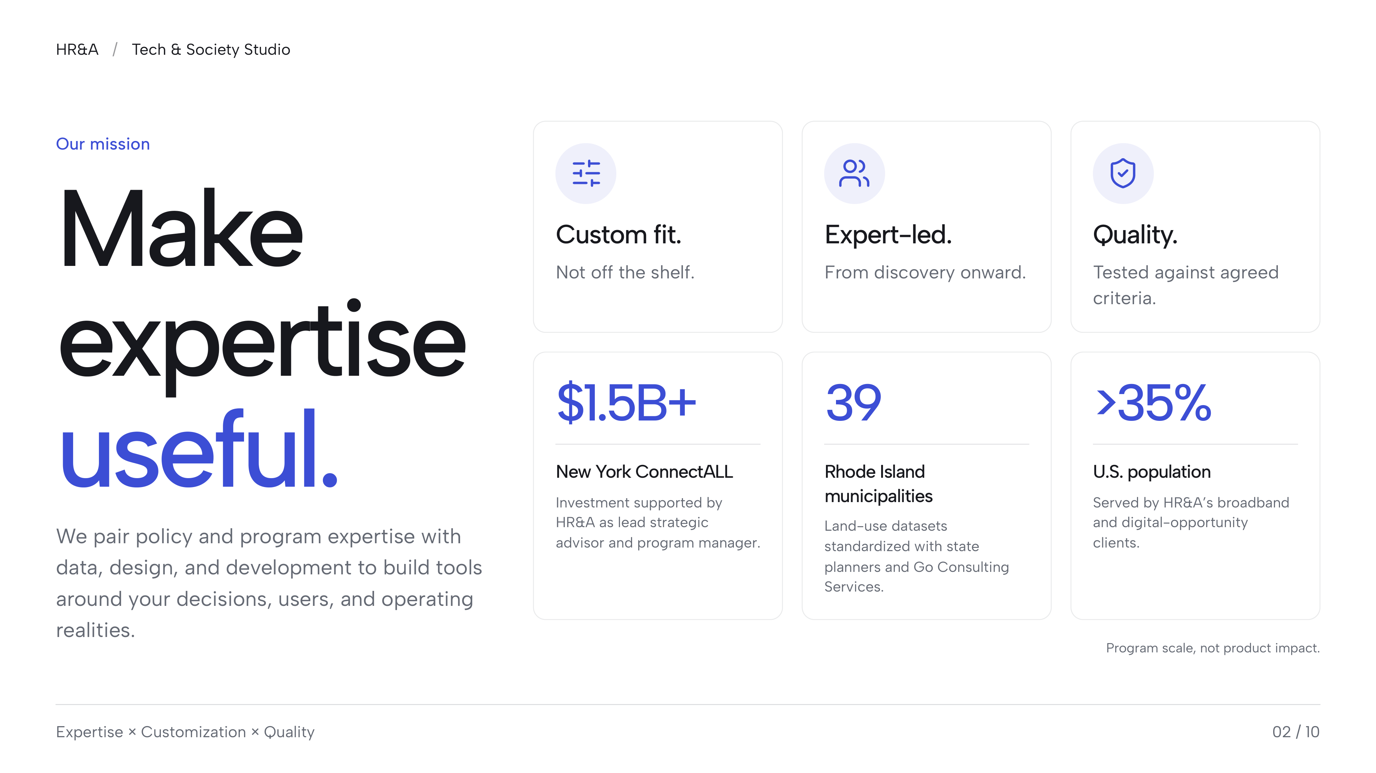
Notes:
Fixed-layout fidelity edition. Slide text, icons, and layout are preserved as a single 4K image to prevent font substitution and reflow. Individual text boxes are not editable. The editable web source and selectable-text PDF remain available separately.
HR&A
Tech & Society Studio
Our mission
Make
expertise
useful.
We pair policy and program expertise with
data, design, and development to build tools
around your decisions, users, and operating
realities.
Custom fit.
Not off the shelf.
Expert-led.
From discovery onward.
Quality.
Tested against agreed
criteria.
$1.5B+
New York ConnectALL
Investment supported by
HR&A as lead strategic
advisor and program manager.
39
Rhode Island
municipalities
Land-use datasets
standardized with state
planners and Go Consulting
Services.
>35%
U.S. population
Served by HR&A’s broadband
and digital-opportunity
clients.
Program scale, not product impact.
Expertise × Customization × Quality
02 / 10
/

Slide 3
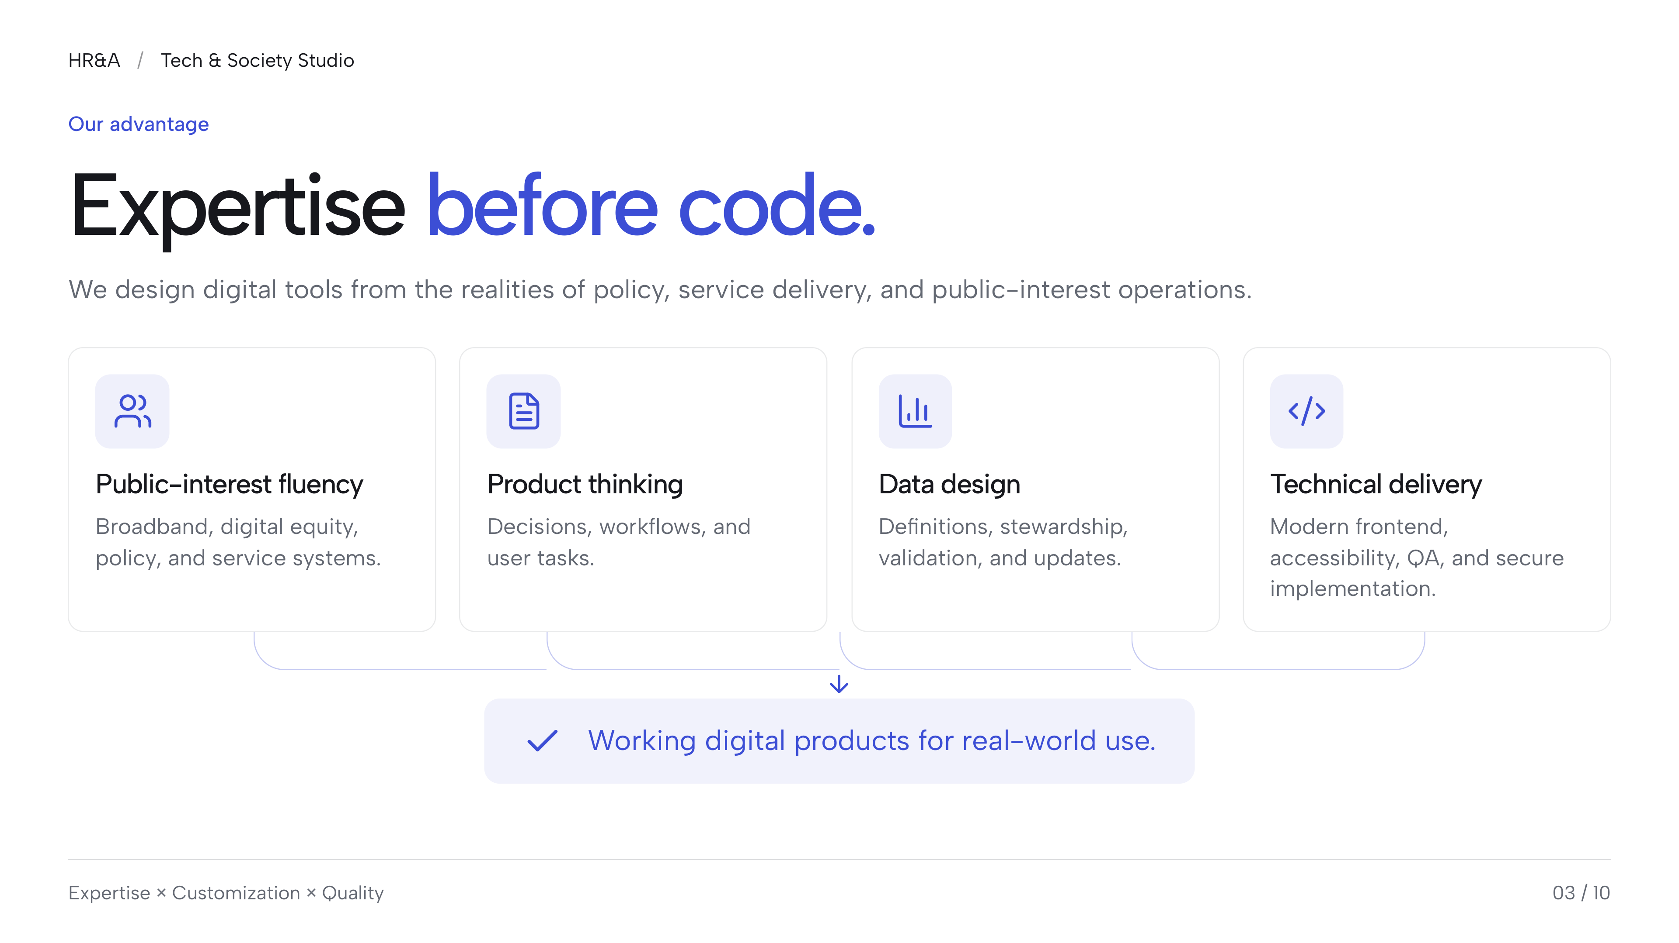
Notes:
Fixed-layout fidelity edition. Slide text, icons, and layout are preserved as a single 4K image to prevent font substitution and reflow. Individual text boxes are not editable. The editable web source and selectable-text PDF remain available separately.
HR&A
Tech & Society Studio
Our advantage
Expertise before code.
We design digital tools from the realities of policy, service delivery, and public-interest operations.
Public-interest fluency
Broadband, digital equity,
policy, and service systems.
Product thinking
Decisions, workflows, and
user tasks.
Data design
Definitions, stewardship,
validation, and updates.
Technical delivery
Modern frontend,
accessibility, QA, and secure
implementation.
Working digital products for real-world use.
Expertise × Customization × Quality
03 / 10
/

Slide 4
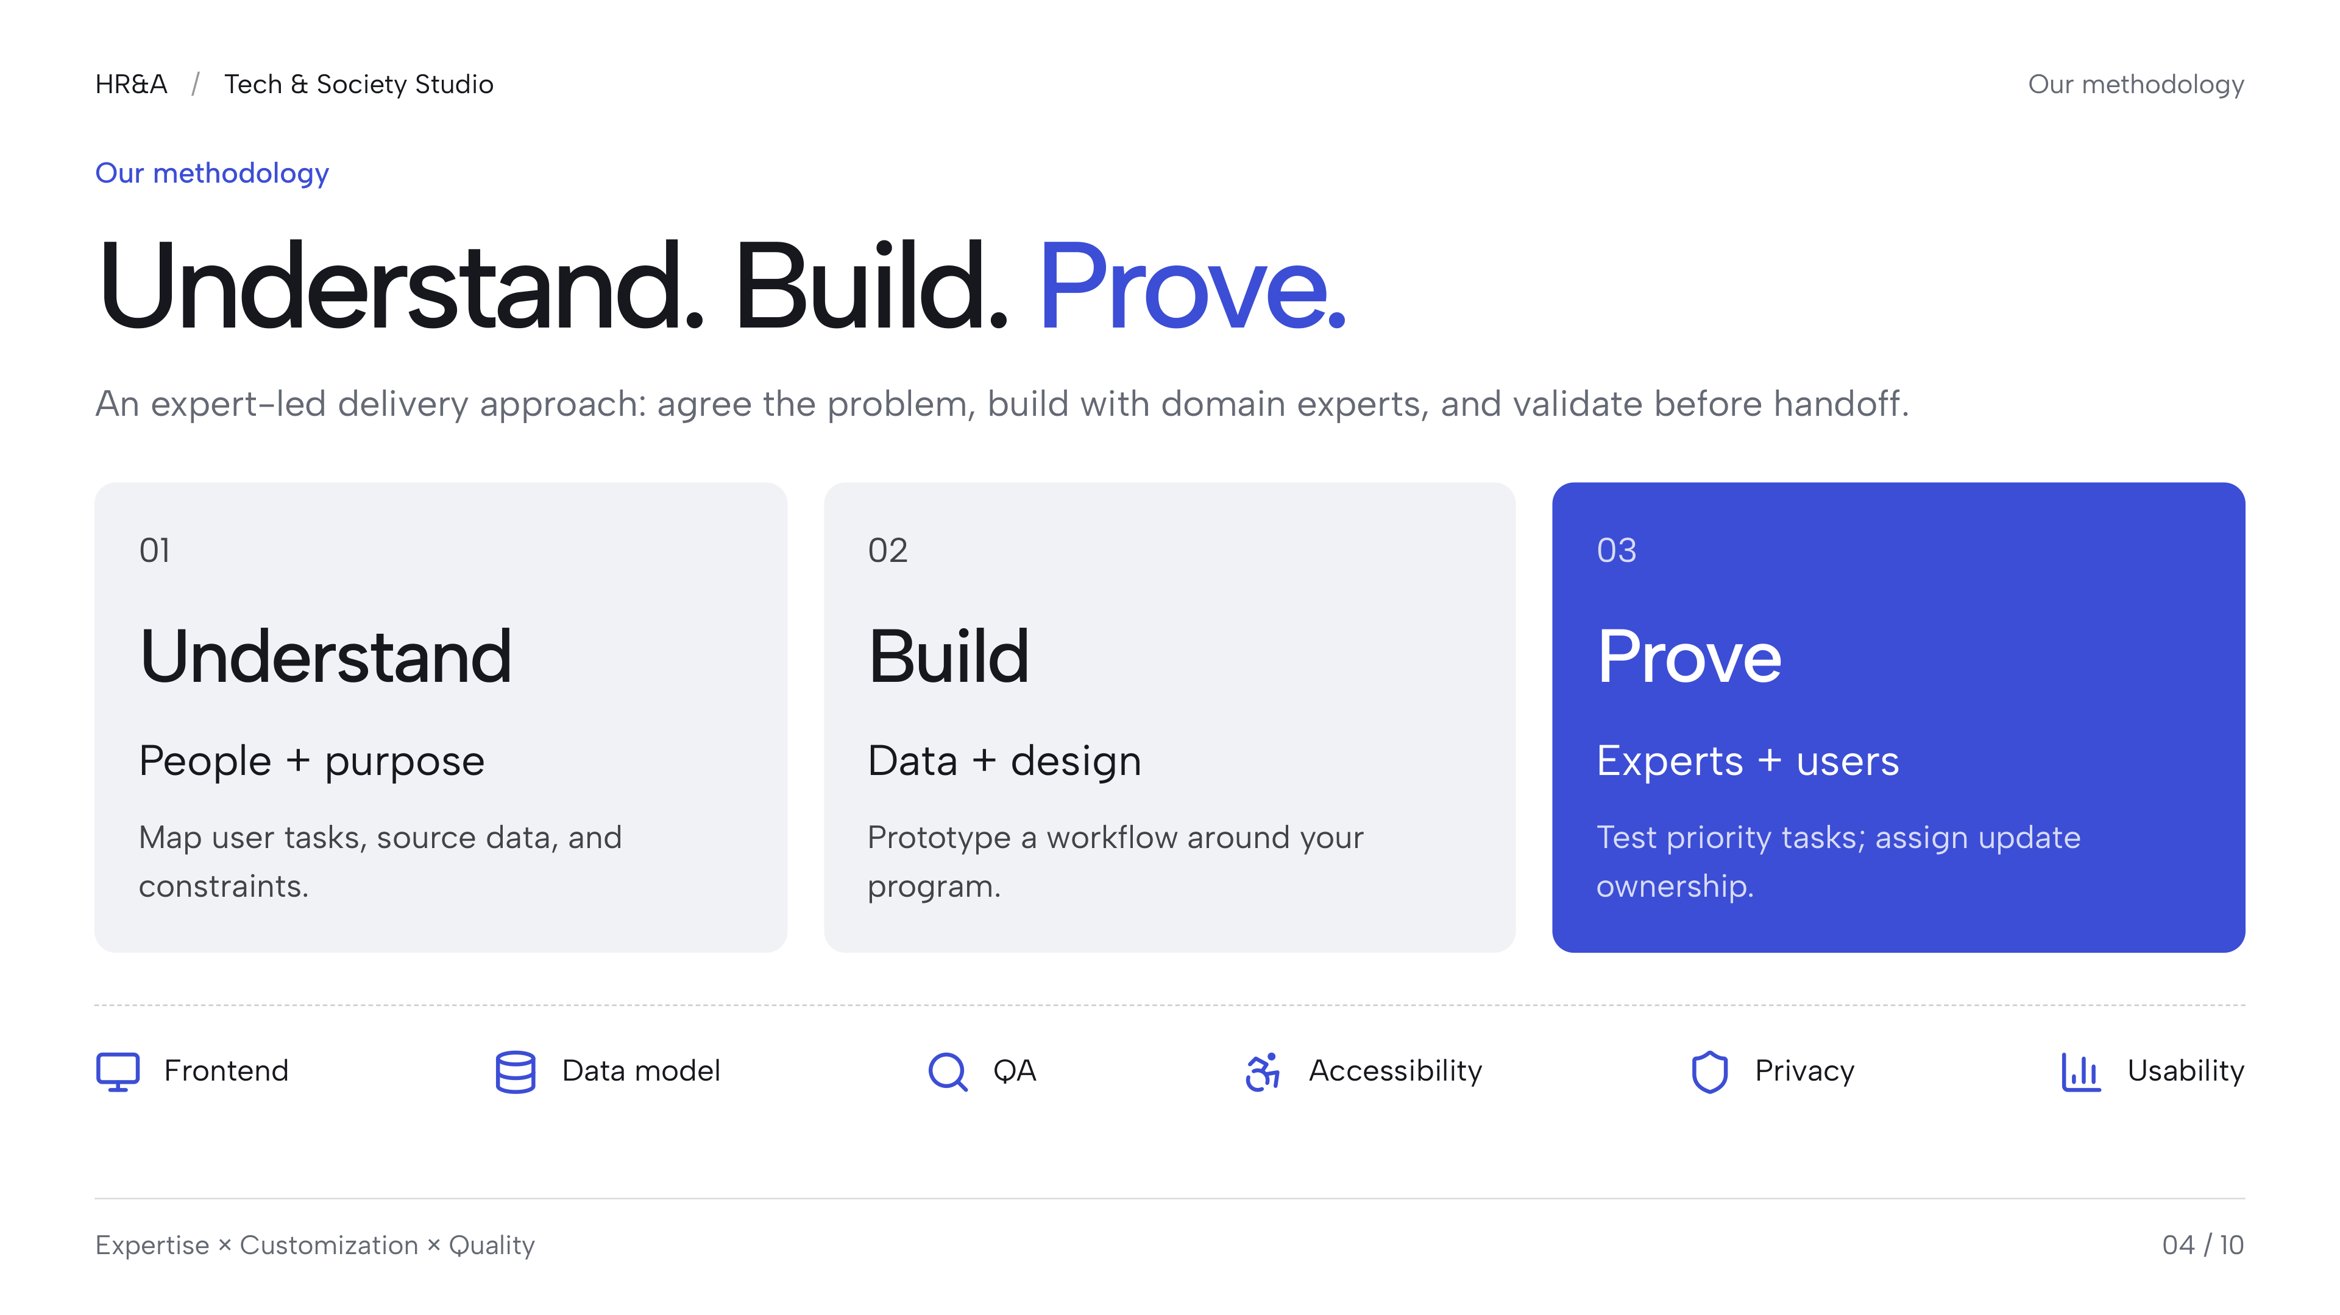
Notes:
Fixed-layout fidelity edition. Slide text, icons, and layout are preserved as a single 4K image to prevent font substitution and reflow. Individual text boxes are not editable. The editable web source and selectable-text PDF remain available separately.
HR&A
Tech & Society Studio
Our methodology
Our methodology
Understand. Build. Prove.
An expert-led delivery approach: agree the problem, build with domain experts, and validate before handoff.
Understand
People + purpose
Build
Data + design
Prove
Experts + users
Frontend
Data model
QA
Accessibility
Privacy
Usability
Expertise × Customization × Quality
04 / 10
/
01
Map user tasks, source data, and
constraints.
02
Prototype a workflow around your
program.
03
Test priority tasks; assign update
ownership.

Slide 5
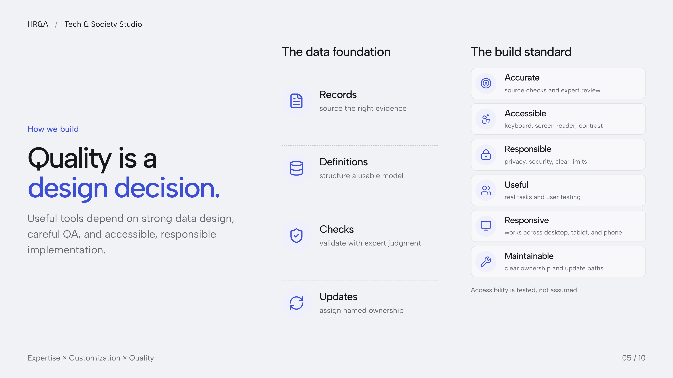
Notes:
Fixed-layout fidelity edition. Slide text, icons, and layout are preserved as a single 4K image to prevent font substitution and reflow. Individual text boxes are not editable. The editable web source and selectable-text PDF remain available separately.
HR&A
Tech & Society Studio
How we build
Quality is a
design decision.
Useful tools depend on strong data design,
careful QA, and accessible, responsible
implementation.
The data foundation
Records
source the right evidence
Definitions
structure a usable model
Checks
validate with expert judgment
Updates
assign named ownership
The build standard
Accurate
source checks and expert review
Accessible
keyboard, screen reader, contrast
Responsible
privacy, security, clear limits
Useful
real tasks and user testing
Responsive
works across desktop, tablet, and phone
Maintainable
clear ownership and update paths
Accessibility is tested, not assumed.
Expertise × Customization × Quality
05 / 10
/

Slide 6
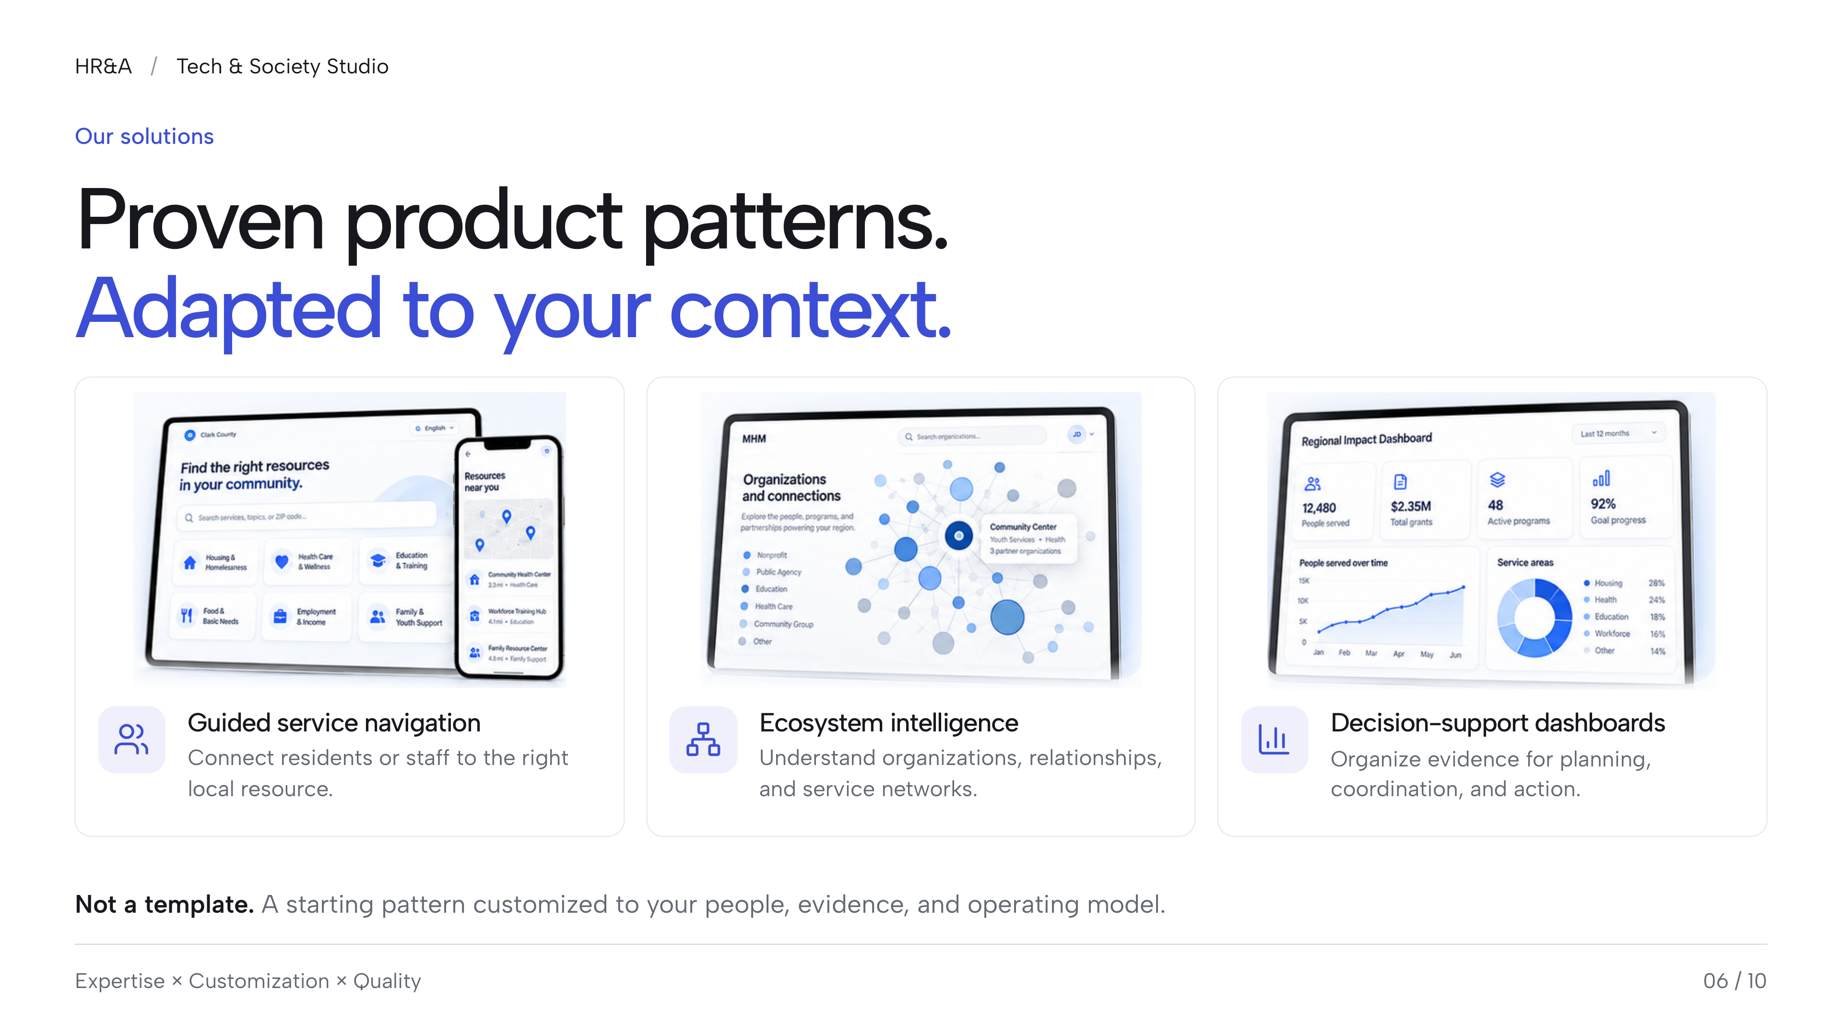
Notes:
Fixed-layout fidelity edition. Slide text, icons, and layout are preserved as a single 4K image to prevent font substitution and reflow. Individual text boxes are not editable. The editable web source and selectable-text PDF remain available separately.
HR&A
Tech & Society Studio
Our solutions
Proven product patterns.
Adapted to your context.
Guided service navigation
Connect residents or staff to the right
local resource.
Ecosystem intelligence
Understand organizations, relationships,
and service networks.
Decision-support dashboards
Organize evidence for planning,
coordination, and action.
Not a template. A starting pattern customized to your people, evidence, and operating model.
Expertise × Customization × Quality
06 / 10
/

Slide 7
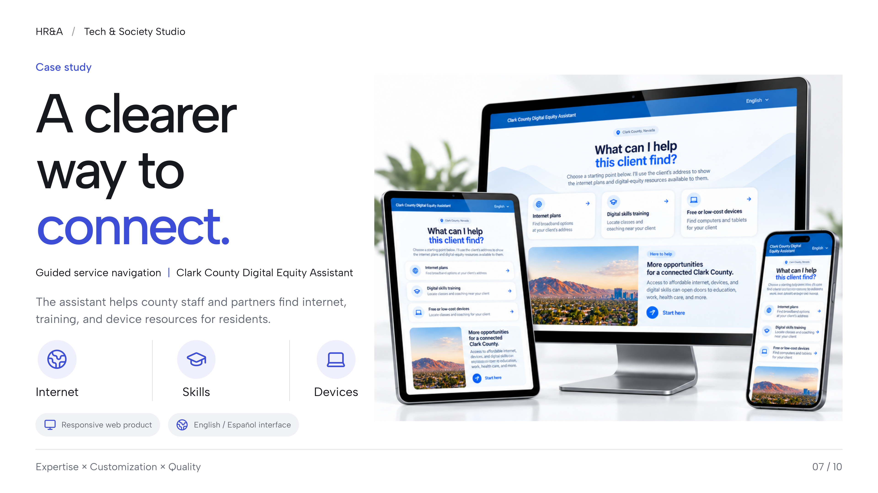
Notes:
Fixed-layout fidelity edition. Slide text, icons, and layout are preserved as a single 4K image to prevent font substitution and reflow. Individual text boxes are not editable. The editable web source and selectable-text PDF remain available separately.
HR&A
Tech & Society Studio
Case study
A clearer
way to
connect.
Guided service navigation | Clark County Digital Equity Assistant
The assistant helps county staff and partners find internet,
training, and device resources for residents.
Internet
Skills
Devices
Responsive web product
English / Español interface
Expertise × Customization × Quality
07 / 10
/

Slide 8
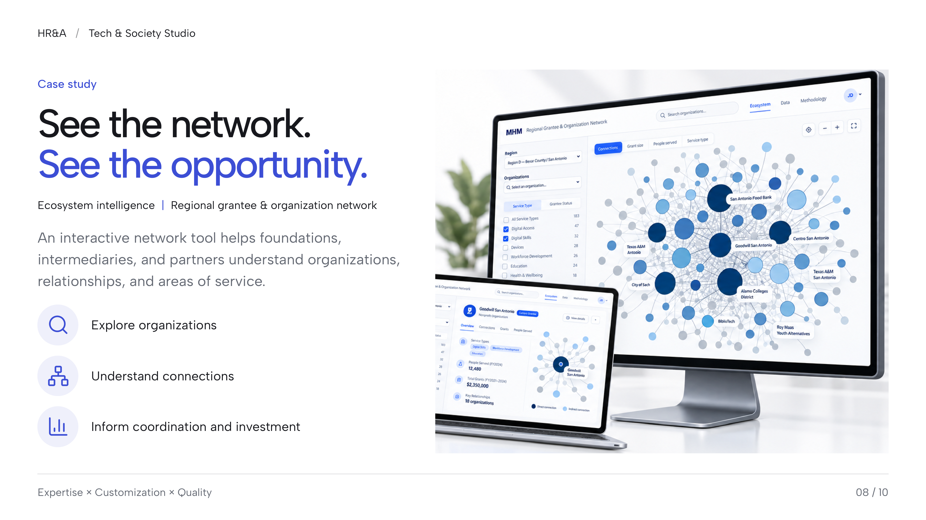
Notes:
Fixed-layout fidelity edition. Slide text, icons, and layout are preserved as a single 4K image to prevent font substitution and reflow. Individual text boxes are not editable. The editable web source and selectable-text PDF remain available separately.
HR&A
Tech & Society Studio
Case study
See the network.
See the opportunity.
Ecosystem intelligence | Regional grantee & organization network
An interactive network tool helps foundations,
intermediaries, and partners understand organizations,
relationships, and areas of service.
Explore organizations
Understand connections
Inform coordination and investment
Expertise × Customization × Quality
08 / 10
/

Slide 9
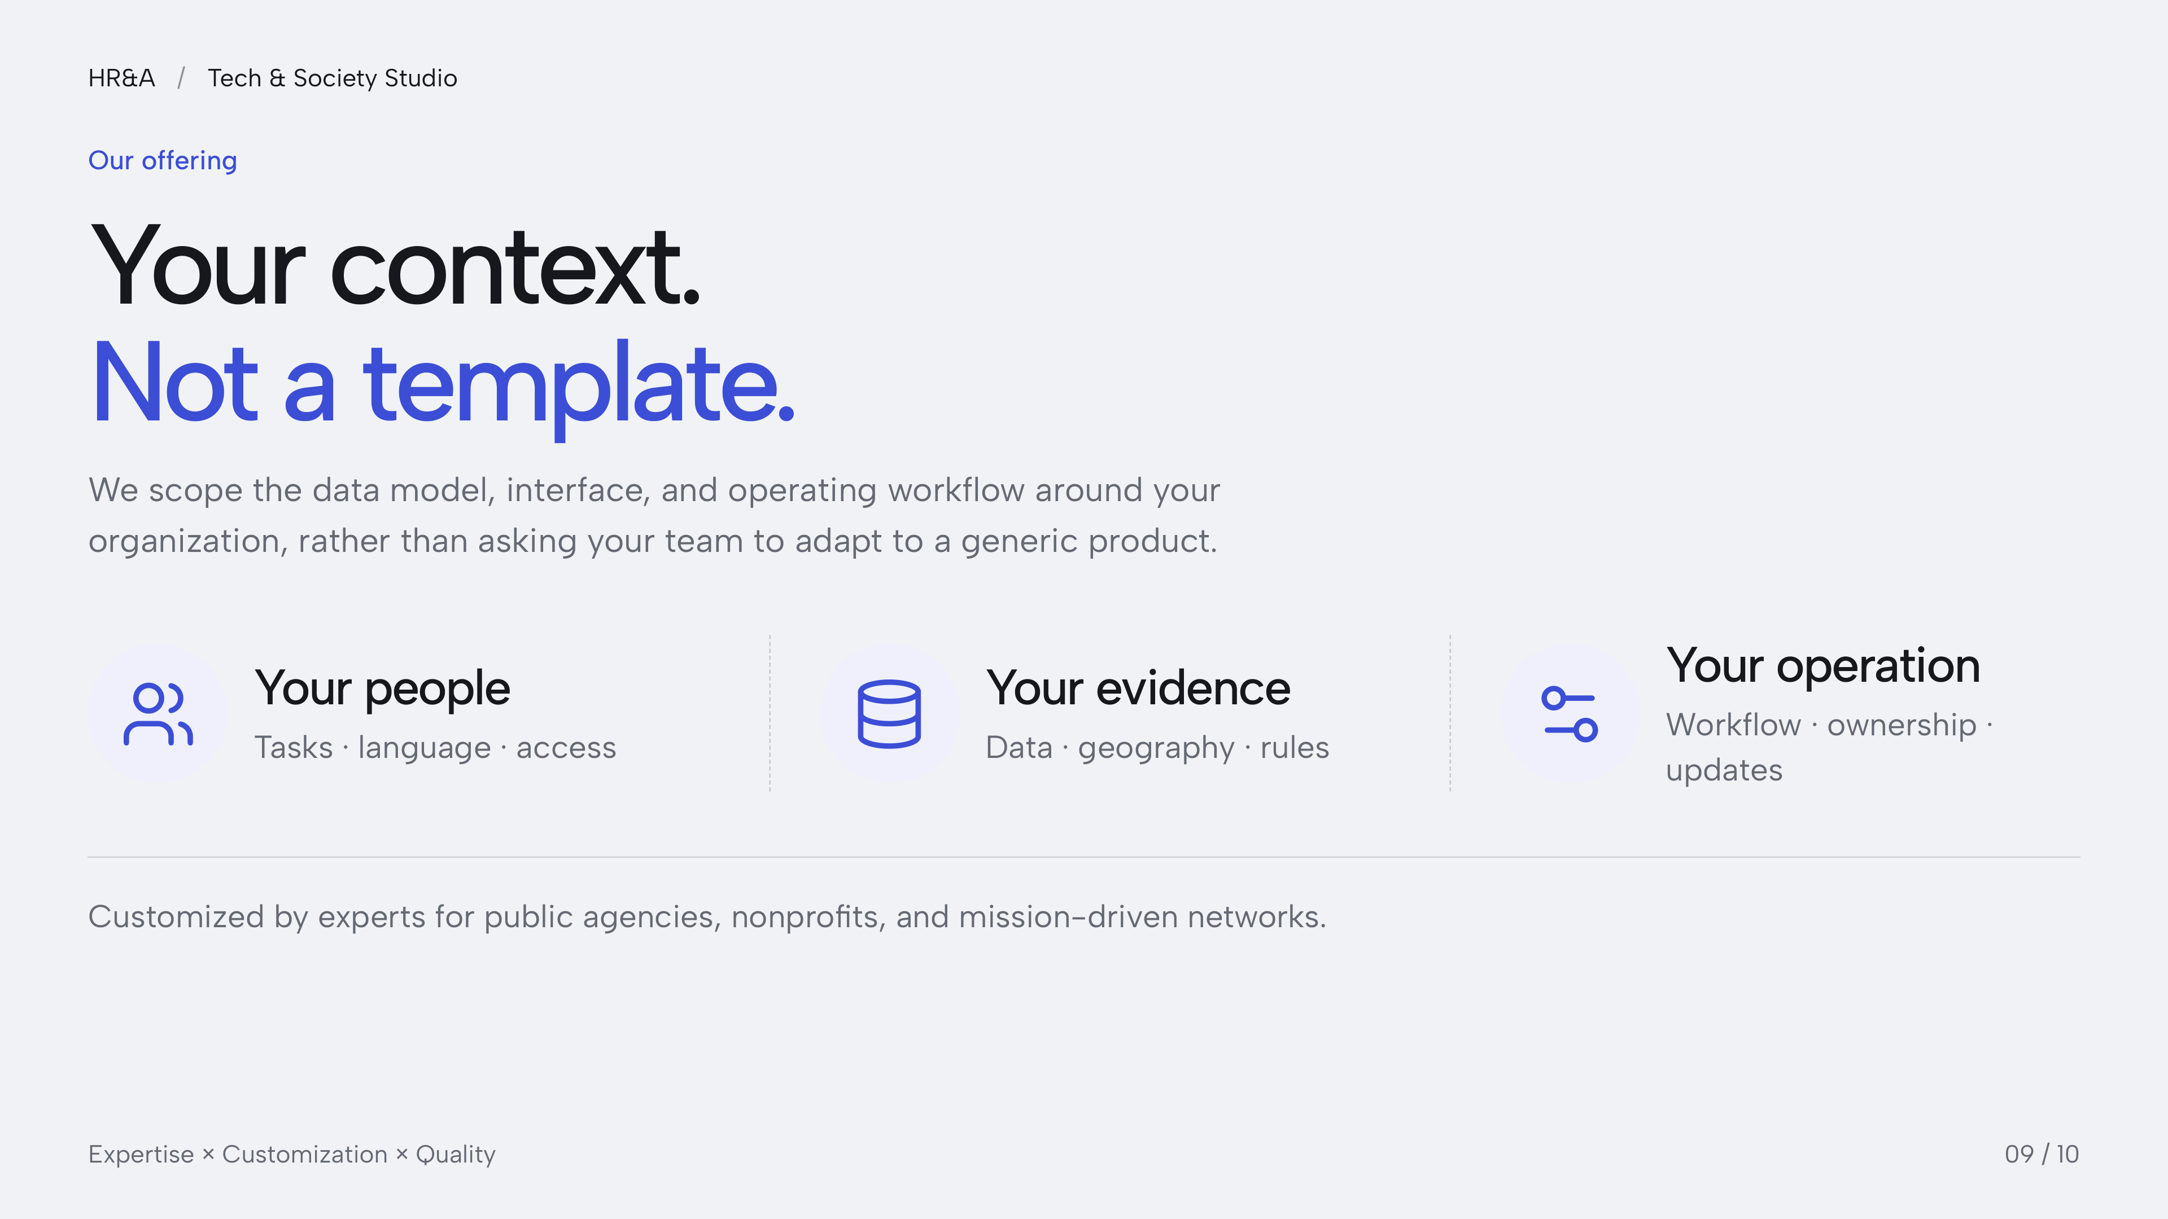
Notes:
Fixed-layout fidelity edition. Slide text, icons, and layout are preserved as a single 4K image to prevent font substitution and reflow. Individual text boxes are not editable. The editable web source and selectable-text PDF remain available separately.
HR&A
Tech & Society Studio
Our offering
Your context.
Not a template.
We scope the data model, interface, and operating workflow around your
organization, rather than asking your team to adapt to a generic product.
Your people
Tasks · language · access
Your evidence
Data · geography · rules
Your operation
Workflow · ownership ·
updates
Customized by experts for public agencies, nonprofits, and mission-driven networks.
Expertise × Customization × Quality
09 / 10
/

Slide 10
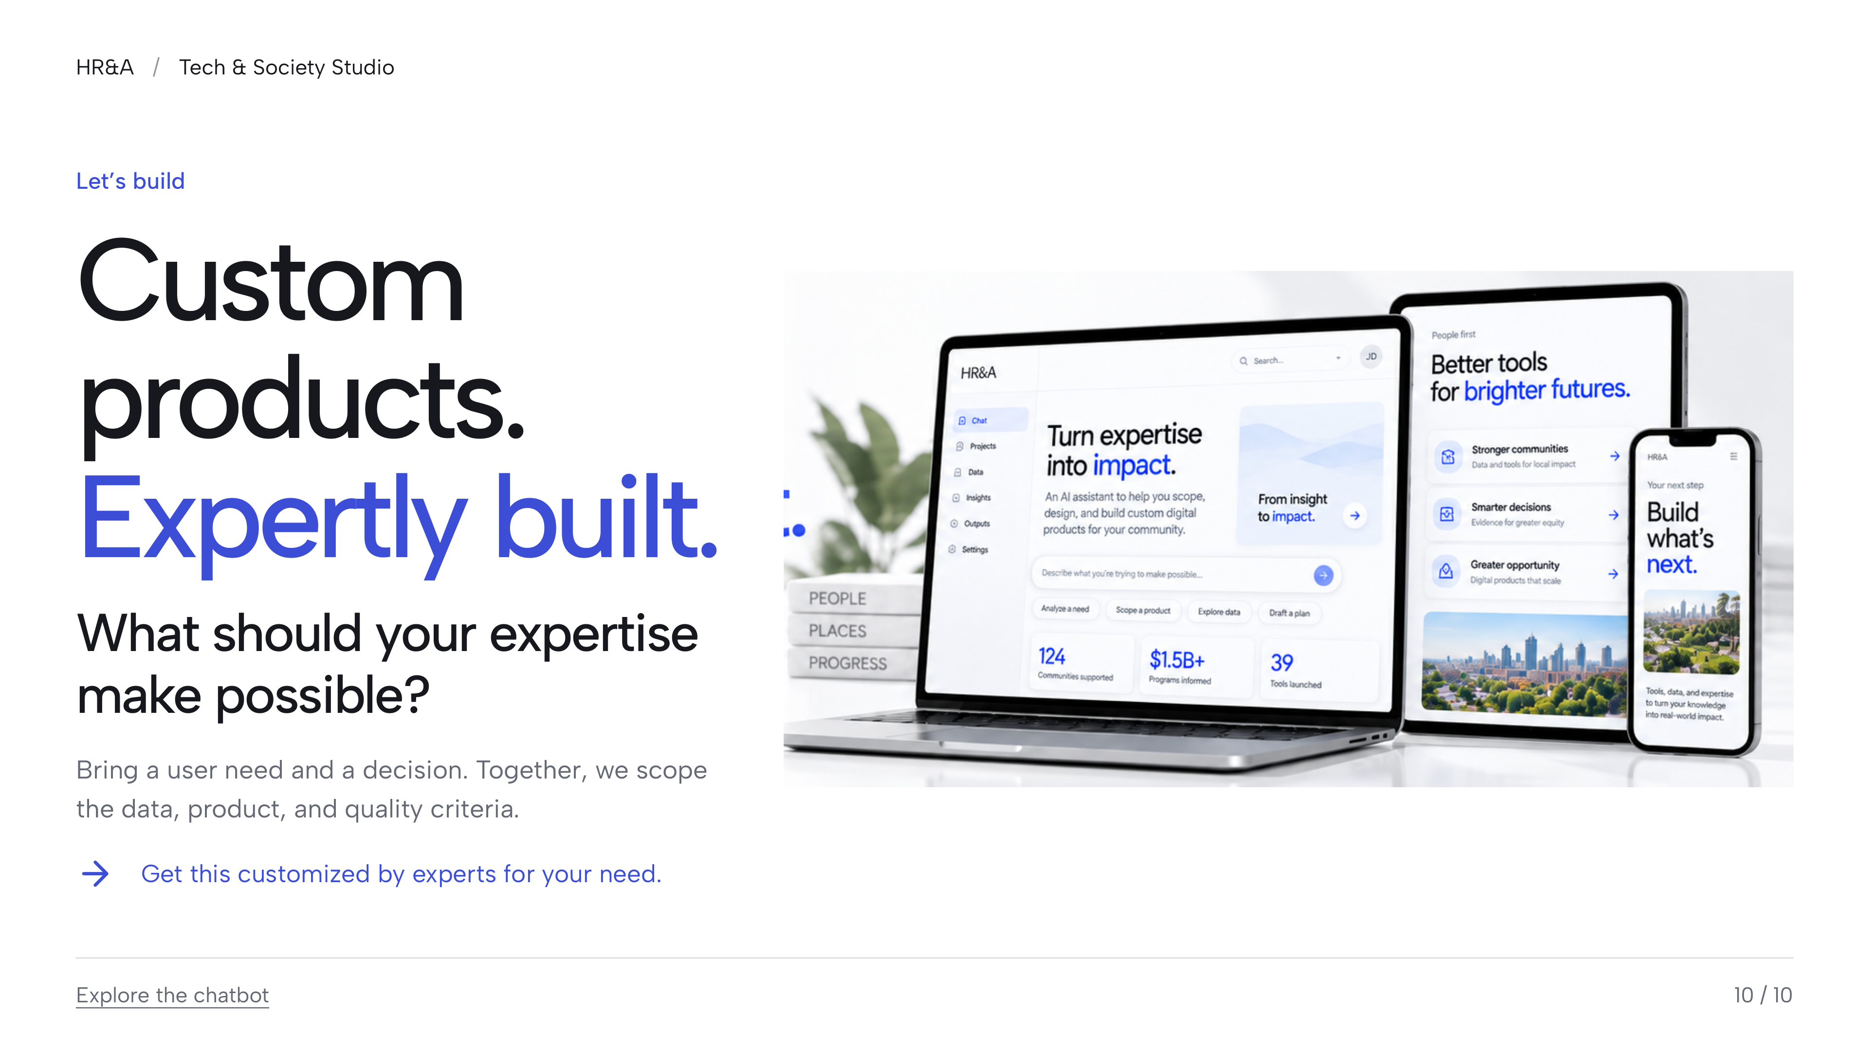
Notes:
Fixed-layout fidelity edition. Slide text, icons, and layout are preserved as a single 4K image to prevent font substitution and reflow. Individual text boxes are not editable. The editable web source and selectable-text PDF remain available separately.
HR&A
Tech & Society Studio
Let’s build
Custom
products.
Expertly built.
What should your expertise
make possible?
Bring a user need and a decision. Together, we scope
the data, product, and quality criteria.
Get this customized by experts for your need.
Explore the chatbot
10 / 10
/

