Slide 1
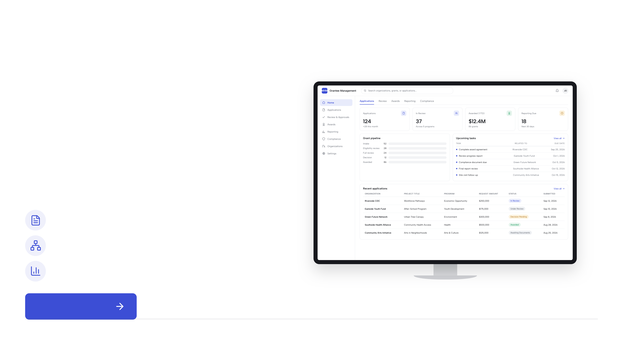
HR&A
/
Tech & Society Studio
Case study 03 · Grantee management
Case study 03 · Grantee management
Grantee
Management
Tech Stack.
A digital operating system for grantmaking teams that
brings application intake, review, awards, compliance,
and reporting into one coordinated workflow.
Centralize grant records
Coordinate review and approvals
Track awards, reporting, and follow-up
See the workflow
Case study 03 · Grantee Management Tech Stack
01 / 3
Notes:
Editable text edition. Headings, body copy, labels, and footers are native PowerPoint text boxes. Original line breaks are retained in separate boxes to preserve the layout. Albert Sans fonts are embedded with the complete character sets for editing. Illustrations, icons, and decorative layout remain in the background artwork; text inside device screenshots is part of those images.
HR&A
Tech & Society Studio
Case study 03 · Grantee management
Case study 03 · Grantee management
Grantee
Management
Tech Stack.
A digital operating system for grantmaking teams that
brings application intake, review, awards, compliance,
and reporting into one coordinated workflow.
Centralize grant records
Coordinate review and approvals
Track awards, reporting, and follow-up
See the workflow
Case study 03 · Grantee Management Tech Stack
01 / 3
/

Slide 2
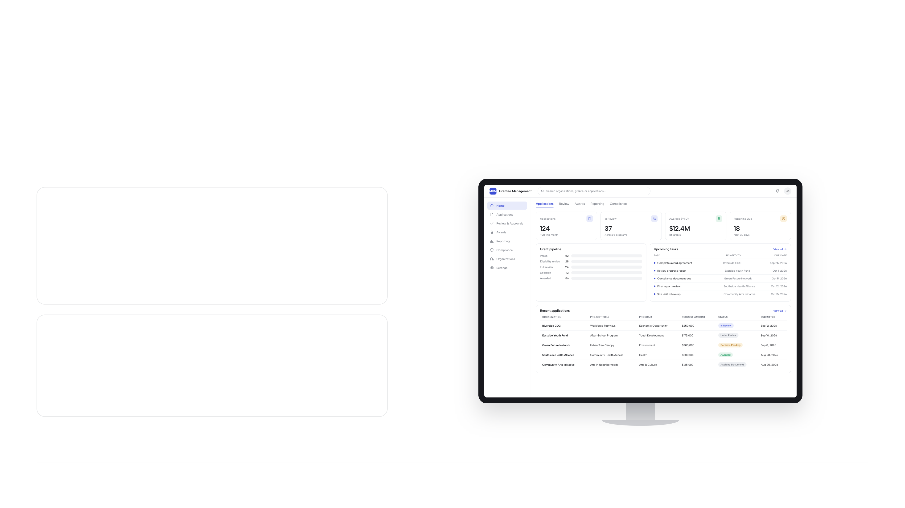
HR&A
/
Tech & Society Studio
Grantee management · Why this solution
The problem & approach
Manage the grant lifecycle,
not just the handoffs.
The problem
Grantmaking teams often work across disconnected
applications, spreadsheets, email threads, and reporting files.
That makes reviews slower, ownership less clear, and follow-up
harder to manage.
Why this solution
A shared tech stack connects intake, review, awards,
compliance, and reporting in one place, so staff can coordinate
decisions and keep grantee information current.
Proposed operating model. Illustrative interface with sample data, not a deployed grantee-management system.
Case study 03 · Grantee Management Tech Stack
02 / 3
Notes:
Editable text edition. Headings, body copy, labels, and footers are native PowerPoint text boxes. Original line breaks are retained in separate boxes to preserve the layout. Albert Sans fonts are embedded with the complete character sets for editing. Illustrations, icons, and decorative layout remain in the background artwork; text inside device screenshots is part of those images.
HR&A
Tech & Society Studio
Grantee management · Why this solution
The problem & approach
Manage the grant lifecycle,
not just the handoffs.
The problem
Grantmaking teams often work across disconnected
applications, spreadsheets, email threads, and reporting files.
That makes reviews slower, ownership less clear, and follow-up
harder to manage.
Why this solution
A shared tech stack connects intake, review, awards,
compliance, and reporting in one place, so staff can coordinate
decisions and keep grantee information current.
Proposed operating model. Illustrative interface with sample data, not a deployed grantee-management system.
Case study 03 · Grantee Management Tech Stack
02 / 3
/

Slide 3
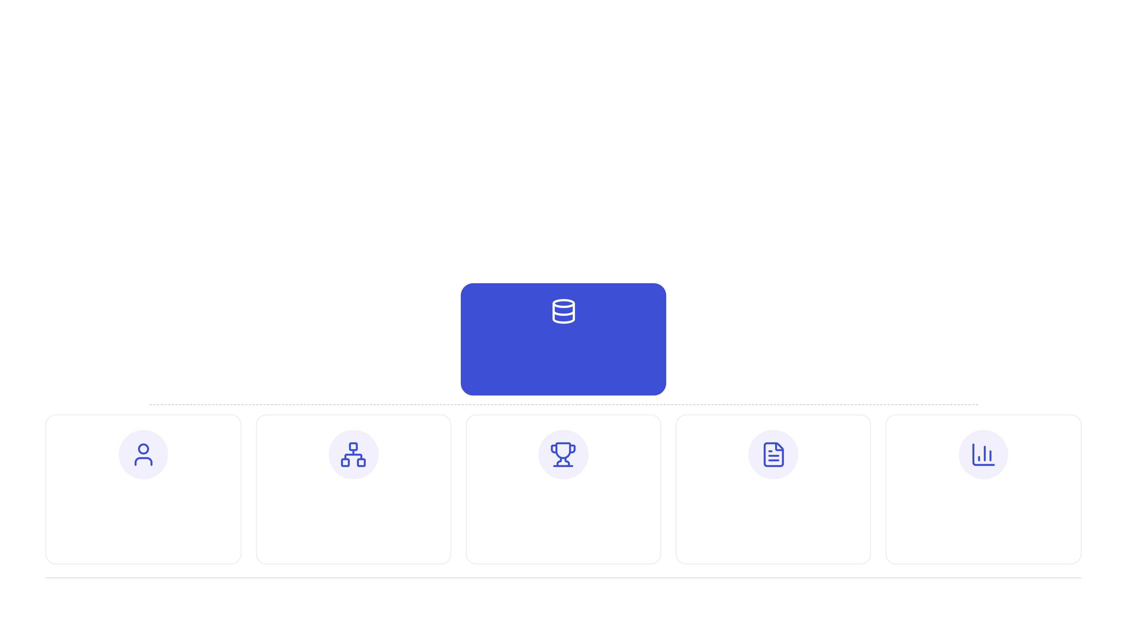
HR&A
/
Tech & Society Studio
Grantee management · Operating model
The operating model
The tech stack connects
applications to decisions and follow-through.
The system links the applicant record, the grant record, reviewer activity, award requirements, and reporting so teams can
move from intake to closeout with context.
Grant
The record at the center
Applicant
Review
Award
Requirements
Reporting
Who is applying
Scores + comments
Amount + terms
Deadlines + compliance
Progress + outcomes
One relational record ties the workflow together, from intake through award, compliance, and closeout.
Case study 03 · Grantee Management Tech Stack
03 / 3
Notes:
Editable text edition. Headings, body copy, labels, and footers are native PowerPoint text boxes. Original line breaks are retained in separate boxes to preserve the layout. Albert Sans fonts are embedded with the complete character sets for editing. Illustrations, icons, and decorative layout remain in the background artwork; text inside device screenshots is part of those images.
HR&A
Tech & Society Studio
Grantee management · Operating model
The operating model
The tech stack connects
applications to decisions and follow-through.
The system links the applicant record, the grant record, reviewer activity, award requirements, and reporting so teams can
move from intake to closeout with context.
Grant
One relational record ties the workflow together, from intake through award, compliance, and closeout.
Case study 03 · Grantee Management Tech Stack
03 / 3
/
The record at the center
Applicant
Who is applying
Review
Scores + comments
Award
Amount + terms
Requirements
Deadlines + compliance
Reporting
Progress + outcomes

