Slide 1
Object Oriented Programming
MAS Foundations Course WS-19
Hochschule Bonn-Rhein-Sieg
Lokesh Veeramacheneni

Slide 2
Outline
Object Oriented Programming
Principles of Object Oriented Programming
Inheritance
Polymorphism
Abstraction
Encapsulation
Hochsule Bonn-Rhein-Sieg Object Oriented Programming – Lokesh

Slide 3
Why Object Oriented Programming?
Real world Modelling can be done with ease.
Entities in real world has attributes and behaviours of their own.
Restricted Access to data can be achieved.
It makes the code modular and easy to maintain.
Hochsule Bonn-Rhein-Sieg Object Oriented Programming – Lokesh

Slide 4
Object Oriented Programming
Basic parts of Object Oriented Programming includes:
Class: It defines the template of object, i.e. What type of data must it store and typically consists of what each function does. It consists of Instance members and functions.
Object: It is the instance of class. They store the data when the program is executed.
Hochsule Bonn-Rhein-Sieg Object Oriented Programming – Lokesh

Slide 5
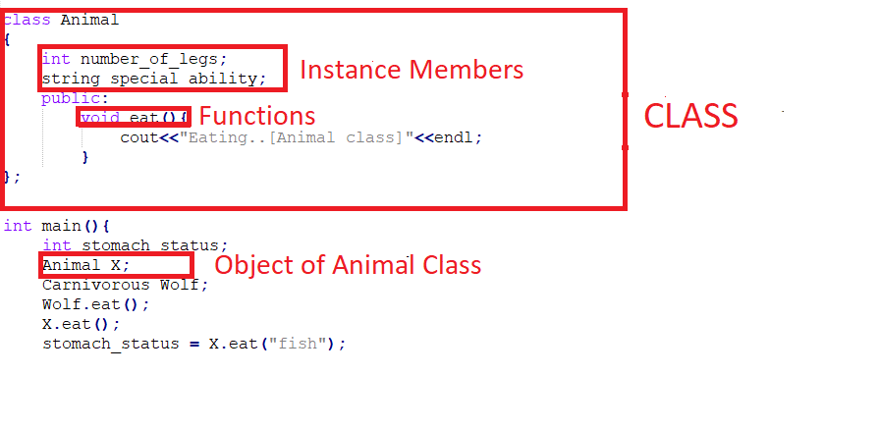
Example:
Hochsule Bonn-Rhein-Sieg Object Oriented Programming – Lokesh

Slide 6
Principles of Object Oriented Programming:
There are four major principles of Object Oriented Programming (OOP).
Inheritance
Polymorphism
Abstraction
Encapsulation
Hochsule Bonn-Rhein-Sieg Object Oriented Programming – Lokesh

Slide 7
Inheritance
Inheritance is the process where one object acquires the properties(public and protected) of all its parent class object.
Why Inheritance:
Inheritance helps in code reusability i.e. the parent class members can be used in child class without declaring them in child class once again.
Types of Inheritance:
Single Inheritance
Multiple Inheritance
Multi-level Inheritance
Hierarchical Inheritance
Hybrid Inheritance
Hochsule Bonn-Rhein-Sieg Object Oriented Programming – Lokesh

Slide 8
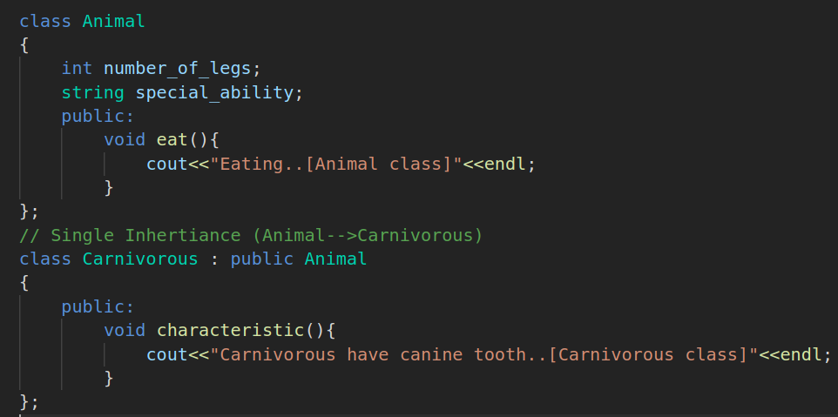
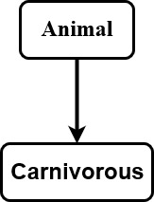
Single Inheritance:
Hochsule Bonn-Rhein-Sieg Object Oriented Programming – Lokesh

Slide 9
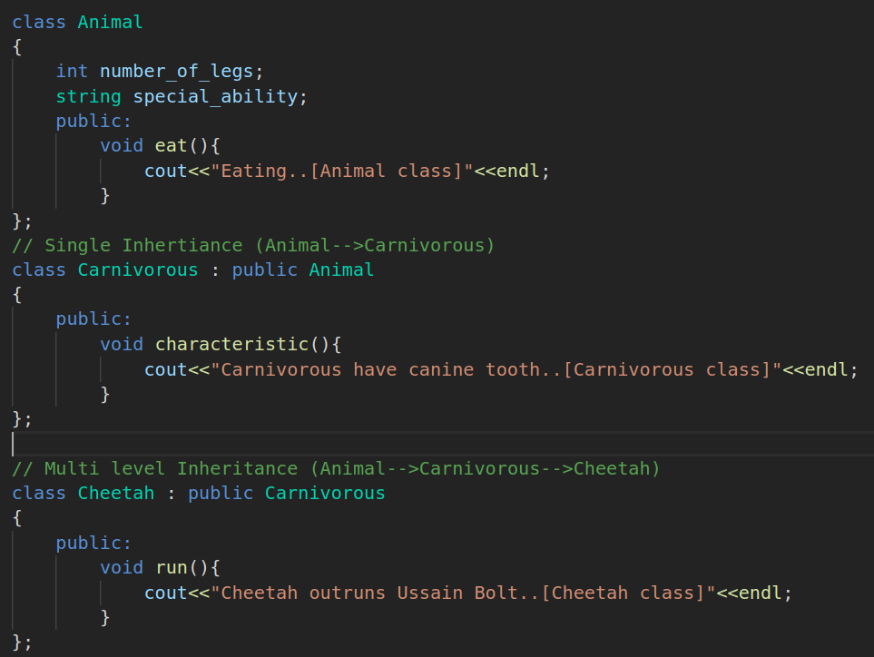
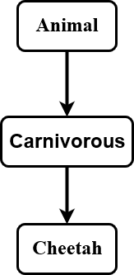
Multi-level Inheritance:
Hochsule Bonn-Rhein-Sieg Object Oriented Programming – Lokesh

Slide 10
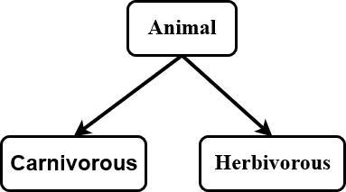
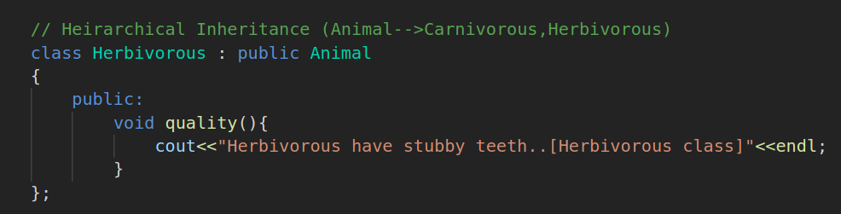
Hierarchical Inheritance:
Hochsule Bonn-Rhein-Sieg Object Oriented Programming – Lokesh

Slide 11
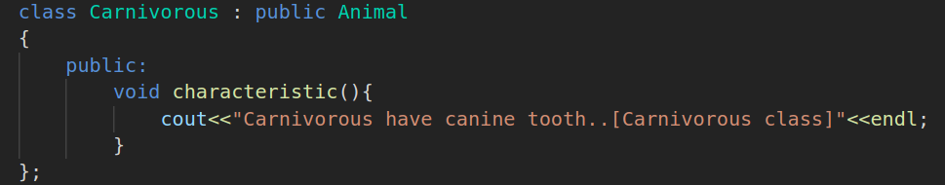
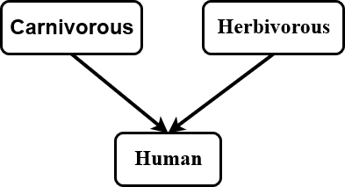
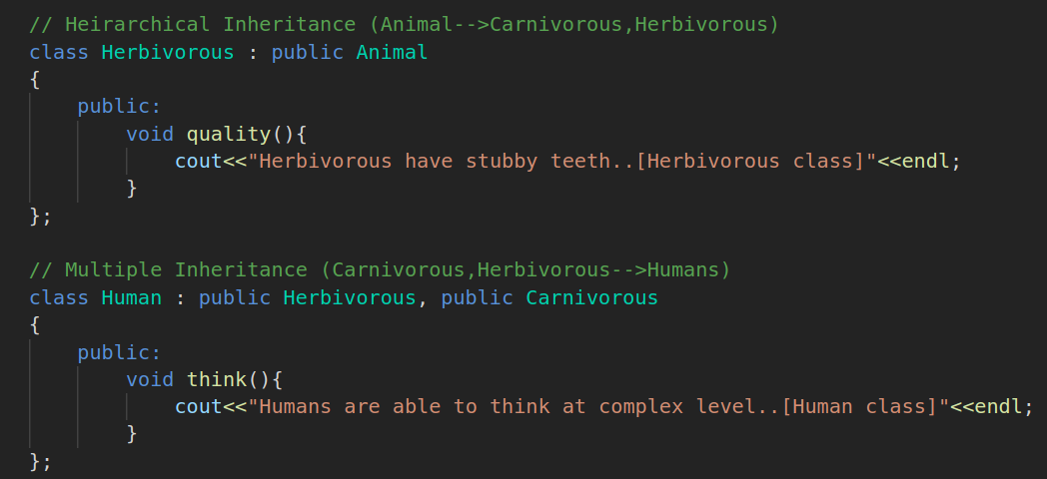
Multiple Inheritance:
Hochsule Bonn-Rhein-Sieg Object Oriented Programming – Lokesh

Slide 12
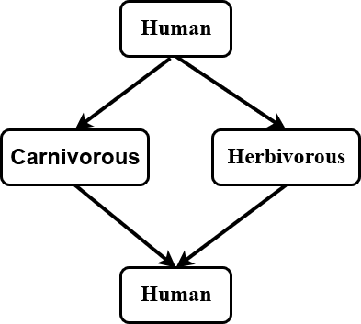
Hybrid Inheritance:
Hochsule Bonn-Rhein-Sieg Object Oriented Programming – Lokesh

Slide 13
Polymorphism
Informally, polymorphism is one in many forms. For Example, A function can have different behaviours with same function name.
There are two kinds of polymorphism:
Static Polymorphism
Dynamic Polymorphism
Static Polymorphism is achieved by Function Overloading. Function overloading is having the same function in same class with different function signatures.
Dynamic Polymorphism is achieved by Function Overriding. Function overriding is having the same function and function signature in both parent and child classes.
Hochsule Bonn-Rhein-Sieg Object Oriented Programming – Lokesh

Slide 14
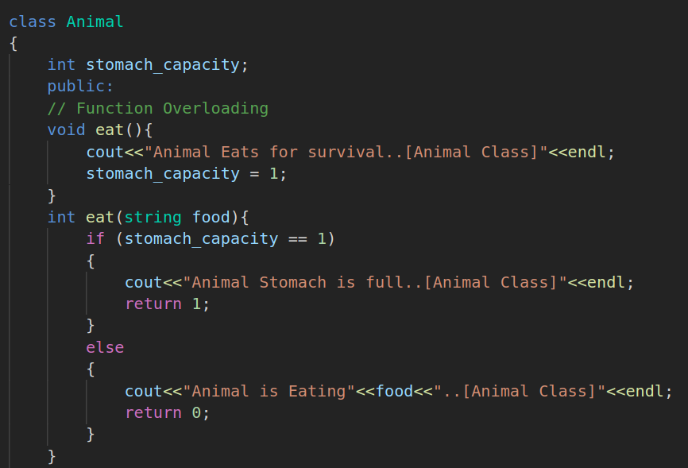
Static Polymorphism:
In this example, the Animal class has two functions eat which are differed by their function signature where one function has no arguments and no return type.
The other eat function accepts a String argument and returns an integer value.
Hochsule Bonn-Rhein-Sieg Object Oriented Programming – Lokesh

Slide 15
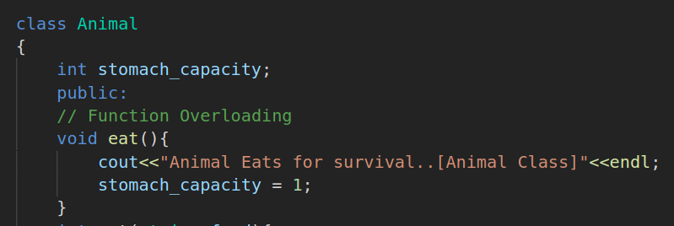
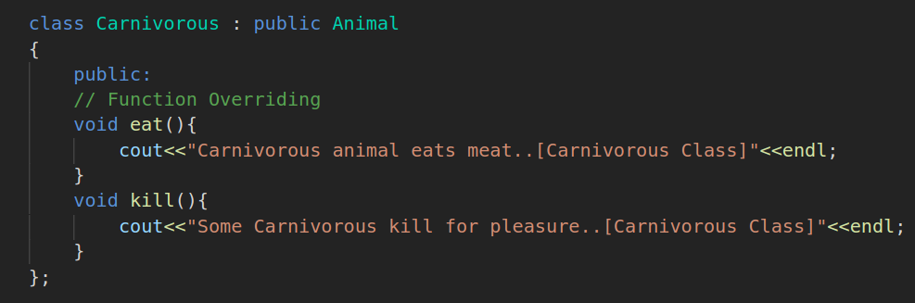
Dynamic Polymorphism:
There exists two eat functions one in Animal and other in its child class.
Both the methods have same function signature but they behave according to the object which called it.
Hochsule Bonn-Rhein-Sieg Object Oriented Programming – Lokesh

Slide 16
Virtual Functions:
Virtual Functions can also be used for achieving Dynamic Polymorphism.
Why Virtual Functions are needed?
Virtual Functions are used for late binding that is implementation of the method is determined by the compiler at the runtime where as in previous implementation the method which must be called is decided at compile time (early binding).
Hochsule Bonn-Rhein-Sieg Object Oriented Programming – Lokesh

Slide 17
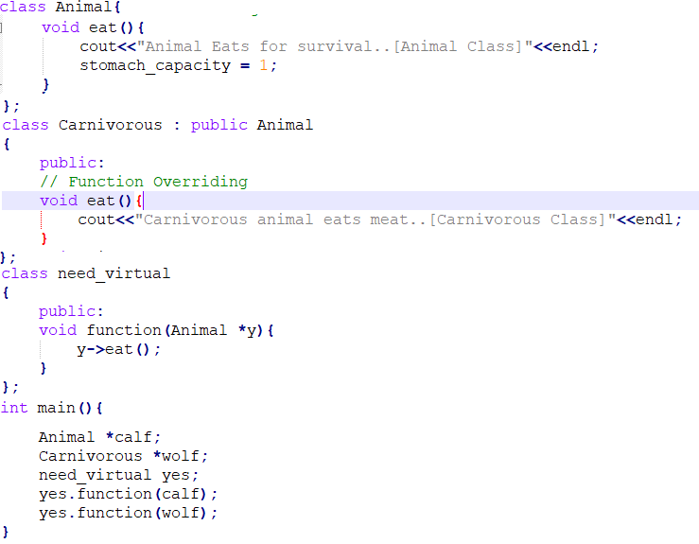
Need for Virtual Functions:
In this kind of implementation when the Animal object pointer and Carnivorous object pointer is sent as argument.
When this function in need_virtual class is called the result is the execution of eat function in Animal class.
Hochsule Bonn-Rhein-Sieg Object Oriented Programming – Lokesh

Slide 18
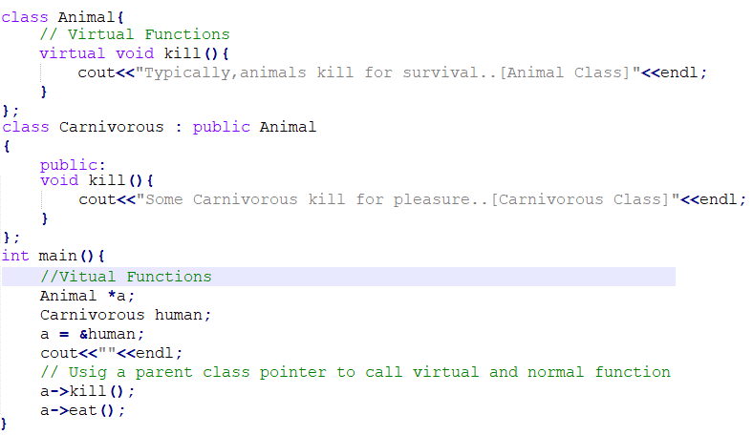
Implementation:
Object Oriented Programming – Lokesh

Slide 19
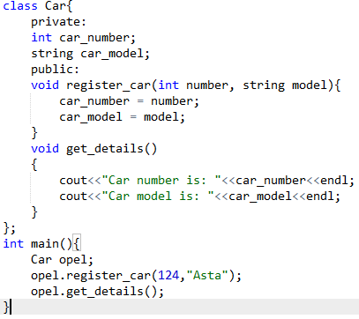
Abstraction
Abstraction is hiding the details and showing necessary details to the end-user.
Abstraction helps in code reusability and also provide some level security since implementation to end-user is unknown.
In the side example the car number and car model are not accessible directly the user can only register a car and get details.
Hochsule Bonn-Rhein-Sieg Object Oriented Programming – Lokesh

Slide 20
References:
C++ Tutorial - javatpoint
Programming: Principles and Practice using C++ - Bjarne Stroustrup
Hochsule Bonn-Rhein-Sieg Object Oriented Programming – Lokesh

