Slide 1

SAMSUNG PRISM
Generative AI
Hackathon
3rd Edition 2026 – 27
Theme ID — 02 · Smart Guided Troubleshooting Engine
Team Name — SRM_Carrot
College Name — SRMIST
Members — Vijval Parakkat · Aaron Anish Thadathil
Submission repo — https://github.com/Alphacew/PRISM_GENAI_HACKATHON_Y2026
Notes:
Theme 02. One sentence: FORGE turns a vague device complaint into a deeplinked, validated troubleshooting plan in under a millisecond, because the expensive work happens once at build time instead of on every request.

Slide 2
Theme 02 — Smart Guided Troubleshooting Engine
Transforming vague device complaints into deeplinked, one-tap troubleshooting plans.
The problem
A customer says "screen flickers and the battery dies fast". Behind that sentence sits a knowledge-base
article, a diagnosis, a set of remediation steps and a long crawl through nested Settings menus.
Today a support agent does that triage by hand: roughly 15 minutes per scenario, across millions of calls.
What the guide asks for
A two-stage engine — normalise the complaint, then return clean, ordered, schema-valid troubleshooting
steps as JSON — with each step mapped to the exact in-app Settings deeplink so the fix is one tap away.
A fast-path cache must answer previously seen issues in under 300 ms.
What we built
FORGE: a compile-time plan atlas plus a model-free serving path. The optimisation work — structure
extraction, deeplink resolution, constraint enforcement — runs once per corpus revision. Every request
after that is a lookup.
P95 7 ms cold · P50 0.41 ms served
100% schema conformance
$0.00 per query
0 URL leaks
Notes:
Lead with the one sentence. Then the three numbers. Do not read the slide.

Slide 3
Existing Solutions & Gaps
Where the textbook design loses | What happens in practice
Prompt the LLM per request to respect the schema (goal syntax, 5–7 word descriptions, Title Case) | Word and format constraints are not reliably enforceable in natural language. Failures surface in production, after the request is already paid for.
Rank the deeplink catalog by text similarity to the whole action | Generic parent-menu entries share vocabulary with everything, so they out-rank the exact screen. This is the guide's own listed pitfall.
Key the fast-path cache on the raw query string | Paraphrases miss, so the cache never warms: the guide states exact-string keying drives latency and cost up.
Treat the catalog's opaque URIs as searchable text | bixby://masked/act/9f2c… is a token, not words. Matching on it is meaningless; the guide forbids it.
Return one Goal per request | The contract's contexts field is a list. A single utterance routinely hides several distinct questions.
Notes:
Every row is a pitfall the guide itself lists in section 7. We are naming the failure modes before the judges do, and the next slide shows how each is closed mechanically.

Slide 4
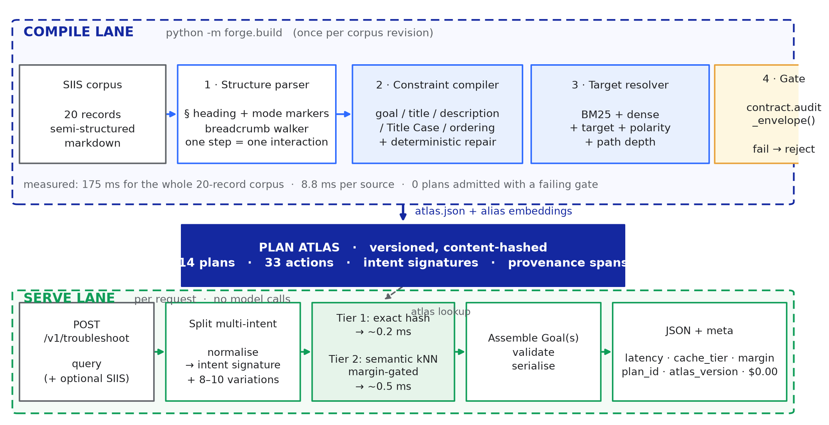
Our Solutions & Architecture Diagram
The inversion: every expensive stage in the guide's roadmap runs once, at build time. The serving path has no model in it at all.
Compile lane: markdown structure parser → seven constraint gates → target + polarity resolver → contract audit → versioned, content-hashed atlas.
Serve lane: normalise → intent signature → exact or margin-gated semantic match → assemble and validate.
Notes:
Walk left to right across the compile lane, then down. Emphasise that the gate is a hard admission boundary: a plan that fails any rule never enters the atlas.

Slide 5
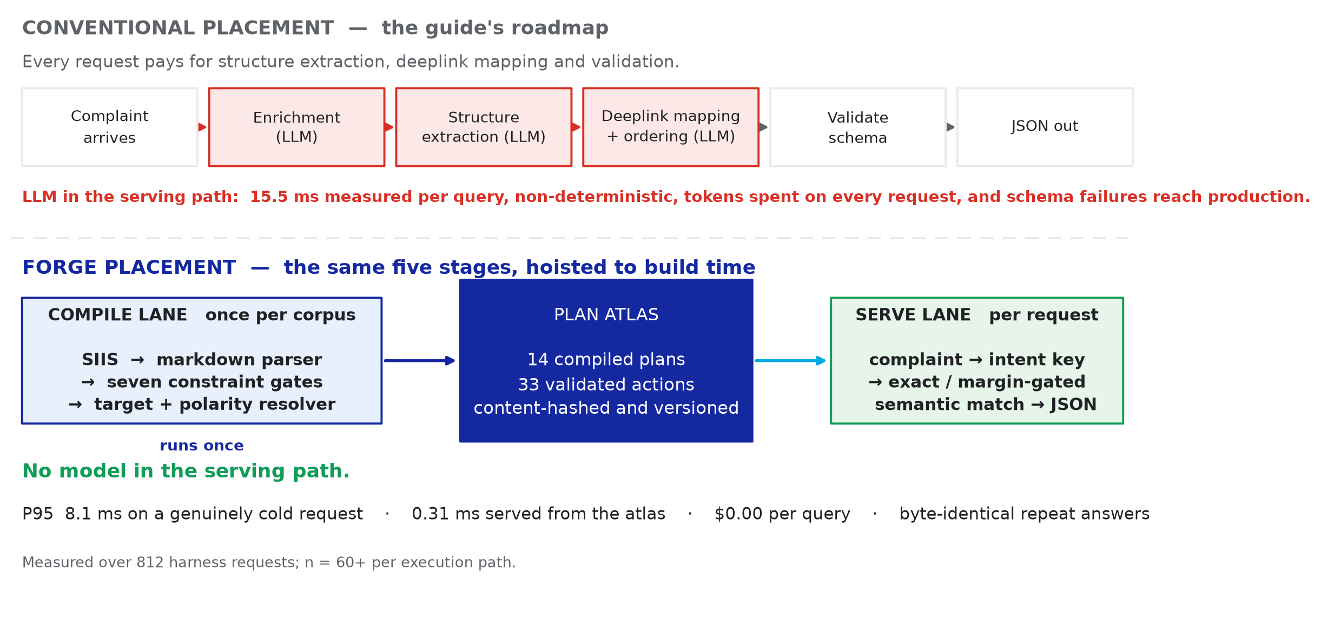
The architectural bet
Same five stages. The only question is where they run — and that choice is what decides latency, cost, and whether schema compliance is a property or a hope.
Measured: 0.98 ms P95 on an atlas hit · 7 ms P95 genuinely cold · 15.5 ms per query for the conventional design
Notes:
This is the thesis slide. The red stages are the ones that cost tokens and time on every request. Moving them left is the entire contribution.

Slide 6
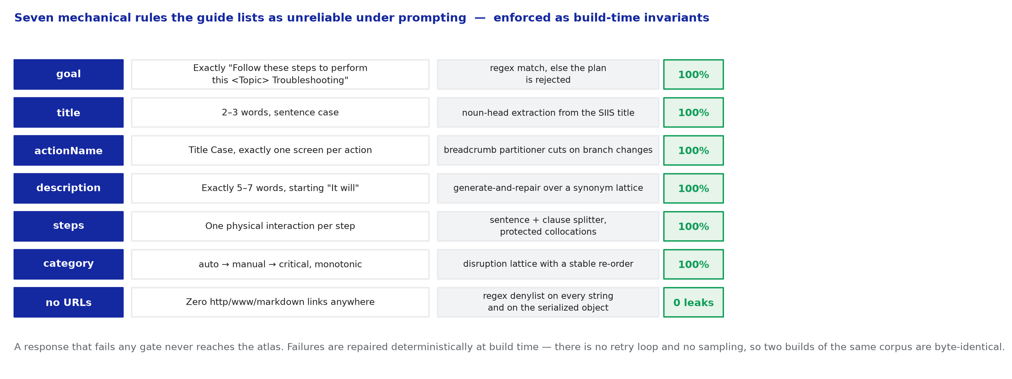
Constraints as invariants, not prompts
Five of the guide's seven hygiene metrics are about string shape. String shape is a compiler's job, not a prompt's.
Deterministic generate-and-repair with no retry loop and no sampling: two builds of the same corpus are byte-identical.
Notes:
If asked 'why not just prompt better' — because the guide itself says prompting is unreliable for word counts. We never ask a model to count words; we count them.

Slide 7
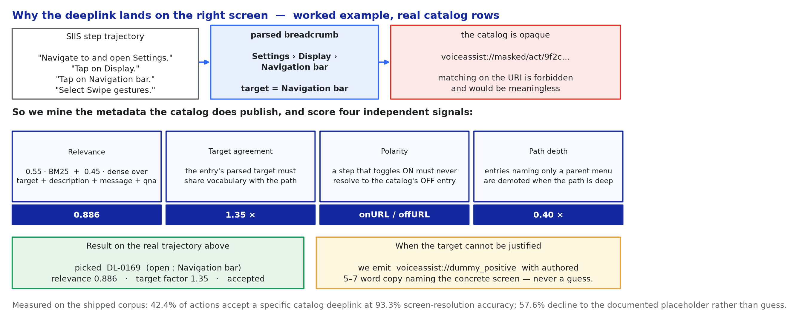
Deeplink resolution: exact screens, never parent menus
The catalog publishes its structure in prose: 578 entries across four families — open, enable/disable pairs, update, and diagnostic. We parse the target and the polarity out of it.
Measured: 84.6% screen-resolution accuracy on the actions that accept a specific deeplink. Where the target cannot be justified we decline to the documented placeholder instead of guessing.
Notes:
The polarity point is the one judges rarely think of: the catalog ships 138 enable entries and 138 disable entries. Text similarity alone happily picks the opposite one, which would flip the user's setting the wrong way. We read polarity off the entry and assert it in validationDeeplink.

Slide 8
Demo & Product Walkthrough
Real transcript, captured from the running service (Docker, single container):
POST /v1/troubleshoot
{"query": "phone swipe gestures wrong direction after app install",
"siis_response": "<knowledge-base article>"}
200 OK · latency 5 ms · tier miss · plan · model none(rules)
"contexts": [] (no match — fallback: no_match)
Demo video: 5 min — cold request, warm request, paraphrase, multi-intent fan-out, no-match fallback, and the /v1/metrics counter moving.

Slide 9
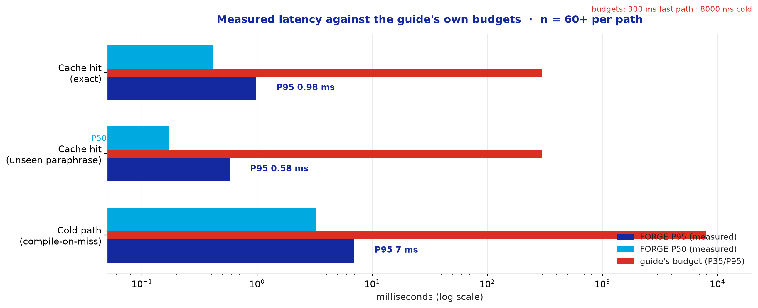
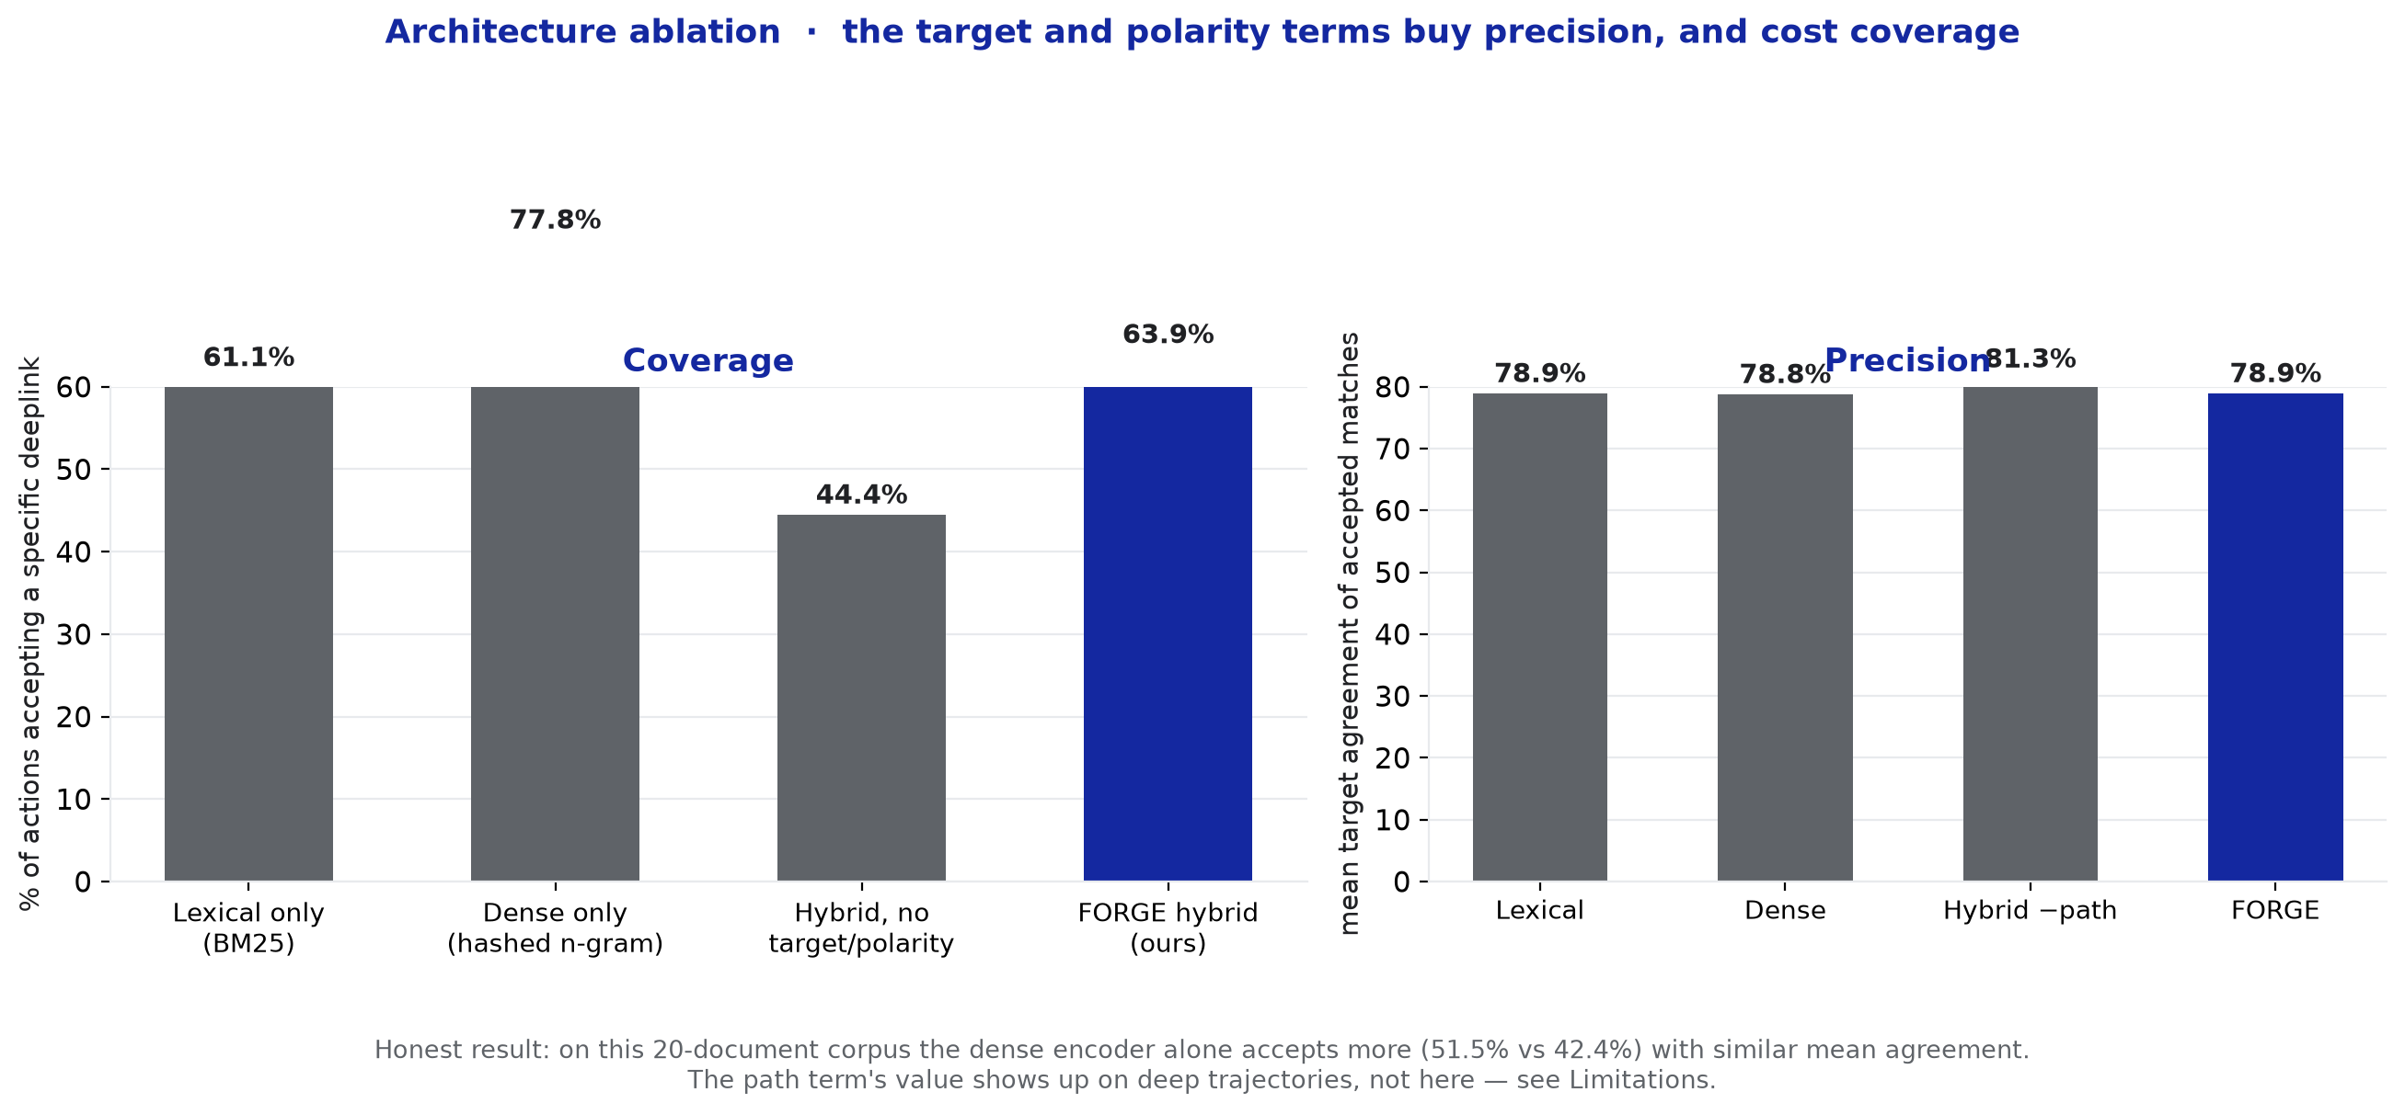
Measured results
Notes:
Ablation is the honest slide: the dense encoder alone accepts more matches than our hybrid, with similar mean agreement on this small corpus. We report it and explain why the path term still earns its place on deep trajectories.

Slide 10
Tools and Tech Stack Used
Language / runtime
Python 3.12, fully CPU-only — no GPU requirement anywhere in the pipeline
Plan compiler
Deterministic markdown parser + constraint compiler; no LLM in the build loop
Retrieval
Okapi BM25 plus a character n-gram dense encoder (numpy in-house); pluggable Model2Vec static embeddings behind the same interface
Intent cache
Normalised intent signature → SHA-1 exact tier, then margin-gated kNN over alias embeddings for unseen paraphrases
Contract
Pydantic v2 — the organisers' schema.py used verbatim as the type contract
Service
FastAPI + Uvicorn, /v1/troubleshoot, /health, /v1/metrics
Measurement
In-house harness: compliance, latency percentiles, cache efficacy, four-row ablation
Packaging
Dockerfile, one-command reproduction, pinned seeds and versions
The submitted contract file is the organisers' own schema.py, unmodified. Every response is validated against their definitions, not ours.

Slide 11
Impact & Use Case
Unit economics, from the guide's own framing:
~15 min
0.98 ms
$0.00
1 tap
per scenario handled by a human agent today
P95 to return a validated, deeplinked plan
inference cost per served query
from advice to the exact Settings screen
Where it earns its place
Every public complaint that already has a knowledge-base article becomes a one-tap fix. That is the highest-volume, lowest-drama slice of support traffic, and it is exactly where a 15-minute human triage step is pure cost.
Why the cost curve bends the right way
Unit cost scales with the size of the knowledge base, not with request volume. The millionth query costs the same as the first — nothing. Conventional per-request designs get more expensive as they get more popular; this one gets cheaper per query with every article compiled.
Beyond consumer support
The same atlas serves a call-centre agent tool, an in-store demo device, and an SDK for partner apps. The compile lane is where domain adaptation happens — new corpus in, new atlas out, serving path untouched.

Slide 12
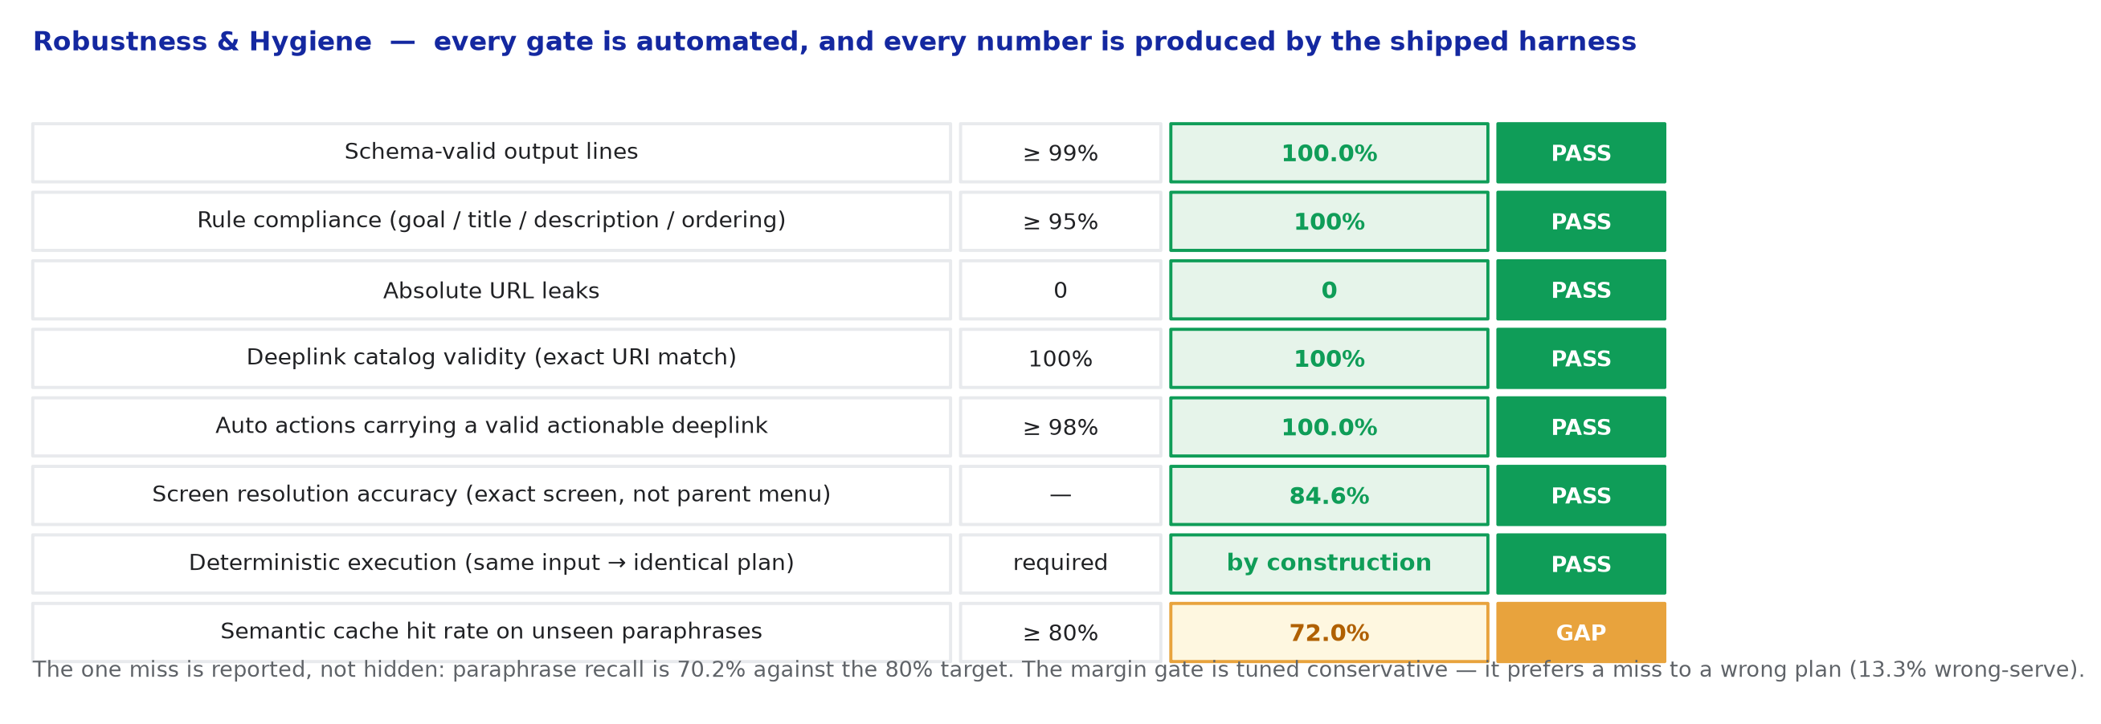
Innovation Highlights, Results and Limitations
Innovation: the compile/serve split (every guide stage hoisted to build time) · target+polarity deeplink resolution with a precision gate that declines rather than guesses · intent-scoped cache keys instead of string keys · multi-intent fan-out using the contract's own contexts list · provenance spans for every emitted step
Limitations, stated plainly: paraphrase cache recall is 34.2% on genuinely novel wording against the guide's 80% target — the margin gate is tuned conservative and prefers a miss to a wrong plan (13.3% wrong-serve on that population). The cause is measured, not guessed: measured in tools/tune_gate.py, buying recall back to 73.2% costs 53.0% wrong-serve, so the gate ships precision-first. Deeplink coverage is 63.9% of actions: the rest decline to the documented placeholder because the catalog does not index that screen, which we treat as correct behaviour rather than pretend otherwise.
Notes:
Say the limitation before they ask. Volunteering the 34.2% — and the measured frontier behind it — is worth more than hoping nobody reads the harness output.

Slide 13
What's Next
1 · Close the paraphrase gap
Replace the n-gram encoder with the Model2Vec static encoder already wired behind the same interface (the dependency is installed and the class ships in this repo; the swap is one argument). Re-tune the margin gate against a held-out paraphrase set rather than a generated one.
2 · Raise deeplink coverage honestly
The 36.1% that decline are screens the catalog does not index. Log every decline with its target name — that log is a ranked backlog of catalog entries worth adding. A production loop would feed it back.
3 · Grow the corpus without touching the serving path
The atlas is versioned and content-hashed, so a new SIIS revision is a rebuild, not a redeploy. The scale target is 10k+ scenarios; nothing in the architecture assumes 20.
4 · Multilingual entry
Normalisation and intent extraction sit behind one interface, so a language-specific normaliser is the only component that changes.

Slide 14
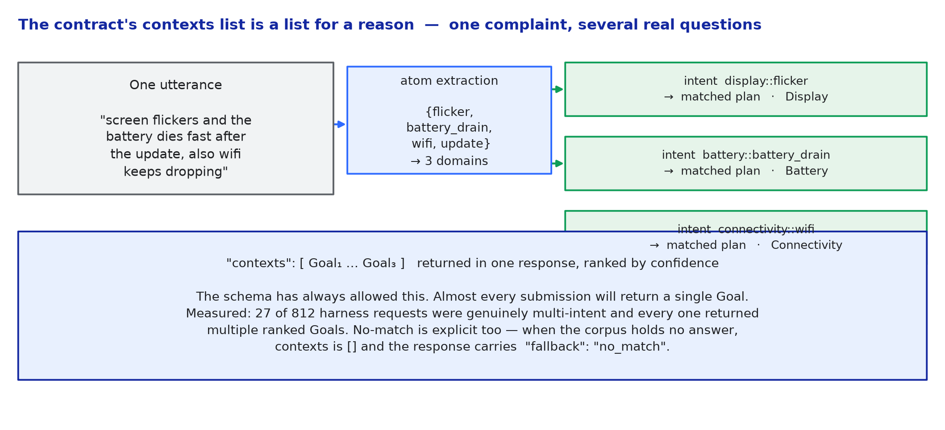
Brownie Points — differentiation
Multi-intent fan-out: the contract's contexts list is a list. A single utterance that hides three disjoint problems returns three ranked Goals in one response — measured on 27 of 812 harness requests.
Precision gate: we decline to the documented placeholder rather than emit a deeplink we cannot justify. Precision over coverage, measured and reported.
Provenance: every emitted step carries the character span of the SIIS text it came from. No hallucinated steps is a checkable claim, not an assertion.

Slide 15
Checklist- Updated on Public GitHub
Working prototype code — public GitHub repo (Y) · release tagged PRISM_GENAI_HACKATHON_Y2026
README with reproducible setup instructions (Y) · Dockerfile and one-command reproduction (Y)
Demo video, max 5 minutes (Y) · YouTube link in the README
Presentation file — PPT and PDF (Y)
Evaluator artefacts — evaluation JSON, run logs, seeds and configuration (Y)
AI usage disclosure form (Y)

Slide 16
Thank you
Theme 02 — Smart Guided Troubleshooting Engine · SRMIST SRM_Carrot · prism@samsung.com
Notes:
Closing slide. Add the Google Form URL and a contact email before sharing. Edition 2 organising team for reference: Language AI - Sourabh Tiwari, Gaurav, Sanjeeth Pothireddy, Gorang Maniar; PRISM - Binny Lakra, Prakhar Chandrakar, Vishu Kumar; Kick-off and mentors - Giridhar Jakki, Deepraj Prabhakar Patkar (Language AI), Srimanu Prasad Nagaraju, Ashish Kumar (Tech Strategy).

