Slide 1



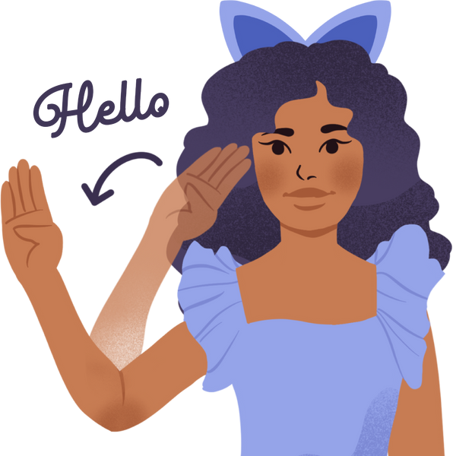
BridgeSpeak
An Accessible Learning Platform
for Deaf and Dumb People
Team Members:
Venkataraman P
Parasuram S
Nawin Viswajith B

Slide 2


Problem Statement
Globally, over 700 million individuals experience hearing impairments. Despite this significant number, there is no unified platform dedicated to converting and learning sign language.
In India, 1-2% of children are born with hearing impairments. Among them, only 20% receive formal sign language education, while the remaining majority lack access to learning opportunities.

Slide 3
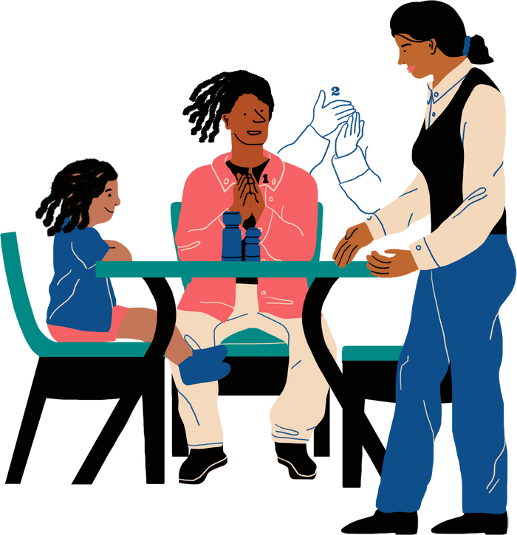
A Comprehensive Sign Language Conversion and Learning Platform
1. Audio-to-Sign Language Conversion:
Upload audio files and have them automatically converted into sign language using a 3D VRM model, ensuring seamless interpretation.
2. Video & Audio Integration:
Experience real-time conversion of uploaded audio and video content into sign language, enhancing accessibility for hearing-impaired individuals.
3. Interactive Learning Module:
Access an extensive library featuring over 100 commonly used words and 26 letters for finger spelling, enabling immersive learning through engaging 3D models.
4. Word Exploration Tool:
Discover and practice sign language through an interactive 3D environment that demonstrates accurate sign execution and contextual meanings.
Solution

Slide 4
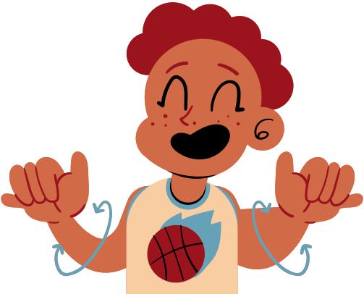
Technical
Overview :
Backend:
Flask (Python), MoviePy for media processing, Sysmocap for 3D VRM model generation.
Audio-to-Text:
Google SpeechRecognition (upgrading to Whisper for production).
Frontend:
HTML, CSS, JavaScript for responsive and interactive UI.

Slide 5
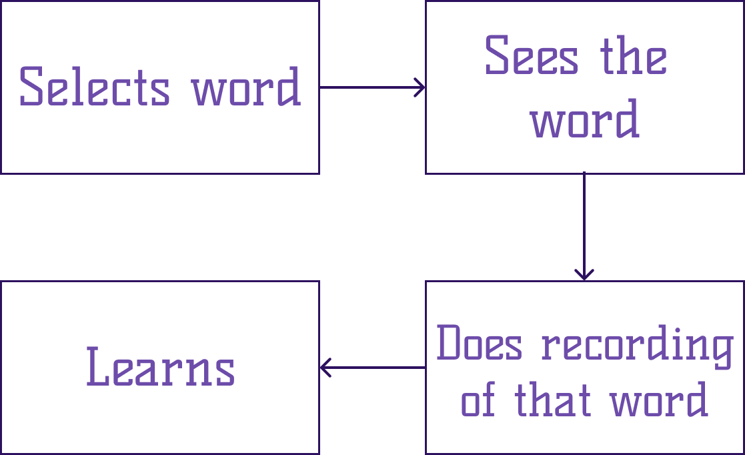
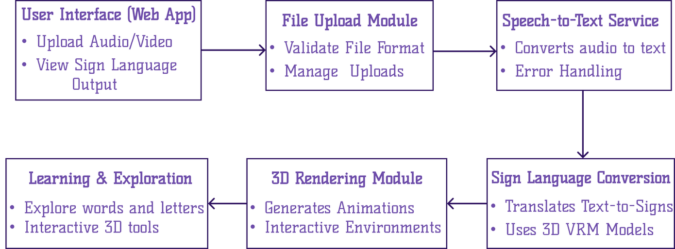
Architecture
User flow for Learning
Architecture Diagram

Slide 6
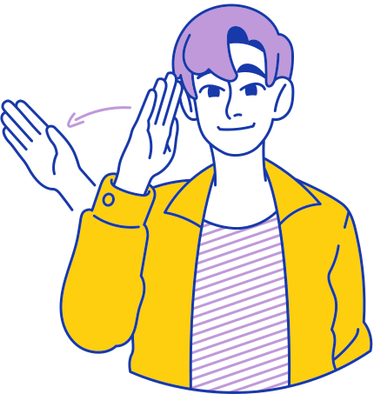
Globally, over 30 million deaf individuals actively access the internet daily. Offering tools and interpreters can significantly enhance their digital experience while driving business growth.
In India, numerous public and private schools provide opportunities for children to learn sign languages. A platform supporting multiple sign languages, including ASL (American Sign Language) and ISL (Indian Sign Language), can bridge communication gaps and expand accessibility.
Business
Potential

Slide 7


Revenue Plans
Freemium Model: Offer a free plan with essential features and premium plans for advanced functionalities.
Character Customization: Generate revenue through in-app purchases for character personalization.
Advertising: Monetize with targeted ads based on customer segments.
Licensing: License the product to other platforms for broader accessibility.
B2B Opportunities: Provide virtual character technology to other products, creating business partnerships.

Slide 8
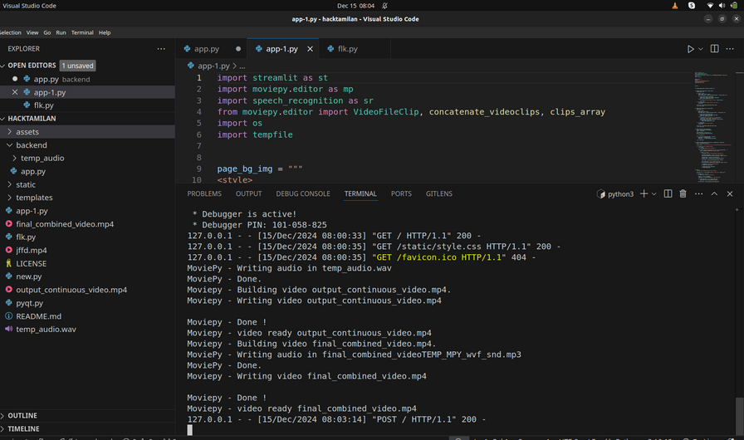
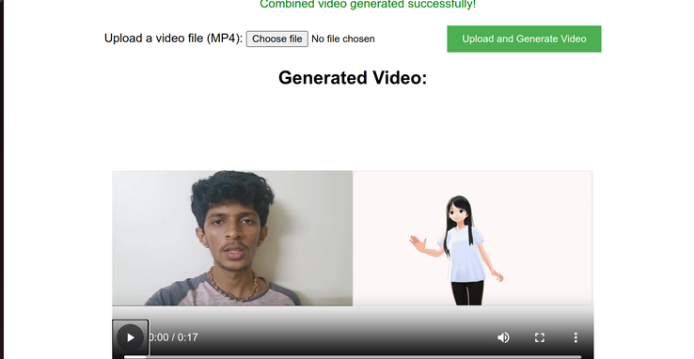
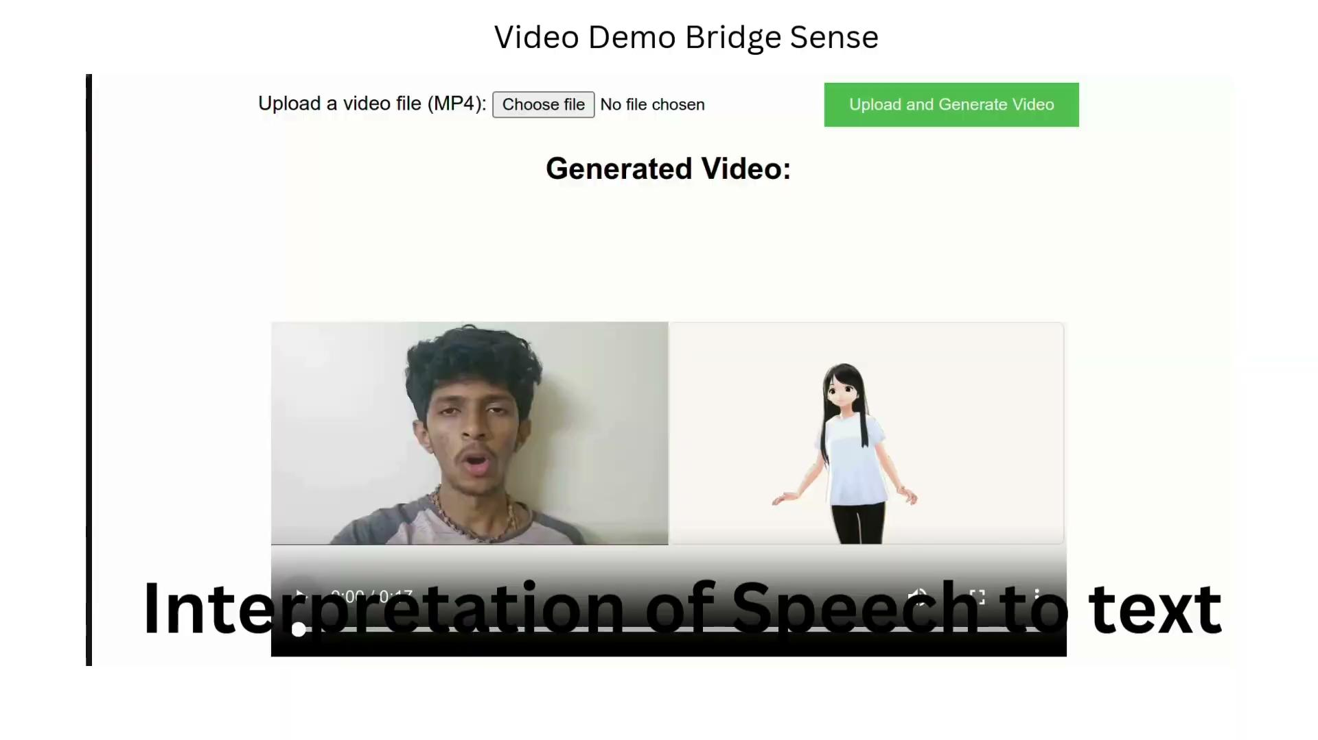
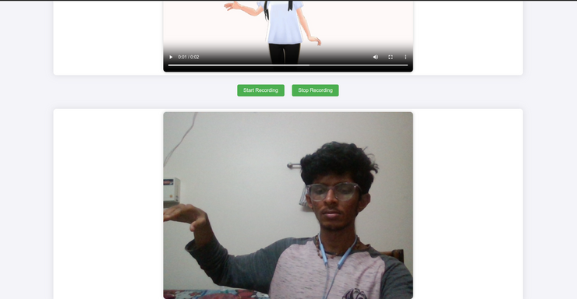
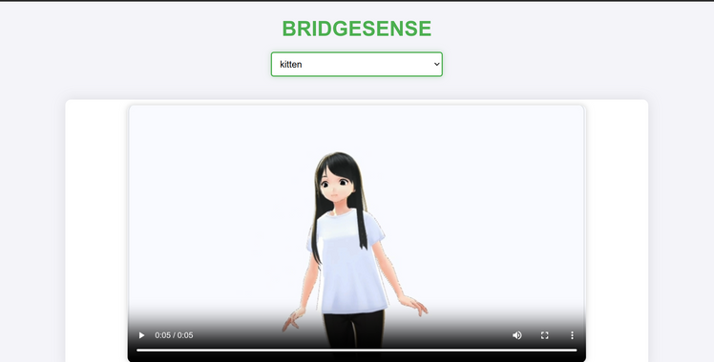
Prototype:
Working Model Prototype Video
Video Link
Generated video
Video is
being generated
GitHub Link
Link
Try Doing it and Store it for further Reference
BridgeSense
Learning Platform

Slide 9
Future Scope:
Multi-Language Integration: Expand support for various sign languages to enhance learning.
Language Translation: Enable translation from multiple spoken languages to sign language.
Gamified Learning: Incorporate gamification to improve user engagement and learning progress.
Future Scope
& Impact:
Impact:
Enhanced Accessibility: Facilitates communication for the deaf community through easy sign language translation.
Educational Empowerment: Provides a platform for learning sign language, enhancing communication skills.
Social Inclusion: Encourages interaction between deaf individuals and the wider community, promoting inclusivity.

