Slide 1
Cure Project Five Presentation
By Evan, Karam, Dylan and Sayma

Slide 2
Introduction
The goal of this project is to create a machine learning model that can classify and predict the quality of white wine using three different attributes: fixed acidity, residual sugar range, and sulfur dioxide.

Slide 3
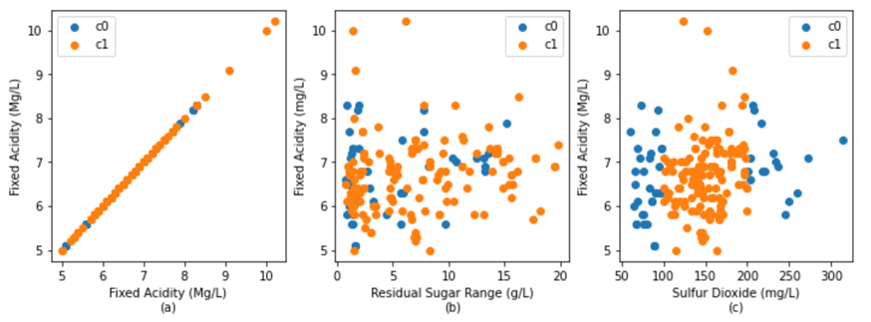
Summary of Project Three
Project Three
Created a new Classification problem:
“Classification of white wine quality based on citric acid, residual sugar concentration, and sulfur dioxide content.”
Method for data organization:
Utilized python to parse the csv files that were retrieved online and created a table with attributes, classes, and instances fit to solve a classification problem.
Created pair - plots in order to make deductions about data and gage how well the classification problem may be solved

Slide 4
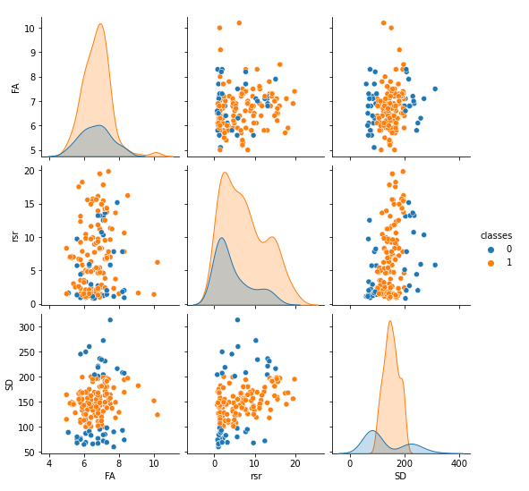
Graphical data analysis
Guide:
Residual sugar range = RSR
Fixed acidity = FA
Sulfur dioxide = SD
There is noticeable separation between the classes when it comes to FA vs SD and RSR vs SD.
For the histograms, Good quality wines were much more frequent than bad quality ones.
Overall:
Histograms and scatter plots make it easier to see the distinctions between different classes.
Given the separation between different classes, these plots show that this dataset would work well in a machine learning model.

Slide 5
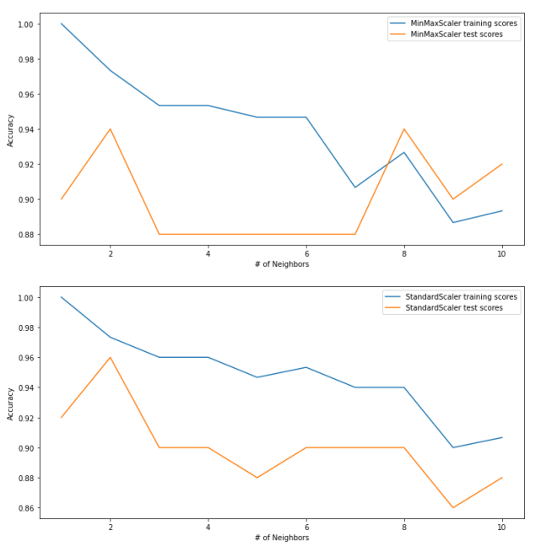
Summary of Project Four
Project Four
A continuation of project three where we created a knn classifier as our machine learning model.
Preprocessed our attributes using a MinMaxScaler()
Found best value of k.
Displayed how our model accuracy varies with each k value, and plotted the different values in two different graphs.
Created a confusion matrix we define and visualize the performance of this classification model.
Notes:
Project 4 is continuation of project 3,

Slide 6
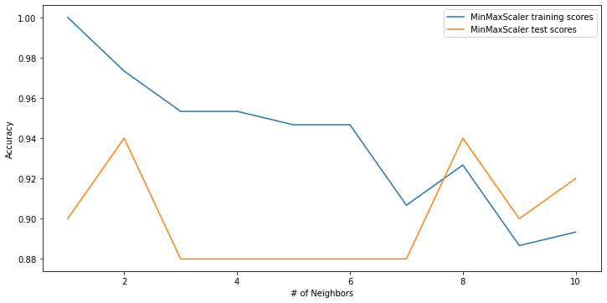
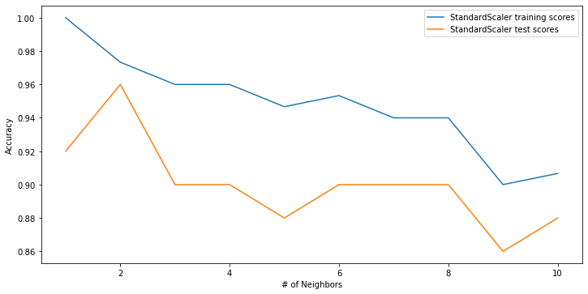
Selection of k value and Scaler
Using a loop to test values of k from 1 -10 we compared their accuracy on a plot, and deduced that the StandardScaler yielded the most accurate results with a value of k = 2 neighbours.
Using k = 2 as our model with StandardScaler
~97% accuracy for training score
~96% accuracy for test score
Using this value we applied it to our model.
Notes:
Using a lo

Slide 7
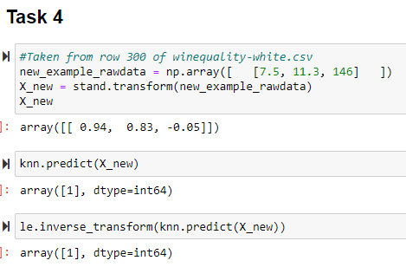
Machine Learning Test
Finally, after constructing the machine learning model. It is now ready for testing.
We took a tuple from the .csv file that we parsed the data from but from a tuple row that wasn’t included in the table for project three, then we inputted it into the model and thereafter the model applied it to the StandardScaler then it outputted that class = 1 in this case. This means that this data most likely marks good - quality wine.

Slide 8
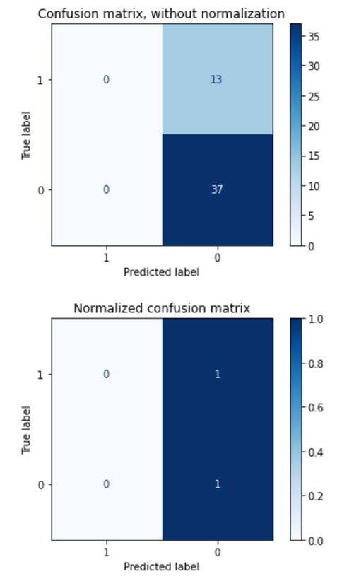
Model Evaluation (Confusion Matrix)
Confusion Matrix
First matrix -> normalization
Second matrix -> without normalization
Details on first matrix vs second
Accuracy % and F1 score
Flaws of machine learning model based off of matrix.

Slide 9

Conclusions
As we worked on assignments 3 & 4, we found a unique dataset for white wine quality, graphed the data, and found the most accurate way to classify it.
We learned the purpose of confusion matrices and incorporated them to further evaluate our machine learning model.
Finally, we tested our model using a new sample of data to see if it was successful.
In the end, we have confidence our machine learning model worked well and will be able to successfully classify any new future instances of data.

