Slide 1
Machine learning in python
From 1 to 100 Real quick
By Josiah Coad, 2017

Slide 2
Class Goals
Learn what deep learning is and how it is being used to solve real life problems
Find out what models are popular today and what they’re used for (RNN, CNN, GAN)
Become comfortable with many of the buzzwords of machine learning (AKA ML) (activation functions, backwards propagation and gradient decent, epochs, etc..)
Start using some of the tools in programming ML (numpy, pandas, keras)
Build a ML model (both regression and classification) using keras and interpret the output
Final: Classify digits with the MNIST data set

Slide 3
Lesson 1: Basics of deep learning and neural networks
Introduction to Deep Learning
Comparison to classical linear regression models
What is a Forward Propagation Network?
Activation Functions
Deeper Networks

Slide 4
What is deep learning?
Artificial Intelligence
Deep Learning
Machine Learning
Neural Networks
Feed Forward NN

Slide 5
Comparison to Linear regression
Linear regression
Neural Network
Multicollinearity Bad!
Multicollinearity Good!
x1
x1
x2
x2
y
H
y
x3
x3
Catches the interaction between x2, x3
x4
x4

Slide 6
Universal Approximation Theorem
A one layer machine learning model can approximate any function!
…

Slide 7
What is a Forward propagation Network?
This is called a densely connected network since every node is connected to the node in the next layer.
Input Layer
Hidden Layer
Edge Weight
Output Layer
8
hr. slept
w = -1
h1
Test grade
w = 1
hr. studied
h2
w = 2
How do we initialize weights?
How do the weights change to get better predictions?
5
18
Node value = ∑ (weights * incoming values)

Slide 8

Activation Functions
Top: RELU (Used in this course).
Bottom: tanh (Also popular)
Applied to the output of each node in the layer (after ∑ (weights * incoming values) is calculated “inside” the node)
Used to capture non-linearities in data (ex: will 0 to 8 hours of sleep have the same effect as 8 to 20?)

Slide 9
adding layers
More layers means more complex relationships can be modelled, i.e. data can be better “detangled” for classifiers
Nothing changes from what we’ve learned here. Same way for calculating node value and applying activation functions
Input Layer
Hidden Layers
Edge Weight
Output Layer
8
hr. slept
w = -1
h1
w = 3
h1
w = -1
h1
w = 3
Test grade
hr. studied
h2
h2
h2
w = 1
w = 2
w = 5
w = 2
5
18
Higher level of complexity “comprehension”

Slide 10
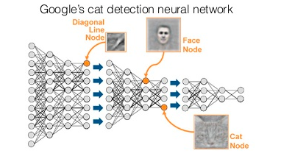
Representation learning
A NN’s ability to capture complex relationships with many layers

