Slide 1
Deep learning in python
From 1 to 100 Real quick
CHAPTER 1-2
By CoadBros, 2017
Josiah and Elisha COad

Slide 2
Time breakdown
6:30 - 6:45 Environment Setup and welcome treats
6:45-7:30 Intro and Chapter 1-2
7:30-8:00 Code Practicals
8:00-8:30 QA
8:15-8:30 Quiz

Slide 3
Introduction
What you’ll walk away from here with (from past students)
How the basic of neural nets work and how simple they are
Get your hands dirty with some of the software tools in data science and machine learning
A rough guide to how machine learning works
How to implement neural networks in Python
Forward-Backward propagation
“I learned enough to begin practicing to set up a basic neural network.”
Getting an overall understanding of deep learning is and how it works
Final: Classify digits with the MNIST data set

Slide 4
WhERE Does this class fit in to the big picture?
We will learn about DENSLY CONNECTED FEED-FORWARD NEURAL NETWORKS (A SUPRIVISED MODEL)
Artificial Intelligence
Feed Forward Neural Network
Machine Learning
Neural Networks
(Supervised) Deep Learning
Artificial Intelligence is a branch of computer science dealing with the simulation of intelligent behavior in computers
Machine learning is an application of artificial intelligence (AI) that provides systems the ability to automatically learn and improve from experience without being explicitly programmed. Machine learning focuses on the development of computer programs that can access data and use to learn for themselves.
Supervised learning is the task of learning from labeled training data. The labeled training data is used to fine tune the model to make more accurate predictions by minimalizing error.
Deep learning is an application of machine learning used to model high-level abstractions in data through the use of nodes and weights which can adjust to capture complex relationships in data.
A Densely Connected Feed Forward Neural Network is one type of supervised machine learning that we will learn about in this class used to predict values and classify data. More on this in the slides to come!

Slide 5
Chapter 1: Basics of deep learning and neural networks
Introduction to Deep Learning
Comparison to classical linear regression models
What is a Forward Propagation Network?
Activation Functions
Deeper Networks

Slide 6
a Forward propagation Network
This is called a densely connected network since every node is connected to the node in the next layer.
Input Layer
Hidden Layer
Edge Weight
Output Layer
8
-1
7
hr. slept
-2
3
4
1
5
18
1
Test grade
hr. studied
2
Node value = ∑ (weights * incoming values)
Weights initialized randomly.
Weights change to get better predictions using backward propagation (coming next)

Slide 7

Activation Functions
Top: ReLu (Used in this course).
Bottom: tanh (Also popular).
Applied to the value of each node before being outputted to the following node
Used to capture nonlinearities in data (ex: will 0 to 8 hours of sleep have the same effect as 8 to 20?). An activation function gives the model the ability to use nonlinearities like these.
ReLu is most commonly used but can’t be the only activation functions used in models that are expected to sometimes produce negative outputs.
Each layer gets an activation function. You can play around with different functions for different layers.

Slide 8
Example with a Relu activation function
Input Layer
Hidden Layer
Output Layer
Edge Weight
hr. slept
8
1
-7
ƒ: 0
-3
-2
18
1
5
ƒ: 18
1
Test grade
hr. studied
2
18
With the RELU activation function applied the hidden nodes, a negative node value outputs 0

Slide 9
adding layers
Adding more layers gives the neural network the chance to learn more complex relationships in the data
Adding more layers doesn’t change the math of what we learned. The forward propagation just gets applied sequentially from the first layer to the last.
Input Layer
Hidden Layers
Edge Weight
Output Layer
hr. slept
8
1
-7
ƒ: 0
-2
ƒ: 0
-32
1
-3
-2
18
1
3
1
5
Test grade
hr. studied
2
18
ƒ: 18
1
18
ƒ: 18

Slide 10
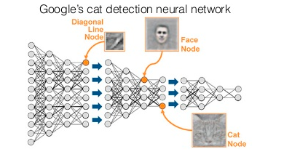
Deep learning
A deep neural network has the ability to capture complex relationships with many layers like how pixels (low level representation of data) can be understood as a object (high level understanding of data)
Google Tenser Flow Visual Representation

Slide 11
Chapter 2: Optimizing a Network with Backpropagation
Calculating Predictive Error (Loss Functions)
Batch Size
Learning Rate
Gradient Descent
Calculating adjustment slopes
Backpropagation (more than one layer)

Slide 12
Minimalizing Error In prediction
In linear regression, your goal is to draw a line through your (two dimensional) data points to so that your line best approximates your data. AKA your line minimizes the total error between your prediction and the data. It does this via mean squared error.
Mean Squared Error tells you how far your prediction (in this case a linear line) is from predicting you data. MEAN is so that you find the best possible fit for all your data. SQUARED is so that error is always positive and further away has a more weight.
MSE is an example of a LOSS FUNCTION: a way for your model to access its accuracy, AKA how far off it was.

Slide 13
Batch Size
A major difference between classical regression and neural networks is that in classical regression, you start by knowing what pattern of data you have and fitting a line to it.
SO, if you know what simple pattern of data you have (linear, polynomial, etc.), use classical regression instead of machine learning.
Machine learning discovers complex patterns in your data by a trial-error method through forward and backward propagation.
Nevertheless, lets say we’ll use a neural network to find the best fit line for educational purposes
Batch size is how much data you forward propagate through the model before tallying the loss (in this case MSE).
The rule of thumb is the more noise you think there is in your data, the bigger your batch size should be.
The obviously problem with this regression is that the line is jumping around to minimize error in each batch instead of learning an overall pattern in the data.

Slide 14
Learning rate
Instead of jumping regressing to minimize error in each new batch, apply a learning rate to better find an overall trend in the data
An industry common learning rate is 0.01
Later we’ll learn about optimizers which find the optimal learning rate for you.

Slide 15
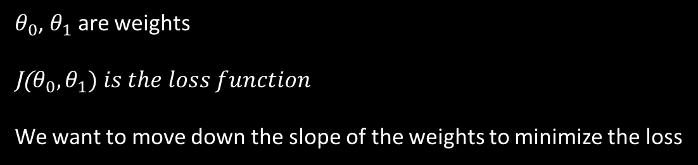
Gradient Descent
The process by which we update the weights to minimize the error.
Gradient: A collection of slopes
Decent: Moving down a slope
Gradient Decent: Moving down a collection of slopes (to minimize error)
Notice a problem: can get stuck in a local minimum and have not ever find a global minimum!
$θ_{0}$, $θ_{1}$ are weights
J($θ_{0},θ_{1}) is the loss function$
We want to move down the slope of the weights to minimize the loss

Slide 16
Calculating Gradient Descent
How will we adjust the weights to get a better prediction next time?
An adjustment value for each weight will be calculated using three things with respect to that weight
The node value feeding into that weight
The slope (derivative) of the activation function of the node feeding into the weight
The slope of the loss function of the node the weight is feeding into
Finally, the gradient gets multiplied by the learning rate to get the final adjustment weight
AND NOW WE UPDATE THE WEIGHT
New_weight = old_weight - adjustment
Input Node
Output Node
w = 3.92
2
w = 4
8
Predicted value: 8
Predicted value: 7.84
Target value: 6
Error: 2
Error: 1.84

Slide 17

SIMPLE Example
Input Node
Output Node
w = 3.92
2
w = 4
8
Predicted value: 8
Predicted value: 7.84
Input node value: 2
Recall loss function MSE is (predicted-target)² = (error)²
Derivative of loss function MSE: 2 * (error) = 4
Activation function derivative: Is 1 because the node with value 2 is an input
LEARNING RATE = .01
Adjustment = (2 * 4 * 1) * .01 = .08
$new_weight=4−.08=3.92$
(note this is a batchsize = 1)
Target value: 6
Error: 2
Error: 1.84
A graph of multiple iterations of gradient decent to adjust weights… see how the predictions get closer to the expected over iterations

Slide 18
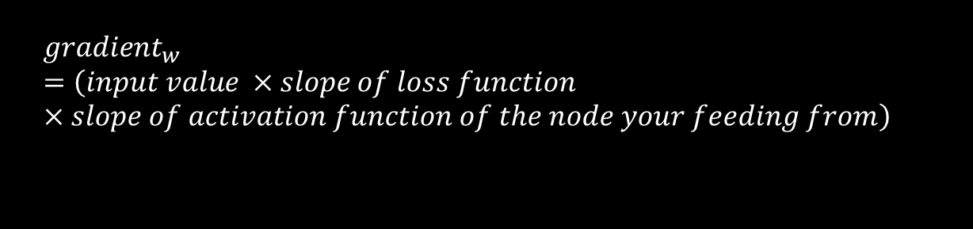
Expanding to Multiple Layers (Backpropagation)
Assume each hidden layer has the ReLu activation function and batchsize = 1.
G1 = 0
G-2 = 0
8
1
G-2 = input * 2 * Error * slope of activation * LR
hr. slept
-7
ƒ: 0
-3
-2
G-3 = 0
74
8
Test grade predicted value
9.42
G8 = -1.42
1
5
ƒ: 74
9.88
hr. studied
2
74
2.88
G1 = -8.88
G1 = 74 * 2 * Error * 1 * LR
G1 = -888 * LR
Error = (74-80) = -6
G2 = 5 * 2 * Error * 1 (no activation function for input) * LR
G2 = -88.8 * LR
G2 = -0.888
G2 = 5 * 2 * -8.88 * LR
Test Grade Target Value: 80
$${gradient}_{w}=\left(input value ×slope of loss function×slope of activation function of the node your feeding from\right)$$
Learning Rate = .01
New Weight = old weight - gradient

Slide 19
Problems with overfitting

Slide 20
End of Chapters 1-2

