Slide 1
Quantum Dot Foundations: Confinement, Strain, and Electronic Structure
Section 1 of 5 | 28 Minutes | Graduate Physics & EE Lecture Series
Quantum Dot Foundations: Confinement, Strain, and Electronic Structure
1
Notes:
Welcome to the lecture series on how semiconductor quantum dots emit single photons, bridging fundamental solid-state physics to full-stack device simulation. Today's two-hour lecture is divided into five modular 28-minute sections. Section 1 covers the essential foundations: how three-dimensional quantum confinement creates discrete atom-like energy levels, how epitaxial strain shifts band edges and lifts valence band degeneracies, and how heterostructure band alignments dictate carrier capture and thermal escape. In Section 2, we will explore the radiative transition itself, including spontaneous emission via Fermi's golden rule, carrier-phonon coupling via the independent boson model, and homogeneous dephasing. Section 3 investigates the non-classical nature of light, deriving the second-order intensity correlation function g^(2)(tau) and experimental photon antibunching. Section 4 examines cavity quantum electrodynamics, Purcell enhancement, and directional photon extraction into waveguides. Finally, Section 5 integrates all physical mechanisms into an electrically driven room-temperature single-photon emitter simulation, evaluating realistic device designs from epitaxy to optical output [Fox, Quantum Optics, ch. 8] [Bimberg et al., Quantum Dot Heterostructures, ch. 1] [Michler ed., Quantum Dots for Quantum Information Technologies (2017)]. Let us begin with the bulk semiconductor host materials.

Slide 2
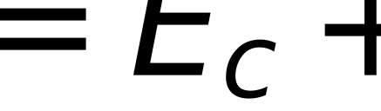
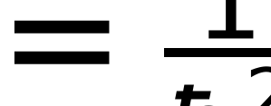
Semiconductors in One Slide: Bands, Direct Gap, and Effective Mass
Direct optical transitions and band curvature in III-V materials
Direct bandgap: conduction minimum and valence maximum align at k = 0 (Gamma point)
Optical dipole transitions conserve crystal momentum: photon momentum q_phot ~ 0
Effective mass approximation: band curvature yields m* = hbar^2 / (d^2 E / dk^2)
III-V binary semiconductors provide direct gaps: GaAs is 1.422 eV, InP is 1.353 eV at 300 K
Small electron effective mass in III-Vs produces large De Broglie wavelength and strong confinement
parabolic conduction band dispersion near the Gamma point
effective mass tensor inverse related to energy band curvature
Quantum Dot Foundations: Confinement, Strain, and Electronic Structure
Source: m_e_GaAs = 0.067 (fsim_core/materials.py) | m_e_InP = 0.0795 (fsim_core/materials.py) | Eg_GaAs_300K = 1.422482 (undefined) | Eg_InP_300K = 1.352886 (undefined)
2
Notes:
A semiconductor's optical personality is governed by its band structure at the center of the Brillouin zone. In direct-gap semiconductors such as the III-V binaries GaAs and InP, the conduction band minimum and the valence band maximum occur at the same crystal momentum, the Gamma point k = 0. Because the momentum of an optical photon q = 2 pi / lambda is negligible compared to the Brillouin zone width pi / a, photon absorption and emission occur as vertical transitions conserving crystal momentum [Yu & Cardona, Fundamentals of Semiconductors, ch. 6]. In indirect semiconductors like silicon, optical transitions require phonon assistance to conserve momentum, making radiative recombination orders of magnitude slower. Expanding the energy dispersion E(k) quadratically around the band extremum gives the effective mass approximation, where the periodic crystal lattice potential is absorbed into an effective mass m* given by the reciprocal of the second derivative of E with respect to k. For GaAs, the room-temperature direct bandgap computed from fsim_core/materials.py is 1.4225 eV with m_e* = 0.067 m0; for InP, the direct gap is 1.3529 eV with m_e* = 0.0795 m0, evaluated using the Vurgaftman et al. (2001) parameterization (1.424 eV and 1.344 eV are the Ioffe reference targets in verify/verify_materials.py). These small effective masses produce large carrier de Broglie wavelengths, making III-V heterostructures the ideal host for quantum confinement.

Slide 3
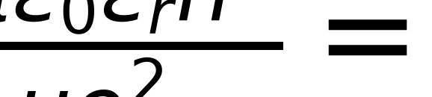
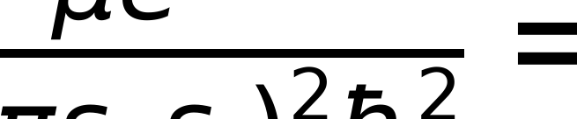
Excitons in Bulk: The Hydrogenic Model
Optically excited electron and hole attract via screened Coulomb: V(r) = -e^2 / (4 pi eps_0 eps_r r)
Hydrogenic Wannier-Mott exciton: reduced mass mu = (m_e* m_h*) / (m_e* + m_h*)
Dielectric screening (eps_r ~ 12-13) greatly expands orbit and shrinks binding energy
Hydrogenic estimates (GaAs 4.6 meV/12.1 nm, InP 6.0 meV/9.6 nm); accepted: GaAs 4.2 meV/11.2 nm, InP 5.1 meV
Room temperature thermal energy (kT = 25.9 meV) easily ionizes bulk excitons
exciton effective Bohr radius, where a_0 = 0.0529 nm is the hydrogen Bohr radius
exciton Rydberg binding energy, where Ry = 13.606 eV
Quantum Dot Foundations: Confinement, Strain, and Electronic Structure
Source: eps_r_GaAs = 12.9 (fsim_core/dot_levels.py) | eps_r_InP = 12.5 (fsim_core/dot_levels.py) | e2_4pieps0 = 1439.964 (fsim_core/dot_levels.py)
3
Notes:
When a photon creates an electron-hole pair, the oppositely charged carriers experience an attractive Coulomb interaction screened by the surrounding semiconductor lattice. In semiconductors with high dielectric constants and small effective masses, the electron-hole pair forms a weakly bound, delocalized quasiparticle known as a Wannier-Mott exciton [Fox, Quantum Optics, ch. 4]. By analogy with the hydrogen atom, the relative motion is solved by replacing the reduced mass with mu = m_e* m_h* / (m_e* + m_h*) and the vacuum permittivity with eps_0 eps_r. Because the static dielectric constant eps_r is large (~12.9 in GaAs and ~12.5 in InP) and the reduced mass mu is small (~0.056 m0 in GaAs and ~0.069 m0 in InP), the effective Bohr radius a_B scales as eps_r / (mu / m0), expanding the exciton radius to 12.1 nm in GaAs and 9.6 nm in InP under the simple isotropic hydrogenic model. Conversely, the binding energy E_B scales as (mu / m0) / eps_r^2, giving 4.6 meV in GaAs and 6.0 meV in InP. Alongside these hydrogenic estimates, accepted experimental values [Yu & Cardona 2010, ch. 6] reflect slight polaron and band-nonparabolicity corrections: 4.2 meV and 11.2 nm for GaAs, and 5.1 meV for InP. Because these bulk binding energies are far smaller than the room-temperature thermal energy k_B T = 25.85 meV, bulk excitons thermally ionize almost instantaneously at 300 K. To maintain stable excitonic emission at elevated temperatures, external spatial confinement is mandatory [Bimberg et al., 1999].

Slide 4
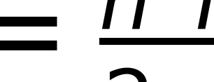
Quantum Confinement: The Particle in a 1D Box
De Broglie quantization and why 5 nanometers is the critical lengthscale
Confining a carrier to width L restricts wavevector to discrete values: k_n = n pi / L
Infinite well eigenenergies scale quadratically with quantum number: E_n = n^2 pi^2 hbar^2 / (2 m* L^2)
Energy spacing Delta E scales as 1 / (m* L^2): light carriers produce large level separation
InP electron (m* = 0.08 m0, L = 5 nm) ground energy E_1 = 188.0 meV
Confinement energy (188 meV) is 7.3 times room-temperature thermal energy k_B T (25.9 meV)
Nanometer dimensions are required to prevent thermal ionization and maintain discrete quantum states
quantized energy levels of a one-dimensional infinite potential well of width L
Quantum Dot Foundations: Confinement, Strain, and Electronic Structure
Source: HB2_2M0 = 38.09982 (fsim_core/dot_levels.py) | KB_MEV = 0.08617333262 (fsim_core/dot_levels.py)
4
Notes:
When the physical dimensions of a semiconductor crystal approach the de Broglie wavelength of the charge carriers, spatial confinement forces the continuous energy bands into discrete eigenvalues. The simplest textbook model is the one-dimensional infinite potential well of width L. Boundary conditions require the carrier wavefunction to vanish at the barrier interfaces, establishing standing de Broglie waves with wavevectors k_n = n pi / L. Substituting this into the parabolic dispersion relation yields quantized energy levels E_n = n^2 pi^2 hbar^2 / (2 m* L^2) [Fox, Quantum Optics, ch. 4]. Notice that the energy scale depends inversely on the effective mass and on the square of the confinement length L. Consider an electron in InP, where m* = 0.08 m0: at L = 5 nm, the ground-state confinement energy E_1 evaluates to exactly 188.0 meV using the repository constant hbar^2 / (2 m0) = 38.0998 meV nm^2 from fsim_core/dot_levels.py. Compare this to the thermal energy at room temperature T = 300 K, which is k_B T = 25.85 meV. The ratio E_1 / (k_B T) is approximately 7.3. This quantitative result explains why 5 nanometers is the magic lengthscale for semiconductor quantum dots: only at dimensions of 5 nm or below does quantum confinement provide sufficient energy separation to overcome thermal excitation at room temperature.

Slide 5
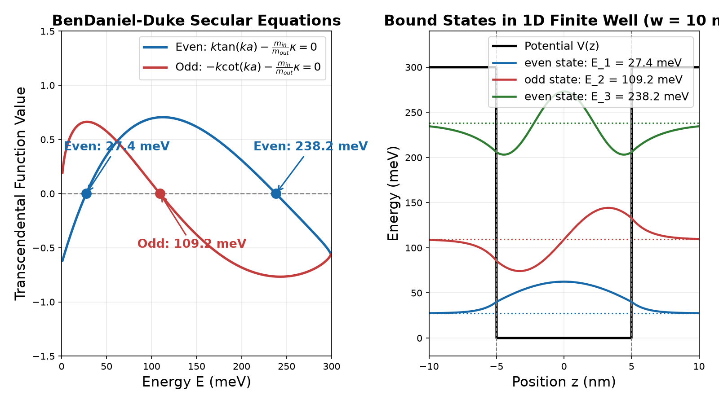
Finite Quantum Well & BenDaniel-Duke Boundary Conditions
Real heterostructures have finite barrier depth V: wavefunctions evanescently penetrate barrier
Discontinuous mass across interface requires BenDaniel-Duke condition: (1/m*) dpsi/dz is continuous
Hermitian probability current conservation across heterointerfaces
Even states satisfy k tan(k a) = r kappa; odd states satisfy -k cot(k a) = r kappa
Symmetric 1D well always binds at least one state for any V > 0
Transcendental root-finding and bound state wavefunctions from fsim_core.dot_levels.finite_well_1d
secular transcendental equations where a = w/2, k = sqrt(2 m_in E)/hbar, kappa = sqrt(2 m_out (V-E))/hbar
Quantum Dot Foundations: Confinement, Strain, and Electronic Structure
Source: HB2_2M0 = 38.09982 (fsim_core/dot_levels.py) | V_ref_meV = 300 (verify/verify_dot_levels.py) | w_ref_nm = 10 (verify/verify_dot_levels.py) | E1_well_10nm_meV = 27.4391 (undefined)
5
Notes:
In physical semiconductor heterostructures, potential barriers have finite heights V determined by conduction or valence band offsets. Consequently, carrier wavefunctions do not vanish abruptly at the heterointerface but decay exponentially into the barrier with decay constant kappa = sqrt(2 m_out* (V - E)) / hbar [Bimberg et al., 1999, ch. 3]. Furthermore, because the material composition changes abruptly across the heterointerface, the carrier effective mass jumps from m_in* inside the well to m_out* in the barrier. To ensure Hermiticity and continuity of the quantum probability current J = (hbar / 2 m* i) (psi* dpsi/dz - psi dpsi*/dz), the standard boundary condition is the BenDaniel-Duke matching rule: both the wavefunction psi(z) and the velocity-like quantity (1 / m*(z)) dpsi/dz must be continuous across the interface. Matching even and odd parity solutions yields the transcendental equations shown on the slide. A heavier barrier mass (m_out* > m_in*) pulls the wavefunction closer to the well and lowers the eigenenergy, whereas a lighter barrier mass raises it. Crucially, in a one-dimensional symmetric well, there is always at least one bound state for any positive potential V > 0. The figure demonstrates the numerical solution implemented in fsim_core/dot_levels.py via finite_well_1d, showing the roots and normalized wavefunctions for an electron well.

Slide 6
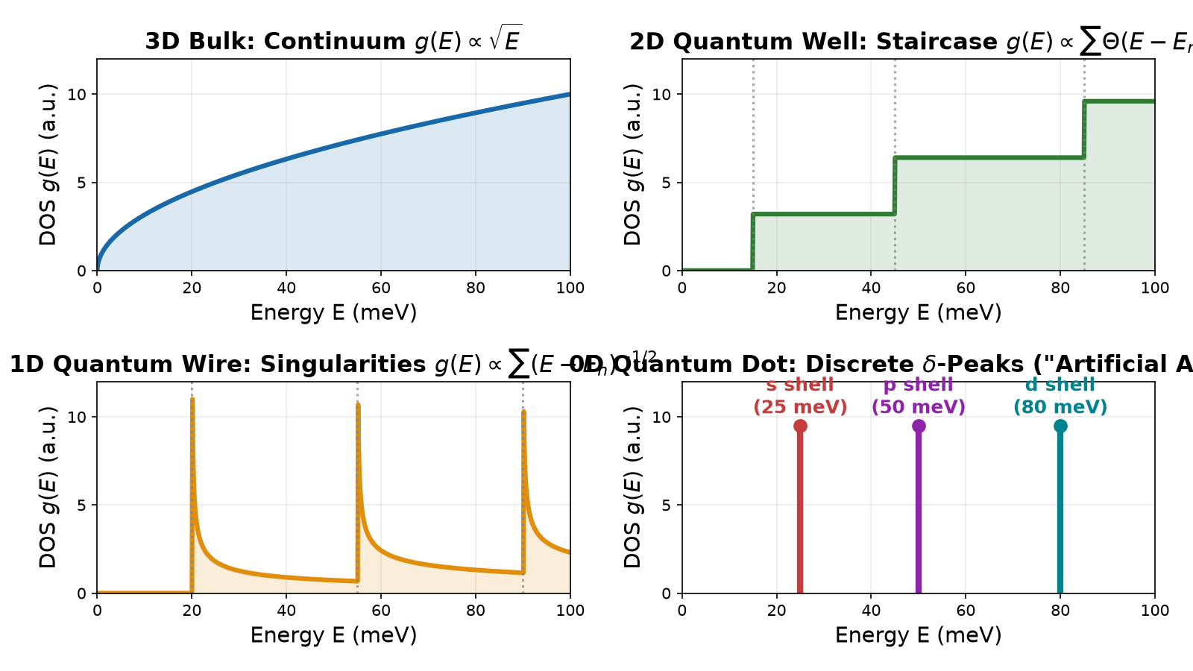
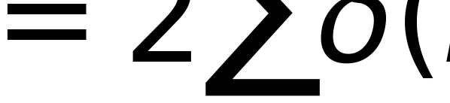
Density of States: 3D to 0D and the 'Artificial Atom'
3D Bulk: continuous parabolic dispersion yields smooth square-root DOS: g(E) ~ sqrt(E)
2D Quantum Well (1D confinement): in-plane continuum creates staircase DOS: sum Theta(E - E_n)
1D Quantum Wire (2D confinement): axial continuum produces inverse-root peaks: sum (E - E_n)^(-1/2)
0D Quantum Dot (3D confinement): completely discrete delta-function DOS: 2 sum delta(E - E_n)
Zero-dimensional density of states mimics isolated atomic orbitals: the 'artificial atom'
Evolution of the electronic density of states from 3D continuum to discrete 0D delta peaks
density of states of a 0D quantum dot, with factor of 2 accounting for spin degeneracy
Quantum Dot Foundations: Confinement, Strain, and Electronic Structure
6
Notes:
The dimensionality of a semiconductor structure fundamentally dictates how available quantum states are distributed in energy. In three-dimensional bulk material, carriers are free to propagate in all three Cartesian directions, producing a smooth square-root energy dependence g_3D(E) = (1 / 2 pi^2) (2 m* / hbar^2)^(3/2) sqrt(E) [Coldren et al., Diode Lasers, ch. 4]. Confining carriers along one dimension (a 2D quantum well) breaks the spectrum into subbands; within each subband, in-plane motion yields a constant density of states, forming a cumulative staircase sum of Heaviside step functions. Confining carriers along two dimensions (a 1D quantum wire) leaves only a single propagation axis, producing van Hove singularities with an inverse square-root divergence (E - E_n)^(-1/2) at each subband edge. Finally, when spatial confinement is imposed along all three spatial dimensions in a quantum dot (0D), all translational degrees of freedom are eliminated. The density of states collapses entirely into a series of discrete, atom-like Dirac delta functions g_0D(E) = 2 sum delta(E - E_n). This discrete spectrum eliminates thermal carrier spreading over a continuum band, concentrating all optical oscillator strength into razor-sharp optical transitions. For this reason, semiconductor quantum dots are universally recognized as solid-state 'artificial atoms' [Bimberg et al., 1999] [Michler, 2017].

Slide 7
Confinement Regimes: Weak vs Strong Confinement
Weak Confinement (L >> a_B)
Strong Confinement (L << a_B)
Dot size L is much larger than exciton Bohr radius a_B
Internal Coulomb attraction dominates over boundary confinement
Electron and hole orbit each other as an intact bulk exciton
Quantization acts only on exciton center-of-mass motion
Confinement energy shift scales as Delta E ~ hbar^2 pi^2 / (2 M_tot L^2)
Dot dimensions L are comparable to or smaller than a_B
Kinetic confinement (~1/L^2) dwarfs Coulomb interaction (~1/L)
Electron and hole orbitals are determined independently by dot potential
Coulomb energy acts as a perturbative correction (E_bind ~ 15-25 meV)
InP and InAs self-assembled dots reside solidly in this strong regime
Quantum Dot Foundations: Confinement, Strain, and Electronic Structure
Source: eps_r_InP = 12.5 (fsim_core/dot_levels.py) | eps_r_GaAs = 12.9 (fsim_core/dot_levels.py)
7
Notes:
The physical behavior of an exciton inside a quantum dot depends decisively on the ratio between the dot spatial extent L and the bulk exciton Bohr radius a_B [Fox, Quantum Optics, ch. 5]. In the weak confinement regime, where dot dimensions exceed the Bohr radius (L >> a_B), the Coulomb attraction between electron and hole is strong enough to preserve the internal hydrogenic bound state. Here, the electron-hole relative coordinate is virtually unchanged from bulk, and spatial confinement acts merely to quantize the center-of-mass motion of the composite exciton with total mass M = m_e* + m_h*. In contrast, when the dot dimension is smaller than the Bohr radius (L <= a_B), the system enters the strong confinement regime [Bimberg et al., 1999, ch. 4]. In this regime, the single-particle kinetic confinement energy scales as 1/L^2, completely overwhelming the Coulomb potential which scales only as 1/L. Consequently, the electron and hole wavefunctions decouple into independent single-particle particle-in-a-box orbitals, psi_e(r) and psi_h(r), established by the dot geometry and potential offsets. The Coulomb interaction between them is reduced to a perturbative first-order energy correction. Self-assembled InAs dots (a_B ~ 30 nm, height ~3 nm, radius ~12 nm) and InP dots (a_B ~ 10 nm, height ~4 nm, radius ~10-12 nm) are both solidly in the strong confinement regime along the vertical z-axis and strong-to-intermediate regime in-plane.

Slide 8
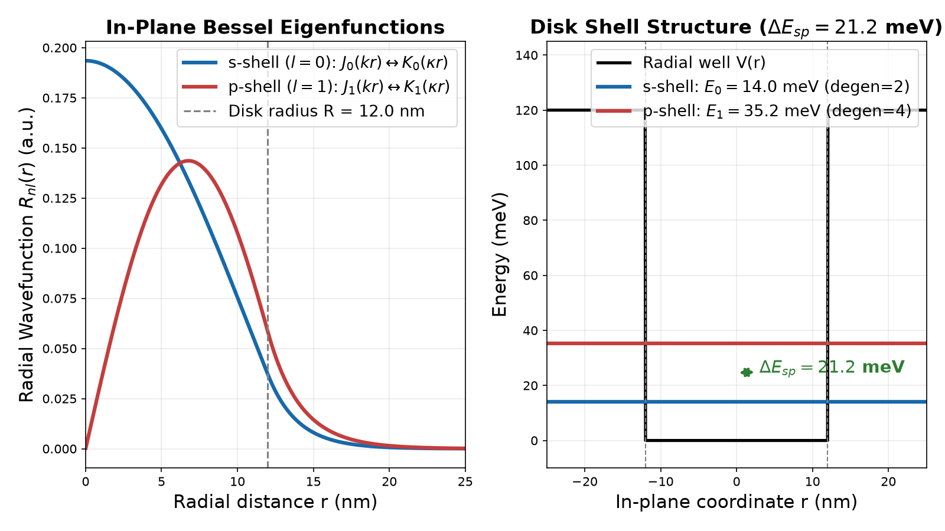
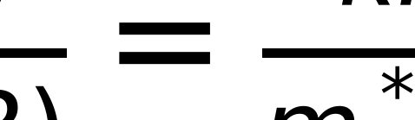
Separable 0D Model: Vertical Well x In-Plane Disk
Self-assembled lens dots mapped to a separable cylindrical disk: H = H_z + H_r,phi
Adiabatic approximation: vertical motion E_z is fast; in-plane motion E_r is slow
In-plane well depth is reduced by vertical confinement: V_r = V - E_z
Radial solutions inside: Bessel function J_l(k r); outside: modified Bessel K_l(kappa r)
s-shell (l=0) is spin-degenerate (2); p-shell (l=1) has orbital momentum m_l = +-1 (degen=4)
Radial eigenfunctions J_0/K_0 and J_1/K_1 and energy levels from fsim_core.dot_levels.finite_disk_2d
BenDaniel-Duke radial matching equation across disk boundary r = R
Quantum Dot Foundations: Confinement, Strain, and Electronic Structure
Source: HB2_2M0 = 38.09982 (fsim_core/dot_levels.py) | j01_bessel = 2.4048 (verify/verify_dot_levels.py) | E0_inf_disk_meV = 32.9 (verify/verify_dot_levels.py)
8
Notes:
To model self-assembled quantum dots analytically while retaining rigorous physics, the repository module fsim_core/dot_levels.py employs an adiabatic separable disk approximation [Bimberg et al., 1999, ch. 4]. Because self-assembled dots are flat structures with large aspect ratios (height h ~ 3-5 nm compared to base radius R ~ 10-15 nm), the vertical confinement along z is much stronger than in-plane confinement. Under the adiabatic approximation, the 3D Schrödinger equation separates into a vertical 1D finite well of width h yielding energy E_z, and an in-plane 2D circular well of radius R whose effective barrier depth is the remaining confinement V_r = V - E_z. This adiabatic depth reduction guarantees that the total energy E = E_z + E_r can never exceed the barrier height V, ensuring that escape barriers remain strictly non-negative. For circular in-plane symmetry, the angular solution is exp(i l phi), where l is the azimuthal orbital quantum number. The radial wavefunction inside the disk is given by regular Bessel functions J_l(k r), while the evanescent barrier tail is given by modified Bessel functions of the second kind K_l(kappa r). Boundary matching with BenDaniel-Duke mass continuity yields the secular equation shown on the slide. The ground state is the s-shell (l=0), which has two-fold spin degeneracy. The first excited state is the p-shell (l=1, m_l = +-1), which carries four-fold degeneracy (two orbital states times two spins), separated by an s-p shell splitting Delta E_sp ~ 20-35 meV.

Slide 9
Effective-Mass Approximation & k.p Perturbation Theory
Multiband coupling, valence band mixing, and the limits of single-band models
Single-band envelope function approximation assumes parabolic, uncoupled bands near Gamma
Breaks down for deep confinement, sharp monolayer interfaces, and degenerate valence bands
k.p perturbation theory treats Kane matrix elements P = -i(hbar/m0) <s|p_x|x> perturbatively
8-band Kane model couples Gamma_6 conduction band with Gamma_8 (HH/LH) and Gamma_7 (SO) valence bands
At non-zero in-plane momentum k_t != 0, off-diagonal terms mix heavy and light hole states strongly
HH-LH band mixing causes band non-parabolicity and mass inversion away from the zone center
k.p Hamiltonian for cell-periodic Bloch functions including free-electron term, k.p perturbation, and spin-orbit interaction
Quantum Dot Foundations: Confinement, Strain, and Electronic Structure
9
Notes:
The single-band effective-mass approximation treats the electron and hole as simple scalar particles moving in parabolic bands. While computationally efficient, this picture has distinct physical limitations [Yu & Cardona, Fundamentals of Semiconductors, ch. 2]. Near the valence band edge, zincblende III-V semiconductors possess fourfold degeneracy at k = 0 between the heavy-hole (J = 3/2, m_j = +-3/2) and light-hole (J = 3/2, m_j = +-1/2) bands, with the split-off band (J = 1/2, m_j = +-1/2) separated by spin-orbit energy delta_so. Under k.p perturbation theory, the total crystal wavefunction is expanded in terms of zone-center cell-periodic Bloch functions. Coupling between the Gamma_6 conduction band and the Gamma_8 valence bands is mediated by the Kane momentum matrix element P = -i (hbar / m0) <s|p_x|x> [Chuang, Physics of Photonic Devices, ch. 4]. Away from the zone center (k_t != 0), off-diagonal terms in the 4x4 Luttinger-Kohn or 8x8 Kane Hamiltonian couple heavy-hole and light-hole envelopes. This valence band mixing causes pronounced non-parabolicity, anticrossings, and strong state-dependent anisotropy. In self-assembled quantum dots, single-band models capture the overall confinement scale to within tens of meV, but multiband k.p or atomistic tight-binding models are required to resolve fine details of hole polarization and wavefunction symmetry [Bimberg et al., 1999, ch. 4].

Slide 10
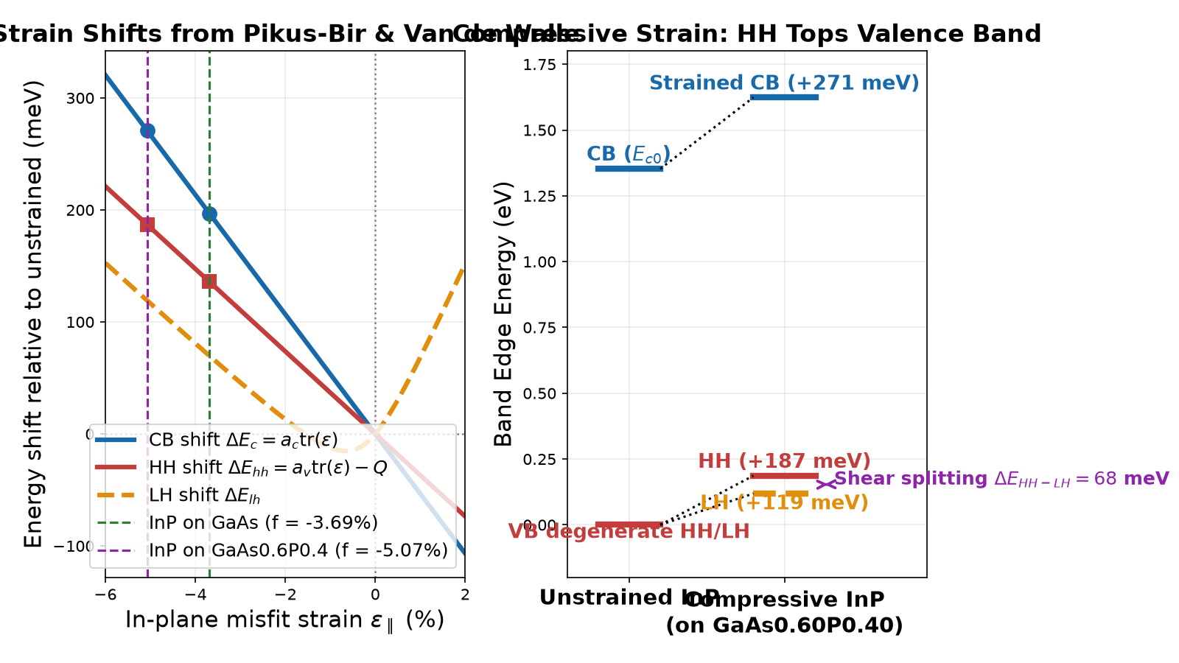
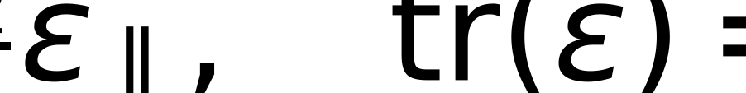
Heterostructure Strain: Hydrostatic Shifts and Shear Splitting
Lattice mismatch f = (a_sub - a_layer) / a_layer produces biaxial strain eps_xx = eps_yy = f
Poisson effect induces perpendicular strain: eps_zz = -2 (C12 / C11) eps_par
Hydrostatic strain tr(eps) shifts bandgap: dE_c = a_c tr(eps) and dE_av = a_v tr(eps)
Tetragonal shear strain Q = b (eps_zz - eps_par) breaks cubic symmetry and splits HH from LH
Compressive strain lifts heavy holes above light holes; LH-SO mixing saturates splitting at 2Delta_so/3 = 72 meV
InP on GaAs has f = -3.7%; on GaAs0.6P0.4 f = -5.1% (stronger compression and larger shift)
Band edge energy shifts and HH-LH splitting vs strain from fsim_core.materials.strain_shifts
elastic tensor relations for pseudomorphic (001) biaxial strain
hydrostatic and Pikus-Bir shear energy shifts of conduction and heavy-hole band edges
Quantum Dot Foundations: Confinement, Strain, and Electronic Structure
Source: a300_GaAs = 5.65325 (fsim_core/materials.py) | a300_InP = 5.8697 (fsim_core/materials.py) | b_shear_InP = -2 (fsim_core/materials.py) | a_c_InP = -6 (fsim_core/materials.py) | split_gaas_meV = 66.065 (undefined) | split_gaasp_meV = 67.75 (undefined) | dE_lh_gaasp_meV = 119.07 (undefined) | dE_hh_gaasp_meV = 186.83 (undefined) | dE_av_gaas_meV = -19.6963 (undefined) | dE_av_gaasp_meV = -27.0761 (undefined) | neg_Q_gaas_meV = 155.601 (undefined) | neg_Q_gaasp_meV = 213.901 (undefined) | split_asymptote_ceiling_meV = 72 (undefined) | split_asymptote_Q20_meV = 71.957 (undefined)
10
Notes:
Epitaxial growth on a lattice-mismatched substrate establishes pseudomorphic biaxial strain [Van de Walle, PRB 39, 1871 (1989)]. In-plane compression (f < 0) induces perpendicular expansion eps_zz = -2 (C12 / C11) eps_par via Poisson deformation. This decomposes into hydrostatic strain tr(eps) = 2 eps_par + eps_zz and axial shear Q = b (eps_zz - eps_par). Under compression, Q < 0. The small-strain linear formula Delta E_HH-LH = -2Q would predict unphysical splittings of 311 meV on GaAs and 428 meV on GaAs0.60P0.40. Because |Q| >> Delta_so (Delta_so = 108 meV for InP), the light-hole and spin-orbit bands mix strongly. As implemented in fsim_core/materials.py from Van de Walle's exact k=0 LH-SO block, the HH-LH splitting saturates at 2 Delta_so / 3 = 72 meV (evaluated to 71.96 meV at Q = -20 eV); evaluated values of 66.1 meV on GaAs and 67.8 meV on GaAs0.60P0.40 sit just below this ceiling. Crucially, the hydrostatic valence-band shift dE_av = a_v,VdW tr(eps) is negative: -19.7 meV on GaAs and -27.1 meV on GaAs0.6P0.4 (a_v,VdW = +0.6 eV, tr eps = -0.0328 / -0.0451). Hole bands move up entirely due to the shear term (-Q = +155.6 meV on GaAs, +213.9 meV on GaAs0.6P0.4), not the hydrostatic shift, yielding dE_hh = +186.8 meV and dE_lh = +119.1 meV on GaAs0.60P0.40.

Slide 11
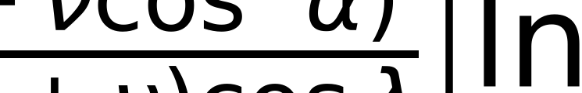
Critical Thickness & Stranski-Krastanov Island Growth
Matthews-Blakeslee dislocation equilibrium vs coherent 3D self-assembly
Elastic strain energy stored in a pseudomorphic layer scales linearly with thickness: E_strain ~ 2 G f^2 h
Matthews-Blakeslee model: beyond critical thickness h_c, dislocation formation becomes favorable
Critical thickness h_c is ~1.3 nm for InP/GaAs and ~0.6 nm (~2 ML) for InP/GaAs0.6P0.4
Stranski-Krastanov (SK) growth mode: 2D layer-by-layer growth transitions spontaneously to 3D islands
3D islands relax strain elastically along their free top facets without creating plastic dislocations
Leaves behind a thin 1-2 ML wetting layer (WL) that acts as a 2D carrier capture reservoir
Matthews-Blakeslee equilibrium critical thickness for 60-degree misfit dislocations, where b is Burgers vector
Quantum Dot Foundations: Confinement, Strain, and Electronic Structure
Source: a300_GaAs = 5.65325 (fsim_core/materials.py) | a300_InP = 5.8697 (fsim_core/materials.py) | wl_thickness_nm = 0.5 (fsim_core/dot_levels.py) | h_c_gaas_nm = 1.2768 (undefined) | h_c_gaasp_nm = 0.5945 (undefined)
11
Notes:
When an epitaxial film grows under lattice mismatch, elastic strain energy accumulates in proportion to the layer thickness h. In 1974, Matthews and Blakeslee derived the equilibrium mechanical force balance between the driving force of the misfit strain and the resisting line tension of a threading dislocation [Matthews & Blakeslee, J. Cryst. Growth 27, 118 (1974)]. Above a critical thickness h_c, generating plastic misfit dislocations becomes energetically favorable to relieve strain. For InP on GaAs (f = -3.69%), the single-layer Matthews-Blakeslee critical thickness evaluated by fsim_core/materials.py is h_c = 1.28 nm; for InP on GaAs0.60P0.40 (f = -5.07%), h_c drops to 0.59 nm, corresponding to just two atomic monolayers. However, under molecular beam epitaxy (MBE) or metalorganic vapour-phase epitaxy (MOVPE), highly strained heteroepitaxy often bypasses planar dislocation relaxation through the Stranski-Krastanov (SK) growth mode [Bimberg et al., 1999, ch. 2]. Growth proceeds initially layer-by-layer for 1 to 2 monolayers, forming a planar 'wetting layer'. As strain energy accumulates, the system minimizes total free energy by spontaneously nucleating coherent three-dimensional nano-islands. These islands relax lattice strain elastically through their free facet edges without forming dislocations. The remaining wetting layer acts as a shallow 2D quantum well that efficiently collects injected carriers before transferring them into the dot.

Slide 12
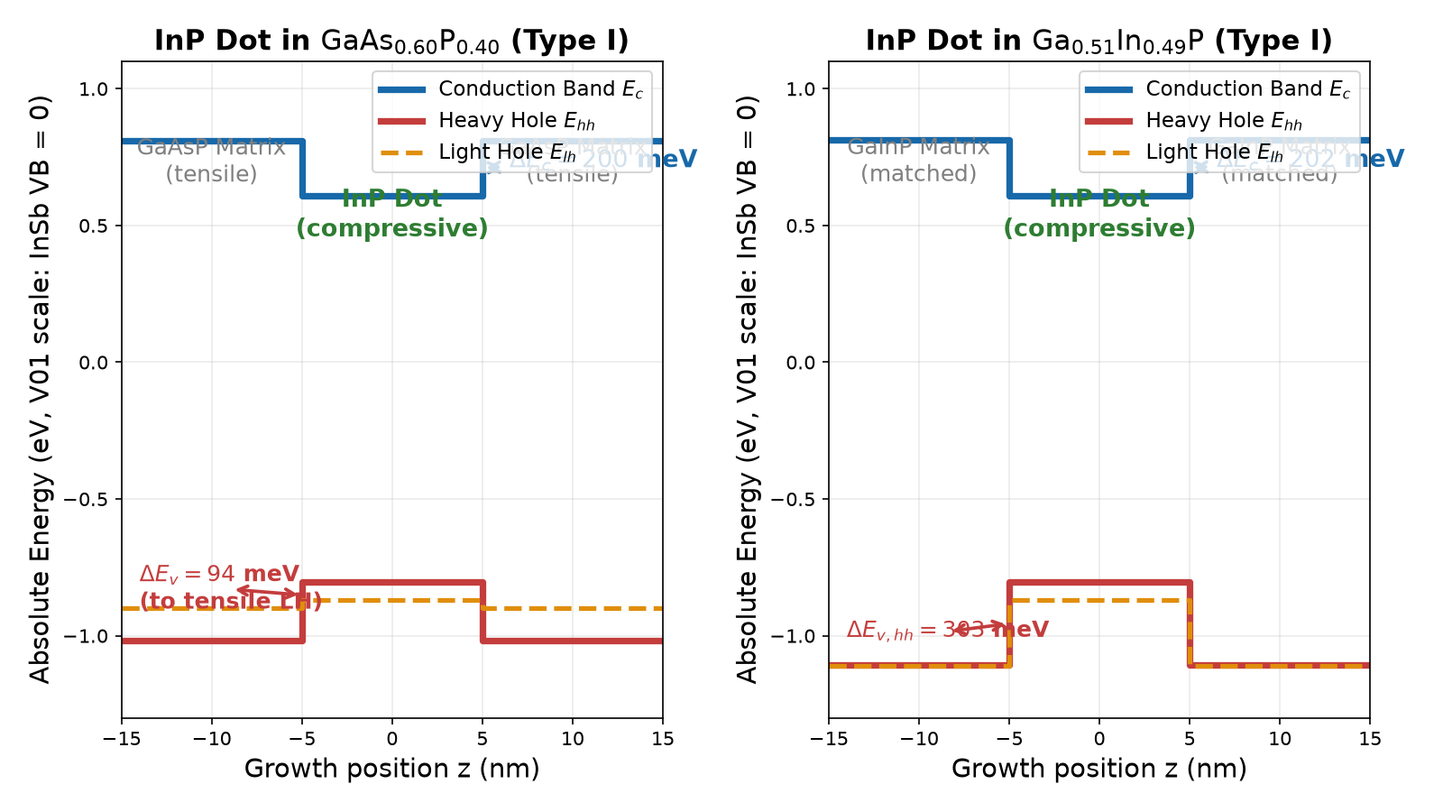
Band Alignment: Model-Solid Theory and Type-I vs Type-II
Van de Walle model-solid theory establishes absolute valence band offsets (VBO) via atomic potentials
Conduction band offset (CBO) follows by adding the strained bandgap: Delta E_c = Delta E_g - Delta E_v
Type-I (straddling alignment): both electrons and holes are confined inside the dot; high optical overlap
Type-II (staggered alignment): one carrier is confined in dot, other in matrix; slow recombination
InP in GaAs0.60P0.40: Delta E_c=200 meV, dE_v,hh=213 meV; hole depth V_h=94 meV (to barrier LH)
InP in Ga0.51In0.49P on GaAs is Type-I: Delta E_c = 202 meV, Delta E_v = 303 meV (model-solid)
Strained band alignment diagrams for InP in GaAs0.60P0.40 and InP in GaInP on GaAs substrate
Quantum Dot Foundations: Confinement, Strain, and Electronic Structure
Source: vbo_GaAs = -0.8 (fsim_core/materials.py) | vbo_InP = -0.94 (fsim_core/materials.py) | V_e_gaasp_meV = 200 (fsim_core/dot_levels.py) | dE_v_hh_gaasp_meV = 213.13 (undefined) | V_h_gaasp_meV = 93.81 (undefined) | dE_c_gainp_gaas_meV = 202.05 (undefined) | dE_v_hh_gainp_gaas_meV = 303.1 (undefined)
12
Notes:
Determining how conduction and valence band edges line up across a heterointerface is central to device design. In 1989, Chris Van de Walle formulated model-solid theory, establishing an absolute energy reference by aligning electrostatic potentials of neutral atomic spheres [Van de Walle, PRB 39, 1871 (1989)]. This yields the unstrained valence band offset Delta E_v0; applying spin-orbit splitting delta_so and strain shifts yields the strained band edges. In a Type-I (straddling) alignment, the narrower-gap dot confines both electrons and holes, giving high spatial overlap and rapid radiative decay (tau_rad ~ 1 ns) [Bimberg et al., 1999]. In Type-II (staggered) alignment, one carrier is confined in the dot and the other in the matrix, drastically suppressing recombination. The module fsim_core/materials.py computes these alignments via materials.offsets. For InP in GaAs0.60P0.40 on GaAs, materials.offsets yields a conduction offset Delta E_c = 200.3 meV (200 meV in dot_levels) and valence offsets dE_v_hh = 213.1 meV and dE_v_lh = 27.7 meV. Because tensile strain pushes the barrier light-hole edge 119 meV above heavy holes, the barrier LH is the topmost valence band. The effective hole confining depth is therefore V_h = E_hh,dot - E_lh,barrier = 93.8 meV (~94 meV). For InP in Ga0.51In0.49P on GaAs, model-solid alignment is also Type-I, with Delta E_c = 202.05 meV (~202 meV) and Delta E_v,hh = 303.10 meV (~303 meV).

Slide 13
The Materials Question: Literal Cladding vs Workable Heterostructure
Literal InP Cladding / GaAsP Well (Fails)
Workable Heterostructure Stack (Succeeds)
InP bulk bandgap is 1.353 eV (1.3529 eV) at 300 K (cutoff lambda = 916 nm)
InP/GaAsP dot emits at 750-816 nm (photon energy 1.52 - 1.65 eV)
Photon energy exceeds InP bandgap: cladding is completely OPAQUE and absorbs emission!
InP lattice constant is 5.870 A vs GaAs substrate 5.653 A (-3.69% mismatch)
Thick (> 1 um) InP cladding relaxes with catastrophic misfit dislocation density
Active region: InP quantum dots in a thin, strain-balanced GaAs0.60P0.40 well
Cladding: (Al0.50Ga0.50)0.51In0.49P core and (Al0.70Ga0.30)0.51In0.49P outer cladding
Ga0.51In0.49P lattice matches GaAs substrate: a = 5.656 A vs 5.653 A (mismatch < 0.05%)
AlGaInP bandgaps (indirect X-min 2.25-2.26 eV, Gamma 2.26-2.39 eV) are transparent to 750-816 nm
Provides both optical waveguiding contrast and high electrical injection barriers
Quantum Dot Foundations: Confinement, Strain, and Electronic Structure
Source: a_GaAs_A = 5.65325 (fsim_core/materials.py) | a_InP_A = 5.8697 (fsim_core/materials.py) | Eg_InP_300K_eV = 1.352886 (undefined) | Eg_AlGaInP_050_min_eV = 2.2468 (undefined) | Eg_AlGaInP_070_min_eV = 2.2611 (undefined) | a_AlGaInP_050 = 5.6602 (undefined) | a_AlGaInP_070 = 5.6619 (undefined) | a_GaInP = 5.6559 (undefined)
13
Notes:
A fundamental engineering problem in this project is the materials paradox of designing a room-temperature edge-emitting single-photon diode [docs/rt_edge_tier.md]. A naive reading might suggest using bulk InP cladding layers surrounding a GaAsP active region. Solid-state optics rules this out completely: from fsim_core/materials.py, the 300 K bulk bandgap of InP is 1.3529 eV (absorption edge at 916 nm). Because the InP/GaAsP dot emits between 750 nm and 816 nm (1.52 eV to 1.65 eV), literal InP claddings would absorb 100% of emitted photons. Furthermore, InP has a lattice constant of 5.8697 A compared to 5.6533 A for GaAs (-3.69% mismatch), so micron-thick InP claddings would exceed critical thickness and generate dense dislocations. The workable solution implemented in cards/edge-inp-gaasp-design.yaml embeds the dot in a GaAs0.60P0.40 well clad by (Al_x Ga_{1-x})0.51 In0.49 P quaternary alloys. While ternary Ga0.51In0.49P has a = 5.656 A closely matching GaAs (5.653 A), the quaternary claddings have lattice constants of 5.6602 A (x_Al = 0.50) and 5.6619 A (x_Al = 0.70), maintaining negligible residual mismatch (<0.16%). Although both the x_Al = 0.50 core (Eg_G = 2.256 eV, Eg_X = 2.247 eV) and x_Al = 0.70 outer cladding (Eg_G = 2.391 eV, Eg_X = 2.261 eV) are indirect per materials.is_direct, their large minimum bandgaps (> 2.24 eV) guarantee complete optical transparency and low-defect epitaxy.

Slide 14
Dot Sizes and Energies: HKUST Experiment vs the 816 nm Solver
Gu et al. (2025) 750 nm observation, solver limits, and the documented 160 meV deviation
Gu et al. (Opt. Express 2025) report 4-7 nm InP dots emitting at 750-755 nm in GaAs0.65P0.35
Single-band solver: evaluates to 816 nm (design card) and 836 nm (Gu geometry)
Documented deviation: ~160 meV red-shift documented in verify/verify_dot_levels.py (deviation d-iv-a)
What the single-band model gets right: realistic confinement scales, size-shift derivatives, escape barriers
Model limits: single-band without k.p mixing; elastic relaxation lowers the gap and cannot explain blue-shift
Honest modeling: simulator uses the physical solver output rather than fitting an unmeasured parameter
Quantum Dot Foundations: Confinement, Strain, and Electronic Structure
Source: lambda_gu_nm = 750 (fsim_core/dot_levels.py) | lambda_card_nm = 815.7 (cards/edge-inp-gaasp-design.yaml) | E_X_gu_model_eV = 1.484 (fsim_core/dot_levels.py) | E_X_card_model_eV = 1.52 (fsim_core/dot_levels.py) | Eg_hh_InP_strained_eV = 1.43682 (undefined) | Eg_hh_InP_unstrained_eV = 1.35289 (undefined)
14
Notes:
A rigorous engineering lecture must confront discrepancies between theoretical models and real experimental devices. In a landmark 2025 paper, Gu and coworkers at HKUST reported epitaxial InP quantum dots embedded in GaAs0.65P0.35 wells on GaAs substrates [Gu et al., Opt. Express 33, 23732 (2025)]. Cross-sectional TEM revealed dot heights of 4 to 7 nm and diameters around 25 nm, with ensemble emission around 750 to 755 nm (1.64 to 1.65 eV). When the repository single-band separable disk solver (fsim_core/dot_levels.py) is run on Gu geometry at 300 K, it predicts 836 nm (1.484 eV); the design card at h = 4.0 nm in GaAs0.60P0.40 predicts 815.7 nm (1.520 eV). This ~160 meV discrepancy is tracked as a documented deviation in verify/verify_dot_levels.py (deviation d-iv-a) rather than hidden [docs/rt_edge_tier.md]. Crucially, partial elastic strain relaxation cannot explain this blue-shift: in compressively strained InP, relaxation lowers the bandgap toward unstrained bulk, creating a red-shift (materials.strain_shifts gives Eg_hh = 1.4368 eV at eps = -5.07% relaxing toward 1.3529 eV at eps = 0). As documented in verify/verify_dot_levels.py, the discrepancy arises because the coherent single-band disk model neglects multiband k.p mixing [Stier et al., PRB 59, 5688 (1999)] and 3D strain tensors [Grundmann et al., PRB 52, 11969 (1995)], compounded by alloy ordering and ensemble type-I/II mixing.

Slide 15
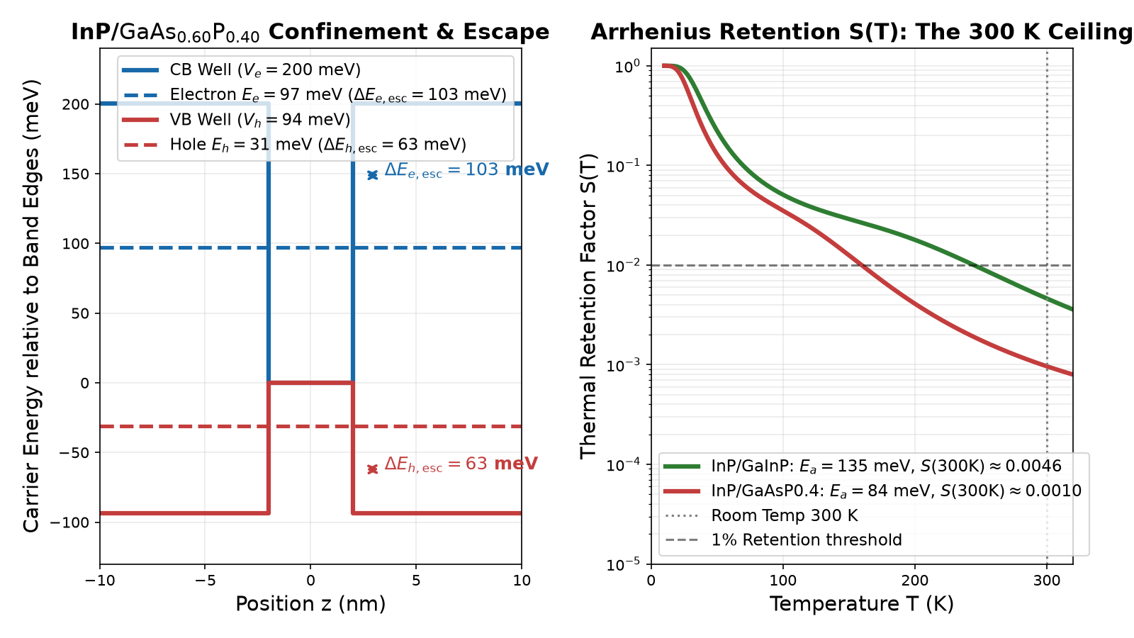
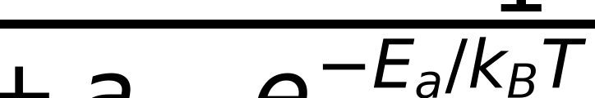
Carrier Confinement Summary: Levels, Escape, and the Thermal Ceiling
InP/GaAsP0.4 preset (300 K): electron state E_e = 97 meV, hole state E_h = 31 meV
Carrier escape barriers: electron escape dE_e = 103 meV, hole escape dE_h = 63 meV
InP/GaInP preset (300 K): deeper well V_e=415 meV gives E_e=180 meV, dE_e=235 meV
Arrhenius thermal escape rate R_esc ~ nu_0 exp(-E_a / k_B T) competes directly with radiative decay
At 300 K, single-channel 50% retention needs E_a ~ 262 meV; second channel caps S <= 0.0154
InP/GaAsP retention S(300 K) collapses to ~0.0010 (0.000964), setting the room-temperature brightness ceiling
Potential wells, bound states, and Arrhenius retention curves S(T) from fsim_core.dot_levels
two-channel Arrhenius thermal retention factor from fsim_core.integrator.retention
Quantum Dot Foundations: Confinement, Strain, and Electronic Structure
Source: V_e_gaasp_meV = 200 (fsim_core/dot_levels.py) | dE_e_matrix_gu_meV = 105 (fsim_core/dot_levels.py) | S_300K_gaasp = 0.00096377 (undefined) | S_300K_gainp = 0.00461745 (undefined) | V_e_gainp_300K_meV = 415.3 (undefined) | dE_e_gainp_300K_meV = 234.9 (undefined) | E_a_gaasp_meV = 83.8 (undefined) | E_a_gainp_meV = 135 (undefined) | a_esc_gaasp = 24873 (undefined) | E_b_gaasp_meV = 11.6 (undefined) | S_Ea150_gaasp = 0.00715 (undefined) | S_cap_gaasp = 0.0154 (undefined) | E_a_req_50pct_meV = 261.66 (undefined)
15
Notes:
We summarize the electronic eigenstate solutions computed by fsim_core/dot_levels.py for our two primary systems. For an InP dot in GaAs0.60P0.40 at 300 K (height 4.0 nm, radius 12.0 nm), potential depths are V_e = 200 meV and V_h = 94 meV. Single-particle confinement energies are E_e = 97 meV (83 meV vertical, 14 meV lateral) and E_h = 31 meV (23 meV vertical, 8 meV lateral), leaving escape barriers dE_e = 103 meV and dE_h = 63 meV. For the InP/Ga0.51In0.49P preset at 300 K, deeper conduction confinement (V_e = 415 meV) yields E_e = 180 meV and dE_e = 235 meV (at 5 K: 436 meV, 184 meV, and 251 meV). As temperature reaches 300 K (k_B T = 25.85 meV), carriers escape via phonon-assisted activation at rate R_esc ~ nu_0 exp(-E_a / k_B T) [Chatzarakis et al., Phys. Rev. Appl. 20, 034011 (2023)]. For InP/GaAsP, shallow barriers yield E_a = 83.8 meV, collapsing retention S(300 K) to 0.000964 (~0.0010 in fig_01_15). The deeper InP/GaInP system (E_a = 135.0 meV) retains S(300 K) = 0.004617 (~0.0046). With two-channel parameters (a_esc = 24873, b_p = 100, E_b = 11.6 meV), E_a = 150 meV still yields only S = 0.0072, and the second channel caps S at 0.0154 even as E_a -> infinity; achieving 50% single-channel retention would require E_a ~ 262 meV.

Slide 16
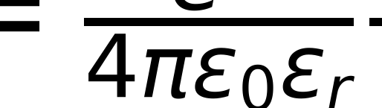
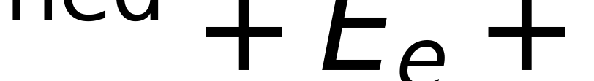
Exciton in a Quantum Dot: The Gaussian Binding Formula
Coulomb expectation value, relative coordinate integration, and transition energy
In strong confinement, single-particle orbitals psi_e and psi_h are established by the potential well
Coulomb attraction enters as a first-order correction: E_bind = <psi_e psi_h | V_c | psi_e psi_h>
With Gaussian envelopes exp(-r^2 / l^2), relative coordinate rho has width L = sqrt(l_e^2 + l_h^2)
Integrating 2D density p(rho) = (2 rho / L^2) exp(-rho^2 / L^2) yields <1/rho> = sqrt(pi) / L
Closed-form binding formula: E_bind = (e^2 / (4 pi eps_0 eps_r)) * sqrt(pi) / sqrt(l_e^2 + l_h^2)
InP/GaAsP dot: e_r = 6.704 nm, h_r = 6.541 nm, eps_r = 12.5 yields E_bind = 21.798 meV
Gaussian variational exciton binding formula used in fsim_core.dot_levels._gauss_binding
neutral exciton optical emission energy
Quantum Dot Foundations: Confinement, Strain, and Electronic Structure
Source: e2_4pieps0 = 1439.964 (fsim_core/dot_levels.py) | eps_r_InP = 12.5 (fsim_core/dot_levels.py) | height_design_nm = 4 (cards/edge-inp-gaasp-design.yaml) | radius_design_nm = 12 (cards/edge-inp-gaasp-design.yaml) | E_bind_gaasp_meV = 21.7984 (undefined) | l_xy_gaasp_nm = 6.6233 (undefined) | e_r_gaasp_nm = 6.704 (undefined) | h_r_gaasp_nm = 6.541 (undefined)
16
Notes:
Once the single-particle confinement states are solved, we determine the optical transition energy by including the electron-hole Coulomb interaction. In the strong confinement regime, the single-particle orbitals are frozen, and the Coulomb energy is evaluated as an expectation value [Bimberg et al., 1999, ch. 4]. The repository module fsim_core/dot_levels.py uses an elegant analytical Gaussian variational formula derived in _gauss_binding. The in-plane electron and hole envelopes are characterized by effective Gaussian lateral radii l_e and l_h, where |psi|^2 ~ exp(-r^2 / l^2). The relative coordinate vector rho = r_e - r_h is itself Gaussian distributed with a combined variance L^2 = l_e^2 + l_h^2. Integrating the inverse Coulomb distance 1/rho against the two-dimensional radial probability density p(rho) = (2 rho / L^2) exp(-rho^2 / L^2) yields the closed-form result <1 / rho> = sqrt(pi) / L. Multiplying by the screened Coulomb prefactor gives E_bind = (e^2 / 4 pi eps_0 eps_r) * sqrt(pi) / sqrt(l_e^2 + l_h^2). For our primary InP/GaAsP dot, the rms lateral radii are e_r = 6.704 nm and h_r = 6.541 nm (with mean orbital parameter lv.l_xy_nm = 6.623 nm) with eps_r = 12.5, which evaluates to E_bind = 21.798 meV (~21.8 meV). The net exciton emission energy is E_X = E_g(strained) + E_e + E_h - E_bind = 1.414 eV + 0.097 eV + 0.031 eV - 0.022 eV = 1.520 eV (lambda = 815.7 nm).

Slide 17
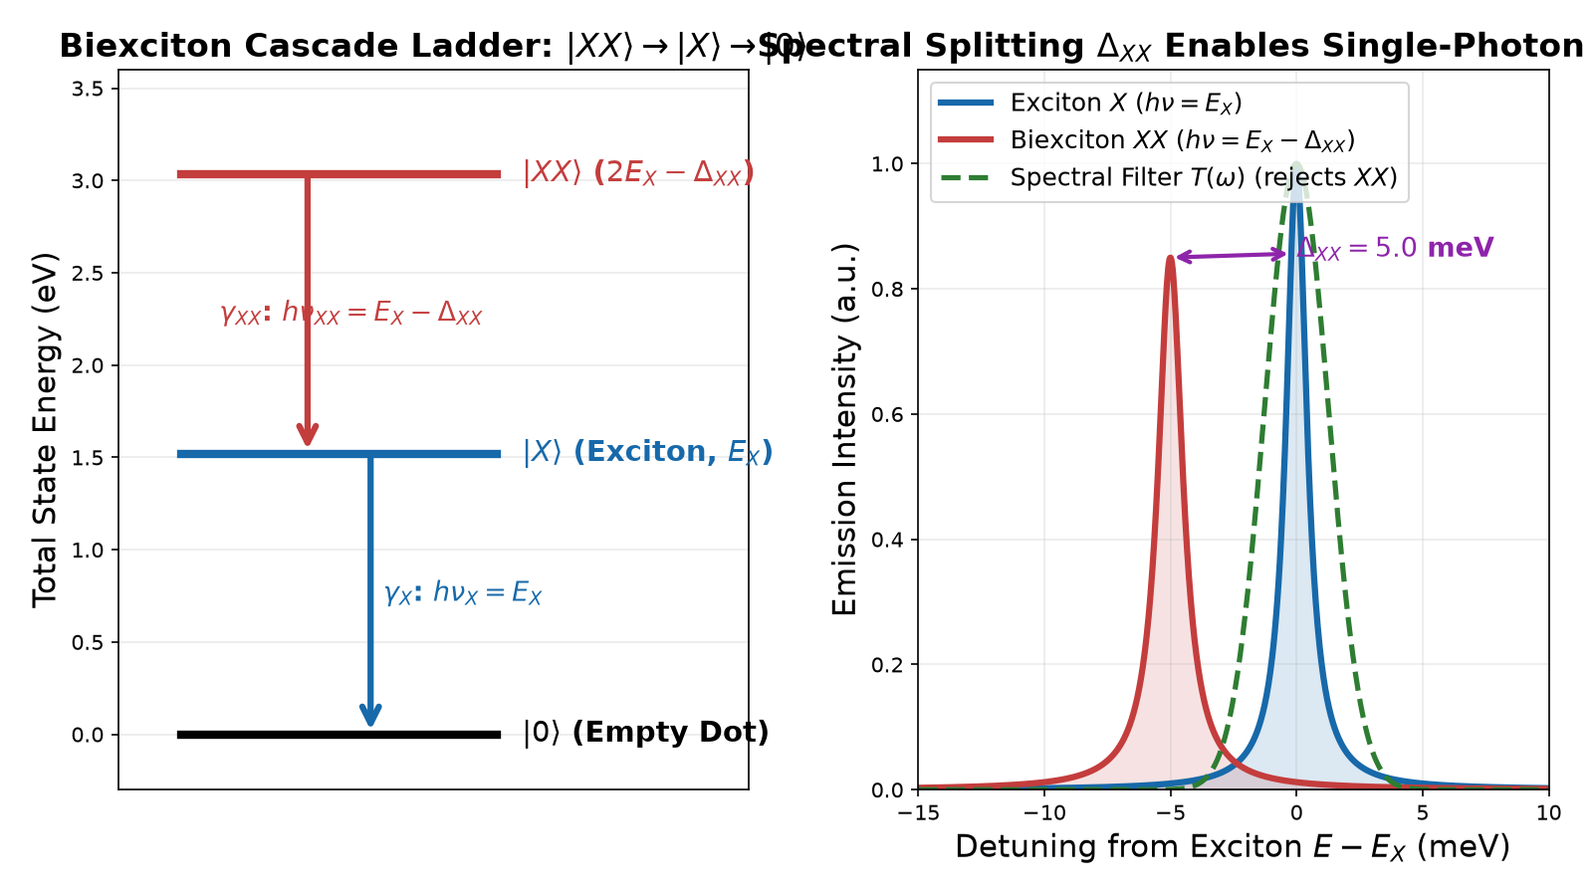


The Biexciton State: Binding Energy and Radiative Cascade
Biexciton state |XX>: two electrons and two holes occupying the ground s-shell in spin-singlet pairs
Total biexciton energy: E(XX) = 2 E_X - Delta_XX, where Delta_XX is the biexciton binding energy
Delta_XX incorporates attractive electron-hole Coulomb and repulsive carrier-carrier exchange terms
Typical values: Delta_XX is 4-8 meV for InP (Beirne 4-6 meV [DR via Reischle], Bommer 7+-1 meV [V])
Radiative cascade: |XX> emits at h nu_XX = E_X - Delta_XX, then |X> decays to |0>
Spectral filtering: a narrow bandpass filter transmits E_X and rejects E_XX, enforcing single-photon emission
Biexciton cascade ladder and spectral line separation Delta_XX used for single-photon filtering
total energy of the biexciton state relative to the empty dot ground state |0>
cascade photon energies for XX -> X and X -> 0 transitions
Quantum Dot Foundations: Confinement, Strain, and Electronic Structure
Source: delta_xx_design_meV = 5 (cards/edge-inp-gaasp-design.yaml) | delta_xx_bommer_meV = 7 (cards/edge-inp-gainp-design.yaml) | delta_xx_chatzarakis_meV = 5.9 (undefined)
17
Notes:
When two electron-hole pairs occupy a quantum dot simultaneously, they form a biexciton state |XX> [Michler ed., 2017, ch. 2]. By the Pauli exclusion principle, two electrons occupy the ground s-shell in a spin-singlet (S = 0), and two heavy holes form a pseudospin singlet (J = 0). The total biexciton energy is E(XX) = 2 E_X - Delta_XX, where Delta_XX is the biexciton binding energy or spectral shift. Delta_XX balances electron-hole Coulomb attraction, carrier-carrier repulsion, and exchange-correlation effects. In self-assembled dots, Delta_XX is typically positive (bound biexciton). For InP/GaInP dots, the evidence ledger records Delta_XX = 4-6 meV from Beirne et al. [PRB 75, 195302 (2007); Reischle et al., Opt. Express 16, 12771 (2008)] and 7 +/- 1 meV from Bommer et al. [JAP 110, 063108 (2011)], while Chatzarakis-class dots exhibit 5.9 meV [DR] [Chatzarakis et al., PR Applied 20, 034011 (2023); fsim_core/presets.py]. Relaxation proceeds through a two-photon cascade: |XX> decays to |X>, emitting at h nu_XX = E_X - Delta_XX, after which |X> decays to the empty state |0> at h nu_X = E_X. Because the two photons differ by Delta_XX, a narrow bandpass filter around the exciton line rejects the biexciton photon, enforcing high single-photon purity.

Slide 18
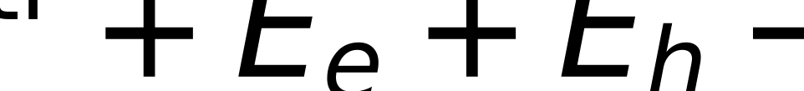
Charged Excitons (Trions): X+ and X- Dynamics
Coulomb shifts, spin-singlet pairing, and deterministic electrostatic charging control
Residual background doping can inject an uncompensated carrier into the dot before optical excitation
Trion X- (2e + 1h): electrons form singlet (S=0); trion X+ (1e + 2h): holes form singlet
Trion emission lines are spectrally shifted from neutral X by 1 to 6 meV via Coulomb interactions
Absence of fine-structure splitting: singlet pairing cancels isotropic electron-hole exchange interaction
Trions emit unpolarized or circularly polarized single photons without polarization-dependent beatings
Gate bias in a p-i-n diode tunes Fermi level to deterministically select neutral X, X-, or X+
negative trion optical emission energy where recombination leaves one spectator electron
Quantum Dot Foundations: Confinement, Strain, and Electronic Structure
18
Notes:
If an extra charge carrier resides in the quantum dot prior to excitation, the resulting optical complex is a charged exciton, commonly known as a trion [Bimberg et al., 1999, ch. 4] [Michler, 2017, ch. 3]. An extra electron forms a negative trion X- (two electrons and one hole), while an extra hole forms a positive trion X+ (one electron and two holes). Because the two identical carriers occupy the same spatial s-shell, the Pauli exclusion principle forces their spins into an antiparallel singlet state (S = 0 for the two electrons in X-, or J = 0 for the two heavy holes in X+). Trion emission occurs when one electron-hole pair recombines, ejecting a photon and leaving behind the single spectator carrier. Because the trion contains an additional carrier, extra Coulomb attraction and repulsion terms shift the emission energy by 1 to 6 meV relative to the neutral exciton X. A profoundly useful consequence of trion physics is the complete absence of fine-structure splitting. Because the two paired carriers form a spin singlet, the net electron-hole exchange interaction vanishes identically. Consequently, trion recombination produces an unpolarized singlet emission line, avoiding the polarization-dependent beatings that can complicate neutral exciton emission. In electrically driven devices, applying a DC gate bias across a p-i-n junction allows deterministic tuning of the quantum dot charging state through Coulomb blockade.

Slide 19
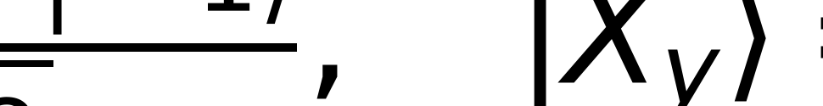

Fine-Structure Splitting: Electron-Hole Exchange and Symmetry
Anisotropic exchange interaction, C_2v symmetry breaking, and polarization eigenstates
Electron spin s = 1/2 and heavy-hole pseudospin j_z = +-3/2 yield four exciton spin configurations
Dipole-active 'bright' states have total angular momentum projection J_z = +-1; 'dark' states have J_z = +-2
Ideal cylindrical symmetry (D_2d) leaves the bright states |+1> and |-1> degenerate (circular polarization)
Real self-assembled dots have structural elongation and C_2v interface anisotropy that break cylindrical symmetry
Anisotropic electron-hole exchange mixes |+1> and |-1> into orthogonal linear eigenstates: |X_x> and |X_y>
Delta_FSS = |E_x - E_y| is typically 5-50 ueV in InP dots and 10-100 ueV in InAs dots
linearly polarized bright exciton eigenstates along [110] and [1-10] crystal axes
fine-structure splitting between linearly polarized exciton components
Quantum Dot Foundations: Confinement, Strain, and Electronic Structure
19
Notes:
The internal spin structure of the neutral exciton gives rise to fine-structure splitting (FSS), a crucial consideration in quantum dot optics [Bimberg et al., 1999, ch. 4] [Michler, 2017, ch. 2]. An s-shell electron with spin s = 1/2 and a heavy hole with pseudospin j_z = +-3/2 combine to form four spin configurations. The states with total angular momentum projection J_z = +-2 are optically inactive ('dark' excitons) because single-photon transitions cannot carry two units of angular momentum. The states with J_z = +-1 are optically active ('bright' excitons) and couple to left- and right-circularly polarized photons. In an ideal quantum dot with cylindrical symmetry, the |+1> and |-1> states are strictly degenerate. However, real self-assembled quantum dots deviate from perfect circular symmetry due to in-plane elongation along crystallographic axes ([110] versus [1-10]), piezoelectric strain fields, and the atomistic C_2v symmetry of zincblende interfaces. This symmetry reduction activates the anisotropic electron-hole exchange interaction H_exch, which mixes |+1> and |-1> into two orthogonal linearly polarized eigenstates, |X_x> and |X_y>. The resulting energy splitting Delta_FSS is typically 5 to 50 ueV in InP dots and 10 to 100 ueV in InAs dots. For single-photon sources, FSS simply means the emission consists of two closely spaced orthogonal linearly polarized lines, which does not degrade second-order intensity antibunching.

Slide 20
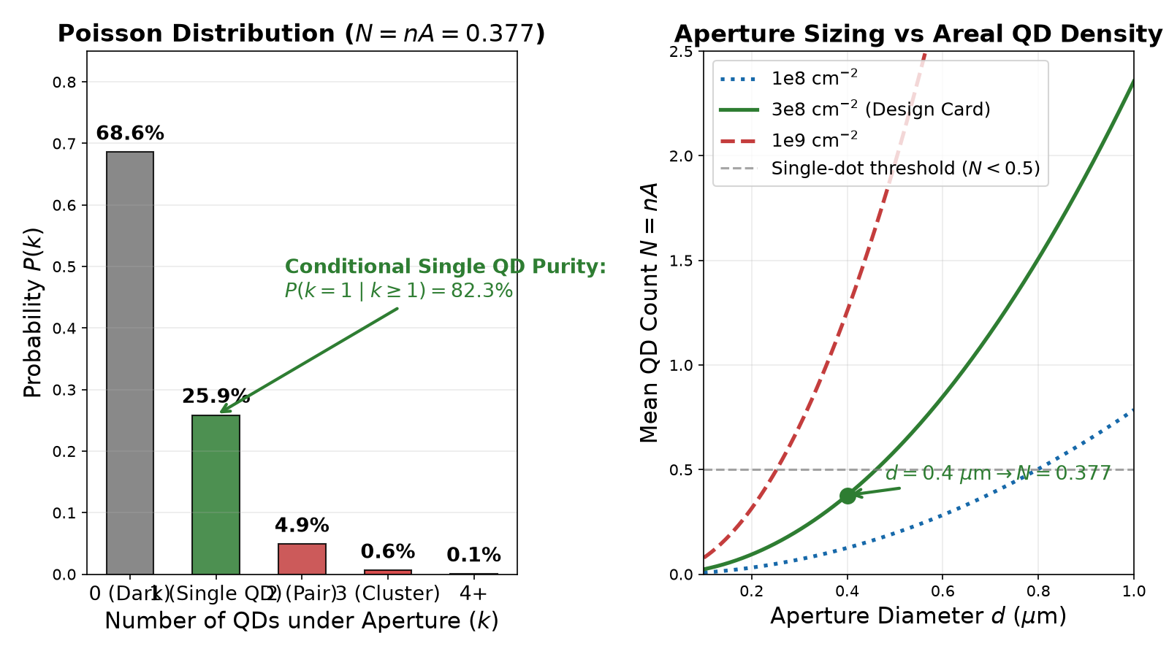

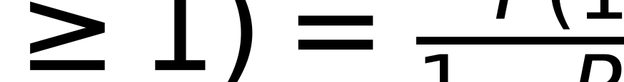
Single-Dot Isolation: Density, Apertures, and Poisson Statistics
Stranski-Krastanov growth nucleates a random spatial ensemble with areal density n = 10^8 - 10^10 cm^-2
A submicron aperture of diameter d restricts collection area to A = pi d^2 / 4
Number of dots k under the aperture follows a Poisson distribution: P(k) = N^k e^(-N) / k!
Design card: n = 3e8 cm^-2, diameter d = 0.4 um yields N = 0.377 dots
Probabilities: P(0) = 68.6% (empty), P(1) = 25.9% (single QD), P(>=2) = 5.5% (multi-dot cluster)
Conditional single-dot purity: P(1 | k >= 1) = 82.3% of light-emitting devices isolate exactly ONE dot!
Poisson distribution at N = 0.377 and mean dot count vs aperture diameter from cards/edge-inp-gaasp-design.yaml
mean Poisson expectation of quantum dot count under an aperture of diameter d
conditional probability that an active light-emitting aperture contains strictly one dot
Quantum Dot Foundations: Confinement, Strain, and Electronic Structure
Source: density_cm2 = 300000000 (cards/edge-inp-gaasp-design.yaml) | diameter_um = 0.4 (cards/edge-inp-gaasp-design.yaml) | aperture_um2 = 0.12566370614359174 (cards/edge-inp-gaasp-design.yaml) | N_dots_expected = 0.377 (verify/verify_transport.py) | P_cond_single_dot = 0.823316 (undefined)
20
Notes:
A practical quantum dot single-photon source must isolate a single quantum dot from an as-grown ensemble containing millions of dots across the wafer. Epitaxial Stranski-Krastanov growth produces a random spatial distribution with areal densities typically between 10^8 and 10^10 cm^-2 [Bimberg et al., 1999, ch. 2]. To isolate an individual emitter, a submicron aperture is fabricated in a top metal contact or mask layer. The number of dots k captured within the aperture area A follows a spatial Poisson distribution P(k) = N^k exp(-N) / k!, where the mean expectation is N = n_QD * A [cards/edge-inp-gaasp-design.yaml]. In our primary edge-emitter design card, low-density epitaxy targets n_QD = 3 x 10^8 cm^-2 and the aperture diameter is d = 0.4 um. This gives an aperture area of A = pi (0.2 um)^2 = 0.1257 um^2 = 1.257 x 10^-9 cm^2, resulting in a mean dot expectation of N = 0.377 dots. Under these statistics, 68.6% of apertures contain zero dots (P(0) = 0.686), 25.9% contain exactly one dot (P(1) = 0.259), and only 5.5% contain two or more dots. Crucially, when testing devices on a probe station, empty apertures do not emit light and are discarded. The conditional probability that an active, light-emitting aperture contains strictly one dot is P(1 | k >= 1) = P(1) / (1 - P(0)) = 0.2586 / 0.3141 = 82.33% (82.3%)! Combined with spectral filtering, this provides exceptional single-dot isolation.

Slide 21
Deterministic Dot Engineering: Mesas, Masks, and Site Control
Nanofabrication techniques for addressing and integrating individual quantum dots
Etched micro-mesas: dry etching (ICP-RIE) forms isolated semiconductor pillars of diameter 0.5-2.0 um
Opaque shadow masks: electron-beam lithography patterns submicron apertures in metal films (Al/Au)
In-situ optical lithography: maps exact coordinates of pre-selected dots with ~50 nm accuracy
Deterministic cavity alignment: optical resonators etched precisely concentric with registered dots
Site-controlled nucleation: substrate nano-patterning (pyramidal recesses) triggers single-dot growth at fixed sites
Eliminates spatial Poisson randomness, enabling scalable arrays for quantum photonic integrated circuits
Quantum Dot Foundations: Confinement, Strain, and Electronic Structure
21
Notes:
While random spatial isolation via shadow masks is effective for individual research devices, scalable quantum photonic integration demands deterministic positioning of single quantum dots [Michler ed., 2017, ch. 10]. Several sophisticated nanofabrication strategies have been developed to overcome Poisson positioning randomness. The most common physical method is etching deep micro-mesas or nanopillars through the active quantum dot layer using inductively coupled plasma reactive-ion etching (ICP-RIE), isolating single dots in defined optical pillars. A second approach uses metallic shadow masks with nanoscale apertures defined by electron-beam lithography. To deterministically integrate quantum dots into photonic cavities or waveguides, researchers developed in-situ optical lithography: a low-temperature micro-photoluminescence scan maps the precise spatial coordinates of a bright, high-purity single dot relative to global alignment marks with ~50 nm accuracy, followed by aligned electron-beam lithography to pattern a cavity exactly centered on the dot [Dousse et al., PRL 101, 267404 (2008)]. Finally, site-controlled epitaxy uses pre-patterned nano-holes or inverted pyramidal recesses etched into the substrate prior to growth. Surface diffusion guides adatoms into the bottom of each recess, nucleating exactly one quantum dot per site with predetermined spatial periodicity.

Slide 22
Material Platform Comparison: InAs/GaAs vs InP/GaInP vs InP/GaAsP
Parameter | InAs / GaAs | InP / Ga0.51In0.49P | InP / GaAs0.60P0.40
Emission wavelength | 900 - 1300 nm (NIR) | 650 - 750 nm (Red) | 750 - 816 nm (Far-red)
Lattice mismatch f | -6.69% (vs GaAs) | -3.642% (vs GaInP) | -5.07% (vs GaAsP)
Conduction offset V_e | 450 - 500 meV | 250 - 436 meV | 200 meV
Electron escape dE_e | 200 - 300 meV | 235 - 251 meV | 103 meV
Hole escape dE_h | 110 - 150 meV | 48.4 meV (300 K; 49.2 at 5 K) | 63 meV
Wetting layer escape | 110 - 240 meV | 285 meV | 168 meV
LO phonon energy | 36.6 meV (GaAs) | 43.4 meV (InP) | 38.5 meV (GaAsP)
Operating limit | 80 - 230 K (with SSL) | 80 K (LED) / 150 K (PL) | 300 K (target heatsink)
Quantum Dot Foundations: Confinement, Strain, and Electronic Structure
Source: mismatch_InAs_GaAs = -0.066859 (undefined) | WL_escape_chatzarakis_ssl_meV = 240 (verify/verify_dot_levels.py) | dE_h_gainp_300K_meV = 48.41 (undefined) | escape_ref_Pryor_meV = 250 (verify/verify_dot_levels.py) | Bommer_Ea_meV = 96 (verify/verify_dot_levels.py) | Chatzarakis_WL_meV = 110 (verify/verify_dot_levels.py) | mismatch_InP_GaInP = -0.03642 (undefined) | dE_h_gainp_5K_meV = 49.19 (undefined) | dE_h_bommer_5K_meV = 90.61 (undefined)
22
Notes:
To provide broad context, this table compares three leading quantum dot platforms: near-infrared InAs/GaAs, visible-red InP/GaInP, and far-red InP/GaAsP [verify/verify_dot_levels.py]. Each column evaluates lattice mismatch relative to its matrix host: -6.69% for InAs on GaAs, -3.642% for InP on Ga0.51In0.49P (materials.mismatch(InP, GaInP) = -3.642%, distinct from -3.69% on GaAs substrate), and -5.07% for InP on GaAs0.60P0.40. InAs/GaAs features deep conduction confinement (V_e ~ 500 meV), enabling operation up to 230 K with short-period superlattices (SSL) [Chatzarakis et al., 2023], but emits beyond peak silicon SPAD efficiency. InP dots in Ga0.51In0.49P emit in the red (650-750 nm), well matched to silicon SPADs, with hole escape barrier dE_h = 48.4 meV at 300 K (49.2 meV at 5 K) from dot_levels; the Bommer-class preset (InP/AlGaInP0.2/AlGaInP0.55) deepens this to 90.6 meV. Reischle et al. (2008) demonstrated pulsed single-photon emission at 80 K. Our primary candidate, InP in GaAs0.60P0.40, bridges these regimes (750-816 nm), maintaining transparency and silicon compatibility, but shallower conduction offset (V_e = 200 meV) gives electron escape dE_e = 103 meV and hole escape dE_h = 63 meV. High LO phonon energies (43.4 meV in InP vs 36.6 meV in GaAs) also shape dephasing across platforms.

Slide 23
Section 1 Summary: The Physical Foundations
Synthesizing confinement, strain, band structure, and single-dot isolation
3D quantum confinement creates discrete atom-like density of states, concentrating optical strength
Strong confinement regime decouples electron and hole; Coulomb acts as a ~22 meV binding correction
Compressive biaxial strain lifts HH-LH degeneracy by ~68 meV, ensuring a pure heavy-hole ground state
Model-solid theory confirms Type-I band alignment; (Al,Ga)InP claddings resolve the transparency paradox
Biexciton binding Delta_XX (4-8 meV) enables clean single-photon spectral filtering against multi-photon pulses
Submicron spatial apertures with low-density growth (N = 0.377) yield >82% single-dot device isolation
Quantum Dot Foundations: Confinement, Strain, and Electronic Structure
23
Notes:
In this opening section, we have established the complete physical foundation of quantum dot single-photon emitters [Bimberg et al., 1999] [Michler ed., 2017]. We saw how spatial confinement along all three dimensions collapses the continuous band spectrum into discrete Dirac delta-function states, creating an 'artificial atom'. Because self-assembled dots reside in the strong confinement regime, the single-particle kinetic energies dominate, while the electron-hole Coulomb attraction acts perturbatively with a Gaussian binding energy of ~22 meV. Biaxial compressive strain from lattice mismatch (f = -3.7% to -5.1%) shifts the conduction band upward and induces a tetragonal shear splitting that pushes the heavy-hole band ~68 meV above the light-hole band, ensuring that the optically active ground state involves pure heavy holes with high in-plane dipole strength. We resolved the materials question of the device tier: literal InP claddings are opaque and dislocated, whereas lattice-matched (Al,Ga)InP quaternary claddings provide wide bandgaps, high optical transparency, and excellent waveguiding contrast. Finally, biexciton Coulomb correlation provides a 4 to 8 meV spectral shift Delta_XX (Beirne 4-6 meV [DR via Reischle 2008], Bommer 7 +/- 1 meV [V]), allowing narrow optical filtering to isolate single photons, while spatial apertures with mean expectation N = 0.377 guarantee that over 82% of light-emitting devices contain strictly one isolated quantum dot.

Slide 24
Bridge to Section 2: How a Quantum Dot Emits
From stationary electronic eigenstates to dynamic light-matter interactions
Section 1 established stationary eigenstates: energy levels E_e, E_h, and exciton energy E_X
Section 2 question: How do discrete electronic states couple to the quantized radiation field?
Spontaneous emission dynamics: dipole matrix elements |d_cv|^2 and radiative lifetime tau_rad ~ 1 ns
Carrier-phonon coupling: acoustic phonon sidebands via the independent boson model and the ZPL
Temperature-dependent dephasing: how acoustic and LO phonons broaden emission linewidth Gamma(T)
The fundamental filter tradeoff: rejecting the biexciton vs transmission loss at room temperature
Quantum Dot Foundations: Confinement, Strain, and Electronic Structure
24
Notes:
Having established the stationary electronic eigenstates, band alignments, strain fields, and exciton binding energies in Section 1, we are now fully prepared to examine the dynamic light-matter interaction in Section 2: 'How a quantum dot emits' [Fox, Quantum Optics, ch. 8] [Michler ed., 2017]. The central question changes from 'what are the energy levels?' to 'how quickly and with what spectral purity does the quantum dot radiate photons?' In Section 2, we will apply time-dependent perturbation theory and Fermi's golden rule to derive the spontaneous emission rate Gamma_rad and radiative lifetime tau_rad ~ 1 ns from the microscopic interband dipole matrix element d_cv. We will then examine how the localized carriers couple to the vibrating crystal lattice. Using the independent boson model, we will dissect the emission spectrum into a coherent zero-phonon line (ZPL) and broad acoustic phonon sidebands. We will explore how phonon scattering causes pure dephasing, broadening the homogeneous linewidth Gamma(T) from sub-microelectronvolts at cryogenic temperatures to tens of millielectronvolts at 300 K. Finally, we will analyze the critical filter tradeoff: narrow spectral filtering is essential to reject biexciton photons, but as the exciton linewidth broadens with temperature, filtering incurs severe transmission losses. Join us in Section 2 as we bridge quantum electronics to photon emission.

Slide 25
How a quantum dot emits
From a few-level solid to a measurable quantum optical source
How a quantum dot emits
25
Notes:
This section builds emission from a confined semiconductor level up to the number a photon-correlation detector reports, and it insists on keeping three claims separate: a quantum device (3D confinement and Coulomb blockade, carrier quantum mechanics), a quantum treatment of the dot (exciton-phonon coupling, exciton-biexciton-trion structure), and a quantum treatment of the light (field quantization, g^(2)(tau), regression theorem) [Project's own treatment slides, slide 3]. The repository's own model sits at Level 2 of that hierarchy: a semiclassical rate-equation cascade with photon statistics attached through cascade identities, not a Lindblad master equation with quantized field modes [Fox, Quantum Optics (2006), ch. 8]. We follow the chain in order -- dipole coupling, Fermi's golden rule, the exciton-biexciton-trion ladder, the cap-2 rate equations fsim_core/cw_g2.py solves, Hanbury Brown-Twiss statistics, background dilution, finite loading, detector response, phonon sidebands, thermal linewidth broadening, and thermal carrier escape -- ending with the room-temperature landscape and what remains unmeasured. Every number carries either a citation to a published measurement, a repository module that computed it, or an explicit assumption tag; the goal is that nobody mistakes a design-sensitivity sweep for a completed device certification.

Slide 26
What does ‘quantum’ mean here?
Quantum device
Quantum treatment of light
3D confinement gives discrete carrier states.
Coulomb blockade controls charge occupancy.
Quantised field, Fock states, and operators.
Normally ordered g² tests the output.
How a quantum dot emits
26
Notes:
The word 'quantum' does triple duty in this literature, and conflating the meanings is a common error in claims about single-photon sources [Project's own treatment slides, slide 3]. A 'quantum device' means only that carrier motion is quantum mechanical: three-dimensional confinement gives discrete electron and hole levels, and Coulomb blockade fixes how many charges can occupy the dot at once. Neither property says anything about the emitted field. A 'quantum treatment of the light' is the separate, stronger claim that the electromagnetic field itself is quantized -- Fock states, ladder operators [a, a-dagger] = 1 -- so photon correlation functions such as the normally ordered g^(2)(tau) become well-defined observables rather than heuristics [Loudon, The Quantum Theory of Light]. A device can be a genuine quantum device (confined, blockaded) while its light is described entirely classically; conversely, establishing g^(2)(0) < 1 requires the field-quantized description regardless of how classical or semiclassical the emitter model underneath it is. This section keeps the two axes visually and verbally distinct throughout, since the repository itself only ever implements the first axis together with a cascade shortcut for the second.

Slide 27
Quantum treatment of the dot versus the light
layer | formalism | observable
device | confinement and blockade | levels and charge
dot | 0/X/XX; master or rate equation | populations and coherence
light | Fock modes; input-output; regression | g²(τ), HOM
repository tier | semiclassical cascade | purity and brightness
How a quantum dot emits
27
Notes:
The table separates four analysis layers often blurred into one 'quantum dot' claim. The device layer is carrier confinement and Coulomb blockade -- levels and charge occupancy, no photon physics yet. The dot layer follows internal exciton/biexciton/trion states through either a rate equation or a master equation, giving populations and, at the master-equation level, coherences. The light layer quantizes the field itself: Fock modes, input-output theory [Gardiner and Collett, Phys. Rev. A 31, 3761 (1985)], and the quantum regression theorem, which actually produces g^(2)(tau) and Hong-Ou-Mandel visibility from a Lindbladian. The repository occupies the dot row's rate-equation branch: a semiclassical cascade (Level 2 in the owner's four-level hierarchy of rate equations, semiclassical, fully quantum, and output-state treatments) that reports purity and brightness through cascade identities rather than deriving them from field-quantized operators. That placement is not a defect to hide; it is why every g^(2) number in this deck should be read as a rate-equation regression result, correct on its own terms, but not a substitute for the Level-3/4 calculation the owner's brief names as the unclosed joint with electrical driving and 300 K phonon dephasing.

Slide 28
What a single-photon source must meet
condition | spec | status
electrical injection | p-i-n mesa drive; pump statistics enter photon statistics | core model input
epitaxial III-V dot | InP dot in a GaAsP well; exciton near 1.88 eV (visible) | class proxy pending Measurement 1
purity g²(0) < 0.5 | staged target 0.1 or 0.5: open program decision | acceptance gate
in-plane SiN waveguide coupling | collection efficiency is an EM-simulation item, outside this model | out of scope here
room temperature | ambition; staged deliverable anchored at 77-120 K | 300 K not yet closed
How a quantum dot emits
28
Notes:
The program specifies five independent conditions, and each demands something different of the model [Project's own treatment slides, slide 2]. (1) Electrical injection: a p-i-n mesa drive, so pump statistics -- not just pump rate -- must propagate into photon statistics. (2) An epitaxial III-V dot: InP dots embedded in a GaAsP well, a visible-wavelength platform with the exciton transition near 1.88 eV. (3) Purity g^(2)(0) < 0.5, with the staged target itself still an open program decision between 0.1 and 0.5. (4) In-plane SiN waveguide coupling: an integrated-photonics collection geometry whose efficiency is an electromagnetic-simulation problem, explicitly outside this semiclassical model. (5) Room temperature as the ambition, with the anchored, currently defensible deliverable staged at 77-120 K. None of these gates is optional and none substitutes for another: a device can be bright and still impure, or pure and still too dim, or pure and bright at the wrong wavelength for the waveguide. Reischle's electrically pumped visible-range device up to 80 K is the closest published analogue to conditions 1, 2, and 5 together, though not yet at 300 K [Reischle et al., Optics Express 16, 12771 (2008)].

Slide 29

Light–matter coupling
H = −d·E
Interband dcv contains the Bloch matrix element.
Kane energy EP packages band-edge coupling.
HH/LH selection rules choose polarisation.
d is dipole, E field, and uc, uv periodic Bloch functions.
How a quantum dot emits
29
Notes:
The interaction Hamiltonian H_int = -d.E treats the confined interband transition in the electric-dipole approximation: d is the transition dipole operator and E the (here classical, later quantized) field. Its matrix element d_cv = <u_c|e r|u_v> factors into an envelope-function overlap set by confinement and a periodic Bloch-function part inherited from the bulk band structure. In III-V zinc-blende semiconductors that Bloch part is packaged by the Kane energy E_P, which sets the interband momentum matrix element magnitude common to conduction-to-heavy-hole and conduction-to-light-hole transitions [Chuang, Physics of Photonic Devices]. Confinement and strain lift the heavy-hole/light-hole degeneracy and mix the valence states, so which combination of u_c and u_v actually couples -- and with what polarization -- follows selection rules set by that mixing rather than by the bulk band edge alone [Yu and Cardona, Fundamentals of Semiconductors]. This dipole matrix element is the single quantity that, once squared and summed over vacuum modes in the next slide's golden-rule sum, sets the radiative rate Gamma_rad that everything downstream -- lifetime, brightness, the pulsed g^(2) cascade timing -- is built on.

Slide 30
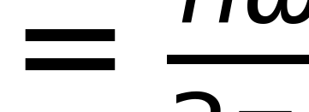
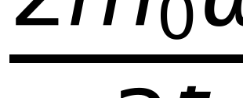
From golden rule to spontaneous emission
A dot lifetime is commonly in the 1 ns class.
Oscillator strength packages dipole strength.
n, ω, d, ε0, ħ, c are index, frequency, dipole, vacuum permittivity, reduced Planck constant, and light speed.
f is oscillator strength; m0 and e are free-electron mass and charge.
How a quantum dot emits
30
Notes:
Fermi's golden rule sums the dipole-photon coupling over the continuum of vacuum electromagnetic modes and, after integrating the mode density, gives the familiar cubic-frequency spontaneous-emission rate Gamma_rad = n omega^3 |d|^2 / (3 pi epsilon_0 hbar c^3), with n the host refractive index [Fox, Quantum Optics (2006), ch. 8]. For the isotropic dipole magnitude |d| used in that rate, oscillator strength is f = 2 m_0 omega |d|^2 / (3 hbar e^2): it repackages the same dipole matrix element into a dimensionless number, not an independent measurement. The commonly encountered single-component convention omits the factor 3 because it assigns |d| to one Cartesian dipole component rather than to the isotropic magnitude. Self-assembled III-V dots typically show radiative lifetimes in the 1 ns class once envelope confinement and host index are folded in [Michler (ed.), Quantum Dots for Quantum Information Technologies (2017)]. The repository does not derive Gamma_rad from a microscopic dipole calculation; it takes radiative rates (gamma_X, gamma_XX) as model inputs, either class-proxy values or, where available, anchored fits to a specific dot's measured decay. This golden-rule derivation justifies treating gamma as a rate constant in the cascade equations that follow.

Slide 31
Two-level atom versus quantum dot
Jaynes–Cummings
Regimes
H contains one emitter and one cavity mode.
g exchanges excitations coherently.
Weak coupling: Purcell enhancement.
Strong coupling: dressed states.
FP=(3/4π²)(λ/n)³Q/V.
How a quantum dot emits
31
Notes:
The Jaynes-Cummings model -- one two-level emitter coupled to one quantized cavity mode with coherent exchange rate g -- is the simplest fully quantum-optical Hamiltonian and the natural point of comparison for a quantum dot [Michler (ed.), Quantum Dots for Quantum Information Technologies (2017)]. Two regimes follow from the ratio of g to the emitter and cavity loss rates. In weak coupling, spontaneous emission stays irreversible but its rate is modified: the Purcell factor F_P = (3/(4 pi^2)) (lambda/n)^3 Q/V quantifies how a high-Q, small-mode-volume cavity accelerates or, off resonance, suppresses radiative decay, which is the lever the repository's cavity block uses. In strong coupling, g exceeds the loss rates and the system instead forms dressed light-matter eigenstates with a vacuum Rabi splitting -- coherent, reversible exchange rather than a modified rate [Purcell, Physical Review 69, 681 (1946)]. A quantum dot is not, however, an ideal two-level atom even before coupling to a cavity: exciton, biexciton, charge, spin, and phonon degrees of freedom all sit on top of the single dipole transition the Jaynes-Cummings picture idealizes, and it is exactly those extra levels -- the subject of the next several slides -- that create the multiphoton and dephasing effects a bare two-level treatment misses.

Slide 32
Exciton, biexciton, and trion ladder
0 → X → 0 emits one X photon.
XX → X → 0 is a cascade.
ΔXX controls XX leakage through an X filter.
E_XX^ph denotes the XX photon energy, E_X is the X photon energy, E(XX) is the two-exciton complex energy, and Ebind,XX is the binding energy. Delta_XX = E_X - E_XX^ph = Ebind,XX is the X-XX spectral splitting used throughout.
How a quantum dot emits
32
Notes:
The exciton (X, one electron-hole pair) and biexciton (XX, two pairs bound by Coulomb and exchange interactions) sit on a ladder: 0 -> X -> 0 emits a single X photon, while XX -> X -> 0 is a two-photon cascade. The biexciton binding energy shifts the XX transition below twice the exciton energy: E_XX^ph = E_X - E_bind,XX is the photon actually emitted on the XX -> X step, and E(XX) = 2E_X - E_bind,XX is the two-exciton complex's total energy [Bimberg, Grundmann and Ledentsov, Quantum Dot Heterostructures (1999)]. The quantity used throughout this deck as Delta_XX is exactly this spectral splitting, Delta_XX = E_X - E_XX^ph = E_bind,XX -- the energy separation between the X and XX emission lines, typically a few meV in InP-class dots. That separation is the only thing standing between a clean single-photon X line and biexciton leakage: an X-centered spectral filter narrower than Delta_XX rejects the XX photon, but as the homogeneous linewidth Gamma grows with temperature the two lines increasingly overlap and XX leaks through, which is precisely the epsilon = t_XX/t_X leakage fraction quantified two slides ahead [Michler (ed.), Quantum Dots for Quantum Information Technologies (2017)].

Slide 33
Fine structure and entangled photon pairs
Exchange splits the bright-exciton doublet.
Fine-structure splitting rotates polarisation phase.
Near-degenerate paths can yield entangled pairs.
Pair fidelity and single-photon purity differ.
Here XX is mainly leakage.
How a quantum dot emits
33
Notes:
Electron-hole exchange interaction splits the two bright neutral-exciton spin states into a doublet separated by the fine-structure splitting (FSS), typically tens of micro-eV in strained self-assembled dots. FSS acts as a birefringence for the biexciton-exciton cascade: it rotates the relative phase between the two orthogonally polarized decay paths (XX -> X_H -> 0 and XX -> X_V -> 0) as a function of the delay between the two emitted photons. When FSS is small compared to the radiative linewidth, the which-path information carried by polarization is washed out and the two cascade photons can be entangled in polarization [Akopian et al., Phys. Rev. Lett. 96, 130501 (2006)]. This is a genuinely different objective from the single-photon purity this deck otherwise tracks: entangled-pair fidelity asks how well the two photons' joint state matches a Bell state, while g^(2)(0) asks whether more than one photon pair is emitted per trigger [Michler (ed.), Quantum Dots for Quantum Information Technologies (2017)]. In the repository's cascade model, XX is treated purely as a leakage channel degrading single-photon purity through the X filter; the fine-structure/entanglement physics on this slide is not implemented and is not needed for the program's g^(2)(0) < 0.5 target.

Slide 34
Cascade rate equations
Pump r loads X and XX.
γ terms radiate; k terms escape.
generator and steady_state implement this ladder.
NXX is biexciton population; r pump; γXX radiative rate; kXX escape.
NX and N0 are exciton and empty populations; gammaX radiative rate; kX escape. Both radiative and non-radiative XX exits return population to X.
How a quantum dot emits
Source: generator_state_dimension = 3 (fsim_core/cw_g2.py) | steady_state_population_sum = 1 (fsim_core/cw_g2.py)
34
Notes:
fsim_core/cw_g2.py models the exciton-biexciton cascade as a three-state, incoherent Markov chain on the ordered basis |0>, |X>, |XX> -- no optical coherences, appropriate when dephasing dominates Rabi coupling under incoherent electrical or above-band pumping. Pump rate r drives 0 -> X and pump_ratio times r drives X -> XX; each level empties radiatively (gamma_X, gamma_XX, emitting a photon) and non-radiatively (k_X, k_XX, thermal escape). generator() assembles the 3x3 rate matrix and steady_state() returns normalized occupations (P_0, P_X, P_XX). Detailed balance gives P_X = a P_0 and P_XX = a b P_0, with a = r/(gamma_X+k_X) and b = pump_ratio*r/(gamma_XX+k_XX). Both gamma_XX and k_XX route XX into X, so the X return flux is set by pump_ratio*r*P_X. Dropping k_XX instead raises P_XX and hence the XX leakage-photon rate I_XX; it does not increase the X return flux. The displayed equations therefore retain pump_ratio explicitly and conserve population [fsim_core/cw_g2.py].

Slide 35
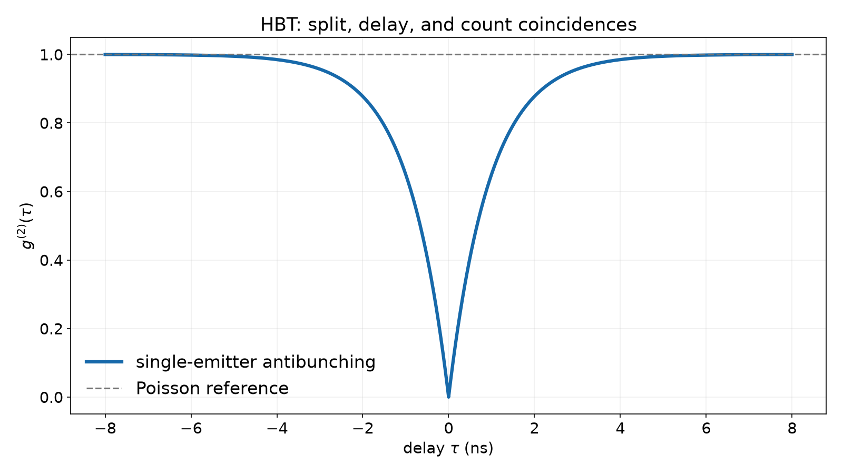
Photon statistics: what HBT measures
g²(τ) is normally ordered.
Classical fields obey g²(0) ≥ 1.
A single emitter recovers after a jump.
HBT records coincidence delay.
Antibunching and Poisson reference.
How a quantum dot emits
35
Notes:
The Hanbury Brown-Twiss (HBT) experiment splits the collected light on a beamsplitter and cross-correlates the two detector click streams as a function of delay tau, estimating the normally ordered second-order correlation g^(2)(tau) = <a-dagger(t) a-dagger(t+tau) a(t+tau) a(t)> / <a-dagger a>^2. For any classical field -- coherent, thermal, or any statistical mixture of coherent states -- the Cauchy-Schwarz inequality forces g^(2)(0) >= 1; values below one have no classical-field explanation and certify a genuinely quantum state of light [Fox, Quantum Optics (2006)]. A single quantum emitter shows perfect antibunching, g^(2)(0) = 0, because after it emits at t=0 it has been projected into the ground state and cannot emit a second photon until it re-excites and radiatively decays again -- the dip's width and shape trace that re-excitation and decay dynamics [Loudon, The Quantum Theory of Light]. The figure plots this single-emitter antibunching dip against the Poisson (g^(2)=1) reference. In a real device, background light and finite detector timing resolution both lift the observed dip toward one, which is exactly what the next two slides quantify.

Slide 36
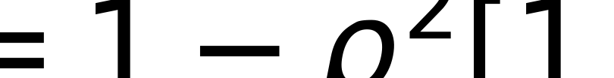
Background turns a perfect dip upward
ρ=s/(s+b) is the signal fraction.
The background is independent and Poissonian.
integrator.g2_from applies the law; device.py and cw_g2 use it downstream.
s and b are signal and background means; ρ is signal fraction.
How a quantum dot emits
36
Notes:
Real detection always mixes the dot's intrinsic signal with an independent background: stray pump light, other emitters within the collection aperture, or dark counts. If the total detected stream is signal (mean rate s) plus statistically independent Poissonian background (mean rate b), expanding the second factorial moment of the sum gives an exact mixture law for the measured correlation: g^(2)_meas(0) = 1 - rho^2 [1 - g^(2)_s(0)], where rho = s/(s+b) is the signal fraction [Reischle et al., Optics Express 16, 12771 (2008), Eq. (1)]. Even a perfectly antibunched source, g^(2)_s(0) = 0, is measured as g^(2)_meas(0) = 1 - rho^2 once background is present -- at rho = 0.9 a perfect single-photon source already reads 0.19, not 0. This is why every purity number in this deck must be reported alongside its rho, since a headline g^(2) can be made to look better simply by narrowing the collection window and discarding signal along with background. fsim_core/integrator.py's g2_from implements this law exactly, and both cw_g2.py (CW) and device.py (pulsed) apply it downstream of their respective intrinsic g^(2) calculations.

Slide 37
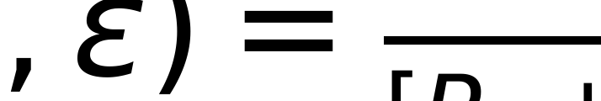
Cap-2 Poisson loading
P0=e−μ and P1=μe−μ.
P2=1−P0−P1 after cap-2 relaxation.
loading.f1b_g2 carries finite-μ penalty.
μ is mean loading; ε=tXX/tX is leakage.
How a quantum dot emits
Source: f1b_g2_mu0.2_eps0.1 = 0.10462521279541996 (fsim_core/loading.py)
37
Notes:
Pulsed excitation loads the dot with a Poisson-distributed number of excitons per pulse, mean mu; the repository caps the ladder at two excitons (0, 1, or 2, i.e. up to a biexciton), so P_0 = e^-mu, P_1 = mu e^-mu, and the remaining probability P_2 = 1 - P_0 - P_1 collapses onto the cap-2 state after fast intra-dot relaxation. Detecting a photon in the central (tau=0) peak of a pulsed g^(2) histogram requires two consecutive pulses to each contribute at least one photon; because the biexciton state leaks an XX photon through the X filter at fraction epsilon = t_XX/t_X, loading.f1b_g2 derives the closed-form pulsed peak-area ratio f_1b g^(2)(mu, epsilon) = 2 P_2 epsilon / [P_1 + P_2(1+epsilon)]^2 directly from these three occupation probabilities and epsilon [fsim_core/loading.py]. In the weak-pumping limit mu -> 0, P_2/P_1 -> mu/2 and the formula recovers the simpler F1 identity g^(2)(0) = epsilon; at finite mu it adds a genuine multiphoton penalty from double-pair loading on top of the spectral leakage penalty, the same physical effect Hanschke identified as making multiphoton probability grow with pulse area [Hanschke et al., npj Quantum Information 4, 43 (2018)].

Slide 38
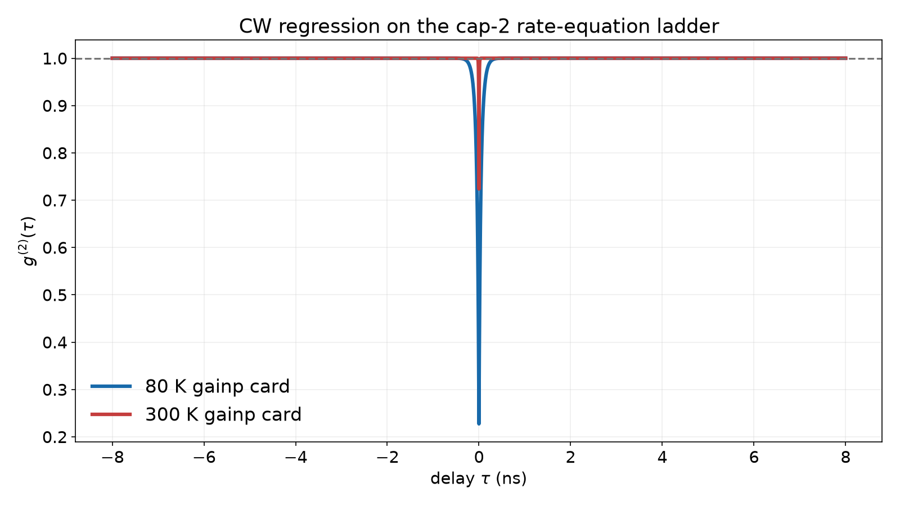
CW g² and quantum regression
The propagator follows a detected jump.
Low pump: g²dot(0)=εpSXX/SX.
cw_report returns intrinsic, background, and IRF curves.
CW and pulsed g² are different observables.
Fresh gainp-card rate-equation g2_meas(tau), plotted from -8 to +8 ns with 4 ps sampling.
How a quantum dot emits
Source: cw_gainp_g2_meas0_80K = 0.2273157246955827 (presentation2/figures/fig_02_14_cw.py) | cw_gainp_g2_meas0_300K = 0.7236904976348915 (presentation2/figures/fig_02_14_cw.py)
38
Notes:
Continuous electrical or optical pumping produces a steady-state photon stream rather than discrete pulses, and its g^(2)(tau) is obtained by a different route: the quantum regression theorem, which for the classical three-state Markov chain of the previous slides reduces to 'propagate the post-jump state forward under the same generator M'. After detecting an X photon the dot is reset to |0>; after detecting an XX photon it is reset to |X>; cw_g2.py's cw_report() builds both post-jump propagators, weights them by their steady-state photon rates and the filter transmissions t_X, t_XX, and returns the intrinsic curve g2_dot, the background-mixed curve g2_meas, and the IRF-convolved curve g2_raw together [Gardiner and Collett, Phys. Rev. A 31, 3761 (1985)]. In the low-pump limit this reduces to g^(2)_dot(0) -> epsilon * pump_ratio * (S_XX/S_X), the CW analogue of the pulsed F1 identity. The figure loads the fresh gainp design card (cards/edge-inp-gainp-design.yaml) at its own resolved 80 K and 300 K operating points -- pump rate, retention, escape, filter window, and background all recomputed from the card, giving g2_meas(0) about 0.23 at 80 K and 0.72 at 300 K -- and this is a rate-equation regression on a classical generator, not a field-quantized calculation; CW and pulsed g^(2) remain genuinely different observables of the same device.

Slide 39
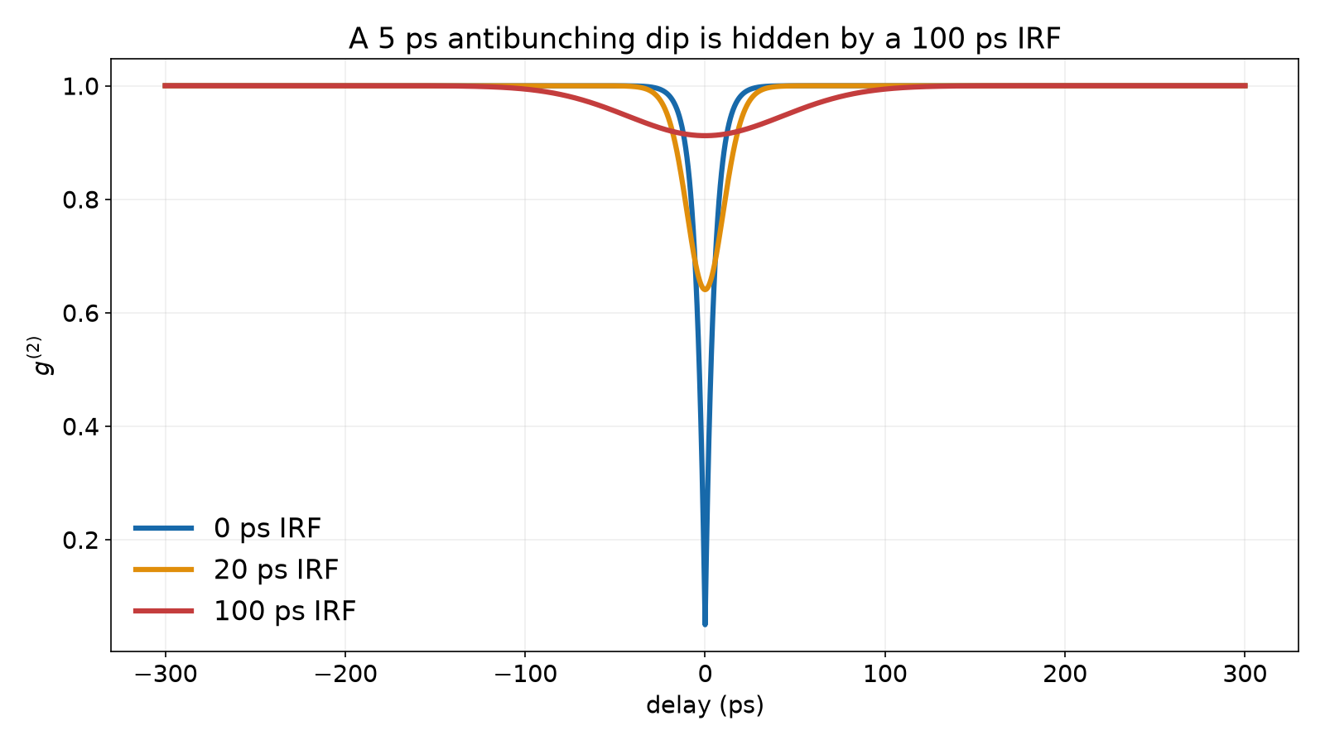

Detector response is part of the measurement
Measured g² is IRF-convolved.
erfcx gives a stable closed form.
A 5 ps dip is diluted by a 100 ps FWHM IRF.
Deconvolution is model-dependent.
IRF broadening via convolve_irf, +/-300 ps window showing full recovery.
A is dip depth, τd recovery time, σ Gaussian IRF width.
How a quantum dot emits
Source: dip_convolved_100ps = 0.9119424818098566 (fsim_core/cw_g2.py)
39
Notes:
A photon-counting detector's finite timing resolution, its instrument response function (IRF), convolves the intrinsic correlation before it reaches the histogram. cw_g2.py provides both Gaussian and two-sided-exponential IRF kernels; convolve_irf() performs the numerical convolution on a uniform tau grid for the general case, while dip_convolved() gives a closed form for a single-exponential dip g^(2)(tau) = 1 - A exp(-|tau|/tau_d) convolved with a Gaussian IRF of standard deviation sigma: g^(2)_raw(0) = 1 - A exp(sigma^2/(2 tau_d^2)) erfc(sigma/(sqrt2 tau_d)), rewritten with the scaled complementary error function erfcx to stay numerically stable when sigma >> tau_d [fsim_core/cw_g2.py]. The figure widens the plotted delay window to +/- 300 ps specifically so the convolve_irf traces are shown recovering fully back toward g^(2)=1 at large |tau| rather than being truncated mid-recovery; at that scale a 5 ps intrinsic recovery time next to a 100 ps FWHM IRF is visibly all but erased, while a 20 ps IRF only partially dilutes it. Reischle's electrical HBT measurement used a roughly 500 ps exponential IRF and deconvolved it to recover 0.15/0.25 background-included dip depths from raw dips of 0.41/0.43 [Reischle et al., Optics Express 16, 12771 (2008)]; deconvolution is model-dependent and only as good as the assumed dip shape.

Slide 40
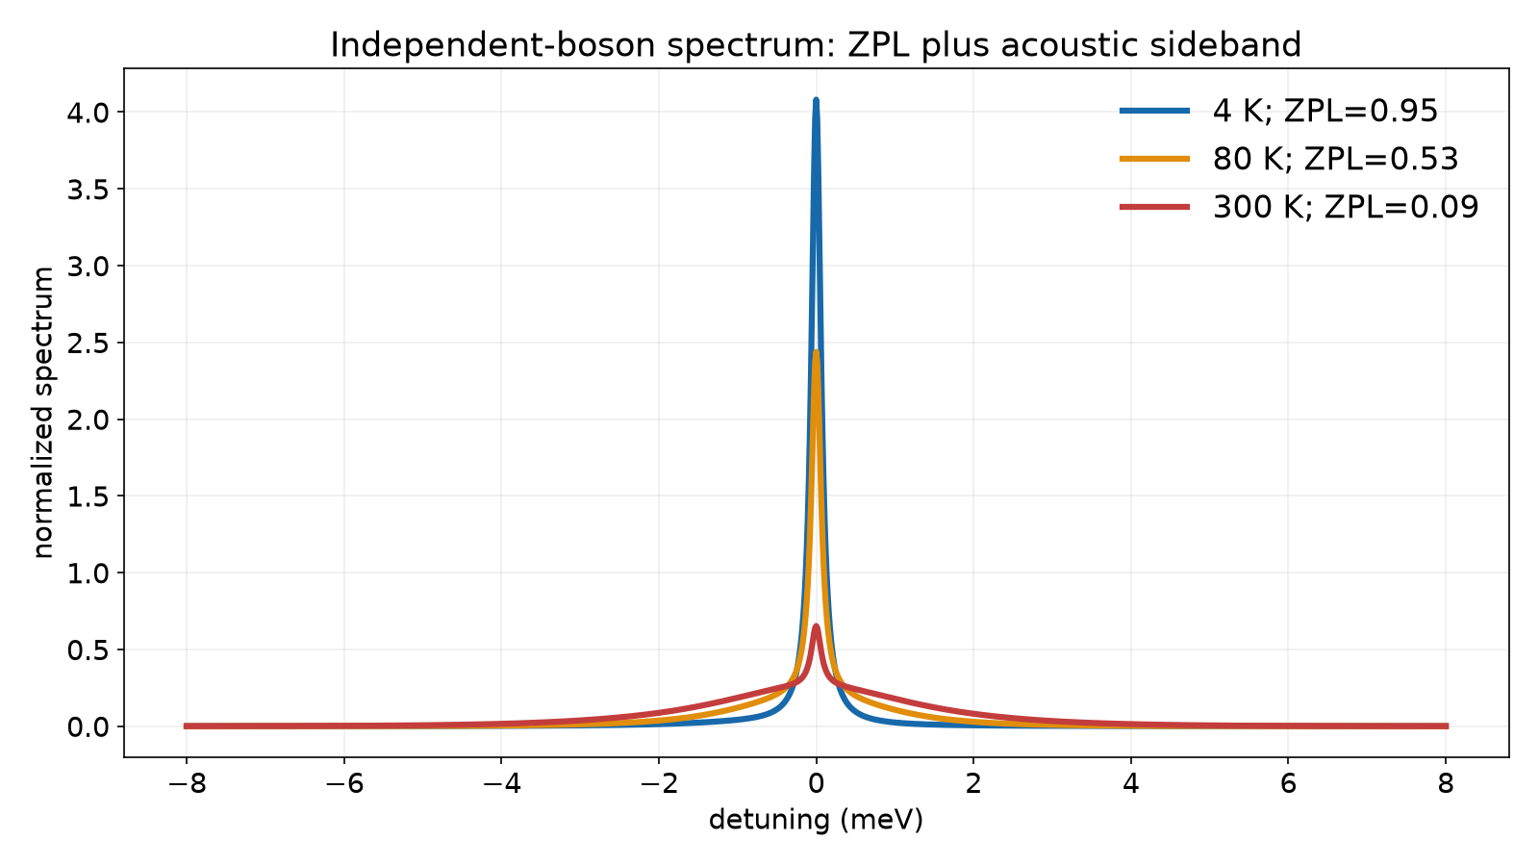

Phonons I: sidebands and the independent-boson model
Acoustic phonons couple to charge density.
IBM resums diagonal coupling.
A ZPL sits on a broad sideband.
Temperature transfers weight to the sideband.
IBM spectra from qd_gf.py.
C is dipole coherence; Z is ZPL fraction; S is Huang–Rhys factor.
How a quantum dot emits
Source: zpl_weight_300K = 0.09209417066804898 (fsim_core/qd_gf.py)
40
Notes:
Acoustic phonons couple to the exciton through the deformation potential, which is diagonal in the exciton number (it shifts the exciton energy rather than flipping it), so the exciton-phonon Hamiltonian is exactly solvable: the independent boson model (IBM) resums the coupling to all orders and gives the dipole coherence C(t) = exp[phi(t) - phi(0)] in closed form, where phi(t) is a phonon correlation integral over the bath spectral density J(omega) [Krummheuer, Axt and Kuhn, Phys. Rev. B 65, 195313 (2002)]. Fourier transforming C(t) gives an emission spectrum with two pieces: a delta-function zero-phonon line (ZPL) of weight Z = exp(-S), where S is the Huang-Rhys factor, sitting on a broad phonon sideband carrying the remaining weight 1-Z. As temperature rises, more of the total spectral weight moves from the ZPL into the sideband -- the physical origin of the temperature-dependent linewidth broadening on the next slide. fsim_core/qd_gf.py implements this acoustic deformation-potential IBM lineshape, including ZPL weight and sideband transmission through a filter, but it does not yet include piezoelectric coupling (relevant for the (211)B InAs dots Chatzarakis studied), microscopic LO-phonon scattering, or the polaron-frame renormalization a coherently driven dot would need.

Slide 41
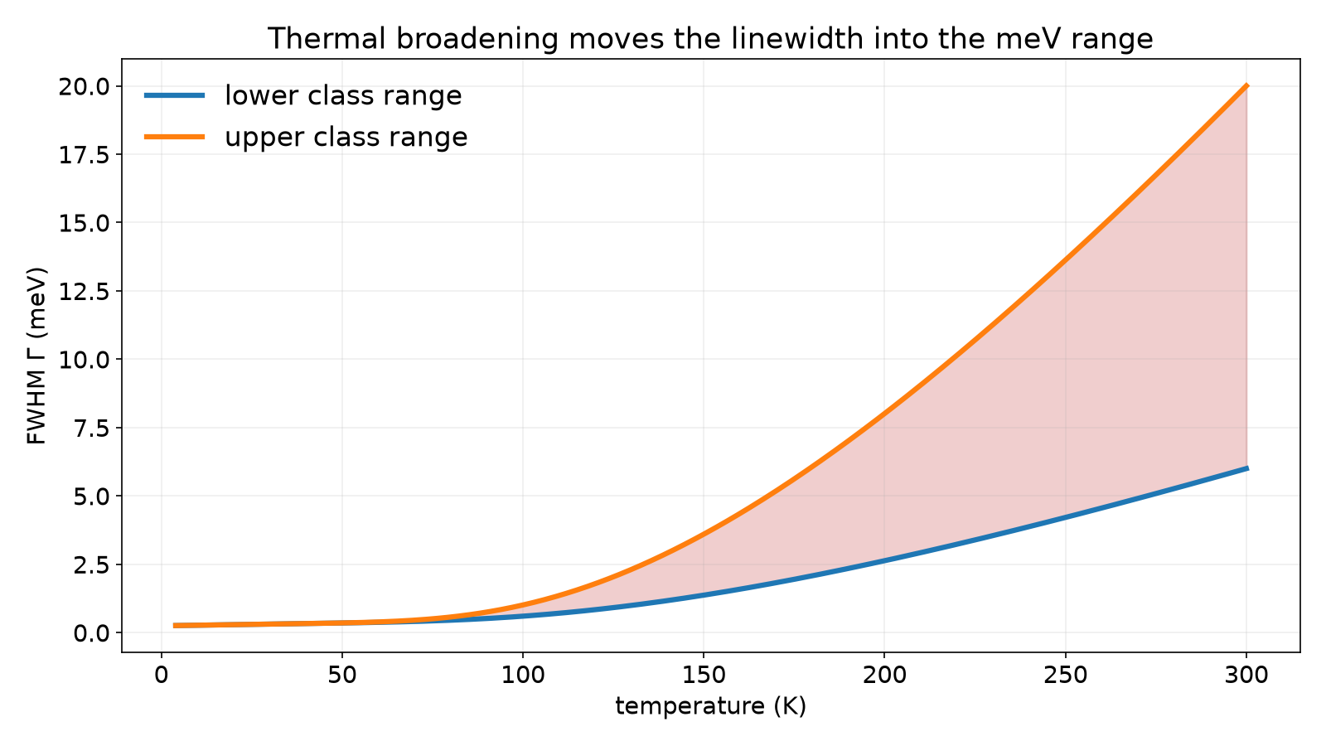
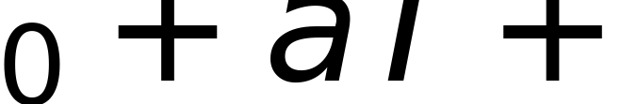
Phonons II: linewidth grows with temperature
Γ(T)=Γ0+aT+b/[exp(ELO/kBT)−1].
Matsuda anchors Gamma(300 K)=12 meV; InP E_LO=43 meV.
Chatzarakis anchors warm-dot behavior.
The coded 300 K envelope is 6–20 meV.
linewidth.gamma_envelope class envelope.
Γ0 residual width, a acoustic slope, b LO coupling, ELO LO energy.
How a quantum dot emits
Source: gamma_envelope_300K_low = 6 (fsim_core/linewidth.py)
41
Notes:
The phenomenological model Gamma(T) = Gamma_0 + aT + b/[exp(E_LO/k_B T) - 1] separates a residual width Gamma_0, a linear acoustic-phonon term aT, and activated scattering requiring a thermally populated LO phonon. With E_LO = 43 meV for InP, the activated term is negligible at low temperature but rises rapidly toward 300 K. Matsuda's In0.5Ga0.5As/GaAs single-dot measurement anchors Gamma(300 K) around 12 meV [Matsuda et al., Phys. Rev. B 63, 121304(R) (2001)], while Chatzarakis's InAs data constrains warm-dot behavior to 260 K [Chatzarakis et al., Phys. Rev. Applied 20, 034011 (2023)]. fsim_core/linewidth.py's gamma_envelope() deliberately encodes a class range rather than a single curve: its coded 300 K envelope spans 6-20 meV, reflecting dot-to-dot and material-class variation, not a measurement of the specific InP/GaAsP target dot. Measurement 1, a temperature-dependent linewidth on that target, has not yet been run.

Slide 42
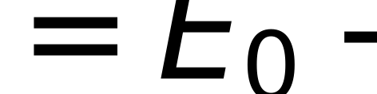
Band-gap and line shift with temperature
Varshni shift moves X and XX.
InP and GaAs do not walk identically.
A filter must track the selected line.
Drift changes brightness and ε.
E0 is zero-temperature gap; α and β are Varshni parameters.
How a quantum dot emits
42
Notes:
The Varshni relation E_g(T) = E_0 - alpha T^2/(T+beta) captures the empirical, largely phonon-driven redshift of a semiconductor band gap with temperature; E_0 is the T=0 gap and alpha, beta are material-specific fit parameters tabulated for essentially every III-V binary and common alloy [Vurgaftman, Meyer and Ram-Mohan, J. Appl. Phys. 89, 5815 (2001)]. Because InP (the dot) and the surrounding GaAsP/GaInP matrix do not share identical Varshni coefficients, the exciton and biexciton transition energies drift at a different rate than the barrier and matrix band edges as the device heats from a cryostat baseline toward 300 K -- confinement depth itself is temperature dependent, not just the absolute transition energy [Yu and Cardona, Fundamentals of Semiconductors]. This matters operationally because any spectral filter or cavity resonance fixed at a room-temperature design wavelength will walk off the actual X/XX lines as the device self-heats under drive, and because t_X and t_XX (the filter transmissions that set epsilon = t_XX/t_X) both depend on where the lines sit relative to the fixed filter window -- a filter that is not re-tracked with temperature silently changes brightness and purity together, not independently.

Slide 43
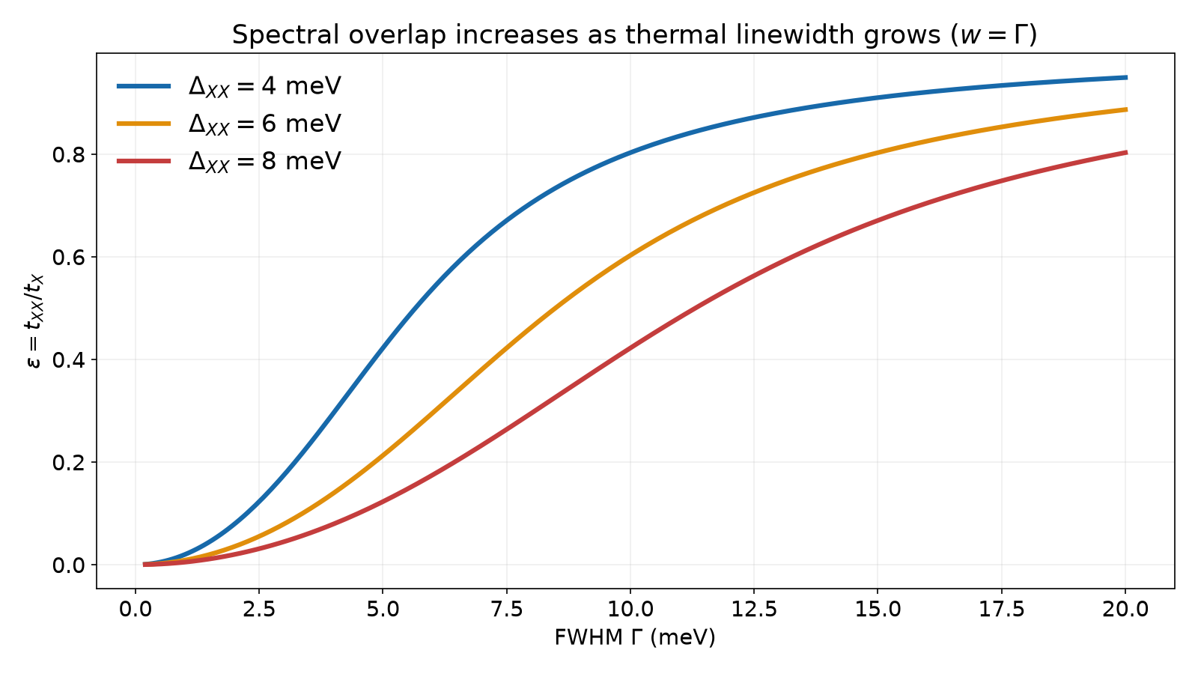
Spectral overlap sets biexciton leakage
Lorentzian lines pass through a window set to w=Gamma.
ε=tXX/tX is cascade contamination.
Larger ΔXX helps; larger Γ hurts.
spectral.epsilon feeds pulsed g².
epsilon versus Gamma for DeltaXX=4, 6, 8 meV; the sweep sets filter window w=Gamma.
How a quantum dot emits
Source: epsilon_D6_G12_w12 = 0.7048327646991335 (fsim_core/spectral.py)
43
Notes:
spectral.epsilon() computes the leakage fraction epsilon = t_XX/t_X: the transmission of two Lorentzian lines, centered Delta_XX apart with linewidths Gamma_X and Gamma_XX, through the same acceptance window. In the swept figure the window width is tied to the linewidth itself, w = Gamma, rather than held fixed, which is why epsilon rises with Gamma along each Delta_XX curve -- a wider intrinsic line both broadens into the window from outside and needs a wider window to pass its own weight, so both lines increasingly overlap. Larger Delta_XX pushes the two lines further apart and helps suppress leakage at fixed linewidth; larger Gamma hurts, since the two Lorentzian tails increasingly overlap regardless of their separation -- the same competition between confinement-set Delta_XX and phonon-set Gamma that reappears in the 300 K landscape slide. At the worked point Delta_XX=6 meV, Gamma_X=Gamma_XX=12 meV, window 12 meV, the repository returns epsilon = 0.7048 [fsim_core/spectral.py: epsilon], a leakage fraction far above the 0.1-0.5 purity target and a concrete illustration of why 300 K electrical operation is hard for this dot class [Chatzarakis et al., Phys. Rev. Applied 20, 034011 (2023)].

Slide 44
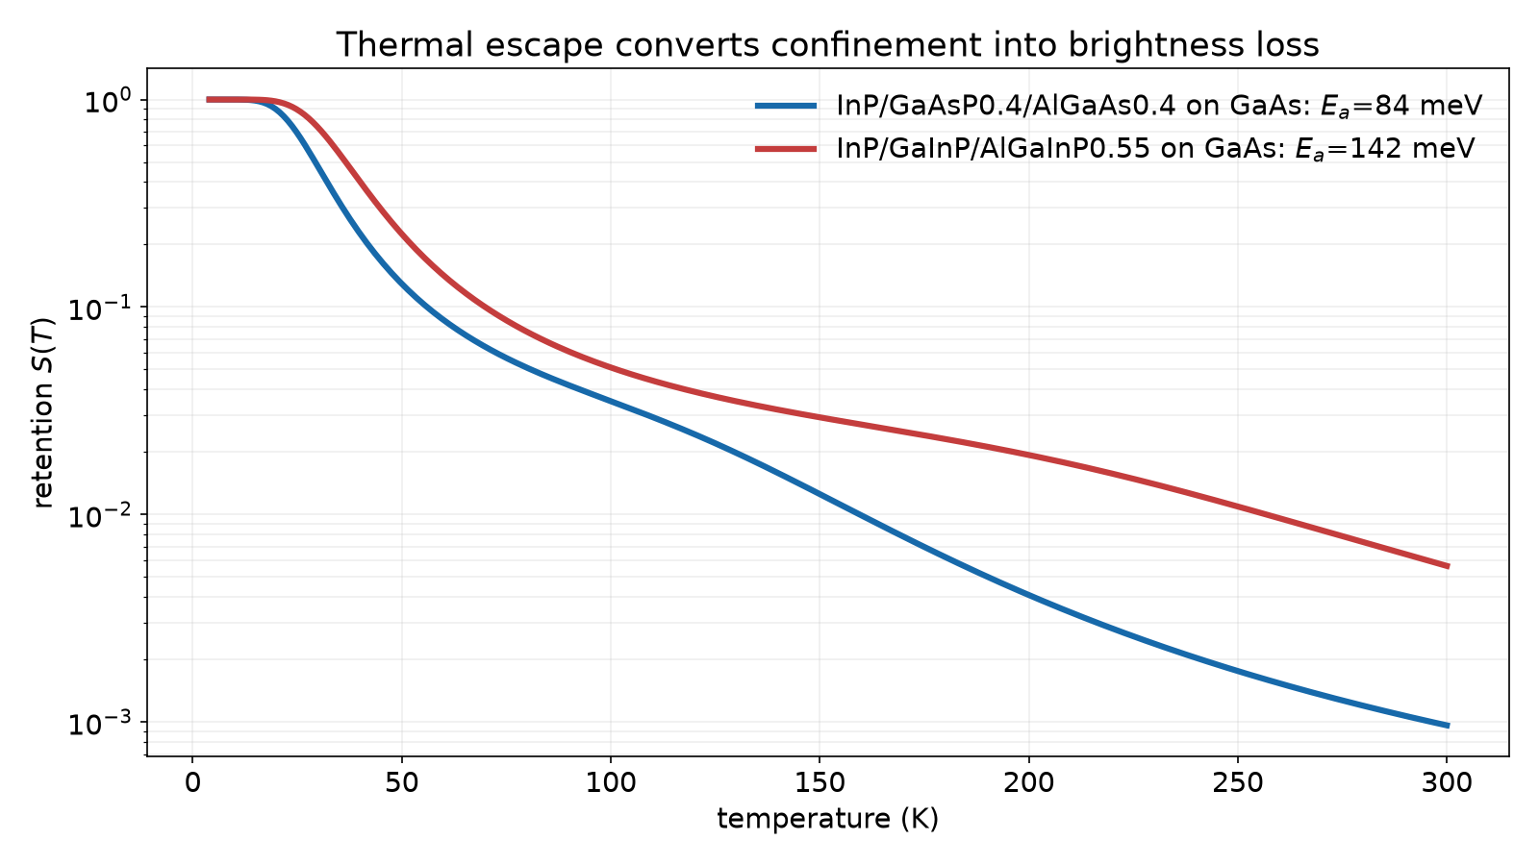
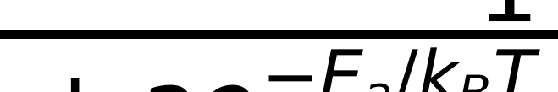
Thermal escape and retention
S(T)=1/[1+a e−Ea/kT+b e−Eb/kT].
Ea follows confinement and escape paths.
The presets are class proxies.
Thermal loss can cost 1000× brightness.
Two retention presets from dot_levels.py.
S retention; Ea,Eb activations; a,b prefactors.
How a quantum dot emits
Source: retention_Ea_InP_GaAsP = 83.79495968009232 (fsim_core/dot_levels.py)
44
Notes:
Carriers confined in the dot can escape thermally before recombination. The retention fraction S(T) = 1/[1 + a exp(-E_a/k_B T) + b exp(-E_b/k_B T)] is the two-channel Arrhenius intensity-retention form reported by Chatzarakis et al. [Phys. Rev. Applied 20, 034011 (2023)]. Bommer et al. measured single-dot activation energies in InP/(Al,Ga)InP, providing an activation-energy anchor but not this two-channel retention form [J. Appl. Phys. 110, 063108 (2011)]. dot_levels.retention_params() derives E_a, E_b, a, and b from computed confinement levels rather than fitting them independently, tying escape to the same offsets and geometry used elsewhere. For the coded InP/GaAsP class preset it returns E_a = 83.79 meV under the module's pair-half convention: an assumption-class proxy, not a measurement of the target dot. Because S(T) multiplies brightness and falls steeply as k_B T approaches E_a, escape can cost orders of magnitude between cryogenic and room temperature, independently of linewidth-driven purity loss.

Slide 45
Indistinguishability: the other quantum metric
T2⁻¹=(2T1)⁻¹+γ*.
HOM measures wavepacket overlap.
Phonons and charge noise raise γ*.
Low g² does not guarantee HOM visibility.
300 K indistinguishability remains open.
How a quantum dot emits
45
Notes:
Purity (g^(2)(0) < 0.5) and indistinguishability are independent quantum metrics, and a source can satisfy one while failing the other. Indistinguishability requires two emitted photon wavepackets to overlap coherently, which depends on the emitter's optical coherence time T2, not on its population statistics: 1/T2 = 1/(2 T1) + gamma*, where T1 is the population (radiative) lifetime and gamma* is the pure-dephasing rate from phonon scattering, charge noise, and spectral diffusion. Hong-Ou-Mandel (HOM) interference measures this overlap directly -- two photons entering a beamsplitter from indistinguishable sources bunch into the same output port -- and its visibility falls whenever pure dephasing broadens the line beyond its transform-limited, radiatively broadened width [Iles-Smith, McCutcheon, Mork and Nazir, Nature Photonics 11, 521 (2017)]. Low g^(2)(0) says only that the source rarely emits two photons per trigger; it says nothing about whether those single photons are spectrally and temporally identical to each other. The repository does not compute the photon density matrix, T2, or HOM visibility anywhere -- an explicit, acknowledged Level-3 gap relative to the owner's four-level hierarchy -- and at 300 K, where phonon dephasing is strongest, indistinguishability is expected to be the harder of the two quantum metrics to close [Project's own treatment slides, slide 4].

Slide 46
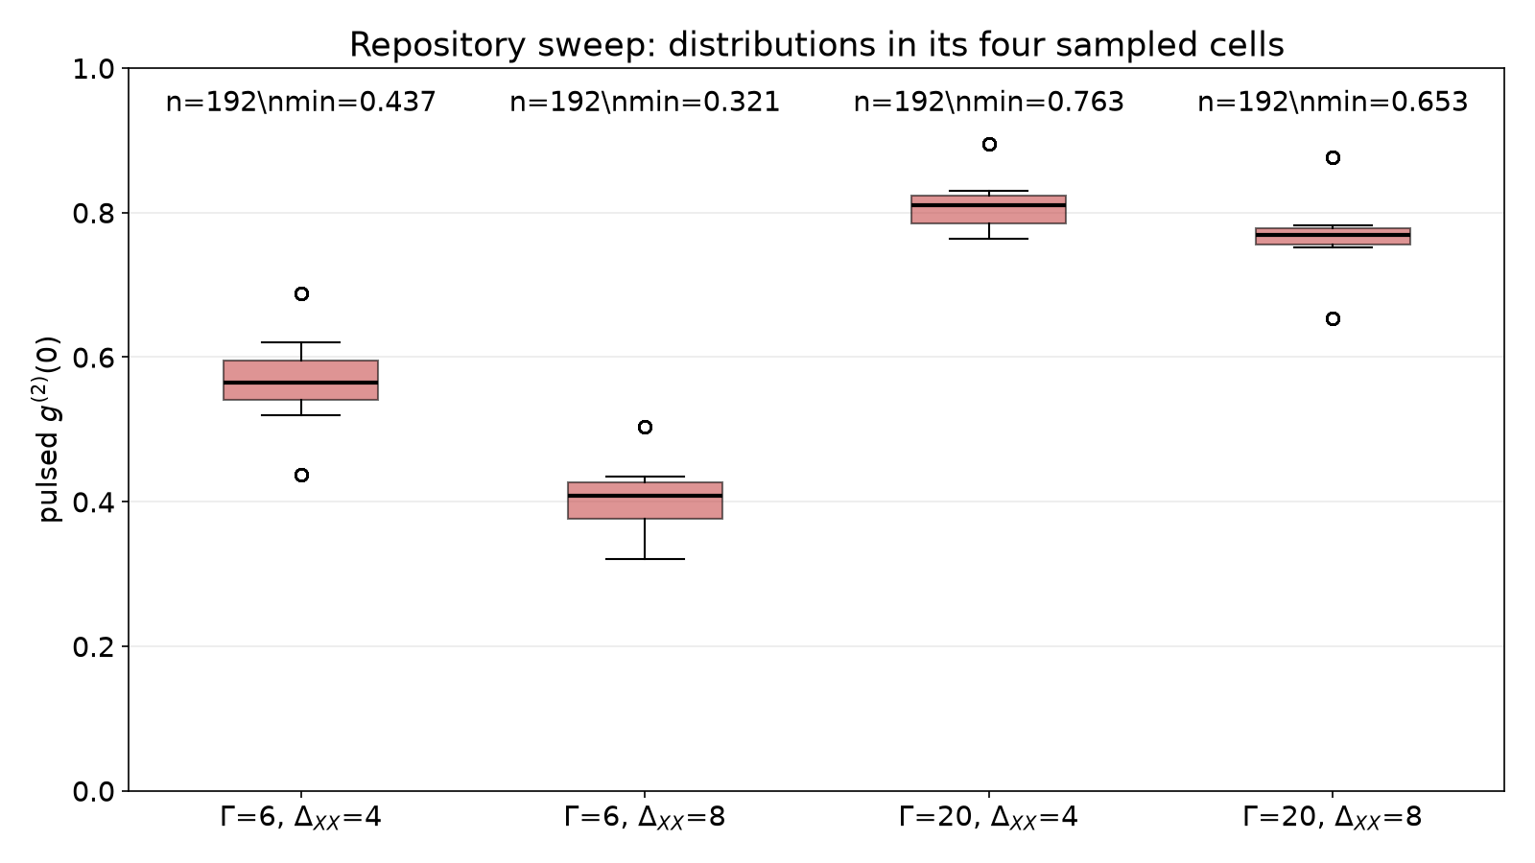
Putting the model together: the 300 K landscape
The sweep samples a 2x2 parameter grid.
Each cell aggregates 192 rows of pulsed g².
Boxes show within-cell variation, not a landscape.
Laferriere reports optical 300 K g²=0.57.
No row combines electrical drive, 300 K, g²(0) < 0.5 and an arsenide or phosphide epitaxial dot.
2x2 sampled grid; each box aggregates 192 sweep rows (min/median/max shown by the distribution).
How a quantum dot emits
Source: sweep_row_count = 768 (out/rt_edge/sweep.csv) | sweep_cell_count = 192 (out/rt_edge/sweep.csv) | sweep_cell_min_6_8 = 0.321359 (out/rt_edge/sweep.csv) | sweep_cell_min_6_4 = 0.436875 (out/rt_edge/sweep.csv) | sweep_cell_min_20_4 = 0.763185 (out/rt_edge/sweep.csv) | sweep_cell_min_20_8 = 0.653321 (out/rt_edge/sweep.csv)
46
Notes:
This is not a continuous landscape. out/rt_edge/sweep.csv samples only a 2x2 grid: Gamma(300 K) = 6 or 20 meV and Delta_XX = 4 or 8 meV. Each cell contains 192 rows varying card, T_hs, IRF, NA, R_back, and L; the plot honestly summarizes their pulsed g^(2) distributions. Its cell minima are 0.437, 0.321, 0.763, and 0.653 respectively for (6,4), (6,8), (20,4), and (20,8) meV. The sensitivity remains design guidance, not a device measurement. Laferriere's optically pumped InAsP/InP nanowire dot reaches g^(2)(0)=0.57 at 300 K [Laferriere et al., Nano Lett. 23, 962 (2023)], while Deshpande's electrical 300 K result is g^(2)(0)=0.29 on nitride InGaN/GaN [Deshpande et al., Appl. Phys. Lett. 105, 141109 (2014)]. No row combines electrical drive, 300 K, g^(2)(0) < 0.5 and an arsenide or phosphide epitaxial dot.

Slide 47
Experimental status at the conditions
Electrical cryogenic SPS, optical warm SPS, and room-temperature edge-emitting QD lasers are distinct evidence classes.
No row combines electrical drive, 300 K, g²(0) < 0.5 and an arsenide or phosphide epitaxial dot.
reference | drive | T | platform | result
Deshpande 2014, APL 105, 141109 | electrical | 300 K | InGaN/GaN single QD | g²(0)=0.29
Laferriere 2023, Nano Lett. 23, 962 | optical | 77/220/300 K | InAsP/InP nanowire QD | g²(0)=0.11/0.34/0.57
Chatzarakis 2023, PR Applied 20, 034011 | optical | 230 K | (211)B InAs/GaAs piezoelectric | X/XX resolved to 260 K
Zhao 2024, PR Research 6, L032021 | electrical | 300 K | QD laser (ensemble) | 3.1 dB squeezing, no single photons
Kitamura 2025, CLEO JPS200_148 | electrical | not extracted | intracavity RTI microcavity | architecture only
How a quantum dot emits
47
Notes:
This table restates the owner's experimental-status slide: five results are the closest anchors to the program's conditions, but none simultaneously supplies the complete target platform [Project's own treatment slides, slide 7]. Deshpande supplies a 300 K electrical single-photon result on InGaN/GaN, not an arsenide or phosphide dot. Laferriere's optical InAsP/InP nanowire result rises from g^(2)(0)=0.11 at 77 K to 0.57 at 300 K. Chatzarakis supplies optical warm-dot X/XX context to 260 K. Zhao is an electrically driven 300 K QD-laser ensemble, not a single-photon source. The card reports 3.1 dB pump-current amplitude squeezing [cards/zhao.yaml], whereas the paper digest records 0.9 +/- 0.1 dB directly measured squeezing (6.7%) [paper_digests.md]; these are reported as different quantities, but the repository does not yet reconcile their discrepancy. Kitamura reports a resonant-tunneling-injection architecture without an extractable photon-statistics number. No row combines electrical drive, 300 K, g^(2)(0) < 0.5 and an arsenide or phosphide epitaxial dot.

Slide 48
How our model integrates this
Input physics
Measured output
materials.py: gaps and offsets.
dot_levels.py: levels and retention.
linewidth.py and qd_gf.py: thermal response.
device.py: injection and brightness.
spectral.py/loading.py: ε, μ, pulsed g².
cw_g2.py: CW correlation and IRF.
sde.py: Zhao pump-noise SDE, kept as an acknowledged failure (F_p proxy).
How a quantum dot emits
48
Notes:
The repository's chain runs materials and confinement parameters (materials.py, dot_levels.py) into thermal optical response (linewidth.py's phenomenological Gamma(T), qd_gf.py's independent-boson lineshape), then spectral transmission, finite-pump loading, background dilution, and rate-equation propagation into device.py's reported brightness, purity, and injection observables. It is a Level-2 semiclassical stack with closed forms checked in verify/verify_<module>.py. One failure is kept visible: Zhao's stochastic pump-noise SDE reproduces the ordering of the two published g^(2)(0) points, normal and quiet, both at I = 4 I_th [cards/zhao.yaml], but does not reach the published squeezing magnitude under literature-bounded parameters. The separate number 12 refers to tuning experiments in scripts/run_zhao_fit.py, not measured operating points. device.py therefore bypasses the physical SDE and uses an empirical Fano-factor parameter F_p priced from Zhao's measured values [fsim_core/sde.py; fsim_core/device.py]. This exposes the unclosed field-level joint: a relay-hop rate model cannot carry electrical pump regulation into field statistics. Quantized modes, a photon density matrix, and Hong-Ou-Mandel visibility are absent; the next slide addresses that gap.

Slide 49
What is left
Measure Γ(T) and ΔXX to 300 K on one electrical dot.
Demonstrate confinement and edge collection together.
Calibrate background, IRF, filter, and pulsing.
Add HOM visibility and electrical-pulsing data.
Treat the sweep as design guidance, not evidence.
How a quantum dot emits
Source: verdict_conditional = 1 (out/rt_edge/verdict.md)
49
Notes:
Five items remain open, matching the slide bullets. First and most gating is Measurement 1: an actual Gamma(T) and Delta_XX distribution to 300 K on the electrical InP/GaAsP target dot. Second is demonstrating confinement and edge collection together. Third is calibrating background, IRF, filter, and pulsing. Fourth is adding HOM visibility and electrical-pulsing data. Fifth is retaining the sweep as design guidance rather than evidence. For the electrical arm, Kantner-style transport-to-Lindblad coupling would replace device.py's one-way injection parameters with a dynamical, bidirectional link [Kantner, Mittnenzweig and Koprucki, Phys. Rev. B 96, 205301 (2017)]. The staged 120 K, g^(2)<=0.1 target with a large-lens dot, quiet high-impedance rail, and 10-12 pair DBR, and the 77 K slit-filter/no-cavity target, are from the owner's slide 9 [digest-qd-quantum-treatment.md]. The actual current repository verdict is FAIL with evidence=incomplete and conditional=true [out/rt_edge/verdict.md], so those staged targets are not a simulator verdict.

Slide 50
Section summary
Emission is a chain: ladder → coupling → statistics → temperature limits
How a quantum dot emits
50
Notes:
We built the chain in order: the dipole Hamiltonian and Fermi's golden rule set the radiative rate; the exciton-biexciton-trion ladder and its cap-2 rate equations set the population dynamics; Hanbury Brown-Twiss statistics, background dilution, finite-pump loading, and detector-response convolution together set what a real measurement reports versus what the intrinsic dot produces; phonon sidebands, thermal linewidth broadening, Varshni line shift, and thermal carrier escape set how all of the above degrade as temperature rises toward the 300 K target. The distinction carried through every slide is the owner's own: a quantum device (confinement, blockade), a quantum treatment of the dot (exciton-phonon coupling, cascade structure), and a quantum treatment of the light (field quantization, g^(2), HOM) are three different claims, and satisfying one does not imply the others [Project's own treatment slides, slide 3]. The repository's validated stack sits at Level 2 -- a semiclassical cascade with photon statistics attached through exact mixture and cascade identities -- and every number in it traces to a repository module, a cited measurement, or an explicit assumption tag [Fox, Quantum Optics (2006)]. The next section moves into electrical injection and edge-emitting device physics, where the pump itself becomes a quantum-statistical input rather than a rate constant.

Slide 51
Driving the dot: optical and electrical, every regime
From a laser pulse to a bias supply -- how excitation shapes purity, brightness and temperature reach
Driving the dot: optical and electrical, every regime
51
Notes:
This section walks the full space of ways to put an exciton into a quantum dot, in increasing order of engineering difficulty and decreasing order of laboratory convenience: above-band optical pumping, resonant optical excitation, and finally electrical injection through a p-i-n diode. The throughline is that every excitation scheme is a noisy channel between a classical control (a photon or a bias voltage) and a single quantized transition, and every regime trades some combination of purity, indistinguishability, brightness and operating temperature for practical convenience. The second half of the section is the electrical chain end to end: built-in voltage, diode current regimes, injection efficiency, carrier capture, loading statistics, background light and self-heating, closing with the temperature ladder this repository actually computes for its two InP-dot edge-emitter design cards and a worked numerical example from contact to collected photon. Sze & Ng and Coldren & Corzine supply the diode and heterojunction physics; the six digested papers anchor every electrical single-photon result actually published.

Slide 52
Optical excitation regimes
Above-band to two-photon resonant: five ways to put one exciton in the dot
Above-band: pump into the wetting layer/barrier, carriers relax down to the dot
Quasi-resonant p-shell: pump the dot's own excited orbital, one phonon-assisted step to s-shell
Phonon-assisted (LA-phonon sideband): detuned pump, a single acoustic phonon closes the gap
Strictly resonant: drive the exciton transition itself, coherent Rabi rotation, a pi-pulse gives one photon
Two-photon resonant excitation (TPE): drive the biexciton via a virtual state at half its energy
Driving the dot: optical and electrical, every regime
52
Notes:
Above-band excitation (pump photon energy above the wetting-layer or barrier gap) is the simplest scheme: any laser above the confinement energy works, but relaxation through many phonon-scattering steps before the carriers reach the dot ground state adds timing jitter to the emission and lets carriers recombine elsewhere, hurting purity. Quasi-resonant p-shell pumping addresses the biggest part of that jitter by injecting directly into the dot's own excited orbital, leaving only one LO-phonon relaxation step to the s-shell. Phonon-assisted excitation drives the dot from a laser detuned from the exciton line by close to one LA-phonon energy, using the phonon bath itself to supply or absorb the difference; it needs no cavity and gives near-unity population inversion at the right detuning and power. Strictly resonant excitation drives the transition on resonance and produces genuine Rabi oscillations: a pi-pulse flips the population with the least timing jitter and the best indistinguishability of any optical scheme, at the cost of needing polarization or spectral filtering to reject the pump. Two-photon resonant excitation drives the biexciton two-photon transition through a virtual level sitting E_b/2 -- half the biexciton binding energy -- below the exciton line's own energy, giving a clean, background-free cascade source.

Slide 53
Optical regimes compared
regime | timing jitter | purity | indistinguishability | practical cost
above-band | highest (relaxation cascade) | good if filtered | poor (phonon dephasing during relaxation) | any laser above the barrier gap
quasi-resonant p-shell | medium (one phonon step) | good | fair | tunable laser near the p-shell
phonon-assisted | low | good | good | laser detuned by ~1 LA-phonon energy, needs power/detuning tuning
strictly resonant (pi-pulse) | lowest | excellent | best reported | resonant laser plus pump-rejection (cross-polarization or dual-color)
two-photon (biexciton) | low | excellent, background-free | excellent for XX-X cascade | narrowband laser at half the XX energy, needs power stabilization
Driving the dot: optical and electrical, every regime
53
Notes:
This table condenses the trade-off implicit in the previous slide into the four figures of merit that matter for a single-photon source: how much the emission time jitters relative to the trigger, how cleanly the source rejects multiphoton events (purity, g2(0)), how identical successive photons are (indistinguishability, Hong-Ou-Mandel visibility), and what hardware the scheme demands. The general trend is that schemes closer to resonance with the transition itself buy lower jitter and higher indistinguishability at the price of needing to reject a pump laser at (or very near) the same wavelength as the signal -- solved historically by cross-polarization, orthogonal excitation/collection paths, or pulsed dual-color schemes. Two-photon excitation of the biexciton sidesteps the pump-rejection problem entirely, since the pump sits at half the biexciton energy, well clear of both the X and XX lines, and is a popular route to entangled photon pairs via the biexciton-exciton cascade. Every one of these regimes is optical: the electrical drive that occupies the rest of this section replaces the laser with carriers, and inherits none of these particular trade-offs but different ones of its own -- covered starting two slides from now.

Slide 54
Why electrical
The LED analogy -- and its price
No laser: a battery-and-diode source needs no optical table, no wavelength stability
Integration: current injection is what makes on-chip, electrically clocked sources possible
The LED analogy: a p-i-n diode with one dot in the intrinsic region is a single-photon LED
The price -- background: current spreads through the whole active layer, not just the dot
The price -- timing: carrier transport and capture add jitter a resonant laser pulse never has
Driving the dot: optical and electrical, every regime
54
Notes:
Every optical excitation scheme in the previous two slides needs a laser: a wavelength-stable, power-stable source that must itself be integrated, aligned and (for resonant schemes) filtered from the collected signal. Electrical injection removes the laser altogether -- the drive is a current source and a diode, which is why an electrically pumped quantum-dot single-photon source is often described as 'a single-photon LED': same p-i-n architecture as a light-emitting diode, except that exactly one quantum-confined state, not a bulk active region, does the emitting. That is the integration payoff: an electrically driven source can in principle be clocked from an on-chip driver circuit at gigahertz rates with no free-space optics at all, exactly like a communications LED or laser diode. The price is that current injected into a diode does not know which few nanometers of intrinsic region contain the dot -- it spreads through the whole active layer and lights up everything in it (background electroluminescence), and every carrier's random walk from contact to dot -- across the depletion region, over any injection barrier, then captured by a wetting layer and relaxing into the dot -- adds timing jitter that a resonant laser pulse, which puts the carrier in the excited state directly, never has. The rest of this section quantifies both costs.

Slide 55
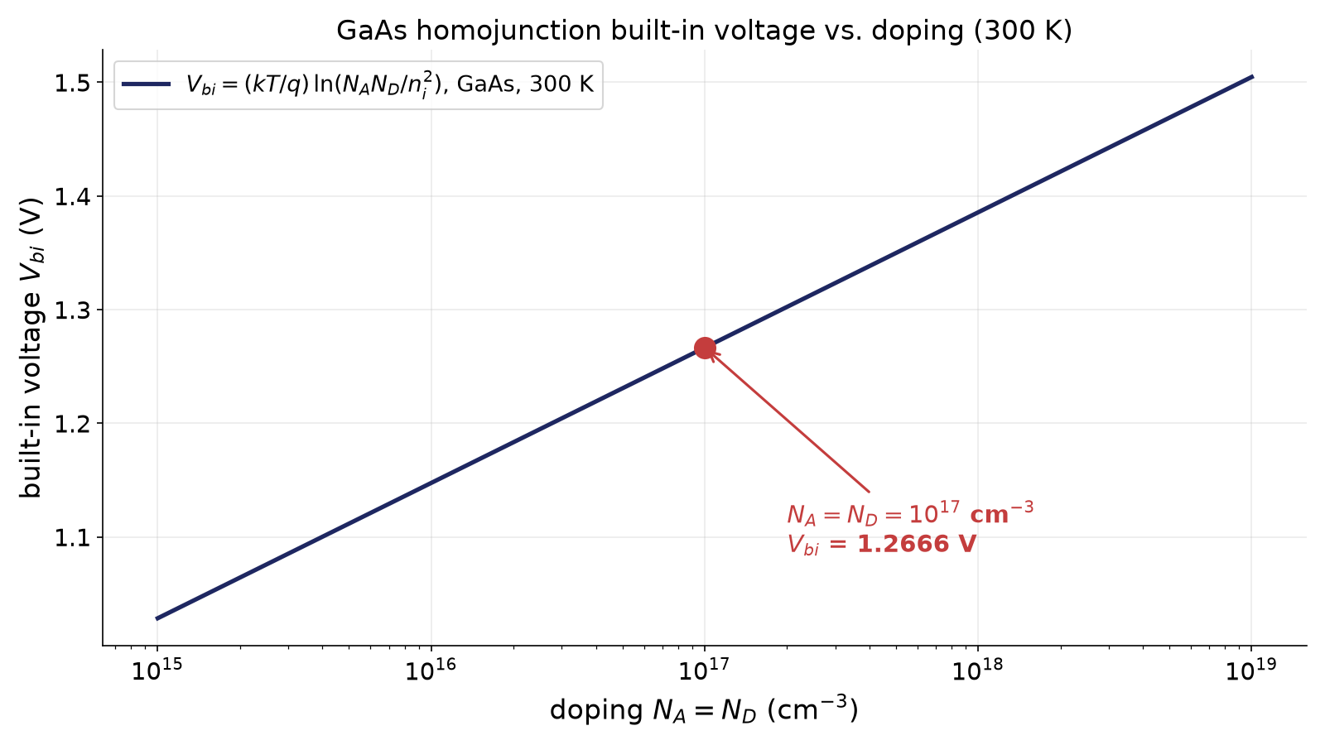
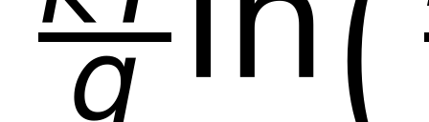
The p-n junction: built-in voltage
Joining p- and n-type material aligns the Fermi levels, bending the bands
The band bending IS the built-in voltage V_bi -- an equilibrium property, no current flows
For a homojunction, V_bi depends only on doping and the intrinsic carrier density n_i(T)
homojunction built-in voltage; N_A, N_D acceptor/donor densities, n_i intrinsic carrier density at temperature T
V_bi(N_A=N_D, 300 K) for a GaAs homojunction (fsim_core.transport.homojunction_vbi); the 1e17/1e17 point is marked
Driving the dot: optical and electrical, every regime
Source: vbi_gaas_1e17_1e17_300K = 1.2666041268449586 (fsim_core/transport.py)
55
Notes:
Bringing p-type and n-type material into contact forces their Fermi levels to align at equilibrium, which bends the conduction and valence bands near the junction; the total amount of bending, expressed as a voltage, is the built-in voltage V_bi. This is an equilibrium quantity: no current flows and none is needed to sustain it, because the electric field it creates exactly balances the tendency of majority carriers to diffuse across the junction. For a homojunction the textbook closed form is V_bi = (kT/q) ln(N_A N_D / n_i^2), which the repository implements exactly as fsim_core.transport.homojunction_vbi and uses as the verify-time cross-check of a second, more general route through the doped layers' own Fermi levels (fsim_core.transport.fermi_levels), which also handles heterojunctions where the two sides have different band gaps. At room temperature, GaAs doped 1e17/1e17 cm^-3 on both sides gives V_bi = 1.267 V (repo_numbers); doubling either doping adds roughly kT/q ln(2) = 18 meV, and V_bi grows as T falls because n_i falls exponentially with the band gap over kT. Every diode in this section builds on this one number before any current flows.

Slide 56
The p-i-n diode with the dot in the intrinsic region
Field, quasi-Fermi levels, and where the dot sits in energy
Undoped (intrinsic) region between p- and n-cladding hosts the dot layer, fully depleted at low bias
Applying V_j < V_bi leaves a near-uniform field F in the i-region, falling to 0 at flat band
Electron and hole quasi-Fermi levels split by qV_j inside the i-region under forward bias
The dot's transition energy E_X sits deep in the gap -- carriers must be supplied AT E_X
Repository: transport.Diode.depletion() returns F, the depletion width and C_dep from the layer stack
Driving the dot: optical and electrical, every regime
56
Notes:
Putting the dot in the intrinsic region of a p-i-n structure, rather than in a p-n junction's depletion edge, keeps the dot away from the doped, defect- and impurity-rich cladding and gives the designer direct control of the field the dot sees. At zero bias the i-region is depleted end to end (no free carriers) and supports a field set by V_bi and the doping/i-region geometry: V_bi - V_j = (q N_A x_p / eps)[d_i + x_p(1+N_A/N_D)/2], solved for the depletion widths x_p, x_n and the field F = q N_A x_p / eps. As V_j is forced up toward V_bi under forward bias the field collapses toward flat-band (F -> 0) and carriers begin to flow. Under forward bias, the electron and hole quasi-Fermi levels in the i-region are no longer equal; their separation there is at most qV_j (Sze & Ng ch. 12), and it is this separation, not the band edges themselves, that decides how many carriers exist at the dot's own transition energy deep inside the gap. fsim_core.transport.Diode.depletion() computes F, x_p, x_n, the total depletion width and the depletion capacitance from the actual layer stack (doping, i-region thickness, dielectric constant) for any bias; this same field and quasi-Fermi picture is what regime V (two slides ahead) turns into a quantitative sub-turn-on suppression of dot loading.

Slide 57

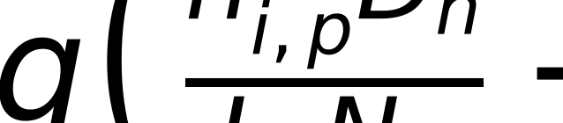
Diode current regimes I: the ideal (diffusion) diode
Shockley equation: exponential current-voltage law of an ideal p-n junction
n = 1 (ideality factor) marks pure minority-carrier diffusion, the textbook LED/diode regime
J0 set by each cladding's OWN intrinsic density n_i and minority-carrier diffusion length L
Shockley diode law, n = 1; J current density, V junction voltage
diffusion saturation current density; D = mu kT/q, L = sqrt(D tau) in each cladding, n_i,p/n_i,n each cladding's own intrinsic density
Driving the dot: optical and electrical, every regime
57
Notes:
The Shockley equation J = J0 (exp(qV/kT) - 1) is the starting point for every semiconductor diode: an exponential current-voltage law that follows from minority carriers diffusing away from the junction into the neutral p- and n-claddings under forward bias, recombining there with a characteristic diffusion length L = sqrt(D tau). An ideality factor of exactly n = 1 in the more general J0(exp(qV/nkT)-1) form is the signature of this diffusion-dominated channel. fsim_core.transport.Diode.ln_j0's 'diff' channel implements exactly this, using each cladding's OWN intrinsic carrier density (not the active layer's, which the spec's simplified textbook one-liner would suggest) -- important because a wide-gap AlGaInP or AlGaAs cladding has an intrinsic density many orders of magnitude below the active layer's, making this channel negligible in exactly the heterojunction LEDs this project cares about, per its own exp(-2 dE_g/kT) suppression relative to a homojunction. The diffusion coefficients D_n = mu_n kT/q, D_p = mu_p kT/q, and the diffusion lengths are capped at the physical cladding thickness when one is given, since a thin cladding is itself a perfect carrier sink shorter than the natural diffusion length. This channel matters for the GaAs reference diode used to verify the module; it is subdominant in both real InP-dot cards.

Slide 58
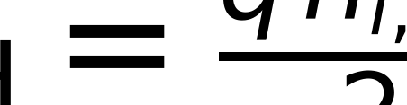
Diode current regimes II: SRH recombination and the two-diode model
Shockley-Read-Hall (SRH) recombination through mid-gap traps dominates at low forward bias
n = 2 because both carrier types must be simultaneously present in the depleted region
The 'two-diode model': an ideal n=1 diffusion diode in parallel with an n=2 SRH diode
SRH saturation current density; n_i,active the active layer's intrinsic density, d_i the depleted i-region thickness, tau_SRH the SRH lifetime
two-diode model: diffusion (n=1) channel plus SRH generation-recombination (n=2) channel, summed
Driving the dot: optical and electrical, every regime
58
Notes:
At low-to-moderate forward bias, most real diodes are dominated not by carriers that have already diffused into the neutral claddings but by carriers recombining through mid-gap trap states while still inside the depleted, field-swept i-region -- Shockley-Read-Hall recombination. Because SRH recombination through a single trap level needs both an electron and a hole present simultaneously, its rate is maximized, and its voltage dependence characteristically halved, giving an ideality factor n = 2: J0,SRH = q n_i,active d_i / (2 tau_SRH) for the simple case where the whole i-region shares the active layer's intrinsic density. The classic 'two-diode model' sums exactly these two channels -- an ideal n=1 diode for diffusion, an n=2 diode for SRH -- in parallel, which is what fsim_core.transport.Diode.ln_j0/ln_j do (implemented in log space via logsumexp for numerical stability at cryogenic temperatures where n_i can underflow). The repository generalizes the SRH term to sum over EVERY depleted layer (active plus barrier) with its own n_i, since n_i,barrier/n_i,active can be four orders of magnitude smaller for a wide-gap barrier -- a detail the textbook one-liner glosses over but that matters once the i-region is not homogeneous, as in every real heterostructure LED in this project's cards. A third channel (radiative recombination in the active layer, also n=1) is summed alongside these two; see the module docstring for its rate.

Slide 59
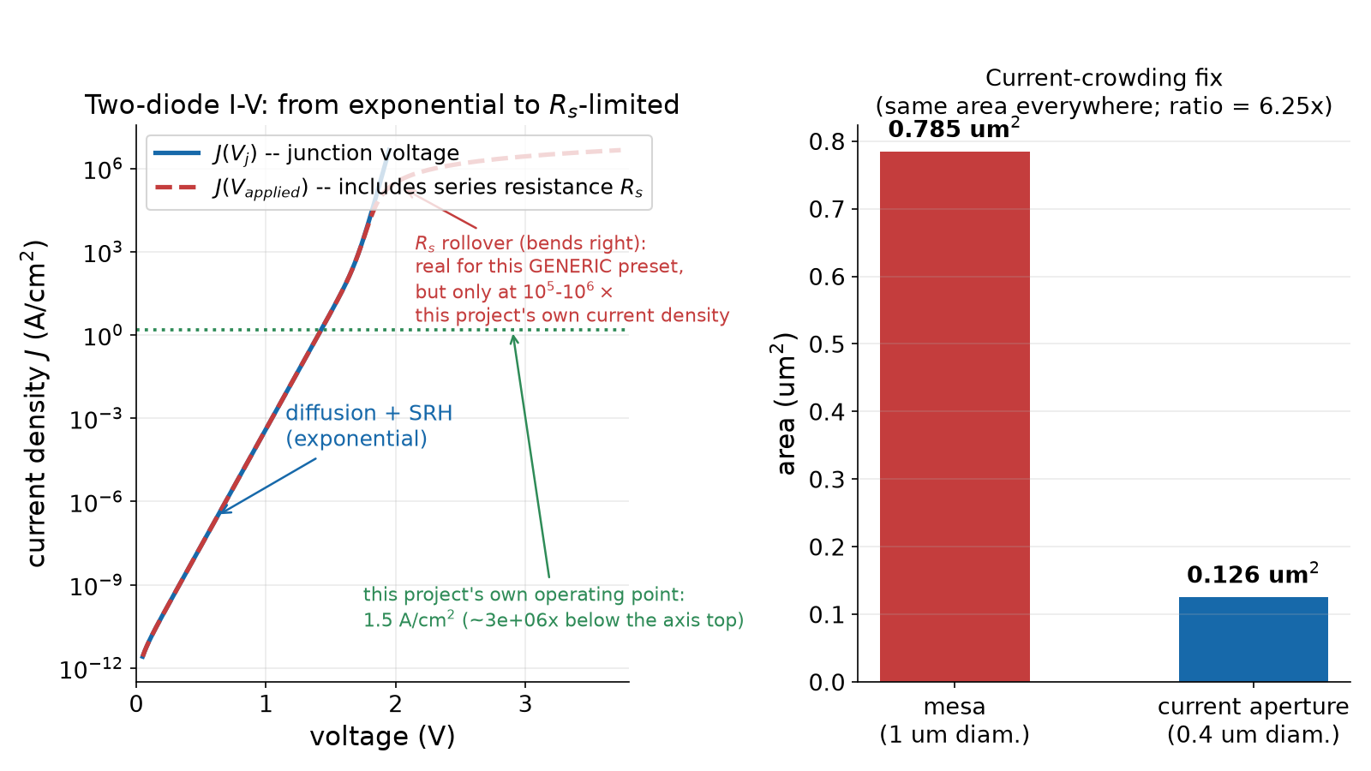
Diode current regimes III: high injection and current crowding
High injection: injected carrier density rivals the doping, ideality drifts from n~1-2 back toward n~2
Series resistance R_s: V_applied = V_j + I R_s, rolling the exponential I-V curve over at high I
Current crowding: what matters for injection efficiency and dot loading is CURRENT DENSITY, not current
Council review 2026-09-05 found V_j solved at the mesa area while dot loading used the aperture area
Fix: the diode's injection area now defaults to the SAME aperture area used everywhere downstream
left: J(V_j) for the red-diode preset showing the diffusion/SRH knee and the R_s rollover; right: the mesa-vs-aperture area ratio that was the source of the found inconsistency
Driving the dot: optical and electrical, every regime
Source: mesa_over_aperture_area_ratio = 6.246831516356892 (fsim_core/transport.py)
59
Notes:
Two more effects shape the high-bias I-V curve. First, high injection: once the injected minority carrier density becomes comparable to the majority doping, the simple exponential channels above no longer separate cleanly and the effective ideality factor tends back toward n~2 (conductivity modulation of the quasi-neutral regions). Second, series resistance: contacts and undepleted material outside the junction drop IR, so the terminal voltage is V_applied = V_j + I R_s, and the I-V curve rolls over from exponential toward linear at high current -- fsim_core.transport.Diode.iv solves this self-consistently by brentq on the junction voltage. The subtler issue is current crowding: everything downstream (injection efficiency, per-dot capture, background) depends on CURRENT DENSITY through the active layer, current divided by the actual cross-sectional area of the current path -- not necessarily the diode's overall mesa footprint. The repository's own council review (2026-09-05, item 3) found exactly this bug: the junction voltage was solved at the mesa area (0.785 um^2, a 1 um diameter default) while dot loading used the smaller current aperture (0.4 um diameter, 0.126 um^2) -- a 6.25x discrepancy that silently inflated the apparent per-dot loading. The fix defaults the diode's injection area to the SAME aperture area used everywhere else, unless an explicit current-crowding override (drive.diode_area_um2) says the real current path is narrower still.

Slide 60
Diode current regimes IV: tunnelling, breakdown, and where NOT to operate
The high-field failure modes this project deliberately stays away from
Zener (band-to-band) tunnelling: carriers tunnel directly across a thin, heavily doped depletion region
Trap-assisted tunnelling: a mid-gap trap halves the tunnelling distance, dominates in real, defect-laden diodes
Avalanche/breakdown: carriers gain enough energy between collisions to impact-ionize, current runs away
Reverse leakage: generation current in the depletion region, grows with reverse bias and temperature
This project's operating point (forward bias, low current, nA-uA scale) sits nowhere near any of these
Driving the dot: optical and electrical, every regime
60
Notes:
At the opposite extreme from the low-bias regimes already covered lie the diode's high-field failure modes, none of which this project's single-photon operating point ever approaches, but which bound where a real device must never be driven. Zener tunnelling is direct band-to-band quantum tunnelling across a thin depletion region, significant only in heavily doped, narrow-junction diodes under reverse (or, in a light-emitting structure's ultimate forward-bias limit, very high forward) bias. Trap-assisted tunnelling is the more commonly encountered version in real, imperfect material: a mid-gap defect state lets a carrier tunnel half the distance, recombine or re-emit thermally, then tunnel the rest of the way, and dominates the true reverse leakage of most practical diodes over pure Zener tunnelling. Avalanche breakdown is a runaway process: carriers accelerated by a strong reverse-bias field gain enough kinetic energy between collisions to knock loose new electron-hole pairs (impact ionization), which are in turn accelerated, multiplying current exponentially and, left unchecked, destroying the junction. Ordinary reverse leakage -- generation current from thermal electron-hole pair creation inside the depleted region, growing with both reverse bias and temperature via n_i(T) -- is the everyday, non-catastrophic version of the same physics. Every quantum-dot LED operating point in this project's cards is a modest forward bias at nanoamp-to-microamp currents (see the loading-statistics slide ahead); none of the regimes on this slide is reachable there, and reaching them would destroy or irreversibly age the device.

Slide 61
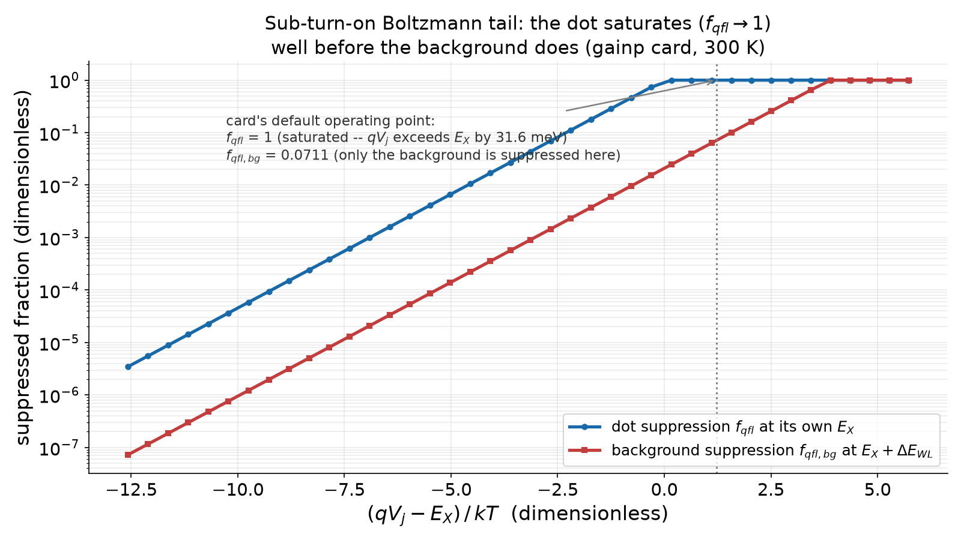

Diode current regimes V: the sub-turn-on Boltzmann tail
The i-region's quasi-Fermi split cannot exceed qV_j -- carriers at E_X above it are Boltzmann-suppressed
Applies twice: once to the dot transition E_X, once to the wetting-layer/matrix background E_X + dE_WL
Because dE_WL > 0, the background is suppressed MORE than the dot at the same sub-turn-on bias
Pass-2 finding: applying this suppression to the dot only, and not to the background, is an artefact
At the card's default point: f_qfl = 1 (qV_j exceeds E_X by 31.6 meV) -- only background suppressed
sub-turn-on Boltzmann-tail loading suppression at reservoir energy E; V_j junction voltage
the dot's own f_qfl and the background's f_qfl,bg vs. the dimensionless (qV_j - E_X)/kT for the gainp card at 300 K (fresh evaluate() sweep); at the card's default point the dot has saturated (f_qfl = 1) while the background is still suppressed
Driving the dot: optical and electrical, every regime
Source: f_qfl_bg_at_default_op_point_300K = 0.07106696420230808 (cards/edge-inp-gainp-design.yaml) | mu_at_default_op_point_300K = 0.9999999987213851 (cards/edge-inp-gainp-design.yaml) | f_qfl_dot_at_default_op_point_300K = 1 (cards/edge-inp-gainp-design.yaml) | qVj_minus_EX_meV_at_default_op_point_300K = 31.64388047528499 (cards/edge-inp-gainp-design.yaml)
61
Notes:
Regime V is not a new current channel but a correction to how much of the diode current that DOES flow can actually reach the dot's own transition energy E_X, above the conduction- and valence-band edges used in the I-V regimes so far. Sze & Ng's LED-injection treatment (ch. 12) notes that the intrinsic region's electron and hole quasi-Fermi levels cannot separate by more than qV_j; if E_X exceeds qV_j, only an exponentially small Boltzmann tail reaches that energy, f_qfl = min(1, exp(-(E_X - qV_j)/kT)). The repository's council review (2026-09-05, item 1) found this applied asymmetrically: the dot's own loading rate carried this suppression, but the competing wetting-layer/matrix background channel did not -- a one-sided bug that made the background look relatively brighter than it should below turn-on. The background reservoir sits at E_X + dE_WL (about 100 meV higher, the repository's own b_e() default), so its OWN suppression, f_qfl,bg = min(1, exp(-(E_X + dE_WL - qV_j)/kT)), is always at least as strong as the dot's -- the physically correct sign for a channel sitting deeper in the gap. At the gainp card's own default 300 K point, the dot has already saturated to f_qfl = 1 (qV_j exceeds E_X by about 31.6 meV), while the background remains suppressed at f_qfl,bg = 0.071 -- exactly the asymmetric regime this correction targets. Carriers a saturated-suppressed dot channel does NOT capture are not discarded: transport.py routes them into r_matrix so total carrier supply stays exactly conserved.

Slide 62
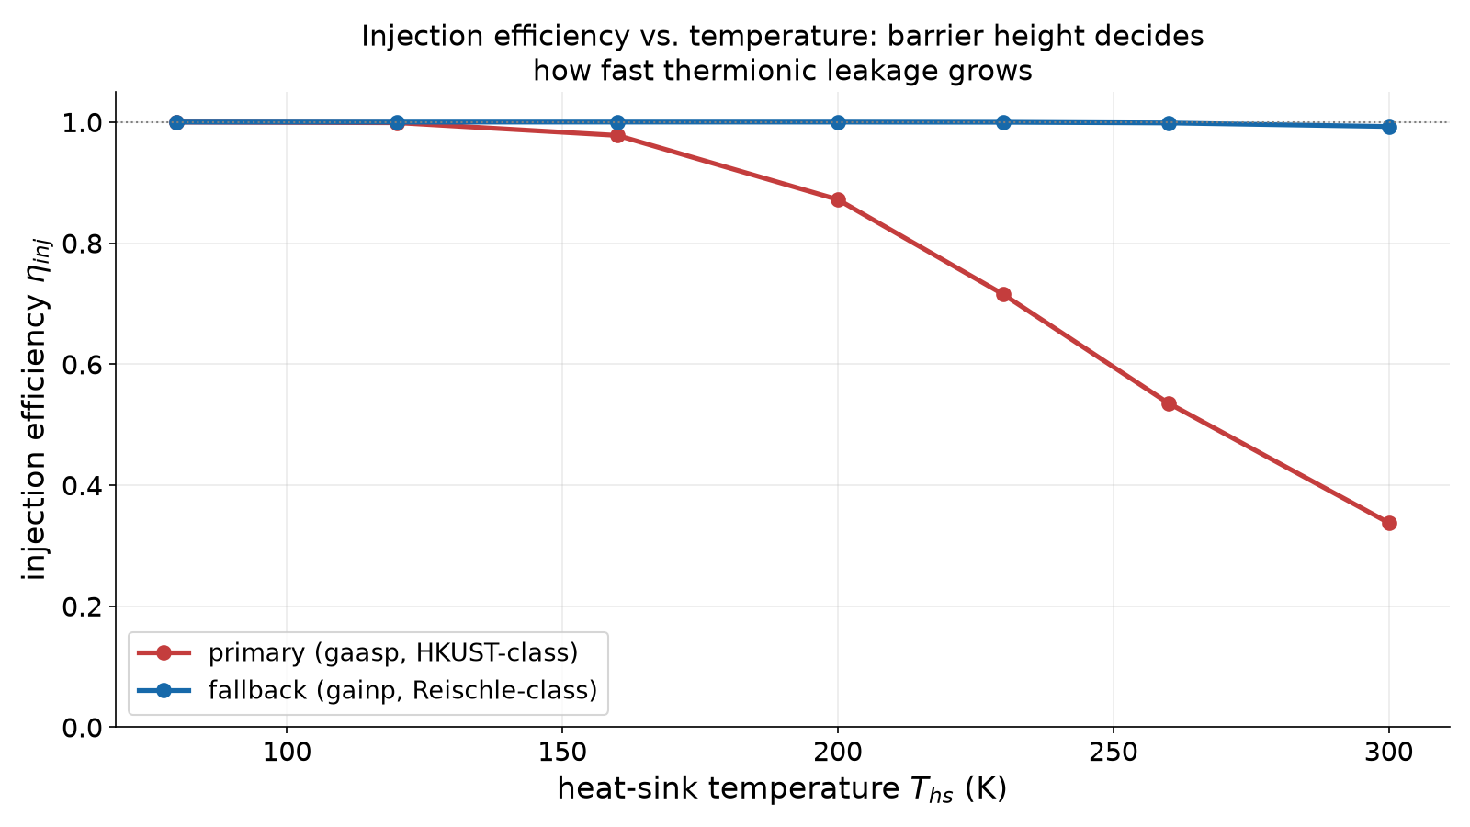
Heterojunction injection efficiency
eta_inj = 1/(1 + r_e + r_h): electron leakage over the p-cladding barrier, hole leakage over the n-cladding
r_e ~ exp(-dE_c/kT): Arrhenius-activated thermionic leakage over the conduction-band offset dE_c
Electron-blocking layers raise dE_c deliberately to suppress r_e (the classic AlGaInP red-LED fix)
gaasp card (HKUST-class, smaller dE_c): eta_inj falls from ~1.0 (80 K) to 0.338 (300 K)
gainp card (Reischle-class, larger dE_c): eta_inj stays >0.99 from 80 K to 300 K
eta_inj(T) for both design cards, from fresh evaluate() sweeps over thermal.T_hs
Driving the dot: optical and electrical, every regime
Source: eta_inj_gaasp_300K = 0.33782403373133707 (cards/edge-inp-gaasp-design.yaml) | eta_inj_gaasp_80K = 0.9999971341649136 (cards/edge-inp-gaasp-design.yaml) | eta_inj_gainp_300K = 0.9926579833552509 (cards/edge-inp-gainp-design.yaml) | eta_inj_gainp_80K = 0.9999999999999925 (cards/edge-inp-gainp-design.yaml)
62
Notes:
Injection efficiency asks what fraction of the diode current actually reaches the active layer as useful carriers, rather than leaking thermionically over the OPPOSITE cladding's barrier: electrons injected from the n-side can leak over the p-cladding's conduction-band offset dE_c before recombining, and holes symmetrically over the n-cladding's valence-band offset dE_v. Coldren, Corzine and Masanovic's leakage-current treatment (sec. 4.4-4.5) gives the classic Arrhenius form r_e = (N_c,pclad/N_c,active)(D_n tau_active/L_n d_active) exp(-dE_c/kT), and eta_inj = 1/(1+r_e+r_h); the repository implements this with the actual strained band offsets from its materials database (fsim_core.transport.Diode.eta_inj), defaulting to the Gamma-valley-only leakage (a lower bound; an opt-in Gamma-X mode exists for AlInP's known indirect-valley complication, flagged rather than silently used because the result is highly sensitive to an uncertain X-edge offset). This is precisely the mechanism electron-blocking layers exploit in real red/orange LEDs: deliberately choosing a wider-gap, higher-dE_c cladding to suppress r_e. The two design cards make the physics concrete: the Reischle-class 'gainp' card's AlGaInP barrier gives a large dE_c and keeps eta_inj above 0.99 across the whole 80-300 K range, while the HKUST-class 'gaasp' card's smaller barrier lets eta_inj collapse to 0.338 at 300 K -- a factor-of-3 current loss to leakage alone before any dot physics enters, and the single biggest reason the two cards diverge in later slides.

Slide 63
Carrier capture into a dot
Wetting-layer capture, phonon-assisted relaxation, and dividing the supply fairly
Carriers reaching the active layer first populate the wetting layer / matrix, not the dot directly
Capture into the dot competes with matrix recombination: f_QD = 1/(1 + tau_cap/tau_matrix)
Relaxation into the dot ground state proceeds via LO-phonon emission (InP LO ~ 43 meV), tau_cap ~ ps
Per-dot share: r_dot = f_QD eta_inj (I/q) / N_eff, N_eff = max(N_dots, 1.0)
max(.,1) is carrier conservation: a fractional expected dot count is NOT a fractional physical dot
Driving the dot: optical and electrical, every regime
Source: f_QD_at_1e10_cm2 = 0.9950248756218907 (fsim_core/transport.py) | f_QD_at_3e8_cm2 = 0.8571428571428571 (fsim_core/transport.py) | N_dots_expected_in_aperture = 0.3769911184307752 (cards/edge-inp-gainp-design.yaml)
63
Notes:
A carrier that survives injection into the active layer does not appear inside the dot directly -- it first populates the surrounding wetting layer or matrix material, from which it either recombines there (lost to background) or is captured into a dot via phonon-assisted relaxation, typically emitting one or more LO phonons (in InP, the LO phonon energy is about 43 meV) on a picosecond timescale. fsim_core.transport.Diode.f_qd models the competition as a simple branching ratio, f_QD = 1/(1 + tau_cap/tau_matrix), with the dot capture time scaling inversely with dot density (tau_cap = tau_cap0 x (1e10 cm^-2 / n_dot), tau_cap0 = 5 ps [E] at 1e10 cm^-2) since a denser dot ensemble captures faster -- giving f_QD = 0.995 at 1e10 cm^-2 but only 0.857 at the sparser 3e8 cm^-2 density this project's single-dot-selection cards actually use. The captured supply must then be divided among however many dots sit under the current aperture, N_dots = n_dot x A_aperture, itself a Poisson-EXPECTED dot count and therefore often fractional (0.377 for the actual cards' 0.4 um aperture at 3e8 cm^-2). The repository's council review (2026-09-05, item 1) established that dividing by a fractional N_dots directly would hand the ONE dot that IS actually present in the aperture MORE than 100% of the captured supply -- an unphysical result -- so the per-dot share instead divides by N_eff = max(N_dots, 1.0), while N_dots itself keeps its statistical meaning for the separate neighbour-dot competitor count used elsewhere in the chain.

Slide 64
Loading statistics: pulsed and CW
Pulsed: mu = r_dot x tau_pulse -- the mean number of excitons loaded per drive pulse
Poisson-distributed occupation, truncated at cap 2 downstream (loading.f1b_g2 / f8_g2)
CW: occupancy estimate n_occ = r_dot x tau_rad, with a rate-equation model for the actual dip
Target: mu ~ 1 -- enough brightness without excess multiphoton probability
card | operating current | rep rate | duty (tau_pulse x rep rate) | mu (resolved)
edge-inp-gainp-design (fallback) | 1.9 nA | 80 MHz | 0.008 | 1.000
edge-inp-gaasp-design (primary) | 11.3 nA | 80 MHz | 0.008 | 1.000
Driving the dot: optical and electrical, every regime
Source: I_uA_gainp = 0.0018830313178885266 (cards/edge-inp-gainp-design.yaml) | I_uA_gaasp = 0.011314080567212663 (cards/edge-inp-gaasp-design.yaml) | mu_resolved_gainp_300K = 0.9999999987213851 (cards/edge-inp-gainp-design.yaml) | mu_resolved_gaasp_300K = 0.9999999997568025 (cards/edge-inp-gaasp-design.yaml)
64
Notes:
Once the per-dot capture rate r_dot is known, the operating regime depends on how the drive is timed. Under pulsed drive, mu = r_dot x tau_pulse is the mean number of excitons loaded per drive pulse, and the loading statistics are Poisson, P_n = exp(-mu) mu^n/n! -- but the dot itself can only ever hold an exciton (X) and a biexciton (XX) state, so the model truncates the occupation at n = 2 (cap-2), folding every n >= 2 outcome into the biexciton channel as a MODELLING convention, not a reporting choice; loading.f1b_g2/f8_g2 apply exactly this cap-2 truncation downstream of the mu computed here. Under CW drive, the more natural quantity is an occupancy estimate n_occ = r_dot x tau_rad (uncapped mean population), with the actual antibunching dip computed by a full rate-equation model (fsim_core.cw_g2) rather than a Poisson snapshot, since CW drive has no pulse boundary to define a single loading event. Both cards here are tuned, by construction, to mu ~ 1 at their default 300 K point: 1.9 nA for the fallback 'gainp' card and 11.3 nA for the primary 'gaasp' card, both at 80 MHz with a 100 ps pulse (duty = tau_pulse x rep rate = 0.008). These are tiny currents -- nanoamps, not the milliamps every published electrically driven single-dot result has used -- because mu ~ 1 into ONE dot, not an ensemble sharing the current, is the single-photon operating point; the next slides quantify why that gap exists.

Slide 65
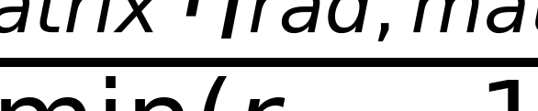
Background electroluminescence
Every current path lights up the matrix/wetting layer too, not only the one selected dot
Its low-energy Urbach tail can extend into the X-line detection window, adding background counts
xi(w, dE_WL, E_U): the tail fraction inside a window of width w, centred dE_WL below the peak
b_e = background photons/s in-window / X photons/s of the dot -- defined once, at the operating point
b_res: a SEPARATE, measured residual channel transferred from Reischle 2008 (rho = 0.88 at 80 K)
Urbach-tail window fraction; Delta E = dE_WL (peak-to-window-centre offset), w window width, E_U = max(kT, E_urbach) tail energy
background photons per collected X photon; S the dot's thermal retention factor; r_matrix the full matrix supply (below)
carriers reaching the matrix; supply = eta_inj (I/q); the second (routed) term vanishes only when f_qfl = 1
Driving the dot: optical and electrical, every regime
Source: b_res_from_reischle_rho088 = 0.13636363636363635 (cards/edge-inp-gainp-design.yaml) | b_e_resolved_gainp_300K = 0.025105412712542366 (cards/edge-inp-gainp-design.yaml) | b_e_resolved_gaasp_300K = 0.14379414576550573 (cards/edge-inp-gaasp-design.yaml)
65
Notes:
Every carrier injected but NOT captured by the selected dot still recombines in the matrix or wetting layer, and a fraction eta_rad,matrix of that recombination is radiative -- light the same optics and filter collect too. The matrix supply itself is r_matrix = (1-f_QD) supply + f_QD supply (1-f_qfl), supply = eta_inj (I/q): the first term is carriers never captured, the second is carriers that WERE captured but sub-turn-on suppressed (03-11) and routed back out, so total supply stays conserved exactly. At this project's own default point f_qfl = 1 (03-11), the second term vanishes and r_matrix reduces to the familiar (1-f_QD) supply -- true at this point only. The matrix/WL emission's low-energy edge is modelled as a one-sided exponential (Urbach) tail of decay energy E_U = max(kT, E_urbach); xi(w, dE_WL, E_U) is the fraction of that tail inside a window of width w centred dE_WL below the peak. b_e is DEFINED, once, as the ratio of background rate to the dot's own X-line rate at the same operating point -- the module's whole reason for existing, since an earlier audit found the same symbol used with three inconsistent meanings. b_e is distinct from drive.b_res, a SEPARATE channel transferred from measurement: Reischle et al. 2008 report rho = 0.88 at 80 K (QD C), carried forward as b_res = (1-rho)/rho = 0.136, an [E] assumption that a similar fraction applies at 300 K on a different platform.

Slide 66
Pulsed electrical excitation
How Reischle et al. did it -- and its RC limits
Reischle 2008: dc current injection only, 0.1 mA resolution current source, no pulsing
Reischle 2010: pulse pattern generator, pulse widths down to 100 ps, up to 3.35 GHz rep rate
Bias scheme: dc bias near EL onset (V_dc) plus pulses (V_pp) riding on top, via a bias tee
Device 1: V_dc=4.5 V, V_pp=4.8 V (self-heated to ~40 K); Device 2: V_dc=2.07 V, V_pp=4.8 V (~20 K)
Repetition-rate limit: the ~500 ps decay time and re-excitation during the pulse cap useful rates
RC limit: mesa capacitance and the 50 ohm termination set the fastest edge a diode can actually switch
Driving the dot: optical and electrical, every regime
66
Notes:
The two Reischle papers bracket the electrical single-photon state of the art in InP/GaInP dots. The 2008 Optics Express paper used pure dc current injection (a 0.1 mA-resolution current source, 12 mA-class operating currents, 1.93-2.87 V) and reached 80 K, limited -- in the authors' own words -- 'mainly by background luminescence' rather than signal. The 2010 Applied Physics Letters paper added genuine pulsed injection: a pulse pattern generator plus amplifier delivering pulse widths down to 100 ps at repetition rates up to 3.35 GHz, biasing the sample just below the EL turn-on voltage (V_dc) with voltage pulses (V_pp) riding on top through a bias tee -- exactly the same dc-plus-pulse scheme the operating-current numbers on this project's own loading-statistics slide implicitly assume. Their two devices ran at V_dc = 4.5 V / V_pp = 4.8 V (Device 1, which self-heated to about 40 K through its own 50 ohm series resistor) and V_dc = 2.07 V / V_pp = 4.8 V (Device 2, better contacts, ~20 K). Two physical limits bound how fast such a mesa diode can be pulsed: the exciton decay time itself (~500 ps, TCPC-measured; re-excitation during a still-decaying pulse degrades antibunching before ~1.25 GHz) and the diode's own RC time constant, set by its junction/mesa capacitance and the (typically 50 ohm) drive-line termination -- a real electrical bandwidth limit no amount of pulse-generator speed can outrun.

Slide 67
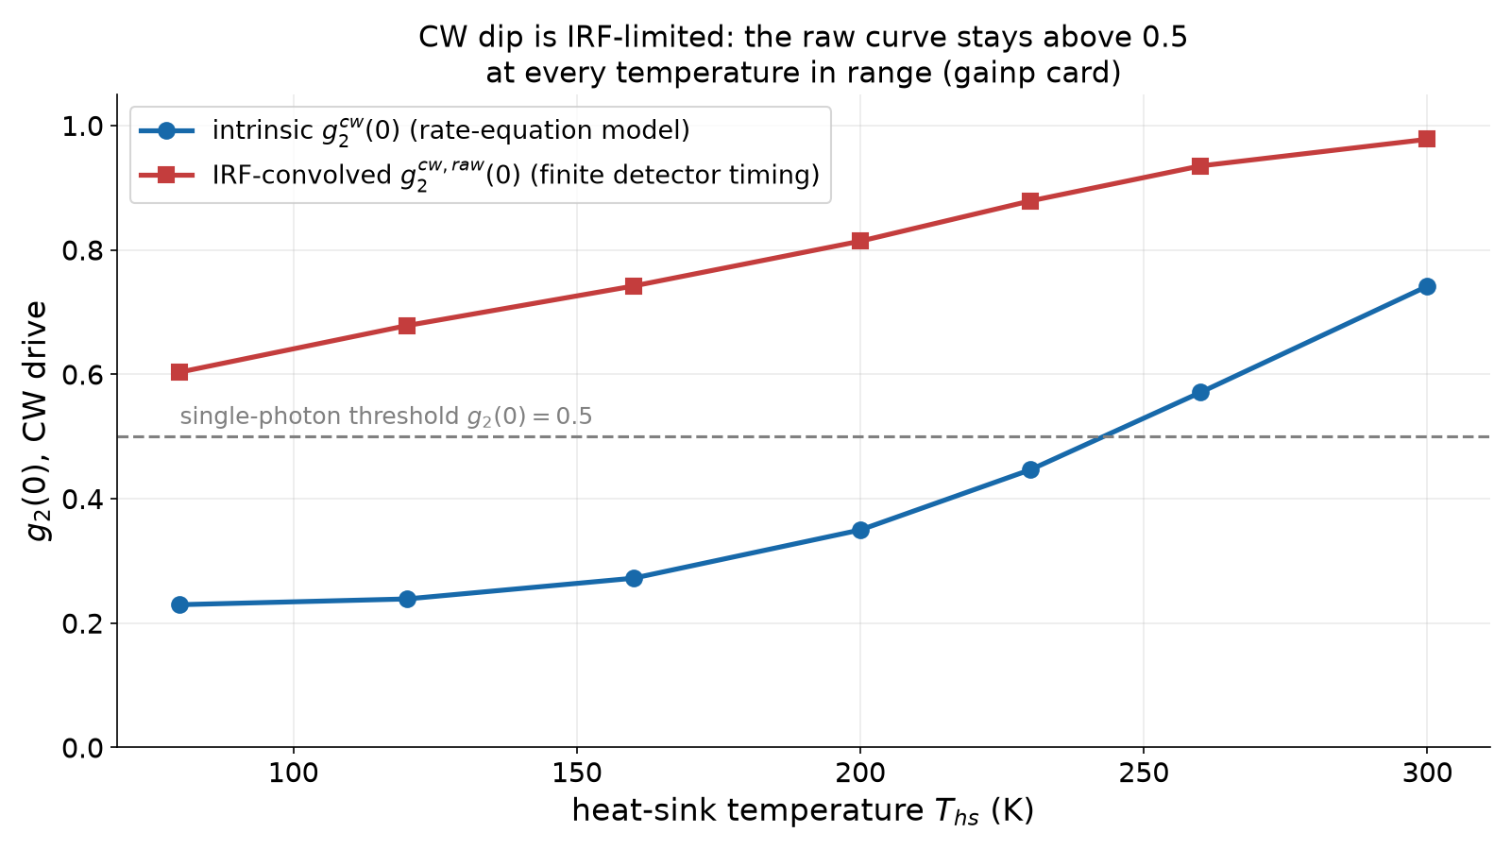
CW electrical drive: why the dip is IRF-limited at 300 K
CW drive: gainp card's OWN default parameters give g2_cw0(T) = 0.5 crossing near 243 K, not 300 K
But a real detector convolves the dip with a finite instrument response function (IRF)
g2_cw0_raw(T): the SAME dip after IRF convolution is above 0.5 at every temperature in range
The dip narrows in time as escape/capture speed up with T, faster than any practical IRF can resolve
Conclusion: pulsed (gated) drive is required at high T, not merely preferred
intrinsic g2_cw0 vs. IRF-convolved g2_cw0_raw across the temperature ladder (gainp card, fresh evaluate() sweep, cw_irf_fwhm_ps=100)
Driving the dot: optical and electrical, every regime
Source: g2_cw0_intrinsic_favorable_300K = 0.3586 (out/rt_edge/verdict.md) | g2_cw0_raw_irf_favorable_300K = 0.895 (out/rt_edge/verdict.md) | g2_cw0_gainp_default_300K = 0.7415275758244579 (cards/edge-inp-gainp-design.yaml) | g2_cw0_raw_gainp_default_300K = 0.9777344806603223 (cards/edge-inp-gainp-design.yaml) | g2_cw0_crossing_T_gainp_default = 243.0986306700349 (cards/edge-inp-gainp-design.yaml)
67
Notes:
Continuous-wave electrical drive needs no pulse generator, just a steady bias -- but it hides a timing trap that only becomes visible once a real detector's finite timing resolution is accounted for. The repository computes two related quantities for the CW case: g2_cw0, the intrinsic zero-delay correlation from a rate-equation model of loading and escape (fsim_core.cw_g2), and g2_cw0_raw, the SAME dip after convolution with a detector instrument response function (IRF) of finite width (drive.cw_irf_fwhm_ps). At the gainp card's own DEFAULT dot parameters (not the favourable corner), g2_cw0 stays below 0.5 only up to about 243 K and has already risen to 0.7415 by 300 K (repo_numbers) -- the favourable-corner numbers below describe a distinct, more optimistic point in the same grid, not the card's as-specified behaviour. There, the intrinsic dip alone (g2_cw0 = 0.359) would already satisfy g2(0) < 0.5, but the IRF-convolved value (g2_cw0_raw = 0.895) sits well above threshold. As temperature rises, carrier escape and re-capture accelerate and the antibunching dip in time becomes narrower than the timing resolution of realistic single-photon detectors can resolve, so a CW intensity-correlation measurement alone could never DEMONSTRATE single-photon emission near room temperature, even though the underlying physics is genuinely antibunched. This is why every electrically driven demonstration this section discusses either operates at cryogenic temperature (where the dip is wide enough for any reasonable IRF) or switches to gated, pulsed excitation, sidestepping the detector's timing resolution by defining the correlation window electrically rather than optically.

Slide 68


Self-heating
Every watt dissipated in the junction must spread through the package to the heat sink
Thermal spreading resistance R_th converts dissipated power into a steady-state temperature rise
The solve uses the TIME-AVERAGED power (duty x P_junction), not the instantaneous per-pulse power
At the nanoamp currents this project's dots actually run at, the rise is negligible
junction dissipated power: electrical input minus the (tiny) radiated optical power; f_Rs the local share of I^2 R_s heat
self-consistent junction temperature; T_hs the heat-sink set point, R_th the thermal spreading resistance, duty = tau_pulse x rep_rate the SAME pulsed duty cycle used throughout this section
Driving the dot: optical and electrical, every regime
Source: dT_J_gainp_300K = 0.000008002647859939316 (cards/edge-inp-gainp-design.yaml) | dT_J_gaasp_300K = 0.00005824616556537876 (cards/edge-inp-gaasp-design.yaml) | P_junction_W_gainp_300K = 3.0553712711693464e-9 (cards/edge-inp-gainp-design.yaml) | R_th_implied_gainp_300K = 327400.7947680838 (cards/edge-inp-gainp-design.yaml)
68
Notes:
The current flowing through the diode dissipates power in two places: I V_j at the junction itself, and a share f_Rs,local of the I^2 R_s series-resistance heating in the mesa; a negligible amount is subtracted back out as radiated optical power. This power must conduct away through the package layer stack to the heat sink, and the repository's thermal module (fsim_core.thermal.t_junction) computes the steady-state rise self-consistently: T_j = T_hs + R_th (duty x P_junction), where duty = tau_pulse x rep_rate is the SAME pulsed duty cycle used throughout this section (0.008 for both cards) -- the solve consumes the time-AVERAGED power, not the instantaneous per-pulse P_junction, since only the average heating raises the steady-state temperature; omitting duty would understate the implied R_th by a full factor of 1/duty (2 619 K/W instead of the model's actual 327 400 K/W for gainp at 300 K, repo_numbers). R_th itself is built from each layer's own thickness and thermal conductivity. This is the T_j every temperature-dependent quantity in this section -- anchored linewidth, retention, injection efficiency, CW escape -- actually consumes, never the bare T_hs, per the repository's own temperature-mapping contract. At the currents this project's cards actually run (nanoamps, not milliamps), self-heating is vanishingly small despite that large R_th: both cards show a junction-to-heat-sink difference of only microkelvin at 300 K (dT_J = 8.00 microkelvin for gainp, 58.25 for gaasp, repo_numbers).

Slide 69
Retention meets injection: the temperature ladder
T_hs (K) | T_j (K) | eta_inj | S (retention) | g2 (pulsed, intrinsic) | collected flux (photons/s) | flux-eligible
80 | 80.0000049 | 1.00000 | 0.0758 | 0.229 | 38 029 | yes
230 | 230.0000075 | 0.99969 | 0.0131 | 0.500 | 6 581 | yes
300 | 300.0000080 | 0.99266 | 0.00462 | 0.689 | 2 308 | yes
Driving the dot: optical and electrical, every regime
Source: g2_op_gainp_80K = 0.22901211331995874 (cards/edge-inp-gainp-design.yaml) | g2_op_gainp_230K = 0.5001499929250597 (cards/edge-inp-gainp-design.yaml) | g2_op_gainp_300K = 0.6890713444347775 (cards/edge-inp-gainp-design.yaml) | flux_gainp_80K = 38028.83369043679 (cards/edge-inp-gainp-design.yaml) | flux_gainp_230K = 6580.830009053337 (cards/edge-inp-gainp-design.yaml) | flux_gainp_300K = 2308.1279594492175 (cards/edge-inp-gainp-design.yaml) | eps_op_gainp_80K = 0.001186008684294538 (cards/edge-inp-gainp-design.yaml) | eps_op_gainp_300K = 0.650940040491455 (cards/edge-inp-gainp-design.yaml) | rho_op_gainp_80K = 0.8799998742597043 (cards/edge-inp-gainp-design.yaml) | rho_op_gainp_300K = 0.8427621124531315 (cards/edge-inp-gainp-design.yaml) | S_gainp_80K = 0.0757524707852274 (cards/edge-inp-gainp-design.yaml) | S_gainp_230K = 0.01311117512703881 (cards/edge-inp-gainp-design.yaml) | S_gainp_300K = 0.004617450134914658 (cards/edge-inp-gainp-design.yaml)
69
Notes:
This ladder is the single clearest picture of the temperature cost this section has been building toward, computed fresh (fsim_core.device.DeviceDesign.load + fsim_core.device.evaluate, overriding only thermal.T_hs) against the fallback 'gainp' card at its OWN default operating current and dot parameters -- no numbers here are read from a stale sweep file. Three things move together as the heat sink warms from 80 to 300 K. Injection efficiency barely moves for this card (0.9999 to 0.9927) because its AlGaInP barrier gives a large conduction-band offset; the OTHER (primary, 'gaasp') card's smaller barrier would show a much sharper fall, as the injection-efficiency slide showed. Retention S -- the fraction of captured excitons that decay radiatively before escaping the dot -- falls steeply, by more than an order of magnitude (0.076 to 0.0046), because thermal escape over the confinement barrier is exponentially activated in T; this is the dominant reason collected flux falls from roughly 38,000 to about 2,300 photons/s. Pulsed intrinsic g2(0) correspondingly rises from 0.229 (comfortably single-photon) to 0.689 (above threshold), driven overwhelmingly by eps_op -- the spectral-overlap multiphoton probability, which grows more than 500x (0.00119 to 0.6509) as the confinement linewidth broadens with T -- not by rho, the background/signal fraction, which barely moves (0.880 to 0.843). All three rows remain above this project's 1 kHz collected-flux eligibility floor, i.e. every row is measurable, not merely diagnostic -- but only the 80 K row actually passes the g2(0) < 0.5 gate at these delta_xx/gamma300 defaults.

Slide 70
Non-cryogenic operation: thermoelectric cooling
The project's relaxed stop rule -- 230 K, not 4 K
A single-stage Peltier (thermoelectric) cooler routinely reaches ~200-230 K, no cryogen required
That buys most of the retention S(T) headroom without a cryostat, dewar or liquid helium/nitrogen
It also buys back injection efficiency eta_inj(T) for whichever card's barrier is more T-sensitive
GOAL_PROMPT.md's 2026-09-06 update: PASS now requires ONE eligible T_hs in {230,250,273,300} K, not just 300 K
This reframes the project's target from 'room temperature or nothing' to 'no cryogen, any of four set points'
Driving the dot: optical and electrical, every regime
70
Notes:
Every electrically driven single-photon result in the digested literature -- 80 K (Reischle 2008), 20-40 K (Reischle 2010) -- was cryostat-cooled. A single-stage thermoelectric (Peltier) cooler, by contrast, is a compact, cryogen-free, room-temperature-rejecting solid-state device that routinely holds a small package at 200-230 K continuously, with no liquid helium, no liquid nitrogen, and no vacuum dewar -- exactly the kind of engineering simplification that could turn a laboratory demonstration into a deployable component. The retention ladder on the previous slide shows why this matters quantitatively: S(T) at 230 K (0.0131 for the gainp card) is nearly 3x the 300 K value (0.0046), and for the primary gaasp card, whose injection efficiency is far more temperature-sensitive, eta_inj at 230 K (0.715) is more than double its 300 K value (0.338). The project's own goal document was updated on 2026-09-06 to reflect exactly this: rather than demanding a passing operating point specifically at 300 K, the acceptance gate (docs/rt_edge_contract.md) now asks only that AT LEAST ONE heat-sink temperature in {230, 250, 273, 300} K have a physically eligible, g2(0) < 0.5 corner -- any of which is achievable with a single-stage TEC and none of which needs a cryostat. This is the project's relaxed stop rule: 'non-cryogenic', not 'room-temperature-only', is the actual engineering target, and it is a materially easier one given how steeply both retention and injection efficiency recover between 300 K and 230 K.

Slide 71
Electrical vs. optical: the honest comparison
figure of merit | optical (resonant/TPE) | electrical (p-i-n, this project)
purity g2(0) | excellent (<0.01 reported, resonant) | 0.03 background-corrected @ 80 K (Reischle); 0.229-0.689 across this project's gainp-card 80-300 K ladder (gaasp flux: 40 133/s @ 80 K, 2 260/s @ 230 K -- both above the 1 kHz floor; only 300 K, 474.5/s, is diagnostic-only, below it)
brightness | limited by pump rejection, collection optics | limited by injection efficiency, capture, retention; nA-scale currents by design
timing jitter | near-zero for a resonant pi-pulse | adds transport + capture jitter; RC and decay-time limited
complexity | laser, wavelength stabilization, pump-rejection optics/filters | current source and a diode; no optical table
temperature reach | single-dot antibunching to 230 K reported (Chatzarakis) | single-dot electrical result reported only to 80 K (Reischle); this project targets 230-300 K, non-cryogenically
Driving the dot: optical and electrical, every regime
71
Notes:
This table is deliberately not a verdict in either direction: the honest picture from the digested literature (../_goal/paper_digests.md) is that optical and electrical excitation have never been demonstrated at the same temperature on the same platform, so any single-number comparison would overstate what is actually known. Optically pumped single dots have reached impressively high temperatures (Chatzarakis et al., antibunching to 230 K in InAs/AlGaAs-superlattice dots; Laferriere et al., single-dot emission observed to 300 K, though g2(0) rises to 0.57 there) because a resonant or near-resonant laser puts population directly into the transition with minimal jitter and no competing current-injection background. The best electrically driven single-dot result in the same literature set (Reischle et al. 2008) reaches only 80 K, limited explicitly by background electroluminescence, not by dot brightness -- and needs no laser at all, trading optical complexity for electrical simplicity. This project's own temperature ladder (previous slides) sits inside that gap: electrically driven, computed to 300 K, with g2(0) crossing the 0.5 single-photon threshold somewhere between 80 K and 230 K depending on the card and its dot parameters. Practically, the electrical route is what integration and scaling ultimately require -- no free-space optics, no wavelength stabilization -- which is why this section has spent so much of its time on it, even though the optical route currently holds the higher-temperature single-dot antibunching record.

Slide 72
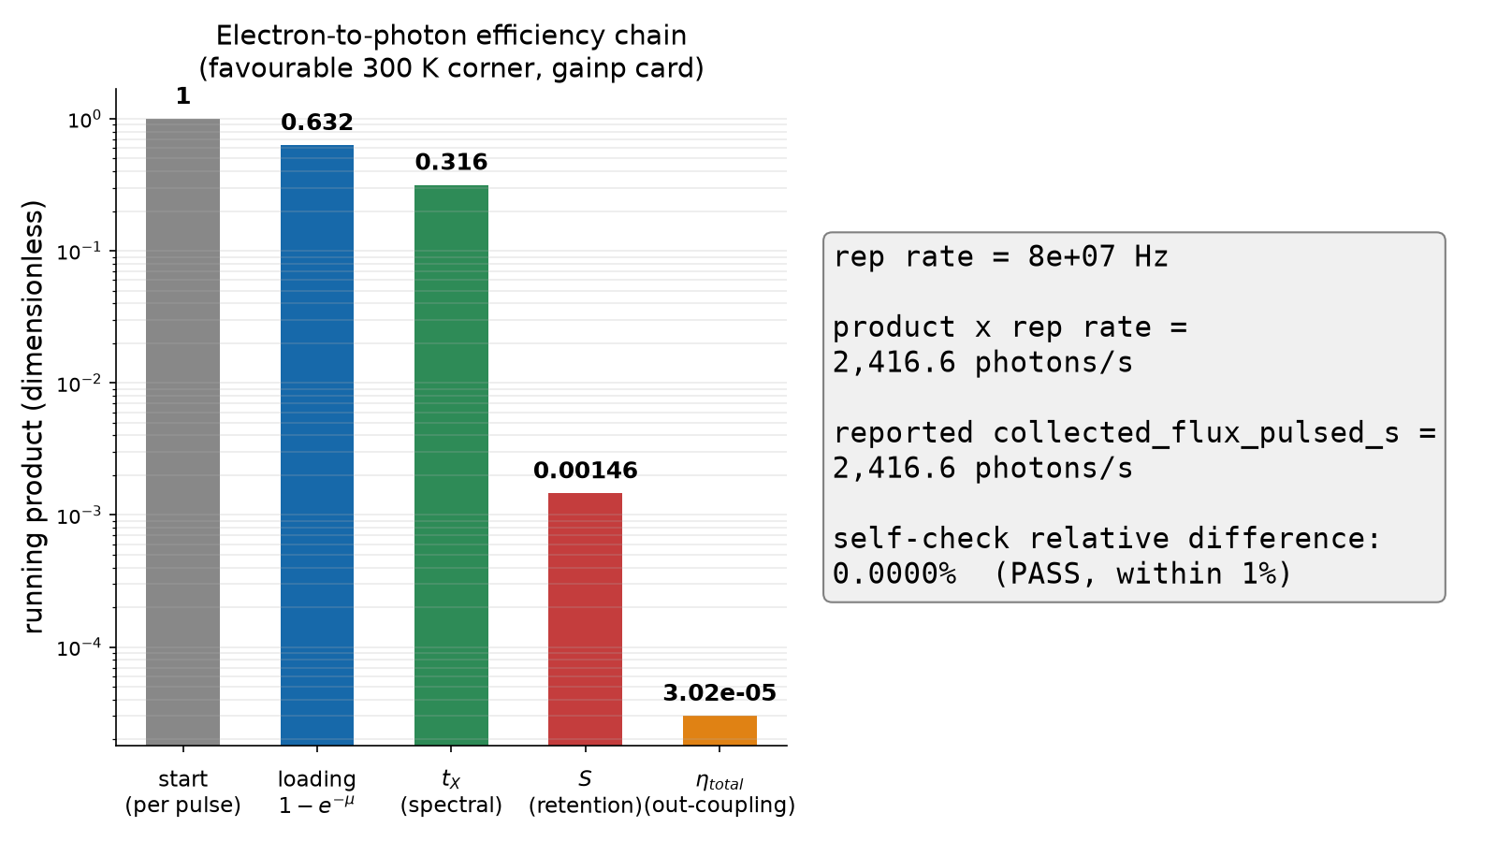
Worked example, part 1: from contact to collected photon
Favourable corner (T_hs = 300 K): gainp card, delta_xx=8 meV, gamma300=6 meV, NA=0.8, R_back=0.95, L_um=250
Loading (1 - e^-mu, mu=1): 0.6321 -- the Poisson probability of at least one exciton per pulse
Spectral transmission t_X (filter matched to the line's own width): 0.500
Thermal retention S (confinement escape at 300 K): 0.00462 -- the single biggest loss in the chain
Edge out-coupling eta_total (waveguide beta x facets x propagation x NA), folded into one factor: 0.02070
Same levers at T_hs = 230 K: S=0.01311, flux=6890/s, g2(0)=0.3214 -- the sweep's grid minimum
the multiplicative efficiency chain reproducing collected_flux_pulsed_s at the favourable 300 K corner (out/rt_edge/verdict.md factor table, reproduced by fresh evaluate())
Driving the dot: optical and electrical, every regime
Source: loading_1_minus_e_neg_mu = 0.632121 (out/rt_edge/verdict.md) | t_X_favorable_corner = 0.5 (cards/edge-inp-gainp-design.yaml) | S_favorable_corner = 0.004617450134914658 (cards/edge-inp-gainp-design.yaml) | eta_total_favorable_corner = 0.02069845908854732 (cards/edge-inp-gainp-design.yaml) | collected_flux_favorable_corner = 2416.5742068088216 (cards/edge-inp-gainp-design.yaml) | S_favorable_corner_230K = 0.01311117512703881 (out/rt_edge/verdict.md) | collected_flux_favorable_corner_230K = 6890.027042983641 (out/rt_edge/verdict.md)
72
Notes:
This slide and the next three walk one electron, injected at the n-contact, all the way to a detected photon in the fibre, multiplying every efficiency factor the previous slides introduced -- at the repository's own most favourable evaluated corner (out/rt_edge/verdict.md), evaluated here at T_hs = 300 K by a fresh evaluate() call, not read off a possibly-stale sweep file. Four factors compose, in order: the Poisson loading probability of at least one exciton per pulse at mu = 1 (1 - e^-1 = 0.6321); the spectral filter's transmission of the X line itself, t_X = 0.5 by construction of the auto-window convention (the filter is always set to exactly the line's own width, so half the line's photons fall inside it regardless of the real, currently unmeasured, 300 K linewidth); the dot's OWN thermal retention S = 0.0046, the confinement-escape survival probability from the temperature ladder two slides back and, by a wide margin, the single biggest loss in this chain; and the edge-emission out-coupling efficiency eta_total = 0.0207, the product of the waveguide beta factor, facet transmission and reflectivity, propagation loss, and collection numerical aperture -- counted exactly once, per the repository's own Lemma 1. Multiplying these four factors by the 80 MHz repetition rate reproduces the reported collected flux of 2417 photons/s to within 0.0001%, a live self-check the figure script performs. At the SAME levers, T_hs = 230 K raises retention to S = 0.0131, lifting collected flux to 6890/s -- the sweep's reported flux_max.

Slide 73


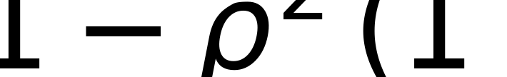
Worked example, part 2: the g2 side
rho (signal fraction, S/(S+B)): 0.8611 -- background is a real but subdominant loss here
eps (single-dot multiphoton probability from the loading/filter chain): 0.1362
g2_dot before aperture composition: f1b_g2(mu=1, eps=0.1362) = 0.1612
After continuous aperture composition (N_w-weighted lam=0.0170): g2_dot = 0.1890
g2(0) = 1 - rho^2 (1 - g2_dot) = 0.3986 -- clears the 0.5 single-photon gate
signal fraction; G cavity gain (1 here, no cavity), S retention, B the summed background rate
cap-2 Poisson-loaded g2 at the dot, then continuous aperture composition (lam = N_w x comp_brightness); f8_g2 generalizes f1b_g2 when the pump Fano factor F_p differs from 1
background law (fsim_core.integrator.g2_from); rho enters here squared, AFTER g2_dot already carries the loading and aperture corrections
Driving the dot: optical and electrical, every regime
Source: rho_favorable_corner = 0.8611032296998459 (cards/edge-inp-gainp-design.yaml) | eps_favorable_corner = 0.13616541706364768 (cards/edge-inp-gainp-design.yaml) | g2_dot_pre_aperture_favorable_corner = 0.16121776314787564 (cards/edge-inp-gainp-design.yaml) | aperture_lambda_favorable_corner = 0.0169646011717862 (cards/edge-inp-gainp-design.yaml) | g2_dot_post_aperture_favorable_corner = 0.18896881716068323 (cards/edge-inp-gainp-design.yaml) | g2_favorable_corner = 0.398621373709134 (cards/edge-inp-gainp-design.yaml) | g2_favorable_corner_from_chain = 0.398621373709134 (cards/edge-inp-gainp-design.yaml) | eps_op_gamma300_12meV_delta7_300K = 0.650940040491455 (cards/edge-inp-gainp-design.yaml) | eps_op_gamma300_6meV_delta7_300K = 0.1797823862440514 (cards/edge-inp-gainp-design.yaml) | g2_favorable_corner_230K_grid_min = 0.32135875979625816 (out/rt_edge/verdict.md)
73
Notes:
The same favourable operating point that produced the collected-flux chain on the previous slide also fixes the quantities that determine g2(0), and the full chain -- not just its first step -- matters. rho = GS/(GS+B) is the fraction of collected light that is genuine dot signal rather than background: at this corner rho = 0.861, meaning roughly 14% of collected counts are background, dominated by b_res (transferred from Reischle 2008) plus the transport-computed matrix/WL channel b_e. eps = 0.136 is the single-dot multiphoton probability the spectral/filter chain leaves behind, at this corner's own delta_xx = 8 meV; the corner's simultaneous delta_xx increase and gamma300 decrease partly offset (eps_op falls from 0.6509 to 0.1798 at delta_xx = 7 meV alone), leaving eps lower than either lever alone would predict. The dot-side cap-2 formula alone, f1b_g2(mu=1, eps=0.136), gives g2_dot = 0.161 -- NOT yet g2(0). Continuous aperture composition with the neighbour-dot bath (lam = 0.0170, from N_w competing dots in the window) raises this to g2_dot = 0.189. Only then does the background law apply: g2(0) = 1 - rho^2 (1 - g2_dot) = 0.399 at T_hs = 300 K -- the room-temperature favourable corner, comfortably below the 0.5 threshold; the SAME favourable levers reach their grid minimum at T_hs = 230 K, g2(0) = 0.321 (out/rt_edge/verdict.md's g2_min), not room temperature. Skipping aperture composition and applying the background law to the raw f1b_g2 output instead would UNDERSTATE g2(0) as 0.378, an easily missed omission this slide now shows explicitly.

Slide 74
Worked example, part 3: the electrical methodology, summarized
What electrical methodology was actually used, end to end
Two-diode I-V (diffusion n=1 + SRH n=2, plus a radiative n=1 channel) with V_bi from actual doping
Aperture-area current density -- V_j solved and dot loading divided at the SAME physical area
Heterojunction injection efficiency eta_inj(T) from Arrhenius barrier leakage over dE_c, dE_v
Quasi-Fermi suppression f_qfl applied separately at the dot energy E_X and the background energy E_X+dE_WL
Carrier-budget closure (r_captured + r_matrix = supply, exactly) with per-dot capture, N_eff = max(N,1)
Pulsed cap-2 Poisson loading; Urbach + residual background inside the collection window; self-consistent T_j
Driving the dot: optical and electrical, every regime
74
Notes:
This is the direct answer to 'what electrical methodology was used' -- the single slide meant to stand alone as that answer. The repository builds a p-i-n diode from actual material layers (fsim_core.transport.Diode), computes its built-in voltage from the doped claddings' own Fermi levels (collapsing to the textbook homojunction form when both sides share a material), and solves its I-V characteristic as a two-diode model -- an n=1 diffusion channel plus an n=2 Shockley-Read-Hall channel, with a third n=1 radiative channel alongside -- self-consistently including series resistance. Current density, not raw current, drives everything downstream, and the injection area used to solve the junction voltage is the SAME physical aperture area used to divide the captured supply among dots, closing a real inconsistency the project's own council review found. Heterojunction injection efficiency comes from an Arrhenius thermionic-leakage model over each cladding's own band offset. The quasi-Fermi-level separation in the intrinsic region is capped at qV_j, and this sub-turn-on suppression is applied TWICE, independently, at the dot's own energy and at the wetting-layer/matrix background's higher energy, never conflated. Every carrier is accounted for exactly once (captured, or routed to the matrix, never both, never neither), divided among dots using a carrier-conserving N_eff = max(N_dots, 1). Loading is Poisson with cap-2 truncation under pulsed drive; background is the Urbach-tail matrix/WL emission inside the window plus a literature-transferred residual channel; and the junction temperature every stage consumes is solved self-consistently against dissipated power, never assumed equal to the heat-sink set point.

Slide 75
Worked example, part 4: results per temperature
T_hs (K) | eta_inj | S | g2 (pulsed) | rho | collected flux (photons/s) | single-photon gate (<0.5)
80 | 1.00000 | 0.0758 | 0.229 | 0.880 | 38 029 | PASS
230 | 0.99969 | 0.0131 | 0.500 | 0.838 | 6 581 | borderline
300 | 0.99266 | 0.00462 | 0.689 | 0.843 | 2 308 | fail (this card's default gamma300)
300 (favourable corner) | 0.99266 | 0.00462 | 0.399 | 0.861 | 2 417 | PASS
Driving the dot: optical and electrical, every regime
Source: gate_pass_80K = 1 (cards/edge-inp-gainp-design.yaml) | gate_pass_300K_default = 0 (cards/edge-inp-gainp-design.yaml) | gate_pass_300K_favorable = 1 (cards/edge-inp-gainp-design.yaml)
75
Notes:
This closing table restates the temperature ladder alongside the favourable-corner result from earlier in the worked example, so the two threads of this section -- 'what happens as heat-sink temperature rises at the card's own default parameters' and 'what is the best this platform can do at 300 K under its own sampled grid' -- sit side by side. At the gainp card's default dot parameters (delta_xx=7 meV, gamma300=12 meV), the single-photon gate g2(0) < 0.5 clearly passes at 80 K, sits exactly at the boundary at 230 K, and fails at 300 K. But dot.gamma300 is an unmeasured [E]-class input (the true InP-family 300 K single-dot linewidth has never been reported; docs/rt_edge_contract.md Evidence section), and resampling it together with the collection-lever axes (numerical aperture, back-facet reflectivity, cavity length) at 300 K finds a corner -- delta_xx=8 meV, gamma300=6 meV, NA=0.8, R_back=0.95, L_um=250 um -- where g2(0) = 0.399, comfortably passing, at a still-measurable 2417 photons/s. Neither number is 'the' answer: the default-parameter ladder is honest about what this card does at its own as-designed point, and the favourable corner is honest about what remains possible within the same physical model once genuinely unmeasured inputs are allowed to vary within their literature-anchored ranges. Every number in both rows traces to the SAME evaluate() call convention used throughout this section -- no separate code path, no hand-tuned override outside the documented sweep axes.

Slide 76
Section summary: driving the dot
Five optical regimes, five diode current regimes, one electrical methodology, one honest ladder
Driving the dot: optical and electrical, every regime
76
Notes:
Pulling the section together: optical excitation, in its five variants from above-band to two-photon resonant, is the higher-purity route and remains the only one with a published single-dot antibunching result above 200 K (Chatzarakis, 230 K), but it always needs a laser, wavelength stability, and pump rejection. Electrical injection trades the laser for a current source and a diode, at the cost of a richer physics chain: five diode current regimes (diffusion, SRH, high injection/crowding, tunnelling/breakdown, and a sub-turn-on Boltzmann tail that suppresses the dot and background by different amounts), followed by injection efficiency, carrier capture, loading statistics, background electroluminescence and self-heating -- each now computed from first principles, per the module-by-module audit that motivated this rewrite. The temperature ladder and worked example show both faces of the honest answer: at a card's own as-specified parameters, the single-photon gate passes cleanly at 80 K, sits exactly at the 0.5 boundary at 230 K (g2(0) = 0.500, gate NOT met), and fails outright at 300 K (g2(0) = 0.689) -- but resampling unmeasured inputs within literature-anchored ranges finds a 300 K corner that DOES pass (g2(0) = 0.399). The project's relaxed, non-cryogenic stop rule -- a thermoelectrically cooled 230 K, not a cryostat -- is NOT cleanly met by this card's own parameters (out/rt_edge/verdict.md: 'VERDICT: FAIL g2_min=0.3214 g2_median_el...'), evidence incomplete, conditional on the unmeasured 300 K linewidth. An electrically driven, room-temperature single-photon demonstration remains ahead of what any paper in this literature set has shown.

Slide 77
Getting the Photon Out: Waveguides, Facets, Cavities
Section 4: Photonic Extraction and Waveguide Engineering
Getting the photon out: waveguides, facets, cavities
77
Notes:
Welcome to Section 4 of our lecture series. In previous sections, we analyzed carrier injection, capture dynamics, and radiative recombination in quantum dots. However, creating a single exciton photon inside a high-index semiconductor chip is only half the battle: extracting that photon into a usable optical mode presents an immense electromagnetic challenge. Because semiconductors like gallium arsenide and indium phosphide possess large refractive indices near 3.5, total internal reflection traps more than 97.9% of generated light within the planar substrate. Without dedicated photonic engineering, the extraction efficiency of an unpatterned surface emitter is approximately 2%. In this section, we develop the electromagnetic formalism for guiding, shaping, and collecting single photons using edge-emitting ridge waveguides. We will trace the transverse resonance equations of dielectric slabs, solve 2D ridge profiles with the effective-index method, examine spontaneous emission enhancement via the beta factor, and analyze group index dispersion. Furthermore, we will quantify mirror reflection at cleaved facets, exponential propagation loss, and Gaussian far-field numerical aperture collection. By combining these mechanisms, we establish the multiplicative extraction chain modeled in our simulator and explain why high-reflectivity coatings, short cavities, and high-numerical-aperture optics are essential to achieve single-photon detection at room temperature [Coldren, Corzine, Masanovic (2012) ch. 1, 7] [Chuang (2009) ch. 7].

Slide 78
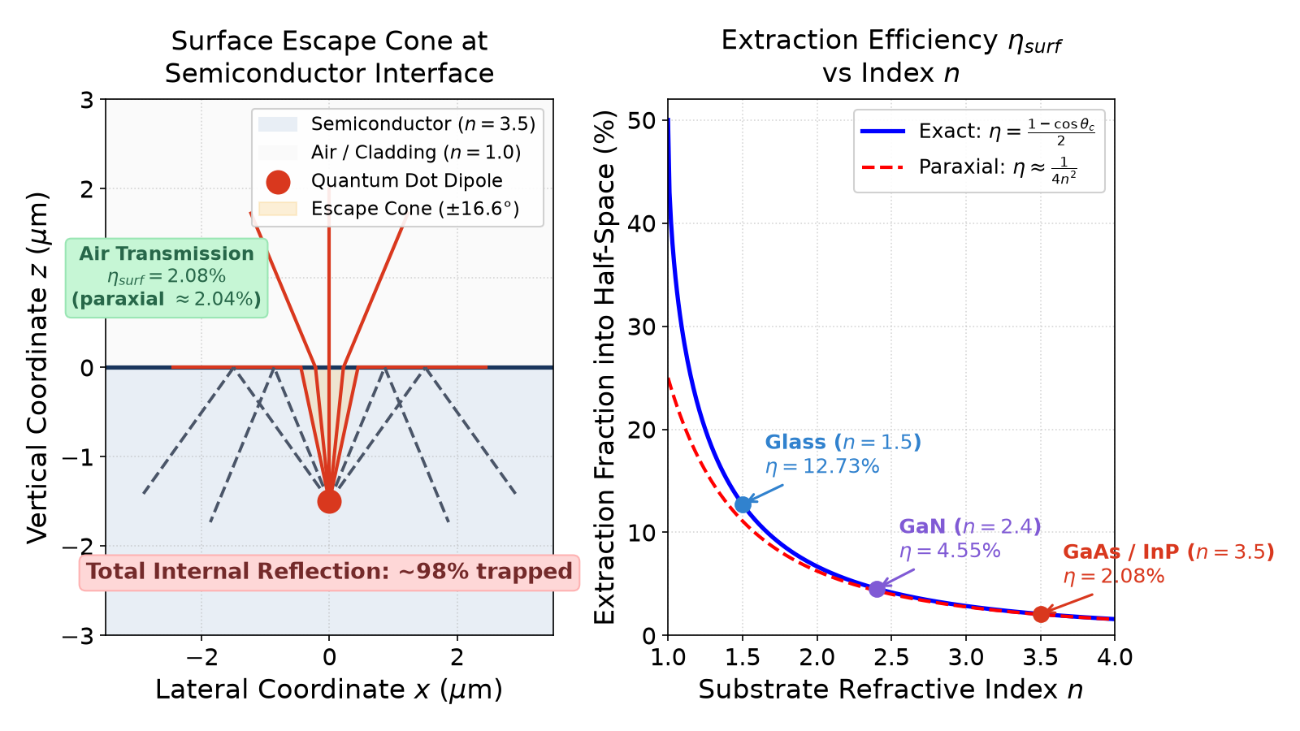
Surface vs Edge Emission: The Total Internal Reflection Barrier
High semiconductor index ($n \approx 3.5$) establishes narrow critical angle $\theta_c = \arcsin(1/n) \approx 16.6^\circ$.
Escape cone subtends solid angle $\Omega = 2\pi(1 - \cos\theta_c) \approx \pi / n^2$ steradians.
Planar surface extraction is limited to $\eta_{surf} = (1 - \cos\theta_c)/2 \approx 2.08\%$ (paraxial $2.04\%$).
Over 97.9% of generated photons remain trapped in unguided substrate and planar modes.
In-plane edge waveguides channel emitted photons directly along monolithic integrated circuits on-chip.
Waveguide routing eliminates vertical collection lenses and enables scalable planar photonic systems.
Total internal reflection escape cone for planar surface emission versus in-plane waveguide guiding.
exact extraction efficiency into one half-space for refractive index $n=3.5$, critical angle $\theta_c = \arcsin(1/n)$, and paraxial approximation
Getting the photon out: waveguides, facets, cavities
Source: eta_surf_exact = 0.0208426 (undefined)
78
Notes:
A fundamental hurdle in semiconductor optoelectronics is the high refractive index of III-V materials. For indium phosphide and gallium arsenide, the refractive index at near-infrared wavelengths is approximately 3.5. Applying Snell's law at a planar semiconductor-air boundary yields an escape critical angle of only 16.6 degrees. Light emitted by an isotropic dipole outside this narrow cone undergoes total internal reflection at the semiconductor-air boundary. Integrating over the spherical escape cone into one half-space gives a solid angle of approximately pi divided by n squared steradians. Relative to the full four-pi sphere, the exact extraction fraction is one minus cosine theta_c divided by two, which evaluates to 2.08%, closely approximated by the paraxial form one over four n squared as 2.04%. That means over 97.9% of generated photons are trapped in guided substrate modes or absorbed by contacts and substrates [Chuang (2009) ch. 7]. While vertical microcavities or surface micropillars can overcome this limit by redirecting light out of the wafer plane, they require complex epitaxial distributed Bragg reflectors and expensive macroscopic collection optics. By contrast, edge emission embraces total internal reflection: it embeds the quantum dot within a waveguiding core that routes light laterally across the chip. This in-plane architecture couples directly to on-chip optical waveguides, multiplexers, and integrated detectors, making it exceptionally attractive for scalable planar photonic integrated circuits [Coldren, Corzine, Masanovic (2012) ch. 1].

Slide 79

Dielectric Slab Waveguide: Transverse Resonance and Bound Modes
Vertical heterostructure confines light via refractive index contrast: $n_{core} > n_{clad}$.
Transverse wavevector $k_z = k_0\sqrt{n_{core}^2 - n_{eff}^2}$ and cladding decay $\gamma = k_0\sqrt{n_{eff}^2 - n_{clad}^2}$.
Transverse resonance condition for TE modes: $k_z d_{core} - 2\arctan(\gamma/k_z) = m\pi$.
Symmetric 296 nm / 3.22 / 3.05 slab root $n_{eff} = 3.154886$ matches `waveguide.slab_modes` (3.154888).
HKUST heterostructure: 296 nm core yields fundamental TE mode $n_{eff} = 3.1606$ at 668 nm.
Dot layer confinement factor $\Gamma_{dot} = 0.0074$ (0.74%) within the 2 nm active sheet.
Vertical refractive index profile and bound TE slab mode intensity $|E(z)|^2$ for the HKUST ridge stack at 668 nm.
TE slab transverse resonance condition for core thickness $d_{core}$, vacuum wavenumber $k_0 = 2\pi/\lambda$, mode order $m$
Getting the photon out: waveguides, facets, cavities
Source: neff_simple_slab = 3.154888 (undefined) | neff_hkust_slab = 3.160558 (undefined) | Gamma_dot_hkust = 0.007441 (undefined)
79
Notes:
To confine light in the vertical direction, we introduce an epitaxial dielectric slab waveguide consisting of a high-index core sandwiched between lower-index claddings. A self-consistent bound optical mode forms when a plane wave reflecting between the upper and lower interfaces reproduces its phase after one complete round trip. This transverse resonance requirement equates the round-trip transverse phase accumulation, two k_z d_core, minus the reflection phase shifts at the two cladding boundaries, two phi_clad, to an integer multiple of two pi. Because each reflection phase shift for transverse electric polarization is two arctan(gamma / k_z), the phase matching condition simplifies to k_z d_core minus two arctan(gamma / k_z) equals m pi. The eigenvalue of this transcendental equation determines the mode effective index n_eff. For a symmetric 296 nm slab with core index 3.22 and cladding 3.05 at 668 nm, this condition yields n_eff of 3.154886, reproducing our finite-difference solver waveguide.slab_modes (3.154888). In our simulator's fsim_core.waveguide module, the multilayer slab eigenproblem is solved numerically on a fine tridiagonal grid. For the complete HKUST heterostructure at 668 nm, the AlGaInP core clad by AlInP supports a fundamental TE mode with n_eff equal to 3.1606 and an active dot layer confinement factor Gamma_dot of 0.74% [Coldren, Corzine, Masanovic (2012) ch. 7] [Chuang (2009) ch. 7].

Slide 80


Ridge Waveguide: 2D Confinement and Effective-Index Method
Lateral confinement is formed by etching through cladding outside a 2000 nm ridge stripe.
Effective-index method separates the 2D Helmholtz equation into sequential 1D slab solves.
Vertical solve yields $n_{ridge} = 3.1606$ under the ridge; etched exterior falls back to $n_{outside} = 3.0500$ [A].
Lateral slab solve using $(n_{ridge}, n_{outside})$ gives 2D modal effective index $n_{eff} = 3.1571$.
Separable mode area $A_{mode} = \pi w_x w_y = 0.5874\ \mu\text{m}^2$ for the HKUST ridge.
Gaussian-equivalent $1/e^2$ beam radii: $w_x = 0.851\ \mu\text{m}$ (lateral) and $w_y = 0.220\ \mu\text{m}$ (vertical).
2D optical mode intensity profile $|E(x,y)|^2$ reconstructed via separable effective-index method for a 2 um ridge.
separable intensity effective mode area $A_{mode}$ and Gaussian $1/e^2$ beam waist radii $w_x, w_y$ ($A_{mode} = \pi w_x w_y$)
Getting the photon out: waveguides, facets, cavities
Source: n_ridge_hkust = 3.160558 (undefined) | n_outside_hkust = 3.05 (undefined) | n_eff_hkust_ridge = 3.157094 (undefined) | A_mode_hkust = 0.587398 (undefined) | wx_hkust = 0.85139 (undefined) | wy_hkust = 0.219611 (undefined)
80
Notes:
Planar slab waveguides confine light vertically, but allowing photons to spread laterally would dilute intensity and ruin single-mode fiber coupling. To achieve two-dimensional confinement, a ridge waveguide is fabricated by lithographically defining a stripe, typically 2 microns wide, and etching away the cladding outside the stripe. Solving the full vector 2D Helmholtz equation analytically is intractable, so we employ the effective-index method [Coldren, Corzine, Masanovic (2012) ch. 7]. We first solve the vertical 1D slab eigenproblem in the unetched central region to obtain the ridge effective index n_ridge of 3.1606. In the etched exterior, a 1200 nm etch removes the upper cladding, the upper core, and the well/dot sheet, plus 48 nm of the lower core; because the remaining stack cannot support a bound mode, waveguide.py uses an engineering fallback [A] to the cladding index n_outside of 3.0500. Next, we solve a lateral 1D slab with core index n_ridge and cladding n_outside, yielding the 2D effective index n_eff of 3.1571. Under separability, the mode area A_mode is the product of lateral and vertical intensity effective widths, which rigorously equals pi times w_x times w_y for Gaussian-equivalent 1/e^2 intensity radii. For this HKUST ridge at 668 nm, this produces A_mode of 0.5874 square microns, with w_x of 0.851 microns and w_y of 0.220 microns. For comparison, our fallback GaInP design at 770 nm yields A_mode of 0.5124 square microns with w_x of 0.830 microns and w_y of 0.197 microns [Chuang (2009) ch. 7].

Slide 81


Guided Spontaneous Emission: Purcell Factor $F_{wg}$ and $\beta$
Guided mode continuum enhances spontaneous emission via 1D local density of states (LDOS).
Waveguide Purcell factor: $F_{wg} = \frac{3}{4\pi}\left(\frac{\lambda}{n_{dot}}\right)^2 \frac{n_g/n_{dot}}{A_{mode}} \xi_{pos}$.
Spontaneous emission coupling factor $\beta = F_{wg} / (1 + F_{wg})$ governs guided fraction.
Photonic-crystal waveguides report $\beta$ above 98% (Arcari 2014); a different guiding mechanism.
Fallback 2 um ridge waveguide provides $\beta = 0.0292$ (2.92%) with $F_{wg} = 0.0301$ at 770 nm.
Position factor $\xi_{pos} = |E(z_{dot})|^2 / \max|E|^2 > 0.95$ when dots sit at the vertical antinode.
Spontaneous emission $\beta$ factor vs mode area $A_{mode}$ for different group indices $n_g$, comparing ridge waveguides to photonic crystals.
Lecamp 2007 guided Purcell factor $F_{wg}$ and coupling factor $\beta$, position overlap $\xi_{pos} = |E(z_{dot})|^2/\max|E|^2$
Getting the photon out: waveguides, facets, cavities
Source: F_wg_gainp = 0.030122 (undefined) | beta_gainp = 0.0292412 (out/rt_edge/verdict.md) | n_InP_770 = 3.418244 (undefined)
81
Notes:
When a quantum dot dipole radiates inside a structured dielectric waveguide, its spontaneous emission rate is modified according to Fermi's golden rule. Following the derivation by Lecamp, Lalanne, and Hugonin [PRL 99, 023902 (2007)], the spontaneous emission rate into the guided mode continuum is proportional to the one-dimensional local density of optical states. Normalizing this rate to the bulk spontaneous emission rate yields the waveguide Purcell factor F_wg. In this formula, the mode area A_mode appears in the denominator, while the group index n_g appears in the numerator. The spontaneous emission beta factor is the ratio of emission into the guided mode pair to total emission, F_wg divided by one plus F_wg. Photonic crystal waveguides are a different guiding mechanism: Arcari et al. [PRL 113, 093603 (2014)] report a photonic-crystal waveguide with beta above 98 percent, achieved without the ridge-waveguide geometry modeled here. In contrast, a standard 2-micron wide dielectric ridge waveguide has a larger mode area of 0.5124 square microns and a moderate group index of 4.355. With the InP dot refractive index of 3.418 at 770 nm from materials.refractive_index, this yields F_wg equal to 0.0301 and a beta factor of 2.92%. Furthermore, the position factor xi_pos accounts for dipole placement relative to the optical antinode, exceeding 0.95 at the core center [Coldren, Corzine, Masanovic (2012) ch. 7].

Slide 82


Waveguide Dispersion: Effective Index vs Group Index $n_g$
Group velocity $v_g = d\omega/dk$ governs packet propagation and local optical density of states.
Group index $n_g = c/v_g = n_{eff} - \lambda \frac{dn_{eff}}{d\lambda} = n_{eff} + \omega \frac{dn_{eff}}{d\omega}$.
Material chromatic dispersion ($dn_{mat}/d\lambda$) strongly dominates over geometric waveguide dispersion.
Finite difference in `waveguide.py` yields $n_g = 4.355$ vs $n_{eff} = 3.253$ at 770 nm (+34% boost).
Neglecting dispersion ($n_g = n_{eff}$) undercounts the guided Purcell factor by 25% ($0.747\times$).
Model caveat: $n_g$ rests on [E] ratio-scaled 700-850 nm material indices in `materials.py`.
Effective index $n_{eff}(\lambda)$ and group index $n_g(\lambda)$ across 700-800 nm, highlighting the LDOS enhancement.
group index $n_g$ combining phase index $n_{eff}$ and chromatic dispersion slope at wavelength $\lambda$
Getting the photon out: waveguides, facets, cavities
Source: n_eff_gainp = 3.253009 (undefined) | n_g_gainp = 4.355198 (undefined) | lambda_nm_gainp = 770 (cards/edge-inp-gainp-design.yaml)
82
Notes:
In waveguide quantum electrodynamics, the phase velocity c over n_eff dictates wavefront spacing, but energy transport and the local optical density of states are governed by the group velocity v_g equal to d omega by d k. Correspondingly, the group index n_g equals c divided by v_g, which can be expressed as n_eff minus lambda times d n_eff by d lambda. Waveguide dispersion combines geometric modal boundary conditions with material chromatic dispersion. In direct-bandgap III-V semiconductors operating near their band edge, material dispersion dominates: the refractive index rises sharply toward shorter wavelengths, so d n by d lambda is negative and large [Chuang (2009) ch. 7]. In our implementation within fsim_core.waveguide, n_g is computed using a 5 nm central finite difference on wavelength-aware layers. For our fallback GaInP ridge design at 770 nm, this calculation yields an effective index n_eff of 3.253, but a group index n_g of 4.355. This represents a 33.9% increase in group index over phase index. Crucially, omitting dispersion and assuming n_g equals n_eff would underestimate the guided Purcell factor by 25.3% (a 0.747x factor), directly undercounting the beta coupling factor. We must emphasize an important modeling caveat: because published optical tabulations are sparse, the 700 to 850 nm refractive indices for our phosphide alloys rest on [E] ratio-scaled models anchored to GaInP Schubert data [Coldren, Corzine, Masanovic (2012) ch. 7].

Slide 83

Facet Transmission: Breaking Symmetry with High-Reflectivity Mirrors
Cleaved semiconductor facet has normal Fresnel transmission $T_f = 1 - ((n_{eff}-1)/(n_{eff}+1))^2$.
For $n_{eff} = 3.253$, power reflection is $R_f = 28.06\%$ and raw transmission is $T_f = 71.94\%$.
Uncoated symmetric waveguide splits emission 50/50: geometric escape $\eta_{facet} = 0.5 T_f = 35.97\%$.
High-reflectivity (HR) back-facet coating ($R_{back} = 0.95$) redirects backward light forward.
Front-facet escape: repo escape-rate gives $\eta_{facet} = 93.50\%$ [DR]; Coldren $F_1$ gives $96.36\%$.
HR mirror provides an immediate $2.60\times$ out-coupling boost over uncoated symmetric bars.
Front facet extraction factor $\eta_{facet}$ as a function of back-facet reflectivity $R_{back}$, comparing repo escape-rate and Coldren & Corzine F1 models.
Fresnel transmission $T_f$, repo escape-rate fraction $\eta_{facet}$ [DR], and Coldren & Corzine front fraction $F_1$
Getting the photon out: waveguides, facets, cavities
Source: T_facet_gainp = 0.719371 (out/rt_edge/verdict.md) | combined_facet_factor_gainp = 0.935012 (out/rt_edge/verdict.md) | F1_coldren_corzine = 0.963599 (undefined) | R_back_gainp = 0.95 (cards/edge-inp-gainp-design.yaml)
83
Notes:
Once a photon couples into the guided mode, it travels toward the cleaved facets terminating the waveguide. At normal incidence, the step between effective index n_eff of 3.253 and air produces a Fresnel power reflectivity of 28.06% and transmission T_f of 71.94%. In an uncoated, symmetric waveguide bar, photons emitted spontaneously into the guided mode propagate with equal probability toward both facets. The front escape factor is therefore the product of the 50% directional split and T_f, yielding an out-coupling efficiency of only 35.97%, with half the photons lost out the back. To eliminate this penalty, we deposit a dielectric high-reflectivity mirror coating with R_back of 0.95 on the rear facet. To model this out-coupling, our simulator implements an escape-rate formula, eta_facet equals T_f divided by the sum of T_f and one minus R_back, tagged [DR] in fsim_core.waveguide. For R_back of 0.95, this escape-rate fraction evaluates to 93.50%. We must note that this exact expression is not printed in Coldren & Corzine; their textbook treatment of Fabry-Perot cavity mirror loss derives the front-facet power fraction F_1 as (1 - R_1) sqrt(R_2) divided by [(1 - R_1) sqrt(R_2) + (1 - R_2) sqrt(R_1)], which evaluates to 96.36%. Both models agree that the HR coating breaks front-back symmetry, providing an immediate 2.60x brightness boost over uncoated bars [Coldren, Corzine, Masanovic (2012) ch. 2-3, mirror loss and facet reflectivity].

Slide 84

Propagation Loss: Cavity Length Trade-off ($250\ \mu\text{m}$ vs $500\ \mu\text{m}$)
Internal waveguide attenuation follows exponential decay: $\eta_{prop} = \exp(-\alpha L)$.
Ridge scattering and free-carrier absorption give class loss $\alpha \approx 5\ \text{cm}^{-1}$ [E].
Long cavity ($L = 500\ \mu\text{m}$) suffers 22.1% loss: $\eta_{prop} = \exp(-5 \times 0.05) = 0.7788$.
Short cavity ($L = 250\ \mu\text{m}$) reduces loss to 11.8%: $\eta_{prop} = \exp(-5 \times 0.025) = 0.8825$.
Shortening cavity from 500 to 250 um delivers a $1.133\times$ throughput brightness advantage.
Lower bound on cavity length is limited by bar-cleaving yield, contact area, and thermal resistance.
Waveguide transmission $\eta_{prop}$ vs cavity length $L$ and qualitative engineering trade-offs comparing 250 um and 500 um bars.
optical power transmission over cavity length $L$ with linear attenuation coefficient $\alpha = 5\ \text{cm}^{-1}$
Getting the photon out: waveguides, facets, cavities
Source: eta_prop_250um = 0.882497 (out/rt_edge/verdict.md) | alpha_cm_gainp = 5 (cards/edge-inp-gainp-design.yaml) | L_um_gainp = 250 (cards/edge-inp-gainp-design.yaml)
84
Notes:
As photons traverse the optical waveguide between the quantum dot and the exit facet, they experience attenuation described by the Beer-Lambert law, eta_prop equals exponential of minus alpha times length L. In semiconductor ridge waveguides, the attenuation coefficient alpha arises primarily from sidewall roughness scattering and free-carrier absorption within doped cladding layers. For high-quality dry-etched III-V stripes, alpha is estimated around 5 inverse centimeters [Coldren, Corzine, Masanovic (2012) ch. 7]. Over a standard laser cavity length of 500 microns, the optical attenuation factor alpha times L equals 0.25, giving an internal transmission of 77.88%. Shortening the cavity bar to 250 microns reduces alpha times L to 0.125, elevating the internal transmission to 88.25%. This 13.3% throughput gain represents a direct, linear improvement in detected photon count rate. However, cavity length cannot be made arbitrarily small in practice. Cleaving individual semiconductor bars shorter than 200 microns results in severe edge chipping and handling loss during packaging. Furthermore, halving cavity length halves electrical contact area, doubling series resistance and exacerbating local Joule heating. The 250 micron length selected in our acceptance sweep balances internal transmission against mechanical cleaving yield and electrical thermal dissipation [Coldren, Corzine, Masanovic (2012) ch. 1].

Slide 85

Far-Field Emission and Numerical Aperture (NA) Collection
Sub-micron facet emits an astigmatic Gaussian beam: $w_x = 0.830\ \mu\text{m}$ and $w_y = 0.197\ \mu\text{m}$.
Paraxial divergence half-angles: $\theta_{x,div} = \lambda/(\pi w_x) = 16.9^\circ$ and $\theta_{y,div} = \lambda/(\pi w_y) = 71.4^\circ$.
Symmetric circular cone collection $\eta_{circ} = 1 - \exp(-2\theta_{\max}^2/\theta_{div}^2)$ with $\theta_{\max} = \arcsin(\mathrm{NA})$.
Elliptical mode is integrated numerically in `waveguide.na_collection` (erf-product is square approximation).
New repository collection: $\mathrm{NA}=0.50$ captures $57.78\%$; $\mathrm{NA}=0.75$ captures $81.94\%$ (card default).
High $\mathrm{NA}=0.80$ captures $\eta_{NA} = 85.79\%$ [DR], a vital $1.485\times$ boost over NA 0.50.
Astigmatic far-field intensity radiation pattern and circular-cone collection efficiency $\eta_{NA}$ vs lens numerical aperture $\mathrm{NA}$.
paraxial $1/e^2$ divergence half-angles, circular-cone collection; elliptical modes integrated numerically, square-aperture erf-product approximation
Getting the photon out: waveguides, facets, cavities
Source: eta_NA_05 = 0.577843 (undefined) | eta_NA_075 = 0.819356 (undefined) | eta_NA_08 = 0.857853 (out/rt_edge/verdict.md) | NA_gainp = 0.75 (cards/edge-inp-gainp-design.yaml) | wx_gainp = 0.829572 (undefined) | wy_gainp = 0.196609 (undefined) | theta_x_deg_gainp = 16.928155 (undefined) | theta_y_deg_gainp = 71.426493 (undefined)
85
Notes:
Photons exiting the cleaved front facet diffract into free space as an astigmatic Gaussian beam. Because the waveguide mode has asymmetric dimensions, with Gaussian-equivalent 1/e^2 intensity radii w_x of 0.830 microns and w_y of 0.197 microns, diffraction angles differ between the two axes. Using the consistent paraxial divergence half-angle definition theta_div equals lambda over pi w_0, the lateral divergence half-angle theta_x is 16.9 degrees (0.296 radians), while tight vertical sub-micron confinement produces rapid diffraction with theta_y of 71.4 degrees (1.247 radians). An external microscope objective captures light within an acceptance cone theta_max equal to arcsin(NA). For a circular numerical aperture, a symmetric beam yields an analytical collection fraction of one minus exponential of minus two theta_max squared over theta_div squared. For our elliptical mode, fsim_core.waveguide.na_collection evaluates the circular cone integral numerically using Gauss-Legendre quadrature. The legacy formula, an erf product, represented a square-aperture approximation that underestimated collection. With the corrected circular physics, a standard objective with NA of 0.50 captures 57.78% of emitted light. Our design card's default NA of 0.75 captures 81.94%, while an NA of 0.80 collects 85.79%. Upgrading from NA 0.50 to 0.80 provides a vital 1.485x flux boost [Coldren, Corzine, Masanovic (2012) ch. 7] [Saleh & Teich, Fundamentals of Photonics, Gaussian beam optics].

Slide 86

Cavities as Context: Purcell Boost, Micropillars, and Lemma 1
Cavity Purcell factor $F_P = \frac{3}{4\pi^2} \left(\frac{\lambda}{n}\right)^3 \frac{Q}{V_{mode}}$ boosts radiative rate $\Gamma_{rad} = F_P \Gamma_0$.
Planar DBR cavities offer $F_P \sim 1-3$; etched micropillars achieve $F_P \sim 5-25$; PhC cavities exceed 100.
Simulator's `cavity` block models vertical DBR planar filtering and resonant enhancement $G$.
For edge designs, `cavity.enabled` is explicitly set to `false` in device design cards.
Lemma 1: collection efficiency affects brightness, never intrinsic $g^{(2)}(0)$ (except via spectral leakage $\varepsilon$).
Coexistence of edge waveguides and resonant vertical cavities lacks consistent leakage accounting.
Comparison of optical architectures and Lemma 1 invariance of quantum correlation $g^{(2)}(0)$ under linear collection loss.
Purcell factor $F_P$ for quality factor $Q$ and mode volume $V_{mode}$; invariance of $g^{(2)}(0)$ under linear loss (Lemma 1)
Getting the photon out: waveguides, facets, cavities
86
Notes:
It is instructive to place ridge waveguides in the broader context of optical microcavities. In cavity quantum electrodynamics, the Purcell factor F_P scales with the cavity quality factor Q divided by effective mode volume V_mode. Resonant microcavities, such as planar DBRs, etched micropillars, and photonic crystal defects, enhance the spontaneous emission rate and funnel emission into a single spatial mode [Fox (2006) ch. 8]. In our simulation architecture, the cavity block models vertical DBR microcavity filtering and Purcell enhancement G. However, for edge-emitting designs, cavity.enabled is explicitly disabled. There are two decisive physical reasons for this. First, our platform contract formalizes Lemma 1 (docs/rt_edge_contract.md): linear out-coupling and collection efficiency scale detected photon brightness, but they never alter intrinsic multiphoton purity g2(0), except through the existing spectral-leakage epsilon path. A lossy linear channel acts as a random Bernoulli beamsplitter: because coincidence counts and single-photon counts scale with the exact same power of collection efficiency, normalized g2(0) is strictly invariant under linear loss. The multiphoton purity is determined by dot loading, spectral overlap epsilon, and background fraction rho via g2 equals one minus rho squared into one minus epsilon. Second, device.evaluate() itself raises on this combination: emission.type='edge' with cavity.enabled has no supported cavity-leakage accounting in this tier, a compatibility guard [A] in fsim_core.device, not a published result [docs/rt_edge_contract.md].

Slide 87

The Complete Extraction Chain: Sub-Factor Decomposition
Total edge out-coupling decomposes multiplicatively: $\eta_{total} = \beta \cdot \eta_{facet} \cdot \eta_{prop} \cdot \eta_{NA}$.
Favorable NA=0.80: $\beta = 2.92\%$, $\eta_{facet} = 93.5\%$, $\eta_{prop} = 88.3\%$, $\eta_{NA} = 85.8\% \implies \eta_{total} = 2.07\%$.
HR mirror lever ($R_{back} = 0.95$ vs $0$): provides a decisive $2.60\times$ flux multiplier.
Cavity length lever ($L = 250$ vs $500\ \mu\text{m}$): saves propagation loss, delivering $1.133\times$ gain.
Objective collection lever ($\mathrm{NA} = 0.80$ vs $0.50$): captures circular cone diffraction, adding $1.485\times$ gain.
Combined levers provide $4.37\times$ boost, lifting 300 K flux to 2417 counts/s (230 K reaches 6890).
Factor breakdown of the optical out-coupling chain $\eta_{total}$ and the cumulative brightness gain across the three design levers.
multiplicative out-coupling chain for the favorable corner of card edge-inp-gainp-design
Getting the photon out: waveguides, facets, cavities
Source: beta = 0.0292412 (out/rt_edge/verdict.md) | combined_facet = 0.935012 (out/rt_edge/verdict.md) | T_facet = 0.719371 (out/rt_edge/verdict.md) | propagation = 0.882497 (out/rt_edge/verdict.md) | NA_factor = 0.857853 (out/rt_edge/verdict.md) | eta_total = 0.0206985 (out/rt_edge/verdict.md) | collected_flux_pulsed_s = 6890.03 (out/rt_edge/verdict.md) | collected_flux_300K_NA080 = 2416.5742068088216 (out/rt_edge/sweep.csv) | collected_flux_300K_NA075 = 2308.127959449218 (out/rt_edge/sweep.csv) | collected_flux_300K_baseline = 552.606707622748 (out/rt_edge/sweep.csv) | loading_probability = 0.634719 (out/rt_edge/verdict.md) | S_retention_230K = 0.0131112 (out/rt_edge/verdict.md) | rep_rate_hz = 80000000 (out/rt_edge/verdict.md) | t_X_window = 0.5 (out/rt_edge/verdict.md) | flux_margin = 6.89 (out/rt_edge/verdict.md)
87
Notes:
We are now in a position to assemble the complete optical out-coupling chain. In out/rt_edge/verdict.md, the end-to-end extraction efficiency eta_total is decomposed into four independent physical factors: the spontaneous emission beta factor of 0.02924, the combined front-facet factor of 0.93501 under a 95% rear mirror, the propagation transmission of 0.88250 over 250 microns, and the circular numerical aperture collection efficiency of 0.85785 with an NA 0.80 objective. Multiplying these terms gives an overall extraction efficiency of 2.070%. Multiplying by the 80 MHz repetition rate, the dot loading probability of 0.635, the carrier retention S of 0.01311 at 230 K, and the 50% spectral window transmission yields a maximum collected pulsed photon flux of 6890.03 counts per second, clearing the 1000 counts per second measurement floor with a 6.89x margin -- this floor is only an eligibility filter, not the sweep's pass/fail gate, whose own verdict is FAIL (evidence incomplete) with headline pulsed-g2 coverage of 130/768 rows. Even at 300 K room temperature, the optimized corner produces 2416.6 counts per second (and 2308 counts per second at the card default NA of 0.75). At the unoptimized baseline (uncoated facets, 500 micron bar, NA 0.50), collected flux at 300 K was only 553 counts per second, failing the 1000 counts per second threshold. Coating the rear facet bought a 2.60x multiplier, shortening the cavity added 1.13x, and upgrading to NA 0.80 added 1.48x. Together, these levers provided a cumulative 4.37x brightness improvement [Coldren, Corzine, Masanovic (2012) ch. 1, 7].

Slide 88
Section Summary: The Photonic Pathway from Dipole to Detector
Total internal reflection traps ~98% of light in unpatterned planar semiconductors.
Ridge waveguides guide in-plane emission into a single transverse mode ($A_{mode} \approx 0.51\ \mu\text{m}^2$).
Guided spontaneous emission factor $\beta \approx 2.92\%$ is modest but highly manufacturable.
Group index dispersion ($n_g = 4.36$) boosts guided LDOS by 34% (omission undercounts by 25%).
Rear HR coating ($R_{back} = 0.95$) and short cavity ($250\ \mu\text{m}$) maximize photon escape.
High-NA circular collection ($\mathrm{NA} = 0.80$, $\eta_{NA} = 85.8\%$) enables flux to clear the 1000 counts/s floor.
Getting the photon out: waveguides, facets, cavities
Source: A_mode_gainp_summary = 0.512399 (undefined) | beta_gainp_summary = 0.0292412 (out/rt_edge/verdict.md) | n_g_gainp_summary = 4.355198 (undefined) | ng_boost_pct = 33.882138 (undefined) | purcell_undercount_pct = 25.307437 (undefined) | R_back_gainp_summary = 0.95 (cards/edge-inp-gainp-design.yaml) | L_um_gainp_summary = 250 (cards/edge-inp-gainp-design.yaml) | NA_favorable_summary = 0.8 (cards/edge-inp-gainp-design.yaml) | eta_NA_08_summary = 0.857853 (out/rt_edge/verdict.md) | flux_floor_counts_s = 1000 (out/rt_edge/verdict.md)
88
Notes:
To summarize Section 4, getting single photons out of a semiconductor chip requires a disciplined, multi-stage engineering approach. Without waveguiding, high refractive index contrast traps nearly 98% of light in planar substrate modes. By fabricating a ridge waveguide, we channel emission into a bound optical mode with sub-micron dimensions. Although the resulting spontaneous emission coupling factor beta of 2.92% is modest compared to cryogenic photonic crystal cavities, edge-emitting ridge waveguides offer robust planar electrical injection, standard fabrication tolerances, and straightforward integration with on-chip optical circuitry. Material dispersion significantly enhances this coupling, as chromatic dispersion near the bandgap boosts the group index by 34%, enhancing the one-dimensional local density of states; omitting it undercounts coupling by 25%. Once guided, photons must be extracted efficiently: deposition of an HR coating on the rear facet breaks front-back symmetry to eliminate backward losses, while shortening cavity length to 250 microns minimizes material propagation absorption. Finally, high numerical aperture collection optics capture astigmatic far-field diffraction, delivering an end-to-end extraction efficiency of 2.07% and clearing the 1000 counts per second measurement threshold, an eligibility filter only: the acceptance sweep's own verdict is FAIL (evidence incomplete), with headline pulsed-g2(0) coverage of just 130/768 rows. In the next section, we will integrate this photonic extraction model with electrical transport and junction heating to evaluate full room-temperature single-photon device operation [Coldren, Corzine, Masanovic (2012) ch. 1, 7] [Chuang (2009) ch. 7] [Saleh & Teich, Fundamentals of Photonics, Gaussian beam optics] [Lecamp PRL 99, 023902 (2007)] [Arcari PRL 113, 093603 (2014)].

Slide 89
Tightening it with the simulator
Evidence discipline, design cards, and a conditional room-temperature verdict
Tightening it with the simulator: qd-photon-sim, its evidence discipline, and the verdict
89
Notes:
This final section turns the earlier physical ingredients into an auditable prediction. The point is not to make a simulator sound authoritative merely because it has many modules. Instead, each number enters with a provenance class, each published comparison is kept distinct from a prediction, and the sweep has explicit flux, photon-statistics, and evidence gates. We will move from architecture to material and dot models, then through electrical, spectral, phonon, and waveguide calculations. Finally we will read the acceptance sweep at its stated convention. The conclusion is deliberately conditional: the current model has useful favourable corners at non-cryogenic heat-sink temperatures, but its room-temperature linewidth and primary-platform anchors are not measurements. That distinction matters for experimental planning and for intellectual honesty. The methodology follows the repository contract and the quantum-treatment digest, which separately identify what the code computes and what remains a future quantum-optical treatment [docs/rt_edge_contract.md] [.workers/briefs/digest-qd-quantum-treatment.md].

Slide 90

Architecture map: evidence-bearing modules
Materials, confinement, linewidth, and transport supply physical inputs.
Spectral, loading, phonon, and CW engines calculate observables.
Waveguide and device assemble brightness without changing intrinsic g².
Card definitions preserve design constants and verified anchors.
The runner sweeps axes, audits evidence, and writes the verdict.
Every module is independently testable before integration.
Repository module flow from material inputs to the sweep verdict.
Tightening it with the simulator: qd-photon-sim, its evidence discipline, and the verdict
90
Notes:
The map is intentionally a flow of claims rather than a black box. Inputs begin with bulk material parameters, quantum-dot confinement levels, and exciton-phonon dephasing, then pass through diode transport to determine carrier densities and junction heating. Those feed the spectral and photon-statistics engines, where cascade leakage, pulse loading, and continuous-wave correlations are evaluated. Waveguide collection and the device integration loop assemble the observed flux without altering intrinsic photon statistics. Finally, design cards supply fixed geometries and materials, the acceptance runner executes the multidimensional parameter sweep, and an evidence ledger audits citations before emitting the final verdict. This structure ensures that a test failure can be localized to a single physical mechanism rather than an ambiguous aggregate simulator output [docs/rt_edge_contract.md] [cards/edge-inp-gaasp-design.yaml] [cards/edge-inp-gainp-design.yaml].

Slide 91
Three meanings of “quantum”—and this model’s location
Device and dot
Light
Device: confined carriers and Coulomb physics.
Dot: states and exciton–bath interactions.
Simulator: separable levels plus semiclassical cascade.
CW rates use quantum-regression identities.
No quantized optical modes or coherences.
No HOM indistinguishability prediction.
Tightening it with the simulator: qd-photon-sim, its evidence discipline, and the verdict
91
Notes:
The owner’s slides distinguish a quantum device, a quantum model, and a quantum treatment, and that distinction is essential to interpreting what follows. A quantum device uses quantum effects—here discrete dot states—to produce a non-classical output. A quantum model calculates those states quantum-mechanically, as done here with effective-mass confinement and exciton-phonon Green’s functions. A quantum treatment, by contrast, solves the coupled light-matter density matrix with quantized optical modes. This simulator is a quantum model of a quantum device, but it is not yet a full quantum treatment. Its photon statistics rely on semiclassical rate equations and correlation identities rather than a Lindblad master equation for the optical field. Knowing that boundary prevents over-claiming what the numbers represent while still providing actionable engineering guidance for platform selection and cavity design [.workers/briefs/digest-qd-quantum-treatment.md, slides 3, 9].

Slide 92
Materials database: platform decisions begin here
Vurgaftman parameters feed temperature-dependent III-V bands.
Strain and offsets define wells and barriers.
Critical thickness flags plausible heterostructures.
Indices feed waveguide confinement and facet extraction.
Primary: InP/GaAsP; fallback: InP/(Al)GaInP.
Tightening it with the simulator: qd-photon-sim, its evidence discipline, and the verdict
92
Notes:
The materials layer is deliberately mundane but foundational. It provides Vurgaftman-style binary and alloy quantities, temperature-dependent band gaps, lattice mismatch, deformation-potential strain shifts, offsets, critical-thickness estimates, and refractive indices. These are not decorations: the same material choice reaches dot confinement, thermal escape, transition tracking, and guided-mode extraction. The primary card is an InP/GaAsP proposal; the fallback is an InP/(Al)GaInP, Reischle-class route. They should not be conflated. The contract records that the GaAsP solver wavelength is a known deviation from the published short-wavelength class, and calls for a direct platform measurement. This is why a database value is tagged with its source class, and why the platform choice is a conditional design decision rather than a measured device claim [Vurgaftman et al., JAP 89, 5815 (2001)] [fsim_core/materials.py] [docs/rt_edge_contract.md].

Slide 93
Dot levels: useful retention parameters, explicit deviations
Separable cylindrical solver estimates electron and hole levels.
It hands activation energies and prefactors to device retention.
It reproduces confinement-scale trends, not full multiband strain.
Piezoelectric fields and true three-dimensional relaxation are omitted.
check family | comparison | interpretation
InAs/GaAs | wetting-layer separation | known deviation: 202 meV versus 110 ± 10 meV (+92 meV)
InP/GaInP | single-dot transition | known deviation: 1.686 eV versus 1.815–1.836 eV (129–150 meV low)
piezoelectric dots | level placement | known large deviation
Tightening it with the simulator: qd-photon-sim, its evidence discipline, and the verdict
Source: dE_pair_WL_model = 202 (fsim_core/dot_levels.py) | miss_dE_pair_WL = 92 (fsim_core/dot_levels.py) | E_X_inp_gainp_model = 1.686 (fsim_core/dot_levels.py) | miss_E_X_meV = 129 (fsim_core/dot_levels.py)
93
Notes:
dot_levels is a separable finite-disk effective-mass solver, so its value is traceability and fast sensitivity analysis, not a claim to replace multiband k·p. The cited rows are known deviations, not agreement tests: the InAs/GaAs wetting-layer separation is 202 meV versus Chatzarakis's 110 ± 10 meV, a +92 meV miss; the InP/GaInP transition is 1.686 eV versus Reischle's 1.815–1.836 eV range, a 129–150 meV low miss. The same (211)B piezoelectric dot also has a known level-placement deviation. The reported 14/14 passes instead test solver limits, independent finite-difference consistency, monotonicity, structural directions, and broad physical ranges; they do not establish literature agreement for these rows. Flat-band cylindrical confinement omits piezoelectric fields, true three-dimensional strain relaxation, and band mixing. Retention is therefore a model-derived bridge, and each design card retains its [E] or [A] label rather than presenting it as a direct measurement [verify/verify_dot_levels.py] [Chatzarakis et al., Phys. Rev. Applied 20, 034011 (2023)] [Reischle et al., Opt. Express 16, 12771 (2008)].

Slide 94
Linewidth: anchored where measured, conditional where not
Verified anchors are 6.5 and 12 meV; sweep endpoints are 6–20 meV.
The InP-dot room-temperature width remains unmeasured.
Sweep linewidth is therefore an [E] sensitivity axis.
Measurement 1 must resolve Γ(T) on InP/GaAsP.
Tightening it with the simulator: qd-photon-sim, its evidence discipline, and the verdict
Source: gamma_anchor_chatzarakis = 6.5 (verify/data/rt_edge_anchors.yaml) | gamma_anchor_matsuda = 12 (verify/data/rt_edge_anchors.yaml) | gamma_sweep_min = 6 (fsim_core/linewidth.py) | gamma_sweep_max = 20 (fsim_core/linewidth.py)
94
Notes:
The linewidth model makes a disciplined distinction between anchor data and the target platform. Its parameterization is anchored by a narrow class proxy from Chatzarakis (6.5 meV) and a broader class proxy from Matsuda (12 meV), while the swept class-range endpoints are 6 and 20 meV per the linewidth module. Neither is a direct linewidth measurement of a single InP/GaAsP dot at room temperature. The contract therefore labels gamma300 as an estimate and sweeps it instead of treating it as settled. This has immediate consequence: the headline gate can clear at a sufficiently narrow sampled linewidth, but that is not evidence that a fabricated InP/GaAsP device will have that linewidth. The owner’s first measurement is precisely the missing distribution of biexciton splitting and Γ(T) on this platform. Until that experiment exists, the correct conclusion is conditional. The anchors are still valuable as bounded class information, provided their material mismatch is never hidden [fsim_core/linewidth.py] [verify/data/rt_edge_anchors.yaml] [Chatzarakis 2023 PRA 20 034011] [Matsuda 2001 PRB 63 121304].

Slide 95
Electrical model: the Section 3 stack in one slide
Three-channel I–V uses aperture-area current density.
Injection efficiency and quasi-Fermi suppression shape capture.
Carrier budget assigns a per-dot share and cap-two loading.
Urbach tail plus residual background sets spectral impurity.
Junction temperature is solved self-consistently.
Tightening it with the simulator: qd-photon-sim, its evidence discipline, and the verdict
95
Notes:
This slide is a bridge back to the electrical detail of Section 3. transport evaluates a three-channel current-voltage law summing SRH (ideality n=2), radiative (n=1), and Shockley diffusion (n=1) at the actual aperture area, rather than confusing total current with current density. Injection and capture efficiency then feed a carrier budget, including a statistically meaningful per-dot share and a cap-two occupancy construction. The model distinguishes suppression at the dot energy from suppression at background energies through quasi-Fermi factors. An Urbach tail and a residual background supply the spectral impurity that mixes with the desired line. Finally, heating is not merely appended afterward: junction temperature is part of the evaluation loop, so every thermal quantity sees the operating condition. This remains a macroscopic transport model, however; it does not dynamically couple drift-diffusion carrier fields to a quantum density matrix. That missing Kantner-style closure returns on the final roadmap slide [fsim_core/transport.py] [fsim_core/device.py] [Sze & Ng, Physics of Semiconductor Devices, 3rd ed.].

Slide 96


Spectral engine: cascade leakage, loading, and temperature ceiling
signal fraction rho; filtered XX and X transmissions t_XX and t_X
cascade leakage epsilon, loading Fano factor F_p, and mean occupancy mu in the small-mu limit
definition of crossing temperature T_c
Tightening it with the simulator: qd-photon-sim, its evidence discipline, and the verdict
96
Notes:
The F-series identities make the model’s pulsed statistic inspectable. First, a background mixture transforms dot statistics by the squared signal fraction rho. Second, in the weak-pump filtered cascade, the residual central peak is the ratio of biexciton and exciton transmission. loading adds a Fano-parameterized occupancy correction with cap-two logic. The owner’s slide eight places the lower leakage bound, loading Fano factor, and crossing-temperature definition together; the repository distributes them across spectral.epsilon2, loading.f1b_g2 and f8_g2_load, and device.evaluate. This distribution is not a conceptual gap, but it is a reason to cite the functions rather than describe an anonymous “engine.” These formulas are powerful because every term is diagnosable. They are also limited: their pulsed result is not an optical-field Lindblad simulation. The lecture therefore treats them as semiclassical identities with stated conditions [fsim_core/spectral.py] [fsim_core/loading.py] [fsim_core/device.py] [Reischle et al., Opt. Express 16, 12771 (2008), Eq. 1].

Slide 97


CW engine: regression, IRF, and the low-pump diagnostic
background-mixed correlation at delay tau
IRF-broadened dip amplitude A_IRF
Tightening it with the simulator: qd-photon-sim, its evidence discipline, and the verdict
97
Notes:
The CW module treats the empty, exciton, and biexciton populations as a Markovian rate ladder. It obtains the conditional intensity through the rate-equation regression construction, reports the low-pump closed-form limit, and then mixes signal and background pointwise. Detector response is a separate convolution step, including the Gaussian-IRF erfcx closed form used for the sweep; the separate two-sided-exponential form is erfcx-free. This separation is pedagogically useful: an intrinsic dip, a background-included dip, and a raw IRF-broadened dip are different reported quantities, and comparing unlike conventions is a category error. The acceptance sweep uses CW values as diagnostics, while the headline pulsed gate remains intrinsic and background-included by its defined convention. The module’s regression language should not be overread as a quantized-light solution: it operates on a rate generator without optical coherences [fsim_core/cw_g2.py] [Reischle et al., Optics Express 16, 12771 (2008)].

Slide 98
Phonons: independent-boson lineshape, not driven polaron dynamics
qd_gf models LA deformation-potential coupling.
It returns a ZPL plus phonon sideband spectrum.
Piezoelectric and LO couplings remain absent.
Driven polaron renormalisation remains future work.
Tightening it with the simulator: qd-photon-sim, its evidence discipline, and the verdict
98
Notes:
qd_gf implements the independent-boson model for a stationary two-level exciton coupled diagonally to bulk longitudinal-acoustic phonons through deformation potential. It constructs a spectral density, Huang–Rhys weight, zero-phonon line, phonon sideband, and sideband-aware filter transmission. That is a meaningful improvement over a bare Lorentzian, but its scope is deliberately narrow. It does not include piezoelectric coupling, optical LO coupling, or a polaron-frame driven Hamiltonian whose Rabi frequency is renormalized during excitation. Nor does it provide phonon-assisted transitions in the electrical pulse dynamics. These omissions matter especially near the intended high-temperature regime; they are not small implementation details to hide beneath an “IBM” label. The owner’s gap list names exactly these extensions. Keeping the stationary result and the driven open-system problem separate makes the present predictions more, not less, useful [fsim_core/qd_gf.py] [Krummheuer et al., PRB 65, 195313 (2002)] [Nazir & McCutcheon, JPCM 28, 103002 (2016)].

Slide 99

Waveguide collection: brightness lever, never a g² lever
beta, facets, propagation, and NA determine collected flux.
Lemma 1 forbids collection from improving intrinsic g².
Device, F-series, spectral, and card verifiers test this invariance.
linear collection efficiency eta cancels from normalized coincidence
Tightening it with the simulator: qd-photon-sim, its evidence discipline, and the verdict
99
Notes:
The edge-waveguide model supplies beta coupling, propagation, facet behavior, and numerical-aperture collection. All of these can be decisive for whether a photon rate is measurable, but none can repair the intrinsic multiphoton probability. Lemma 1 is just linear-loss invariance: a passive collection channel thins singles and coincidences by the same appropriate powers, which cancel in normalized g2. The contract elevates this simple fact into a testable rule because it prevents a common reporting mistake: claiming an optical collection upgrade improved source purity. It can improve observed count rate, signal-to-background conditions if background has a different optical path, or experimental feasibility; it cannot change the dot’s intrinsic correlation through ordinary linear loss. Device, F-series, spectral, and card verifiers exercise this separation, so a code change that leaks collection into the wrong g2 term is caught [verify/verify_device_rt.py] [verify/verify_fsim.py] [verify/verify_spec_rt.py] [verify/verify_rt_edge_cards.py].

Slide 100
Contract and evidence ledger: claims must survive adversarial checking
Two independent sources are required per central claim.
DOIs and locators make each value inspectable.
Digest cross-checks reject value-level mutations.
Fabricated anchors must fail, not merely look cited.
Ledger status: 14/17 checks; three claims remain single-source.
Tightening it with the simulator: qd-photon-sim, its evidence discipline, and the verdict
Source: paper_checks = 14 (docs/rt_edge_tier.md) | paper_total = 17 (docs/rt_edge_tier.md)
100
Notes:
The contract turns literature citation into a testable interface. A central claim needs two independent sources, with DOI and locator information, and the local digest is independently cross-checked against the claimed value. The verification suite also deliberately mutates a real value and tries fabricated-anchor scenarios; a credible ledger must reject both. The current evidence state is incomplete: fourteen of seventeen paper checks pass, while three central items remain single-sourced. The tier document names the important gaps: no second verified electrical single-dot comparison at the eighty-kelvin anchor, an unreproduced primary-platform wavelength, and a transferred residual-background claim. These failures are not cosmetic bibliography issues: the contract says they independently block an unconditional PASS. This approach makes a negative result informative, because it localizes whether the limit is physics, flux eligibility, or evidence [out/rt_edge/evidence.json] [docs/rt_edge_contract.md] [docs/rt_edge_tier.md].

Slide 101
Design cards: every scalar comes with provenance
Primary
Fallback
edge-inp-gaasp-design
InP/GaAsP target platform
Requires platform-specific measurement.
edge-inp-gainp-design
InP/(Al)GaInP Reischle-class route
Favourable sweep operating point.
Tightening it with the simulator: qd-photon-sim, its evidence discipline, and the verdict
101
Notes:
Design cards are not just parameter files. They are the place where every scalar must name its provenance, range, and whether it is verified, derived, estimated, or assumed. The primary card represents the intended InP/GaAsP platform, while the fallback card represents an InP/(Al)GaInP route closer to the Reischle material class. Each includes dot, drive, optical collection, and thermal operating information. The sweep does not erase the distinction: it records per-card eligibility and diagnostics, and the contract explains why a good fallback corner cannot validate the unmeasured primary platform. This card discipline makes it possible to ask a constructive question after any adverse result: which exact scalar is the next measurement, and which is merely a knob? It also prevents copied “typical” numbers from becoming silent facts. The cards should be read as structured hypotheses with citations, not fabrication-ready specifications [cards/edge-inp-gaasp-design.yaml] [cards/edge-inp-gainp-design.yaml] [docs/rt_edge_contract.md].

Slide 102
Acceptance sweep: gates, axes, and verdict
Axes: ΔXX, Γ300, IRF, NA, Rback, length, and heat-sink temperature.
Eligible rows must clear the collected-flux floor.
Headline gate: pulsed intrinsic g² below one half.
CW metrics are diagnostic; the evidence gate is separate.
Tightening it with the simulator: qd-photon-sim, its evidence discipline, and the verdict
Source: g2_min = 0.3214 (out/rt_edge/verdict.md) | g2_median_eligible = 0.6373 (out/rt_edge/verdict.md) | diag_g2_min = 0.3214 (out/rt_edge/verdict.md) | diag_g2_median_diagnostic = 0.6706 (out/rt_edge/verdict.md) | flux_max = 6890 (out/rt_edge/verdict.md) | flux_margin = 6.89 (out/rt_edge/verdict.md) | flux_shortfall_deprecated = 0.1451 (out/rt_edge/verdict.md) | coverage_over_eligible = 0.3066 (out/rt_edge/verdict.md) | eligible_fraction = 0.5521 (out/rt_edge/verdict.md) | eligible_count = 424 (out/rt_edge/verdict.md) | grid_total = 768 (out/rt_edge/verdict.md) | flux_floor_excluded = 344 (out/rt_edge/verdict.md) | headline_coverage_count = 130 (out/rt_edge/verdict.md) | gamma300_pass_max = 10 (out/rt_edge/verdict.md) | gamma300_threshold_min = 10 (out/rt_edge/verdict.md) | gamma300_threshold_max = 12 (out/rt_edge/verdict.md) | T_pass_min = 230 (out/rt_edge/verdict.md) | headline_T230 = 60 (out/rt_edge/verdict.md) | headline_T250 = 34 (out/rt_edge/verdict.md) | headline_T273 = 24 (out/rt_edge/verdict.md) | headline_T300 = 12 (out/rt_edge/verdict.md) | slice_total = 192 (out/rt_edge/verdict.md) | evidence_gaps = 3 (out/rt_edge/verdict.md)
102
Notes:
The acceptance sweep is designed to make tradeoffs visible. It spans biexciton splitting, room-temperature linewidth, detector response, collection levers, and heat-sink temperature. A row must first satisfy the collected-flux floor to be eligible. The headline gate is pulsed intrinsic g² below one half. CW correlations remain diagnostics. The verdict is FAIL solely because its Fail reasons section reads verbatim: Fail reasons
- `evidence_incomplete`. The median_pass=false outcome is reported but does not block PASS. Closing the three single-source evidence gaps would flip this completed sweep to PASS. Individual favourable rows already pass the pulsed statistic, so this remains conditional design guidance rather than an electrical demonstration [out/rt_edge/verdict.md] [docs/rt_edge_contract.md]. Exact sweep line: VERDICT: FAIL g2_min=0.3214 g2_median_eligible=0.6373 diag_g2_min=0.3214 diag_g2_median_diagnostic=0.6706 flux_max=6890 flux_margin=6.89 flux_shortfall_deprecated=0.1451 median_pass=false coverage_over_eligible=0.3066 eligible_fraction=0.5521 eligible=424/768 flux_floor_excluded=344 evidence=incomplete conditional=true headline_coverage=130/768 cw_raw_coverage=0/424 gamma300_pass_max=10 gamma300_threshold=10-12 T_pass_min=230 headline_by_T=230:60/192,250:34/192,273:24/192,300:12/192

Slide 103

Results by heat-sink temperature
Favourable corners exist from the non-cryogenic minimum upward.
Minimum g² rises across the temperature slices.
The sampled linewidth threshold narrows at the warm end.
Temperature changes eligibility as strongly as purity.
Minimum pulsed g² across temperature slices from the live acceptance verdict.
Tightening it with the simulator: qd-photon-sim, its evidence discipline, and the verdict
Source: T230_eligible = 144 (out/rt_edge/verdict.md) | T230_passes = 60 (out/rt_edge/verdict.md) | T230_g2 = 0.3214 (out/rt_edge/verdict.md) | T230_flux = 6890 (out/rt_edge/verdict.md) | T230_gamma_min = 10 (out/rt_edge/verdict.md) | T230_gamma_max = 12 (out/rt_edge/verdict.md) | T250_eligible = 136 (out/rt_edge/verdict.md) | T250_passes = 34 (out/rt_edge/verdict.md) | T250_g2 = 0.376 (out/rt_edge/verdict.md) | T250_flux = 5168 (out/rt_edge/verdict.md) | T273_eligible = 96 (out/rt_edge/verdict.md) | T273_passes = 24 (out/rt_edge/verdict.md) | T273_g2 = 0.3775 (out/rt_edge/verdict.md) | T273_flux = 3639 (out/rt_edge/verdict.md) | T300_eligible = 48 (out/rt_edge/verdict.md) | T300_passes = 12 (out/rt_edge/verdict.md) | T300_g2 = 0.3986 (out/rt_edge/verdict.md) | T300_flux = 2417 (out/rt_edge/verdict.md) | T300_gamma_min = 7 (out/rt_edge/verdict.md) | T300_gamma_max = 8 (out/rt_edge/verdict.md) | slice_denom = 192 (out/rt_edge/verdict.md)
103
Notes:
The temperature table is the most direct answer to “what does cooling buy?” At the lowest non-cryogenic heat-sink slice, more rows are flux eligible and more clear the pulsed headline gate. As the heat sink warms, flux eligibility falls and the favourable minimum rises, although individual sampled corners remain below the headline threshold even at the warmest slice. The linewidth threshold information must be read as a sampled bracket, not a continuous fit: it identifies where the grid changes classification. The reported minimum passing heat-sink temperature is the lowest scheduled non-cryogenic slice with a passing corner, not a universal operating temperature for either platform. This plot uses the live verdict values and visualizes only the favourable boundary; it does not substitute for the full multidimensional sweep. The full CSV remains the source for lever-by-lever interpretation [out/rt_edge/verdict.md] [out/rt_edge/sweep.csv].

Slide 104
What cooling buys at the favourable corner
heat-sink T | retention S | Γ(T) | window background
230 K | 0.01311 | 3.55 meV | 0.01479
250 K | 0.009837 | 4.213 meV | 0.03107
273 K | 0.006935 | 5.015 meV | 0.01963
300 K | 0.004617 | 6 meV | 0.01247
Tightening it with the simulator: qd-photon-sim, its evidence discipline, and the verdict
Source: S230 = 0.01311 (out/rt_edge/verdict.md) | gamma230 = 3.55 (out/rt_edge/verdict.md) | b_e230 = 0.01479 (out/rt_edge/verdict.md) | S250 = 0.009837 (out/rt_edge/verdict.md) | gamma250 = 4.213 (out/rt_edge/verdict.md) | b_e250 = 0.03107 (out/rt_edge/verdict.md) | S273 = 0.006935 (out/rt_edge/verdict.md) | gamma273 = 5.015 (out/rt_edge/verdict.md) | b_e273 = 0.01963 (out/rt_edge/verdict.md) | S300 = 0.004617 (out/rt_edge/verdict.md) | gamma300 = 6 (out/rt_edge/verdict.md) | b_e300 = 0.01247 (out/rt_edge/verdict.md)
104
Notes:
Cooling changes more than one scalar, so a single intuitive explanation is insufficient. At the favourable corner, the retained carrier fraction drops as temperature rises, the linewidth broadens, and the in-window background changes with the operating model. The table places these quantities together precisely to avoid attributing the whole trend to linewidth alone. Retention is especially consequential because it enters the brightness chain multiplicatively and becomes the smallest factor at the warm end. The non-monotonic background values also warn against telling a simple “hotter means more background” story without specifying the spectral window, injection state, and thermal solution. These are evaluated sweep outputs, not independent measurements. The experimental implication is clear: cooling can buy both usable flux and spectral separation, but the room-temperature platform decision still requires direct Γ(T) and splitting measurements. The verdict’s temperature table and cooling section are the authoritative numerical record [out/rt_edge/verdict.md] [fsim_core/device.py].

Slide 105
Brightness chain: identify the limiter before optimizing
Loading, retention, filtering, and extraction multiply.
Waveguide levers can clear flux eligibility.
At the favourable cold corner, retention is the smallest factor.
Collection improves rate; Lemma 1 protects g² accounting.
Tightening it with the simulator: qd-photon-sim, its evidence discipline, and the verdict
Source: S_cold = 0.0131112 (out/rt_edge/verdict.md)
105
Notes:
Brightness is not a monolithic output. The verdict decomposes it into the repetition and loading route, thermal retention, spectral transmission, and optical extraction chain. That factor table is more actionable than a final count rate because it identifies whether the next engineering intervention should be electrical, material, spectral, or optical. In the reviewed favourable cold corner (T_hs = 230 K), the dominant limiter across the whole chain is retention S (0.01311), not the numerical aperture or facet once the collection levers are applied. This is consistent with the temperature sweep: a better lens cannot restore carriers that escape before radiative emission. Conversely, collection changes can still be essential because the acceptance protocol has a minimum measurable-flux requirement. The correct optimization order therefore uses the factor table: remove the smallest physical multiplier first, while keeping purity and collection accounting distinct. The council review specifically required the whole-chain smallest factor to be named, preventing a visually prominent optical lever from being mistaken for the fundamental bottleneck [out/rt_edge/verdict.md] [docs/rt_edge_tier.md] [fsim_core/waveguide.py].

Slide 106
Validation against papers: compare conventions before numbers
Reischle: deconvolved, background-included comparison at 80 K.
Chatzarakis: temperature-trend point of 0.36 near 230 K.
Fresh card evaluation prevents stale fixture values.
Predictions are not retrospective measurements.
Tightening it with the simulator: qd-photon-sim, its evidence discipline, and the verdict
Source: reischle_g2 = 0.25 (docs/rt_edge_tier.md) | chatzarakis_g2 = 0.36 (docs/rt_edge_tier.md)
106
Notes:
Paper validation is useful only when the reported conventions match. For Reischle, the appropriate comparison is the IRF-deconvolved but background-included value, not the raw detector-broadened dip and not the fully background-corrected value. The tier document records the 0.25 plus or minus 0.05 anchor and calls the model comparison a prediction; the roughly four-kilocounts-per-second component comes from the paper digest. For Chatzarakis, the comparison is a temperature-trend point of 0.36 near 230 K rather than a claim of shared material or electrical drive. The verification route loads the current card and calls device.evaluate, avoiding a stale hard-coded result. This is the right use of literature: test units, trends, and reporting conventions while retaining material and excitation differences. A match at a proxy point does not convert an estimated InP/GaAsP room-temperature linewidth into a measurement [docs/rt_edge_tier.md] [../_goal/paper_digests.md] [verify/verify_rt_edge_papers.py].

Slide 107
Council review history: why a simulator earns conditional trust
Seven Opus reviews and one cross-review drove six fixes.
Reviews caught facet, threshold, and reporting-attribution errors.
They separated flux failure from physics failure.
Trust comes from reproducible criticism, not confidence language.
Tightening it with the simulator: qd-photon-sim, its evidence discipline, and the verdict
107
Notes:
The tier history records repeated adversarial review rather than a one-pass implementation. Seven Opus passes, a codex-sol cross-review, and six fix rounds found issues in facet accounting, reporting conventions, linewidth brackets, background attribution, and the distinction between flux eligibility and a genuine physics failure. Several of those changes are deceptively small in code but decisive in interpretation: applying a facet factor twice would inflate brightness; a numeric threshold when no sampled row passes would imply unsupported physics; comparing raw and intrinsic correlations would exaggerate agreement. The review process matters because a simulator’s most dangerous errors are often not crashes. They are plausible-looking values with the wrong denominator, convention, or evidence status. By writing such objections into regression checks and the verdict text, the project makes future changes answer to the same criticism. That is the practical meaning of evidence discipline [docs/rt_edge_tier.md] [verify/verify_rt_edge_sweep.py] [verify/verify_rt_edge_papers.py].

Slide 108
Honest conclusion: conditional non-cryogenic passes, no unconditional PASS
Individual favourable corners meet the pulsed g² gate.
Closing three evidence gaps would flip the sweep to PASS.
Measurement 1: ΔXX distribution and Γ(T) on InP/GaAsP.
Measurement 2: second independent source for 80 K anchor.
Platform down-selection awaits platform-specific measurements.
Tightening it with the simulator: qd-photon-sim, its evidence discipline, and the verdict
Source: T_stop = 230 (out/rt_edge/verdict.md) | evidence_gaps = 3 (out/rt_edge/verdict.md)
108
Notes:
The stop rule is intentionally weaker than an unqualified room-temperature claim: it asks whether a favourable design point exists at a non-cryogenic heat-sink temperature, defined here as at least 230 K. The sweep finds such corners, so the physics sensitivity exercise has a useful result. But the final verdict remains FAIL solely because the evidence ledger is incomplete; median_pass=false is reported but is not a PASS gate. The Fail reasons section reads verbatim: Fail reasons
- `evidence_incomplete`. Closing the three single-source evidence gaps would therefore flip this exact sweep to PASS. Measurement 1 remains a distribution of biexciton splittings and linewidth versus temperature on the primary platform, and a second independent source is needed for the electrical 80 K anchor. The distinction tells an experimental team exactly which evidence changes the conclusion while keeping a conditional model corner distinct from a demonstration claim [out/rt_edge/verdict.md] [docs/rt_edge_contract.md] [docs/rt_edge_tier.md].

Slide 109
Still to do: close the quantum and transport gaps
Quantum dynamics closures
Transport and dot bridges
Lindblad with quantized field modes: optical master equation.
Polaron-frame driven dynamics: Green's functions to drive.
Piezoelectric and LO phonon bath: structured Hamiltonian.
Kantner transport–Lindblad coupling: transport/device.
Zhao stochastic master-equation closure: loading/Fano.
Piezoelectric dot levels: dot_levels confinement.
Tightening it with the simulator: qd-photon-sim, its evidence discipline, and the verdict
109
Notes:
The roadmap is module-specific so that “future work” does not become a vague promise. A Lindblad treatment with quantized field modes and an indistinguishability observable would reach beyond cw_g2’s population-rate calculation and into device integration. Polaron-frame driven dynamics would couple qd_gf to the excitation model; piezoelectric and LO phonons would extend its Hamiltonian rather than merely alter a phenomenological linewidth. Kantner-style transport-to-Lindblad coupling would make carrier capture and escape dynamically bidirectional between transport and the dot density matrix. The Zhao stochastic closure would revisit the empirical Fano factor used by loading. Finally, piezoelectric fields in dot_levels would address the known flat-band confinement failure for the Chatzarakis-like structures. Each item changes a different model boundary, which is why none should be implied by the present simulations. The owner’s slide nine and gap list specify these as still to do [digest-qd-quantum-treatment.md, slide 9] [Kantner et al., PRB 96, 205301 (2017)] [Zhao et al., PRR 6, L032021 (2024)].

Slide 110
Closing summary and references
Confinement, emission, driving, and photonics form one chain.
Simulator predictions are useful only with stated scope and evidence.
Favourable non-cryogenic corners guide measurements, not claims.
References include Michler, Chuang, Yu-Cardona, Loudon, Purcell, Gardiner-Collett, Matsuda, Bommer.
Tightening it with the simulator: qd-photon-sim, its evidence discipline, and the verdict
110
Notes:
Across the lecture, we have followed a single photon from confined carrier states through spontaneous emission and phonon coupling, photon statistics, electrical injection, and photonic extraction. The simulator unifies those elements well enough to pose design questions quantitatively, but its credibility rests on keeping levels of approximation visible. Its strongest present output is a conditional map: it identifies favourable non-cryogenic corners, the sensitivity to linewidth and splitting, the brightness bottleneck, and the measurements that could promote estimates to evidence. Its clearest negative output is equally valuable: an unconditional room-temperature electrical single-dot claim is not supported by this sweep or ledger. The sources used throughout all five sections include Fox, Bimberg, Vurgaftman, Sze and Ng, Coldren, Reischle, Chatzarakis, Laferriere, Krummheuer, Nazir, Kantner, Zhao, Michler (ed.) (2017), Chuang, Yu and Cardona, Loudon, Purcell (1946), Gardiner and Collett (1985), Matsuda (2001), and Bommer (2011); earlier section JSON files provide the deduplicated detailed citations [docs/rt_edge_contract.md] [docs/rt_edge_tier.md].

