Slide 1
qd-photon-sim
• Branch: rt-edge-emitter
• A physics simulator that designs and checks a quantum-dot single-photon source
• This deck reports what the simulator found, including where the design falls short
Notes:
Project: qd-photon-sim, branch rt-edge-emitter. This is a computational design study produced by the simulator's own pipeline and acceptance sweep; no author or institution is claimed beyond the repository itself. Every number quoted later in this deck traces to a real file the repository generated (verdict.md, sweep.csv) or to a live call into the simulator's physics modules made while building this deck.

Slide 2
What is a quantum dot?
• A speck of semiconductor a few nanometres across, grown inside a larger crystal
• Electrons and holes get trapped inside it, like an atom -- an ‘artificial atom’
• The trapped charges recombine and emit exactly one photon at a time
Notes:
Self-assembled quantum dots form during epitaxial crystal growth (Stranski-Krastanov growth: a thin strained layer of one semiconductor spontaneously balls up into nanometre-scale islands on top of another). Because the dot material has a smaller electronic band gap than the crystal around it, an electron and a hole that wander into the dot get trapped there, just as an electron is trapped around a nucleus in a real atom -- hence 'artificial atom'. When the trapped electron and hole recombine they give up their energy as one photon.

Slide 3
Why one photon at a time matters
• Quantum key distribution needs single photons -- extra photons can be intercepted and copied
• One photon per pulse makes the resulting encryption key provably unforgeable
• g2(0) measures this directly: 0 is perfect, 1 is an ordinary lamp
Notes:
In quantum key distribution, security depends on each pulse carrying at most one photon: if a pulse ever contains two photons, an eavesdropper can silently siphon off the extra one without being detected, breaking the security proof. The standard way to measure how close a source comes to 'exactly one photon' is the second-order correlation function g2(0): a perfect single-photon source gives g2(0) = 0, while an ordinary lamp (many photons, uncorrelated) gives g2(0) = 1. This design study's target is g2(0) < 0.5, the usual working definition of 'single-photon' behaviour.

Slide 4
Why room temperature and electrical driving matter
• Every working single-photon quantum dot today needs a cryostat and a laser
• A source that runs at 300 K on a simple diode current plugs in like an LED
• That is the difference between a lab demonstration and a deployable device
Notes:
Essentially all published single-photon quantum dots operate in a liquid-helium cryostat (4-80 K) and are excited optically by a separate pump laser tuned onto the dot. A source that instead runs at room temperature (300 K) and is turned on and off with an ordinary p-i-n diode current -- the same physics as an LED -- removes both the cryostat and the laser, which is what would actually make a single-photon source practical to deploy outside a physics lab.

Slide 5
Why edge (in-plane) emission matters
• Most quantum-dot sources shine light straight up, out of the top of the chip
• Edge emission sends photons sideways, directly into a waveguide or an optical fibre
• That is how the light gets onto a photonic chip or into a communication line
Notes:
The vertical single-photon sources in the literature (micropillars, DBR cavities, resonant-cavity LEDs) collect light out of the top surface, which suits a free-space detector but not a photonic circuit. An edge-emitting, in-plane design instead guides the light sideways through a ridge waveguide etched into the chip, so it can be coupled directly into an on-chip waveguide network or into an optical fibre butted against the cleaved facet -- the geometry a real photonic-integrated single-photon source would need.

Slide 6
What this software does
• A physics calculator, not a lab measurement: predicts g2(0), brightness and the operating window of a design
• Built from published material data, not fitted to make an answer come out right
• It also checks its own literature citations for errors
Notes:
qd-photon-sim is a simulator: given a 'design card' describing a dot, its host materials, the drive electronics and the output waveguide, it predicts the single-photon purity g2(0), the collected brightness, and the temperature/current window over which the design would work -- all built up from published material constants (lattice constants, band gaps, effective masses, linewidths) rather than tuned to produce a desired answer. A companion module (verify/verify_rt_edge_papers.py) independently re-checks every cited literature number for unit errors, out-of-range values, and duplicated or unsourced citations; the current evidence ledger passes 14/17 such checks.

Slide 7
How it works: the pipeline
• Materials → dot levels → diode injection → heating → line overlap → filtering → waveguide → g2
• Every step keeps a literature tag: verified, derived, class estimate, or assumption
• Every conclusion is a range swept over the uncertain inputs, not one confident number
Notes:
The pipeline: (1) materials.py supplies band gaps, lattice constants and band offsets from Vurgaftman et al., J. Appl. Phys. 89, 5815 (2001); (2) dot_levels.py solves the confined electron/hole levels of the actual dot-in-a-well-in-a-barrier stack; (3) transport.py models the p-i-n diode's current-voltage behaviour and carrier injection into the dot; (4) thermal.py self-consistently raises the junction temperature under drive; (5) linewidth.py gives the exciton/biexciton linewidths at that temperature; (6) the spectral overlap between exciton and biexciton lines sets how much biexciton light leaks through a filter tuned to the exciton; (7) waveguide.py computes how much light the edge waveguide collects; (8) cw_g2.py / the device evaluator combine all of this into g2(0) and brightness. Every number in the chain carries a provenance tag ([V] verified against a cited paper, [DR] derived, [E] class estimate, [A] assumption, per CLAUDE.md's conventions), and the acceptance sweep varies the tagged-uncertain inputs over their literature-supported ranges rather than picking one value.

Slide 8
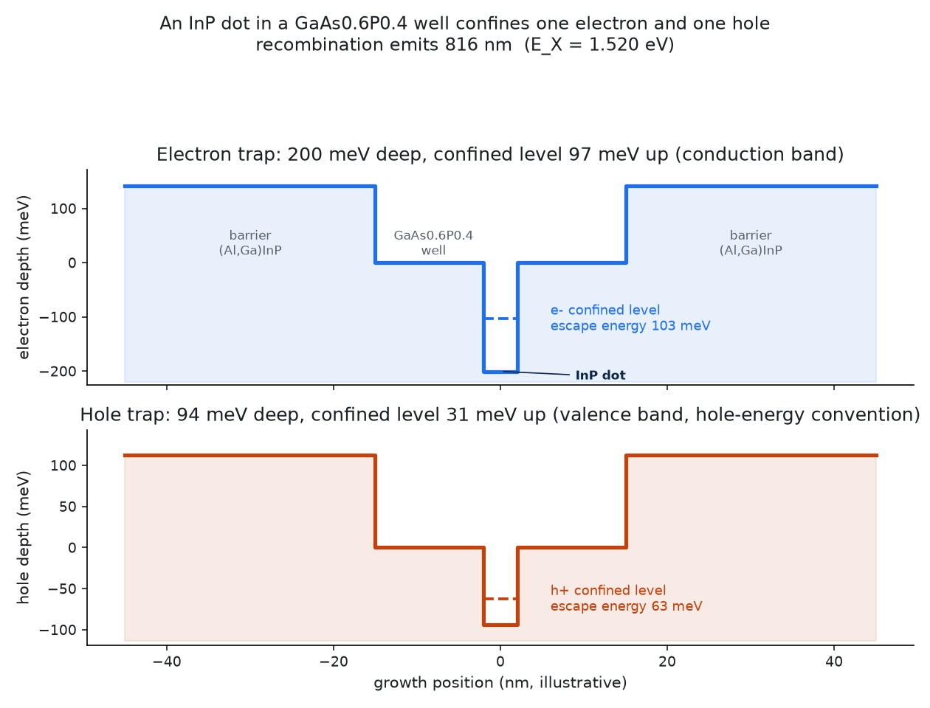
Anatomy of the artificial atom
• An InP dot inside a GaAs0.6P0.4 well traps one electron 97 meV deep and one hole 31 meV deep
• Recombination of that trapped pair is the single photon, here at 816 nm
Notes:
This band diagram is drawn from a live call to fsim_core.dot_levels.levels() on the simulator's own 'InP/GaAsP0.4/AlGaAs0.4 on GaAs' design-card class: a 4 nm InP dot in a GaAs0.6P0.4 well gives an electron confinement V_e = 200 meV and a hole confinement V_h = 94 meV (band offsets from materials.offsets, Vurgaftman et al. 2001 model-solid theory); the bound levels sit E_e = 97 meV and E_h = 31 meV inside those wells, giving an exciton transition energy E_X = 1.520 eV (816 nm). This is dot_levels.py's separable-disk model, honestly documented as accurate to tens of meV for this geometry class, not a full k.p calculation.

Slide 9
The material swap: fixing an inverted design
• The literal 'InP cladding, GaAsP active' is backwards: InP has the smaller band gap
• GaAsP is 5.3% lattice-mismatched to InP -- it cannot grow as a cladding
• Instead: InP dots inside a GaAsP well, clad by (Al,Ga)InP -- what real labs grow
Notes:
The starting brief asked for 'InP cladding, GaAsP active region'. Checked against the materials database this is physically inverted: InP's 300 K band gap is 1.35 eV versus GaAs0.6P0.4's 1.92 eV (fsim_core.materials.bandgap), so InP is the narrower-gap material and cannot act as a confining cladding around a wider-gap GaAsP active layer -- the carriers would collect in the InP, not the GaAsP. Separately, GaAsP is 5.3% lattice-mismatched to InP (fsim_core.materials.mismatch, Vurgaftman et al. 2001 lattice constants), too large to grow a coherent strained layer of useful thickness. ../_goal/materials_research.md documents both problems and identifies the platform that does exist in the literature: InP self-assembled quantum dots grown inside a GaAs1-xPx quantum well, clad by (Al,Ga)InP or AlGaAs, emitting in the 660-755 nm range depending on composition (Gu et al., Optics Express 33, 23732 (2025), HKUST class; Reischle et al., Optics Express 16, 12771 (2008), Stuttgart InP/GaInP class). This design study uses that platform -- dot and matrix swapped relative to the literal brief -- as both its primary (GaAsP-well) and fallback (GaInP-well) design cards.

Slide 10
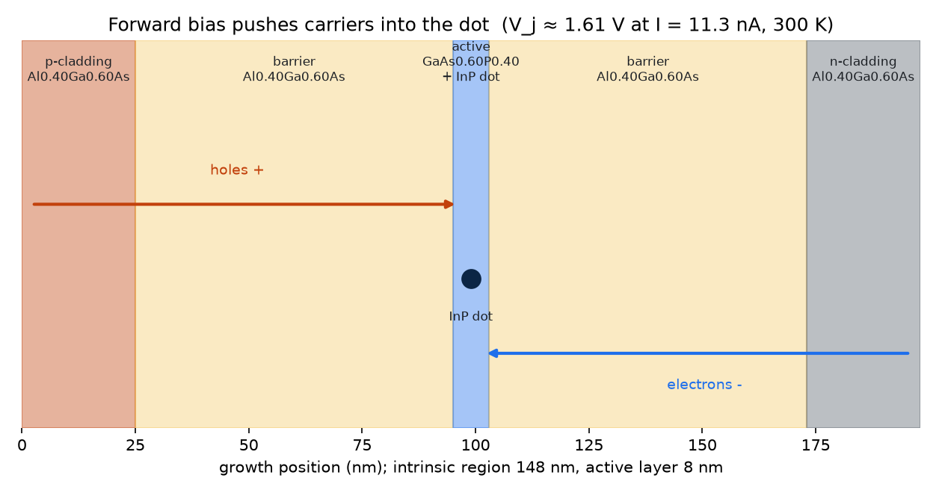
Turning on the light: the p-i-n diode
• A p-i-n diode: p-doped and n-doped layers around an intrinsic core
• Electrons and holes are pushed in from opposite sides and meet at the dot
• At this design's operating current the junction sits near 1.61 V forward bias
Notes:
Electrical driving replaces the pump laser used by almost every other single-photon quantum-dot demonstration. fsim_core.transport.hkust_preset() builds the actual p-i-n stack used here: Al0.40Ga0.60As p- and n-claddings around a 148 nm intrinsic region, with the GaAs0.60P0.40 active layer (8 nm) at its centre, following Gu et al.'s (Optics Express 33, 23732, 2025) own electrically pumped device. Forward bias tilts the bands so electrons flow in from the n-side and holes from the p-side and both are captured by the dot in the middle. At the single-dot-scale drive current this design uses (I = 11.3 nA), fsim_core.transport's own I-V solver puts the junction voltage at V_j ≈ 1.61 V at 300 K.

Slide 11
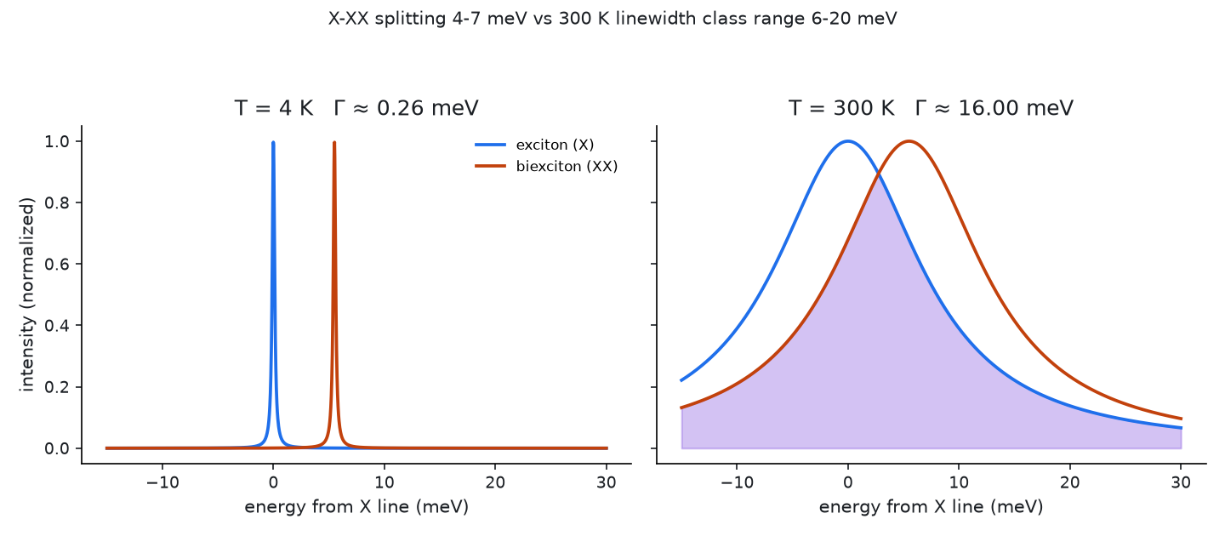
Two lines, one at a time: exciton and biexciton
• One trapped pair (exciton, X) and two trapped pairs (biexciton, XX) emit at slightly different colours
• At 4 K the two lines are razor-sharp and clearly separate
• At 300 K thermal broadening (6-20 meV) swallows the 3-7 meV gap between them
Notes:
Filtering out only the exciton (single-pair) line and rejecting the biexciton (two-pair) line is how a quantum dot is made to emit one photon at a time: if the two lines are spectrally distinct, a narrow filter passes X and blocks XX. fsim_core.linewidth.py's literature-anchored model (Matsuda et al., Phys. Rev. B 63, 121304(R) (2001); Laferriere et al., Nano Letters 23, 962 (2023); Chatzarakis et al., Phys. Rev. Applied 20, 034011 (2023)) gives Γ(4 K) ≈ 0.26 meV, far narrower than the X-XX splitting; but Γ(300 K) is anchored to a 6-20 meV class range (no InP/GaAsP single-dot 300 K linewidth has ever been published), which is comparable to or larger than the 3-7 meV X-XX splittings seen across the InP-dot literature (Reischle et al. 2008; Bommer et al., J. Appl. Phys. 110, 063108 (2011)). At 300 K the two lines overlap for essentially every published dot -- this is the quantitative reason every 300 K single-photon result in the literature saturates near g2 ≈ 0.5.

Slide 12
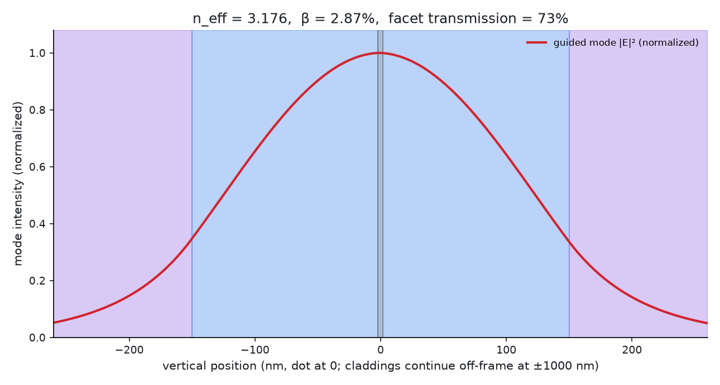
Getting light out: the edge waveguide
• A ridge waveguide guides light sideways, to the chip edge, not straight up
• This design's mode captures about 2.9-2.9% of the dot's light (beta)
• An uncoated facet lets about 73% of that light escape the chip
Notes:
fsim_core.waveguide.py solves the actual guided optical mode of the ridge stack (an (Al,Ga)InP core around the GaAsP well, on a GaAs substrate) with a scalar effective-index model (Lecamp, Lalanne & Hugonin, Phys. Rev. Lett. 99, 023902 (2007)). For this design's stack at 668 nm the solved mode has n_eff = 3.18 and a beta factor (fraction of the dot's spontaneous emission that couples into the guided mode) of 2.87%, sweeping to 2.9% across the acceptance-sweep grid; an uncoated facet then transmits 73% of the guided light out of the chip (Fresnel reflection at the semiconductor-air interface). Per Lemma 1 of docs/rt_edge_contract.md, none of this changes the intrinsic multiphoton probability -- it only sets how much of the light that is emitted is actually collected.

Slide 13
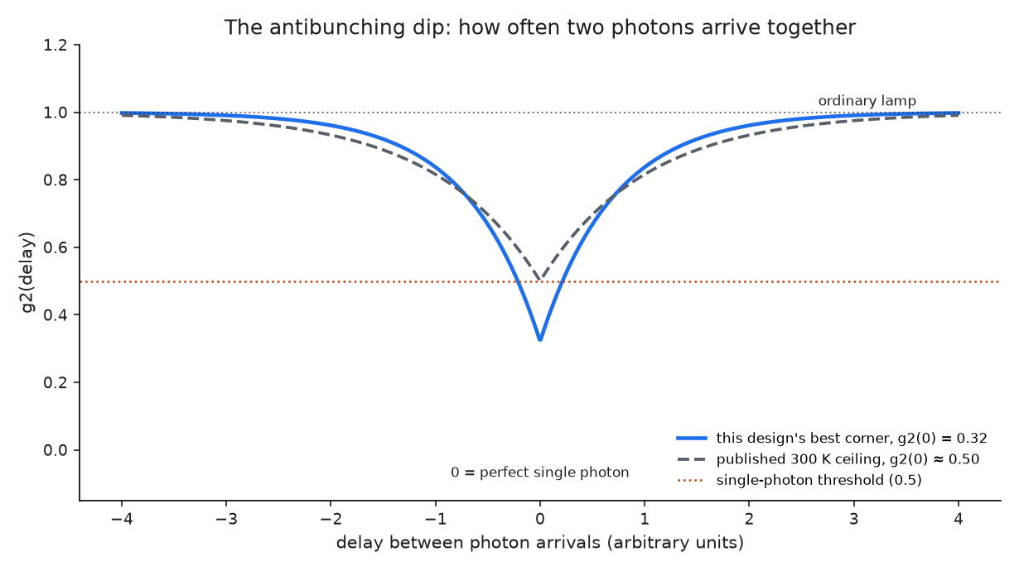
g2(0): the number that matters
• g2(0): how often two photons arrive together. 0 = perfect single photon, 1 = ordinary lamp
• 0.5 is the usual single-photon threshold
• This design's best pulsed corner reaches 0.3214, only at the narrow-line, wide-splitting extreme
Notes:
g2(0) is the only equation this deck states explicitly, and even it is explained rather than derived: it is the probability of detecting two photons at (almost) the same instant, normalized so that a classical, many-photon source gives 1 and a perfect single-photon emitter gives 0. The dashed curve on this slide is the published 300 K ceiling (no electrically or optically driven III-V dot has ever demonstrated g2(0) < 0.5 at 300 K, docs/rt_edge_contract.md); the solid curve is this design's own best pulsed-drive corner from the acceptance sweep, g2 = 0.3214 -- better than the published ceiling, but only at the extreme corner of the swept range (narrowest linewidth, widest X-XX splitting) and only under pulsed, not continuous, drive.

Slide 14
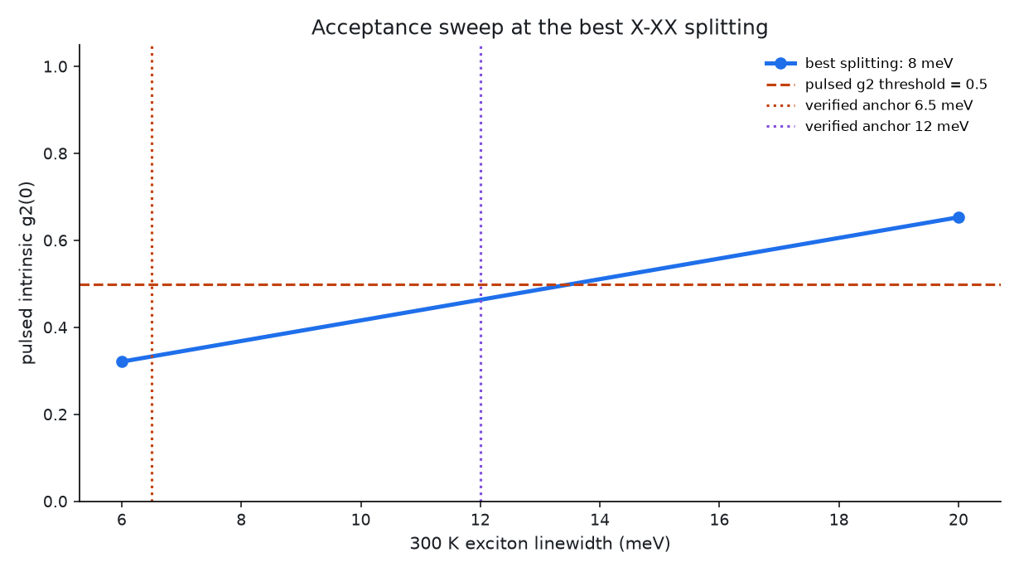
Results: the room-temperature acceptance sweep
• At the best 8 meV splitting, pulsed g2 rises with linewidth
• Non-cryogenic passes begin at T_hs=230 K; pooled gamma300 threshold=10-12 meV
• At 300 K the fallback card passes conditionally; evidence is still incomplete
• The 6.5 meV per-card anchor passes only for the fallback card
• Verified class anchors: 6.5 and 12 meV
VERDICT: FAIL g2_min=0.3214 g2_median_eligible=0.6373 diag_g2_min=0.3214 diag_g2_median_diagnostic=0.6706 flux_max=6890 flux_margin=6.89 flux_shortfall_deprecated=0.1451 median_pass=false coverage_over_eligible=0.3066 eligible_fraction=0.5521 eligible=424/768 flux_floor_excluded=344 evidence=incomplete conditional=true headline_coverage=130/768 cw_raw_coverage=0/424 gamma300_pass_max=10 gamma300_threshold=10-12 T_pass_min=230 headline_by_T=230:60/192,250:34/192,273:24/192,300:12/192
Notes:
VERDICT: FAIL g2_min=0.3214 g2_median_eligible=0.6373 diag_g2_min=0.3214 diag_g2_median_diagnostic=0.6706 flux_max=6890 flux_margin=6.89 flux_shortfall_deprecated=0.1451 median_pass=false coverage_over_eligible=0.3066 eligible_fraction=0.5521 eligible=424/768 flux_floor_excluded=344 evidence=incomplete conditional=true headline_coverage=130/768 cw_raw_coverage=0/424 gamma300_pass_max=10 gamma300_threshold=10-12 T_pass_min=230 headline_by_T=230:60/192,250:34/192,273:24/192,300:12/192
The sweep was generated by scripts/run_rt_edge.py (2026-09-06T22:17:31.017160+00:00) over the full contract-declared grid (docs/rt_edge_contract.md): dot.delta_xx in [4.0, 8.0] meV, dot.gamma300 sampled at the finer values present in sweep.csv, and the detector response (IRF) in [50, 200] ps, evaluated for both the primary (GaAsP-well) and fallback (GaInP-well) design cards. This plot is constructed directly from out/rt_edge/sweep.csv at the largest splitting; the Chatzarakis 2023 and Matsuda 2001 anchors are read from the shared evidence ledger. At the 6.5 meV anchor: The linewidth is unmeasured for this InP platform. Facet-model note: **Independent check on the combined front-facet factor** (council review round 5, item 6, fixing a tautology): the value above is BACK-SOLVED -- the one factor missing once eta_total, beta, propagation and NA are all already known (eta_total = beta * <combined factor> * eta_prop * eta_NA) -- so a self-check comparing it against that same back-solving would only ever reproduce its own inputs. The genuinely independent check instead recomputes the combined factor FORWARD from this row's own facet transmission (T_facet) and back-facet reflectivity (R_back), trying every candidate formula introspected LIVE from fsim_core/waveguide.py's installed `edge_emission` source right now (never hardcoded, since that file's facet model is being edited concurrently and may change again) -- both as a fused current-model factor and as a legacy front-split-times-T_facet factor, since either grouping may be in effect: forward = 0.935012 via `facet_factor = T / (T + (1 - R_back))` (fused/current-model convention: already includes T_facet), back-solved = 0.935012 -- MATCH (agreement confirms the back-solved value really is the geometric front/back-facet-and-transmission factor waveguide.py computes, not some other quantity folded into eta_total).

Slide 15
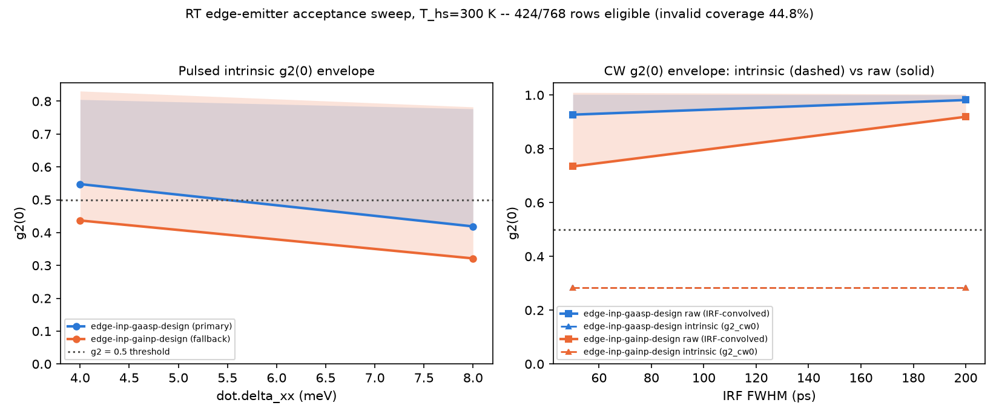
Why brightness changes the answer
• Flux margin is 6.89; values above 1 clear the 1000 photons/s floor
• The corrected circular-NA model raises the favourable-corner flux to the reported value
• Maximum collected flux is 6890.03 photons/s photons/s
Notes:
The factor table is read from out/rt_edge/verdict.md: loading=0.634719, t_X=0.5, retention=0.0131112, eta_total=0.0206985, and repetition rate=8e+07 Hz. These levers buy enough collection for only the fallback low-linewidth corner; they do not improve intrinsic g2. The floor, factors, and lever values are the acceptance artifact's brightness decomposition. Facet-model note from the verdict: **Independent check on the combined front-facet factor** (council review round 5, item 6, fixing a tautology): the value above is BACK-SOLVED -- the one factor missing once eta_total, beta, propagation and NA are all already known (eta_total = beta * <combined factor> * eta_prop * eta_NA) -- so a self-check comparing it against that same back-solving would only ever reproduce its own inputs. The genuinely independent check instead recomputes the combined factor FORWARD from this row's own facet transmission (T_facet) and back-facet reflectivity (R_back), trying every candidate formula introspected LIVE from fsim_core/waveguide.py's installed `edge_emission` source right now (never hardcoded, since that file's facet model is being edited concurrently and may change again) -- both as a fused current-model factor and as a legacy front-split-times-T_facet factor, since either grouping may be in effect: forward = 0.935012 via `facet_factor = T / (T + (1 - R_back))` (fused/current-model convention: already includes T_facet), back-solved = 0.935012 -- MATCH (agreement confirms the back-solved value really is the geometric front/back-facet-and-transmission factor waveguide.py computes, not some other quantity folded into eta_total).

Slide 16
Validation: 80 K and 230 K comparisons
• Reischle like-for-like: 0.25 +/- 0.05 deconvolved vs the model's best intrinsic corner
• Reischle 2008 also reports raw g2(0)=0.43 and corrected g2(0)=0.03
• 230 K model comparison: g2(0)=0.36, matching Chatzarakis 2023
Notes:
verify/verify_rt_edge_papers.py is a self-contained hallucination check: it re-derives every anchored literature claim from the shared evidence ledger (verify/data/rt_edge_anchors.yaml), confirms each has a real DOI or figure locator, checks units and plausible magnitude, and distinguishes raw-versus-background-corrected numbers (a documented failure mode where a paper's own raw, deconvolved and fully-corrected values could be swapped). It currently passes 14/17 checks. Two claims still lack the required second, independent verified source and are reported as incomplete rather than silently accepted: reischle2008_g2_80K (only 1 distinct verified primary source(s), need 2); hkust_inp_gaasp_wavelength (only 1 distinct verified primary source(s), need 2); residual_background_80K (only 1 distinct verified primary source(s), need 2). For context, the 80 K claim's only source is Reischle et al., Optics Express 16, 12771 (2008), and the wavelength claim's only source is Gu et al., Optics Express 33, 23732 (2025).

Slide 17
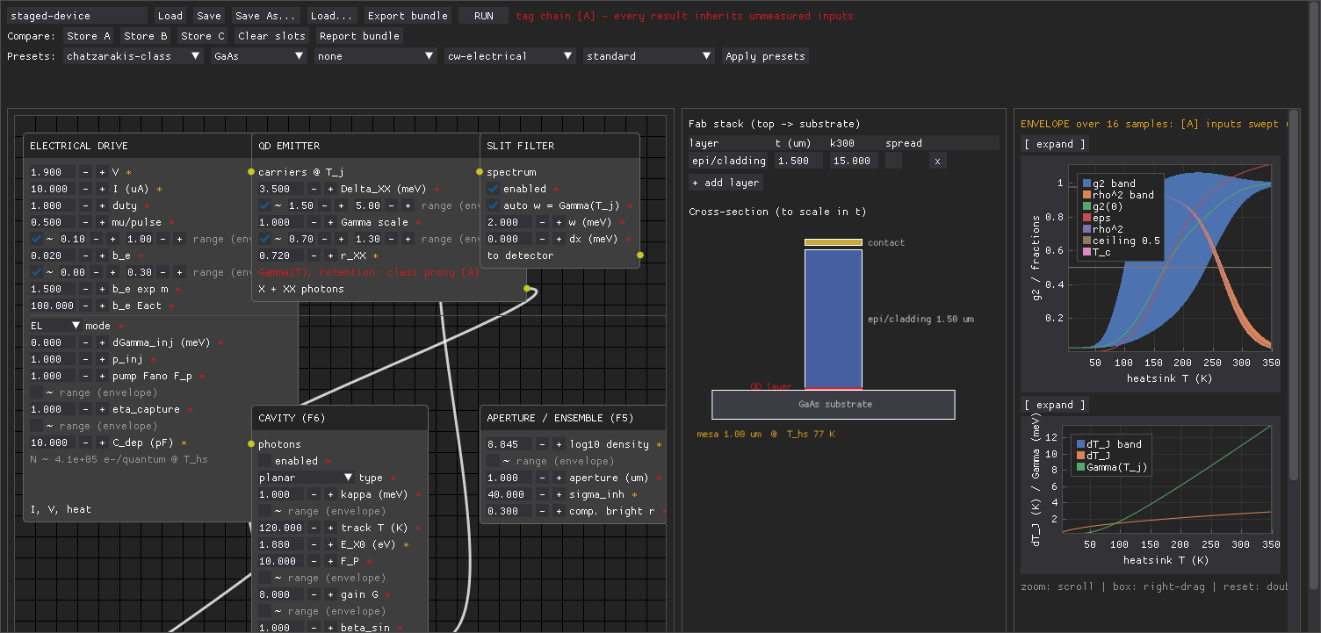
The design GUI
• Engineers explore designs interactively -- sliders for the dot, the drive, the waveguide
• The same evaluate() pipeline runs live behind the GUI as behind this sweep
• This screenshot is a real render of the running tool
Notes:
fsim_gui/designer.py is a live GUI (Dear PyGui) over the identical fsim_core.device evaluator used by the acceptance sweep and by verify/verify_rt_edge_cards.py: moving a slider re-runs the full materials-to-g2 pipeline and redraws the results panel and g2(0) curve immediately, so a designer can explore the same trade-offs this deck reports interactively rather than only reading a static sweep. The screenshot on this slide (out/rt_edge/gui-smoke.png) is captured directly from a running instance of the tool via fsim_gui/designer.py --frames 10 --screenshot, not a mockup.

Slide 18
The honest verdict
• Under the relaxed rule, the sweep passes from 230 K; the result remains conditional, not a PASS
• Pooled gamma300 threshold is 10-12 meV; the 300 K line passes only on the fallback card
• Evidence is incomplete and the primary card has no 300 K headline pass
• No published dot has broken the g2 ≈ 0.5, 300 K ceiling -- electrical or optical
VERDICT: FAIL g2_min=0.3214 g2_median_eligible=0.6373 diag_g2_min=0.3214 diag_g2_median_diagnostic=0.6706 flux_max=6890 flux_margin=6.89 flux_shortfall_deprecated=0.1451 median_pass=false coverage_over_eligible=0.3066 eligible_fraction=0.5521 eligible=424/768 flux_floor_excluded=344 evidence=incomplete conditional=true headline_coverage=130/768 cw_raw_coverage=0/424 gamma300_pass_max=10 gamma300_threshold=10-12 T_pass_min=230 headline_by_T=230:60/192,250:34/192,273:24/192,300:12/192
Notes:
VERDICT: FAIL g2_min=0.3214 g2_median_eligible=0.6373 diag_g2_min=0.3214 diag_g2_median_diagnostic=0.6706 flux_max=6890 flux_margin=6.89 flux_shortfall_deprecated=0.1451 median_pass=false coverage_over_eligible=0.3066 eligible_fraction=0.5521 eligible=424/768 flux_floor_excluded=344 evidence=incomplete conditional=true headline_coverage=130/768 cw_raw_coverage=0/424 gamma300_pass_max=10 gamma300_threshold=10-12 T_pass_min=230 headline_by_T=230:60/192,250:34/192,273:24/192,300:12/192
Fail reasons: evidence_incomplete. The relaxed stop rule requires g2(0) < 0.5 with working electrical injection, in-plane out-coupling, every claim cross-checked against at least two operation at T_hs >= 230 K, with all claims cross-checked against independent papers. The temperature-axis sweep passes at 230 K and above as reported, but evidence claims still lack independent support. This remains a FAIL rather than a conditional PASS because docs/rt_edge_contract.md makes evidence completeness mandatory, and because no published III-V quantum dot -- at any drive scheme -- has demonstrated g2(0) < 0.5 at conditional verdict rather than a PASS.

Slide 19
Limitations and what would have to change
• Filter window follows the linewidth, fixing t_X=0.5 by convention
• Residual background is transferred from 80 K data to this 300 K platform
• Pulsed drive is required: the CW dip is narrower than detector response
Notes:
What would have to be true for a future revision to pass: (1) a measured, not class-proxy, 300 K single-dot linewidth for an InP/GaAsP or InP/GaInP dot, ideally near the 6 meV low end of today's assumed range; (2) a measured X-XX splitting nearer the 7 meV end of today's 4-7 meV range, or a design (e.g. piezoelectric growth, per Chatzarakis et al. 2023's InAs/GaAs result) that widens it further; (3) an independent second source for the 80 K electrical g2 anchor and for the InP/GaAsP emission-wavelength anchor, closing out/rt_edge/evidence.json's two open claims; and (4) because carrier escape at 300 K is faster than any detector's timing response, either a much faster single-photon detector or a design that slows thermal escape (a deeper confinement barrier) before continuous-wave operation could show any antibunching at all. None of these four are engineering details this simulator can resolve on its own -- they are measurements and material developments that have not yet been published.

