Slide 1
Frameworks
Bijay Gaudel

Slide 2
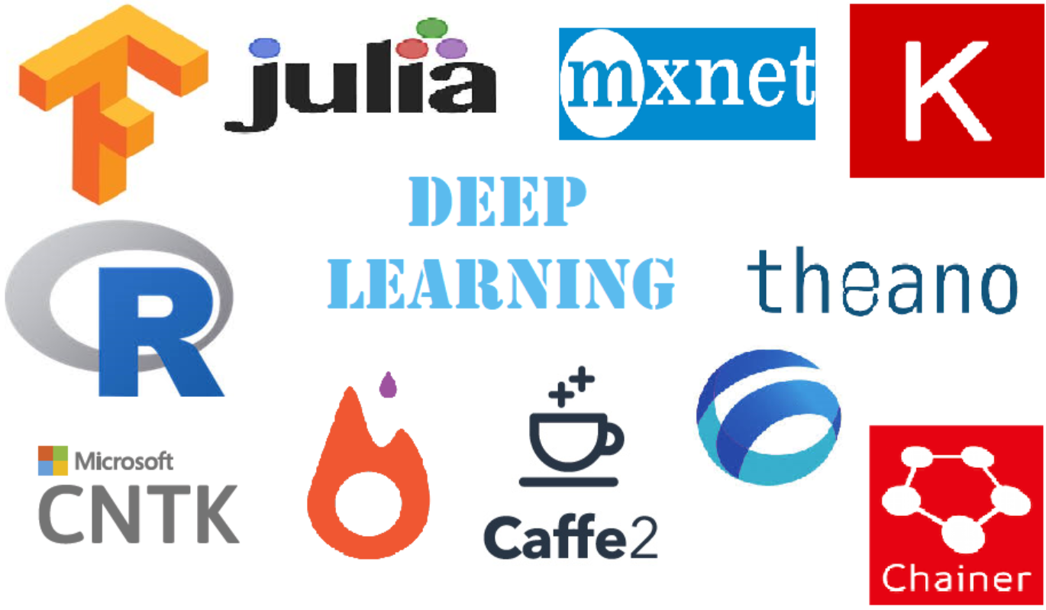

Slide 3

TensorFlow
Google open-source high level library for numerical computation (Mostly used in Machine learning and deep learning).
Developed by Google Brain team
First release : November 9, 2015
$$A=πr^{2}L$$

Slide 4

TensorFlow
$$A=πr^{2}L$$

Slide 5
TensorFlow
Training
Train datasets
Validation datasets
Epochs, batch size, etc
Compile
Loss function
Optimizer
Evaluation metrics
$$A=πr^{2}L$$
Evaluation
Test datasets
Prediction:
New data

Slide 6
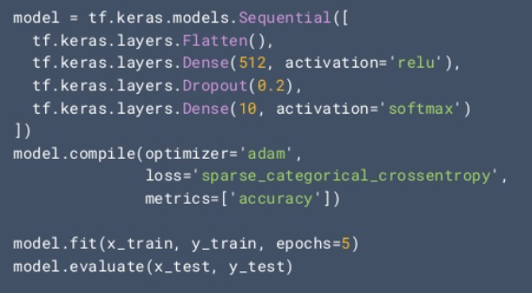
TensorFlow
For Beginners
$$A=πr^{2}L$$

Slide 7
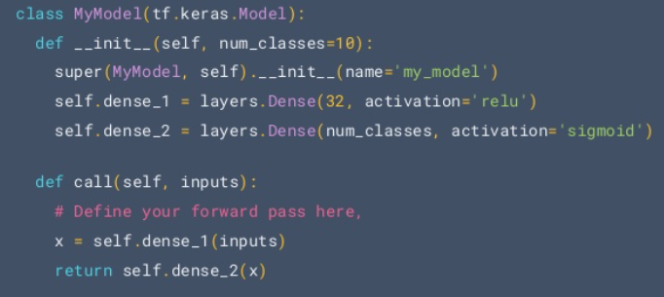
TensorFlow
For Expert
$$A=πr^{2}L$$

