Slide 1
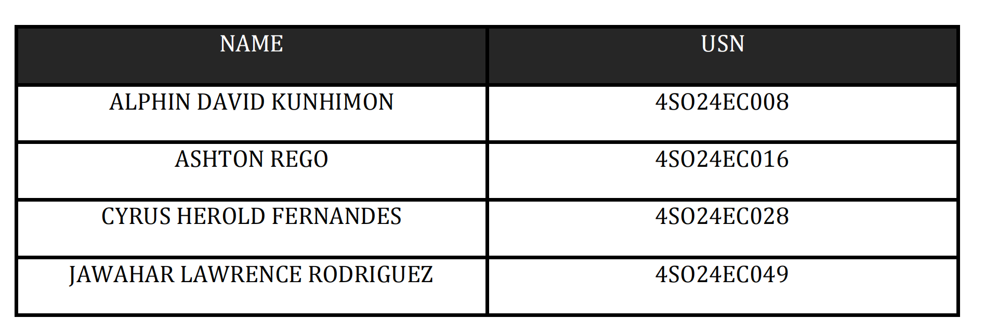
DEPARTMENT OF ELECTRONICS & COMMUNICATION ENGINEERING ST JOSEPH ENGINEERING COLLEGE VAMANJOOR MANGALURU-575028 Course Title: Digital Design using HDL Course Code: 22ECE42 Semester: Fourth Semester PBL Secondary Research Report FPGA Based-Advanced Encryption Standard (AES)

Slide 2
What is AES? Advanced Encryption Standard AES is a method used to protect data by converting normal readable information into coded information using a secret key, so only authorized users can read it.
Plaintext to statematrix
*Explanation with respect to code

Slide 3
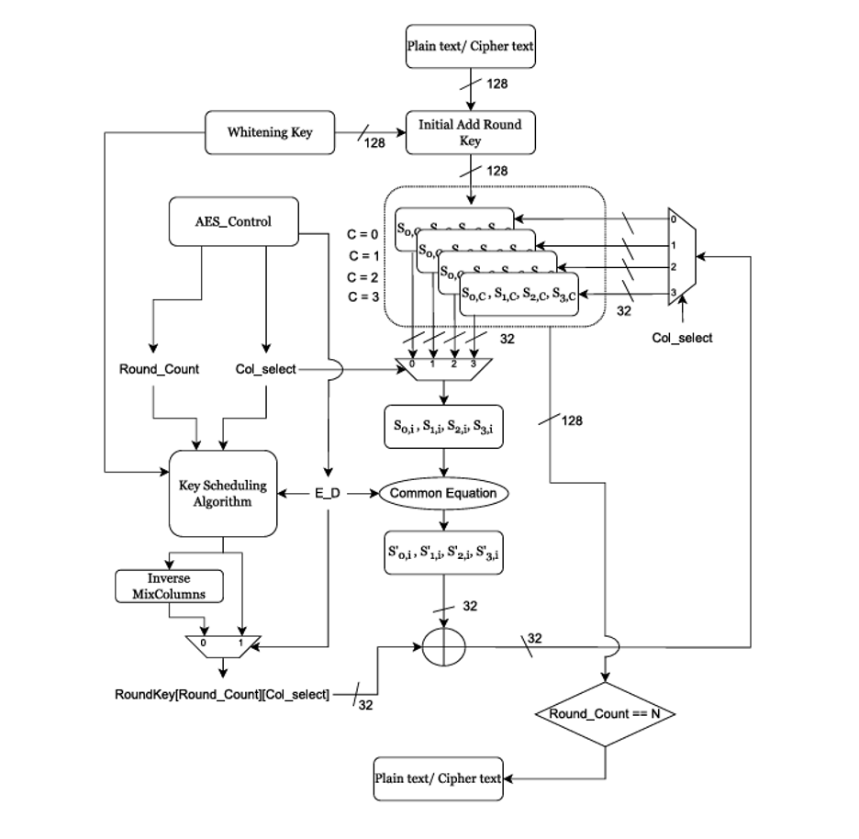
Architecture
1. Control & Scheduling
AES Control: Manages the round progression and column selection.
Key Scheduling: Expands the initial 128-bit key into unique round keys for every column and round.
Inverse MixColumns: Modifies the keys during decryption to match inverse operations.
2. Data Handling & Logic
Initial Add Round Key: XORs the plaintext with a "Whitening Key" before the main rounds start.
State Registers: Store the 128-bit block, allowing the system to select one 32-bit column at a time.
Common Equation Block: A unified module containing the Leaf Cells (S-Box and Galois Multiplier) to transform the data.
3. The Execution Steps
Selection: The controller picks a 32-bit column from the state registers.
Processing: The column passes through the substitution and mixing layers.
Key Application: The transformed data is XORed with the corresponding round key.
Feedback: The result is fed back into the registers, and the process repeats for all columns and rounds until encryption is complete.

Slide 4
Core models
Subbytes
SubBytes is the only non-linear step in AES. In cryptography, non-linearity is vital because it creates "Confusion," making it extremely difficult for an attacker to use mathematical shortcuts (like linear cryptanalysis) to crack the code.
How it works mathematically:
SubBytes treats each byte as an element in a finite field, specifically Galois Field$GF(2^8)$. The transformation happens in two steps:
Multiplicative Inverse: It finds the multiplicative inverse of the byte in $GF(2^8)$. If the byte is $00_{16}$, it stays $00_{16}$.
Affine Transformation: It applies a complex bitwise matrix multiplication and adds a constant ($63_{16}$).

Slide 5
SHIFTROWS
In a 128-bit AES system, the data is treated as a $4 \times 4$ matrix of bytes. Each byte is 8 bits, totaling $16 \times 8 = 128$ bits.
The mapping of the 128-bit input () to the matrix in your code follows this pattern:data_in
Row 0: $b_0, b_4, b_8, b_{12}$
Row 1: $b_1, b_5, b_9, b_{13}$
Row 2: $b_2, b_6, b_{10}, b_{14}$
Row 3: $b_3, b_7, b_{11}, b_{15}$
The goal of ShiftRows is to cyclically shift the last three rows of the state matrix to the left by different offsets.
How it works:
Row 0: No shift.
Row 1: Shift left by 1 byte.
Row 2: Shift left by 2 bytes.
Row 3: Shift left by 3 bytes.

Slide 6
Gf multiplier
In GF arithmetic:
numbers are treated like polynomials
addition is XOR
overflow is reduced using a special polynomial
So multiplication behaves differently.
----------------------------------------
Flow:
Input a
↓
Check sel
↓
00 → multiply by 1
01 → multiply by 2
10 → multiply by 3
↓
Output result
--------------------------------------------------
What if the msb is 1?
AES uses a fixed polunomial reduction modulo which is:
x^8 + x^4 + x^3 + x + 1
So when overflow happens, it is shifted and xor'd with 8'h1b.

Slide 7
Gf mixcoloumns single
In this operation, a single coloumn is taken and the follow equations are performed to get a new coloumn
assign b0 = mul2(a0) ^ mul3(a1) ^ a2 ^ a3;
assign b1 = a0 ^ mul2(a1) ^ mul3(a2) ^ a3;
assign b2 = a0 ^ a1 ^ mul2(a2) ^ mul3(a3);
assign b3 = mul3(a0) ^ a1 ^ a2 ^ mul2(a3);

Slide 8
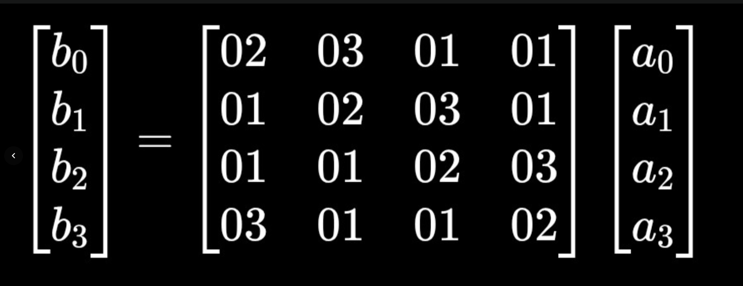
mixcoloumn
In Advanced Encryption Standard, MixColumns is the step that mixes the bytes inside each column of the AES state matrix to create strong diffusion

Slide 9
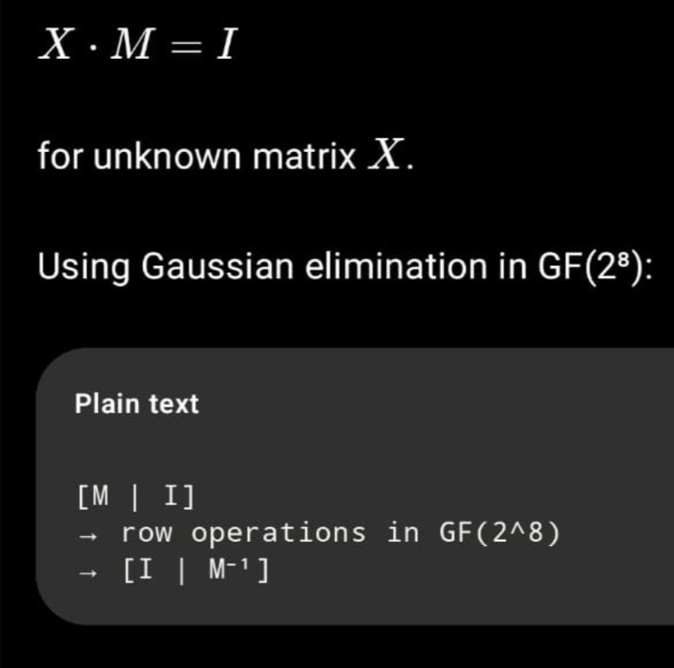
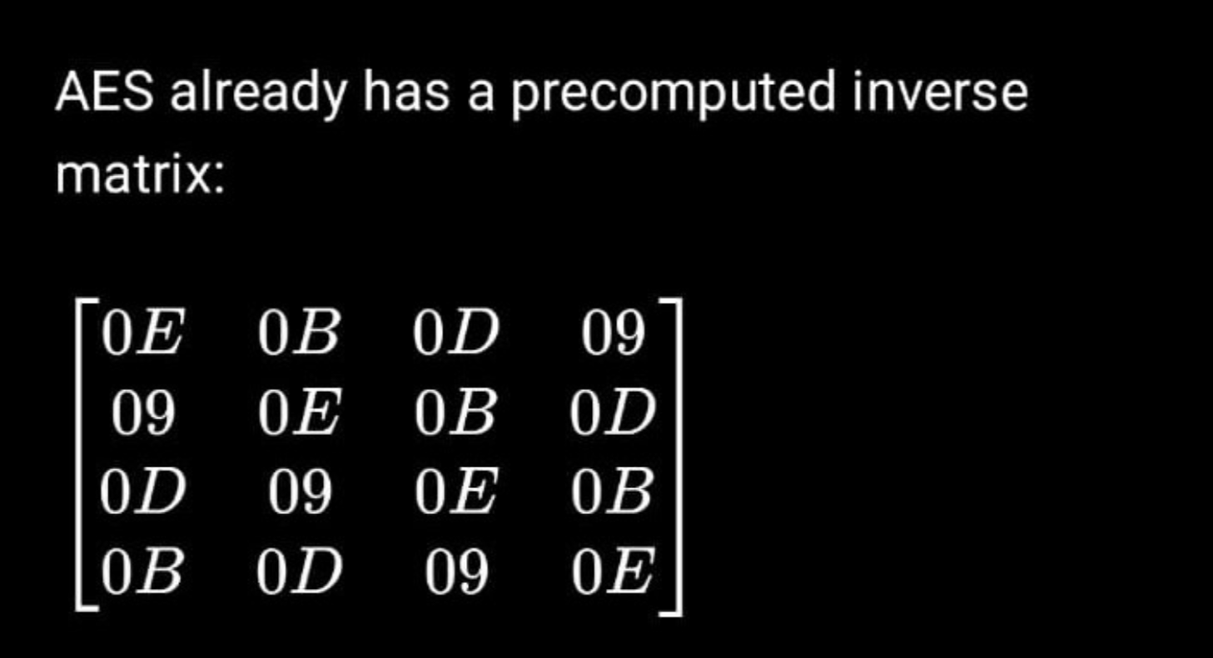
Inverse mixcoloumn

Slide 10
Round Key Expansion
So in the beginning a master key is exored with the plain text, then the scrambled text is produced. All in 128 bits for round 0.
Then for all the remaining rounds, round key is derived from the master key.
In round 1-9 there is subybtes, shift rows, mix columns, add round key.
In round 1-9, each round produces a round key that is exored with the curreent state.
Then in round 10 again there is all this except mix columns. The output of the last exor is my cipher text.
The formula is: state(out)= state(in)^roundkey
Formula for key expansion:
Rotword([b0, B1, B2, B3]) = [B1, B2, B3, B0]
Temp = rotword(w3) ^ rcon[round]

Slide 11
ROUND KEY EXPANSION
Transformation Flow:
reg [31:0] temp; A temporary register used to hold intermediate calculations for the transformation.
temp = rot_word(w3) rotates the last word.
temp = temp ^ {rcon_val, 24'h0} performs a bitwise XOR between the rotated word and the round constant.
Key Generation: The new words are created by XORing the previous words with the transformed temporary word in a "chain" fashion:
key_out[127:96] = w0 ^ temp.
key_out[95:64] = w1 ^ key_out[127:96].
key_out[63:32] = w2 ^ key_out[95:64].
key_out[31:0] = w3 ^ key_out[63:32]

Slide 12
Planning:
Alphin David k:
Mixcoloumns, mixcoloumns single, leaf cell GF multiplier, invmixcol, invmixcol single , block diagram, state matrix, 1 paper(anniruden bin kasmin), README(updates)
Ashton Rego:
Sbox,inversesbox,subbytes, inversesubbytes throughput and resource usage of papers,1 paper(Arulmurugan Azhaganantham)
Cyrus herold fernandes:
Shiftrows,inverse shiftrows,sbox leaf cellsimulation, 1 paper(R. Parthasarathy)
Jawahar lawrence rodrigues:
Leaf cell Addroundkey(EXOR), keyexpansion, README(update),1 paper(SALMAN AHMED)
Everyone has uploaded their respective codes and testbenches along with simulation pictures present in github.
Github:
https://github.com/Alphin12345/AES_TP

