Slide 1
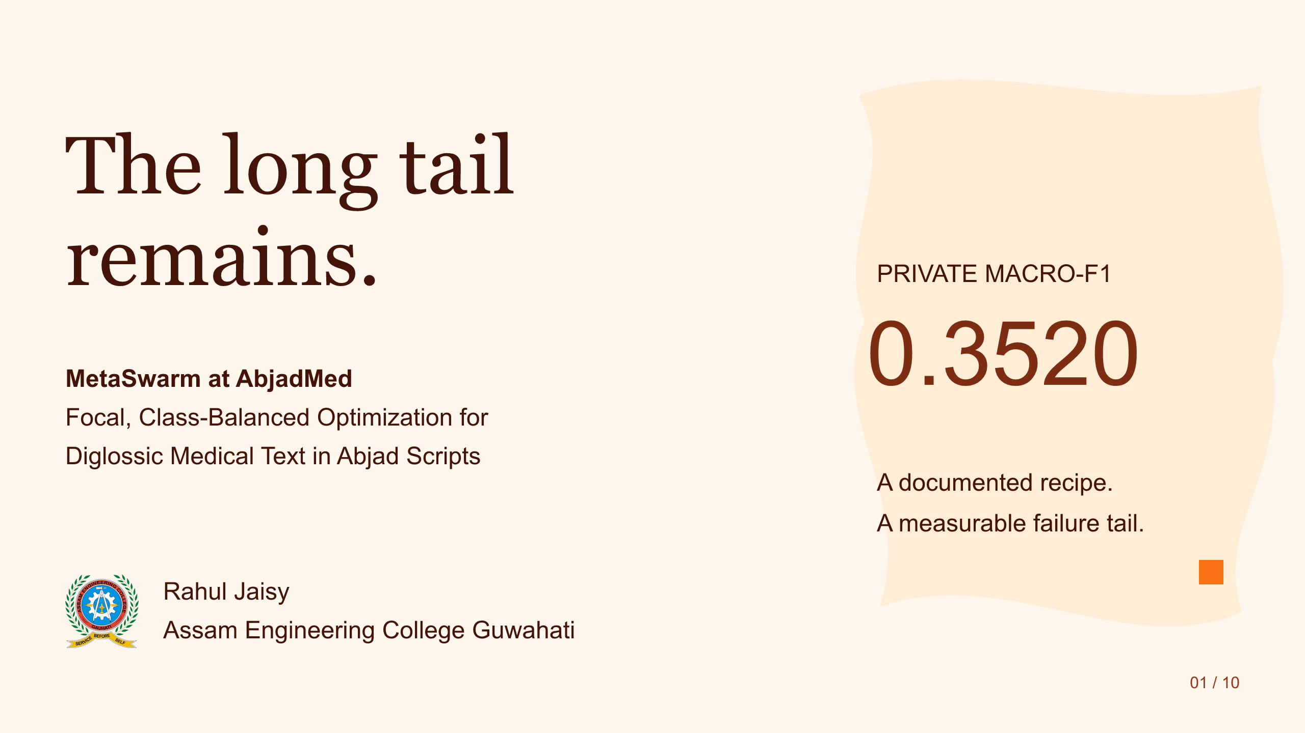
Notes:
Source: S1.svg. Faithful image conversion; slide text is not individually editable.
The long tail
remains.
MetaSwarm at AbjadMed
Focal, Class-Balanced Optimization for
Diglossic Medical Text in Abjad Scripts
PRIVATE MACRO-F1
0.3520
A documented recipe.
A measurable failure tail.
Rahul Jaisy
Assam Engineering College Guwahati
01 / 10

Slide 2
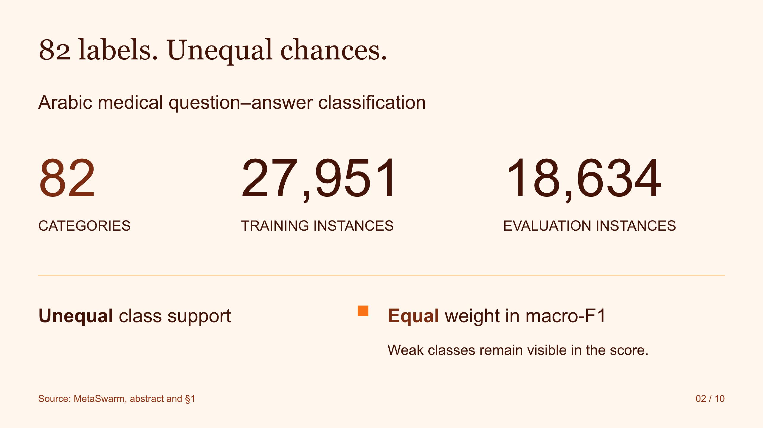
Notes:
Source: S2.svg. Faithful image conversion; slide text is not individually editable.
82 labels. Unequal chances.
Arabic medical question–answer classification
82
CATEGORIES
27,951
TRAINING INSTANCES
18,634
EVALUATION INSTANCES
Unequal class support
Equal weight in macro-F1
Weak classes remain visible in the score.
Source: MetaSwarm, abstract and §1
02 / 10

Slide 3
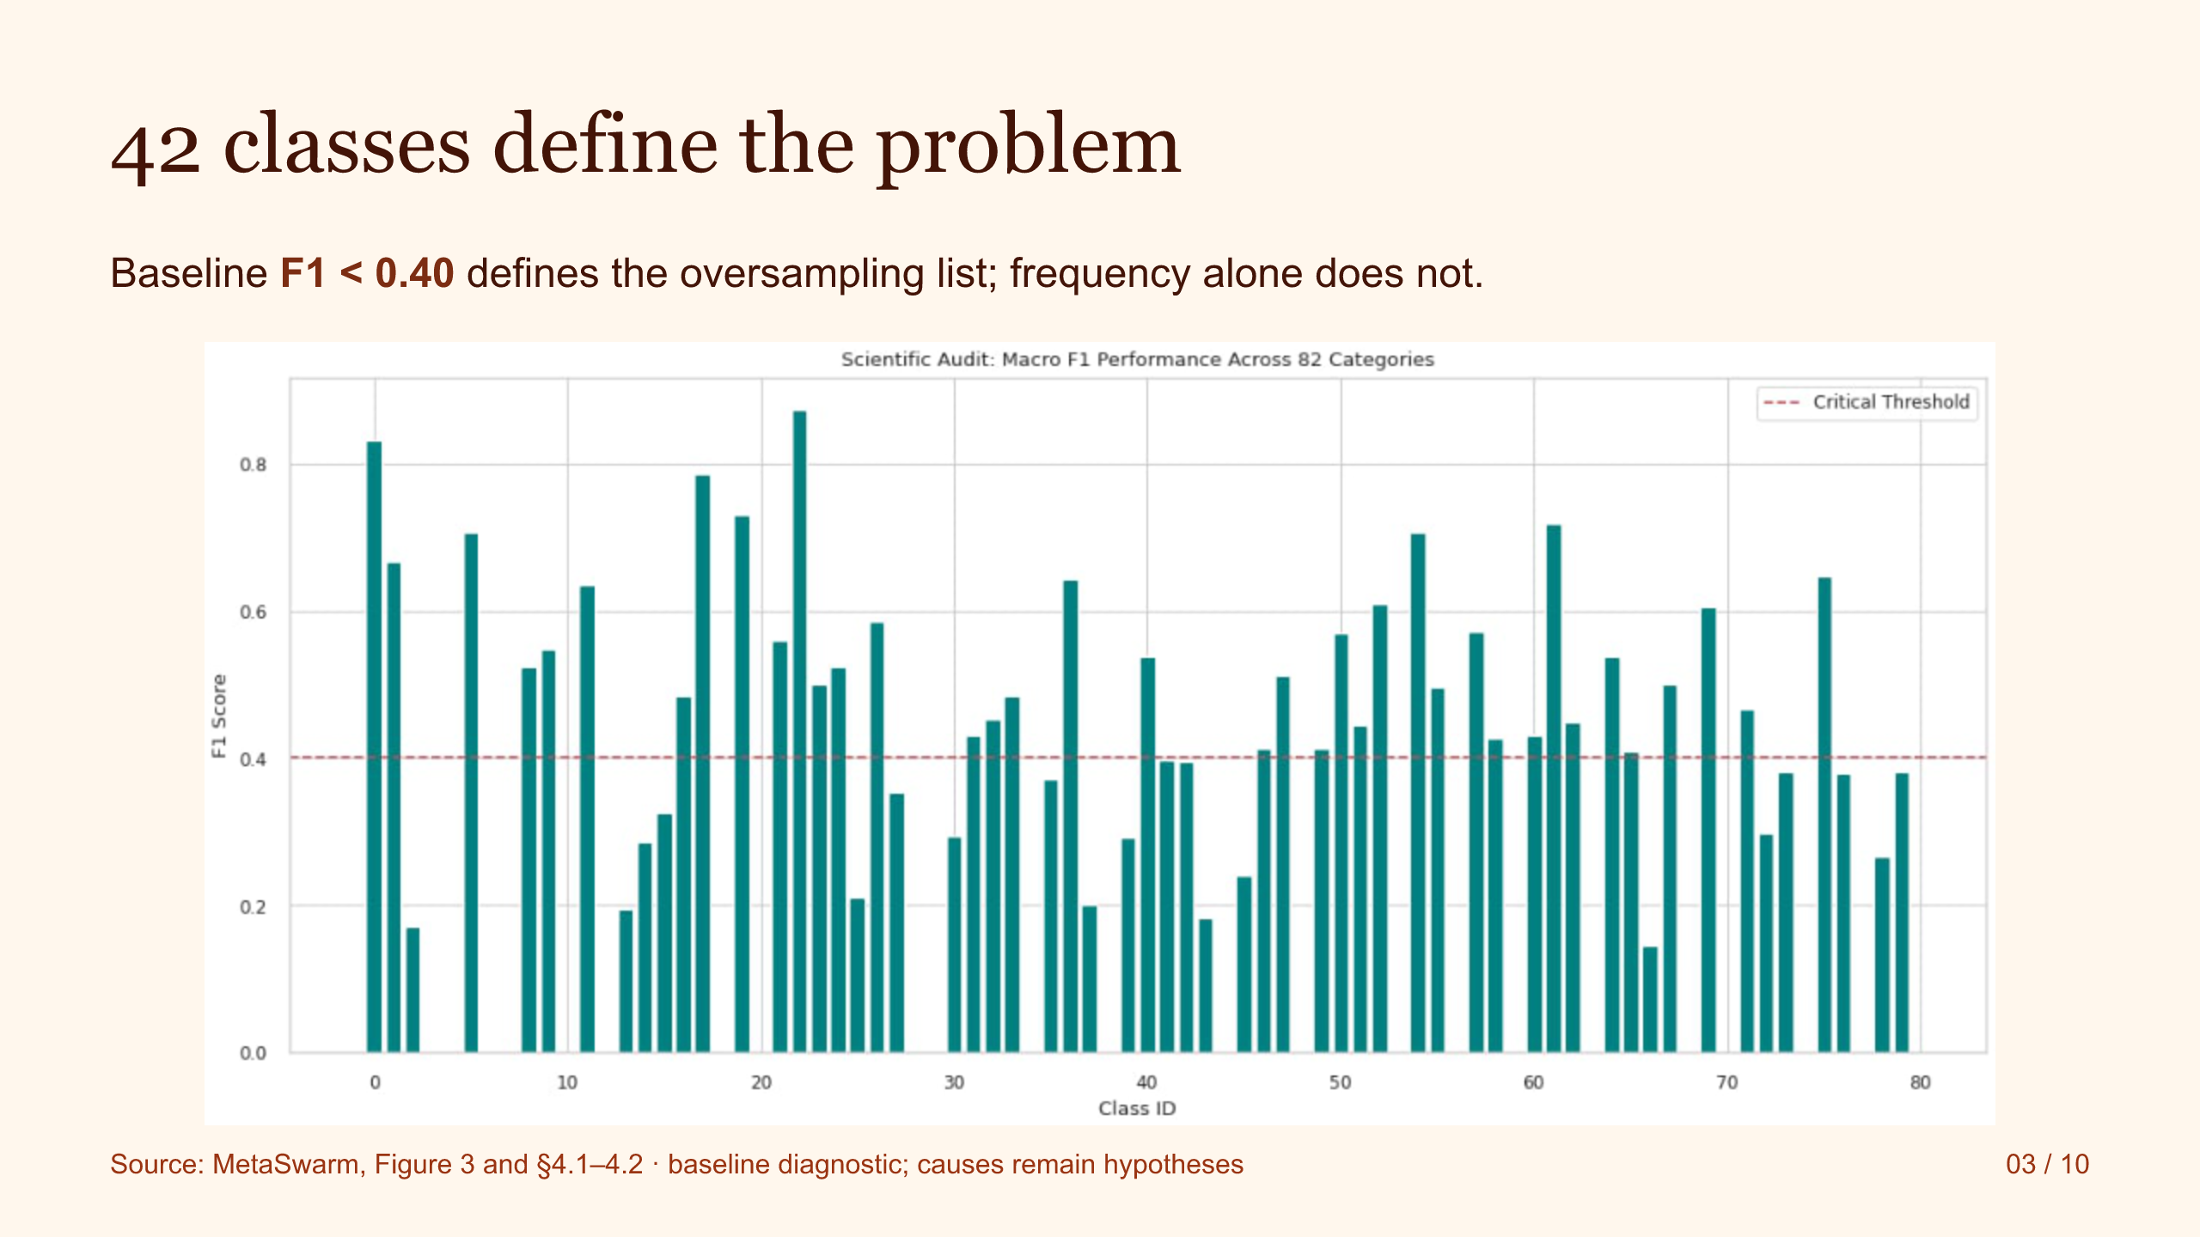
Notes:
Source: S3.svg. Faithful image conversion; slide text is not individually editable.
42 classes define the problem
Baseline F1 < 0.40 defines the oversampling list; frequency alone does not.
Source: MetaSwarm, Figure 3 and §4.1–4.2 · baseline diagnostic; causes remain hypotheses
03 / 10

Slide 4
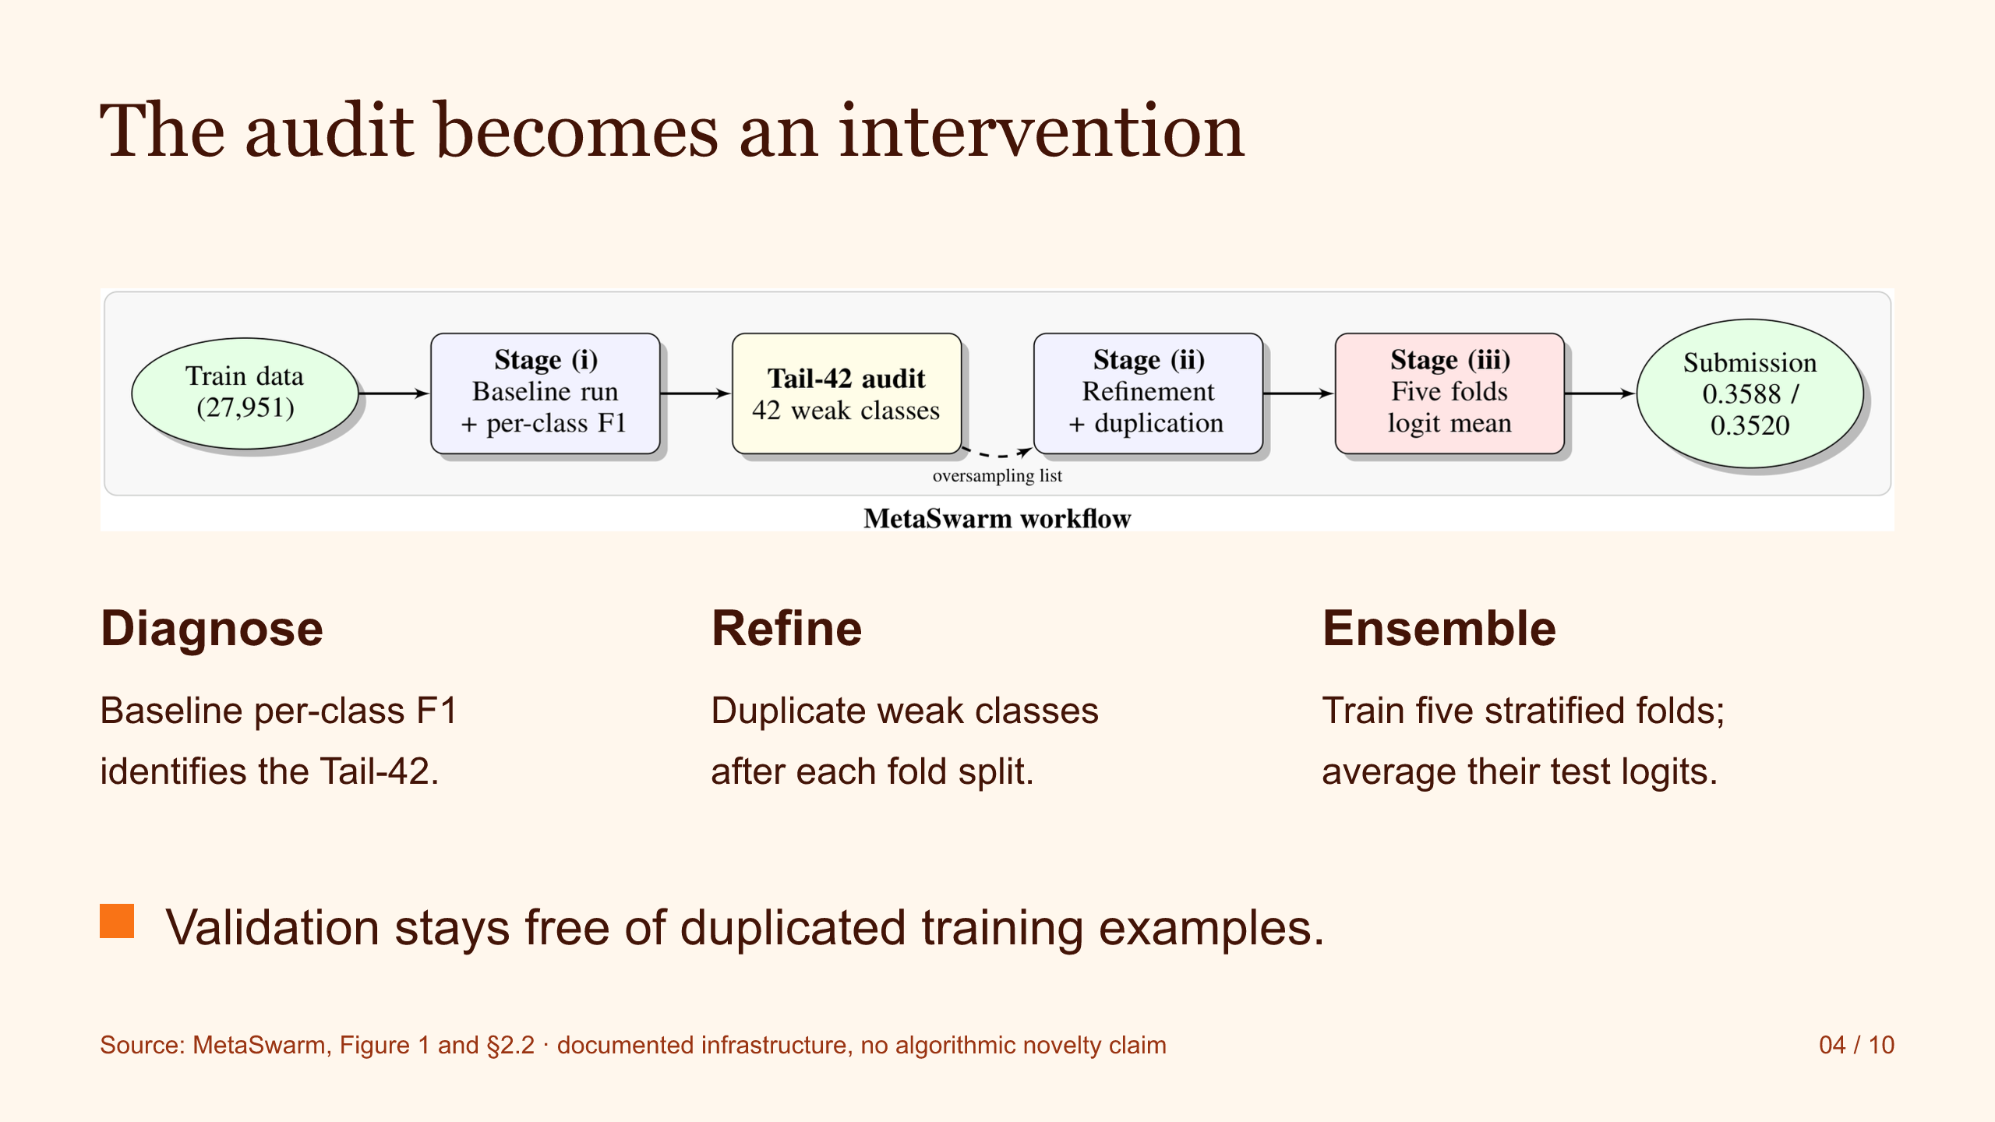
Notes:
Source: S4.svg. Faithful image conversion; slide text is not individually editable.
The audit becomes an intervention
Diagnose
Baseline per-class F1
identifies the Tail-42.
Refine
Duplicate weak classes
after each fold split.
Ensemble
Train five stratified folds;
average their test logits.
Validation stays free of duplicated training examples.
Source: MetaSwarm, Figure 1 and §2.2 · documented infrastructure, no algorithmic novelty claim
04 / 10

Slide 5
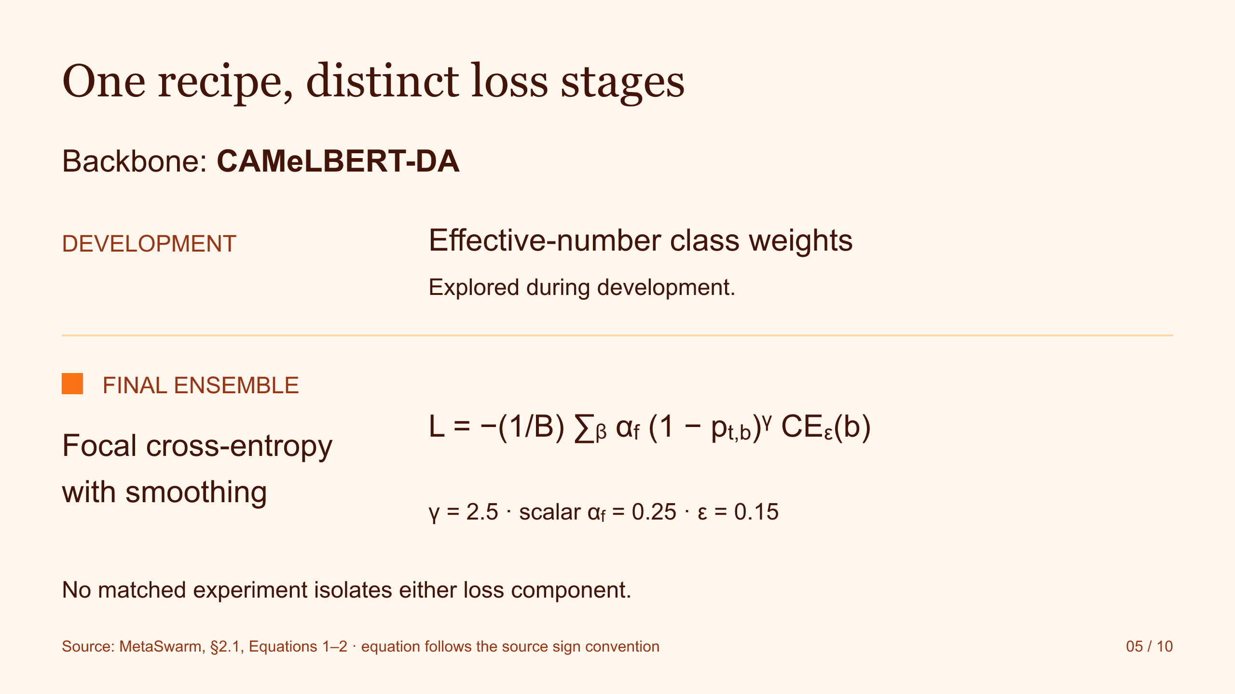
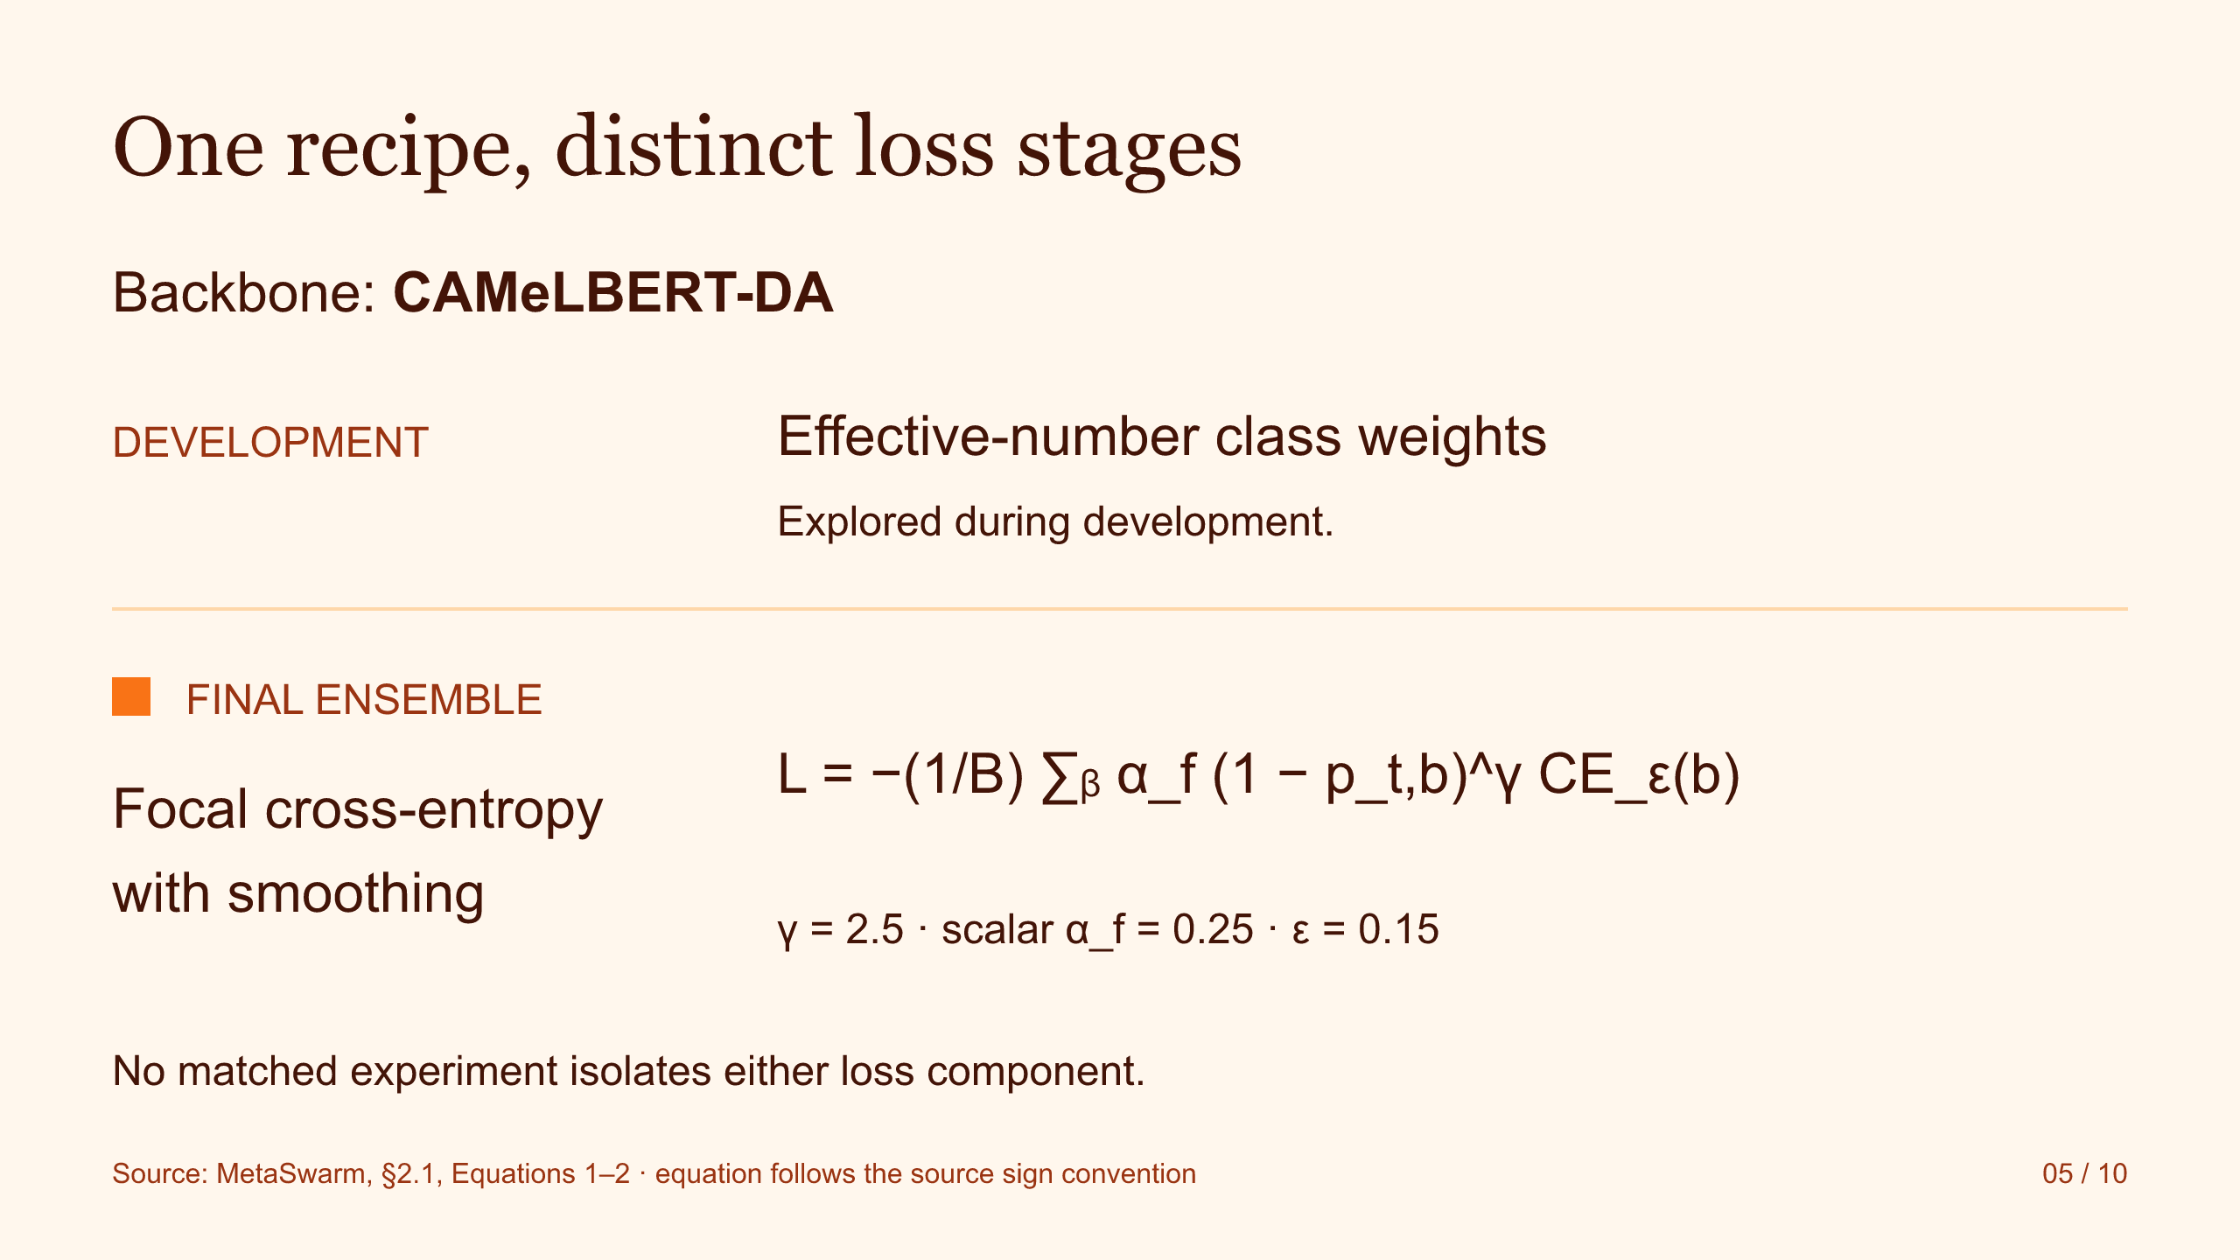
Notes:
Source: S5.svg. Faithful image conversion; slide text is not individually editable.
One recipe, distinct loss stages
Backbone: CAMeLBERT-DA
DEVELOPMENT
Effective-number class weights
Explored during development.
FINAL ENSEMBLE
Focal cross-entropy
with smoothing
L = −(1/B) ∑ᵦ α_f (1 − p_t,b)^γ CE_ε(b)
γ = 2.5 · scalar α_f = 0.25 · ε = 0.15
No matched experiment isolates either loss component.
Source: MetaSwarm, §2.1, Equations 1–2 · equation follows the source sign convention
05 / 10

Slide 6
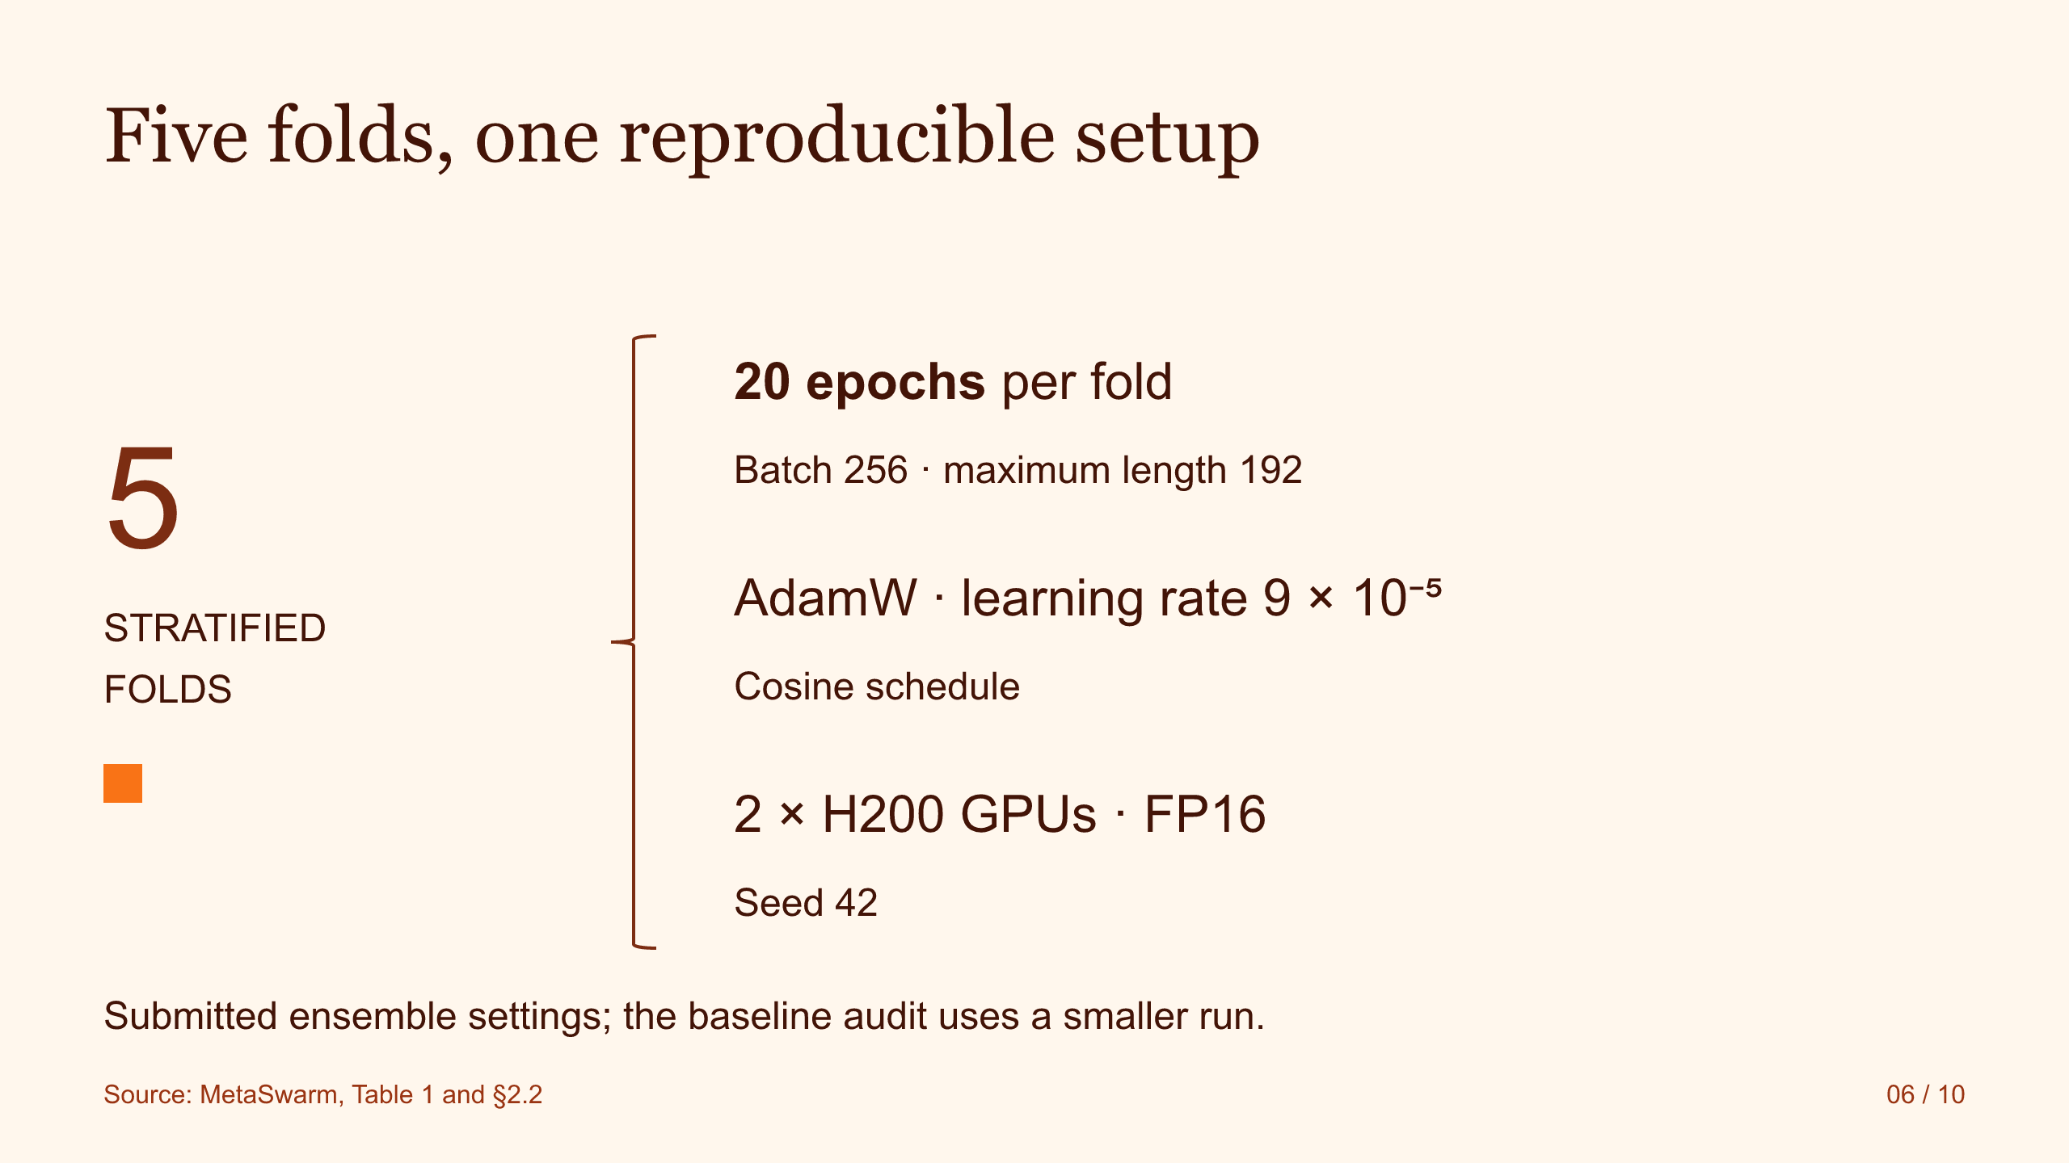
Notes:
Source: S6.svg. Faithful image conversion; slide text is not individually editable.
Five folds, one reproducible setup
5
STRATIFIED
FOLDS
20 epochs per fold
Batch 256 · maximum length 192
AdamW · learning rate 9 × 10⁻⁵
Cosine schedule
2 × H200 GPUs · FP16
Seed 42
Submitted ensemble settings; the baseline audit uses a smaller run.
Source: MetaSwarm, Table 1 and §2.2
06 / 10

Slide 7
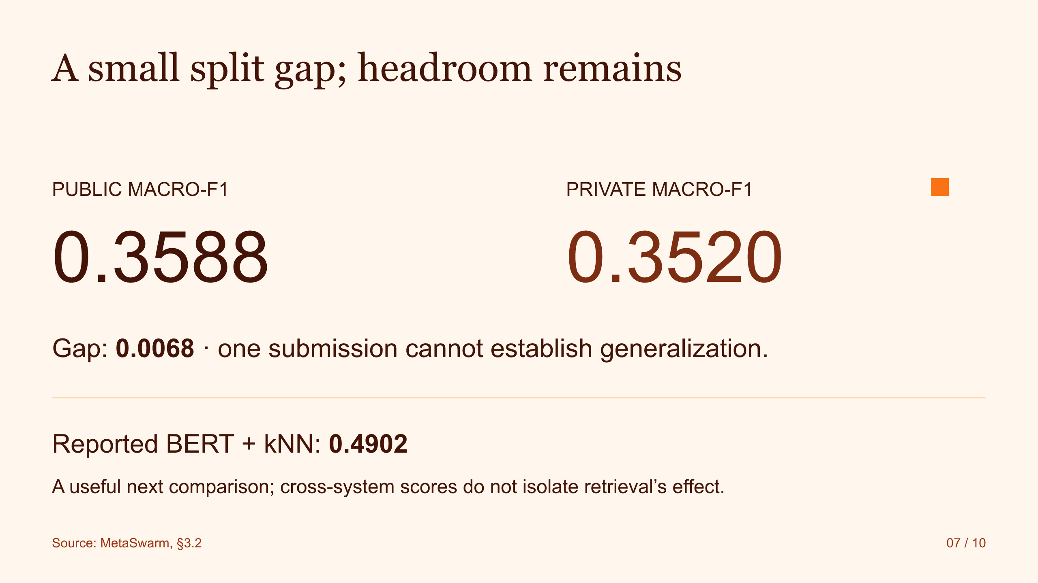
Notes:
Source: S7.svg. Faithful image conversion; slide text is not individually editable.
A small split gap; headroom remains
PUBLIC MACRO-F1
0.3588
PRIVATE MACRO-F1
0.3520
Gap: 0.0068 · one submission cannot establish generalization.
Reported BERT + kNN: 0.4902
A useful next comparison; cross-system scores do not isolate retrieval’s effect.
Source: MetaSwarm, §3.2
07 / 10

Slide 8
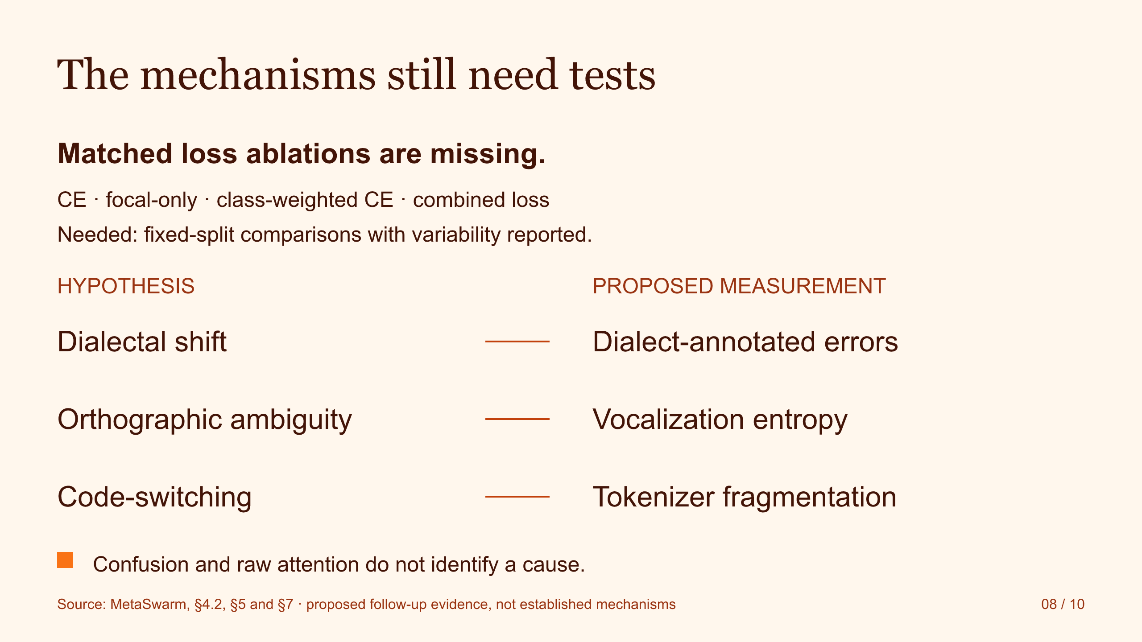
Notes:
Source: S8.svg. Faithful image conversion; slide text is not individually editable.
The mechanisms still need tests
Matched loss ablations are missing.
CE · focal-only · class-weighted CE · combined loss
Needed: fixed-split comparisons with variability reported.
HYPOTHESIS
PROPOSED MEASUREMENT
Dialectal shift
Dialect-annotated errors
Orthographic ambiguity
Vocalization entropy
Code-switching
Tokenizer fragmentation
Confusion and raw attention do not identify a cause.
Source: MetaSwarm, §4.2, §5 and §7 · proposed follow-up evidence, not established mechanisms
08 / 10

Slide 9
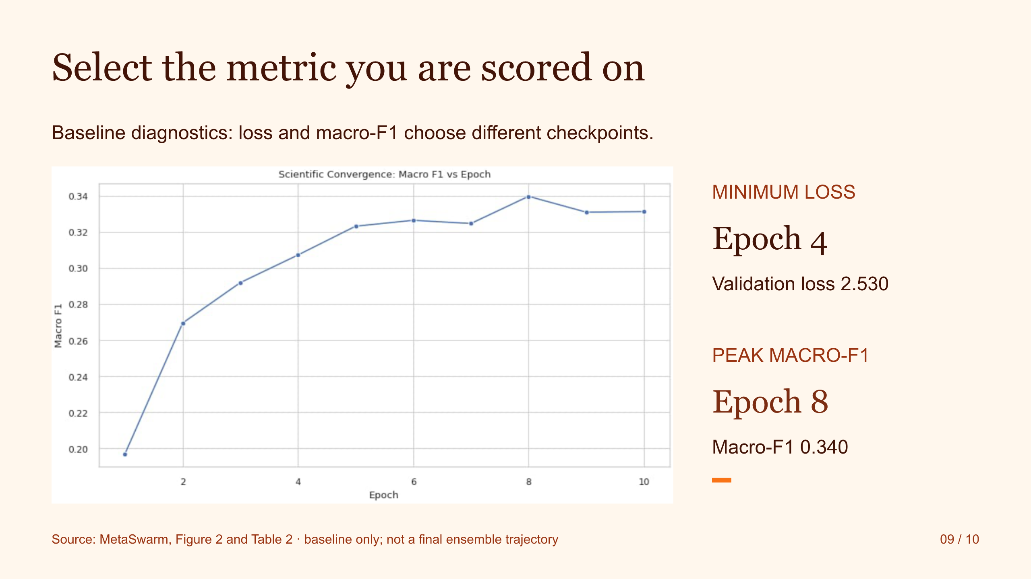
Notes:
Source: S9.svg. Faithful image conversion; slide text is not individually editable.
Select the metric you are scored on
Baseline diagnostics: loss and macro-F1 choose different checkpoints.
MINIMUM LOSS
Epoch 4
Validation loss 2.530
PEAK MACRO-F1
Epoch 8
Macro-F1 0.340
Source: MetaSwarm, Figure 2 and Table 2 · baseline only; not a final ensemble trajectory
09 / 10

Slide 10
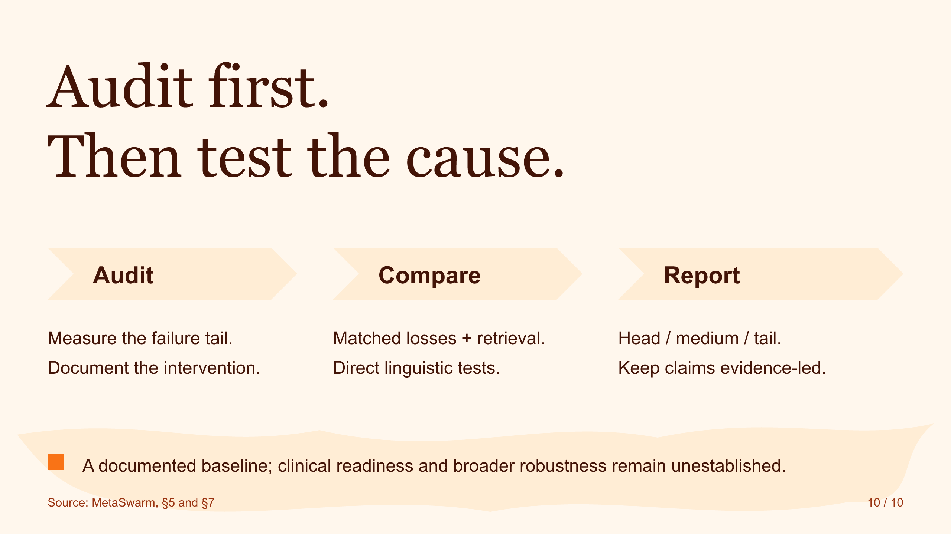
Notes:
Source: S10.svg. Faithful image conversion; slide text is not individually editable.
Audit first.
Then test the cause.
Audit
Measure the failure tail.
Document the intervention.
Compare
Matched losses + retrieval.
Direct linguistic tests.
Report
Head / medium / tail.
Keep claims evidence-led.
A documented baseline; clinical readiness and broader robustness remain unestablished.
Source: MetaSwarm, §5 and §7
10 / 10

