Slide 1
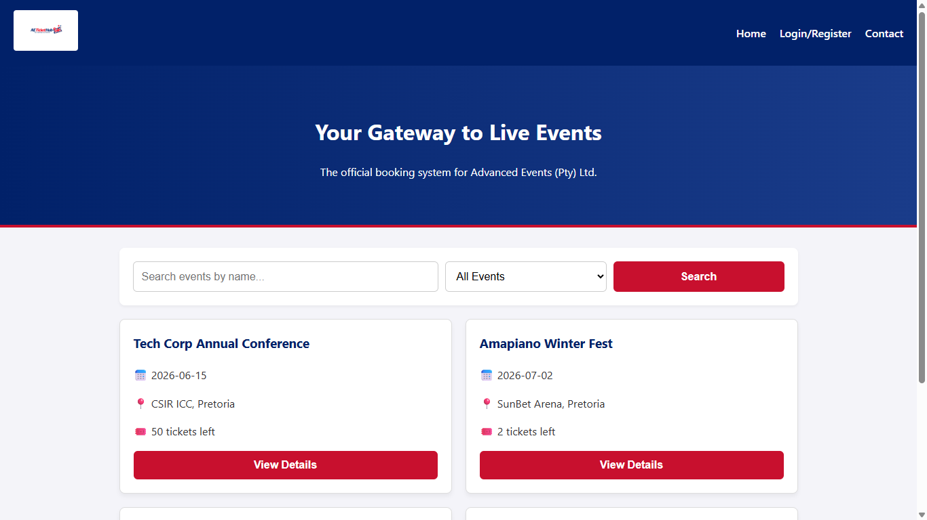
COVER
AETicketHub live system walkthrough
Smart event management and ticketing platform for Advanced Events (Pty) Ltd.
1. Event discovery and filtering
2. Secure registration and login
3. Ticket booking with capacity validation
4. Booking history, admin management, enquiries
README demo flow captured from the running Express/EJS application with Playwright.
AETicketHub demo flow | Cover

Slide 2
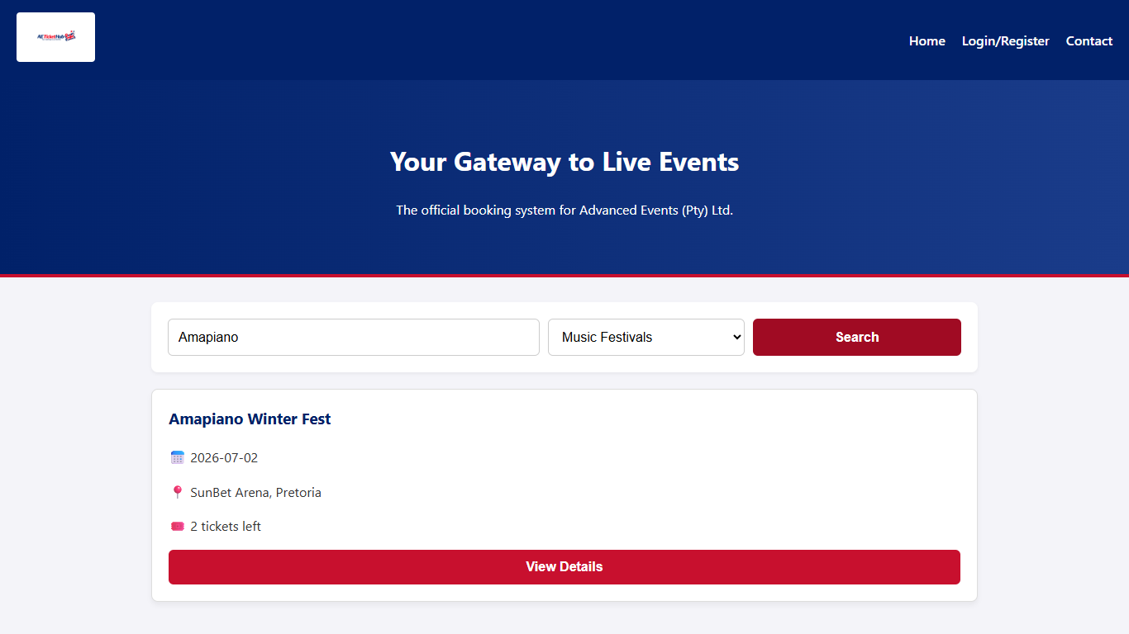
PARTICIPANT
The demo is aligned to the README flow and final QA path
Ethan Ogle
602114
Presentation, assignment alignment, final QA
The opening journey proves the assignment story: users can reach event listings, filter by event type, and move from discovery into ticket booking.
AETicketHub demo flow | Ethan Ogle

Slide 3
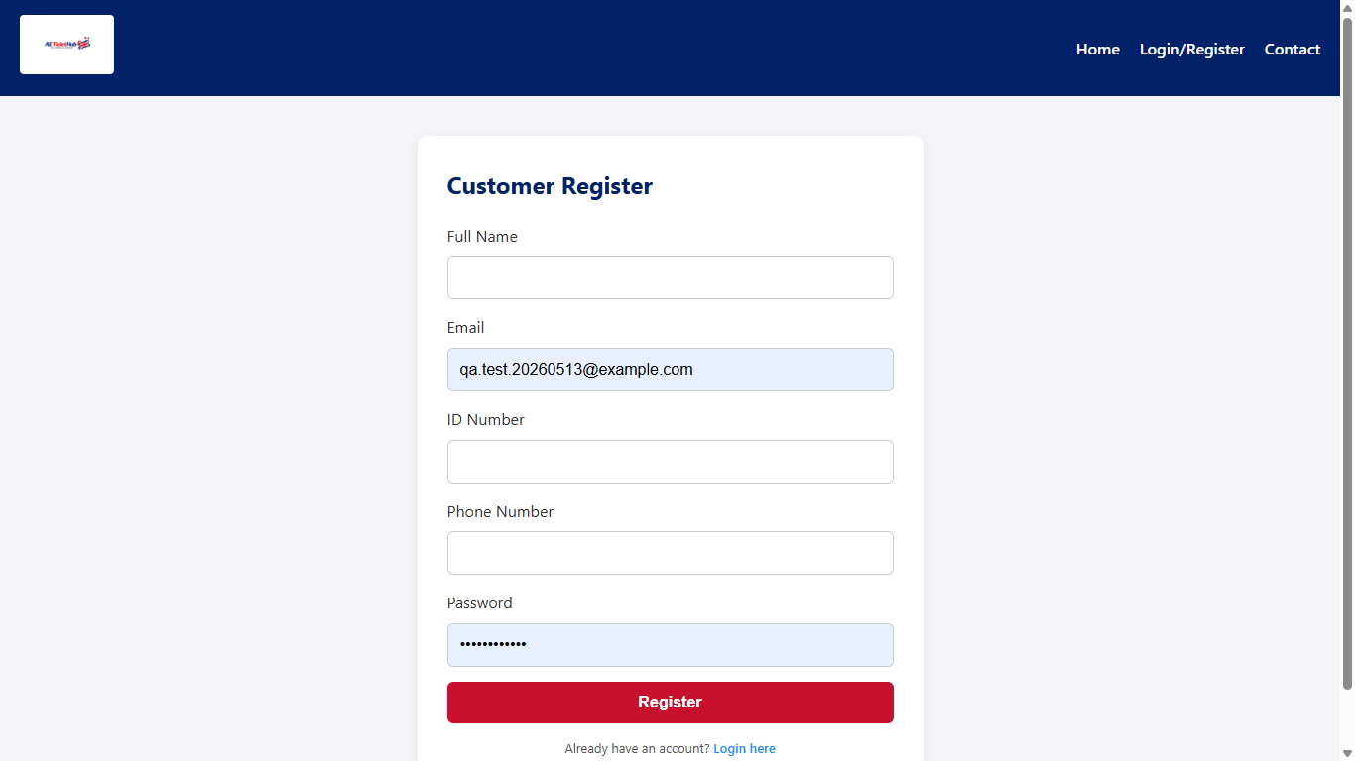
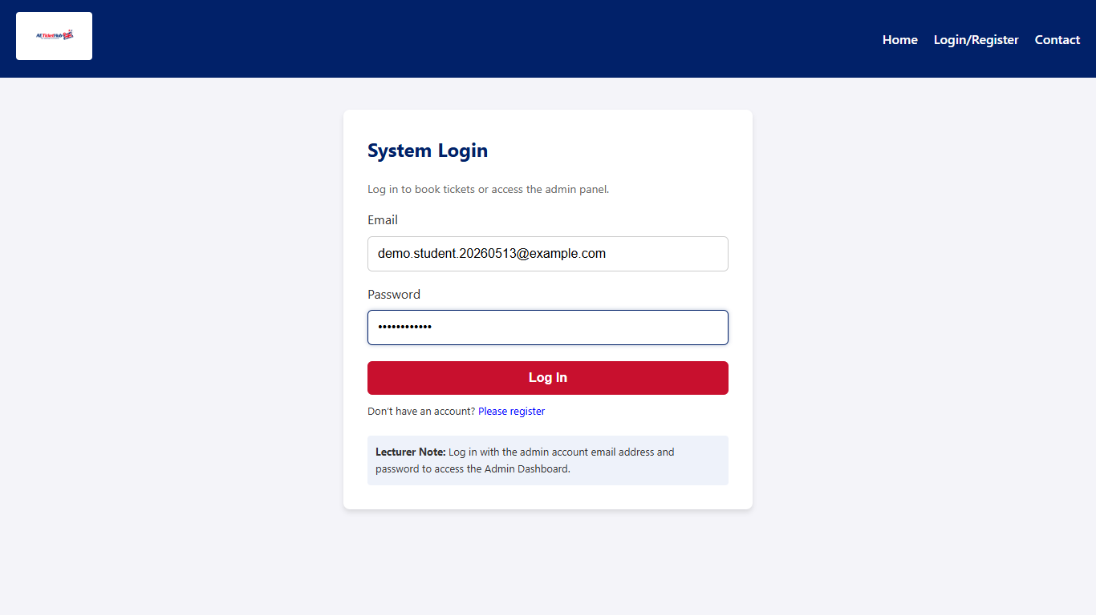
PARTICIPANT
Authentication gates the protected dashboard before bookings
Jaden Van der Lely
600690
GitHub repository, authentication, security
The login step issues the user token used by the dashboard and booking journey, keeping the protected areas behind the authentication path.
AETicketHub demo flow | Jaden Van der Lely

Slide 4
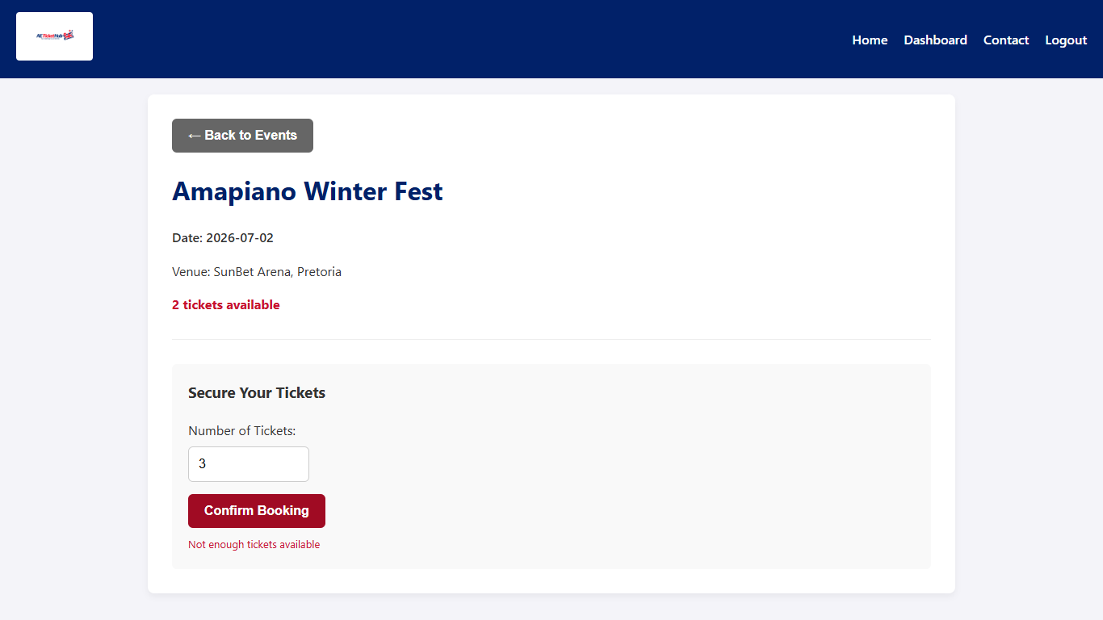
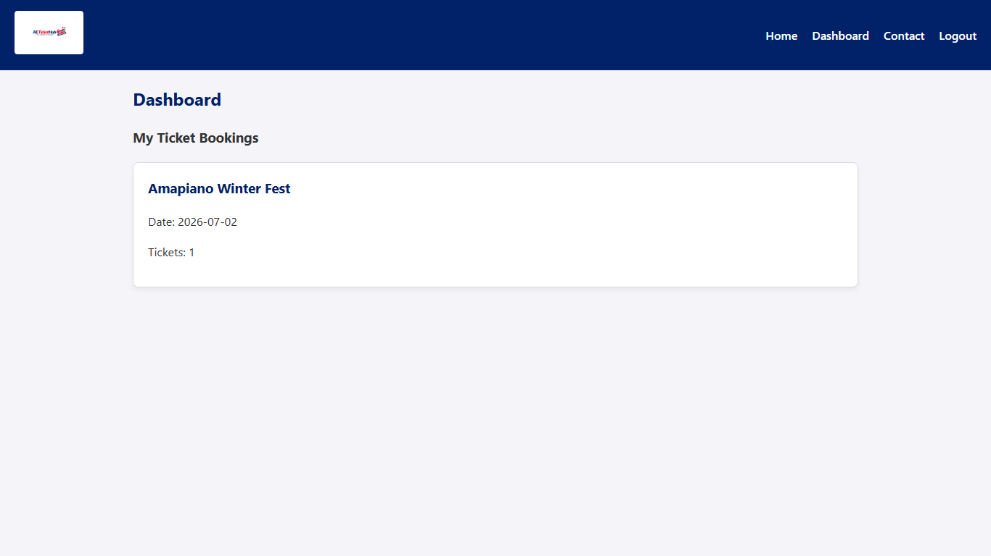
PARTICIPANT
Capacity checks and booking history keep ticket state visible
Aphiwe Shabalala
602517
MongoDB, Mongoose models, database integration
The ticket flow exposes availability at the event level, blocks over-capacity requests, then records the successful booking in the user's history.
AETicketHub demo flow | Aphiwe Shabalala

Slide 5
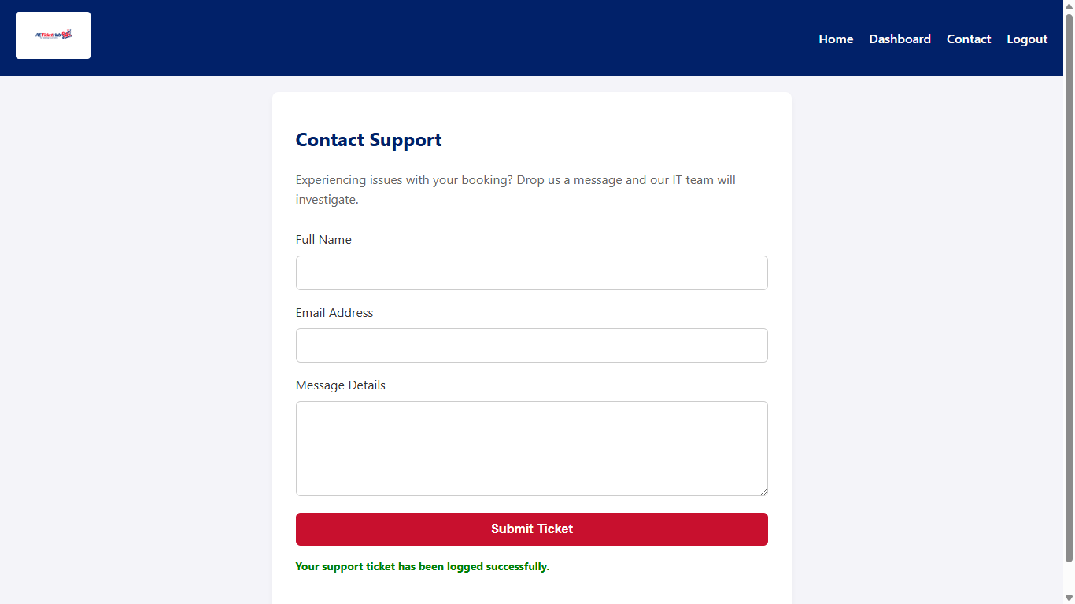
PARTICIPANT
The EJS interface keeps discovery and support simple
Nokwanda Legoabe
578051
Frontend, EJS pages, routing UI
The UI uses direct forms, visible navigation, and consistent page structure so users can discover events, book tickets, and request support quickly.
AETicketHub demo flow | Nokwanda Legoabe

Slide 6
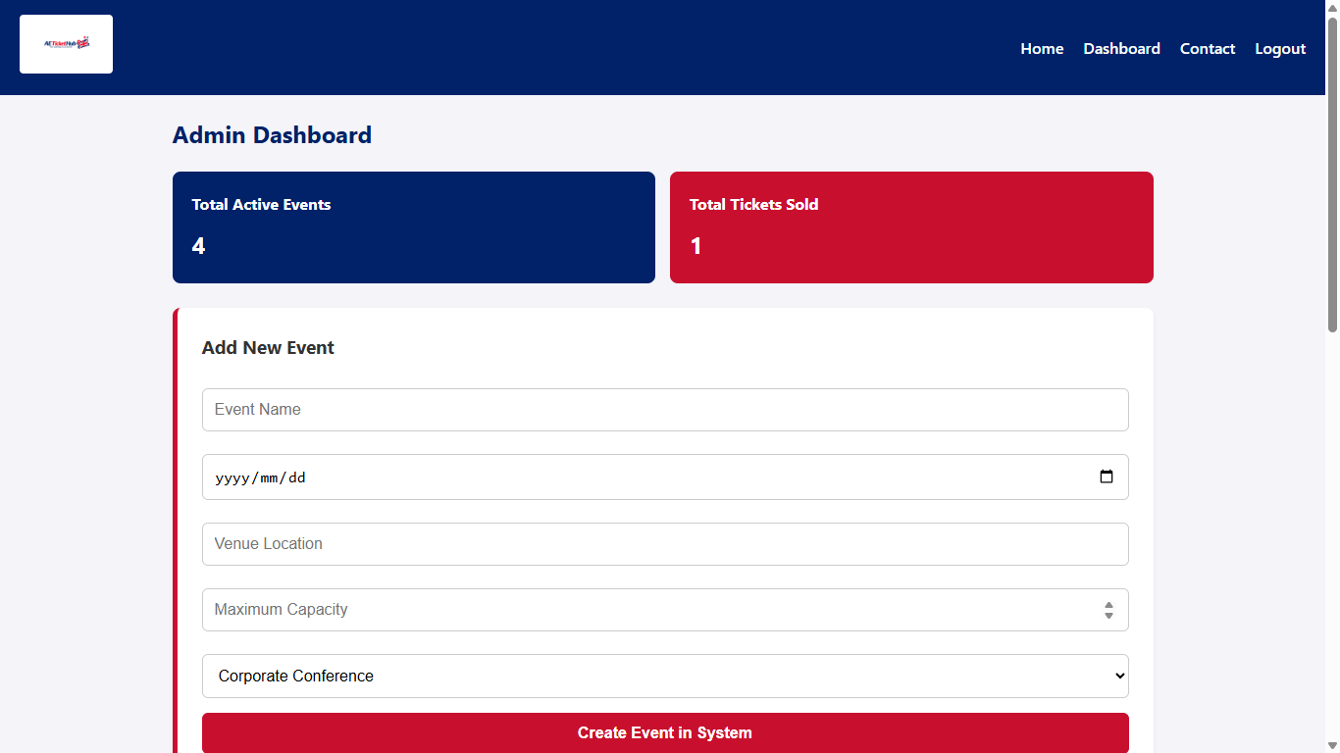
PARTICIPANT
Admin operations combine analytics, event creation, and management
Agobakwe Sedikwe
576505
Express backend, controllers, routes, business logic
The admin dashboard view groups event counts, ticket activity, event creation, and management actions in the same operational workspace.
AETicketHub demo flow | Agobakwe Sedikwe

Slide 7
CONCLUSION
The system demonstrates a complete ticketing loop
Covered: event listings, search, filtering, registration and login.
Covered: protected dashboard, booking, capacity validation, booking history.
Covered: admin analytics, event management view, contact enquiry submission.
Ready for demo: the evidence is captured directly from the running app.
Final handoff
The deck keeps one claim per slide, one system screenshot as proof, and one participant contribution in focus.
AETicketHub demo flow | Conclusion

