Slide 1
EDA Project – Spotify Dataset

Slide 2
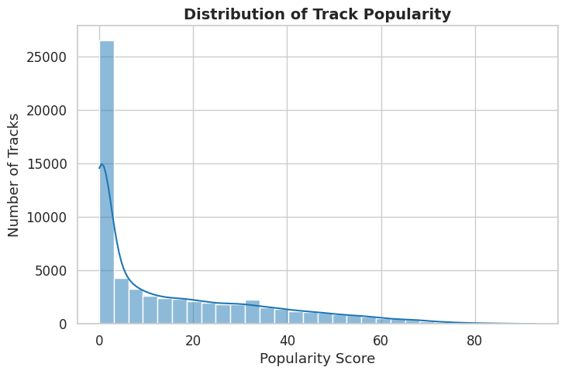
Understanding Track Popularity Score Distribution
The distribution is highly right-skewed, with the vast majority of songs having very low popularity and only a few achieving high scores.
  Playback Concentration: Listening activity is likely dominated by the few "hit" tracks. Core engagement may rely on this small song pool.
  Discovery Engine is Critical: The player's main challenge is surfacing relevant tracks from the massive "long-tail" (left side) to prevent user boredom.
  Engagement Metrics: The "average" popularity score is misleading. Use the median (near 0) to understand the typical track's performance.

Slide 3
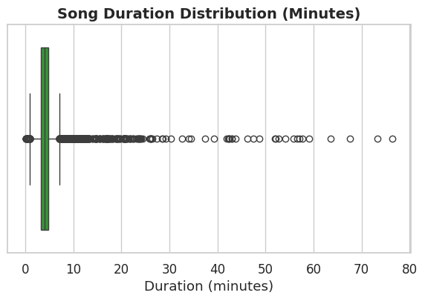
Analyzing Song Duration Distribution
The typical (median) song duration is 4.04 minutes, but the data is highly skewed by many long outliers.
  Core Listening Experience: The main user experience is built around songs in the 3-5 minute range (the green box).
  Handling Outliers: The many "outlier" dots are likely podcasts or DJ mixes. These must be tagged to avoid breaking song-only features.
  Feature Impact (Shuffle/Radio): Playing these long outliers during a "shuffle" or "radio" session would create a poor user experience. They must be filtered.

Slide 4
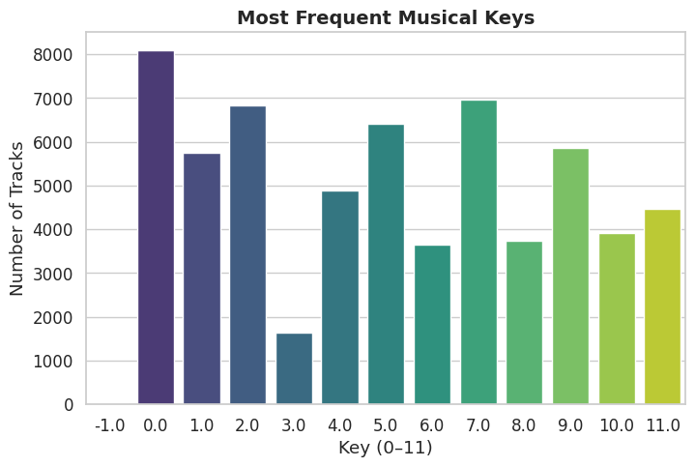
Analyzing Musical Key Frequency Distribution
The distribution of musical keys is uneven, with keys 0, 7, 2, and 5 being significantly more frequent than others.
  Playlist/Radio Flow: Smart playlists can create better harmonic flow by sequencing tracks in common, related keys like 0, 7, and 5.
  Music Discovery: The player can break user listening ruts by actively recommending high-quality tracks from rarer keys (like 3, 6, and 8).
  Feature Development: The data supports a "harmonic mixing" feature, as key is known for most tracks. This appeals to DJs and power-users.

Slide 5
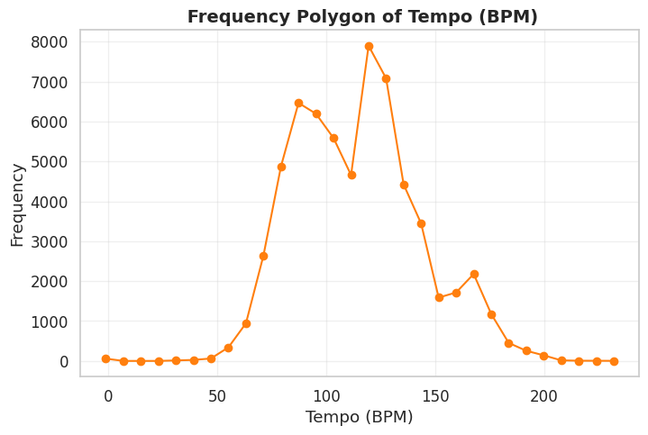
Analyzing Song Tempo (BPM) Clusters
The distribution is bimodal (two-peaked), showing a major cluster of songs around 125 BPM and a smaller, secondary cluster around 170 BPM.
  Two Core Energy Levels: The library has two distinct energy groups, perfect for separate "mid-tempo" and "high-energy" radio stations.
  Contextual Playlist Opportunity: These two peaks are ideal for contextual playlists, such as "Jogging" (125 BPM) and "Running" (170 BPM) modes.
  Shuffle/Radio Experience: The 125 BPM peak is the "default" tempo. A standard shuffle mode will heavily favor this mid-fast energy level.

Slide 6
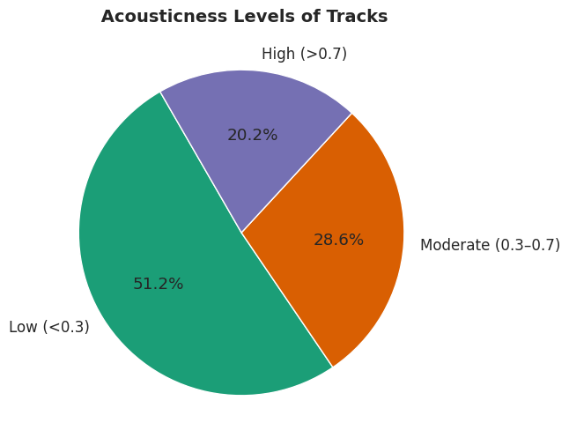
Analyzing Track Acousticness Levels
The dataset leans heavily towards low acousticness (electronic/produced) sounds, which make up just over half (51.2%) of all tracks.
  Core Library Vibe: The player’s core library (51.2%) is electronic and produced, defining the default "vibe" for shuffle play.
  Playlist Segmentation: The "High" (20.2%) and "Low" (51.2%) groups represent different moods. They should not be mixed in auto-generated playlists.
  Recommendation Opportunity: The "Moderate" group (28.6%) is a key bridge, useful for transitioning users between electronic and acoustic genres.

Slide 7
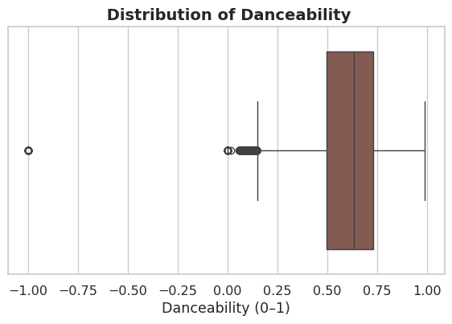
Analyzing Song Danceability Distribution
The distribution is left-skewed, meaning most songs have a moderately high danceability score, with the typical track falling between 0.5 and 0.73.
  High-Energy Default: The high median (~0.63) means the player’s default shuffle "feels" energetic, which is great for active-listening users.
  Playlist Segmentation: The main box (0.5-0.73) is perfect for "Workout" stations. The left tail (low scores) is for "Chill" modes.

Slide 8
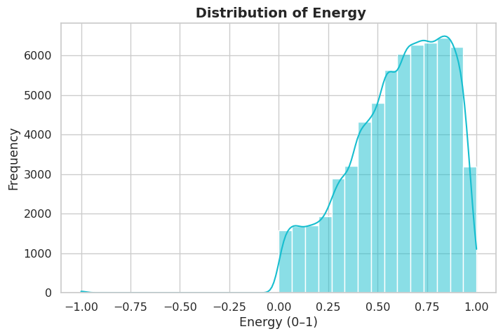
Analyzing Track Energy Distribution
The distribution is left-skewed, with the overwhelming majority of songs having high energy levels, peaking around 0.75-0.85.
  High-Energy Default: The player’s default experience is high-energy. This is perfect for "Workout" or "Party" radio stations.
  Playlist Purity: The small low-energy cluster (near 0.1) must be filtered from high-energy playlists to avoid ruining the vibe.
  Shuffle Experience: With a high median energy (~0.64), a standard "shuffle play" will almost always feel energetic and upbeat.

Slide 9
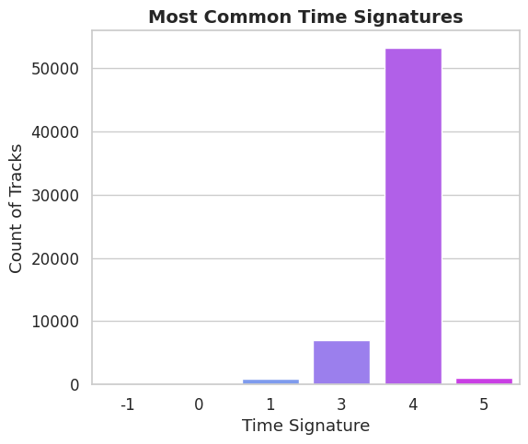
Analyzing Time Signature Distribution
The music is overwhelmingly dominated by a 4/4 time signature (bar "4"), with 3/4 time (bar "3") as a distant second.
  Uniform Rhythmic Feel: The library's "default feel" is 4/4 time (bar "4"). This makes shuffle play rhythmically predictable and familiar.
  Niche Playlist Opportunity: Tracks in 3/4 (waltzes) and 5/4 (prog/jazz) are rhythmic outliers, perfect for creating unique, genre-specific playlists.

Slide 10
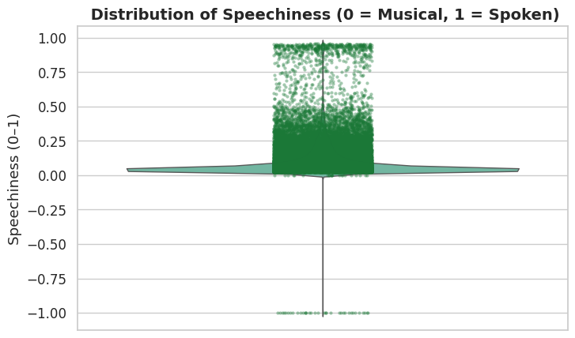
Analyzing Speechiness: Music vs. Spoken
The distribution is extremely right-skewed, showing most tracks are purely musical (speechiness near 0), with a small tail of spoken-word content.
  Content Separation: The library has two distinct products: music (cluster at 0.0) and spoken word (outliers > 0.3).
  Playlist Experience: Spoken-word tracks must be filtered from music-only radio/shuffle modes to avoid a poor user experience.

Slide 11
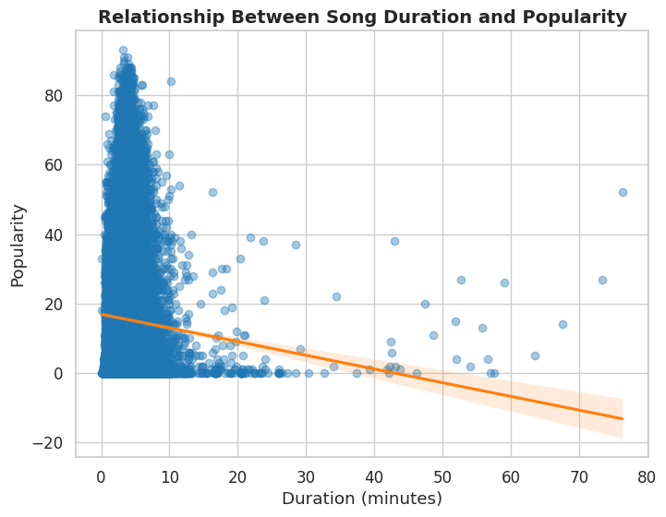
Analyzing Song Duration's Popularity Impact
There's a very weak negative correlation; the most popular songs are overwhelmingly shorter (under 10 minutes), while long songs rarely achieve high popularity.
  The "Hit" Zone: Virtually all high-popularity tracks (popularity > 60) are standard-length songs, clustered in the 2-10 minute range.
  Content Segmentation: Long-duration tracks (20+ min) are a different product (e.g., podcasts, DJ mixes) and must be filtered from music-only radio.
  Recommendation Strategy: Do not use "duration" as a driver for popularity. Instead, focus on audio features within the 2-10 minute "hit zone."

Slide 12
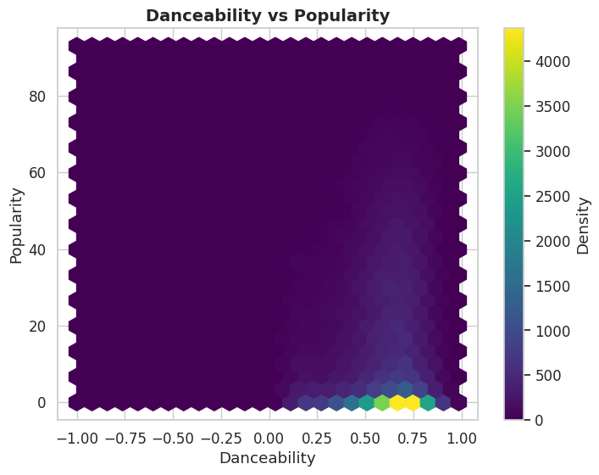
Danceability's Link to Popularity
No, there is no strong correlation; the densest cluster of songs has high danceability (0.5-0.8) but very low popularity (near 0).
  Popularity isn't Danceability: High popularity is not guaranteed by high danceability. "Hit" songs are spread thinly across all dance levels.
  "Long-Tail" of Dance Tracks: The bright yellow spot shows a massive "long-tail" of danceable but unpopular songs, ideal for discovery.
  Playlist Segmentation: High danceability does not equal a "hit." "Popular Hits" and "Dance Club" playlists serve different user needs.

Slide 13
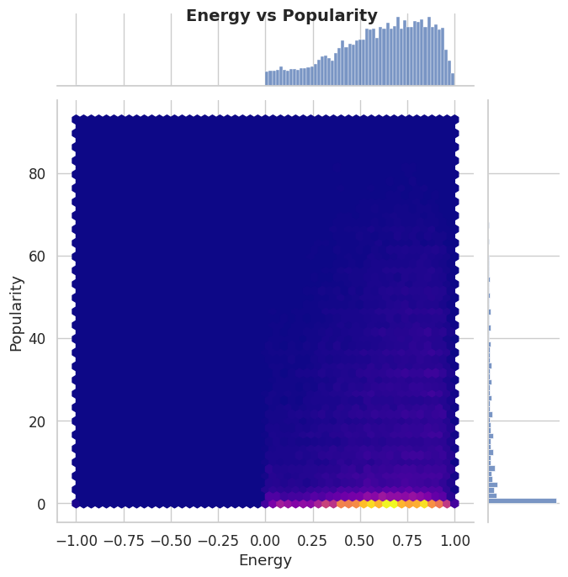
Analyzing Energy's Link to Popularity
No, there is no strong correlation; the densest (brightest) cluster shows that the vast majority of high-energy songs have very low popularity.
  The "Long-Tail" of Energy: The bright yellow cluster is a "long-tail" of high-energy, unpopular tracks. This is the main discovery pool.
  Energy Doesn't Predict Hits: "Hit" songs are rare. High popularity exists at all energy levels, meaning energy is not a good popularity predictor.
  High-Energy Default Library: The top histogram confirms the library is high-energy by default, making it perfect for "Workout" or "Party" radio.

Slide 14
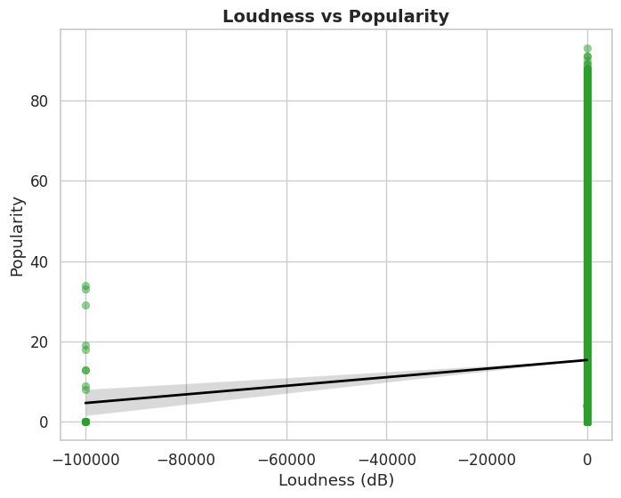
Analyzing Loudness vs. Popularity
It shows that all high-popularity songs exist in the "normal" loudness cluster (near 0 dB).
  Loudness is a Prerequisite: No song with high popularity is silent. All popular tracks exist in the "normal" loudness range near 0 dB.

Slide 15
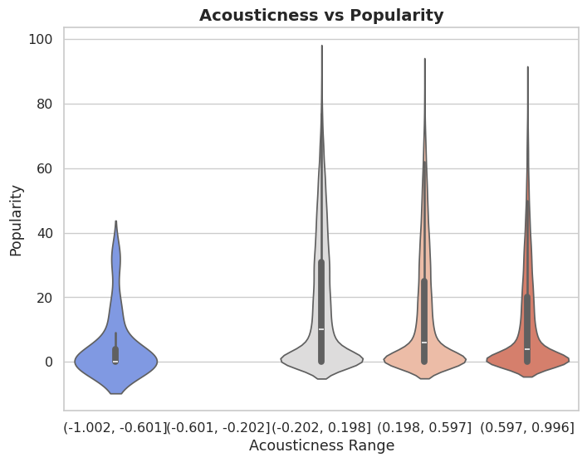
Analyzing Acousticness and Popularity
All valid ranges (from electronic to organic) show an identical "long-tail" distribution where most tracks have zero popularity.
  Hits Exist Everywhere: "Hit" songs (the long spikes) exist at all acousticness levels. This feature is a poor predictor of popularity.
  Playlist Segmentation: The different groups (electronic, mixed, acoustic) represent distinct moods. Create separate radio stations for each to improve user experience.

Slide 16
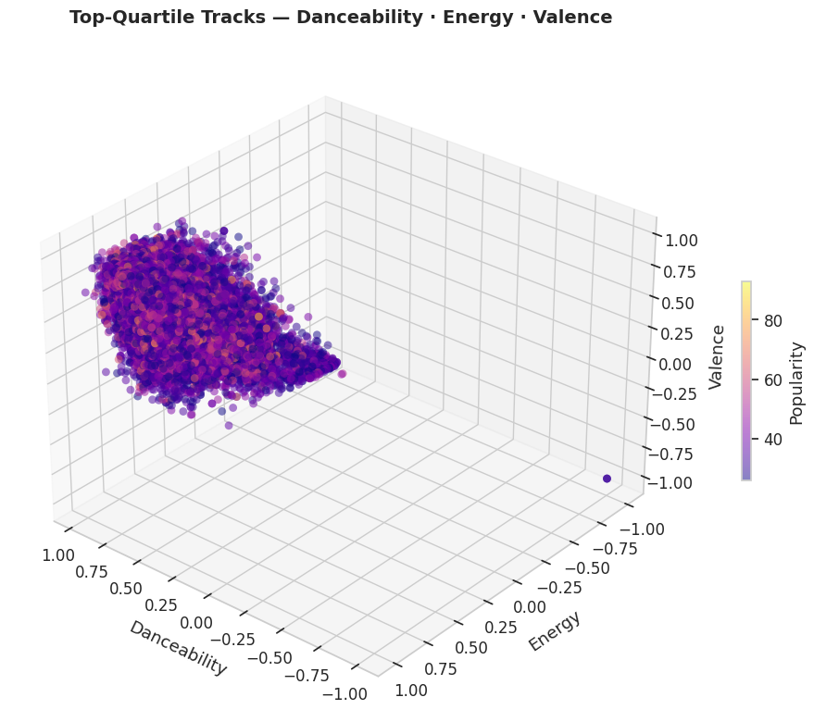
The 'Hit Song' Audio Profile
The most popular tracks cluster in a "sweet spot" of high danceability (~0.61), high energy (~0.66), and moderate-to-high valence (~0.51).
  The "Hit" Formula: The "hit" formula is a cluster of high energy, high danceability, and positive feelings.
  Radio Feature: The "auto-play" and "radio" features should prioritize tracks inside this high-energy/high-danceability "hit cluster."

Slide 17
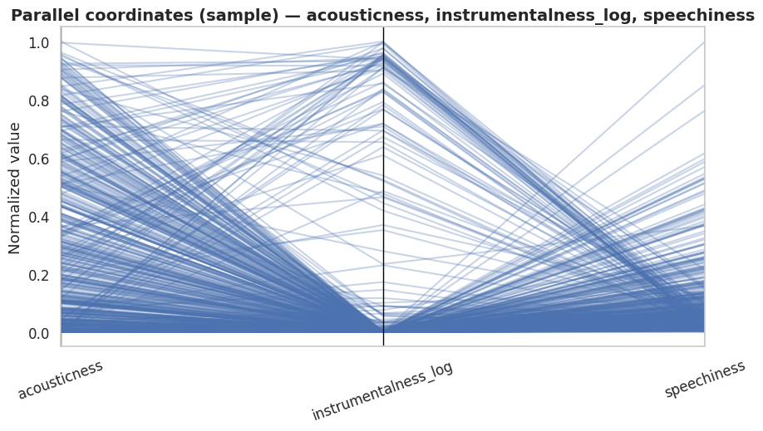
Analyzing Audio Feature Clusters
The graph identifies four distinct audio profiles (clusters), but it does not contain popularity data to show which cluster is most popular.
  Four Key Products: The clusters define four products: Cluster 0 (Acoustic), Cluster 1 (Spoken Word/Rap), Cluster 2 (Instrumental), and Cluster 3 (Produced Pop).
  Playlist Segmentation: These clusters are perfect for creating pure radio stations (e.g., "Acoustic Hits," "Instrumental Focus") to improve user experience.
  Content Separation: Cluster 1 (high speechiness) and Cluster 2 (high instrumentalness) must be filtered from standard "pop" radio.

Slide 18
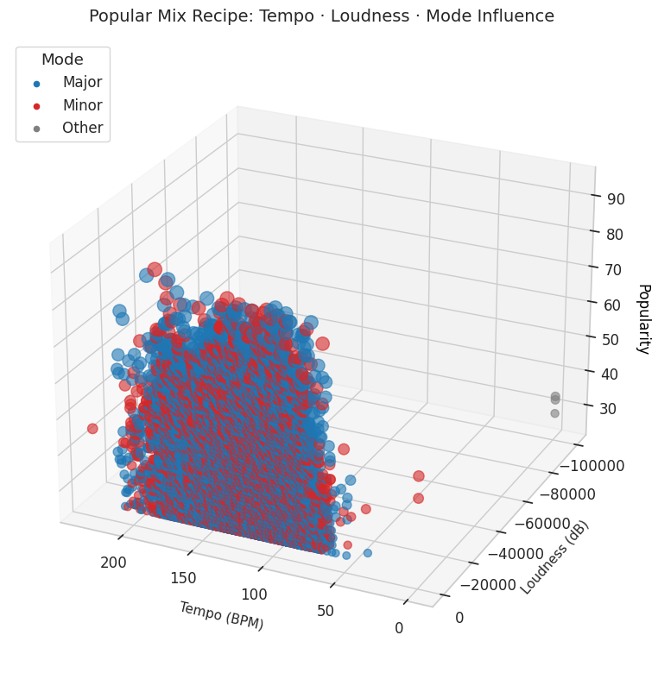
The "Popular Mix Recipe"
The "popular mix recipe" requires normal loudness (near 0 dB), but high-popularity tracks exist across a wide range of tempos and in both Major and Minor modes.
  Loudness Normalization is Key: No popular songs are quiet. This confirms a "loudness normalization" feature is essential for a good user experience.
  Mode is Not a Hit Predictor: High-popularity tracks (Popularity > 60) are a mix of Major (blue) and Minor (red) keys. Mode is a poor predictor.

Slide 19
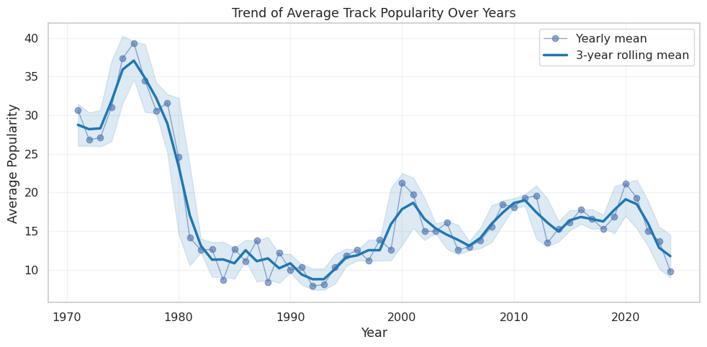
Analyzing Track Popularity Trends
Average popularity fluctuates significantly, peaking in the 1970s before a sharp crash, followed by a low period and a rebound in the 2000s.
  "Classics" Dominate: The 1970s peak shows a powerful "nostalgia" effect. These "classic" tracks are highly popular with the current user base.
  The "Discovery Gap": Tracks from the 1980s and early 1990s are the least popular, suggesting a "discovery gap" for these decades.
  Modern Volatility: Popularity rebounded in the 2000s and has been volatile since, showing no clear upward trend for modern music.

Slide 20
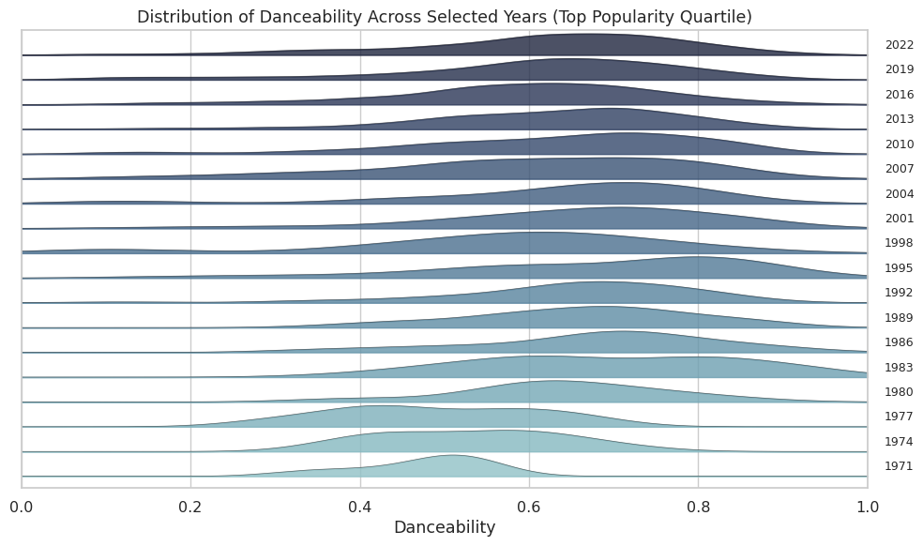
Evolving Danceability of Hit Songs
The optimal danceability for popular songs has significantly increased over time, shifting from a peak near 0.5 in 1971 to a peak above 0.7 in 2022.
  "Classic" vs. "Modern" Vibe: "Classic Hits" (1970s) playlists will feel audibly less danceable than "Today's Top Hits" (2020s) playlists.
  Modern "Hit" Formula: Modern hits (2010-2022) are consistent. The recommendation engine should prioritize the 0.6-0.8 danceability "sweet spot."
  Inconsistent Shuffle: An "all-time" library shuffle will have an inconsistent vibe, justifying a "consistent energy" smart-play feature.

Slide 21
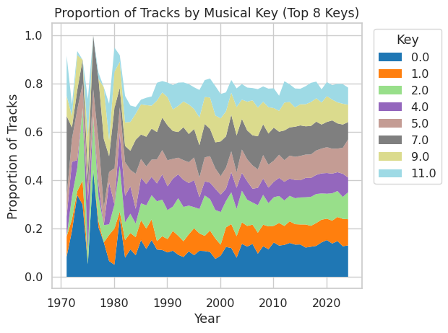
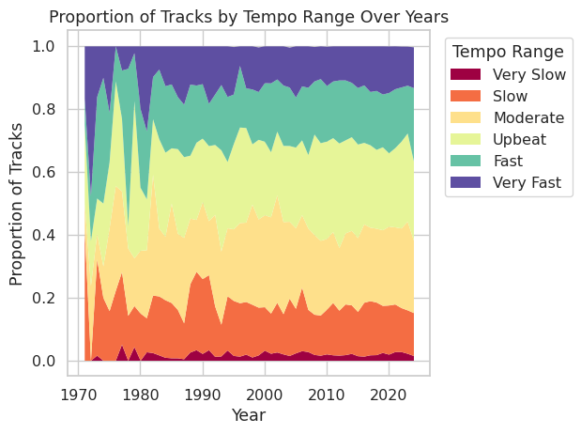
Analyzing Key and Tempo Trends
Tempo and key proportions changed dramatically in the late 1970s but have been relatively stable and consistent since 1980.
  "Upbeat/Fast" is the Default: "Upbeat" and "Fast" tempos have dominated since 1980. This defines the player's core "default" radio sound.
  Harmonic Consistency: The mix of musical keys (dominated by 0, 7, 2, 5, 9) has been very stable, allowing for consistent "harmonic mixing" features.
  "Disco" Anomaly: The huge late-70s spike in "Moderate" tempo is a unique audio profile, perfect for creating "Disco Fever" nostalgia playlists.

Slide 22
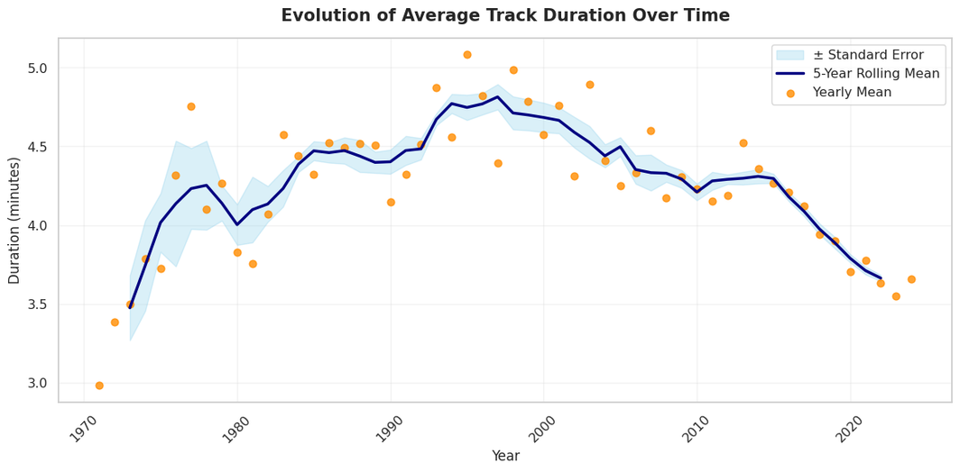
Analyzing Song Duration Trends
Average song duration peaked in the mid-1990s at nearly 5 minutes and has been in a steep, consistent decline ever since, trending towards shorter tracks.
  The "TikTok Effect": The modern trend (since ~2010) is a rapid decline in song length, showing a clear shift towards shorter, punchier tracks.
  Playlist Pacing: A "90s Hits" radio (the peak) will feel significantly slower-paced and longer than a "Today's Hits" radio (the trough).
  Era-Specific Listening: Users listening to 90s music expect longer songs. Users listening to 2020s music expect shorter, more "skippable" tracks.

Slide 23
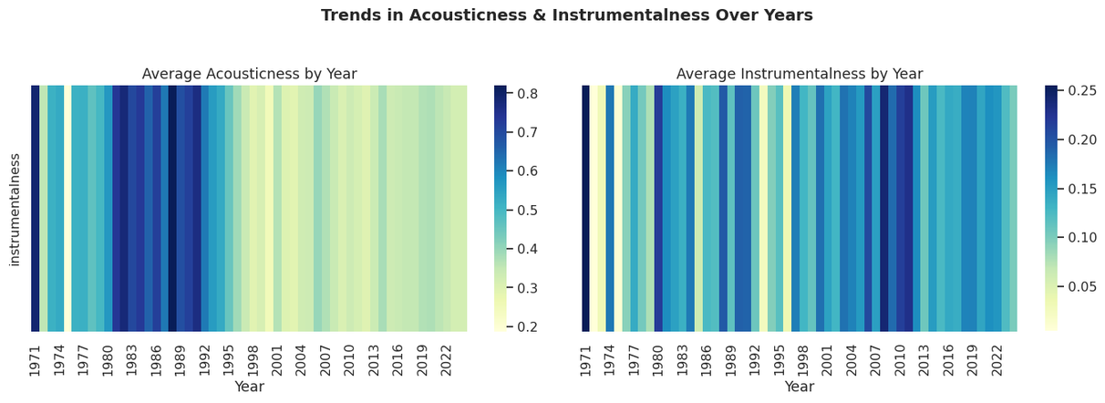
Evolving Production Styles Over Time
Popular music shifted from produced (low acousticness) to acoustic after 1998 and has also become consistently vocal-driven (low instrumentalness).
  The "Acoustic Era": The "Acoustic Era" began around 1998. Music since then is far more "organic" than 80s produced tracks.
  Modern Music is Vocal-Driven: The 1980s were a peak for instrumentals. Modern music (since ~1998) is overwhelmingly vocal-driven.
  Era-Based Playlists: Era-based playlists are distinct: 80s radio is electronic, while 2000s radio is acoustic and vocal-focused.

Slide 24
Thank You

