Slide 1

The GUI
PSP103 XIAOTIAN XU

Slide 2
What is gui?
GUI=graphical user interface

Slide 3
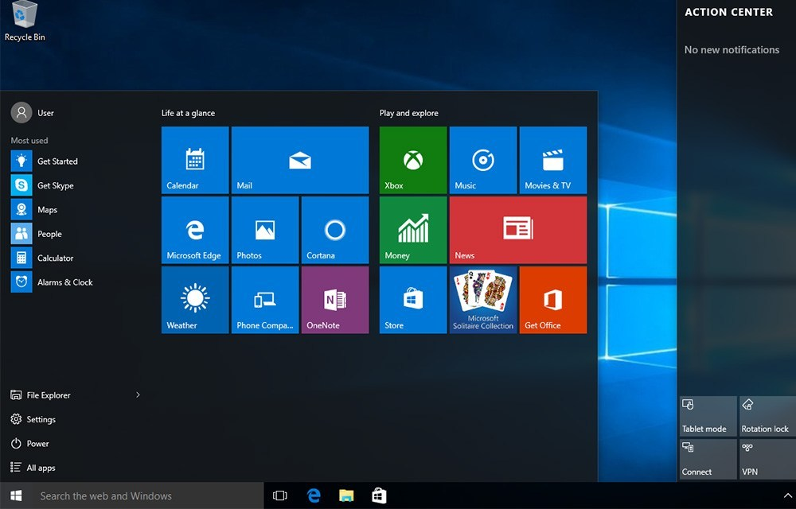
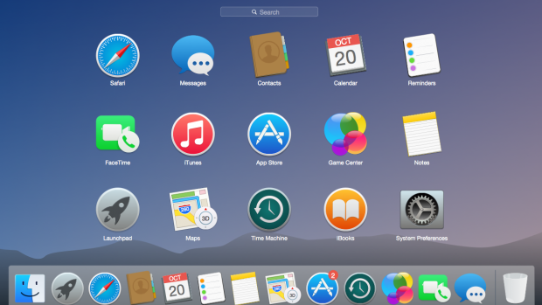
a form of user interface
graphical icons

Slide 4

The GUI is the most important aspect of any piece of software

Slide 5



relationship
software
GUI
people
Communication ability

Slide 6
outline
Argument
Rebuttal
Counter-argument
Summary

Slide 7
teaching studying become easier
argument

Slide 8

EVIDENCE
Depcik & Assanis, 2005
Teachers and students use GUI more and more because it can provide a friendly and visual way to selecting all input parameters and growing flexible configuration.

Slide 9
Counter argument
Wei & Tingdi,2011
compiler diversity is an important part of software

Slide 10
Counter argument
REBUTTAL
the code of GUI is larger than other part of the application

Slide 11


SUMMARY
Argument
Counter-Agreement
GUI makes education easier
Compiler is not important

Slide 12
Conclusion
The GUI is the
most important

Slide 13
Reference List
Depcik, C. & Assanis, D.N. (2005) Graphical user interfaces in an engineering educational environment. Computer Applications in Engineering Education. 13 (1), 48–59.
Wei, X. & Tingdi (2011) A Study on Compiler Selection in Safety-critical Redundant System based on Airworthiness Requirement. Procedia Engineering. 17 (C), 497–504.

Slide 14


thanks
XIAOTIAN XU

