Slide 1
Trigger
Field
Mesh
Performance
Stateful
optional
Custom

Slide 2
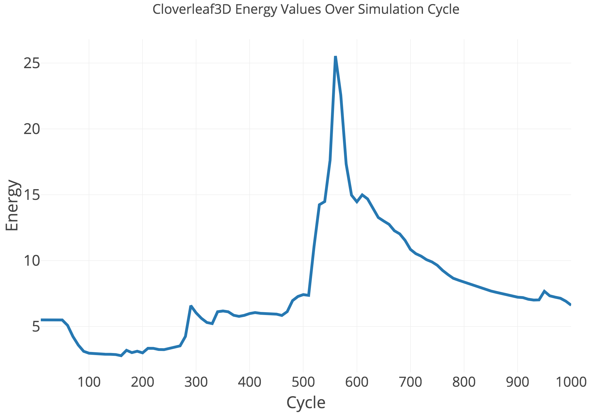
max value
threshold value

