Slide 1
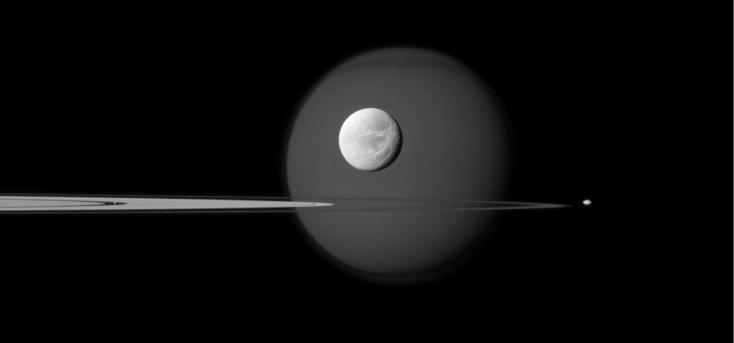
Do Planets Cause Earthquakes?
John Williams
March 4, 2020

Slide 2
Gravitational Force
Mars
Earth
r

Slide 3

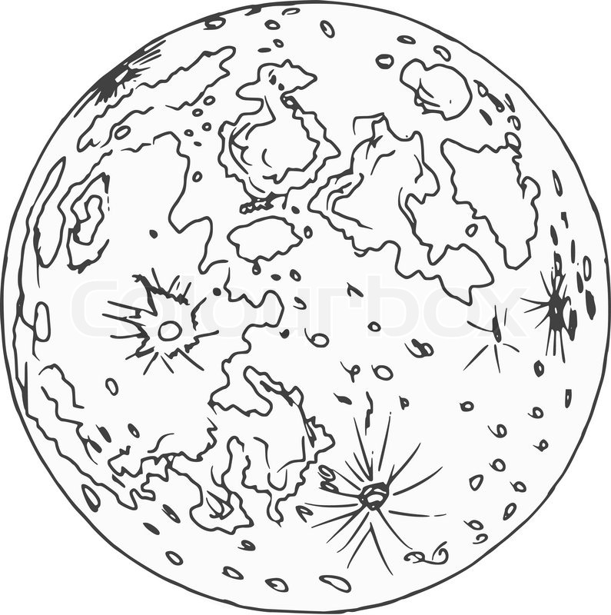
Tidal Forces
Earth – No Moon
Earth – Moon System

Slide 4
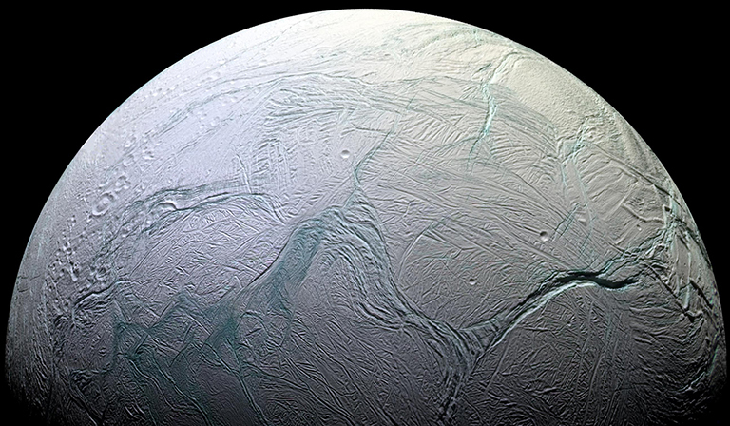
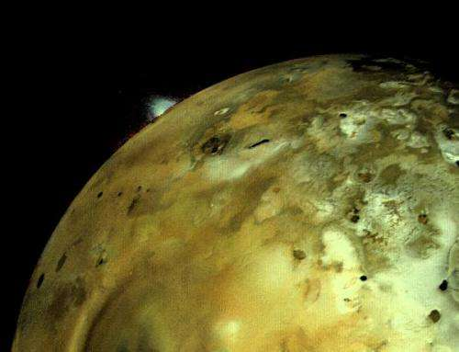
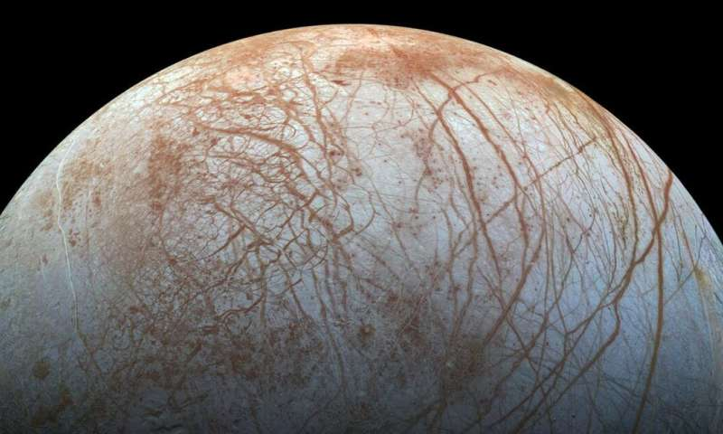
Gravitational Effects
Enceladus
Io
Europa

Slide 5
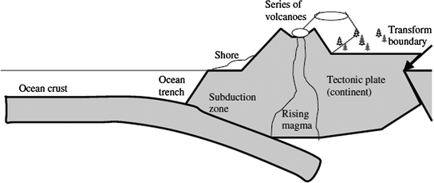
Forces and Subduction Zones

Slide 6
Data
Kaggle: Earthquakes (1986 - 2016)
Magnitude, Latitude, Longitude
Navigation and Ancillary Information
Facility(NAIF) : Ephemerides
Considerations :
Fracking
Uncertainties
Trust

Slide 7
Plot of Normalized Force Versus Time
Plot of Normalized Force Versus Time
Sun
10
11
Mercury
Venus
Moon
10
9
Mars
Jupiter
7
Saturn
10
Uranus
Neptune
Normalized Force
5
Pluto
10
10
3
10
1
1985
1990
1995
2000
2005
2010
2015
Time (years)

Slide 8
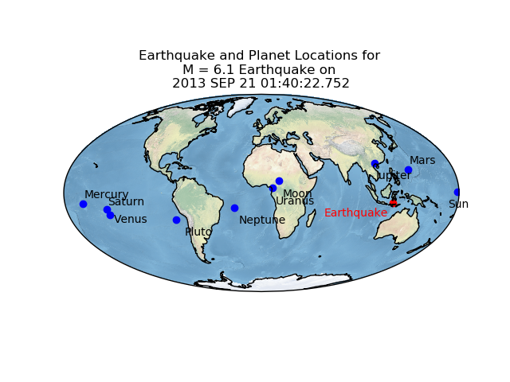

Slide 9
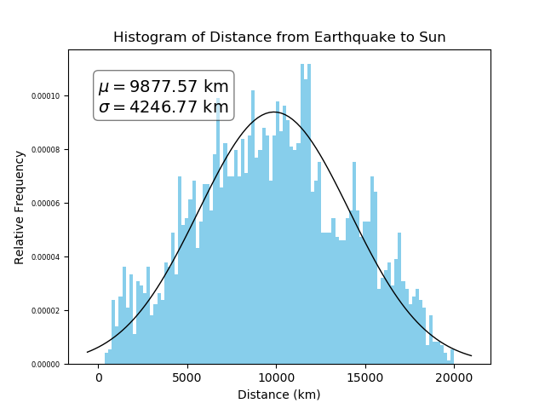

Slide 10
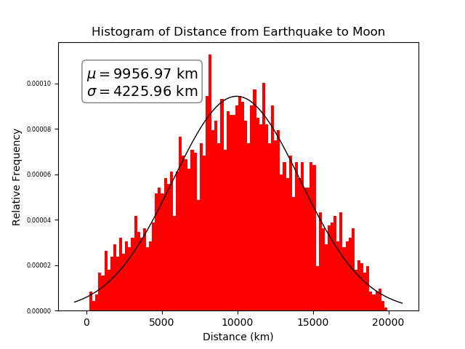

Slide 11
Statistics of Inference
Let
be the mean distance between earthquake
and planetary vector location
If earthquakes are caused by planetary gravitational forces
then the distance between earthquake and planetary vector location
should be small or zero.
If earthquakes are not related to planetary gravitational forces
then the distance between earthquake and planetary vector
location is greater than zero.

Slide 12
Statistics of Inference

Slide 13
Conclusion:
Earthquakes are unlikely to be
caused by Gravitational Changes
Due to Planetary motion

