Slide 1

SMART INDIA HACKATHON 2026
Problem Statement ID – SIH26190
Problem Statement Title- Secure Digital Document Management System for Legal and Investigation Documents
Theme- Blockchain & Cybersecurity
PS Category- Software
Team Name :- StithPragya

Slide 2
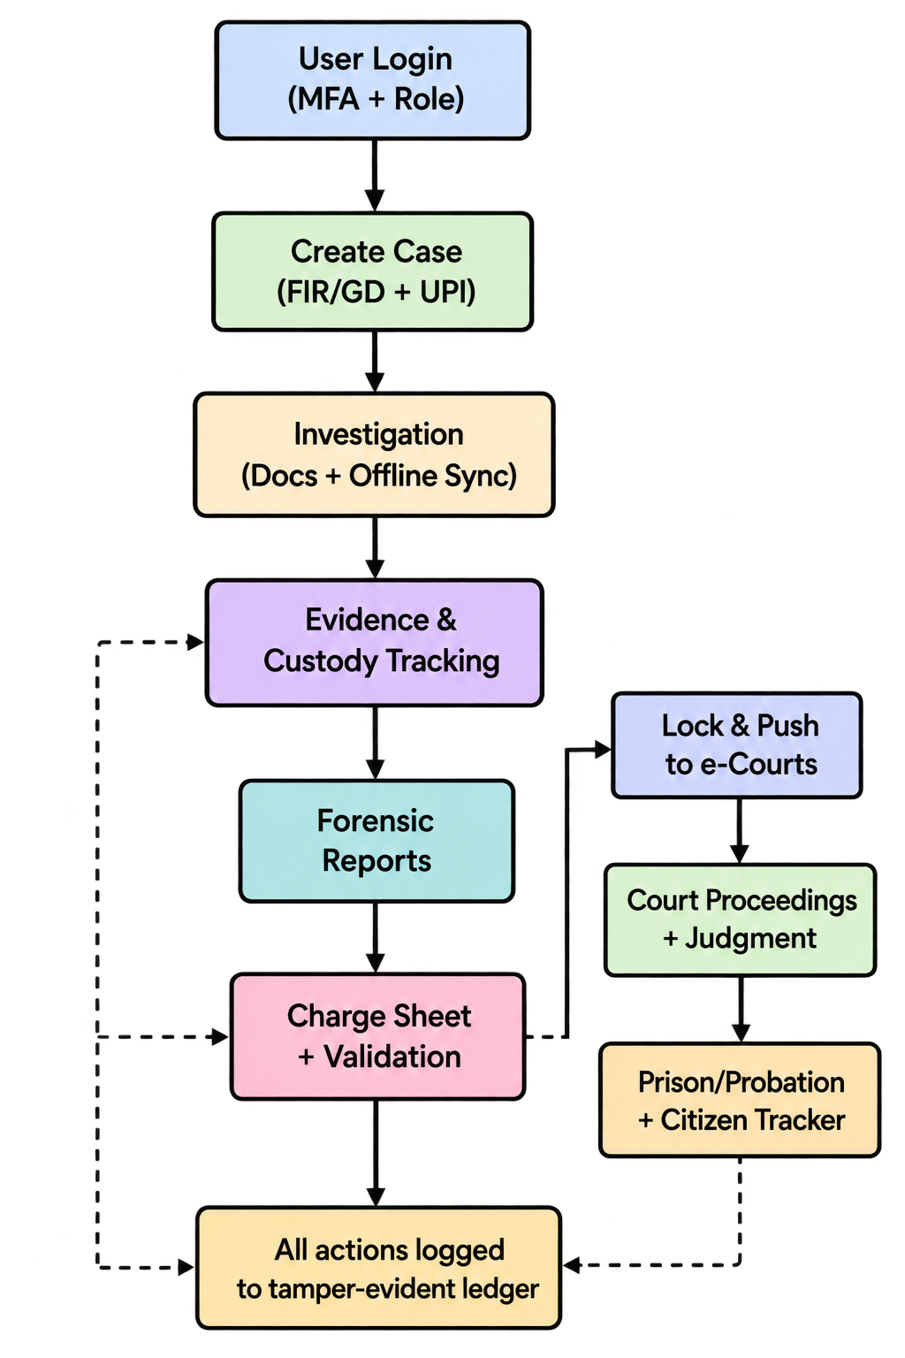
Secure Legal Vault
StithPragya
Proposed Solution
  A secure, AI-powered middleware that connects police fieldwork to India’s justice system—using blockchain for tamper-proof records, smart document processing, and offline mobile sync to keep every case file accurate, fast, and court-ready.
  Zero-Trust Hashing: Cryptographically locks every document (FIR, case diary, charge sheet) the moment it’s created—no backdating or tampering.
  AI Document Intelligence: Auto-reads handwritten and printed text, extracts key case details, and flags contradictions across witness statements.
  Strict Access Control: Only authorized IOs and judges can access classified files, enforced by biometrics and role-based permissions.
  Auto Sync with e-Courts: Securely pushes finalized charge sheets directly to the e-Courts system as soon as they’re approved.
Unique Special Points
  Offline-First Field Sync: Officers can record testimonies and sign search memos anywhere—even without internet—and sync automatically when back online.
  Smart Evidence Lockers: Physical evidence (weapons, narcotics) is linked to digital records via QR codes and smart locks that only open with verified, tamper-proof authorization.
  Private Case Tracker: Victims can check case progress through a secure tracker that shows milestones without revealing any sensitive investigation details.
  Instant Digital Verification: Citizens receive official background certificates directly in their DigiLocker—no paper forms, no delays.

Slide 3
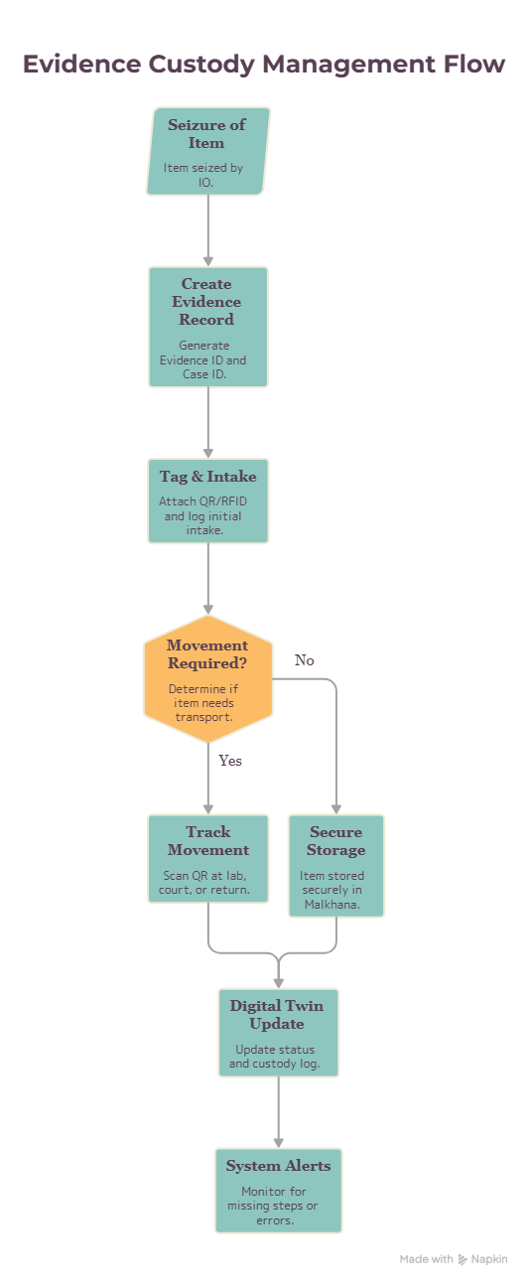
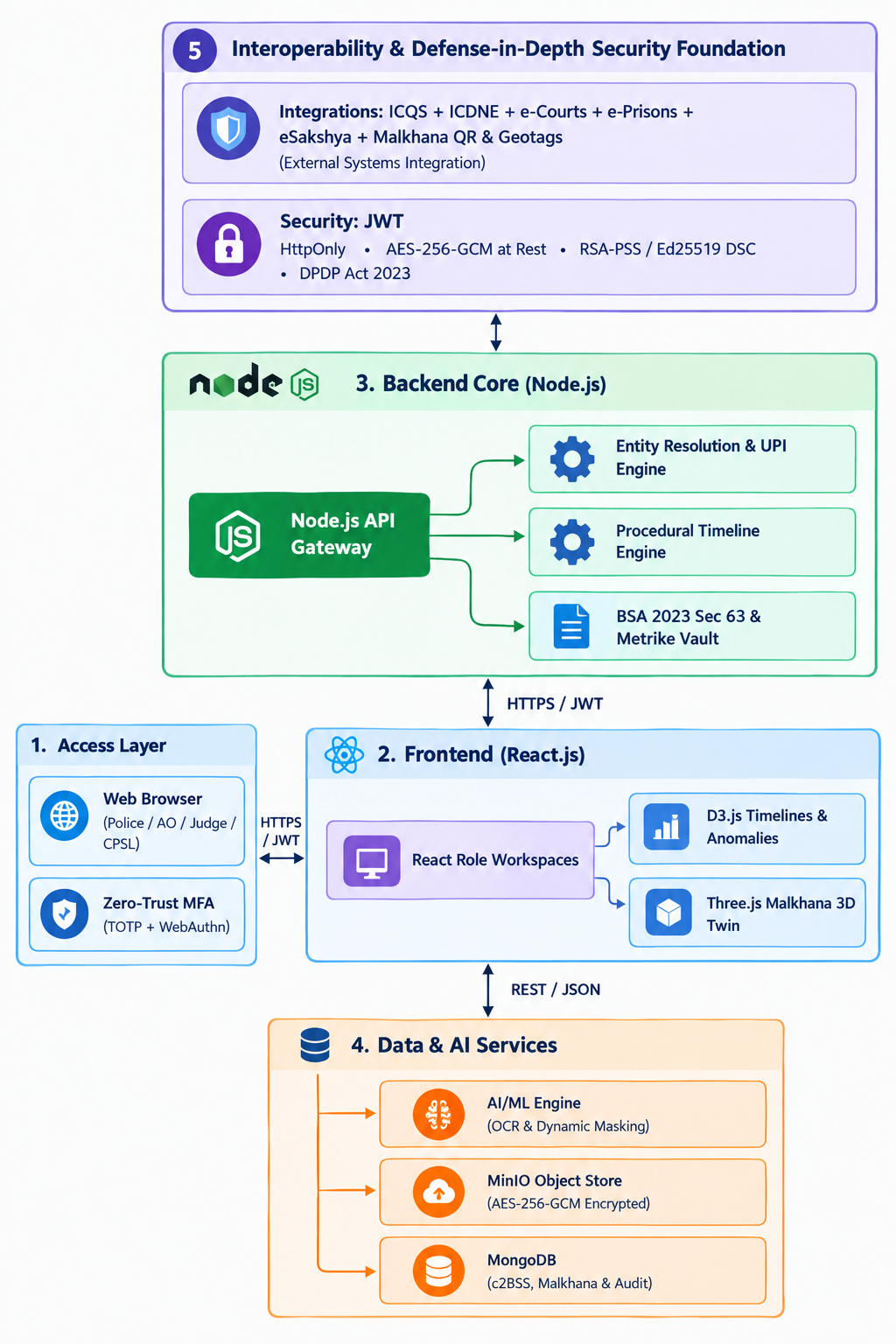
TECHNICAL APPROACH
StithPragya
Frontend
  Web: React.js + Material UI
  Mobile: React Native / Flutter
Backend
  API: Node.js (Express/NestJS) or Python (FastAPI)
Databases
  Primary: PostgreSQL
  Graph (optional): Neo4j
  Offline (mobile): SQLite (encrypted)
Security
  Auth: JWT + OTP (MFA)
  Encryption: AES-256 (data at rest), TLS 1.3 (in transit)
  Hashing: SHA-256
  Signatures: Ed25519 / RSA
AI / OCR
  OCR: Tesseract / EasyOCR
  NLP: IndicBERT / AI4Bharat models (for Indian languages)
Integration
  APIs: REST / GraphQL
  Gateway: Kong / AWS API Gateway
  Queue: Kafka / RabbitMQ (for OCR, notifications)
DevOps
  Containers: Docker
  Orchestration: Kubernetes (optional for pilot)
  CI/CD: GitHub Actions
  Cloud: AWS / Azure / GCP or Govt Cloud

Slide 4
FEASIBILITY AND VIABILITY
StithPragya
Feasibility Metrics (Architectural & Operational View)
Technical Feasibility
  Uses lightweight permissioned blockchain (no heavy gas fees).
  Real-time document hashing works on existing police cloud servers.
  Offline mode (SQLite/PouchDB) runs on low-end smartphones and tablets.
Operational Feasibility
  Auto-sends locked charge sheets to e-Courts and e-Prisons via webhooks—no manual work.
  Background OCR and AI read scanned documents automatically; officers don’t need to change their workflow.
Economic Feasibility
  Works as a software layer on top of existing databases—no need for new servers.
  Uses current police smartphones/tablets; no extra hardware cost.
Strategic Feasibility
  Aligns with India’s national criminal justice digitization timelines.
  Offline sync works even in remote areas with poor or no network.
User Feasibility
  Simple, field-tested interface with one-tap actions.
  Minimal training needed; reduces human error during high-pressure situations.
Viability Framework (Execution & Strategic Outlook)
Training Viability
  Complex crypto operations are hidden from users.
  Officers learn basic workflows quickly; no deep technical knowledge required.
Field Viability
  Works offline using local queues; syncs when network is back.
  Fully functional during raids or in areas with no connectivity.
Economic & Administrative Viability
  Automates citizen background checks and document requests.
  Saves thousands of manual officer hours every year.
Legal & Statutory Viability
  Fully compliant with BNSS (Bharatiya Nagarik Suraksha Sanhita) procedures.
  Keeps original legal document formats intact for easy court admissibility.
Technological & User Viability
  Microservice design allows easy updates and scaling.
  Public ZKP-based tracker shows case progress without exposing sensitive investigation details.

Slide 5
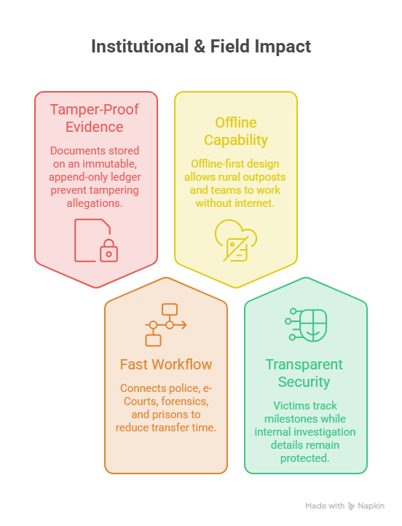
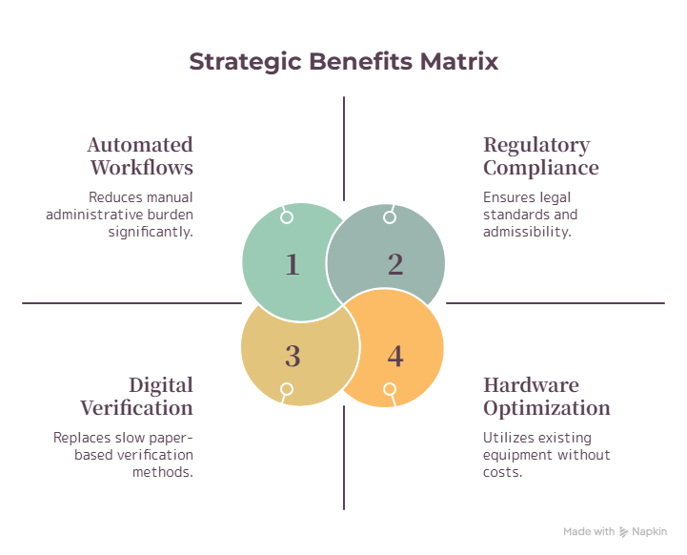
IMPACT AND BENEFITS
StithPragya

Slide 6
RESEARCH AND REFERENCES
StithPragya
MHA ICJS Portal
Explains how police, courts, forensics, prisons, and prosecution share digital case records across India.
🔗 https://www.mha.gov.in/en/commoncontent/icjsncrb-administration
e-Sakshya Evidence Guidelines
Official rules for capturing audio-video evidence at crime scenes using the mobile app.
🔗 https://www.pib.gov.in/PressReleasePage.aspx?PRID=2226442
Vishvasya National Blockchain
Shows the government’s blockchain security framework for cross-department document validation.
🔗 https://www.pib.gov.in/PressReleasePage.aspx?PRID=2182023
Judiciary Chain Manual
Describes how courts cryptographically lock digital evidence using blockchain hashes.
🔗 https://blockchain.gov.in/Home/Product?product=JudiciaryChain
CAG Report on Digital Policing
Highlights gaps in CCTNS—data sync issues, timeline errors, and missing case records.
🔗 https://www.telegraphindia.com/india/cag-finds-major-loopholes-in-cctns-implementation-missing-child-complaints-unregistered-prnt/cid/2125056
National Digital Justice Rollout
Outlines India’s plan for fully digital case management across the criminal justice system.
🔗 https://www.thehindu.com/news/national/criminal-justice-systems-digital-push-aims-for-a-full-roll-out-by-next-year/article71166359.ece

