Slide 1

Project Presentation
on
Ayushveda
Presented By:
Alpita Singh (Reg No. 2024PUFCEBCAX17573)
Ankit Sharma (Reg No. 2024PUFCEBCAX18113)
Akshay Pathak (Reg No. 2024PUFCEBCAX16940)
Aditya Choudhary (Reg No. 2024PUFCEBCAX16847)
Aditya Kamra (Reg No. 2024PUFCEBCAX17122)
Department of First Year
Poornima University, Jaipur
Under the Supervision of
TANUSHREE MAM
Assistant Professor,
Faculty of Computer Science and Engineering,
Poornima University, Jaipur
Submitted To:
Department of First Year
Poornima University, Jaipur

Slide 2
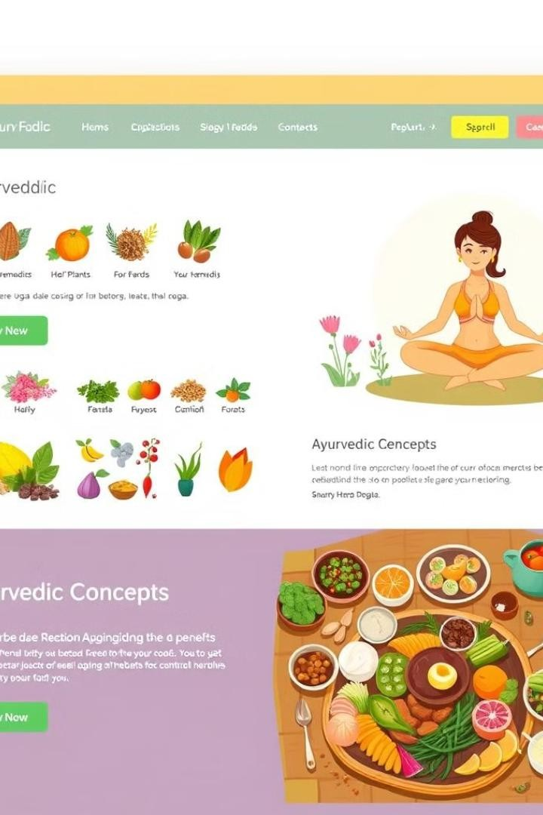
Introducing: Ayurvedic Information Website
Our website serves as a comprehensive platform for exploring the principles of Ayurveda. Users can access informative articles, video resources, and interactive tools to deepen their understanding of this ancient system of
healing.
Holistic Health
Empowering individuals to take control of their well-being by providing comprehensive knowledge and resources.
Personalized Solutions
Offering tailored guidance based on individual needs and health concerns, promoting a personalized approach to wellness
.
Community Engagement
Creating a vibrant community where individuals can connect, share experiences, and support each other on their health journeys.

Slide 3
Addressing User Needs: Personalized Solutions & Expert Advice
We understand that each individual's health journey is unique. Our website offers personalized solutions tailored to specific health concerns. Users can access customized recommendations based on their individual needs, including diet, lifestyle modifications, and Ayurvedic remedies.
Personalized Health Assessment BAMS Doctors Consultancy
A comprehensive questionnaire that gathers information about user's health, lifestyle, and preferences.
Consultations with qualified BAMS doctors who can provide expert guidance and address specific health concerns.
Users can book appointments for virtual consultations
or ask questions via online chat.
Based on the assessment, users will receive tailored recommendations.

Slide 4
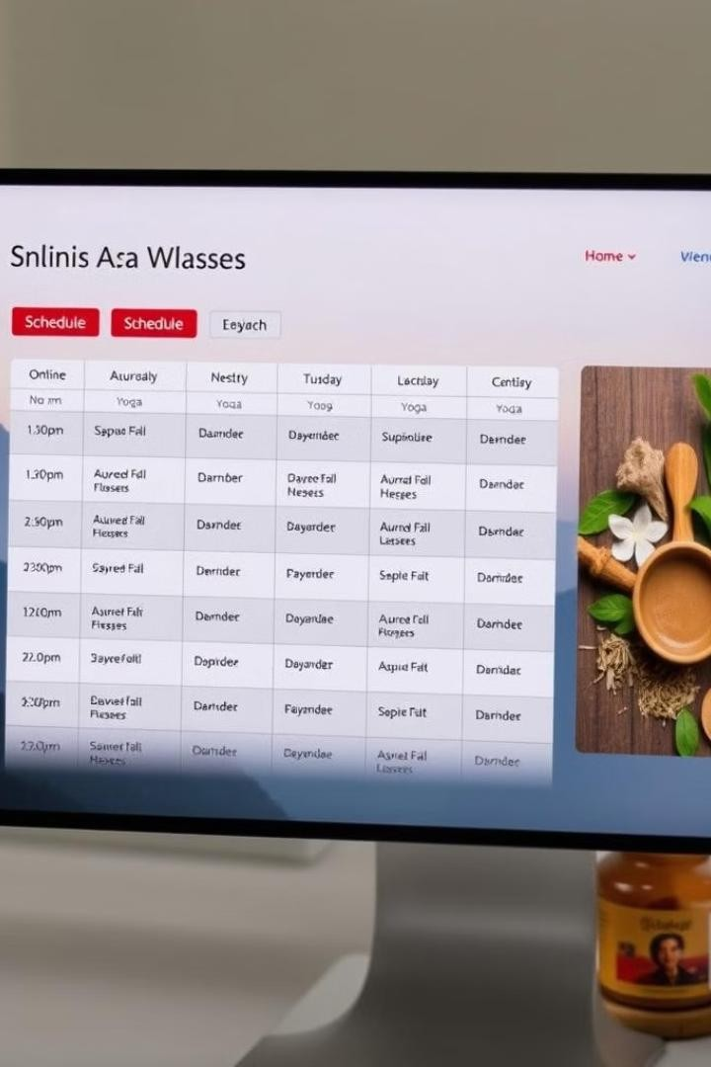

Holistic Wellness: Yoga Sessions & Medicine Delivery
We believe that a holistic approach to health includes both physical and mental well-being. Our website offers access to guided yoga sessions and facilitates the delivery of Ayurvedic medicines.
Yoga Sessions
Live and on-demand yoga classes led by experienced instructors, covering a range of styles and levels.
Medicine Deliveries
A secure and convenient platform for ordering authentic Ayurvedic medicines directly from trusted manufacturers.

Slide 5

Technical Details: Website Architecture and Development
The technical architecture of our website is designed to ensure a seamless and secure user experience. We leverage cutting-edge technologies to deliver a robust and scalable platform.
1
Frontend Development
HTML, CSS, and JavaScript will be used for creating the user interface, ensuring a visually appealing and interactive experience.
Database Management
MySQL or PostgreSQL will be used to store user data, health information, and website content.
2
Backend Development
Python, PHP, or Node.js will be employed to manage data storage, user authentication, and backend logic.
3
4
Security Measures
SSL certificates and other security protocols will be implemented to protect user data and maintain a safe environment.

Slide 6


Languages: Empowering Our Development
Choosing the right programming languages is crucial for building a robust and scalable platform. We recommend a combination of languages that offer flexibility, efficiency, and security.
Language Purpose
Python
Backend development, data analysis, and machine learning.
HTML & CSS
Creating the structure and style of the user interface.
JavaScript
Adding interactivity and dynamic features to the website.
SQL
Managing data storage and retrieval within the database.

Slide 7
Working of the Project: A Step-by-Step Guide
Our website operates on a user-centric approach, providing a seamless experience from registration to accessing personalized solutions.
Registration
Users create an account, providing basic information and health
details.
1
2
Health Assessment
Users complete a personalized questionnaire to identify health concerns and preferences.
Personalized Recommendations
The website generates tailored recommendations based on the assessment, including dietary advice, lifestyle modifications, and
Ayurvedic remedies.
3
4
Consultations
Users can schedule virtual consultations with BAMS doctors to address specific health concerns.
Medicine Orders
Users can order authentic Ayurvedic medicines directly from
trusted manufacturers.
5
6
Yoga Sessions
Access live and on-demand yoga classes guided by experienced instructors.

Slide 8






A Glimpse of Holistic Wellness
The front page of our website will be a welcoming and informative introduction to the world of Ayurveda. It will showcase the core values of our platform and highlight the benefits of holistic wellness.
Ayurveda's Wisdom
Explore the ancient knowledge of Ayurveda and its principles for a balanced and healthy life.
Yoga and Meditation
Engage in calming yoga sessions and mindfulness practices to achieve inner peace and well-being.
Natural Remedies
Discover a range of Ayurvedic herbs and remedies to support your health and vitality.
Personalized Guidance
Receive tailored recommendations and expert consultations to address your specific health needs.

Slide 9
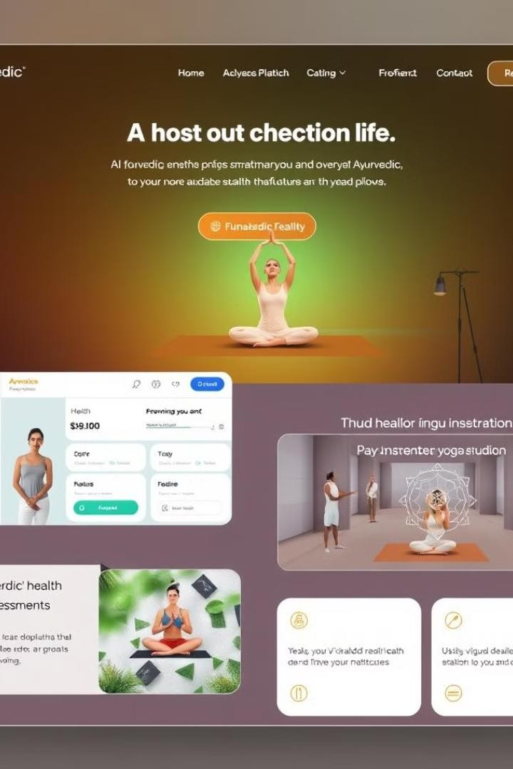
Conclusion & Future Work: Shaping the Future of Ayurvedic Wellness
We are committed to continuously evolving our website to provide an enriching and empowering experience for users. Our future plans include integrating advanced features and expanding our content offerings.
1
AI-Powered Health Assessments
Developing an AI-powered system for more accurate and personalized health assessments.
2
Virtual Reality Yoga Sessions
Introducing immersive virtual reality yoga experiences to enhance user engagement.
3
Expanded Content Library
Continuously adding new articles, videos, and interactive resources on various Ayurvedic topics.
4
Community Forum
Creating a forum where users can connect, share experiences, and support each other on their health journeys.

Slide 10
References: Knowledge and Inspiration
Our website draws inspiration from numerous sources, including reputable books, research papers, and traditional Ayurvedic texts. We strive to provide accurate and reliable information based on the principles of Ayurveda.
THANK YOU

