Slide 1
S-AES (Simplified Advanced Encryption Standard)
Encryption is a coding technique for the protection of information. There are many different methods for this, one of which is AES (Advanced Encryption Standard).
S-AES( Simplified Advanced Encryption Standard) is a simplified version of AES.It is simple, applicable and fast. Since it encrypts only with a 16-bit key, it is more suitable to be used especially in embedded systems as it does not take up much space in memory.

Slide 2
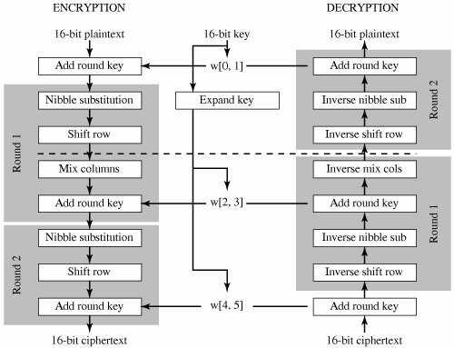
S-AES (Simplified Advanced Encryption Standard)
Round0
S-AES is to AES as S-DES is to DES. In fact, the structure of S-AES is exactly the same as AES. The differences are in the key size (16 bits), the block size (16 bits) and the number of rounds (2 rounds).
Round0

Slide 3
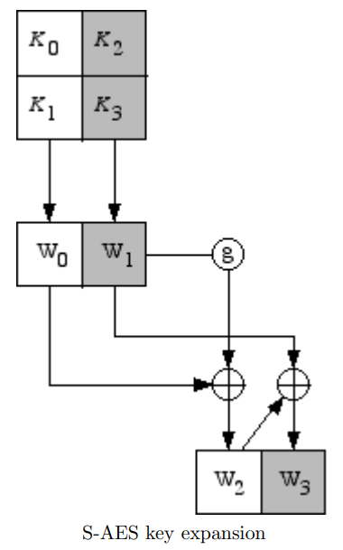
S-AES (Simplified Advanced Encryption Standard)
KeyExpand
Key0 = w0w1 (User sets key0)
𝑤0 = First 8 Bit of Key0
𝑤1 = Last 8 Bit of Key0
𝑤2 = 𝑤0 ⊕ RCON(1) ⊕ SubNibble(RotNibble(𝑤1))
𝑤3 = 𝑤1 ⊕ 𝑤2
Key1 = w2w3
𝑤4 = 𝑤2 ⊕ RCON(2) ⊕ SubNibble(RotNibble(𝑤3))
𝑤5 = 𝑤3 ⊕ 𝑤4
Key2 = w4w5
RCON(1) = 0x80 and RCON(2) = 0x30 are constant
As we saw above, if the first key (Key0) is not correct, the other keys cannot be accessed.
Column Priority!

Slide 4
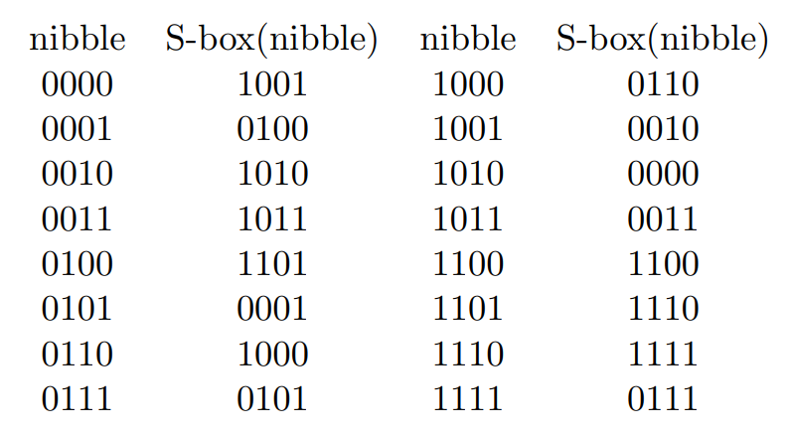
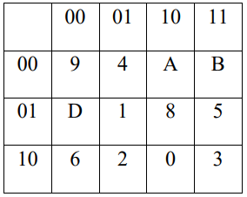
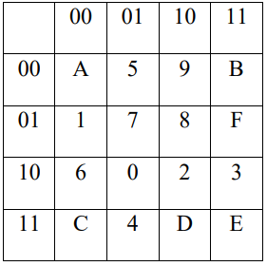

SUBSTİTUTE NİBBLES
S-AES (Simplified Advanced Encryption Standard)
0100 ➔ 1101(D in hexa-base) (S-Box)
Basicly an S-box is used to translate each nibble into a new nibble.
The operation is entered as nibbles (4bit), the first 2 bits specify the row in the S-box, the last 2 bits indicate the column.
S-box is used to encrypt, inverse S-box is used to decrypt
Row
Col
0100 ➔ 0001 (Inverse S-Box)
Row
Col
S-BOX
INVERSE S-BOX

Slide 5
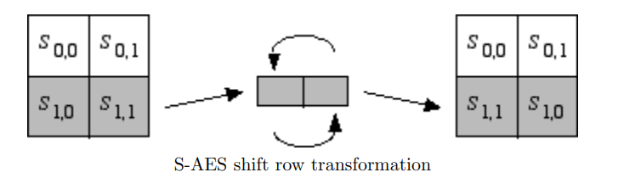
S-AES (Simplified Advanced Encryption Standard)
Shift Rows
In aes, the number of shifts increases with each line. the shift number will be one less than the line. for example, it scrolls twice on the third line. But since there are only two rows in S-Aes, we can simply say that the second and fourth nibbles are swapped (since the matrices are column priority).
0010 0011 0101 0001
Second Nibble (S1,0)
Fourth Nibble (S1,1)
0010 0001 0101 0011
Second Nibble (S1,1)
Fourth Nibble (S1,0)

Slide 6
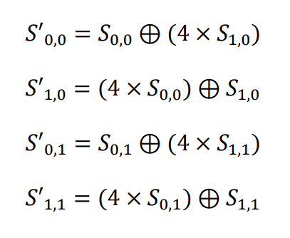
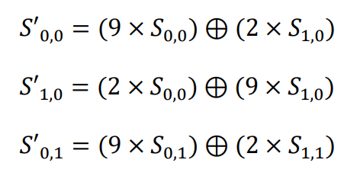
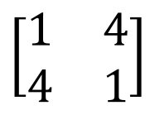

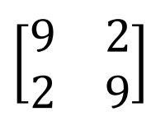
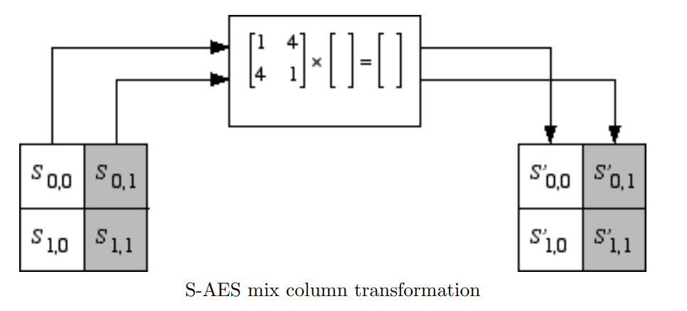
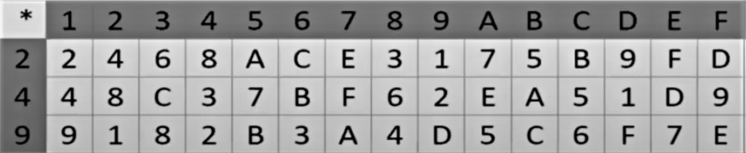
S-AES (Simplified Advanced Encryption Standard)
MixColumn
After shifting the rows, we mix the columns. Each column is multiplied by the MDS matrix which is
For Inverse MixColumn (Decryption) we change the MDS matrix to
For Encryption
For Decryption
I used the table below for multiplication operations

Slide 7
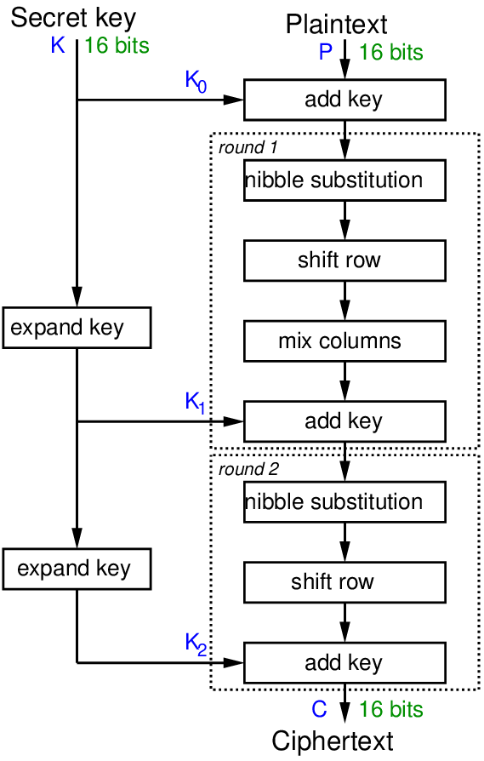
S-AES (Simplified Advanced Encryption Standard)
Encryption
KEY EXPAND:
Using the first key (key0) we set here, two more keys are generated at the end of each round (key1 and key2).
ROUND 0:
In the encryption process, we first XOR the message we want to encrypt, namely plainText, with the key we specify, that is, key0. let's call this process round0 and we get state0 as output
ROUND 1:
state0 from the previous round enters the SubNibble, ShiftRow and MixColumn functions, respectively, and the output of each is the input of the next one. Output from MixColumn function is XORed with key1 and round 1 ends. Let's call the output of Round 1 state1.
ROUND 2:
state1 leaving round 1 enters round 2. round 2 is almost the same as round 1 but there is no MixColumn operation here. The input(state1) enters the SubNibble and ShiftRow operations respectively, and enters the xor operation with the last key, key2, and leaves round 2 as state2. So this state2 is our encrypted message. We'll call it cipherText.
Round 0

Slide 8
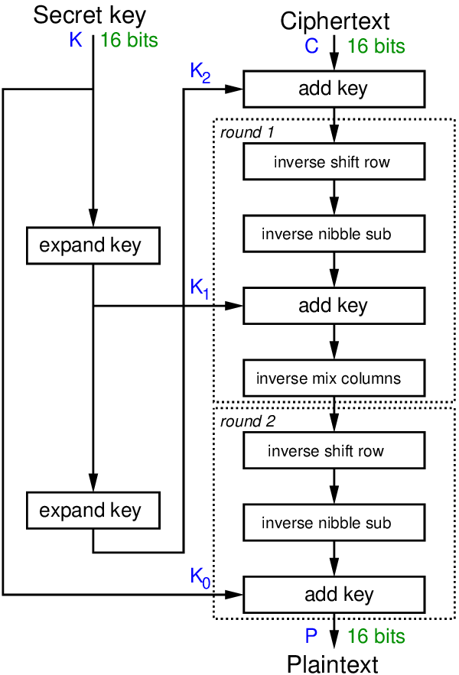
S-AES (Simplified Advanced Encryption Standard)
Decryption
KEY EXPAND:
Using the first key (key0) we set here, two more keys are generated at the end of each round (key1 and key2).
ROUND 0:
In the decryption process, like the encryption process, the first step is to XOR with the key, but this time we process key2 instead of key0, so in the decryption process, the keys will be entered in the reverse order this time. Output is state0.
ROUND 1:
State0 enters the round 1 stage as input, and enters the InverseShiftRow (same as ShiftRow), InverseSubNibble (only S-BOX is different), Addkey1 (X0R operation with key1) and finally InverseMixColumn and completes the Round. Let's call the output of Round 1 state1.
ROUND 2:
Round 2 is pretty much the same as round 1 except there is no MixColumn operation. just like encryption. Here state2 enters InverseShiftRow and InverseSubNibble, respectively, and then XOR with our first key, key0, and completes the round. Let's call the output here state2. so this state2 is our decrypted message.
Round 0

Slide 9
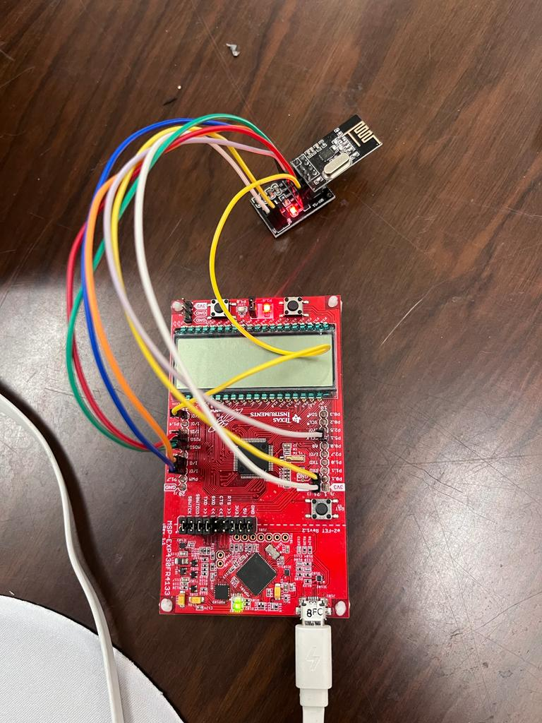
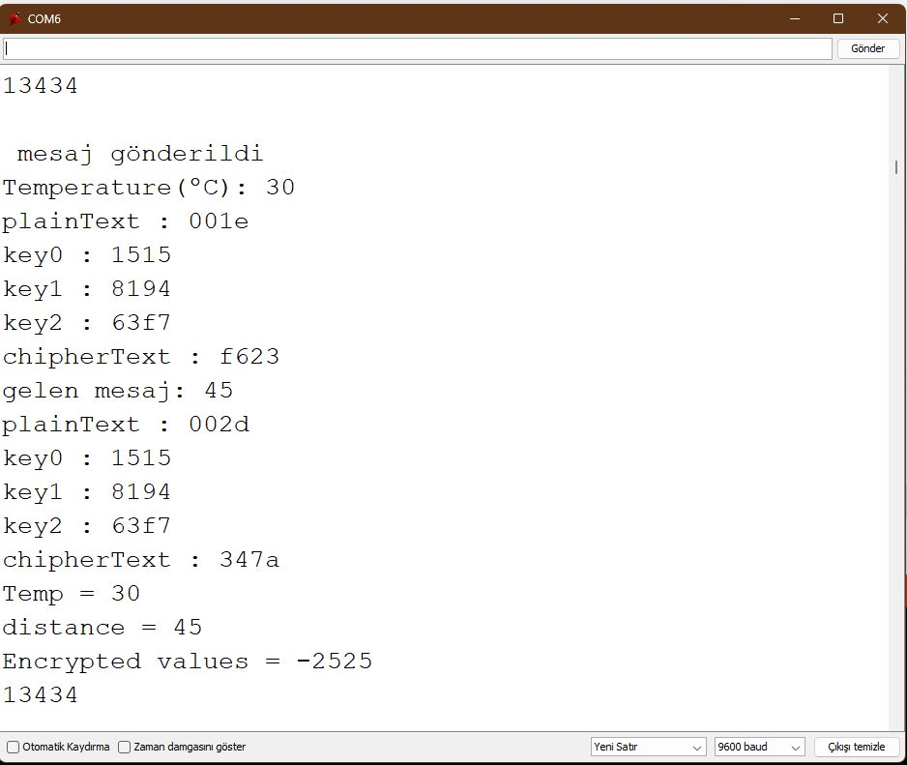
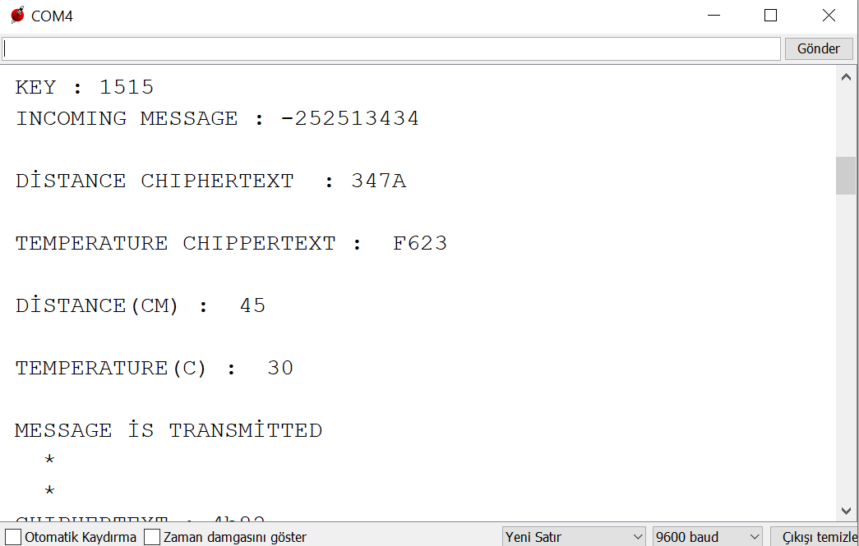
S-AES (Simplified Advanced Encryption Standard)
My msp430FR4133 and NRF24L01
Serial Port Screen of MSP Where I Get Encrypted Information
Serial Port Screen of My MSP

Slide 10
Sources
http://www.openaccess.hacettepe.edu.tr:8080/xmlui/bitstream/handle/11655/26031/MasterTezi_BarisBerkZorba_YOK.pdf?sequence
https://bilgisayarkavramlari.com/2009/06/03/aes-ve-rijndeal-sifreleme/
https://www.rose-hulman.edu/class/ma/holden/Archived_Courses/Math479-0304/lectures/s-aes.pdf
https://flylib.com/books/en/3.190.1.59/1/
https://www.youtube.com/watch?v=NEmsy8_59q4

