Slide 1
Machine Learning
CS-871
Lecture-4
Instructor
Dr. Ihsan Ullah Khalil
Graduate course for students of
Artificial Intelligence
Electrical Engineering
Cyber Security & Data Sciences
Department of Electronics and Power Engineering
Pakistan Navy Engineering College, Karachi
National University of Sciences and Technology, NUST

Slide 2
Constant predictors

Slide 3
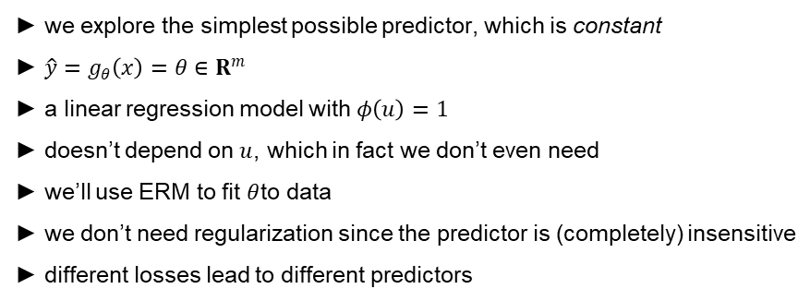
Constant predictors
► we explore the simplest possible predictor, which is constant
► $\hat{y}=g_{θ}\left(x\right)=θ∈R^{m}$
► a linear regression model with $φ\left(u\right)=1$
► doesn’t depend on $u$, which in fact we don’t even need
► we’ll use ERM to fit $θ$to data
► we don’t need regularization since the predictor is (completely) insensitive
► different losses lead to different predictors

Slide 4
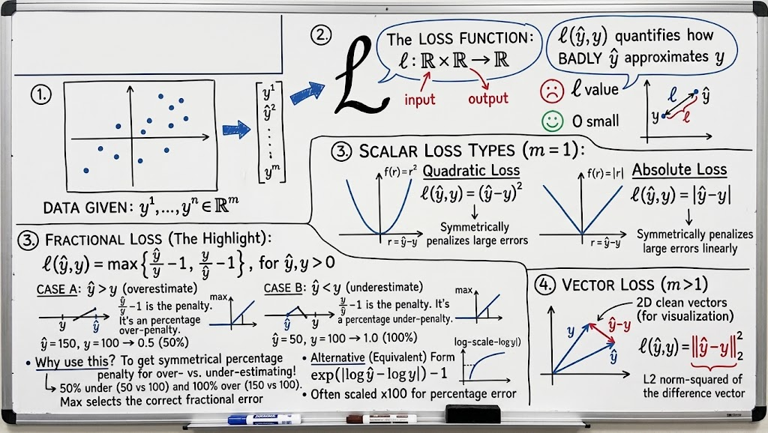
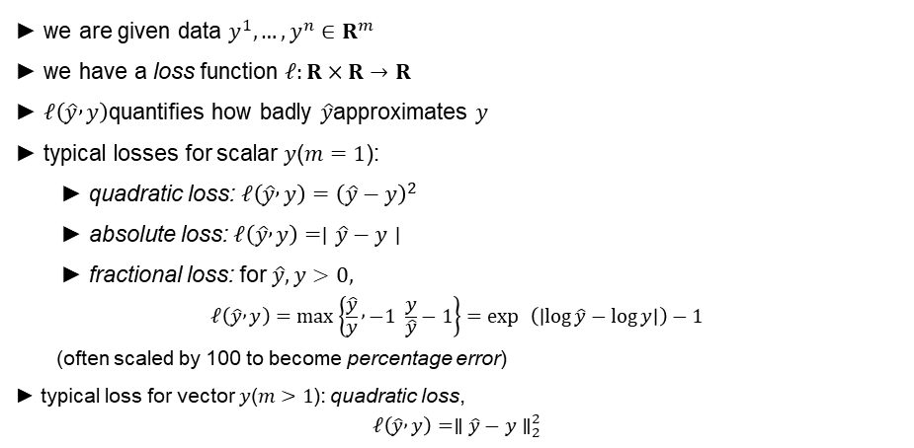
Losses
► we are given data $y^{1},…,y^{n}∈R^{m}$
► we have a loss function $ℓ:R×R→R$
► $ℓ\left(\hat{y} , y\right)$quantifies how badly $\hat{y}$approximates $y$
► typical losses for scalar $y$($m=1$):
► quadratic loss: $ℓ\left(\hat{y} , y\right)={\left(\hat{y}−y\right)}^{2}$
► absolute loss: $ℓ\left(\hat{y} , y\right)=∣\hat{y}−y∣$
► fractional loss: for $\hat{y},y>0,$
$$ℓ\left(\hat{y} , y\right)=\max\left\{\frac{\hat{y}}{y} , −1 \frac{y}{\hat{y}}−1\right\}=\exp{ }\left(∣\log{\hat{y}}−\log{y}∣\right)−1$$
(often scaled by 100 to become percentage error)
► typical loss for vector $y$($m>1$): quadratic loss,
$$ℓ\left(\hat{y} , y\right)=∥\hat{y}−y∥_{2}^{2}$$

Slide 5
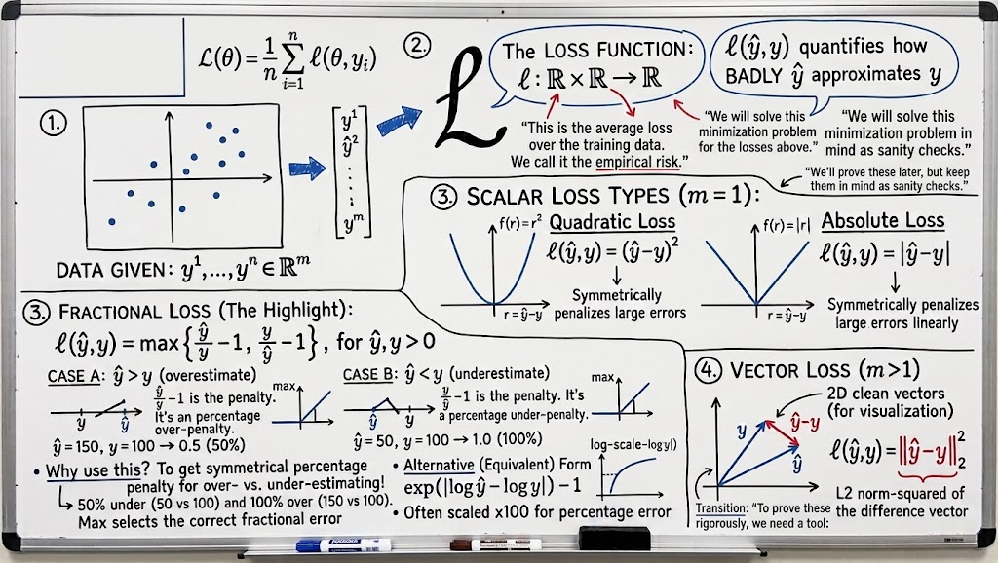
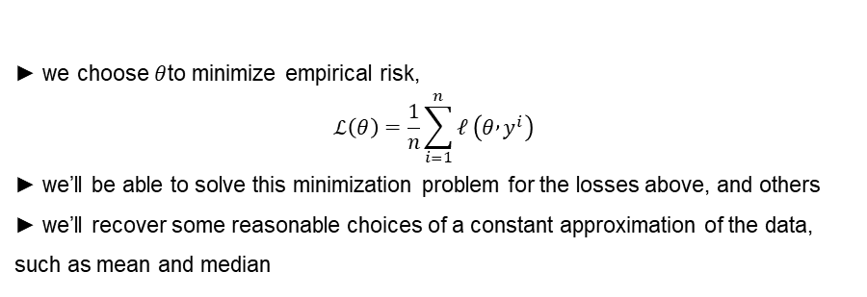
ERM
► we choose $θ$to minimize empirical risk,
$$ℒ\left(θ\right)=\frac{1}{n}\sum_{i=1}^{n}{ℓ}\left(θ , y^{i}\right)$$
► we’ll be able to solve this minimization problem for the losses above, and others
► we’ll recover some reasonable choices of a constant approximation of the data, such as mean and median
Notes:
“This is the average loss over the training data. We call it the empirical risk.”

Slide 6
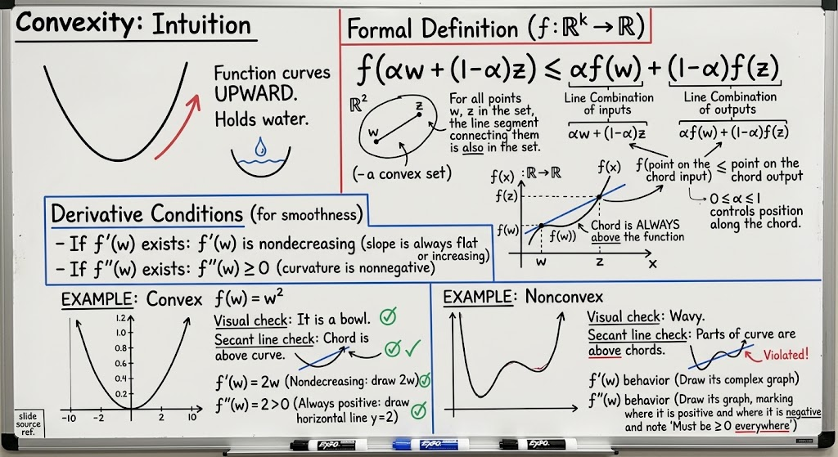
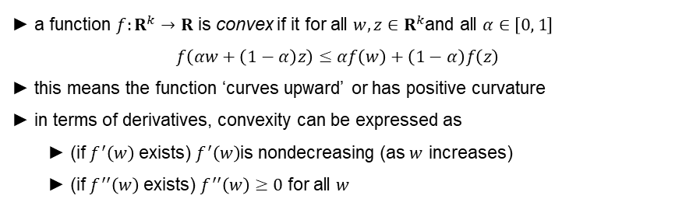
Convexity
► a function $f:R^{k}→R$ is convex if it for all $w,z∈R^{k}$and all $α∈\left[0 , 1\right]$
$$f\left(αw+\left(1−α\right)z\right)≤αf\left(w\right)+\left(1−α\right)f\left(z\right)$$
► this means the function ‘curves upward’ or has positive curvature
► in terms of derivatives, convexity can be expressed as
► (if $f^{′}\left(w\right)$ exists) $f^{′}\left(w\right)$is nondecreasing (as $w$ increases)
► (if $f^{′′}\left(w\right)$ exists) $f^{′′}\left(w\right)≥0$ for all $w$
1 .0
convex
1 .0
nonconvex
0.8
0.8
0.6
0.6
0.4
0.4
0.2
0.2
0.0
0.0
0.0 0.2 0.4 0.6
0.8 1 .0
0.0
0.2 0.4 0.6 0.8 1 .0

Slide 7
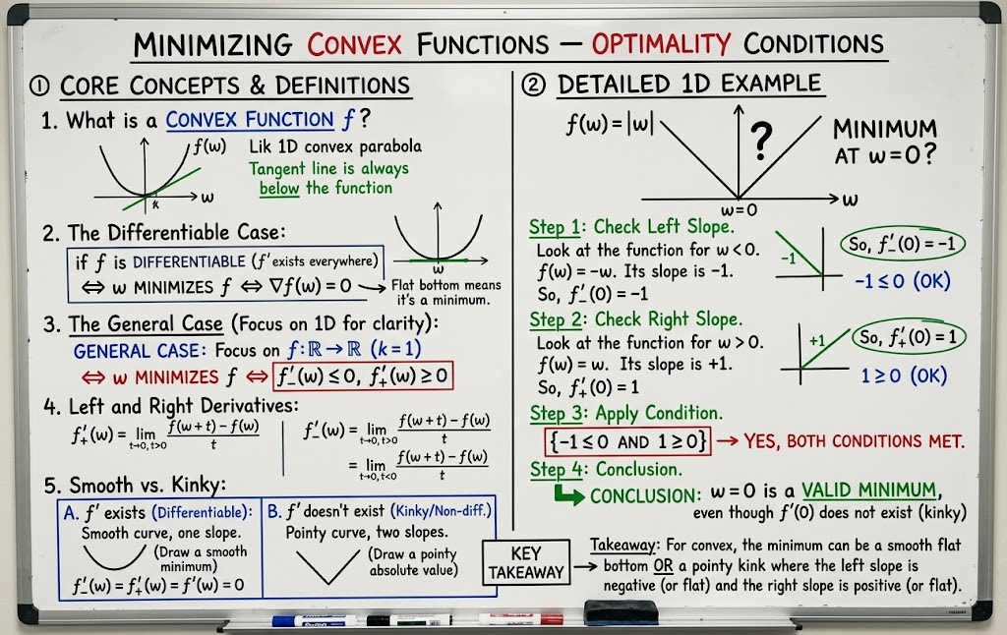
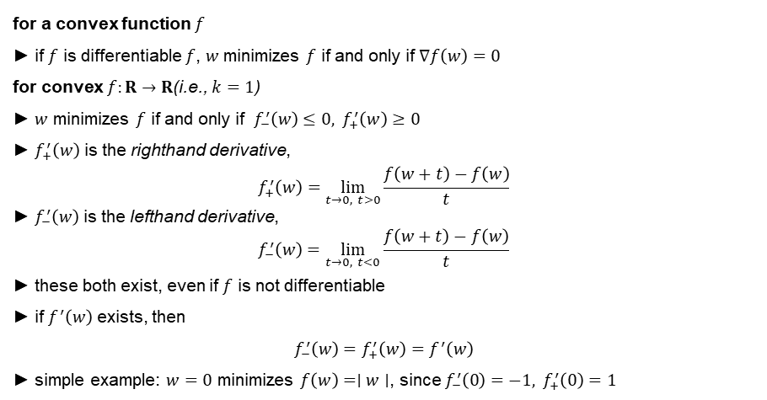
Minimizing convex functions — optimality conditions
for a convex function $f$
► if $f$ is differentiable $f$, $w$minimizes $f$ if and only if $∇f\left(w\right)=0$
for convex $f:R→R$(i.e., $k=1$)
► $w$ minimizes $f$ if and only if $f_{−}^{′}\left(w\right)≤0, f_{+}^{′}\left(w\right)≥0$
► $f_{+}^{′}\left(w\right)$ is the righthand derivative,
$$f_{+}^{′}\left(w\right)=\lim_{t→0, t>0}\frac{f\left(w+t\right)−f\left(w\right)}{t}$$
► $f_{−}^{′}\left(w\right)$ is the lefthand derivative,
$$f_{−}^{′}\left(w\right)=\lim_{t→0, t<0}\frac{f\left(w+t\right)−f\left(w\right)}{t}$$
► these both exist, even if $f$ is not differentiable
► if $f^{′}\left(w\right)$ exists, then
$$f_{−}^{′}\left(w\right)=f_{+}^{′}\left(w\right)=f^{′}\left(w\right)$$
► simple example: $w=0$ minimizes $f\left(w\right)=∣w∣$, since $f_{−}^{′}\left(0\right)=−1, f_{+}^{′}\left(0\right)=1$

Slide 8
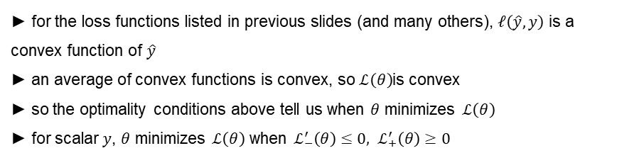
ERM and convexity
► for the loss functions listed in previous slides (and many others), $ℓ\left(\hat{y} , y\right)$ is a convex function of $\hat{y}$
► an average of convex functions is convex, so $ℒ\left(θ\right)$is convex
► so the optimality conditions above tell us when $θ$ minimizes $ℒ\left(θ\right)$
► for scalar $y$, $θ$ minimizes $ℒ\left(θ\right)$ when $ℒ_{−}^{′}\left(θ\right)≤0, ℒ_{+}^{′}\left(θ\right)≥0$

Slide 9
Square loss

Slide 10
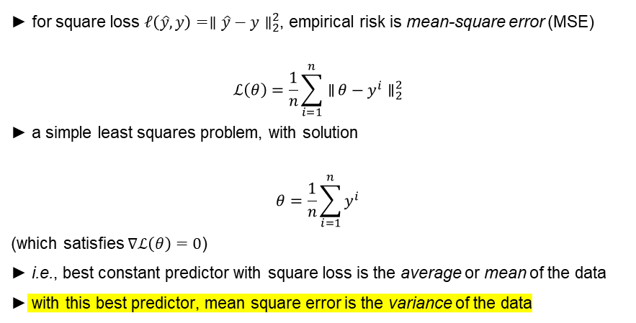
ERM with square loss
► for square loss $ℓ\left(\hat{y} , y\right)=∥\hat{y}−y∥_{2}^{2}$, empirical risk is mean-square error (MSE)
$$ℒ\left(θ\right)=\frac{1}{n}\sum_{i=1}^{n}{∥}θ−y^{i}∥_{2}^{2}$$
► a simple least squares problem, with solution
$$θ=\frac{1}{n}\sum_{i=1}^{n}{y^{i}}$$
(which satisfies $∇ℒ\left(θ\right)=0$)
► i.e., best constant predictor with square loss is the average or mean of the data
► with this best predictor, mean square error is the variance of the data

Slide 11
Absolute loss

Slide 12
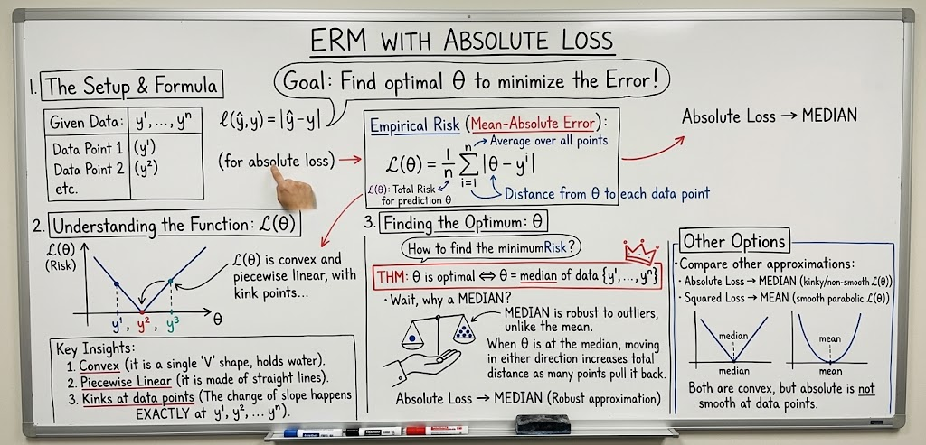
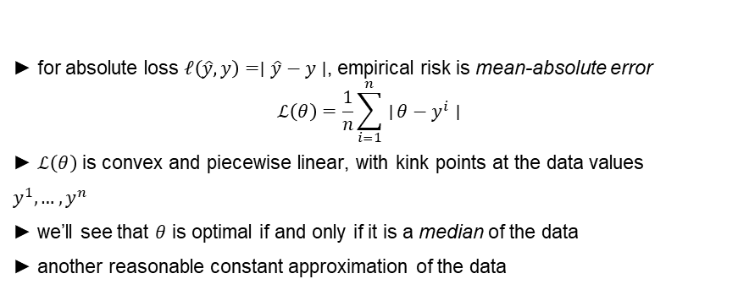
ERM with absolute loss
► for absolute loss $ℓ\left(\hat{y} , y\right)=∣\hat{y}−y∣$, empirical risk is mean-absolute error
$$ℒ\left(θ\right)=\frac{1}{n}\sum_{i=1}^{n}{∣}θ−y^{i}∣$$
► $ℒ\left(θ\right)$ is convex and piecewise linear, with kink points at the data values $y^{1},…,y^{n}$
► we’ll see that $θ$ is optimal if and only if it is a median of the data
► another reasonable constant approximation of the data

Slide 13
ERM with absolute loss
1 .4
absolute loss
median y^i
1 .2
1 .0
0.8
0.6
0.4
0.2
0.0
( )
0.25 0.50 0.75 1 .00 1 .25 1 .50 1 .75
2.00

Slide 14
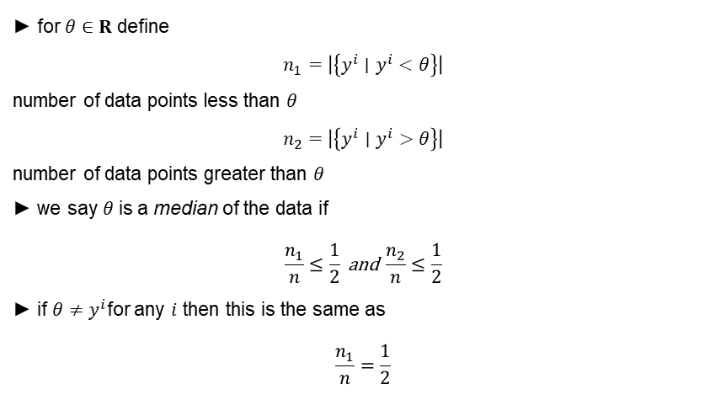
Median
► for $θ∈R$ define
$$n_{1}=∣\left\{y^{i}∣y^{i}<θ\right\}∣$$
number of data points less than $θ$
$$n_{2}=∣\left\{y^{i}∣y^{i}>θ\right\}∣$$
number of data points greater than $θ$
► we say $θ$is a median of the data if
$$\frac{n_{1}}{n}≤\frac{1}{2} \text{and} \frac{n_{2}}{n}≤\frac{1}{2}$$
► if $θ≠y^{i}$for any $i$ then this is the same as
$$\frac{n_{1}}{n}=\frac{1}{2}$$

Slide 15
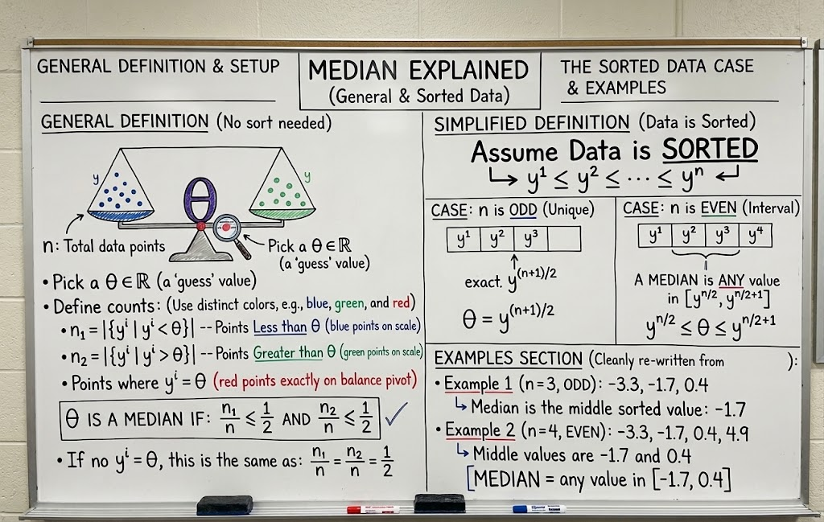
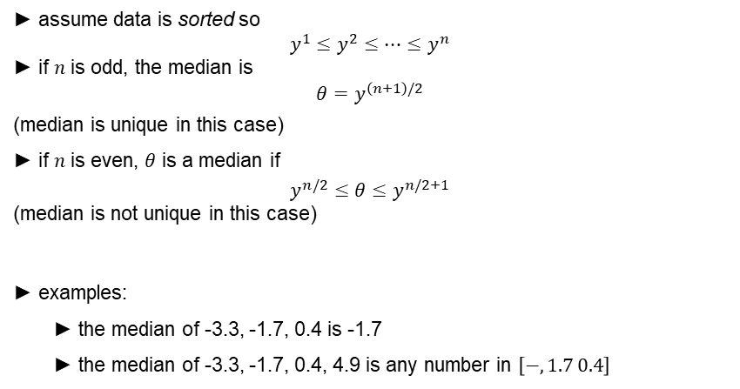
Median
► assume data is sorted so
$$y^{1}≤y^{2}≤⋯≤y^{n}$$
► if $n$ is odd, the median is
$$θ=y^{\left(n+1\right)/2}$$
(median is unique in this case)
► if $n$ is even, $θ$ is a median if
$$y^{n/2}≤θ≤y^{n/2+1}$$
(median is not unique in this case)
► examples:
► the median of -3.3, -1.7, 0.4 is -1.7
► the median of -3.3, -1.7, 0.4, 4.9 is any number in $\left[− , 1.7 0.4\right]$

Slide 16
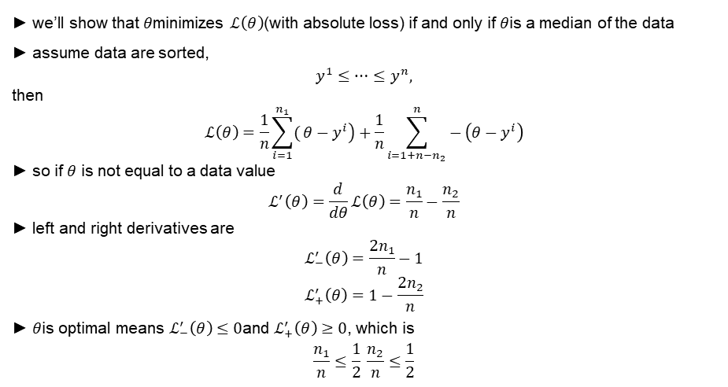
Medians minimize empirical risk with absolute loss
► we’ll show that $θ$minimizes $ℒ\left(θ\right)$(with absolute loss) if and only if $θ$is a median of the data
► assume data are sorted,
$$y^{1}≤⋯≤y^{n},$$
then
$$ℒ\left(θ\right)=\frac{1}{n}\sum_{i=1}^{n_{1}}{(}\left.θ−y^{i}\right)+\frac{1}{n}\sum_{i=1+n−n_{2}}^{n}{−}\left(θ−y^{i}\right)$$
► so if $θ$ is not equal to a data value
$$ℒ^{′}\left(θ\right)=\frac{d}{dθ}ℒ\left(θ\right)=\frac{n_{1}}{n}−\frac{n_{2}}{n}$$
► left and right derivatives are
$$ℒ_{−}^{′}\left(θ\right)=\frac{2n_{1}}{n}−1$$
$$ℒ_{+}^{′}\left(θ\right)=1−\frac{2n_{2}}{n}$$
► $θ$is optimal means $ℒ_{−}^{′}\left(θ\right)≤0$and $ℒ_{+}^{′}\left(θ\right)≥0$, which is
$$\frac{n_{1}}{n}≤\frac{1}{2} \frac{n_{2}}{n}≤\frac{1}{2}$$

Slide 17
Tilted absolute loss

Slide 18
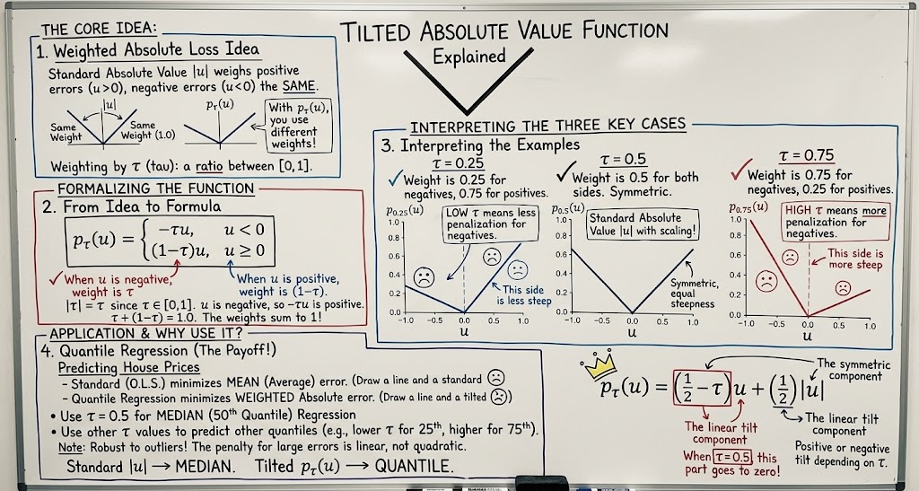

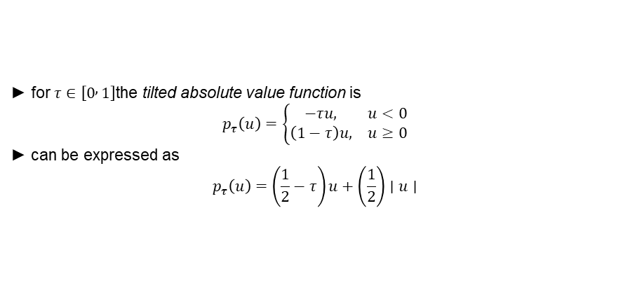


Tilted absolute value function
► for $τ∈\left[0 , 1\right]$the tilted absolute value function is
$$p_{τ}\left(u\right)=\left\{\begin{matrix}−τu, & u<0 \\ \left(1−τ\right)u, & u≥0\end{matrix}\right.$$
► can be expressed as
$$p_{τ}\left(u\right)=\left(\frac{1}{2}−τ\right)u+\left(\frac{1}{2}\right)∣u∣$$
1 .0
z = 0. 25
1 .0
z = 0. 5
1 .0
z = 0. 75
0.8
0.8
0.8
0.6
$$p_{τ}\left(u\right)$$
$$p_{τ}\left(u\right)$$
$$p_{τ}\left(u\right)$$
0.6
0.6
0.4
0.4
0.4
0.2
0.2
0.2
0.0
1 .0
0.5 0.0
u
0.5
1 .0
0.0
1 .0
0.5 0.0
u
0.5
1 .0
0.0
1 .0
0.5 0.0
u
0.5
1 .0

Slide 19
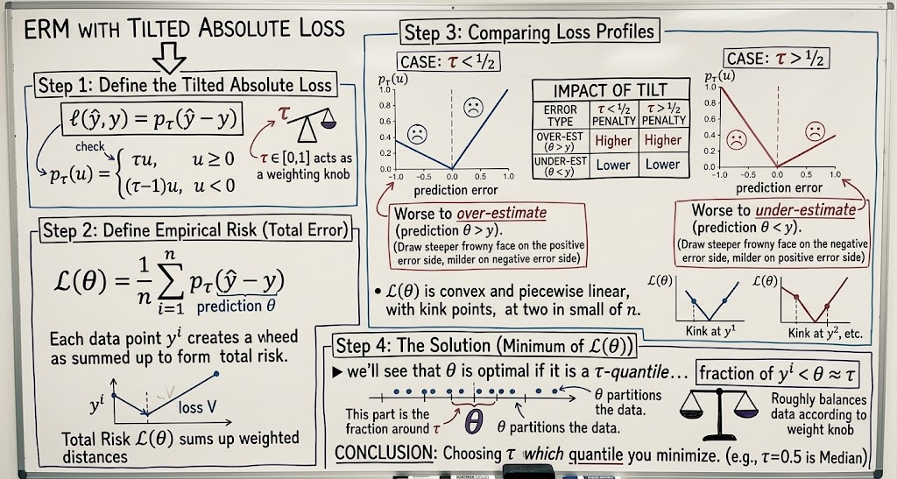
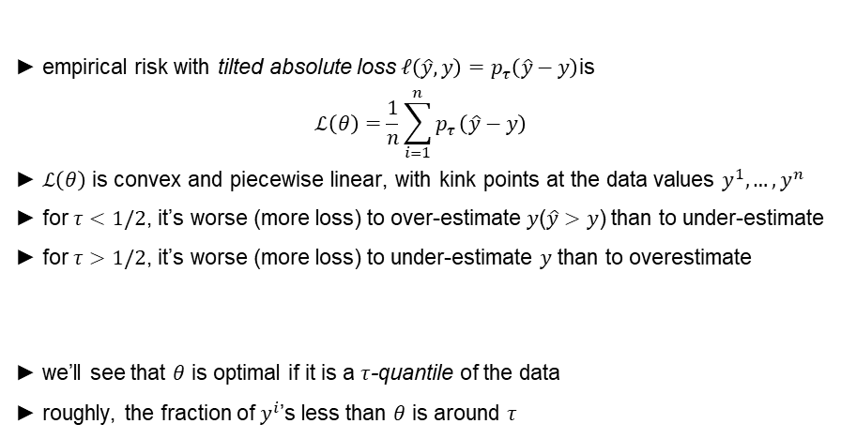
ERM with tilted absolute value loss
► empirical risk with tilted absolute loss $ℓ\left(\hat{y} , y\right)=p_{τ}\left(\hat{y}−y\right)$is
$$ℒ\left(θ\right)=\frac{1}{n}\sum_{i=1}^{n}{p_{τ}}\left(\hat{y}−y\right)$$
► $ℒ\left(θ\right)$ is convex and piecewise linear, with kink points at the data values $y^{1},…,y^{n}$
► for $τ<1/2$, it’s worse (more loss) to over-estimate $y$($\hat{y}>y$) than to under-estimate
► for $τ>1/2$, it’s worse (more loss) to under-estimate $y$ than to overestimate
► we’ll see that $θ$ is optimal if it is a $τ$-quantile of the data
► roughly, the fraction of $y^{i}$’s less than $θ$ is around $τ$

Slide 20
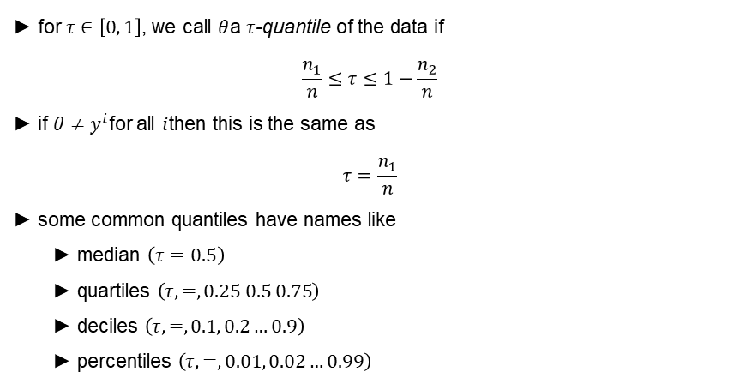
Quantiles
► for $τ∈\left[0 , 1\right]$, we call $θ$a $τ$-quantile of the data if
$$\frac{n_{1}}{n}≤τ≤1−\frac{n_{2}}{n}$$
► if $θ≠y^{i}$for all $i$then this is the same as
$$τ=\frac{n_{1}}{n}$$
► some common quantiles have names like
► median $\left(τ=0.5\right)$
► quartiles $\left(τ , = , 0.25 0.5 0.75\right)$
► deciles $\left(τ , = , 0.1 , 0.2…0.9\right)$
► percentiles $\left(τ , = , 0.01 , 0.02…0.99\right)$

Slide 21
Quantiles
1 0
8
z-quantile
6
4
2
0.0
0.2
0.4
0.6
0.8
1 .0
z
Ş if the data is (4,7,7,8,9) then
Ş the 0.1 quantile is 4
Ş the 0.2 quantile is any number in [4,7]
Ş the 0.5 quantile is 7

Slide 22
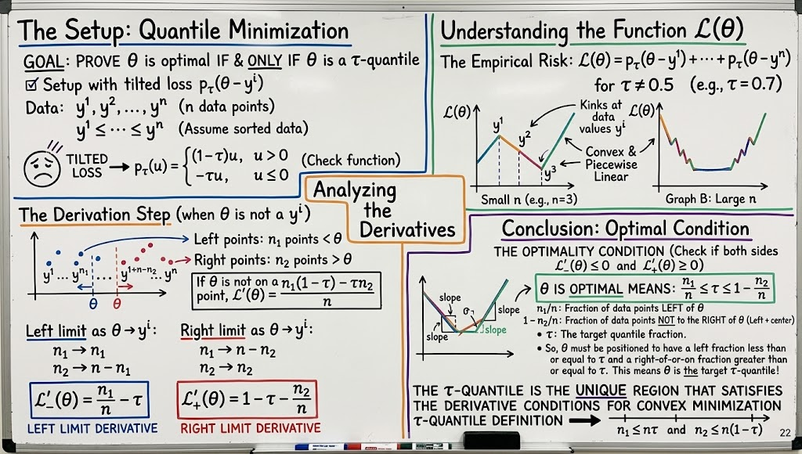
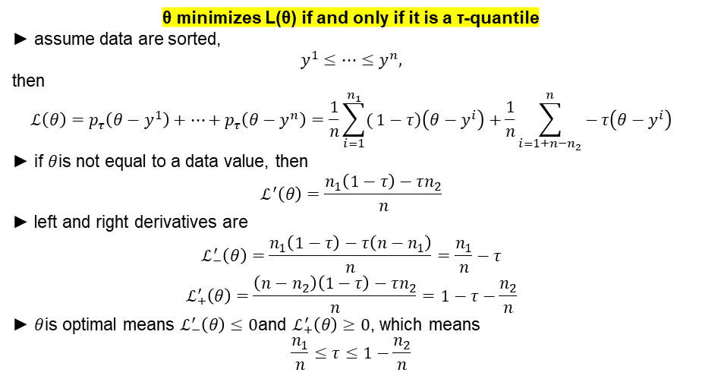
τ-quantile​ minimizes empirical risk with tilted absolute loss
θ minimizes L(θ) if and only if it is a τ-quantile​
► assume data are sorted,
$$y^{1}≤⋯≤y^{n},$$
then
$$ℒ\left(θ\right)=p_{τ}\left(θ−y^{1}\right)+⋯+p_{τ}\left(θ−y^{n}\right)=\frac{1}{n}\sum_{i=1}^{n_{1}}{(}\left.1−τ\right)\left(θ−y^{i}\right)+\frac{1}{n}\sum_{i=1+n−n_{2}}^{n}{−}τ\left(θ−y^{i}\right)$$
► if $θ$is not equal to a data value, then
$$ℒ^{′}\left(θ\right)=\frac{n_{1}\left(1−τ\right)−τn_{2}}{n}$$
► left and right derivatives are
$$ℒ_{−}^{′}\left(θ\right)=\frac{n_{1}\left(1−τ\right)−τ\left(n−n_{1}\right)}{n}=\frac{n_{1}}{n}−τ$$
$$ℒ_{+}^{′}\left(θ\right)=\frac{\left(n−n_{2}\right)\left(1−τ\right)−τn_{2}}{n}=1−τ−\frac{n_{2}}{n}$$
► $θ$is optimal means $ℒ_{−}^{′}\left(θ\right)≤0$and $ℒ_{+}^{′}\left(θ\right)≥0$, which means
$$\frac{n_{1}}{n}≤τ≤1−\frac{n_{2}}{n}$$

Slide 23
Fractional loss

Slide 24
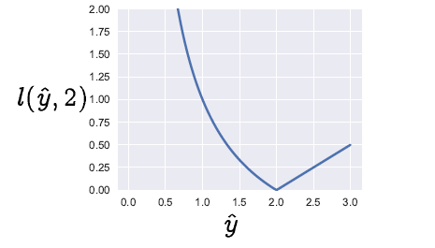
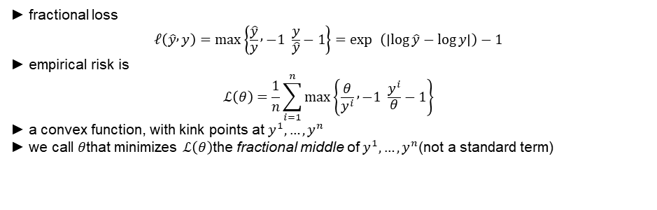
ERM with fractional loss
► fractional loss
$$ℓ\left(\hat{y} , y\right)=\max\left\{\frac{\hat{y}}{y} , −1 \frac{y}{\hat{y}}−1\right\}=\exp{ }\left(∣\log{\hat{y}}−\log{y}∣\right)−1$$
► empirical risk is
$$ℒ\left(θ\right)=\frac{1}{n}\sum_{i=1}^{n}{max}\left\{\frac{θ}{y^{i}} , −1 \frac{y^{i}}{θ}−1\right\}$$
► a convex function, with kink points at $y^{1},…,y^{n}$
► we call $θ$that minimizes $ℒ\left(θ\right)$the fractional middle of $y^{1},…,y^{n}$(not a standard term)

Slide 25
ERM with fractional loss
4.0
fractional loss fractional middle
3.5
y^i
3.0
2.5
2.0
1 .5
1 .0
0.5
0.0
( )
0.25 0.50 0.75 1 .00 1 .25 1 .50
1 .75 2.00

Slide 26
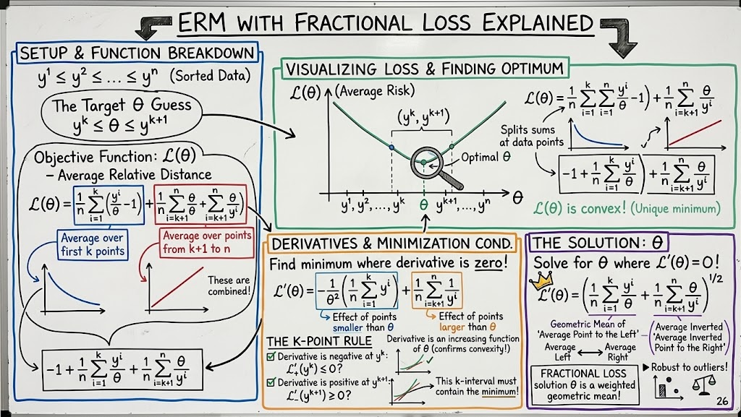
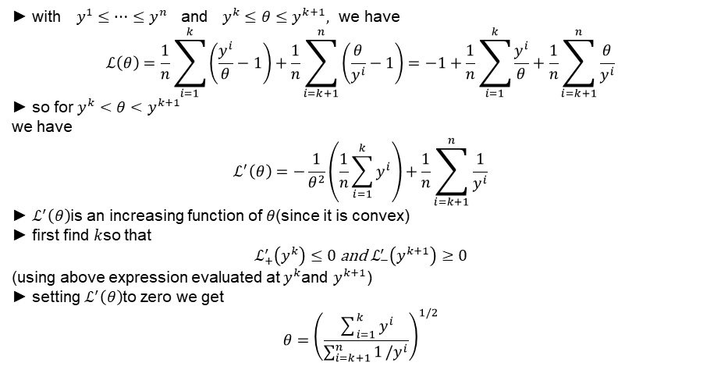
ERM with fractional loss
► with$y^{1}≤⋯≤y^{n}$ and$y^{k}≤θ≤y^{k+1},$ we have
$$ℒ\left(θ\right)=\frac{1}{n}\sum_{i=1}^{k}{\left(\frac{y^{i}}{θ}−1\right)}+\frac{1}{n}\sum_{i=k+1}^{n}{\left(\frac{θ}{y^{i}}−1\right)}=−1+\frac{1}{n}\sum_{i=1}^{k}{\frac{y^{i}}{θ}}+\frac{1}{n}\sum_{i=k+1}^{n}{\frac{θ}{y^{i}}}$$
► so for$y^{k}<θ<y^{k+1}$
we have
$$ℒ^{′}\left(θ\right)=−\frac{1}{θ^{2}}\left(\frac{1}{n}\sum_{i=1}^{k}{y^{i}}\right)+\frac{1}{n}\sum_{i=k+1}^{n}{\frac{1}{y^{i}}}$$
► $ℒ^{′}\left(θ\right)$is an increasing function of $θ$(since it is convex)
► first find $k$so that
$$ℒ_{+}^{′}\left(y^{k}\right)≤0 \text{and} ℒ_{−}^{′}\left(y^{k+1}\right)≥0$$
(using above expression evaluated at $y^{k}$and $y^{k+1}$)
► setting $ℒ^{′}\left(θ\right)$to zero we get
$$θ={\left(\frac{\sum_{i=1}^{k}{y^{i}}}{\sum_{i=k+1}^{n}{1}/y^{i}}\right)}^{1/2}$$

Slide 27
Non-Quadratic Losses

Slide 28
Penalty functions and error histograms

Slide 29
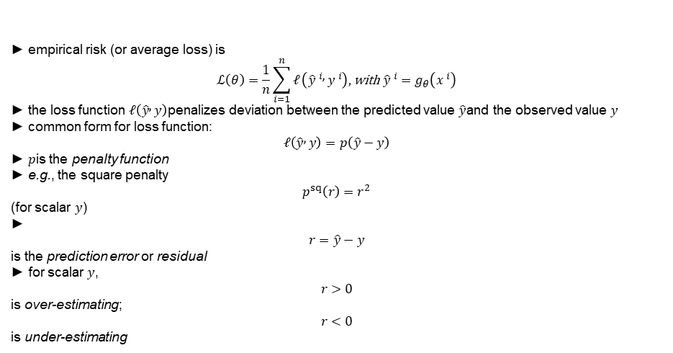
Loss and penalty functions
► empirical risk (or average loss) is
$$ℒ\left(θ\right)=\frac{1}{n}\sum_{i=1}^{n}{ℓ}\left({\hat{y}}^{ i} , y^{ i}\right), \text{with }{\hat{y}}^{ i}=g_{θ}\left(x^{ i}\right)$$
► the loss function $ℓ\left(\hat{y} , y\right)$penalizes deviation between the predicted value $\hat{y}$and the observed value $y$
► common form for loss function:
$$ℓ\left(\hat{y} , y\right)=p\left(\hat{y}−y\right)$$
► $p$is the penalty function
► e.g., the square penalty
$$p^{sq}\left(r\right)=r^{2}$$
(for scalar $y$)
►
$$r=\hat{y}−y$$
is the prediction error or residual
► for scalar $y$,
$$r>0$$
is over-estimating;
$$r<0$$
is under-estimating

Slide 30
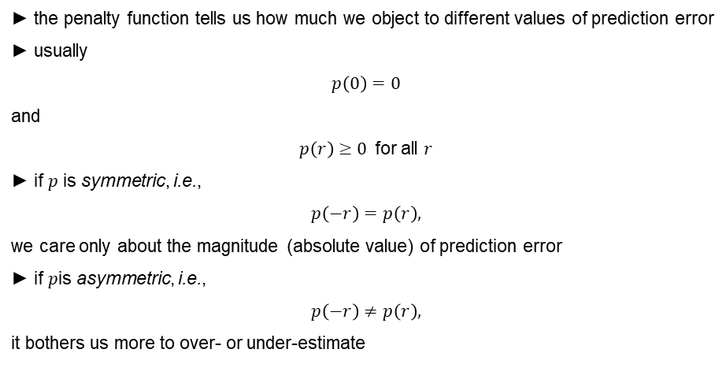
Penalty functions
► the penalty function tells us how much we object to different values of prediction error
► usually
$$p\left(0\right)=0$$
and
$p\left(r\right)≥0$for all $r$
► if $p$ is symmetric, i.e.,
$$p\left(−r\right)=p\left(r\right),$$
we care only about the magnitude (absolute value) of prediction error
► if $p$is asymmetric, i.e.,
$$p\left(−r\right)≠p\left(r\right),$$
it bothers us more to over- or under-estimate

Slide 31
Square versus absolute value penalty
4
3
2
1
abs sqr
0
3
2
1
0
1
2
3
for square penalty p^{sqr}(r) == r²
  for small prediction errors, penalty is very small (small squared)
  for large prediction errors, penalty is very large (large squared)
for absolute penalty p^{abs}(r) == | r|
  for small prediction errors, penalty is large (compared to square)
  for large prediction errors, penalty is small (compared to square)

Slide 32

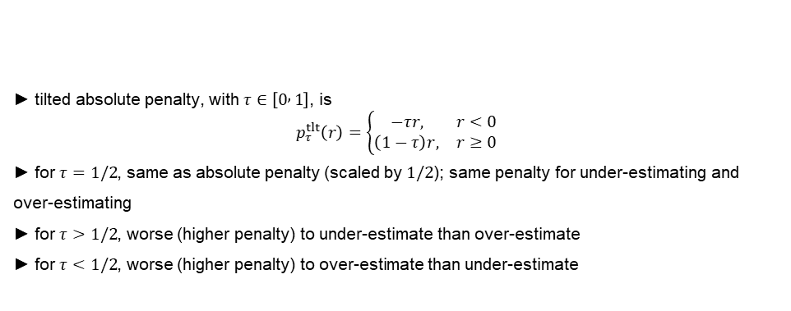


Tilted absolute penalty function
1 .0
z == 0. 25
1 .0
z == 0. 5
1 .0
z == 0. 75
0.8
0.8
0.8
$$p_{τ}^{tlt}\left(r\right)$$
0.6
$$p_{τ}^{tlt}\left(r\right)$$
0.6
$$p_{τ}^{tlt}\left(r\right)$$
0.6
0.4
0.4
0.4
0.2
0.2
0.2
0.0
1 .0
0.5 0.0
r
0.5
1 .0
0.0
1 .0
0.5 0.0
r
0.5
1 .0
0.0
1 .0
0.5 0.0
r
0.5
1 .0
► tilted absolute penalty, with $τ∈\left[0 , 1\right]$, is
$$p_{τ}^{tlt}\left(r\right)=\left\{\begin{matrix}−τr, & r<0 \\ \left(1−τ\right)r, & r≥0\end{matrix}\right.$$
► for $τ=1/2$, same as absolute penalty (scaled by $1/2$); same penalty for under-estimating and over-estimating
► for $τ>1/2$, worse (higher penalty) to under-estimate than over-estimate
► for $τ<1/2$, worse (higher penalty) to over-estimate than under-estimate

Slide 33
Predictors and choice of penalty function
penalty function expresses how you feel about large, small, positive, or negative prediction errors
different choices of penalty function yield different predictor parameters
choice of penalty function shapes the histogram of prediction errors, i.e.,
1 n
r , . . . , r
(usually divided into bins and displayed as bar graph distribution)

Slide 34
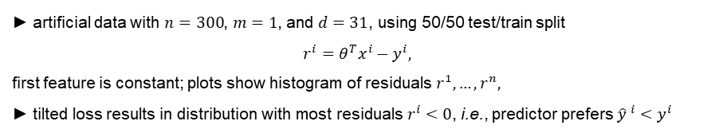
Histogram of residuals
40
40
8
8
30
6
30
6
square ²⁰
4
20
4
1 0
2
1 0
2
0
0
0
0
3
2
1
0
1
2
3
3
2
1
0
1
2
3
40
3
40
3
30
2
30
2
tilted ²⁰
20
1 0
1
1 0
1
0
0
0
0
3
2
1
0
1
2
3
3
2
1
0
1
2
3
train test
► artificial data with $n=300$, $m=1$, and $d=31$, using 50/50 test/train split
$$r^{i}=θ^{T}x^{i}−y^{i},$$
first feature is constant; plots show histogram of residuals $r^{1},…,r^{n},$
► tilted loss results in distribution with most residuals $r^{i}<0$, i.e., predictor prefers ${\hat{y}}^{ i}<y^{i}$

Slide 35
Robust fitting

Slide 36
Outliers
in some applications, a few data points are ‘way off’, or just ‘wrong’
occurs due to transcription errors, error in decimal point position, etc.
these points are called outliers
even a few outliers in a data set can result in ERM picking a poor predictor
several standard methods are used to remove outliers, or reduce their impact
one simple method:
  create predictor from data set
  flag data points with large prediction errors as outliers
  remove them from the data set and repeat
it’s also possible to use a penalty function that is less sensitive to outlier data points

Slide 37
Robust penalty functions
we say a penalty function is robust if it has low sensitivity to outliers
robust penalty functions grow more slowly for large prediction error values than the square penalty
and so ‘allow’ the predictor to have a few large prediction errors (presumably for the outliers)
so they handle outliers more gracefully
a robust predictor might fit, e.g., 98% of the data very well

Slide 38
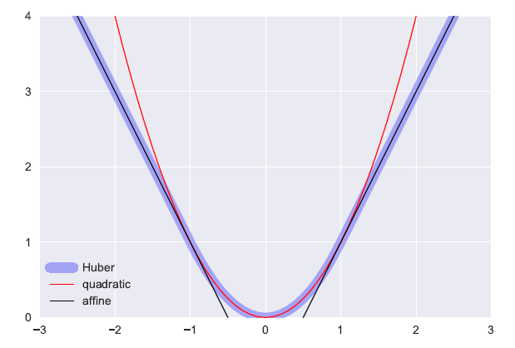
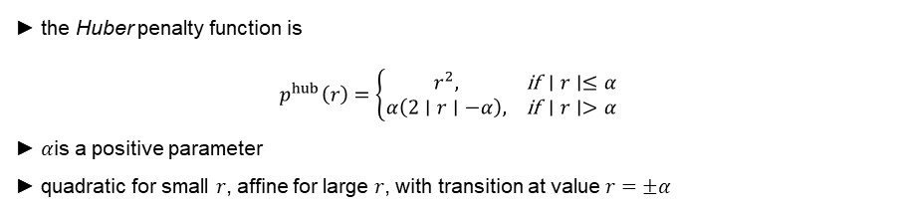
Huber loss
► the Huber penalty function is
$$p^{hub}\left(r\right)=\left\{\begin{matrix}r^{2}, & \text{if }∣r∣≤α \\ α\left(2∣r∣−α\right), & \text{if }∣r∣>α\end{matrix}\right.$$
► $α$is a positive parameter
► quadratic for small $r$, affine for large $r$, with transition at value $r=±α$

Slide 39
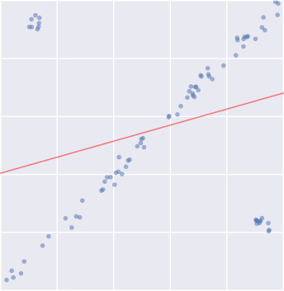
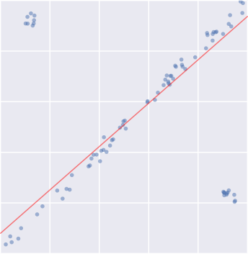
Huber loss
linear growth for large r makes fit less sensitive to outliers
ERM with Huber loss is called a robust prediction method
1 .0
1 .0
0.8
0.8
0.6
0.6
0.4
0.4
0.2
0.2
0.0
0.0
0.0
0.2
0.4 0.6
square loss
0.8
1 .0
0.0
0.2
0.4 0.6
Huber loss
0.8
1 .0

Slide 40
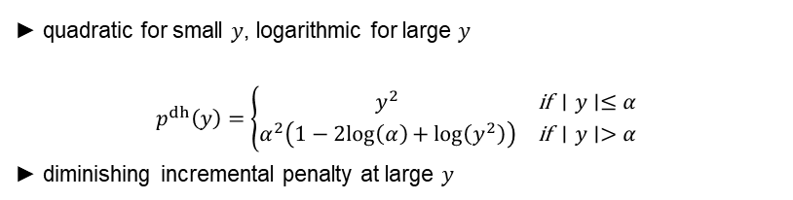
Log Huber
4
3
2
1
log Huber logarithmic quadratic
0
► quadratic for small $y$, logarithmic for large $y$
$$p^{dh}\left(y\right)=\left\{\begin{matrix}y^{2} & \text{if }∣y∣≤α \\ α^{2}\left(1−2log⁡\left(α\right)+log⁡\left(y^{2}\right)\right) & \text{if }∣y∣>α\end{matrix}\right.$$
► diminishing incremental penalty at large $y$

Slide 41
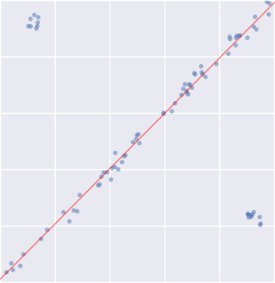
Log Huber
1 .0
0.8
0.6
0.4
0.2
0.0
0.0
0.2 0.4 0.6 0.8
log Huber loss
1 .0
* even less sensitive to outliers than Huber

Slide 42
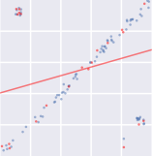
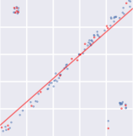
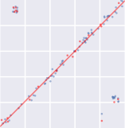
Error histogram
1 .0
40
40
0.8
35
35
30
30
square
0.6
25
25
20
20
0.4
1 5
1 5
0.2
1 0
1 0
train test
5
5
0.0
0.0
0.2
0.4
0.6
0.8
1 .0
0
3
2
1
0
1
2
3
0
3
2
1
0
1
2
3
1 .0
40
40
0.8
35
35
30
30
Huber
0.6
25
25
20
20
0.4
1 5
1 5
0.2
1 0
1 0
train test
5
5
0.0
0.0
0.2
0.4
0.6
0.8
1 .0
0
3
2
1
0
1
2
3
0
3
2
1
0
1
2
3
1 .0
40
40
0.8
35
35
30
30
log Huber
0.6
25
25
20
20
0.4
1 5
1 5
0.2
1 0
1 0
train test
5
5
0.0
0.0
0.2
0.4
0.6
0.8 1 .0
0
3
2
1 0 1
training error
2
3
0
3
2
1 0 1
test error
2
3
fit

Slide 43
Summary
loss function is often expressed as a penalty function of the residual r == y ^ — y
the loss function expresses how we object to different values of residual
different choices of loss function lead to different ERM predictors
specific applications include
  robust fitting: fitting data with some outliers
  quantile regression: fitting data with a specified fraction of over-estimation

