Slide 1
CI/CD Pipeline for a Containerized Web App
with Monitoring & Infrastructure as Code
Presentation by: Mohammad Alquamah Ansari
Final-year B.Sc. Artificial Intelligence

Slide 2
Problem Statement
Modern applications need fast, reliable, automated deployment
Manual deployment → errors, delays, no monitoring
Goal: Automate deployment, infrastructure, and monitoring in one pipeline

Slide 3
Tools & Technologies
GitHub Actions
Docker
Terraform
Ansible
AWS / Local VM
Grafana / ELK
Linux, Python/Flask

Slide 4
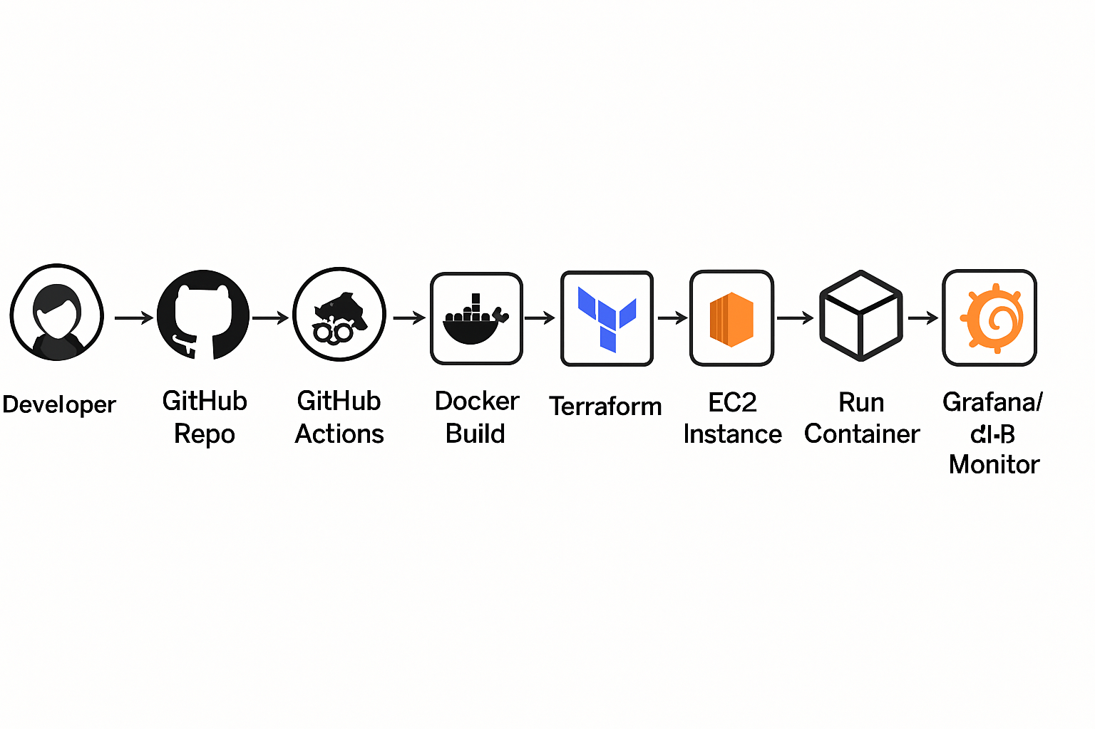
Architecture Diagram
Developer → GitHub Repo → GitHub Actions → Docker Build → Push Image → Terraform → EC2 Instance → Ansible → Run Container → Grafana/ELK Monitor

Slide 5
Project Workflow
Code pushed to GitHub
GitHub Actions runs CI/CD pipeline
Docker image built & deployed
Terraform provisions EC2 infra
Ansible configures server & runs container
Grafana/ELK monitors system

Slide 6
Implementation Highlights
CI/CD: GitHub Actions with automated builds
Docker: Containerized Flask app
Terraform: EC2 provisioning
Ansible: Server setup + app deployment
Monitoring: Grafana dashboard for metrics/logs

Slide 7
Files
FROM python:3.8-slim
WORKDIR /app
COPY . /app
RUN pip install -r requirements.txt
CMD ["python", "app.py"]
name: Hello World
on: [push]
jobs:
say-hello:
runs-on: ubuntu-latest
steps:
- uses: actions/checkout@v4
- name: Say Hello
run: echo "Hello, World!"

Slide 8
Results / Benefits
Automated pipeline reduces manual effort
Portable containerized deployment
Reproducible environments via IaC
Real-time monitoring with Grafana

Slide 9
Challenges & Learnings
Challenge: Connecting Terraform + Ansible workflows
Challenge: Setting up monitoring stack
Learning: Integration matters more than individual tools

Slide 10
Future Improvements
Add Kubernetes for orchestration
1
Integrate automated testing in pipeline
2
Scale monitoring for larger workloads
3

Slide 11
Closing
This project demonstrates how DevOps practices bring speed, reliability, and observability to software delivery.
Thank you!

