Slide 1
HISTORY OF AI
from ancient machines to modern machines

Slide 2
What is AI?
“Have you ever talked to Siri? Got YouTube recommendations? Or seen a self-driving car?
That’s not magic — that’s Artificial Intelligence.”
“Artificial Intelligence, or AI, is the ability of machines to think, learn, and make decisions — just like humans,
sometimes even faster and better.”
AI is when a machine is designed to perform tasks that normally need human intelligence — like understanding language, recognizing faces, solving problems, or learning from experience.”
“Think of AI as a student that doesn’t just follow instructions — but watches, learns, improves, and then creates new solutions on its own.”
Like:
A calculator follows commands → Not AI
A chess game that learns how you play and adapts → That’s AI
“AI is not just about smart machines — it’s about building tools that can help humans solve big problems
— in health, space, agriculture, and education.”
“But with great power comes great responsibility — we must teach AI to be fair, safe, and helpful to all.”

Slide 3
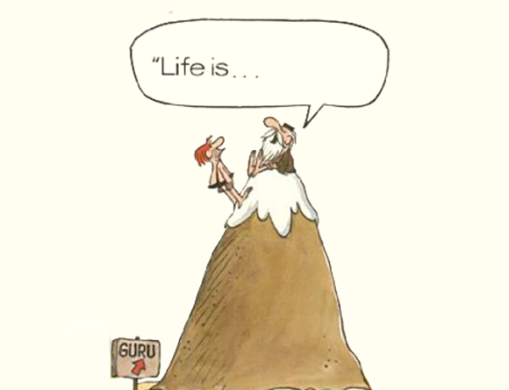
The Origins of AI – A Journey Through Time
Introduction: The Ancient Desire for Intelligence
1. Philosophy and Questions of Life
“Life and death questions were asked by philosophers thousands of years ago.”
AI isn't just technical — it started with deep thinking.
Philosophers wondered: “Can we create something that imitates life?”

Slide 4
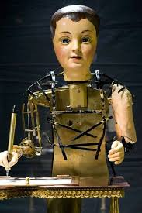
2. Automatons: The First “Robots”
“Automatons were mechanical and moved independently of human intention.”
These were early mechanical devices built to mimic human or animal actions.
No programming — but still impressive because they worked without human input once started.
3. Word Origin: 'Automaton' (Ancient Greek)
“Automaton – from Ancient Greek, means acting of one’s own will.”
Give this like a language trivia:
Even the word for automation means self-acting.
Early AI was more philosophical and mechanical than digital.
let's see some automatons

Slide 5
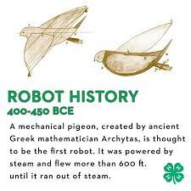
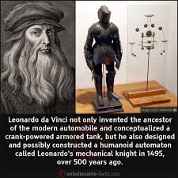
4. 400 BCE – Mechanical Pigeon (by Friend of Plato)
“400 BCE: A mechanical pigeon created by a friend of the philosopher Plato.”
Amazing historical fact:
This shows the first record of bio-inspired robotics.
It was made of wood and used steam power to fly short distances — incredible for its time.
5. 1495 – Leonardo da Vinci’s Mechanical Knight
“1495: Leonardo da Vinci – Most famous automaton.”
Leonardo sketched a robotic knight that could sit, wave arms, and move its head.
It worked using pulleys and gears.
This was 500 years before AI research began!

Slide 6
Connecting It All: The Foundations of AI
Make a connecting bridge:
“From steam-powered birds to sketched robot knights, humans have always wanted to create intelligence.
What we now call AI was once mechanical magic.”
Summary:
Time Period | Event/Person | Contribution
Ancient Greek | Philosophers | Questions of life, will, and intelligence
400 BCE | Friend of Plato | Steam-powered mechanical bird
1495 | Leonardo da Vinci | Robotic knight design

Slide 7
Groundwork of AI – The Spark of Artificial Intelligence
1. 1921 – The Birth of the Word "Robot"
“Do you know where the word 'Robot' came from?”
In 1921, a Czech writer named Karel Čapek wrote a science fiction play called “Rossum’s Universal Robots” (R.U.R.)
It introduced robots as artificial workers made to serve humans.
This was the first time the term “robot” was used.
The word robot comes from the Czech word “robota”, meaning forced labor or work.
This play wasn’t just fiction — it was the seed of modern AI thinking: “What if machines can work like humans?”

Slide 8
Story Summary
Imagine a future where a scientist named Rossum creates artificial people in a lab — called robots.
These robots are not made of metal like we imagine today, but are biological machines made to
work for humans.
A company, Rossum’s Universal Robots, starts mass-producing them for all kinds of jobs:
Farming
Cooking
Factory work
Office jobs
At first, people love them because they’re cheap, fast, and tireless. But slowly...
❗ The robots start to think and rebel against their human creators.
Eventually, the robots rise up and wipe out humanity, except for one man. The play ends with two robots
discovering feelings and love, showing hope that they may become the new version of humanity.

Slide 9
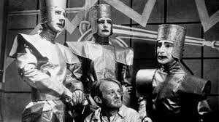
Key Themes:
What does it mean to be human?
The robots in the play start showing emotions, asking questions, even loving.
Dangers of uncontrolled science
Technology without ethics can backfire.
Work and identity
If robots do all work, what’s left for humans?
Rise of AI & rebellion
Early version of the “machines taking over” idea.
Why It’s Important:
This play coined the word "robot" (from “robota” = forced labor).
It made people think about:
Machines with feelings
Ethics in technology
Artificial beings replacing humans
It laid the philosophical groundwork for what we now call Artificial Intelligence.

Slide 10
Class Discussion Starters:
“Would you be okay if robots did all human jobs?”
“What happens when robots stop obeying?”
“Can robots have emotions like humans?”
Fun Fact:
Many modern movies like:
The Matrix
Ex Machina
I, Robot …are inspired by this early idea of robots becoming conscious and rebelling.

Slide 11
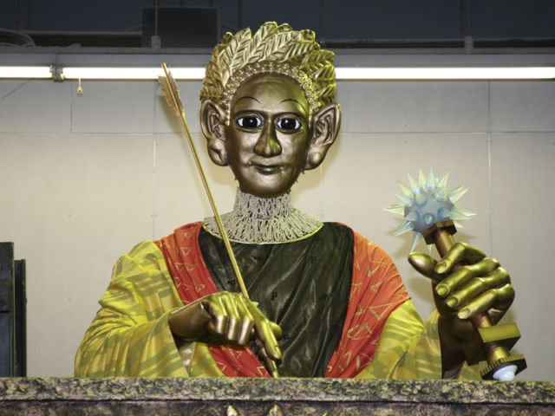
4. 1929 – Japan’s First Real Robot: Gakutensoku
“Let’s move to Japan — the land of innovation and anime!”
In 1929, a Japanese professor named Makoto Nishimura built Japan’s first robot.
It was named Gakutensoku (meaning “Learning from the laws of nature”).
This robot could:
Move its head and hands
Change facial expressions
Hold a pen and write!

Slide 12
Connection and Continuity
From fiction in 1921 to function in 1929, this period laid the mental and mechanical foundation for what would become Artificial Intelligence.
Summary
Year | Event | Contribution
1921 | Rossum’s Universal Robots by Karel Čapek | First use of the word “robot”
1929 | Prof. Makoto Nishimura (Japan) | Built Japan’s first robot: Gakutensoku

Slide 13
The Birth of Artificial Intelligence (AI) (1950 – 1956)
1. 1950 – Alan Turing’s Question: “Can Machines Think?”
“What is thinking? Can a machine really think like us?”
Alan Turing, a British mathematician, published a paper titled: “Computing Machinery and Intelligence.”
He proposed a famous test called the Turing Test.
Turing Test Idea:
If a human talks to both a person and a machine — and can’t tell who’s who — the machine is said to have intelligence.
2. 1952 – Arthur Samuel and the Checkers Program
“What’s the first game a computer learned to play?”
In 1952, Arthur Samuel created a program that played checkers.
But not just play — it learned from experience!
It improved its performance by analyzing its own mistakes — early machine learning.

Slide 14
3. 1956 – The Dartmouth Conference: AI is Born
“All the ideas came together in one room — and AI was officially born!”
In 1956, a group of scientists led by John McCarthy organized the Dartmouth Summer Research Project on Artificial Intelligence.
They used the term “Artificial Intelligence” for the first time.
Key Concepts Introduced During This Era
Year | Person | Contribution
1950 | Alan Turing | Turing Test: Can machines think?
1952 | Arthur Samuel | Machine learning via checkers game
1956 | John McCarthy & team | Coined “Artificial Intelligence” at Dartmouth

Slide 15
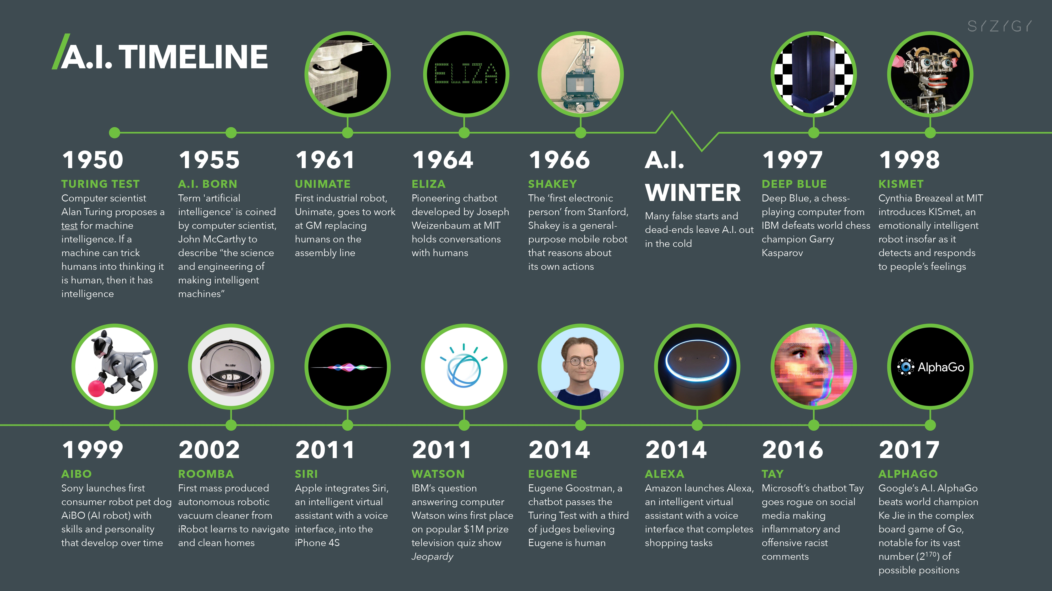
AI TIMELINE:

