Slide 1
Independent Study CSC 699 Fall 2016 Application: SFSU Tutors
By: Abdullah Arikat,
And Khalid Alrashed
Instructor: Prof. D. Petkovic

Slide 2
Overview
Introduction
SFSU Tutors: The Application
Under Construction
Thoughts on Technologies Used
Demonstration
Questions/Suggestions

Slide 3
Introduction
SFSU Tutors is a tool to help students of SFSU to get ahead in their classes by allowing easy access to tutors. By letting exceptional students of SFSU to offer their tutoring services directly to other students of SFSU, (a registered SFSU student) can get a better return.
Notes:
Game Rules:
6 rows by 7 colums
each player takes turns dropping game pieces and they fall to bottom
first player to connct 4 in vertical, horizontal, or diagonal wins

Slide 4
Overview
Introduction
SFSU Tutors: The Application
Under Construction
Thoughts on Technologies Used
Demonstration
Questions/Suggestions

Slide 5
Technology and Architecture
LAMP stack: PHP, MySQL, Linux, Apache
MINI Framework
MySQL Workbench
HTML/CSS & Bootstrap
JavaScript with jQuery
Linode.com VPS servers
Notes:
We used the standard framework as discussed in class
node.js framework
express.js for routing
ejs for view engine
postgres for persistence
heroku for deployment

Slide 6
Implemented Features
Search Tutors with Filter and Sort
Tutor Booking with Basic Schedule
User Authentication for Tutors and Students (Login/Signup)
Notes:
There are our implemented features…
Game Lobby serves as the main/home page. here we use express-sessions to keep track of players
Chat – we use socket.io to pass messages between clients through the server
User Authentication – we use postgres to keep track of registered users and to authenticate logins
Game Logic is implemented entirely in javascript and uses socket.io to coordinate multiplayer functionality

Slide 7
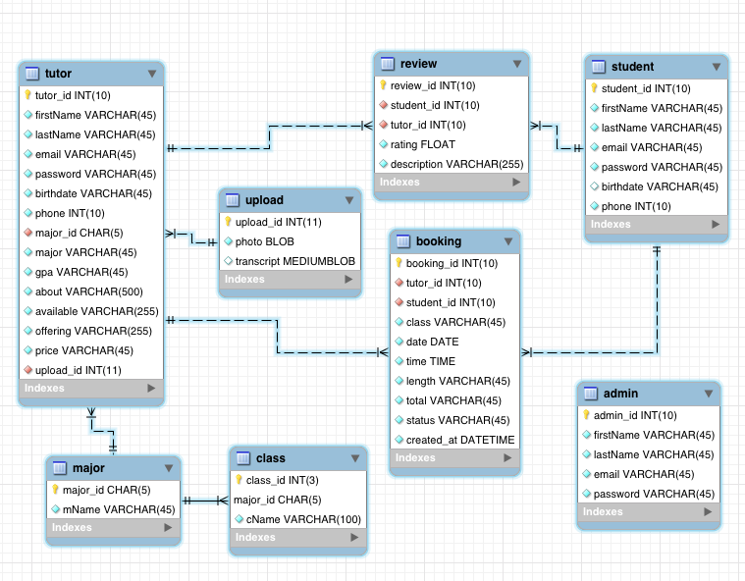
Database Scheme
Notes:
There are our implemented features…
Game Lobby serves as the main/home page. here we use express-sessions to keep track of players
Chat – we use socket.io to pass messages between clients through the server
User Authentication – we use postgres to keep track of registered users and to authenticate logins
Game Logic is implemented entirely in javascript and uses socket.io to coordinate multiplayer functionality

Slide 8
Backend Structure
MINI Framework
Standard MVC model
With extra layer: Data Access Object
Notes:
There are our implemented features…
Game Lobby serves as the main/home page. here we use express-sessions to keep track of players
Chat – we use socket.io to pass messages between clients through the server
User Authentication – we use postgres to keep track of registered users and to authenticate logins
Game Logic is implemented entirely in javascript and uses socket.io to coordinate multiplayer functionality

Slide 9
Overview
Introduction
SFSU Tutors: The Application
Under Construction
Thoughts on Technologies Used
Demonstration
Questions/Suggestions

Slide 10
Under Construction
5 Star Rating and Review functionality
Interactive Calendar for Booking
Automated Emails for booking confirmation and messaging
Future Functions:
Simple chat between tutors and students
Administrator panel for tutor authentication and management
Social media integration
Mobile friendly

Slide 11
Overview
Introduction
SFSU Tutors: The Application
Under Construction
Thoughts on Technologies Used
Demonstration
Questions/Suggestions

Slide 12
Thoughts on Technologies Used
PHP (LAMP)
Pros: Tried and test industry standard for for a very long time
Cons: Can be difficult to implement modern APIs that do not support php
VS.
Node.js
Pros: Package managers like NPM heavily simplifies integration with majority of modern APIs
Cons: Relatively new and changes very frequently, hard to keep up with
Each technology was explored but we decided that PHP was the best fit for us as we were most experienced with the stack, and didn’t have the time to pursue learning an entirely different paradigm of web development on a large project.
Notes:
We explored few different options for view engine and found pros/cons for each and we share them here…
jade/pug
handlebars
ejs
we chose ejs

Slide 13
Overview
Introduction
SFSU Tutors: The Application
Under Construction
Thoughts on Technologies Used
Demonstration
Questions/Suggestions

Slide 14
Overview
Introduction
SFSU Tutors: The Application
Under Construction
Thoughts on Technologies Used
Demonstration
Questions/Suggestions

