Slide 1
CSC 699 Fall 2016 SFSUTUTORS.COM
Prof. D. Petkovic
Abdullah Arikat
Khalid Alrashed

Slide 2
About our service (SFSUTUTORS.com)
SFSU Tutors is a tool to help students of SFSU to get ahead in their classes by allowing easy access to tutors,. By letting exceptional students of SFSU to offer their tutoring services directly to other students of SFSU, (a registered SFSU student) can get a better return.
URL: www.sfsututors.com

Slide 3
Team members:
Abdullah Arikat(UI)
Khalid Alrashed(Back-End)
Both of us are CS students at SFSU

Slide 4
UI principals used(inspired by CSC648)Prof.
User should know the context all the time. This is especially challenging for Web UIs
User should never get lost
Should always be able to easily go back and go home
For search: always know what you search for, where you applied the search for
For applications consisting of several ordered steps (shopping etc.): same as above, plus know what is the next step, easy to abort at any time
In navigation and browsing: show the lineage (see new Apple browser)
In Windows one way of keeping context is multiple windows.
Context is harder to do in the WWW. What means of keeping context in WWW are you aware of?

Slide 5
What is a UI?
User Interface Design is the design of websites, computers, appliances, machines, mobile communication devices, and software applications with the focus on the user's experience and interaction.

Slide 6
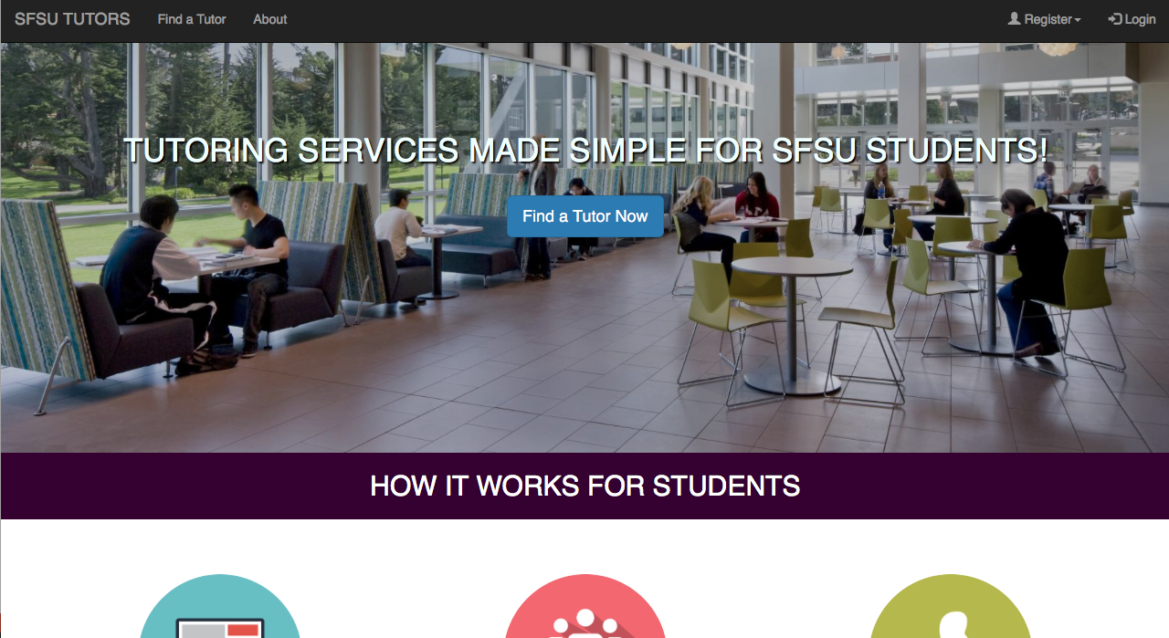

Slide 7
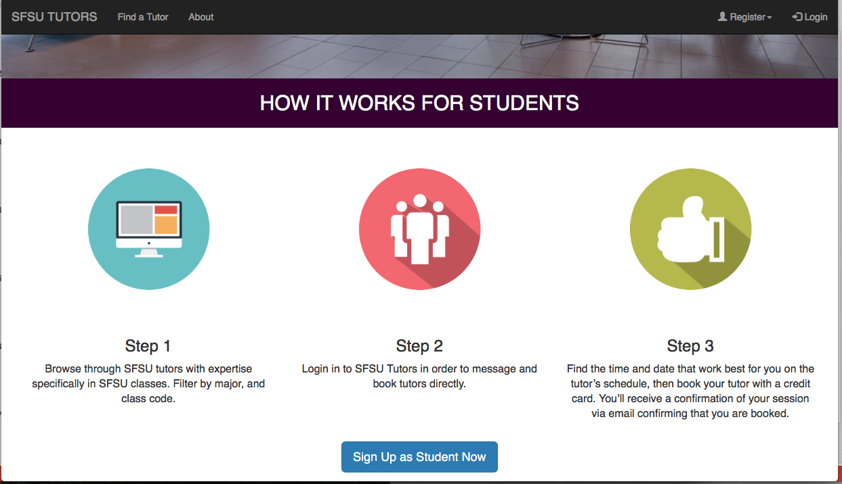

Slide 8
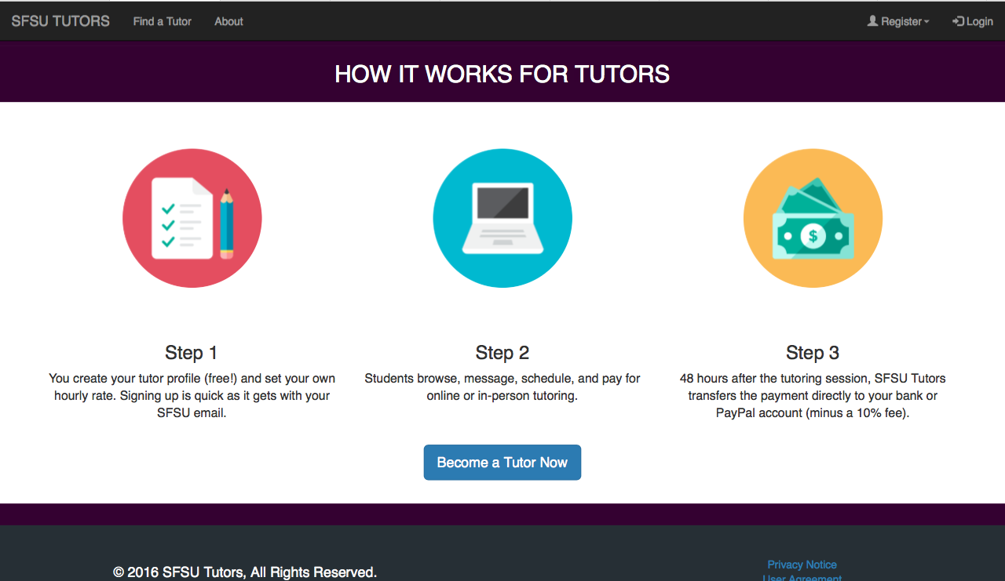

Slide 9
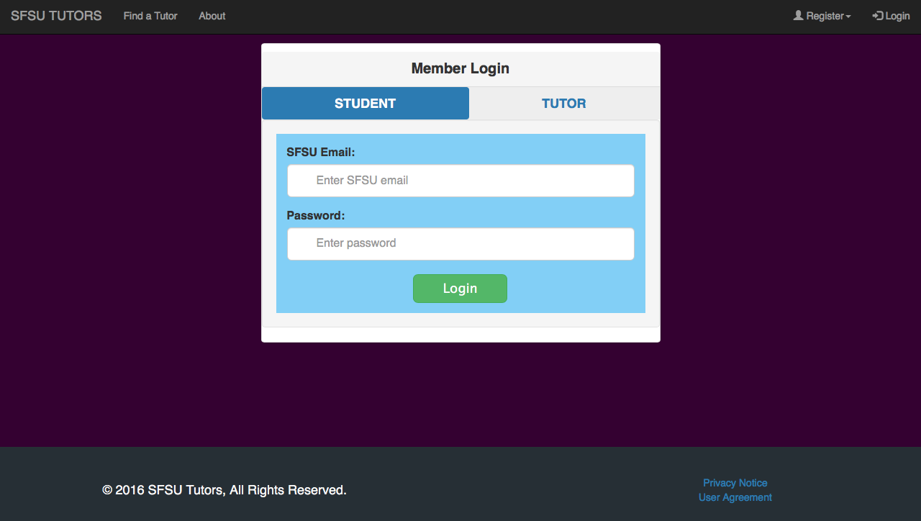

Slide 10
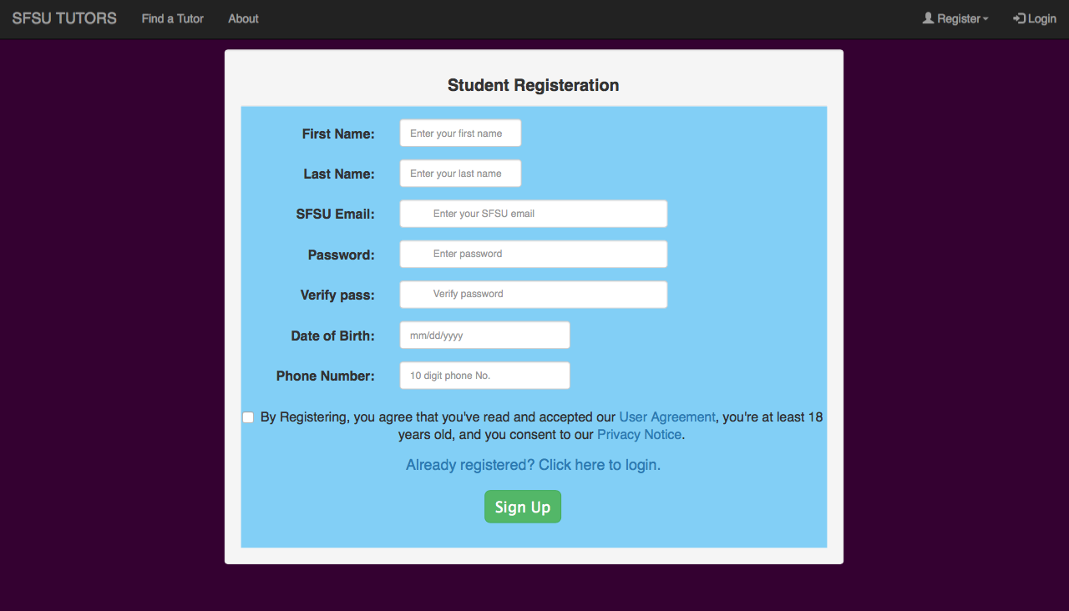

Slide 11
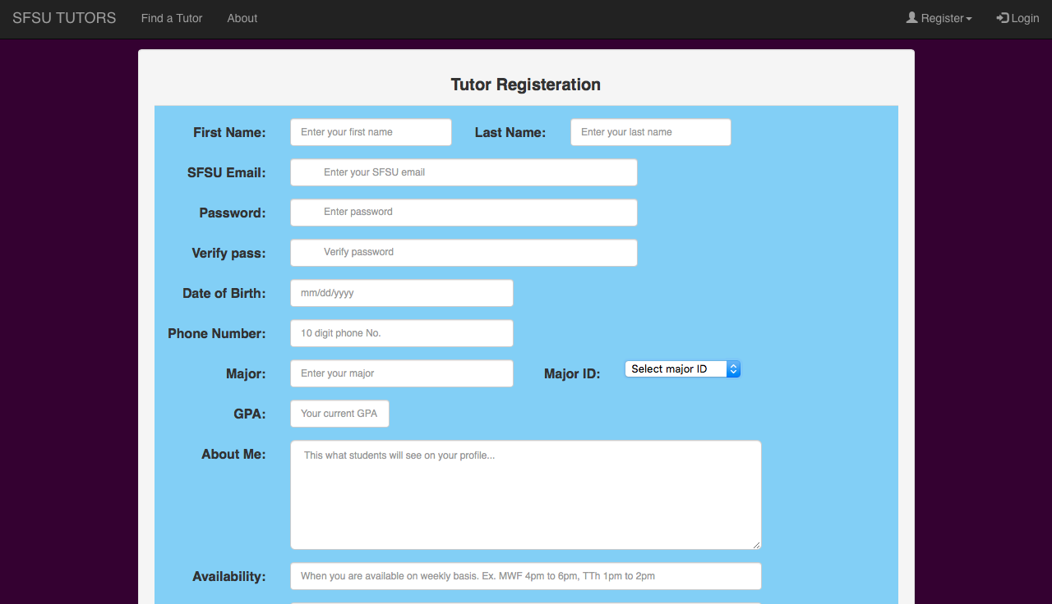

Slide 12
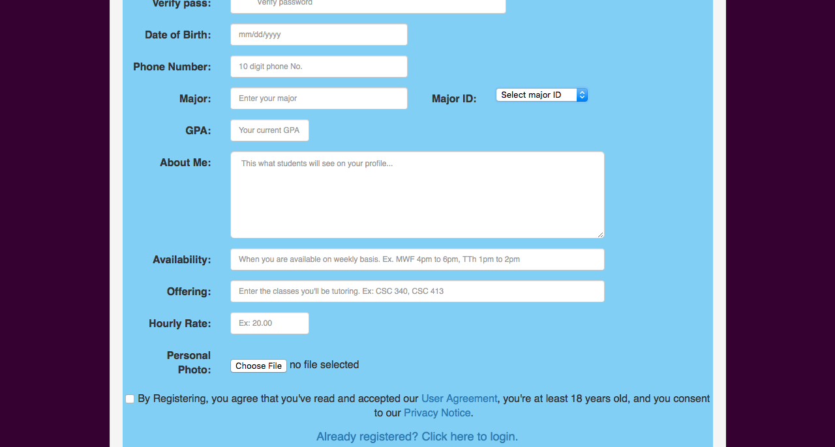

Slide 13
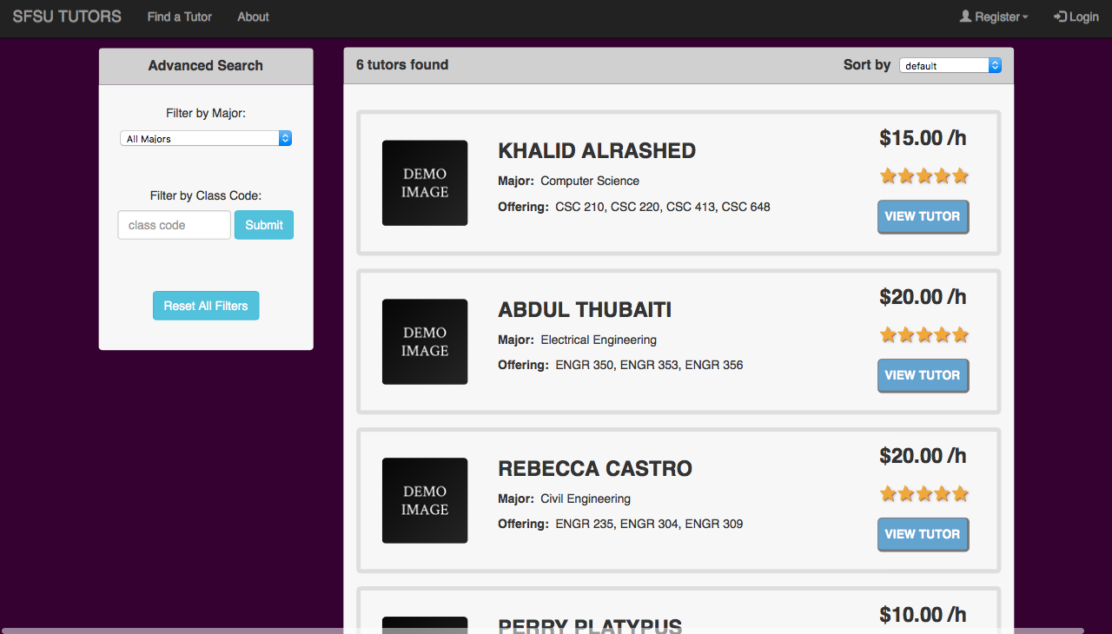

Slide 14
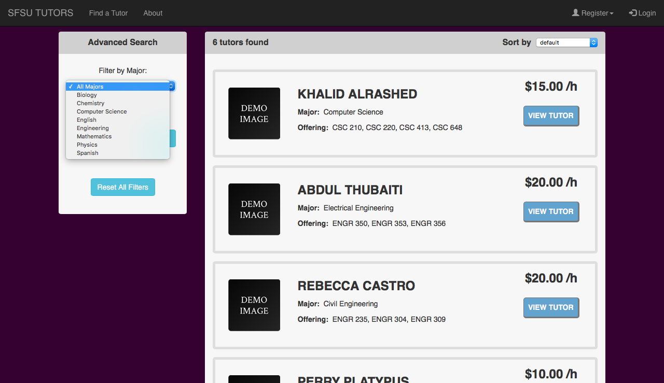

Slide 15
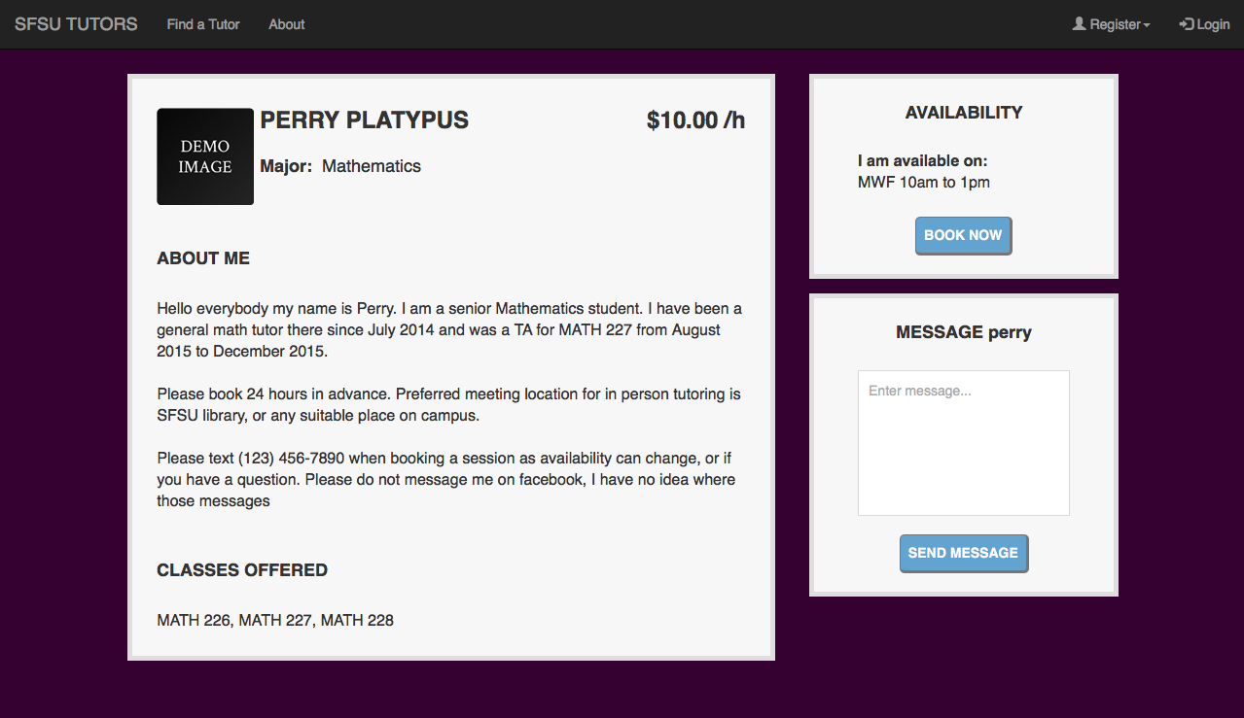

Slide 16
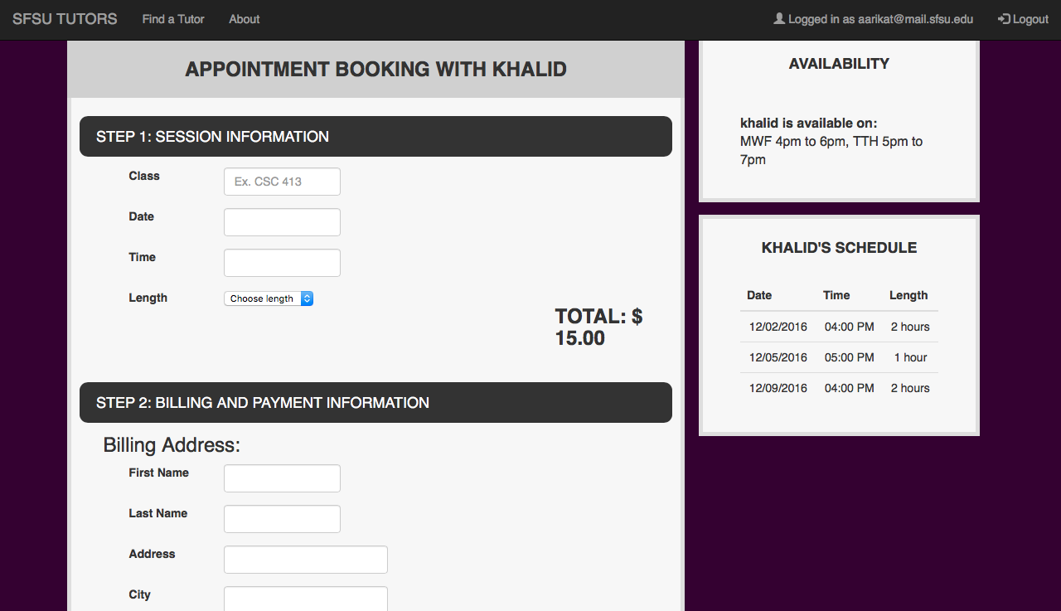

Slide 17
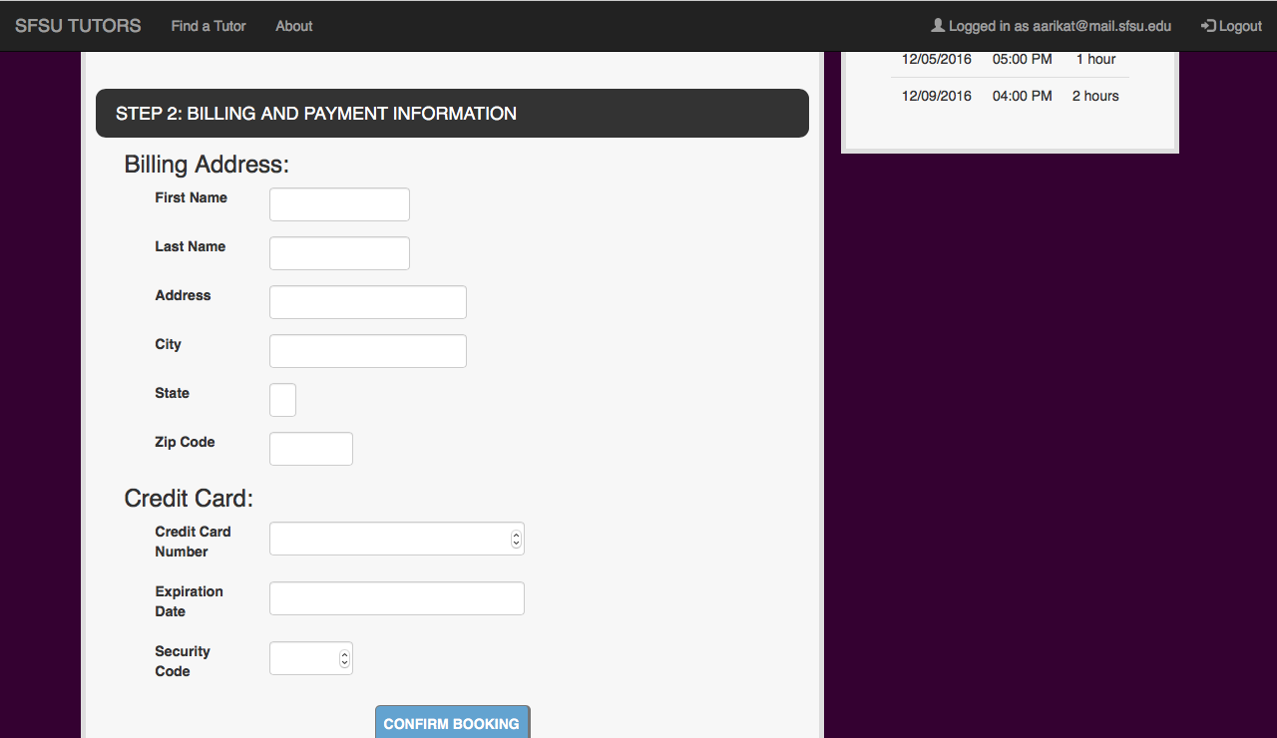

Slide 18
