Slide 1
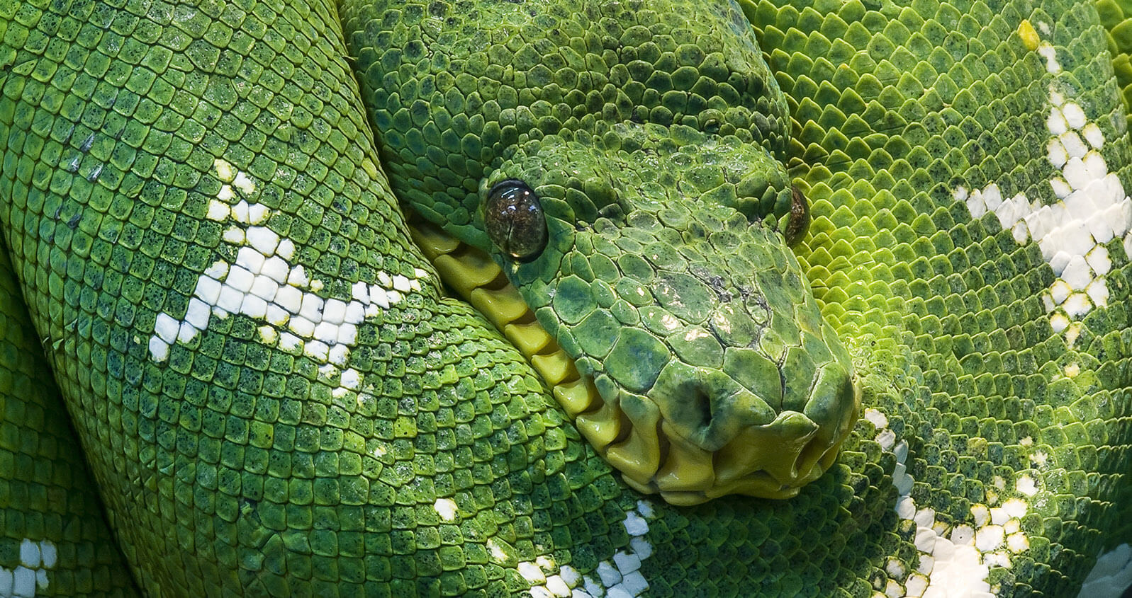

PYTHON 101

Slide 2
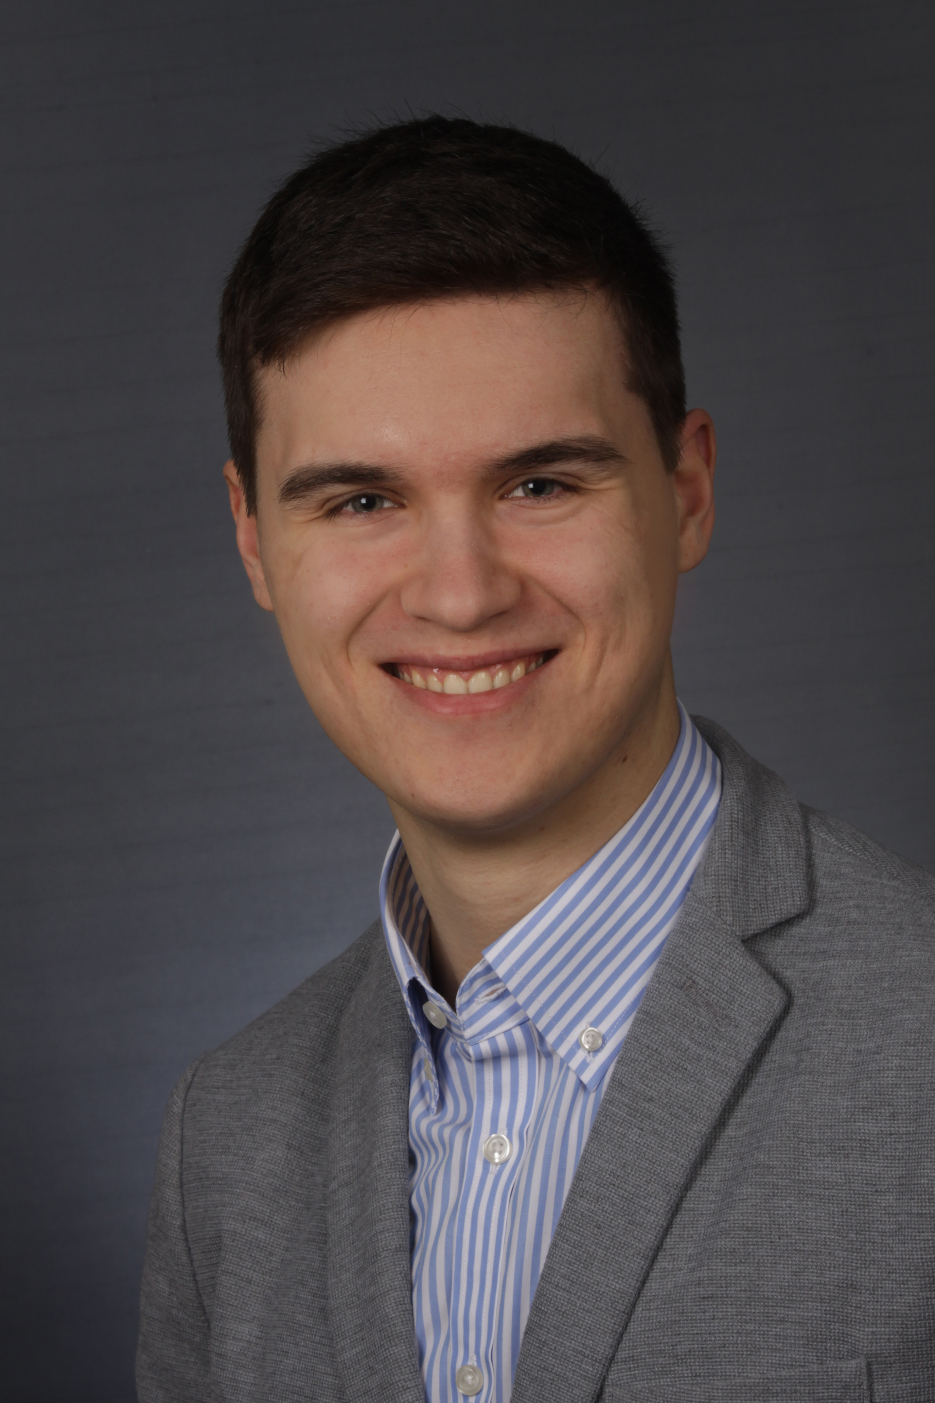
Who is this voice from the internet?
Jonas Eichhorn, B.Sc. Chemistry
Moved from Franconia to Jena 7 Semesters ago
Programming since school
Self taught programmer

Slide 3
Who are you?
Which OS are you using?
Have you programmed before?
Did you manage to install everything?

Slide 4
What is the plan?
DAY 1
Introduction
Basics with Exercises
Advanced Programming with Exercises
DAY 2
Recap
Three Complex Exercises
Some Topics We Skipped

Slide 5

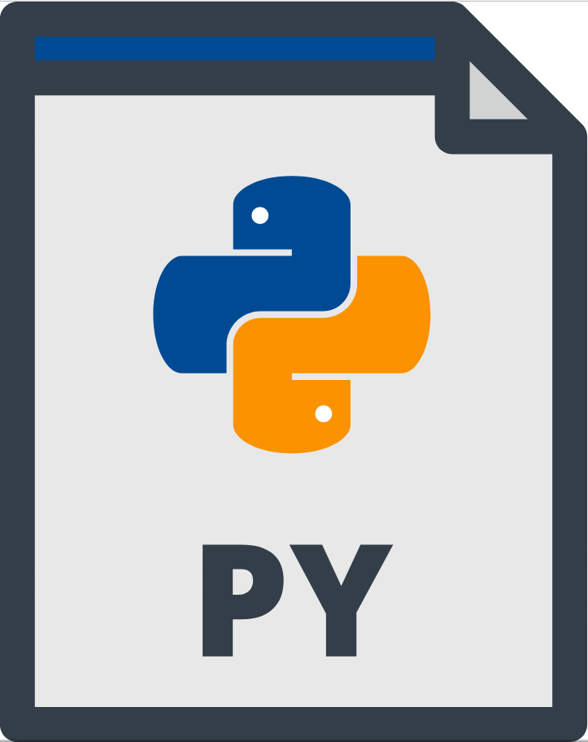


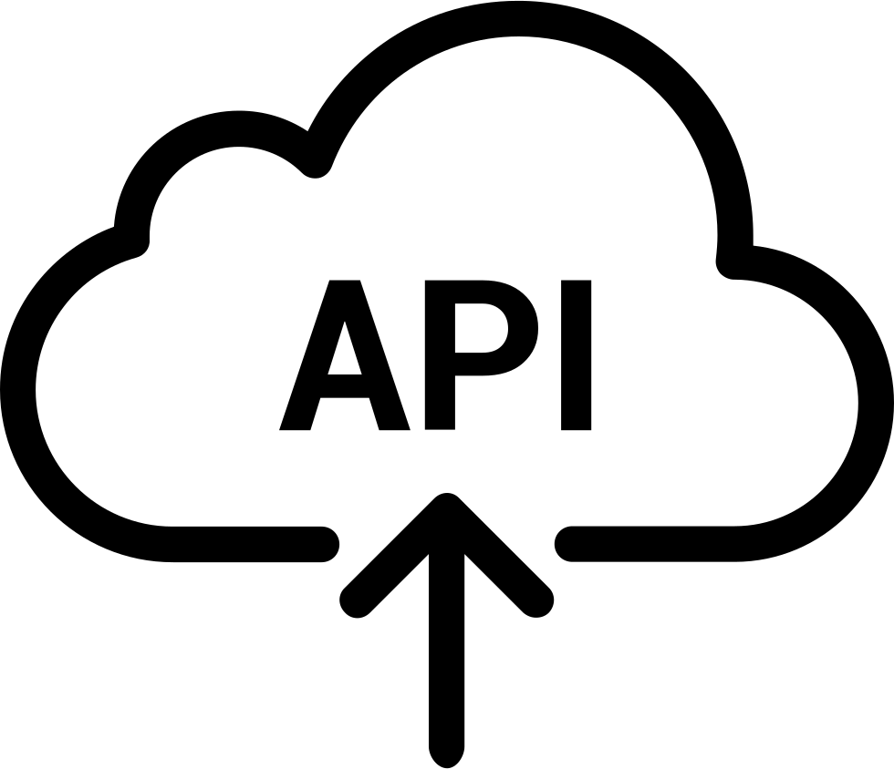









What is Python?
Text goes in
Python executes command
Information comes out
Python 2
Python 3
Notes:
Python is an interpreted programming language:
- You write human readable commands
- The python interpreter knows the commands and does what you tell him to do
- Give instructions line by line and execute them seperately
- Or give the interpreter a whole file to run
Python can do a bunch of stuff:
- Generate various output formats (image, text)
- Control your browser/visit websites
- Communicate with the internet to get/share data
- Interact with special services like API (a bit like HTML but more advanced and specific)
Why Python? Process lot of data or do repetitive stuff in a consistent way; Fast development
Every System can run your file; if they have python

Slide 6


How to code? the short version

Slide 7

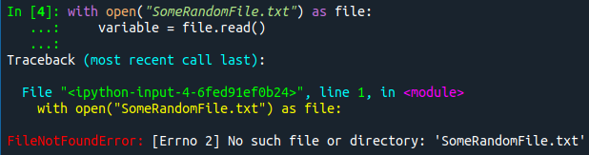


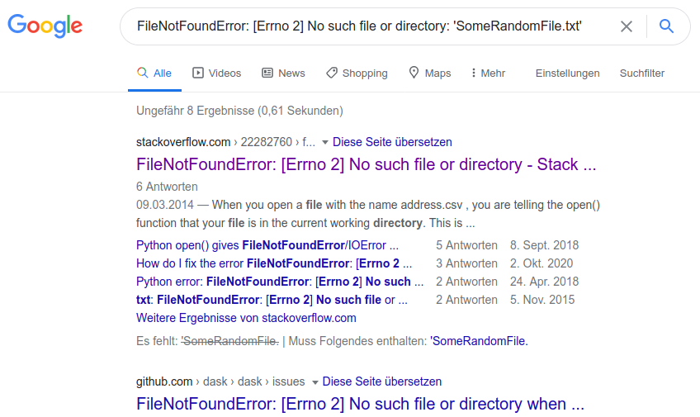

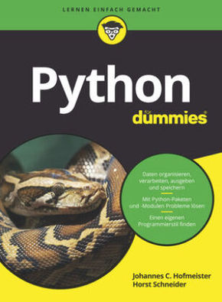


How to code? the short version

Slide 8
How to code? the short version
Think before programming.
What do I want my program to do?
Search for solutions on the internet.
Has anyone solved my problem or part of it already?
Document/Comment your code.
Will I understand my code one month from now?

Slide 9
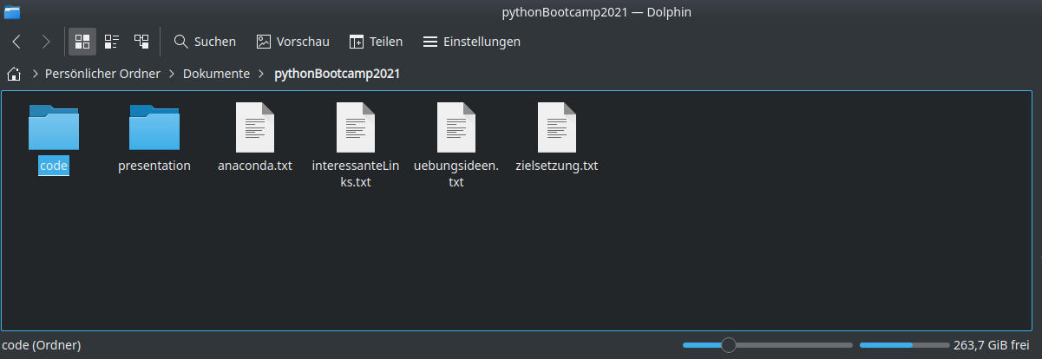
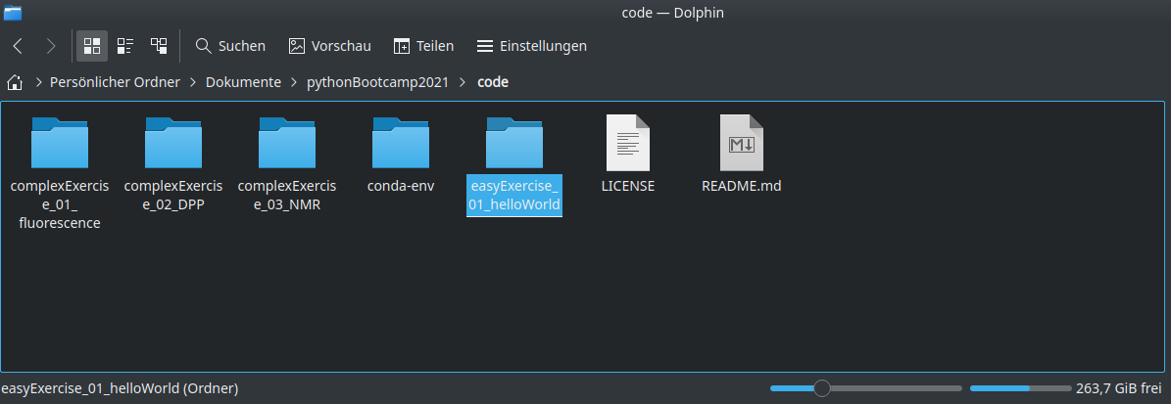
Hello, World! / Setup
(1) Organise your code in folders.
Create a folder for all the exercises we will do.
Create a folder for our first exercise.
(2) Create a new python environment with Anaconda.
Go to your console.
Win : Search and open Anaconda Prompt.
Linux : Open the terminal program.
macOS : ⌘+[Space] and type “terminal”.
Anaconda?
Environments?

Slide 10
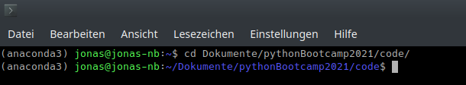
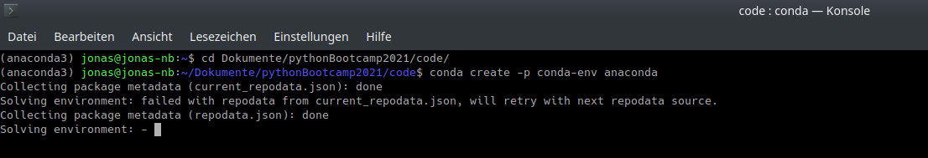
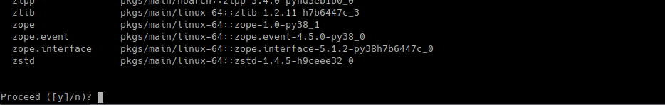
Hello, World! / Anaconda
Go to the our folder with “cd”.
Create a new environment with “conda create -p … anaconda”.
Optional command:
conda config --set env_prompt '({name}) '
Alternative command:
“conda create -n …”

Slide 11
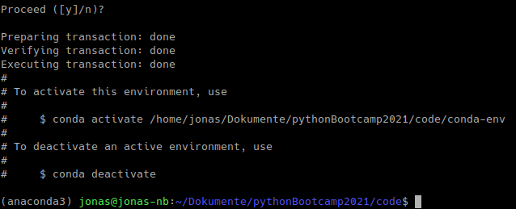
Hello, World! / Anaconda
Change the environment with “conda activate ...” or “conda deactivate”.
Leave all environments by deactivating the base environment.
Install new packages with “conda install”

Slide 12
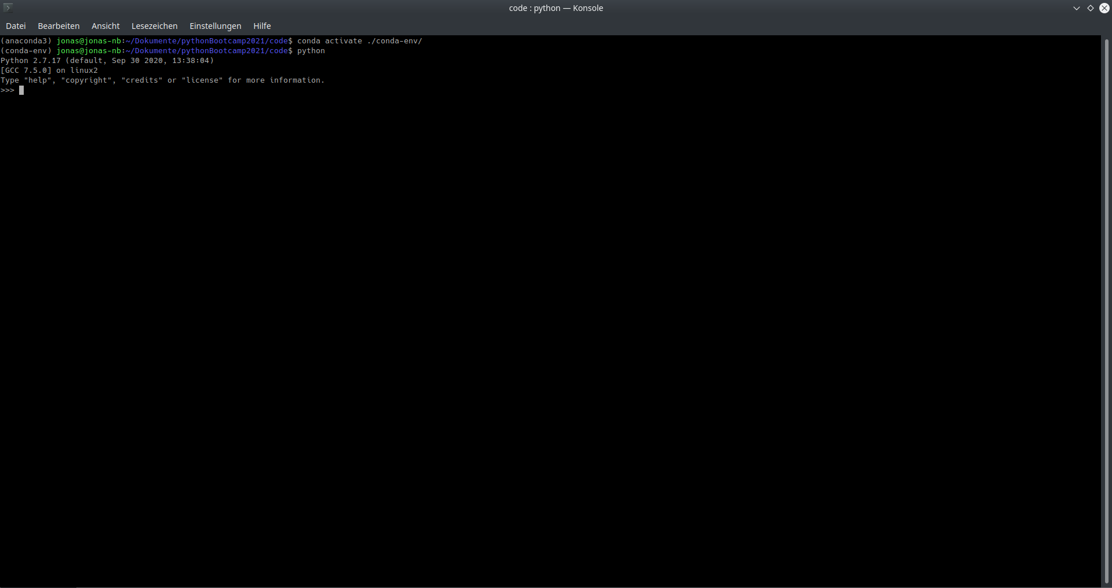
Hello, World! / Console
Let’s have a look at some python commands: print, help, comments

Slide 13
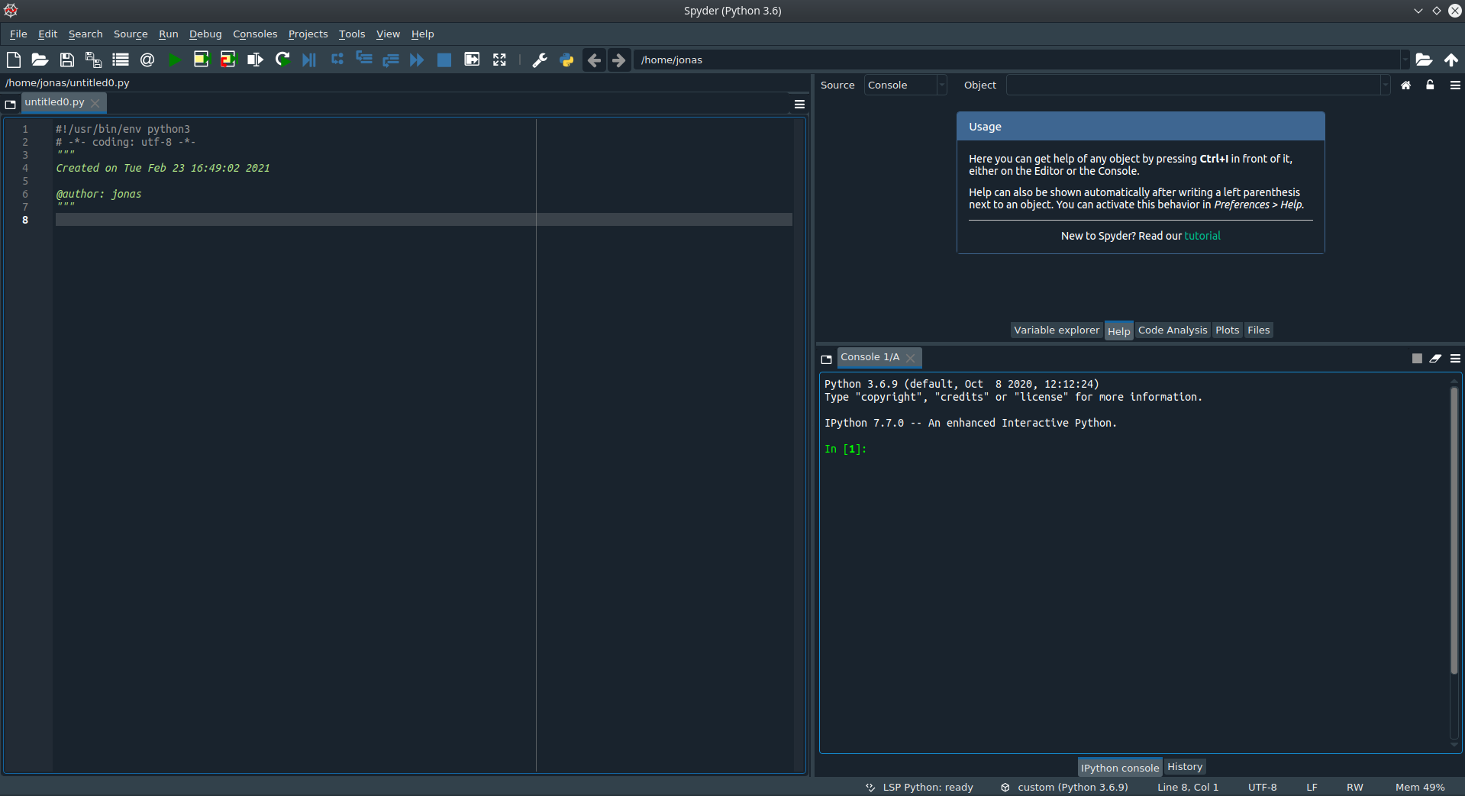
Hello, World! / Editor
Your python
file
Inspector
Interpreter/Console
Notes:
Write “Hello, World!”-program.
How to execute scripts in spyder and console?
What are the three windows in spyder for?

