Slide 1
Variables
and Data Structures

Slide 2
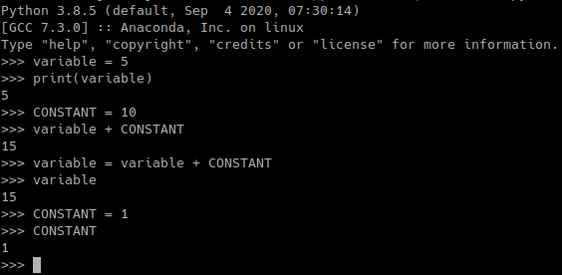
Variables
Allowed characters:
letters
digits
underscore
Exceptions:
no starting digit
no keywords

Slide 3

Keywords
False, None, True, and, as, assert, async, await, break, class, continue, def, del, elif, else, except, finally, for, from, global, if, import, in, is, lambda, nonlocal, not, or, pass, raise, return, try, while, with, yield

Slide 4
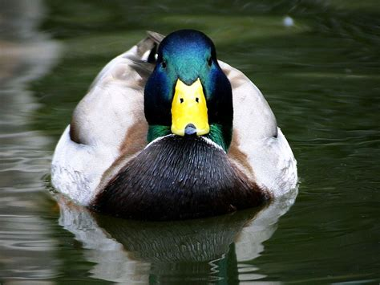
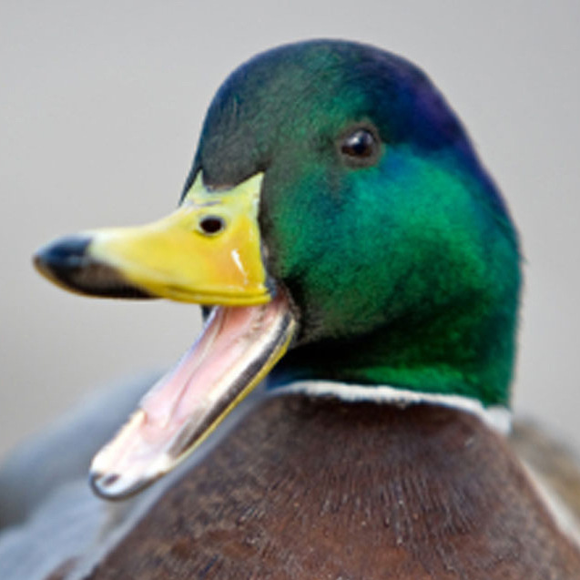
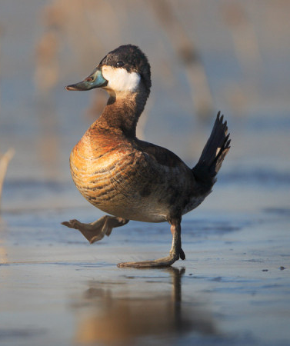
Data Types
Numbers
String
Boolean
Float
False/0
Integer
True/1
Numpy
float32
complex64
float64
…

Slide 5





Data Structures

Slide 6
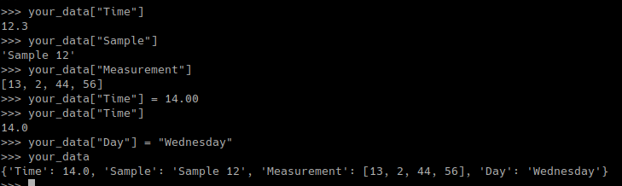
Dictionaries
your_data
“Time” | 12.30
“Sample” | “Sample 12”
“Measurement” | [13, 2, 44, 56]
Key
Value

Slide 7

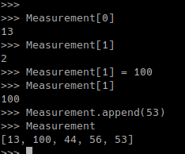
Arrays
Measurement
0 | 13
1 | 2
2 | 44
3 | 56
Index
Value

Slide 8





Sets
your_set
“a”
24
“a”
3.151492
your_set
“a”
24
3.151492
No Index
Elements unchangable
Value
Use them like mathematical sets.

Slide 9

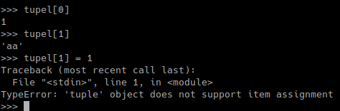
Tupels
tupel
0 | 1
1 | ”aa”
2 | 12.75
3 | 56
Index
Value

Slide 10

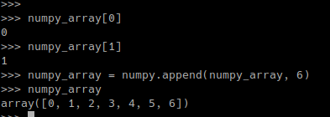

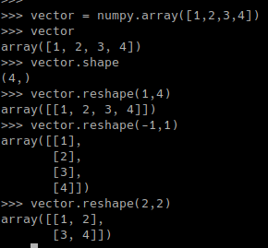
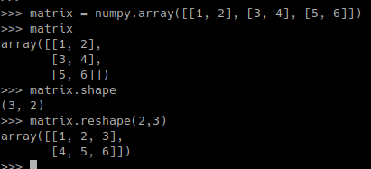
Numpy Arrays
numpy_array
0 | 0
1 | 1
2 | 2
... | ...
Index
Value

Slide 11

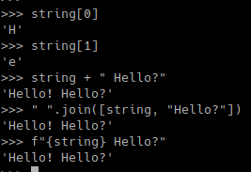
Strings
Data Type no Data Structure, but is similar to arrays
string
0 | “H”
1 | “e”
2 | “l”
... | ...
Index
Character

Slide 12
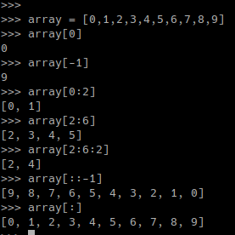
Slicing
Slicing works for: Strings, Arrays, Numpy Arrays, Tupels
array
0 | ...
1 | ...
2 | ...
3 | ...
4 | ...
5 | ...
6 | ...
7 | ...
8 | ...
9 | ...
array_copy
start | ...
start + step | ...
start + 2*step | ...
… | ...
end-1 | ...
array[start:end:step]

Slide 13
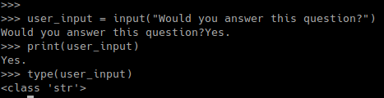
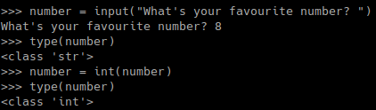
Simple In- & Output
input() reads a string from the console
print() prints a string to the console

Slide 14
Exercise 2: Hello, You!
Ask the users name and generate a customised greeting.
Ask the users age and store it as integer.
Print only the middle letters of the name and spell it backwards.

